Slide 1
Session 14: Narrative to Numbers

Slide 2
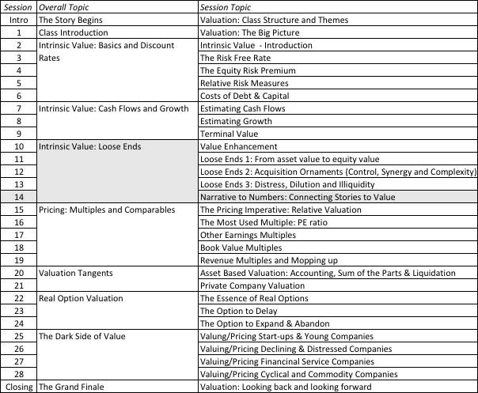
From a story to a valuation

Slide 3
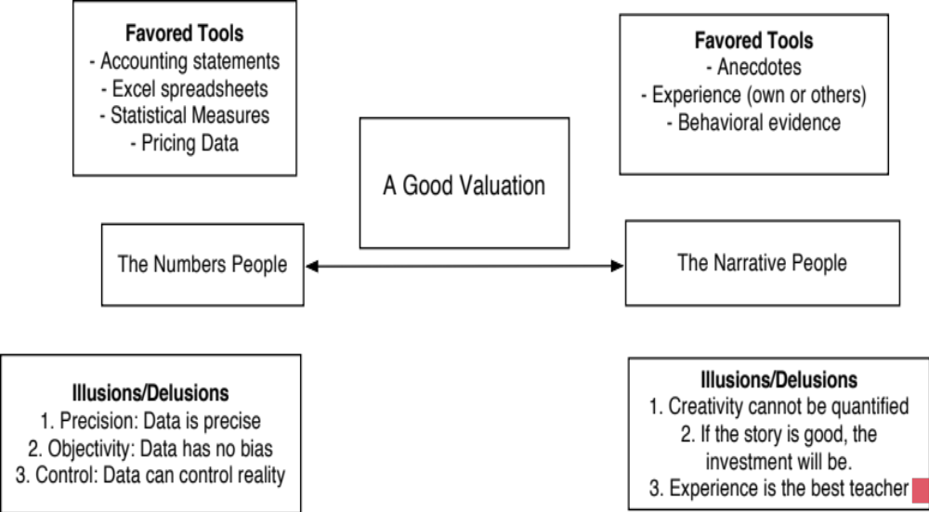
Valuation as a bridge
Number Crunchers
Story Tellers
Notes:
A good valuation connects stories to numbers and that linkage helps both sides. It forces number crunchers out of their models and to think about the stories underlying their valuations. In the process, they will have to confront the uncertainty and bias in their stories and recognize how little control they often have over how the stories unfold. For story tellers, the number crunching acts as a discipline, keeping them from wandering off into fantasy land.

Slide 4
Step 1: Survey the landscape
Every valuation starts with a narrative, a story that you see unfolding for your company in the future.
In developing this narrative, you will be making assessments of
  Your company (its products, its management and its history.
  The market or markets that you see it growing in.
  The competition it faces and will face.
  The macro environment in which it operates.
Notes:
Before you tell a story about a company, you need to understand its products/services, who uses them and why and the landscape that they operate in (the market and the competition).

Slide 5
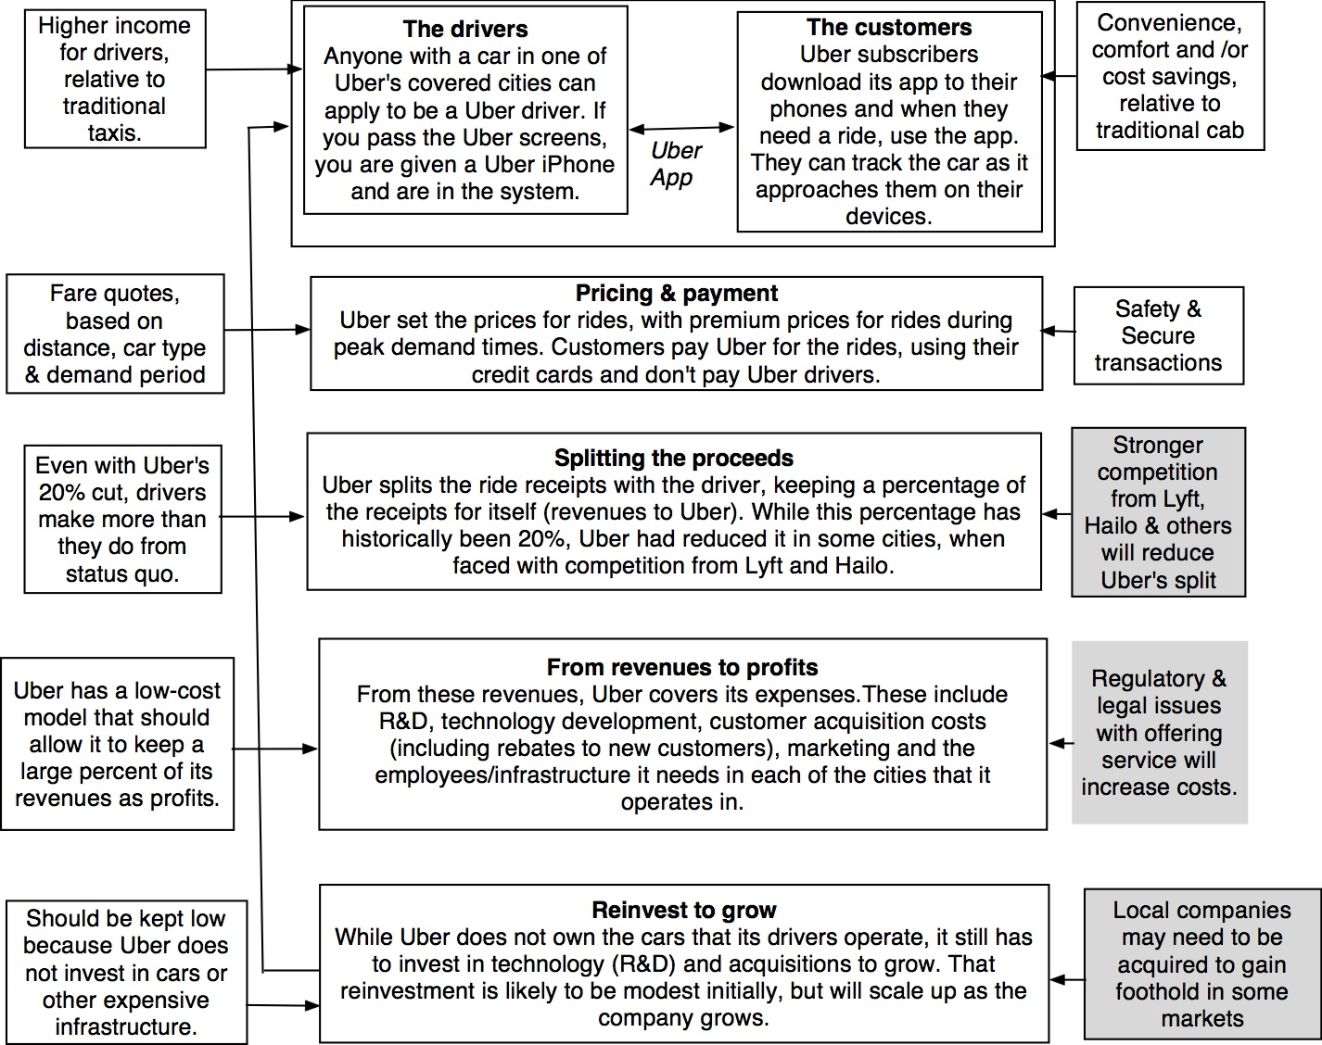
Notes:
My story about Uber began by my trying to understand its basic business model, why it appealed to drivers and customers and how the company operated.

Slide 6
Step 2: Create a narrative for the future
Every valuation starts with a narrative, a story that you see unfolding for your company in the future.
In developing this narrative, you will be making assessments of your company (its products, its management), the market or markets that you see it growing in, the competition it faces and will face and the macro environment in which it operates.
  Rule 1: Keep it simple.
  Rule 2: Keep it focused.
  Rule 3: Stay grounded in reality.
Notes:
Tell a story but this is not a creative novel. It is a business story. So, keep it short, keep it focused and stay grounded in reality.

Slide 7
The Uber Narrative
In June 2014, my initial narrative for Uber was that it would be
An urban car service business: I saw Uber primarily as a force in urban areas and only in the car service business.
Which would expand the business moderately (about 40% over ten years) by bringing in new users.
With local networking benefits: If Uber becomes large enough in any city, it will quickly become larger, but that will be of little help when it enters a new city.
Maintain its revenue sharing (20%) system due to strong competitive advantages (from being a first mover).
And its existing low-capital business model, with drivers as contractors and very little investment in infrastructure.
Notes:
My initial story for Uber reflected my understanding of the company and where I thought it would succeed.

Slide 8
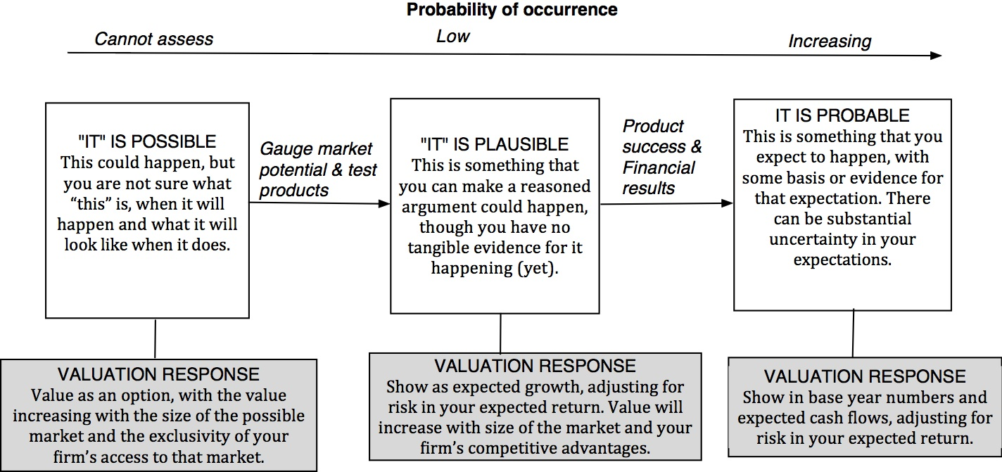
Step 3: Check the narrative against history, economic first principles & common sense
Notes:
The three tests are in order of difficulty. Lots of stories are possible, a subset are plausible and an even smaller subset are probable.

Slide 9
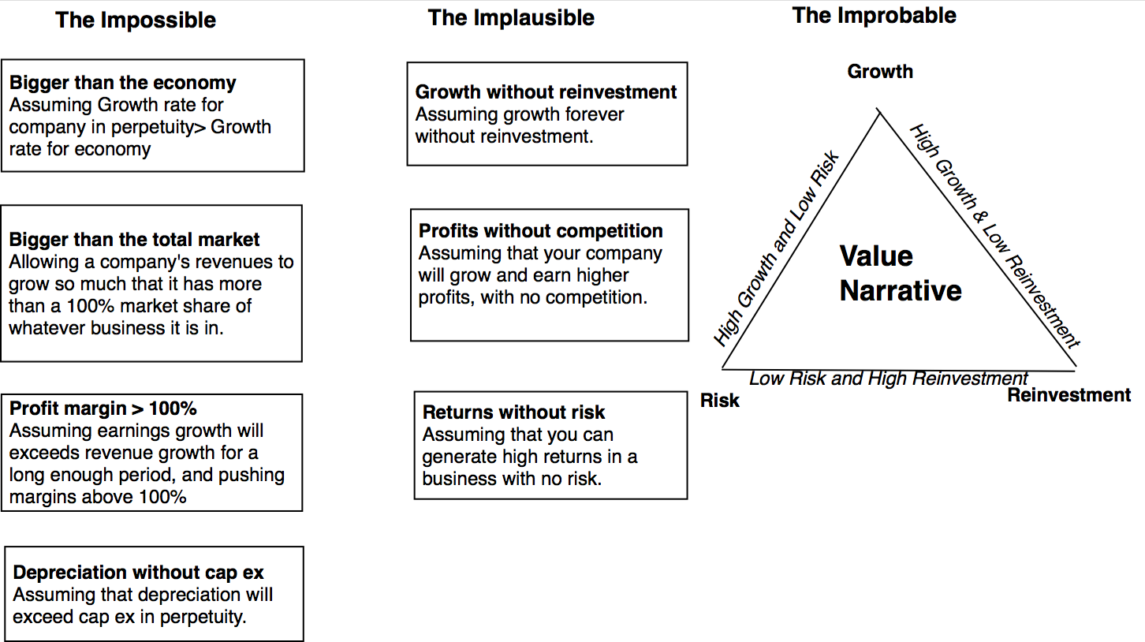
The Impossible, The Implausible and the Improbable
Notes:
There are a surprising number of valuations that fail the possibility test. They just cannot happen.
Quite a few stories are implausible, with very low chances of occurring. With these stories, you are probing to see if you have an exceptional company.
The improbable is more likely than the implausible. Again, you are checking for stories that seem to be able to do the good stuff (grow) without very much of the bad stuff (risk and reinvestment).

Slide 10
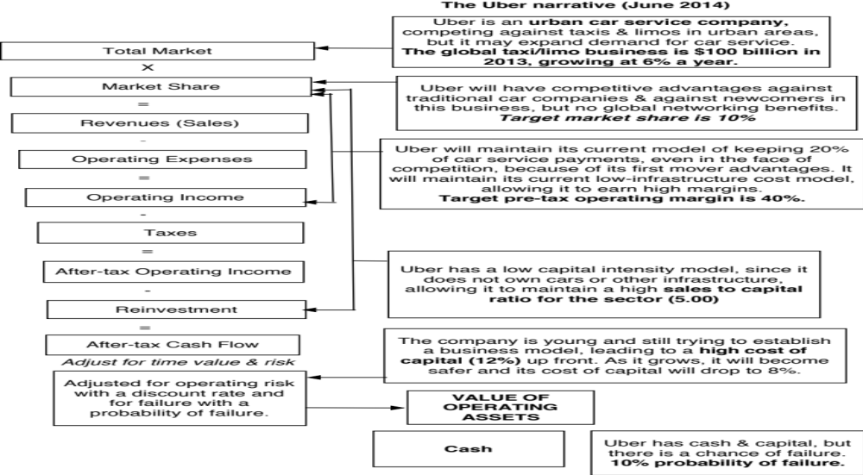
Step 4: Connect your narrative to key drivers of value
Notes:
This is the connecting step, where parts of stories are converted into value inputs. Again, keep it helps if you have parsimonious models.

Slide 11
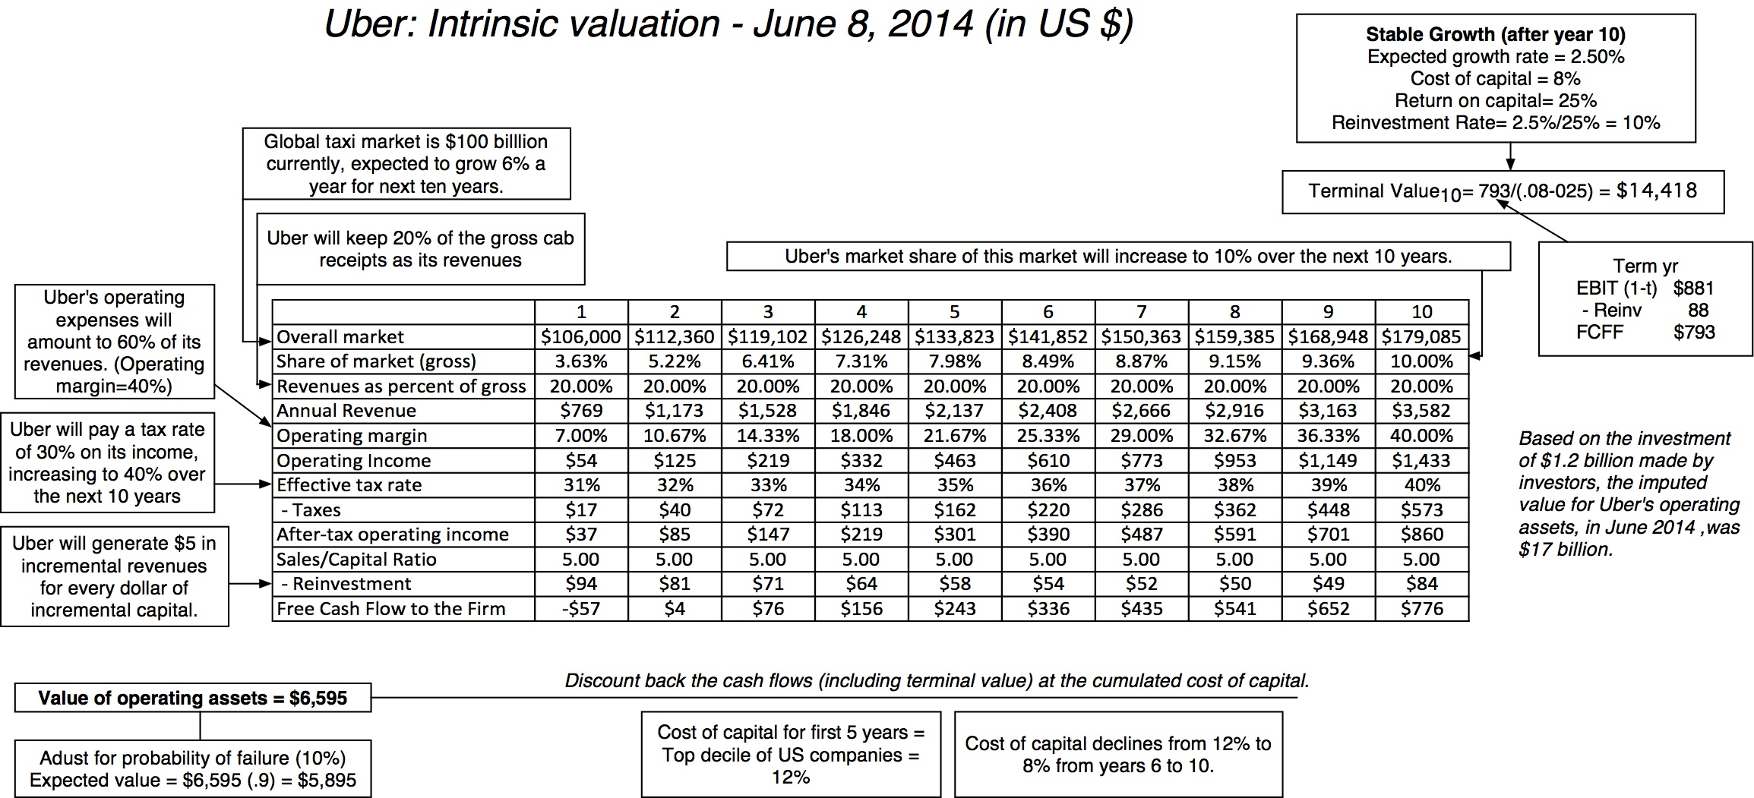
Step 4: Value the company (Uber)
Notes:
The valuation that comes out of the numbers.. It is the story that explains my $6 billion value.

Slide 12
Step 5: Keep the feedback loop
Not just car service company.: Uber is a logistics company, not just a car service company.
Not just urban: Uber can create new demands for car service in parts of the country where taxis are not used (suburbia, small towns).
Global networking benefits: By linking with technology and credit card companies, Uber can have global networking benefits.
Notes:
Listen to those who agree with you the least, especially when they know more than you do.. And Bill Gurley knew a lot more about Uber than I did.. And this was his pushback against my story.

Slide 13
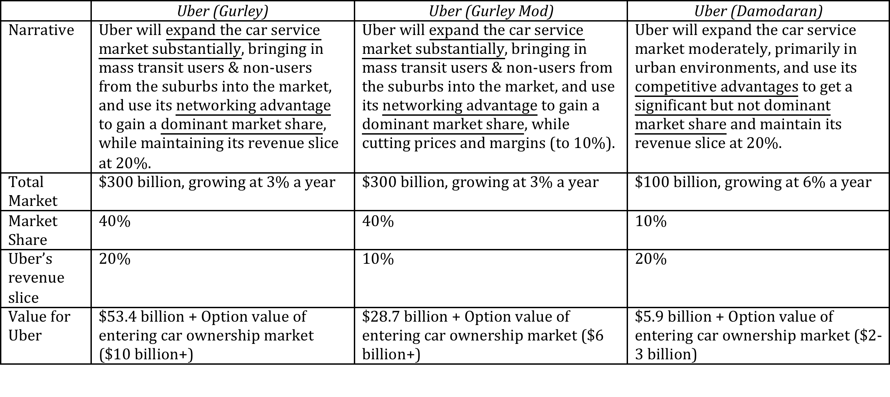
Valuing Bill Gurley’s Uber narrative
Notes:
A revaluation of Uber based on Gurley’s story with a second try when he suggested that Uber may have to settle for a smaller slice of the revenue pie.

Slide 14
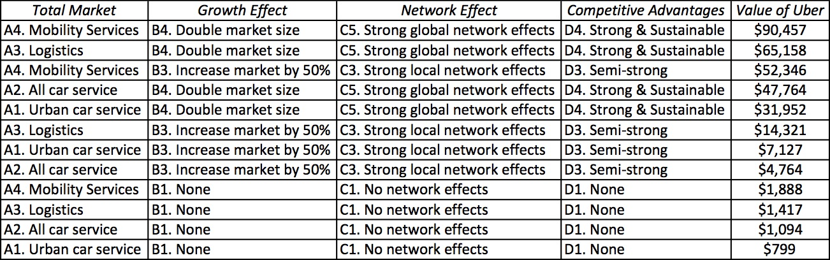
Different narratives, Different Numbers
Notes:
A build-your-own valuation of Uber, where readers made their choices on the total market, growth effect, network effect and competitive advantages and I computed the value under each set of choices.

Slide 15
Step 6: Be ready to modify narrative as events unfold
Narrative Break/End | Narrative Shift | Narrative Change (Expansion or Contraction)
Events, external (legal, political or economic) or internal (management, competitive, default), that can cause the narrative to break or end. | Improvement or deterioration in initial business model, changing market size, market share and/or profitability. | Unexpected entry/success in a new market or unexpected exit/failure in an existing market.
Your valuation estimates (cash flows, risk, growth & value) are no longer operative | Your valuation estimates will have to be modified to reflect the new data about the company. | Valuation estimates have to be redone with new overall market potential and characteristics.
Estimate a probability that it will occur & consequences | Monte Carlo simulations or scenario analysis | Real Options
Notes:
Stories will changes as the real world throws surprises at you.

