Slide 1
Session 15: The Pricing imperative

Slide 2
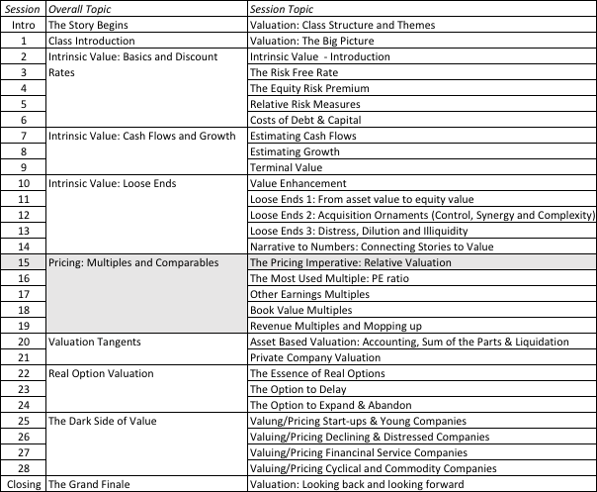
A Pricing Game

Slide 3

Test 1: Are you pricing or valuing?

Slide 4

Test 2: Are you pricing or valuing?

Slide 5
The Essence of relative valuation?
In relative valuation, the value of an asset is compared to the values assessed by the market for similar or comparable assets.
To do relative valuation then,
  Identify comparable assets and obtain market values for these assets
  convert these market values into standardized values (multiples).
  compare the standardized value or multiple for the asset being analyzed to the standardized values for comparable asset, controlling for any differences between the firms.
Notes:
These are the three ingredients you find in almost every equity research report - comparables, a multiple (or standardized price) and a story (which represents the attempt to control for differences).

Slide 6
Relative valuation is pervasive…
Most asset valuations are relative.
Most equity valuations on Wall Street are relative valuations.
  Almost 85% of equity research reports are based upon a multiple and comparables.
  More than 50% of all acquisition valuations are based upon multiples
  Rules of thumb based on multiples are not only common but are often the basis for final valuation judgments.
While there are more discounted cashflow valuations in consulting and corporate finance, they are often relative valuations masquerading as discounted cash flow valuations.

Slide 7
The Four Steps to Deconstructing Multiples
Define the multiple
  Understand how the multiples have been estimated
Describe the multiple
  Use more of the data.
Analyze the multiple
  Identify the drivers of pricing
Apply the multiple
  Control and compare
Notes:
While we can rail about the fact that a valuation based upon multiples is not as detailed as a discounted cashflow valuation,, the reality is that analysts will continue to use multiples to value companies and that we will often have to use these valuations.
Given this reality, we have to think about how best to use multiples. These four steps represent a way in which we can deconstruct any multiple, understand how to use it well and discover when it is being misused.

Slide 8
Definitional Tests
Is the multiple consistently defined?
  Proposition 1: Both the value (the numerator) and the standardizing variable ( the denominator) should be to the same claimholders in the firm.
Is the multiple uniformly estimated?
  The variables used in defining the multiple should be estimated uniformly across assets in the “comparable firm” list.
Notes:
Consistent definition:
Consider two widely used multiples that are consistently defined. In the price-earnings ratio (PE), the numerator is equity value per share and the denominator is equity earnings per share. In the enterprise value/ EBITDA multiple, the numerator is firm value and the denominator is a pre-tax cash flow to all claimholders in the firm. In contrast, the price to EBITDA multiple is inconsistent. Why is this a problem? If you are comparing firms with different debt ratios, the firms will more debt will look cheaper on a price to EBITDA basis.
Uniformally Estimated:
This is actually much more difficult than it looks. Even if accounting standards are the same across firms, you run into two problems:
The degree to which firms bend accounting rules for their own purposes varies across firms. Some firms are inherently more conservative in reporting earnings than others.
The financial year ends at different points for different firms. If the denominator is the earnings in the most recent financial year, the multiple may not be comparable if some firms have December year-ends and some have June year-ends.

Slide 9
Descriptive Tests
What is the average and standard deviation for this multiple, across the universe (market)?
What is the median for this multiple?
How large are the outliers to the distribution, and how do we deal with the outliers?
Are there cases where the multiple cannot be estimated? Will ignoring these cases lead to a biased estimate of the multiple?
How has this multiple changed over time?
Notes:
Before you use a multiple and develop rules of thumb (8 times EBITDA is cheap), you need to get a sense of the cross-sectional distribution.
Multiples have skewed distributions. Because a multiple cannot be less than zero but can potentially be infinite, the averages for multiples will be much higher than their medians, and the difference will increase as the outliers become larger. Many services cap outliers to prevent them from altering the averages too much, results…
The PE ratio cannot be estimated when the earnings per share are negative. Thus, if you have a sample of 20 firms and 10 have negative earnings, you will be able to compute the PE ratio for only the 10 that have positive earnings and will throw out the remaining firms. This will induce a bias in your sample. One way to avoid this is to take the cumulative values for market capitalization and net income for all 20 firms, and compute a PE ratio based upon the cumulated values. The resulting PE ratio will generally be much higher….

Slide 10
Analytical Tests
What are the fundamentals that determine and drive these multiples?
  Proposition 2: Embedded in every multiple are all of the variables that drive every discounted cash flow valuation - growth, risk and cash flow patterns.
How do changes in these fundamentals change the multiple?
  Proposition 3: It is impossible to properly compare firms on a multiple, if we do not know the nature of the relationship between fundamentals and the multiple.

Slide 11
Application Tests
Given the firm that we are valuing, what is a “comparable” firm?
  Proposition 4: There is no reason why a firm cannot be compared with another firm in a very different business, if the two firms have the same risk, growth and cash flow characteristics.
Given the comparable firms, how do we adjust for differences across firms on the fundamentals?
  Proposition 5: It is impossible to find an exactly identical firm to the one you are valuing.
Notes:
In practice, we all too often define comparable as a firm in the same industry or business. This is too narrow a definition. You can have firms in different businesses that have similar cashflow, growth and risk characteristics. These firms can be viewed as comparable firms.
You will never find two identical firms, no matter how hard you search. You therefore have to always control for the residual differences when making comparisons.

