Slide 1
Session 16: The PE RAtio

Slide 2
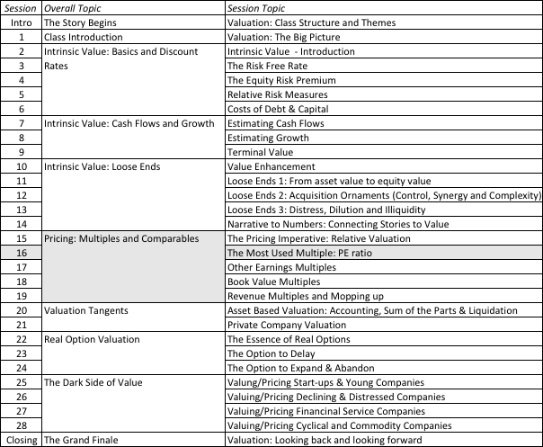
A Pricing Game

Slide 3
PE: The Consistency Test
PE = Market Price per Share / Earnings per Share
There are a number of variants on the basic PE ratio in use. They are based upon how the price and the earnings are defined.
  Price: is usually the current price
  is sometimes the average price for the year
  EPS: earnings per share in most recent financial year
  earnings per share in trailing 12 months (Trailing PE)
  forecasted earnings per share next year (Forward PE)
  forecasted earnings per share in future year
Notes:
This is only the tip of the iceberg. You can have EPS before and after extraordinary items, primary and diluted EPS..
When you are negotiating with someone else and you are both using PE ratios to make your case, the first step is to make sure that you are using the same PE ratio.
There is also the tendency on the part of analysts to pick the definition of pE that best fits their biases. For instance, bullish analysts in the 1990s almost always used forward PE whereas bearish analysts used trailing PE. Since earnings were rising the former were generally much lower than the latter.

Slide 4
PE: Distribution for the US
Notes:
This graph for all U.S. firms with data available on the Value Line CD ROM (contains about 7200 firms in the overall sample). Notice that the distributions are skewed to the left and that we have capped the PE ratios at 100….

Slide 5
With key statistics
 | Current PE | Trailing PE | Forward PE
Number of firms | 7480 | 7480 | 7480
Number with PE | 3,344. | 3,223. | 2,647.
Average | 59.42 | 46.04 | 29.63
Median | 18.53 | 18.29 | 16.98
Minimum | 0.11 | 0.28 | 0.15
Maximum | 32,269.00 | 6,900.00 | 2,748.00
Standard deviation | 777.02 | 256.06 | 81.27
Standard error | 13.44 | 4.51 | 1.58
Skewness | 37.27 | 19.9 | 18.74
25th percentile | 11.88 | 12.32 | 13.1
75th percentile | 30.25 | 29.52 | 24.28
US firms in January 2016
Notes:
Four things to note…
Notice the number of firms that we have lost in the sample as we compute PE ratios.
You lose even more firms as you go to forward PE, because you need analyst estimates of expected earnings per share to compute this. Any firms not followed by analysts will not have a forward PE…
The means were computed without capping the PE ratios… the outliers (notice the maximum values for the ratios) push the average to almost twice the median.
The median forward PE is higher than the trailing PE which is higher than the current PE…

Slide 6
Comparing Global PEs
 | Average | 25th perc. | Median | 75th perc.
United States | 46.04 | 12.32 | 18.29 | 29.52
Europe | 57.57 | 10.27 | 16.69 | 26.76
Japan | 29.83 | 9.96 | 15.08 | 24.93
Emerging Markets | 91.08 | 9.57 | 16.77 | 39.69
Aus, NZ & Canada | 67.42 | 8.87 | 15.69 | 27.52
Global | 71.16 | 10.00 | 16.69 | 32.07
Notes:
This compares the percentages of firms in each market that trade in each PE ratio class… In 2012, it is difficult to tell them apart. That is a change from a few years ago, when US and European stocks traded at much higher PE ratios than emerging market stocks. The convergence of PE ratios globally may reflect the blurring of the line between developed and emerging markets.

Slide 7
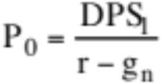
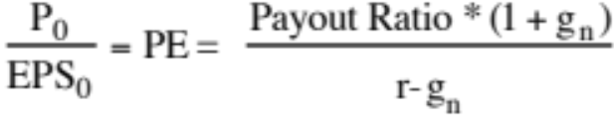
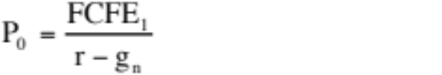
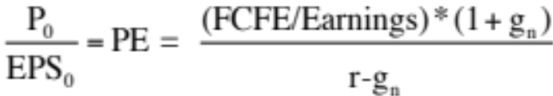
PE Ratio: The Analytics
To understand the fundamentals, start with a basic equity discounted cash flow model.
With the dividend discount model,
Dividing both sides by the current earnings per share,
If this had been a FCFE Model,
Notes:
To get to the heart of equity multiples, we start with an equity DCF model. In this case, we consider the simplest equity valuation model - a stable growth dividend discount model. Restated in terms of the PE ratio, we find that the PE ratio fo a stable growth firm can be written in terms of three variables:
The expected growth rate in earnings per share
The riskiness of the equity, which determines the cost of equity
The efficiency with which the firm generates growth,which is measured by how much the firm can pay out or afford to pay out after reinvested to create the growth.

Slide 8
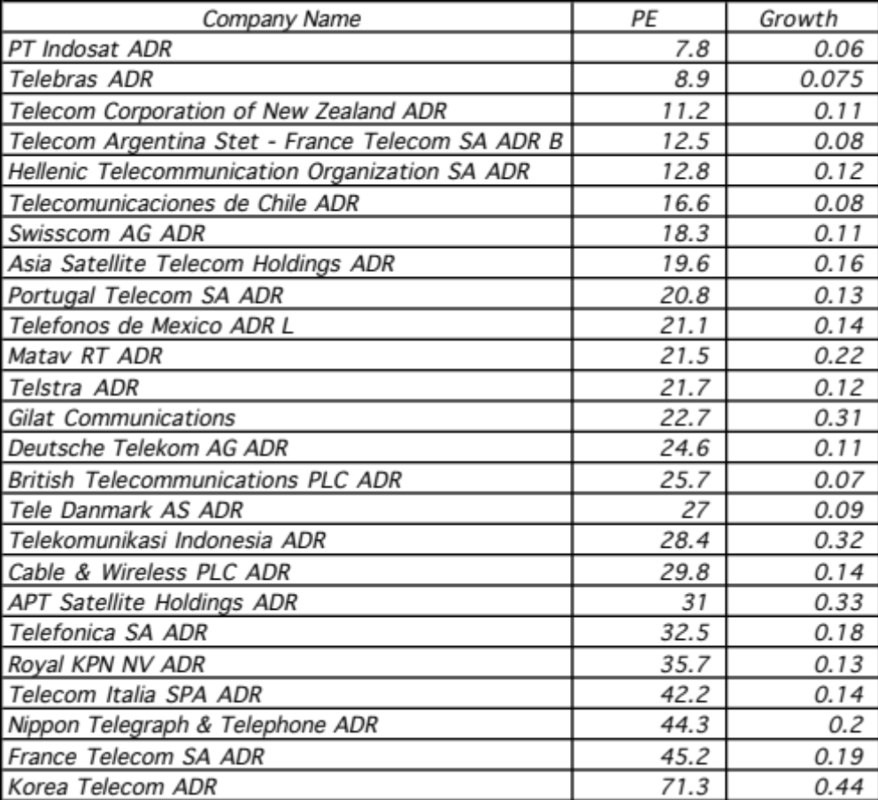
And Example: Comparing PE Ratios across a Sector
Notes:
In this sample, note that some of the firms in the sample are emerging market firms any may be exposed to more risk (political risk, economic risk, inflation risk…)

Slide 9
PE, Growth and Risk
Dependent variable is: PE
R squared = 66.2% R squared (adjusted) = 63.1%
Variable Coefficient SE t-ratio prob
Constant 13.1151 3.471 3.78 0.0010
Growth rate 121.223 19.27 6.29 ≤ 0.0001
Emerging Market -13.8531 3.606 -3.84 0.0009
Emerging Market is a dummy: 1 if emerging market
0 if not
Notes:
Higher growth telecomm companies have higher PE ratios..
One way to read this regression: If you have two companies - one with a growth rate of 10% and one with a growth rate of 20%, the latter should have a PE that is 12.1 higher..
If the firm happens to be an emerging market firm, though, you would expect its PE ratio to be 13.85 lower than a firm with similar growth in a developed market.

Slide 10
Is Telebras under valued?
Predicted PE = 13.12 + 121.22 (.075) - 13.85 (1) = 8.35
At an actual price to earnings ratio of 8.9, Telebras is slightly overvalued.
Notes:
With a 7.5% growth rate and being an emerging market company, Telebras is overvalued slightly, even though it has a low PE ratio.

Slide 11
PE Ratio versus the market
PE versus Expected EPS Growth: January 2016
Notes:
The expected growth rate is the consensus estimate of growth in earnings per share over the next 5 years - this is available from services like Zacks and I/B/E/S.
The relationship between PE and expected growth is positive - the line fit through is the regression line - but it is noisy… The band represents one standard error from the regression line of PE versus growth…

Slide 12
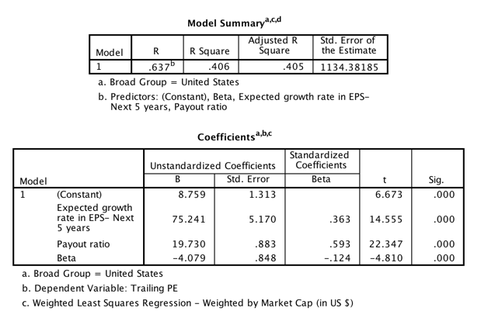
PE Ratio: Standard Regression for US stocks - January 2016
The regression is run with growth and payout entered as decimals, i.e., 25% is entered as 0.25)
Notes:
This regression has about 1600 firms. While the low R-squared may be troubling, it should not be unexpected, given the scatter plot on the previous page.
The signs of the coefficients are consistent with our priors for growth and higher growth have higher PE ratios. With risk and payout, though, the signs on the coefficient are wrong. Higher risk and lower payout firms firms seems to have higher (instead of lower) PE ratios.

Slide 13
PE ratio regressions across markets – January 2016
Region | Regression – January 2016 | R²
US | PE = 8.76 + 75.24 g_{EPS} + 19.73 Payout – 4.08 Beta | 40.5%
Europe | PE = 13.43 + 54.46 g_{EPS} + 17.63 Payout - 4.16 Beta | 24.7%
Japan | PE = 20.10+ 26.46 g_{EPS} + 24.87 Payout – 7.60 Beta | 28.4%
Emerging Markets | PE = 15.13 + 40.99 g_{EPS} + 9.03 Payout - 2.14 Beta | 11.5%
Australia, NZ, Canada | PE = 7.31 + 73.42 g_{EPS} + 13.94 Payout – 3.73 Beta | 26.8%
Global | PE = 12.51 + 87.48 g_{EPS} + 11.48 Payout - 3.96 Beta | 27.5%
g_{EPS}=Expected Growth: Expected growth in EPS or Net Income: Next 5 years
Beta: Regression or Bottom up Beta
Payout ratio: Dividends/ Net income from most recent year. Set to zero, if net income < 0
Notes:
Note how much in common these regressions have… though the effects of growth, risk and quality of growth may vary across markets, the direction of the effect is the same.

