Slide 1
Session 17: Other Earnings Multiples

Slide 2
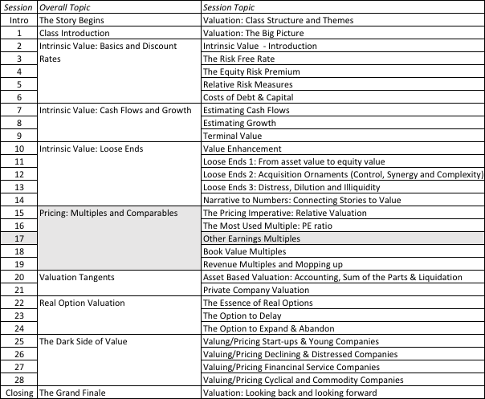
To PE and beyond..

Slide 3
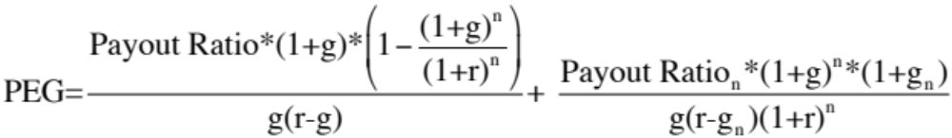
I. PEG Ratio
PEG Ratio = PE ratio/ Expected Growth Rate in EPS
  For consistency, you should make sure that your earnings growth reflects the EPS that you use in your PE ratio computation.
  The growth rates should preferably be over the same time period.
The PEG Ratio Fundamentals
Notes:
Back to a two-stage dividend discount model (you could adapt it to make it a 2-stage FCFE model) ..
The PEG ratio is a function of risk, payout and expected growth. Thus, using the PEG ratio does not neutralize growth as a factor (which is the rationale presented by analysts who use it). Instead, it makes the relationship extremely complicated.

Slide 4
PEG Ratios and Fundamentals
Risk and payout, which affect PE ratios, continue to affect PEG ratios as well.
  Implication: When comparing PEG ratios across companies, we are making implicit or explicit assumptions about these variables.
Dividing PE by expected growth does not neutralize the effects of expected growth.
Notes:
Analysts who use PEG ratios are making implicit assumptions about risk, growth and payout…

Slide 5
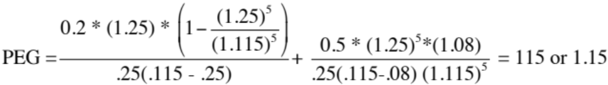
A Simple Example
Assume that you have been asked to estimate the PEG ratio for a firm which has the following characteristics:
Variable High Growth Phase Stable Growth Phase
Expected Growth Rate 25% 8%
Payout Ratio 20% 50%
Beta 1.00 1.00
Riskfree rate = T.Bond Rate = 6%
Required rate of return = 6% + 1(5.5%)= 11.5%
The PEG ratio for this firm can be estimated as follows:
Notes:
Returns to the example used to illustrate PE ratios. The fair PEG ratio for this firm is 1.15. (Incidentally, the PE ratio we computed for this company earlier was 28.75.. Dividing 28.75 by the growth rate 25 yields 1.15.)

Slide 6
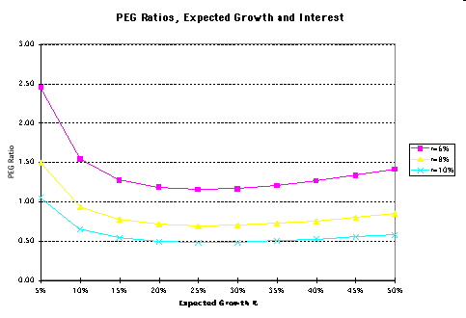
PE Ratios and Expected Growth
Notes:
Shows how complicated the relationship between growth and PEG ratio becomes. As growth increases initially, the PEG ratio decreases. At some point, however, the PEG ratio starts increasing again.. In fact, as the growth rate decreases towards 0%, the PEG ratio will approach infinity.. This is a direct consequence of the incorrect assumption that PE ratios and growth are linearly related. Consider a stock with earnings and dividends per share of $2.00 and assume that you can expect to earn this forever (no growth). The linearity assumption would lead you to conclude that the PE ratio should be 0 for this firm and that you would pay nothing for this stock….

Slide 7
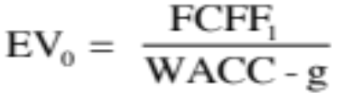
II. EV to EBITDA - Determinants
The value of the operating assets of a firm can be written as:
Now the value of the firm can be rewritten as
Dividing both sides of the equation by EBITDA,
The determinants of EV/EBITDA are:
  The cost of capital
  Expected growth rate
  Tax rate
  Reinvestment rate (or ROC)
Notes:
To delve into the fundamentals that determine EBITDA multiples, we return to a FCFF valuation model. We keep things simple by using a stable growth model.

Slide 8
A Simple Example
Consider a firm with the following characteristics:
  Tax Rate = 36%
  Capital Expenditures/EBITDA = 30%
  Depreciation/EBITDA = 20%
  Cost of Capital = 10%
  The firm has no working capital requirements
  The firm is in stable growth and is expected to grow 5% a year forever.
In this case, the Value/EBITDA multiple for this firm can be estimated as follows:
Notes:
A hypothetical firm. Note that I am making assumptions about the reinvestment rate and growth rate. Implicitly, I am also making assumptions about the return on capital. In fact, I am assuming (whether I want to or not) that my return on capital will be 25.60%. Note that the return on capital implied in this growth rate can be calculated as follows:
g = ROC * Reinvestment Rate
.05 = ROC * Net Cap Ex/EBIT (1-t)
= ROC * (.30-.20)/[(1-.2)(1-.36)]
Solving for ROC, ROC = 25.60%

Slide 9



The Determinants of EV/EBITDA
^{Tax}
^{Rates}
^{Reinvestment}
^{Needs}
^{Excess}
^{Returns}
Notes:
Holding all else constant, we can back out the determinants of EV/EBITDA multiples:
Tax rate: The higher the tax rate, the lower the EV/EBITDA multiple. Firms that face low tax rates should trade at higher EV/EBITDA multiples than otherwise similar firms that face higher tax rates. (An Irish telecom company versus a German telecom company)
Reinvestment rate: Holding growth fixed, higher reinvestment rates should lead to lower EV/EBITDA multiples, since it implies that the growth is being delivered less efficiently.
Excess returns: Holding growth fixed, a higher return on capital (or a lower cost of capital) should lead to more valuable growth and higher EV/EBITDA multiples.
Firms that deliver low growth, with high reinvestment and substandard returns on capital deserve to trade at low multiples of EBITDA.

Slide 10

An Example: EV/EBITDA Multiple for Trucking Companies
Notes:
Trucking companies have fleets that they replace every few years. Thus, the capital expenditures for these firms are often discontinuous, with a year of very heavy cap ex followed by a few years of almost no cap ex…

Slide 11
A Test on EBITDA
Ryder System looks very cheap on a Value/EBITDA multiple basis, relative to the rest of the sector.
The low pricing can be explained by the fact that Ryder Systems had the oldest fleet, at the time of this analysis, making it due for major reinvestment.
Notes:
It could well be that Ryder Systems has the oldest fleet in this group. In that case, the firm may look cheap right now but it will soon have to make a large capital expenditure to replace the fleet.
(While cap ex is discontinuous, depreciation and amortization are smoothed out…)

Slide 12
EV/EBITDA – Market Regressions
Region | Regression – January 2016 | R squared
United States | EV/EBITDA= 19.54 + 3.64 g - 1.97 WACC – 12.71 DFR – 3.30 Tax Rate | 2.3%
Europe | EV/EBITDA= 17.28 + 18.82 g - 17.94 WACC – 7.55 DFR – 9.10 Tax Rate | 9.0%
Japan | EEV/EBITDA= 22.49 + 1.75 g - 79.45 WACC – 6.03 DFR – 19.00 Tax Rate | %
Emerging Markets | EV/EBITDA= 50.71 + 9.57 g - 212.55 WACC – 18.27 DFR – 21.40 Tax Rate | 5.9%
Australia, NZ & Canada | EV/EBITDA= 25.86+ 10.10 g - 162.14 WACC – 1.41 DFR – 10.50 Tax Rate | 8.6%
Global | EV/EBITDA= 27.42 + 6.90 g -55.15 WACC – 12.03 DFR – 16.20 Tax Rate | 3.7%
g = Expected Revenue Growth: Expected growth in revenues: Near term (2 or 5 years)
DFR = Debt Ratio : Total Debt/ (Total Debt + Market value of equity)
Tax Rate: Effective tax rate in most recent year WACC = Cost of capital (in US$)
Notes:
Confirms our priors, looking at the entire market .. Higher growth and return on capital result in higher value to EBITDA multiples… A lower tax rate increases the EBITDA multiple as well… The debt to capital ratio cuts both ways: it can imply a high cost of capital or a low one, depending upon the company. (For a sensible company with low business risk, using more debt lowers the cost of capital… For a not-so-sensible company, using more debt increases risk and increases the cost of capital)

