Slide 1
Session 18: Book Value Multiples

Slide 2
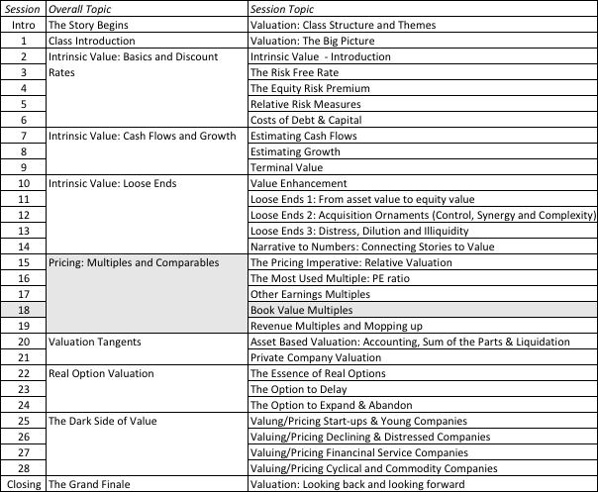
Accounting Value..

Slide 3
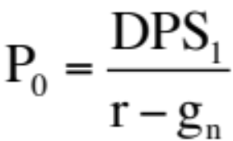
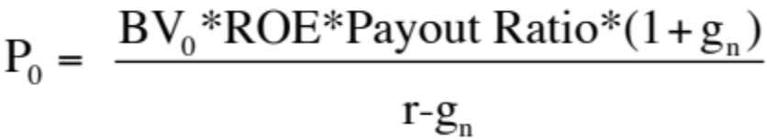
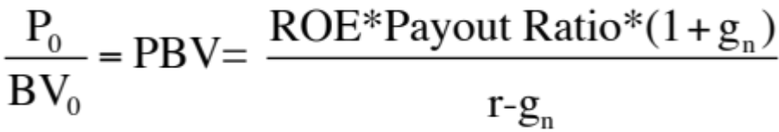
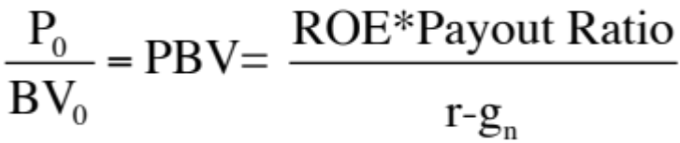
III. Price to Book Ratio
Going back to a simple dividend discount model,
Defining the return on equity (ROE) = EPS0 / Book Value of Equity, the value of equity can be written as:
If the return on equity is based upon expected earnings in the next time period, this can be simplified to,
Notes:
Following a familiar route.. The price to book ratio is an equity multiple and you go back to an equity valuation model…
The price to book ratio is determined by the three variables that determine the PE ratio (growth, payout and risk) and one variable that is unique to it (the return on equity)
Every multiple has one variable that can be considered its key determinant - its companion variable, so to speak. For PE, it was growth.. For Value/EBITDA, it was the reinvestment rate. For price to book, it is return on equity.

Slide 4
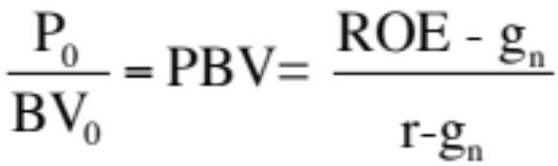
Price Book Value Ratio: Stable Growth Firm
Another Presentation
This formulation can be simplified even further by relating growth to the return on equity:
g = (1 - Payout ratio) * ROE
Substituting back into the P/BV equation,
The price-book value ratio of a stable firm is determined by the differential between the return on equity and the required rate of return on its projects.
Building on this equation, a company that is expected to generate a ROE higher (lower than, equal to) its cost of equity should trade at a price to book ratio higher (less than, equal to) one.
Notes:
Restates the price to book in terms of excess returns.. Firms that earn excess returns (on equity) will trade at high price to book ratios… If the return on equity is estimated using the expected earnings next year, the two equations will converge.. Otherwise, the first equation will be higher by a factor (1+g)….

Slide 5
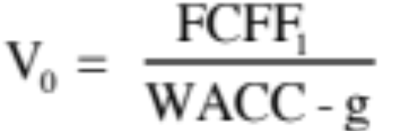
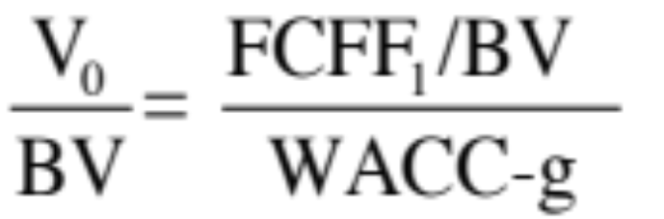
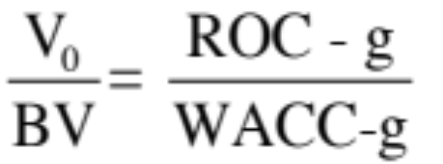
Now changing to an Enterprise value multiple
EV/ Book Capital
To see the determinants of the value/book ratio, consider the simple free cash flow to the firm model:
Dividing both sides by the book value, we get:
If we replace, FCFF = EBIT(1-t) - (g/ROC) EBIT(1-t),we get:
Notes:
To analyze a firm value ratio, we go back to a firm valuation. The determinant of the value to book ratio is the spread between the ROC and the cost of capital…

Slide 6
An Example: An Eyeballing Exercise with P/BV Ratios for European Banks in 2010
Name | PBV Ratio | Return on Equity | Standard Deviation
BAYERISCHE HYPO-UND VEREINSB | 0.80 | -1.66% | 49.06%
COMMERZBANK AG | 1.09 | -6.72% | 36.21%
DEUTSCHE BANK AG -REG | 1.23 | 1.32% | 35.79%
BANCA INTESA SPA | 1.66 | 1.56% | 34.14%
BNP PARIBAS | 1.72 | 12.46% | 31.03%
BANCO SANTANDER CENTRAL HISP | 1.86 | 11.06% | 28.36%
SANPAOLO IMI SPA | 1.96 | 8.55% | 26.64%
BANCO BILBAO VIZCAYA ARGENTA | 1.98 | 11.17% | 18.62%
SOCIETE GENERALE | 2.04 | 9.71% | 22.55%
ROYAL BANK OF SCOTLAND GROUP | 2.09 | 20.22% | 18.35%
HBOS PLC | 2.15 | 22.45% | 21.95%
BARCLAYS PLC | 2.23 | 21.16% | 20.73%
UNICREDITO ITALIANO SPA | 2.30 | 14.86% | 13.79%
KREDIETBANK SA LUXEMBOURGEOI | 2.46 | 17.74% | 12.38%
ERSTE BANK DER OESTER SPARK | 2.53 | 10.28% | 21.91%
STANDARD CHARTERED PLC | 2.59 | 20.18% | 19.93%
HSBC HOLDINGS PLC | 2.94 | 18.50% | 19.66%
LLOYDS TSB GROUP PLC | 3.33 | 32.84% | 18.66%
Average | 2.05 | 12.54% | 24.99%
Median | 2.07 | 11.82% | 21.93%
Notes:
This was just before the crisis. Note that the banks that trade at low P/BV ratios also tend to have low ROEs…
The standard deviation in stock prices is a proxy for risk. If that is not a good measure, you may consider others that are specific to banks (toxic assets on the balance sheet, regulatory capital ratios, loan losses/write offs)

Slide 7
The median test…
We are looking for stocks that trade at low price to book ratios, while generating high returns on equity, with low risk. But what is a low price to book ratio? Or a high return on equity? Or a low risk
One simple measure of what is par for the sector are the median values for each of the variables. A simplistic decision rule on under and over valued stocks would therefore be:
  Undervalued stocks: Trade at price to book ratios below the median for the sector,(2.07), generate returns on equity higher than the sector median (11.82%) and have standard deviations lower than the median (21.93%).
  Overvalued stocks: Trade at price to book ratios above the median for the sector and generate returns on equity lower than the sector median.
Notes:
A simple way to look for mismatches….

Slide 8
How about this mechanism?
We are looking for stocks that trade at low price to book ratios, while generating high returns on equity. But what is a low price to book ratio? Or a high return on equity?
Taking the sample of 18 banks, we ran a regression of PBV against ROE and standard deviation in stock prices (as a proxy for risk).
  PBV = 2.27 + 3.63 ROE - 2.68 Std dev
  (5.56) (3.32) (2.33)
R squared of regression = 79%
Notes:
A slightly more sophisticated take which brings in more than one variable into the analysis…
Note how much of the variation in price to book ratios is explained by just ROE and standard deviation. The caveats about small samples and linear relationships continue to apply.

Slide 9

And these predictions?
Notes:
Using the regression to get predicted values, we can estimate what the PBV ratio should be for each bank, given its ROE and standard deviation.

Slide 10
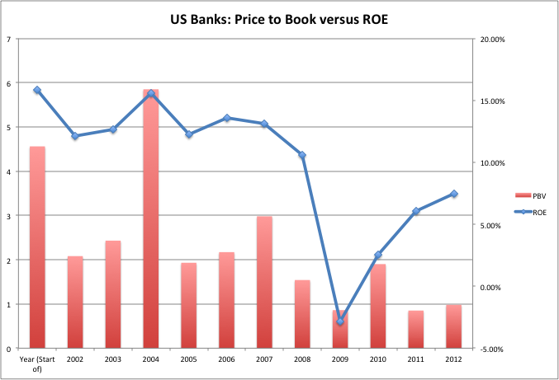
A follow up on US Banks
Notes:
While banks have historically traded well above book value, the price to book ratios for US banks collectively has dropped to below one in the last two years, even though returns on equity bottomed out in 2009 and have improved since. If the price to book is a forward looking measure, this would suggest either than investors don’t expect bank ROEs to recover very much (maybe to their costs of equity) or that banks are under valued.

Slide 11

Example 2: The Largest Market Cap Companies - PBV versus ROE
Notes:
Looks at the 100 largest market cap firms in the United States… Shows how strong the link is between price to book and return on equity. With a 90% confidence interval, a handful of stocks fall outside the range, but there may be good reasons for each:
The two stocks that fall below the undervalued line are MO (Altria or Philip Morris) and FNMA (because of recent accounting and management scandals.
Above the overvalued line are the high flyers - EBAY, Dell, SAP where presumable investors expect the return on equity to climb over time and high growth to continue…

Slide 12
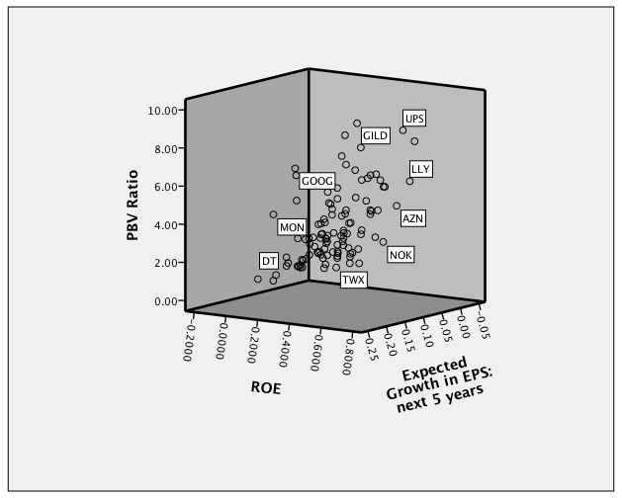
Missing growth?
Notes:
We control for growth differences. The most undervalued firm is MO…. And all of the overvalued firms drop off the list.

Slide 13
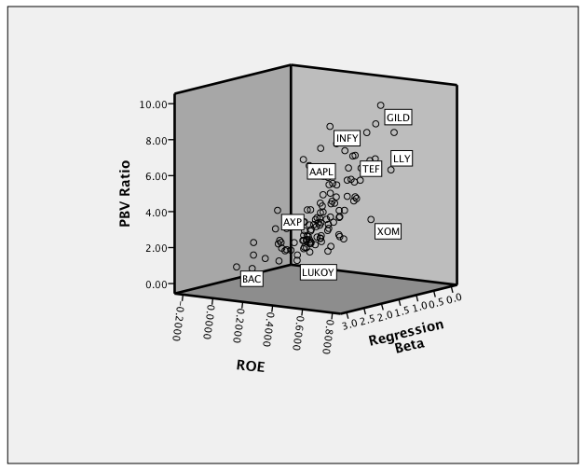
PBV, ROE and Risk: Large Cap US firms
Most overvalued
Cheapest
Most undervalued
Notes:
Graphs out the largest US market cap firms on a three dimensional graph with risk being the third dimension…
You could also try growth as the third dimension…

Slide 14


Bringing it all together… Largest US stocks in January 2010

Slide 15
Market Regressions - Global
Region | Regression – January 2016 | R²
US | PBV= -1.68 + 14.59 g_{EPS} – 0.99 Beta + 3.79 Payout + 19.58 ROE | 50.2%
Europe | PBV = 2.66 + 6.30 g_{EPS} – 1.40 Beta + 9.39 ROE + 1.80 Payout | 40.6%
Japan | PBV= 2.01 + 2.15 g_{EPS} – 1.18 Beta + 0.97 Payout + 8.28 ROE | 29.1%
Emerging Markets | PBV= -0.43 + 2.71 g_{EPS} - 0.74 Beta + 2.48 Payout + 18.91 ROE | 34.1%
Australia, NZ, Canada | PBV= -1.20 + 8.97 g_{EPS} - 0.69 Beta + 1.01 Payout + 21.90 ROE | 55.4%
Global | PBV= 0.22 + 5.41 g_{EPS} - 0.95 Beta + 2.68 Payout +16.09 ROE | 43.1%
g_{EPS}=Expected Growth: Expected growth in EPS/ Net Income: Next 5 years
Beta: Regression or Bottom up Beta
Payout ratio: Dividends/ Net income from most recent year. Set to zero, if net income < 0
ROE: Net Income/ Book value of equity in most recent year.
Notes:
Japan is the outlier. It is difficult to explain differences in price to book ratios across Japanese companies… May have something to do with Japanese accounting… and how it affects book value.

