Slide 1
Session 1: Valuation – The Big Picture
Aswath Damodaran
Notes:
It always helps to lay a philosophical foundation for what is to come. This presentation, which is usually my first session, attempts to do this. I use it not only as an opportunity to provide an overview of valuation approaches but also to link each to specific views about how markets work and what inefficiencies have to come into play for each approach to yield excess returns.

Slide 2
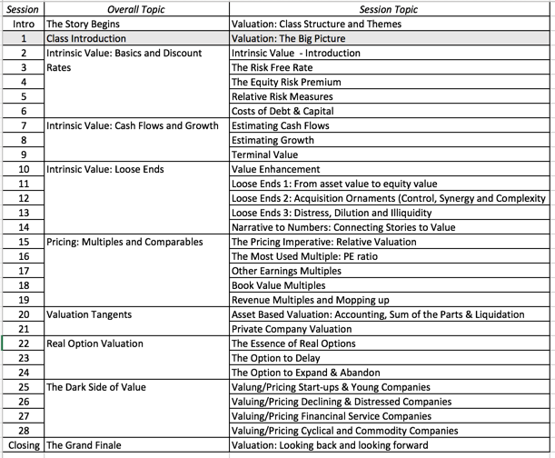
Baby steps..

Slide 3
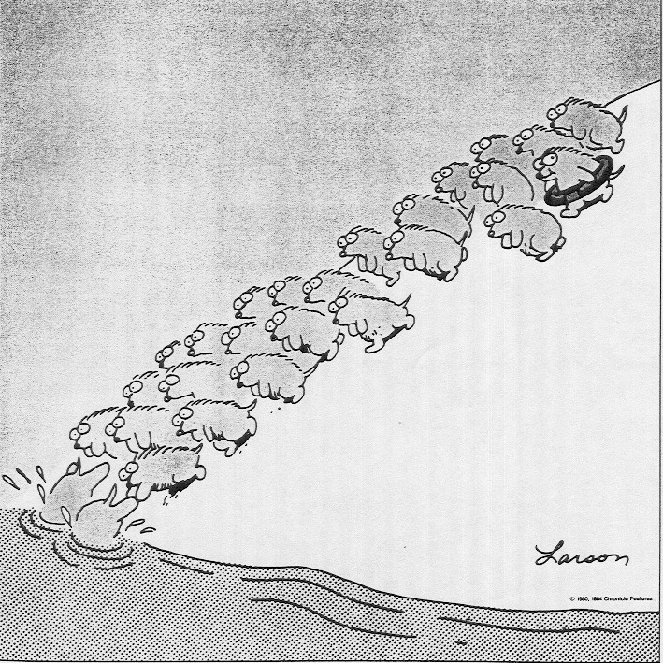
Some Initial Thoughts
Notes:
This is one of my favorite cartoons of all time. As humans, we all have a little bit (or a lot) of the lemming in each of us - it is very difficult to go against the crowd, no matter what your rational part tells you. Some investors are lemmings and proud of it - we call them momentum investors. Other investors think they are smarter than the rest - they think they can veer away just as the cliff approaches. Mr. Druckenmiller’s quote cuts to the heart of why that might be difficult to do… All to often, the cliff comes as a surprise to even the most savvy investors…. If you are going to be a lemming, be a lemming with a life vest… that is what valuation gives you - a life vest that can sustain you when perceptions shift…

Slide 4
Misconceptions about Valuation
Valuation is not a science.
  All valuations are biased
  The degree of bias is determined by who pays you to do the valuation
Precision is a poor measure of valuation quality
  Uncertainty is a feature, not a bug.
  Payoff to valuation is greatest when you are most uncertain.
Bigger models don’t yield better values
  The model is your tool.
  Less is more. Simpler models do better.
Notes:
While we use the cover of numbers and models to obscure the fact, valuation is extraordinarily subjective. Your biases find their way into your valuations.
Every semester, students in my equity valuation class pick companies to value over the semester. A few years ago, I asked students to let me know at the start of the semester what companies they would be valuing and also whether they thought these companies were under or over valued (before they had actually done the valuation). At the end of the semester, I chronicled what they concluded in their quantitative valuations - 88% of those who thought that their companies were under valued at the start of the semester found them to be undervalued, and 82% of those who thought their companies were overvalued found them to be overvalued.
The current debate about conflicts of interest faced by analysts who have to bring in investment banking business or own stock in the companies that they analyze is well chronicled.
Valuation is also inherently imprecise because you are looking at the future. You cannot apply the same tests of precision to valuing a stock that you would to valuing a bond, or within stocks, to valuing a stable utility to valuing a technology company. The imprecise valuation of a risky company may be more valuable than the precise valuation of a stable company.
Finally, adding more inputs may seem costless to those building models, but they are never costless to those using them.

Slide 5
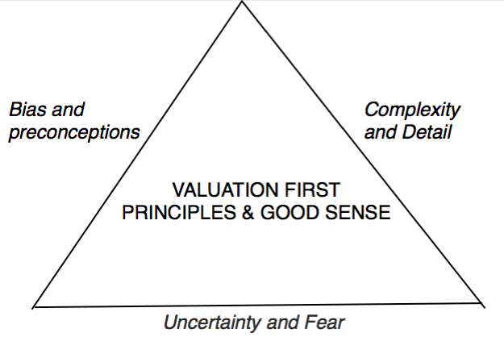
The Bermuda Triangle of Valuation

Slide 6
Approaches to Valuation
Intrinsic valuation, usually in the form of a DCF.
Relative valuation or Pricing
Contingent claim valuation or Real Options
Notes:
There are some who suggest that there is a fourth way to approach valuation, which is to value the assets of a firm individually. Asset based valuation, however, requires that you use either discounted cash flow or relative valuation models to value the individual assets. Consequently, we view it as a subset of these approaches.

Slide 7
Basis for all valuation approaches
When you use a valuation model, you are assuming
  A market inefficiency
  A correction of that inefficiency.
In an efficient market, the market price is the best estimate of value. The purpose of any valuation model is then the justification of this value.
Notes:
Implicit in most valuation is the assumption that markets make mistakes and that we can find those mistakes by using the right valuation models. An often unstated assumption is that markets will correct their mistakes, resulting in excess returns for investors.
If you do believe that markets are efficient, valuation still may be a useful tool in different contexts:
Valuing private businesses (where there is no market to yield a price)
Valuing the effect of a restructuring or a merger, where the market has not had a chance to react to the changes being considered.

Slide 8
Discounted Cash Flow Valuation
What is it: In discounted cash flow valuation, the value of an asset is the present value of the expected cash flows on the asset.
Philosophical Basis: Every asset has an intrinsic value that can be estimated, based upon its characteristics in terms of cash flows, growth and risk.
Information Needed: A life for the asset, expected cash flows and discount rates.
Market Inefficiency: Markets make mistakes, you can find them and the market corrects over time.
Notes:
Discounted cash flow valuation is geared for assets that derive their value from the cashflows that they are expected to generate - most businesses and financial assets fall into this category.
The inputs needed for all discounted cash flow models - cash flows, discount rates and asset life - are the same, though the ease with which they can be estimated may vary from asset to asset.
When we use discounted cash flow valuation, we are assuming that we can estimate intrinsic value and that market prices can deviate from intrinsic values. We also assume that prices will revert back to intrinsic value sooner or later - this is why a long time horizon is a pre-requisite.

Slide 9
Relative Valuation
What is it?: The value of any asset can be estimated by looking at how the market prices “similar” or ‘comparable” assets.
Philosophical Basis: The value of an asset is whatever the market is willing to pay for it (based upon its characteristics)
Information Needed: To do a relative valuation, you need similar assets, a standardized price and control variables.
Market Inefficiency: Markets are right, on average, but can be wrong on individual assets.
Notes:
Most valuations on Wall Street are relative valuations, involving three components - a multiple, a set of comparable firms and a story. (In an informal survey of equity research reports that I did in 1998 and 1999, 92% of equity research reports could be categorized as relative valuations (though some had appendices with expected cash flows).
Implicitly, you assume that markets are correct on average. (A logical follow-up is that equity research analysts must be much stronger believers in market efficiency than they claim to be, if their primary tools are multiples.)

Slide 10
Contingent Claim (Option) Valuation
What is it: You value an asset with cash flows contingent on an event happening as options.
Philosophical Basis: When you buy an option-like asset, you change your risk tradeoff – you have limited downside risk and almost unlimited upside risk. Risk becomes your ally.
Information Needed: To use contingent claim valuation, you need an underlying asset, an intrinsic value based upon expected cash flows and a specified contingent payoff.
Market Inefficiency: Investors who ignore the optionality in option-like assets will misprice them.
Notes:
There are a lot of assets that have these characteristics that may not be categorized as options…. Option pricing models will do a better job of valuing these assets than traditional discounted cash flow models.

Slide 11
Indirect Examples of Options
Equity in a deeply troubled firm - a firm with negative earnings and high leverage - can be viewed as an option to liquidate that is held by the stockholders of the firm. Viewed as such, it is a call option on the assets of the firm.
The reserves owned by natural resource firms can be viewed as call options on the underlying resource, since the firm can decide whether and how much of the resource to extract from the reserve,
The patent owned by a firm or an exclusive license issued to a firm can be viewed as an option on the underlying product (project). The firm owns this option for the duration of the patent.
The rights possessed by a firm to expand an existing investment into new markets or new products.
Notes:
These options are often referred to as real options. Most firms have at least some assets that have option characteristics - vacant land owned by a real estate company, undeveloped patents owned by a pharmaceutical firm…

Slide 12
In summary…
While there are hundreds of valuation models and metrics around, there are only three valuation approaches:
  Intrinsic valuation (usually, but not always a DCF valuation)
  Relative valuation
  Contingent claim valuation
The three approaches can yield different estimates of value for the same asset at the same point in time.
To truly grasp valuation, you have to be able to understand and use all three approaches. There is a time and a place for each approach, and knowing when to use each one is a key part of mastering valuation.

