Slide 1
Session 20: Asset Based Valuation

Slide 2
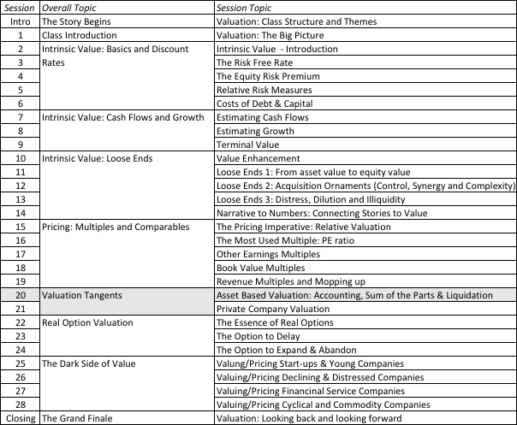
Asset Based Valuation

Slide 3
What is asset based valuation?
In intrinsic valuation, you value a business based upon the cash flows you expect that business to generate over time.
In relative valuation, you value a business based upon how similar businesses are priced.
In asset based valuation, you value a business by valuing its individual assets. These individual assets can be tangible or intangible.
Notes:
Perhaps the best way to contrast asset based valuation with intrinsic valuation, is that the latter is focused on the income and cash flow statements, the former is rooted in the balance sheet.

Slide 4
When is asset-based valuation easiest to do?
Separable assets: If a company is a collection of separable assets (a set of real estate holdings, a holding company of different independent businesses), asset-based valuation is easier to do.
Stand alone earnings/ cash flows: An asset is much simpler to value if you can trace its earnings/cash flows to it.
Active market for similar assets: If you plan to do a relative valuation, it is easier if you can find an active market for “similar” assets which you can draw on for transactions prices.
Notes:
If a company is a collection of five real estate holdings, it is easy to do an asset based valuation. Each property can be valued separately and the values of the properties can be added together to get to the value of the company. If the same company is a brand name hotel with five properties, it will be more difficult to value the company using asset based valuation. Each property has a value that is attributable not only to it but to the hotel brand and other centralized services.

Slide 5
I. Liquidation Valuation
In liquidation valuation, you are trying to assess how much you would get from selling the assets of the business today, rather than the business as a going concern.
Consequently, it makes more sense to price those assets (i.e., do relative valuation) than it is to value them (do intrinsic valuation).
To the extent that the liquidation is urgent, you may attach a discount to the estimated value.
Notes:
While liquidation valuation requires you to assess what you can get if you sell the asset today, this can be more difficult to do for some assets than others.. Trusting book value as the basis for liquidation value is a dangerous practice.

Slide 6
II. Accounting Valuation: Glimmers from FAS 157
The ubiquitous “market participant”: Through FAS 157, accountants are asked to attach values to assets/liabilities that market participants would have been willing to pay/ receive.
Tilt towards relative value: “The definition focuses on the price that would be received to sell the asset or paid to transfer the liability (an exit price), not the price that would be paid to acquire the asset or received to assume the liability (an entry price).”
Split mission: While accounting fair value is titled towards relative valuation, accountants are also required to back their relative valuations with intrinsic valuations.
Notes:
Accounting fair value does not seem to have a clear focus both about what value accountants are supposed to estimate and why they are doing the estimation. On the first question, while FAS 157 seems to suggest that fair value is what a willing buyer will pay for an asset today, the rules seem to also require that accountants estimate intrinsic values that match this fair value. On the second, it is not clear whether the intent here is a balance sheet that reflects the fair value of all asset, including future growth opportunities, or one that reflects the fair value of only existing assets.

Slide 7
III. Sum of the parts valuation
You can value a company in pieces, using either relative or intrinsic valuation.
If you are long term, passive investor in the company, your intent may be to find market mistakes that you hope will get corrected over time. If that is the case, you should do an intrinsic valuation of the individual assets.
If you are an activist investor that plans to acquire the company or push for change, you should be more focused on relative valuation, since your intent is to get the company to split up and gain the increase in value.
Notes:
Sum of the parts valuation, in most cases, is haphazardly done. First, a firm is broken down into asset classes or businesses, even though there may be overlap across businesses or centralized support services. Second, the earnings or other operating metric for each asset class/business is converted to an estimated value, using the average multiple at which publicly traded companies in that business trade for. Third, the estimated values of the businesses are added up and compared the actual market value.

Slide 8
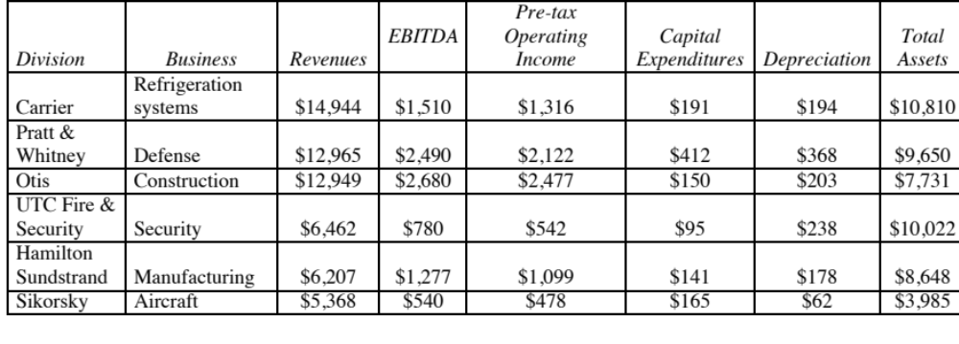
Let’s try this
United Technologies: Raw Data - 2009
The company also had corporate expenses, unallocated to the divisions of $408 million in the most recent year.
Notes:
United Technologies is a multi business company. As with many multi-business companies, UT reports revenues and EBITDA by business, but it also provides information on cap ex, depreciation and total assets, unusual for a company.
The added item on corporate expenses is a typical one, since most multi-business companies have at least some corporate or G&A expense that is not allocated to the divisions.

Slide 9
United Technologies: Relative Valuation
Median Multiples
Division | Business | EBITDA | EV/EBITDA for sector | Value of Business
Carrier | Refrigeration systems | $1,510 | 5.25 | $7,928
Pratt & Whitney | Defense | $2,490 | 8.00 | $19,920
Otis | Construction | $2,680 | 6.00 | $16,080
UTC Fire & Security | Security | $780 | 7.50 | $5,850
Hamilton Sundstrand | Industrial Products | $1,277 | 5.50 | $7,024
Sikorsky | Aircraft | $540 | 9.00 | $4,860
Sum of the parts value for business = |  |  |  | $61,661
Notes:
Most sum of the parts valuations is fairly simplistic and represent approximate values. You are not controlling for differences between the company’s business and competitors (on margins, growth and risk) when you use the median value of the multiple. Also, using the same multiple for different businesses may not be optimal.

Slide 10
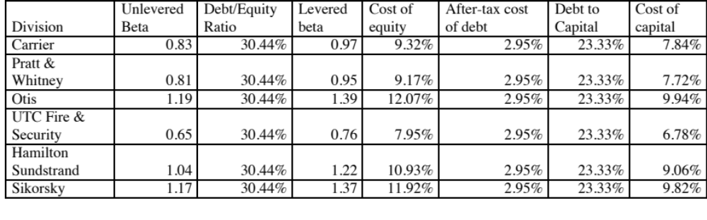
United Technologies: DCF parts valuation
Cost of capital, by business
Notes:
In this case, I chose to use the same debt to equity and capital ratios for all of the businesses, since UT had no distinct breakdown of debt. I could have tried allocating the debt, based upon the debt ratios of comparable companies…. But I did not bother…

Slide 11
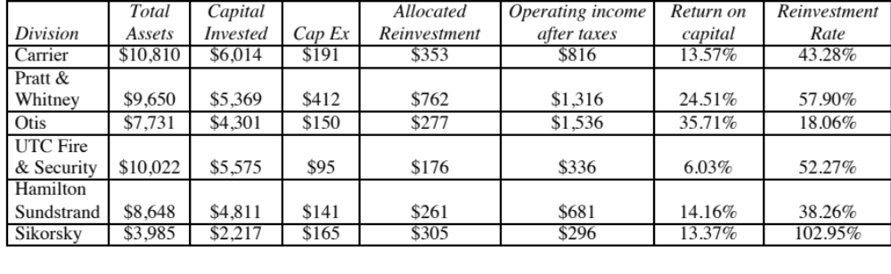
United Technologies: DCF valuation
Fundamentals, by business
Notes:
Estimate the key numbers that drive growth for each business separately. I was able to do this only because UT broke down total capital and net cap ex by business. I scaled down the total assets line to reflect the ratio of capital invested for UT as a whole, relative to its total assets.

Slide 12
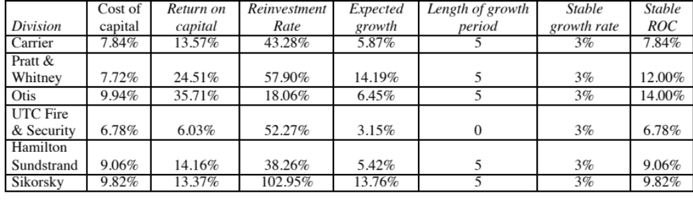
United Technologies, DCF valuation
Growth Choices
Notes:
Made different assumptions about growth period and growth rate for different businesses as well as what happens in stable growth to the ROC.

Slide 13
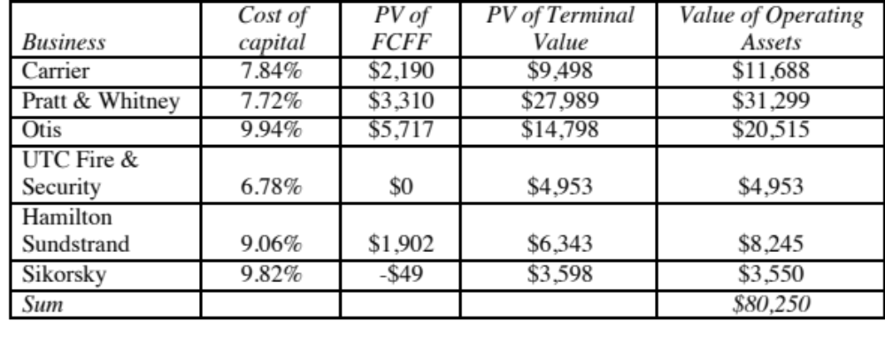
United Technologies, DCF valuation
Values of the parts
Notes:
Valued the operating assets for each business, by discounting cash flows to the firm at the cost of capital.

Slide 14
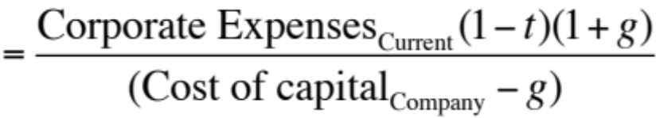
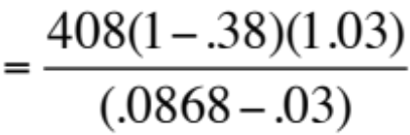
United Technologies, DCF valuation
Sum of the Parts (SOTP)
Value of the parts = $80,250
- Value of corporate expenses
= $ 4,587
= Value of operating assets (SOTP DCF) = $75,663
Value of operating assets (sum of parts RV) = $74,230
Value of operating assets (company DCF) = $71,410
Enterprise value (based on market prices) = $52,261-
Notes:
Comparison of the values for UT using the different approaches. Note that in the DCF approach, we have valued the corporate expenses as a perpetuity (with a growth rate of 3% a year forever) and the cost of capital for the company.

