Slide 1
Session 21: Private company valuation

Slide 2
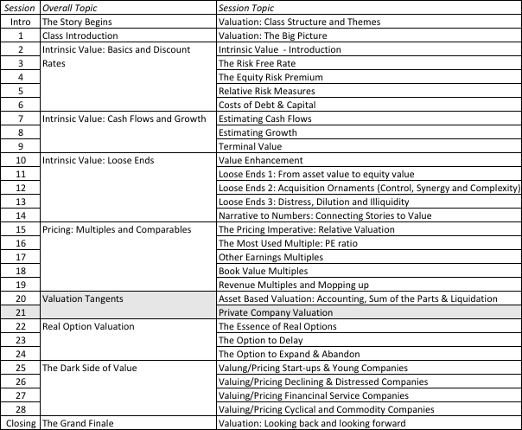
Private Business Valuation

Slide 3
Private Company Valuation: Motive matters
You can value a private company for
  ‘Show’ valuations
  Transaction valuations
  As prelude to setting the offering price in an initial public offering
You can value a division or divisions of a publicly traded firm
  As prelude to a spin off
  For sale to another entity
  To do a sum-of-the-parts valuation to determine whether a firm will be worth more broken up or if it is being efficiently run.
Notes:
The motive for a valuation can have significant effects on how you estimate cash flows and discount rates. In other words, the same private firm may be worth more to a publicly traded firm than to a private entity.

Slide 4
Private company valuations: Four broad scenarios
Private to private transactions: You can value a private business for sale by one individual to another.
Private to public transactions: You can value a private firm for sale to a publicly traded firm.
Private to IPO: You can value a private firm for an initial public offering.
Private to VC to Public: You can value a private firm that is expected to raise venture capital along the way on its path to going public.
Notes:
Four classes of transactions… can lead to four different valuations… for the same company.

Slide 5
I. Private to Private transaction
In private to private transactions, a private business is sold by one individual to another. There are three key issues that we need to confront in such transactions:
  Neither the buyer nor the seller is diversified
  The investment is illiquid
  Key person value
Notes:
With very small businesses, this is the most common transaction…
In service businesses (a doctor’s practice, a plumbing business), you generally see all of these problems come into play.

Slide 6
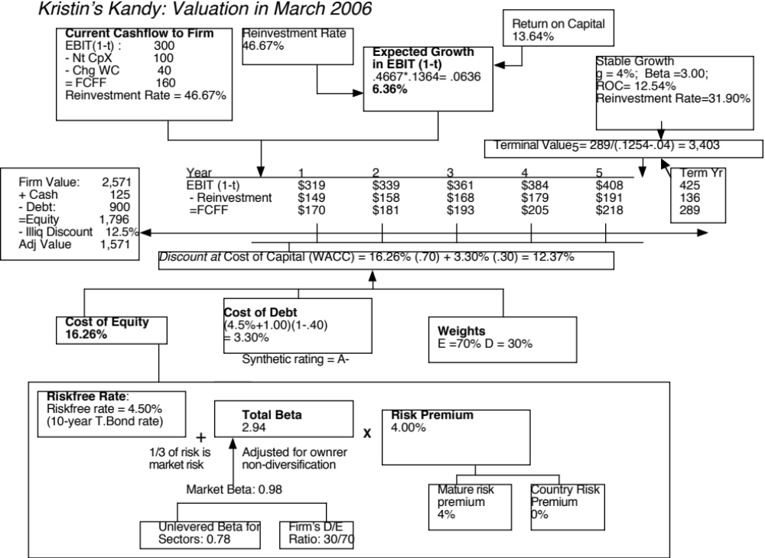

Slide 7
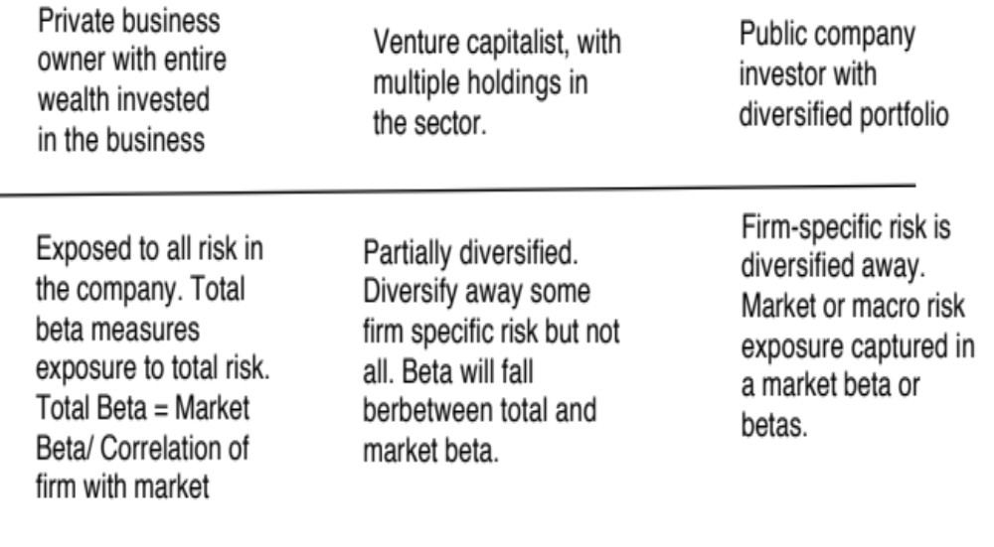
Lesson 1: In private businesses, risk in the eyes of the “beholder” (buyer)

Slide 8
Total Risk versus Market Risk
Adjust the beta to reflect total risk rather than market risk. This adjustment is a relatively simple one, since the R squared of the regression measures the proportion of the risk that is market risk.
  Total Beta = Market Beta / Correlation of the sector with the market
To estimate the beta for Kristin Kandy, we begin with the bottom-up unlevered beta of food processing companies:
  Unlevered beta for publicly traded food processing companies = 0.78
  Average correlation of food processing companies with market = 0.333
  Unlevered total beta for Kristin Kandy = 0.78/0.333 = 2.34
  Debt to equity ratio for Kristin Kandy = 0.3/0.7 (assumed industry average)
  Total Beta = 2.34 ( 1- (1-.40)(30/70)) = 2.94
  Total Cost of Equity = 4.50% + 2.94 (4%) = 16.26%
Notes:
This assumes that
The owner of the private business has all of his or her wealth invested in the business
The reality is that most individuals will fall somewhere between the two extremes.
If you were a private business looking at potential acquirers - one is a publicly traded firm and the other is an individual . Which one is likely to pay the higher price and why?
If both acquirers have the same cash flow expectations, the publicly traded firm will win out (Blockbuster Video, Browning-Ferris are good examples of publicly traded firms which bought small private businesses to grow to their current stature.)

Slide 9
Lesson 2: With financials, trust but verify..
Different Accounting Standards: Looser and more diverse accounting standards.
Intermingling of personal and business expenses: Personal expenses may be reported as business expenses.
Separating “Salaries” from “Dividends”: No separation between the two for sole owner..
The Key person issue: In some private businesses, with a personal component, the cashflows may be intertwined with the owner being part of the business.

Slide 10
Lesson 3: Illiquidity is a clear and present danger..
In private company valuation, illiquidity is a constant theme. All the talk, though, seems to lead to a rule of thumb. The illiquidity discount for a private firm is between 20-30% and does not vary across private firms.
But illiquidity should vary across:
  Companies: Financial healthy, Cash flows and Asset type
  Time: Liquidity is worth more when markets are in crisis.
  Buyers: Liquidity is worth more to buyers who have shorter time horizons and greater cash needs.

Slide 11
II. Private company sold to publicly traded company
The key difference between this scenario and the previous scenario is that the seller of the business is not diversified but the buyer is (or at least the investors in the buyer are). Consequently, they can look at the same firm and see very different amounts of risk in the business with the seller seeing more risk than the buyer.
The cash flows may also be affected by the fact that the tax rates for publicly traded companies can diverge from those of private owners.
Finally, there should be no illiquidity discount to a public buyer, since investors in the buyer can sell their holdings in a market.
Notes:
If the buyer is a public company, there should be no total beta effect (since investors in the company can diversify) or illiquidity effect (since investors can buy and sell shares of the company…) The valuation therefore will look very much like the valuation of a publicly traded company.

Slide 12
III. Private company for initial public offering
In an initial public offering, the private business is opened up to investors who clearly are diversified (or at least have the option to be diversified).
There are control implications as well. When a private firm goes public, it opens itself up to monitoring by investors, analysts and market.
The reporting and information disclosure requirements shift to reflect a publicly traded firm.
Notes:
Valuing a company for an IPO is a standard public company valuation, albeit without the market price crutch (you are trying to estimate it)…

Slide 13
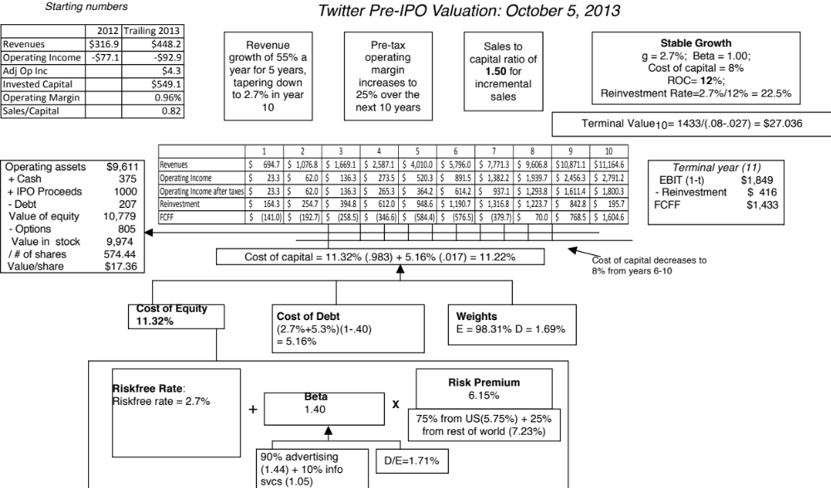
Notes:
The value of Twitter for a public offering…Note that the inputs are those of a publicly traded firm because the investors in the public offering are assumed to be the marginal investors and well diversified.

Slide 14
The twists in an initial public offering
Valuation issues:
  Use of the proceeds from the offering: Proceeds can be taken out of the firm, held as cash or used to retire debt.
  Warrants/ Special deals with prior equity investors: Option claims from prior equity offerings may stay on.
Pricing issues:
  Institutional set-up: Most IPOs are backed by investment banking guarantees on the price, which can affect how they are priced.
  Follow-up offerings: The proportion of equity being offered at initial offering and subsequent offering plans can affect pricing.
Notes:
When a company does an IPO, it issues shares to the public and raises cash. What it does with the cash can affect the value/share.
Since the IPO of a private business is after a series of capital issues to venture capitalists, each of whom may have different arrangements with the company’s owners, you have to factor in the costs of these special deals.
In most IPOs, only a portion of the equity is issued to the public at the time of the IP). This can have consequences for pricing and valuation.

Slide 15
IV. An Intermediate Problem
Private to VC to Public offering…
Assume that you have a private business operating in a sector, where publicly traded companies have an average beta of 1 and where the average correlation of firms with the market is 0.25. Consider the cost of equity at three stages (Riskfree rate = 4%; ERP = 5%):
Stage 1: The nascent business, with a private owner, who is fully invested in that business.
Perceived Beta = 1/ 0.25 = 4
Cost of Equity = 4% + 4 (5% ) = 24%
Stage 2: Angel financing provided by specialized venture capitalist, who holds multiple investments, in high technology companies. (Correlation of portfolio with market is 0.5)
Perceived Beta = 1/0.5 = 2
Cost of Equity = 4% + 2 (5%) = 14%
Stage 3: Public offering, where investors are retail and institutional investors, with diversified portfolios:
Perceived Beta = 1
Cost of Equity = 4% + 1 (5%) = 9%
Notes:
Most private businesses go through different phases of raising capital, and the investor profile (in terms of diversification) can change at each stage. Even if the underlying business does not change, your beta and cost of equity may…

Slide 16
To value this company…
Assume that this company will be fully owned by its current owner for two years, will access the technology venture capitalist at the start of year 3 and that is expected to either go public or be sold to a publicly traded firm at the end of year 5.
 | 1 | 2 | 3 | 4 | 5 | Terminal year
E(Cash flow) | $100 | $125 | $150 | $165 | $170 | $175
Market beta | 1 | 1 | 1 | 1 | 1 | 1
Correlation | 0.25 | 0.25 | 0.5 | 0.5 | 0.5 | 1
Beta used | 4 | 4 | 2 | 2 | 2 | 1
Cost of equity | 24.00% | 24.00% | 14.00% | 14.00% | 14.00% | 9.00%
Terminal value |  |  |  |  | $2,500
Cumulated COE | 1.2400 | 1.5376 | 1.7529 | 1.9983 | 2.2780 | 2.4830
PV | $80.65 | $81.30 | $85.57 | $82.57 | $1,172.07
Value of firm | $1,502 | (Correct value, using changing costs of equity)
Value of firm | $1,221 | (using 24% as cost of equity forever. You will undervalue firm)
Value of firm | $2,165 | (Using 9% as cost of equity forever. You will overvalue firm)
Growth rate 2% forever after year 5
^{175/}
^{(.09-.02)}
Notes:
I think that the fair value today for this company is $1.5 million.
Note, though, how much the value gets skewed if you do not adjust the cost of equity for the changes in the investor profile.

