Slide 1
Session 22: The Essence of real options

Slide 2
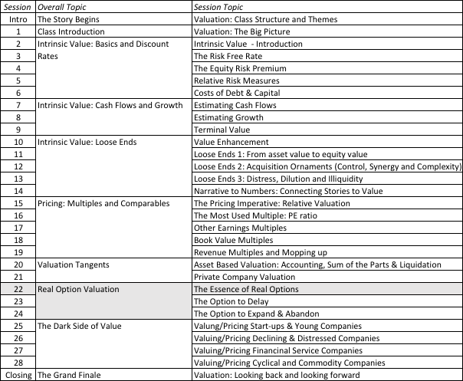
Optionality

Slide 3
Underlying Theme: Searching for an Elusive Premium
Traditional discounted cashflow models under estimate the value of investments, where there are options embedded in the investments to
  Delay or defer making the investment (delay)
  Adjust or alter production schedules as price changes (flexibility)
  Expand into new markets or products at later stages in the process, based upon observing favorable outcomes at the early stages (expansion)
  Stop production or abandon investments if the outcomes are unfavorable at early stages (abandonment)
Put another way, real option advocates believe that you should be paying a premium on discounted cashflow value estimates.
Notes:
The allure of real options is that they allow you to add a premium to traditional value estimates (NPV, discounted cash flow value) and override what are generally considered hard and fast rules in finance. Thus, you can use the real options argument to take a negative NPV investment, bid for a non-viable patent or pay more than fair value (estimated from cashflows) on an acquisition.

Slide 4
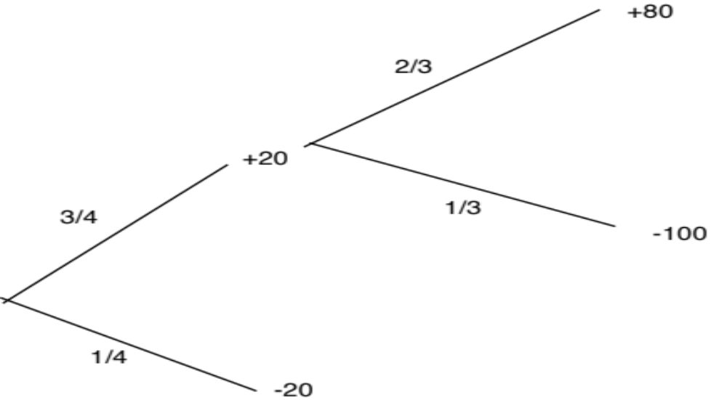
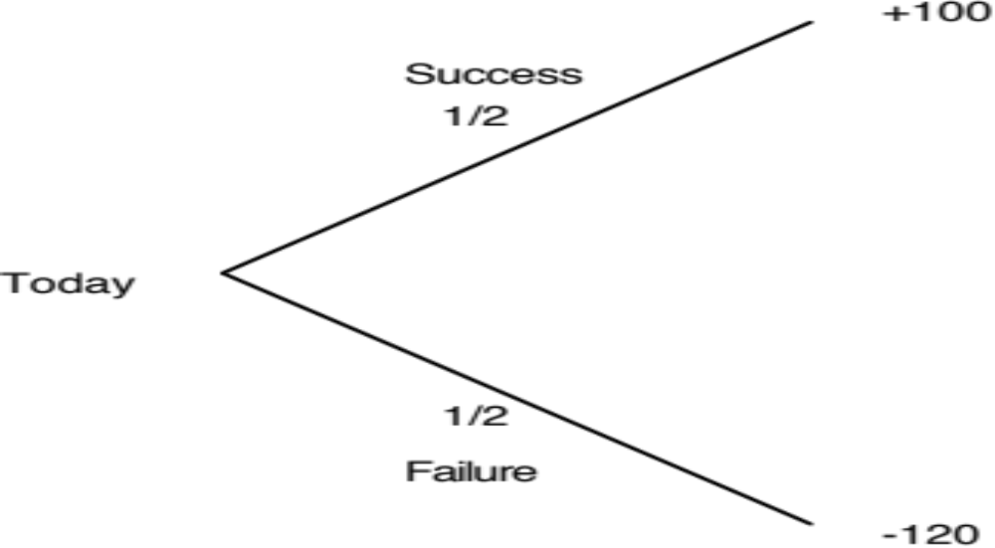
The roots of the option premium
A bad investment
Becomes a good one..
Notes:
Expected value of the fist investment = -10
If you ignore time value, the cumulative probabilities of success and failure and the cumulative costs of each have not changed in this example but the expected value has become positive…
The gain comes from the fact that what you learn at the first stage allows you to make better decisions in the second. This learning is the essence of the value of real options and is what often gets ignored in conventional discounted cashflow valuation, where we take the expected cashflows from today’s vantage point without considering other pathways that the firm might choose given what happens in the first year, the second year etc.
The keys to real option value then come from learning and adaptive behavior

Slide 5
Three Basic Questions
When is there a real option embedded in a decision or an asset?
When does that real option have significant economic value?
Can that value be estimated using an option pricing model?
Notes:
To prevent real options arguments from overwhelming common sense, we have to ensure that all three questions get answered in the affirmative before we use the argument in the first place.

Slide 6
When is there an option embedded in an action? It’s in the payoff diagram
Net Payoff
on Call
Strike
Price
Price of underlying asset
Notes:
Any asset with a cash flow payoff that resembles this has call option characteristics.
The key is that losses are limited and profits are not.

Slide 7
Payoff Diagram on Put Option
Net Payoff
On Put
Strike
Price
Price of underlying asset
Notes:
Any asset with a cash flow payoff that resembles this has put option characteristics.

Slide 8
When does the option have significant economic value?
For an option to have significant economic value, there has to be a restriction on competition in the event of the contingency. In a perfectly competitive product market, no contingency, no matter how positive, will generate positive net present value.
At the limit, real options are most valuable when you have exclusivity - you and only you can take advantage of the contingency. They become less valuable as the barriers to competition become less steep.
Notes:
Exclusivity is the defining variable determining whether an option has value. If you and only you can exercise the option, you get 100% of its value. If others also have the opportunity, you start losing value. In effect, opportunities that are available to every one are not options.

Slide 9
Determinants of option value
Variables Relating to Underlying Asset
  Value of Underlying Asset; as this value increases, the right to buy at a fixed price (calls) will become more valuable and the right to sell at a fixed price (puts) will become less valuable.
  Variance in that value; as the variance increases, both calls and puts will become more valuable because all options have limited downside and depend upon price volatility for upside.
  Expected dividends on the asset, which are likely to reduce the price appreciation component of the asset, reducing the value of calls and increasing the value of puts.
Variables Relating to Option
  Strike Price of Options; the right to buy (sell) at a fixed price becomes more (less) valuable at a lower price.
  Life of the Option; both calls and puts benefit from a longer life.
Level of Interest Rates; as rates increase, the right to buy (sell) at a fixed price in the future becomes more (less) valuable.
Notes:
These six variables are constants in all option pricing models. The one variable that is key is risk. Unlike every other asset, options gain value as the underlying asset becomes riskier, because the downside is limited (see limited losses in cash flow diagram).

Slide 10
When can you use option pricing models to value real options?
The notion of a replicating portfolio that drives option pricing models makes them most suited for valuing real options where
  The underlying asset is traded - this yield not only observable prices and volatility as inputs to option pricing models but allows for the possibility of creating replicating portfolios
  An active marketplace exists for the option itself.
  The cost of exercising the option is known with some degree of certainty.
When option pricing models are used to value real assets, we have to accept the fact that
  The value estimates that emerge will be far more imprecise.
  The value can deviate much more dramatically from market price because of the difficulty of arbitrage.
Notes:
The key insight that Black and Scholes had in the early 1970s (and which every option pricing model has used since) is that you can value options by just valuing a portfolio composed of the underlying asset and the riskfree asset that has exactly the same cash flows as the option. All option pricing models try to pinpoint this replicating portfolio and then use the arbitrage argument to justify why its value = option value.
To do replication, though, you have to be able to trade the underlying asset, trade the option and borrow/lend at the riskfree rate.

Slide 11
Creating a replicating portfolio
The objective in creating a replicating portfolio is to use a combination of riskfree borrowing/lending and the underlying asset to create the same cashflows as the option being valued.
  Call = Borrowing + Buying D of the Underlying Stock
  Put = Selling Short D on Underlying Asset + Lending
  The number of shares bought or sold is called the option delta.
The principles of arbitrage then apply, and the value of the option has to be equal to the value of the replicating portfolio.
Notes:
The mechanics of creating a replicating portfolio…

Slide 12
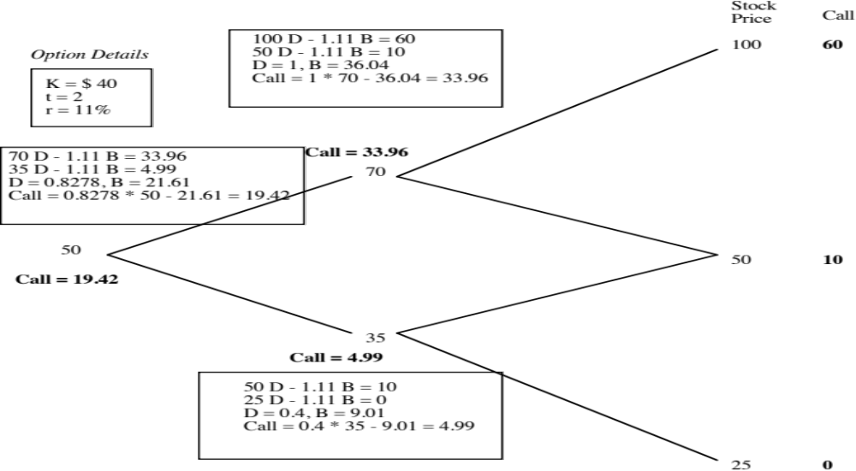
The Binomial Option Pricing Model
Notes:
Binomial models allow you to see arbitrage play out at each step in the process.
Here are the keys:
Start with the end node and work backwards (since the end node is the only time at which you know the cash flows on the option with certainty)
At each stage, compute the combination of the underlying asset and the riskless asset (lending/borrowing) you will need to get the same cash flows as the option
Estimate how much it will cost you to create this combination and make that the value of the option at that stage
Go to the prior stage and repeat the process.

Slide 13
The Limiting Distributions….
As the time interval is shortened, the limiting distribution, as t -> 0, can take one of two forms.
  If as t -> 0, price changes become smaller, the limiting distribution is the normal distribution and the price process is a continuous one.
  If as t->0, price changes remain large, the limiting distribution is the poisson distribution, i.e., a distribution that allows for price jumps.
The Black-Scholes model applies when the limiting distribution is the normal distribution , and explicitly assumes that the price process is continuous and that there are no jumps in asset prices.
Notes:
For most real-world options, the only chance you have of using a binomial is by making the time intervals really, really small (a minute or even a second). The catch is that your binomial will have thousands and thousands of branches…
The limiting distributions as time approaches zero are simple: if price changes also become small as the time interval becomes small, you end up with the normal distribution and the Black Scholes. If not, things are messier..

Slide 14
Black and Scholes…
The version of the model presented by Black and Scholes was designed to value European options, which were dividend-protected.
The value of a call option in the Black-Scholes model can be written as a function of the following variables:
  S = Current value of the underlying asset
  K = Strike price of the option
  t = Life to expiration of the option
  r = Riskless interest rate corresponding to the life of the option
  ² = Variance in the ln(value) of the underlying asset
Notes:
Fischer Black and Myron Scholes won the Nobel prize for this model to value options…
Notice the absence of dividends in the original BS… It was designed to value dividend protected options (if the stock paid a dividend, the exercise price would be lowered by the dividend as well to match the stock price drop.) It was also designed to value options that could be exercised only at expiration (European options rather than American options)

Slide 15
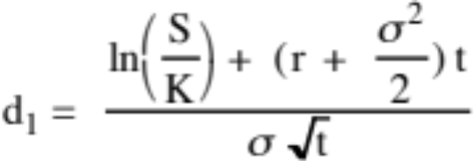
The Black Scholes Model
Value of call = S N (d1) - K e^{-rt} N(d2)
where
      d2 = d1 - σ √t
The replicating portfolio is embedded in the Black-Scholes model. To replicate this call, you would need to
  Buy N(d1) shares of stock; N(d1) is called the option delta
  Borrow K e^{-rt} N(d2)
Notes:
Note:
The entry of the normal distribution in the form of cumulative normal distribution variable (N(d1) and N(d2)
The replacement of the standard discount factor (1/(1+r)^n) with the continuous time version (e-rt)
The standard deviation input to capture the uncertainty about future value
The replicating portfolio is embedded in the equation. Almost every measure in option trading/pricing is built around this replicating portfolio.

Slide 16
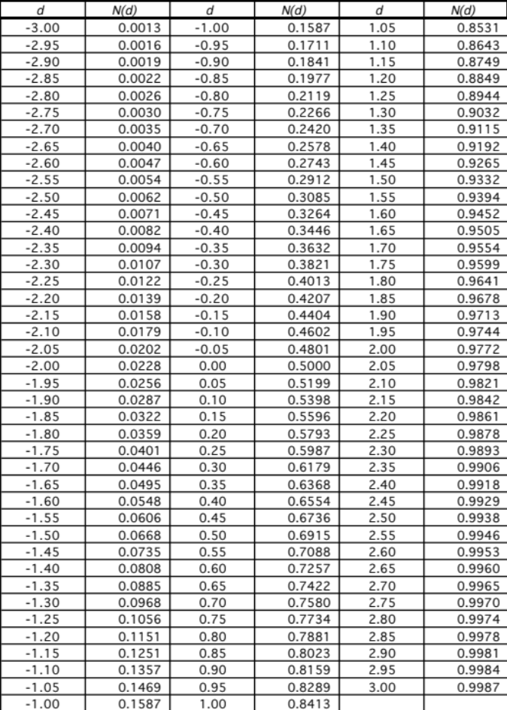
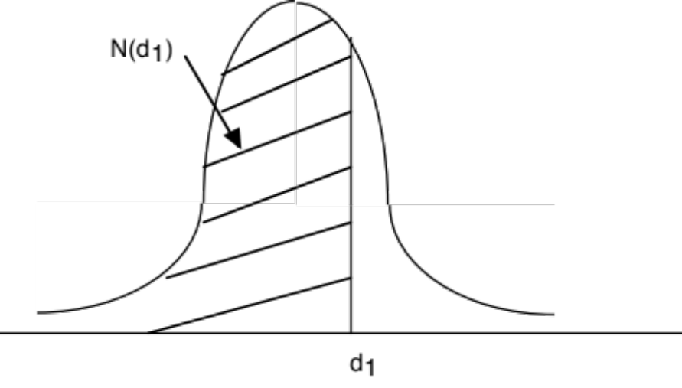
The Normal Distribution
Notes:
A standardized cumulative normal distribution yields values between 0 and 1… It looks and acts like a probability…
In face, N(d2) is the risk neutral probability that your option will end up in the money (S>K) over its lifetime.

Slide 17

Adjusting for Dividends
If the dividend yield (y = dividends/ Current value of the asset) of the underlying asset is expected to remain unchanged during the life of the option, the Black-Scholes model can be modified to take dividends into account.
C = S e^{-yt} N(d1) - K e^{-rt} N(d2)
  where,
  d2 = d1 -  √t
The value of a put can also be derived:
P = K e^{-rt} (1-N(d2)) - S e^{-yt} (1-N(d1))
Notes:
An adapted version of the Black Scholes, assuming that the dividend yield stays constant over the life of the option.
The carrying cost for the replicating portfolio is reduced by the dividend yield. (You pay the riskfree rate on your borrowing but the shares you buy will pay a dividend that offsets some of the interest expense)
The current stock price is reduced to reflect the effect of the dividend payments over the life of the option (It is discounted at the dividend yield…)

Slide 18
Choice of Option Pricing Models
Most practitioners who use option pricing models to value real options argue for the binomial model over the Black-Scholes and justify this choice by noting that
  Early exercise is the rule rather than the exception with real options
  Underlying asset values are generally discontinous.
If you can develop a binomial tree with outcomes at each node, it looks a great deal like a decision tree from capital budgeting. The question then becomes when and why the two approaches yield different estimates of value.
Notes:
Most real options are exercised early… True.. But it is also true that getting the inputs to a binomial model is cumbersome. So, it may still make sense to get at least a lower bound on value by using the Black Scholes.

Slide 19
Key Tests for Real Options
Is there an option embedded in this asset/ decision?
  Can you identify the underlying asset?
  Can you specify the contingency under which you will get payoff?
Is there exclusivity?
  If yes, there is option value.
  If no, there is none.
  If in between, you have to scale value.
Can you use an option pricing model to value the real option?
  Is the underlying asset traded?
  Can the option be bought and sold?
  Is the cost of exercising the option known and clear?
Notes:
For every 100 “would be options”, perhaps 70 pass the first test (is it an option), maybe 10 pass the second test (that the option have significant economic value) and even fewer pass the third test (option pricing model can be used)

