Slide 1
Session 23: The Option to delay

Slide 2
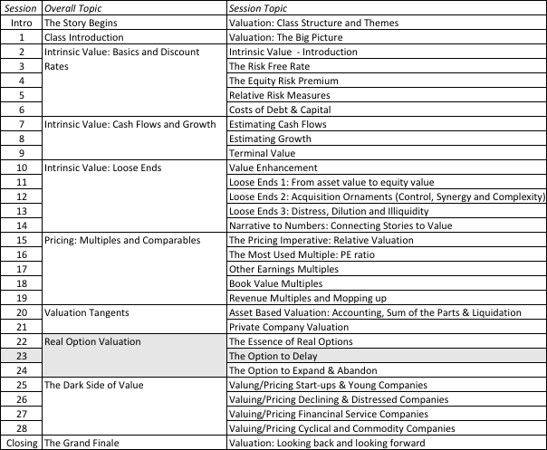
The Option to Delay

Slide 3
The Option to Delay
PV of Cash Flows
from Project
Initial Investment in
Project
Present Value of Expected
Cash Flows on Product
Project's NPV turns
Project has negative
positive in this section
NPV in this section
Notes:
This looks at the option to delay a project, to which you have exclusive rights.
The initial investment in the project is what you would need to invest to convert this project from a right to a real project.
The present value of the cash flows will change over time.
If the perceived present value of the cash flows stays below the investment needed, the project should never be taken.

Slide 4
Example 1: Valuing product patents as options
A product patent provides the firm with the right to develop the product and market it.
  Develop: If PV of cash flows from developing (V)> Cost of developing (I)
  Don’t develop: If PV of cash flows from developing (V) < Cost of developing (I)
Payoff from owning a product patent = V - I if V> I
= 0 if V ≤ I
Notes:
The optionality comes from the fact that you have the right to develop a patent, not an obligation and you get that right through the life of the patent.

Slide 5
Payoff on Product Option
Net Payoff to
introduction
Cost of product
introduction
Present Value of
cashflows on product
Notes:
The payoff diagram on the patent as an option…

Slide 6
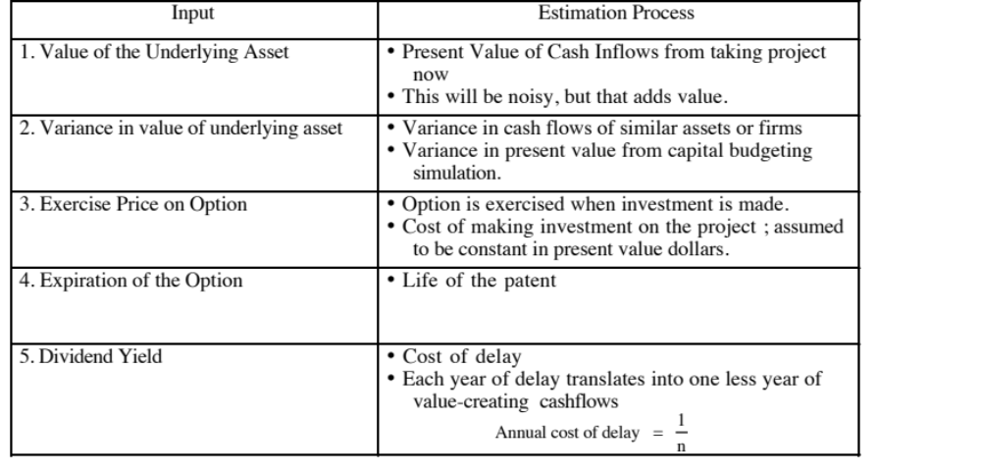
Obtaining Inputs for Patent Valuation
Notes:
The cash flows from developing the patent today may just be estimates (and you may be uncertain about them) but that is what makes the option valuable.
We introduce a cost to not developing the patent, once it becomes viable. (If you don’t do this, the option will never be exercised until the last moment of the last day, which makes no sense with a patent, since you are giving up the exclusivity) The cost is the cash flow you give up in the next year by not developing, as a percent of overall value. We use 1/n as an approximation of this value.

Slide 7
Valuing a Product Patent: Avonex
Biogen, a bio-technology firm, has a patent on Avonex, a drug to treat multiple sclerosis, for the next 17 years, and it plans to produce and sell the drug by itself.
The key inputs on the drug are as follows:
  PV of Cash Flows from Introducing the Drug Now = S = $ 3.422 billion
  PV of Cost of Developing Drug for Commercial Use = K = $ 2.875 billion
  Patent Life = t = 17 years Riskless Rate = r = 6.7% (17-year T.Bond rate)
  Variance in Expected Present Values =σ² = 0.224 (Industry average firm variance for bio-tech firms)
  Expected Cost of Delay = y = 1/17 = 5.89%
The output from the option pricing model
  d1 = 1.1362 N(d1) = 0.8720
  d2 = -0.8512 N(d2) = 0.2076
  Call Value= 3,422 exp^{(-0.0589)(17)} (0.8720) - 2,875 exp^{(-0.067)(17)} (0.2076)= $ 907 million
Notes:
An old example…. But one where I was able to get my hands on the original cash flow projections to get the PV of $3,422 million.
NPV of this project = 3422 – 2875 = $ 547 million
This is an in the money option (a viable patent) but this analysis suggests that Biogen will gain more from waiting (the value of the option of $907 million > NPV of $547 million from developing today)

Slide 8
The Real Options Test: Patents and Technology
The Option Test:
  Underlying Asset: Product that would be generated by the patent
  Contingency:
    If PV of CFs from development > Cost of development: PV - Cost
    If PV of CFs from development < Cost of development: 0
The Exclusivity Test:
  Patents restrict competitors from developing similar products
  Patents do not restrict competitors from developing other products to treat the same disease.
The Pricing Test
  Underlying Asset: Patents are not traded.
  Option: Patents are bought and sold, though not as frequently as oil reserves or mines.
  Cost of Exercising the Option: Experience does help and drug firms can make fairly precise estimates of the cost.
Notes:
On the second test, the exclusivity comes almost entirely from the legal system. If you operate in a porous legal system, where property rights are violated with impunity, the exclusivity is lost. This is a problem that the pharmaceutical companies face as they grow in Asia, where the legal protection offered by patents tends to be weaker. Even in markets with strong legal systems, the exclusivity is weakened by the presence of strong competitors with active research departments working on their alternative cures for the same diseases…

Slide 9
Example 2: Valuing Natural Resource Options
In a natural resource investment, the underlying asset is the resource and the value of the asset is based upon two variables - the quantity of the resource that is available in the investment and the price of the resource.
Defining the cost of development as X, and the estimated value of the resource as V, the potential payoffs on a natural resource option can be written as follows:
  Payoff on natural resource investment = V - X if V > X
  = 0 if V≤ X
Notes:
Note that the option is strongest for undeveloped reserves. However, even after the reserves are developed, there is some optionality since production levels can be varied as a function of the price of the commodity.

Slide 10
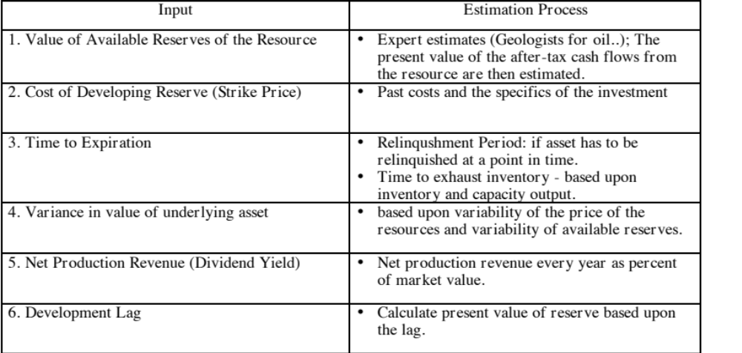
Estimating Inputs for Natural Resource Options
Notes:
For convenience and simplicity, we assume that the only variable that you are uncertain about is the oil price. In fact, you are probably also uncertain about the magnitude of your reserves and even your development costs. Adding that uncertainty to the process does not change the logic but it does make the option more difficult to value.
The net production revenue lost by not developing the reserve once it is viable is the prod that pushes towards developing reserves.
The longer the development lag, the less the value of the option (both because of time value and because the oil price may change…)

Slide 11
Valuing Gulf Oil
Gulf Oil was the target of a takeover in early 1984 at $70 per share (It had 165.30 million shares outstanding, and total debt of $9.9 billion).
  Estimated reserves of 3038 million barrels of oil & average cost of developing these reserves was estimated to be $10 a barrel
  The development lag is 2 years
  The average relinquishment life of the reserves is 12 years.
  The price of oil was $22.38 per barrel, and the production cost, taxes and royalties were estimated at $7 per barrel.
  The bond rate at the time of the analysis was 9.00%.
  Net production revenues each year of approximately 5% of the value of the developed reserves.
  The variance in oil prices is 0.03.
Notes:
Uses the real options approach to value an oil company.
Why go back in time? Because Gulf Oil was not only targeted for its undeveloped reserves but because information was provided on all reserves that the oil company had at that point in time.
Most oil companies report only “viable” reserves (i.e., options in the money)…

Slide 12
Valuing Undeveloped Reserves
Inputs for valuing undeveloped reserves
  Value of underlying asset = Value of estimated reserves discounted back for period of development lag= 3038 * ($ 22.38 - $7) / 1.05² = $42,380.44
  Exercise price = Estimated development cost of reserves = 3038 * $10 = $30,380 million
  Time to expiration = Average length of relinquishment option = 12 years
  Variance in value of asset = Variance in oil prices = 0.03
  Riskless interest rate = 9%
  Dividend yield = Net production revenue/ Value of developed reserves = 5%
Based upon these inputs, the Black-Scholes model provides the following value for the call:
  d1 = 1.6548 N(d1) = 0.9510
  d2 = 1.0548 N(d2) = 0.8542
  Call Value= 42,380.44 exp^{(-0.05)(12)} (0.9510) -30,380 (exp^{(-0.09)(12)} (0.8542)
  = $ 13,306 million
Notes:
The value of the reserves on a pure DCF basis is $12 billion = $42.38 - $30.38 billion
The value of the option is $13.3 billion
The difference is the time premium created by the optionality…
Note that the reserves are, on average, viable and that there is a very high probability (N(d2) = 85.4%) that they will be developed.

Slide 13
Valuing Gulf Oil
In addition, Gulf Oil had free cashflows to the firm from its oil and gas production of $915 million from already developed reserves and these cashflows are likely to continue for ten years. The present value of these developed reserves, discounted at the weighted average cost of capital of 12.5%, yields:
  Value of already developed reserves = 915 (1 - 1.125⁻¹⁰)/.125 = $5065.83
Adding the value of the developed and undeveloped reserves
  Value of undeveloped reserves = $ 13,306 million
  Value of production in place = $ 5,066 million
  Total value of firm = $ 18,372 million
  Less Outstanding Debt = $ 9,900 million
  Value of Equity = $ 8,472 million
  Value per share = $ 8,472/165.3 = $51.25
Notes:
Add the option value of the undeveloped reserves to the DCF value of the developed reserves.
Note that you cannot a full DCF value of an oil company, with growth incorporating the undeveloped reserves, and add the value of the options on top of that.. That would be double counting.

