Slide 1
Session 24: The Option to expand & abandon

Slide 2
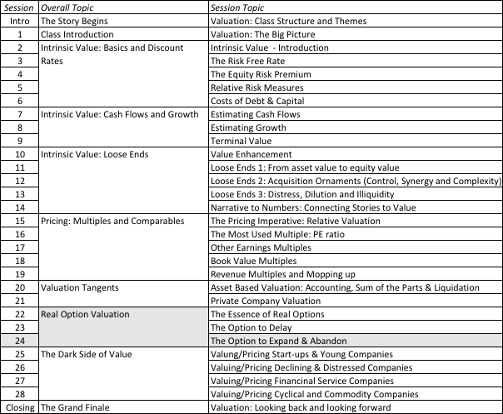
The Option to Expand & Abandon

Slide 3
1. The Option to Expand
PV of Cash Flows
from Expansion
Additional Investment
to Expand
Present Value of Expected
Cash Flows on Expansion
Expansion becomes
Firm will not expand in
attractive in this section
this section
Notes:
Here, the initial project gives you the option to invest an additional amount in the future which you will do only if the present value of the additional cash flows you will get by expanding are greater than the investment needed.
For this to work, you have to do the first project to be eligible for the option to expand.

Slide 4
The option to expand: Valuing a young, start-up company
You have complete a DCF valuation of a small anti-virus software company, Secure Mail, and estimated a value of $115 million.
Assume that there is the possibility that the company could use the customer base that it develops for the anti-virus software and the technology on which the software is based to create a database software program sometime in the next 5 years.
  It will cost Secure Mail about $500 million to develop a new database program.
  Expect to generate about $ 40 million a year in after-tax cashflows for ten years. Cost of capital is 12%.
  The annualized standard deviation in firm value at publicly traded database companies is 50%.
  The five-year treasury bond rate is 3%.
Notes:
This is a negative net present value project, but it gives Disney the option to expand later. Implicitly, we are also saying that if Disney does not make the initial project investment (with a NPV of - $ 20 million), it cannot expand later into the rest of Latin America.

Slide 5
Valuing the Expansion Option
S = Value of entering the database software market
= PV of $40 million for 10 years @12% = $226 million
K = Exercise price
= Cost of entering the database software market = $ 500 million
t = Period over which you have the right to enter the market
= 5 years
s = Standard deviation of stock prices of database firms = 50%
r = Riskless rate = 3%
Call Value= $ 56 Million
DCF valuation of the firm = $ 115 million
Value of Option to Expand to Database market = $ 56 million
Value of the company with option to expand = $ 171 million
Notes:
This values the option, using the Black Scholes model.
The value from the model itself is affected not only by the assumptions made about volatility and value, but also by the asssumptions underlying the model.
The value itself is not the key output from the model. It is the fact that strategic options, such as this one, can be valued, and that they can make a significant difference to your decision.

Slide 6
The Real Options Test for Expansion Options
The Options Test
  Underlying Asset: Expansion Project
  Contingency
    If PV of CF from expansion > Expansion Cost: PV - Expansion Cost
    If PV of CF from expansion < Expansion Cost: 0
The Exclusivity Test
  Barriers may range from strong (exclusive licenses granted by the government) to weaker (brand name, knowledge of the market) to weakest (first mover).
The Pricing Test
  Underlying Asset: Underlying asset is not traded..
  Option: Licenses are sometimes bought and sold but not often.
  Cost of Exercising the Option: Not known with any precision and may itself evolve over time as the market evolves.
Notes:
Many of these options flounder on the “exclusivity” test.
Opportunities are not options. (Just because China is a big market, it does not mean that you should be willing to lose money entering the market to learn about it…)

Slide 7
2. The Option to Abandon
A firm may sometimes have the option to abandon a project, if the cash flows do not measure up to expectations.
PV of Cash Flows
from Project
Cost of Abandonment
Present Value of Expected
Cash Flows on Project
Notes:
You would like to abandon a project, once you know that it will create only negative cash flows for you. This is not always possible, because of contracts you might have entered into with employees or customers.

Slide 8
Valuing the Option to Abandon
The Project: Airbus is considering a joint venture with Lear Aircraft to produce a small commercial airplane
  Airbus will have to invest $ 500 million for a 50% share of the venture
  Its share of the present value of expected cash flows is 480 million.
The Option: Lear Aircraft offers to buy Airbus’s 50% share of the investment anytime over the next five years for $ 400 million, if Airbus decides to get out of the venture.
Details: A simulation of the cash flows on this time share investment yields a variance in the present value of the cash flows from being in the partnership is 0.16. The project has a life of 30 years.
Notes:
We are assuming that Lear Aircraft will be in a position to honor his or her commitment to buy back Airbus’s share for $ 400 million.

Slide 9
Project with Option to Abandon
S = PV of Cash Flows from Project = $ 480 million
K = Salvage Value from Abandonment = $ 400 million
Variance in Underlying Asset’s Value = 0.16
Time to expiration = Life of the Project =5 years
Dividend Yield = 1/Life of the Project = 1/30 = 0.033
Assume that the five-year riskless rate is 6%.
Notes:
These are the inputs to the model. The likelihood of abandonment will increase over time, as the value of the project decreases.

Slide 10
Should Airbus enter into the joint venture?
Value of Put =Ke^{-rt} (1-N(d2))- Se^{-yt} (1-N(d1))
  =400 exp^{(-0.06)(5)} (1-0.4624) - 480 exp^{(-0.033)(5)} (1-0.7882)
  = $ 73.23 million
Add this value on to the net present value of the project of -$ 20 million, yielding a total value with the abandonment option of $ 53.23 million.
Notes:
If you can negotiate this option into your investment projects, you increase their value. To the degree that you have to pay for this option, you would be willing to pay the price of the option.

Slide 11
Implications for Investment Analysis/ Valuation
Having a option to abandon a project can make otherwise unacceptable projects acceptable.
Other things remaining equal, you would attach more value to companies with
  More cost flexibility
  Fewer long-term contracts/obligations
These actions will undoubtedly cost the firm some value, but this has to be weighed off against the increase in the value of the abandonment option.
Notes:
Building in escape hatches and flexibility into investments, especially big ones (relative to your size as a company) is not a sign of weakness but one of prudences…

Slide 12
3. The Value of Financial Flexibility
Firms maintain excess debt capacity or larger cash balances than are warranted by current needs, to meet unexpected future requirements.
While maintaining this financing flexibility has value to firms, it also has a cost; the excess debt capacity implies that the firm is giving up some value and has a higher cost of capital.
The Option: A firm maintains large cash balances and excess debt capacity in order to have the option to take projects that might arise in the future.
Notes:
If the argument for financial flexibility is that you need it in order to be able to raise debt financing to take that great project that may come along, you are talking about an option…

Slide 13

The Value of Flexibility
Notes:
Shown as a payoff diagram..
Note that the cost of the option emanates from the fact that you borrow less than optimal (to preserve your debt capacity and financial flexibility) and thus have a higher cost of capital.

Slide 14
Determinants of the Value of Flexibility
Capital Constraints (External and Internal): The greater the capacity to raise funds, either internally or externally, the less the value of flexibility.
  1.1: Firms with significant internal operating cash flows should value flexibility less than firms with small or negative operating cash flows.
  1.2: Firms with easy access to financial markets should have a lower value for flexibility than firms without that access.
Unpredictability of reinvestment needs: The more unpredictable the reinvestment needs of a firm, the greater the value of flexibility.
Capacity to earn excess returns: The greater the capacity to earn excess returns, the greater the value of flexibility.
  1.3: Firms that do not have the capacity to earn or sustain excess returns get no value from flexibility.
Notes:
The value of flexibility should be greater for
Small firms over large firms
Private businesses over public companies
Emerging market over Developed market companies
During crisis than during periods of stability
The value of flexibility should be greater in young businesses, with significant uncertainties about the future (social media companies…)
The value of flexibility should be greater for firms with significant competitive advantages that will allow them to earn excess returns

