Slide 1
Session 25: Valuing Young companies & start-ups

Slide 2

Valuing Young Companies & Start-ups

Slide 3
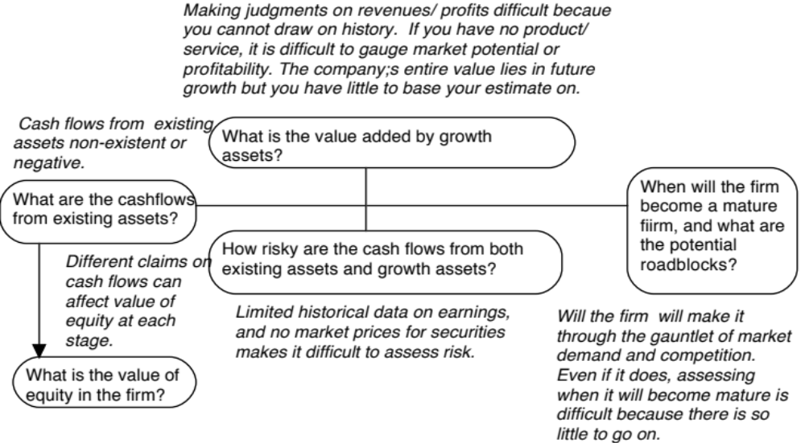
The challenge with young companies…
Notes:
Consider a young, start-up firm in a new business or industry…The financial statements provide scanty information because the firm’s operations are small, there is no historical data because the firm has not been around for very long and there are either no comparable firms or they all look like the firm being valued.

Slide 4
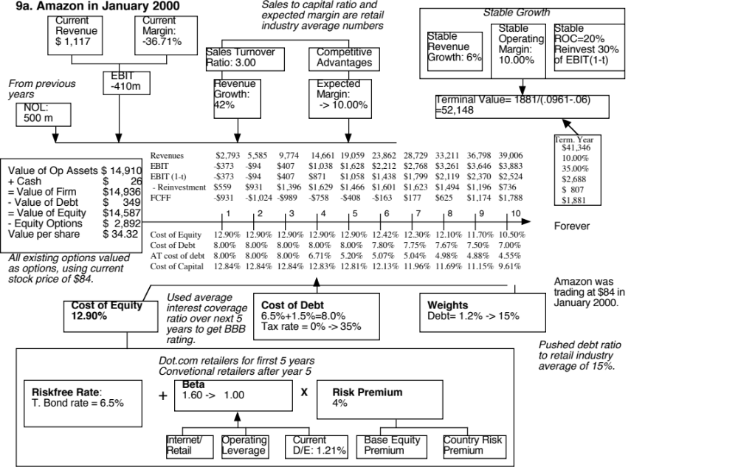
Notes:
To estimate a bottom-up beta for Amazon in January 2000, we used the average beta of internet retailers for the first five years as the bottom-up beta but assume that the beta will move towards the average beta for specialty retailers over time. The high operating leverage that is typical of an internet retailer (high infrastructure and technology costs) provides an intuitive explanation for why they should have higher betas than their brick-and-mortar counterparts.
When a firm has operating losses, the interest coverage ratio is negative. Using the interest coverage ratio table on the next page would yield a D rating for the firm. In January 2000, this seemed a little harsh. For better or worse, bondholders and lenders to the firm seemed to be lending based upon expected operating income in the future rather than past operating income. The interest coverage ratio was therefore defined as follows:
Interest coverage ratio = Average EBIT next 5 years/ Current interest expense
The interest coverage ratio yielded a synthetic rating of BBB and a default spread of 1.50% in January 2000.
3. The pre-tax cost of debt is equal to the after-tax cost for the next 2 years because the firm is expected to keep losing money. In year 3, Amazon is expected to make an operating profit, but it wil have net operating losses that shelter the income leading to no taxes. In year 4, Amazon is able to partially cover the operating income with carried-forward net operating losses… Starting in year 6, we lower the cost of debt since the firm is expected to become a profitable firm with substantial increases in operating income in the subsequent years.
Year 1 2 3 4 5
EBIT -$373 -$94 $407 $1,038 $1,628
Taxes $0 $0 $0 $167 $570
EBIT(1-t) -$373 -$94 $407 $871 $1,058
Tax rate 0% 0% 0% 16.13% 35%
NOL $500 $873 $967 $560 $0
The value per share in January 2000 is $ 34. This valuation was done with all of the inputs at the high end of my expectations and can be considered optimistic. Notwithstanding this, the stock is still overvalued. In fact, the optimism shows when you see that the free cashflows to the firm are negative for the first 6 years… I am assuming that Amazon will have no trouble raising the capital to fund these cashflows…

Slide 5
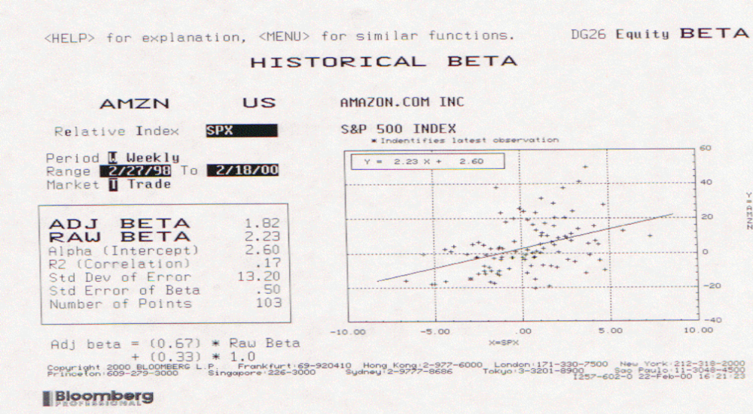
Lesson 1: Don’t sweat the small stuff
Spotlight the business the company is in & use the beta of that business.
Don’t try to incorporate failure risk into the discount rate.
Let the cost of capital change over time, as the company changes.
If you are desperate, use the cross section of costs of capital to get your estimation going (use the 90th or 95th percentile across all companies).
Notes:
Regression betas are inherently unreliable, but even more so for young companies. In general, if you allow the cost of capital to change as the company changes over time, it becomes a less critical input and one not suited for carrying the burden of corporate failure. If you have trouble figuring out what business your company is in, use the cross section of costs of capital across all companies and use the 90th or 95th percentile to get your estimation started.

Slide 6
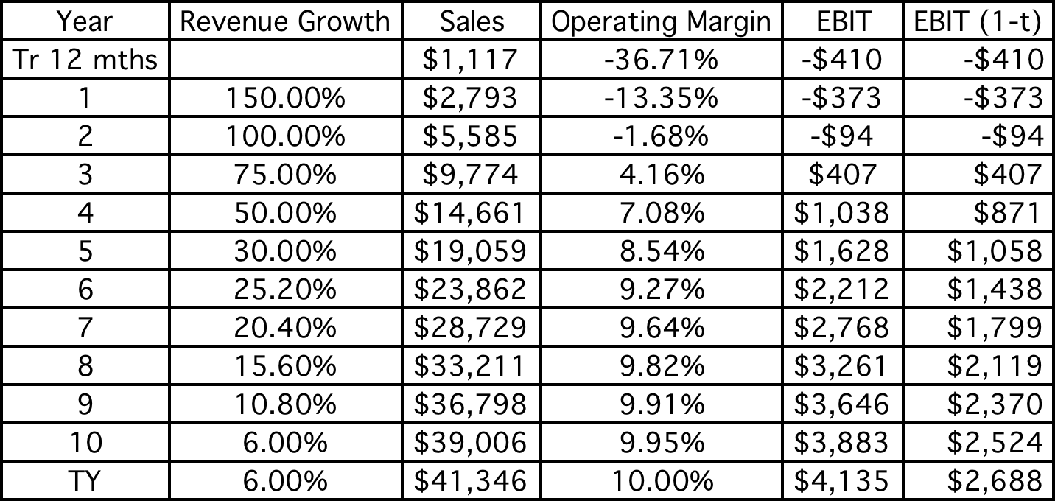
Lesson 2: Work backwards and keep it simple…
Notes:
Less is more… Trying to estimate growth rates and revenues sequentially through time will drive you crazy. Look at the market size, the biggest players in the market and work backwards.

Slide 7
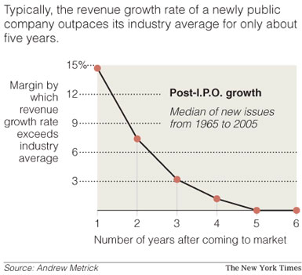
Lesson 3: Scaling up is hard to do & failure is common
Lower revenue growth rates, as revenues scale up.
Keep track of dollar revenues, as you go through time, measuring against market size.
Notes:
Most growth companies don’t grow for long for two reasons. First, as they get bigger, it gets more difficult to grow. Second, competition picks up, drawn by your success.

Slide 8
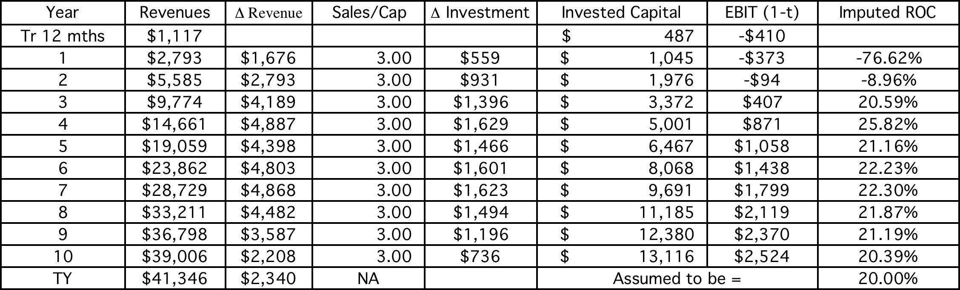
Lesson 4: Don’t forget to pay for growth…
Notes:
Just because you are a growth companies does not mean that the lessons about tying growth to reinvestment can be abandoned. The sales to capital ratio becomes your proxy for the efficiency of growth (with higher numbers indicating more efficient growth). You can look at sector averages and let the number change (go up or down over the years) if you feel that growth will get easier or more difficult over time.

Slide 9
Lesson 5: The dilution is taken care off..
With young growth companies, the number of shares outstanding will usually increase over time:
  To grow, the company will have to issue new shares
  To compensate employees with options or restricted shares.
In DCF valuation, both effects are already incorporated into the value per share, even though we use the current number of shares in estimating value per share
  Negative cash flows capture dilution effect
  The options are valued and netted out against the current value.
Notes:
Options are incorporated into value, as in any companyWhen a company has big negative cash flows to equity, they have to be covered with new stock issues, which will result in higher share count in future years. However, when computing the DCF value, that dilution effect has already been incorporated into the value when the negative cash flows were discounted back (thus lowering the value today). Counting the new shares that will be issued in the future will result in double counting.

Slide 10
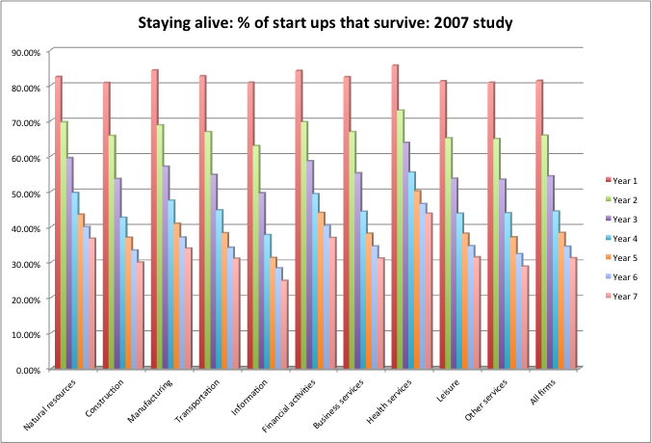
Lesson 6: If you are worried about failure, incorporate into value
Notes:
If you feel that there is a chance that your company will not make it, the best way to incorporate that effect into value is by estimating a probability of failure and the consequences of failure (your assets may be worth nothing) and estimating an expected value:
Expected Value = DCF Value of equity (Proabability of going concern) + Failure value of equity (1 – Probability of going concern)

Slide 11
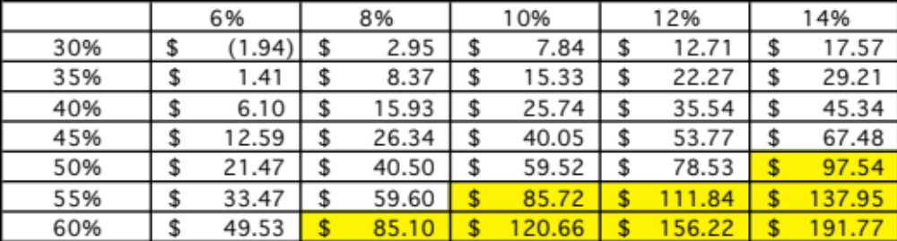
Lesson 7: There are always scenarios where the market price can be justified…
Notes:
Is $ 84 feasible? The answer is yes - a combination of compounded 10-year revenue growth of 60% and margins of 8%, revenue growth of 55% and margins of 10%, revenue growth of 50% and margins of 14% all yield values greater than $ 84…. The problem is that to generate higher revenue growth, Amazon will have to settle for lower margins…
Is $84 likely? The answer is no…

Slide 12
Lesson 8: You will be wrong 100% of the tim and it really is not your fault…
Your estimate of value will change both as new information comes out about the company, the business and the economy.
As information comes out, you will have to adjust and adapt your model to reflect the information.
A test: If your valuations are unbiased, you should find yourself increasing estimated values as often as you are decreasing values
Notes:
You will be wrong but so will everyone else. So, get used to being wrong, adjusting your valuations as new information comes out and moving on.

Slide 13
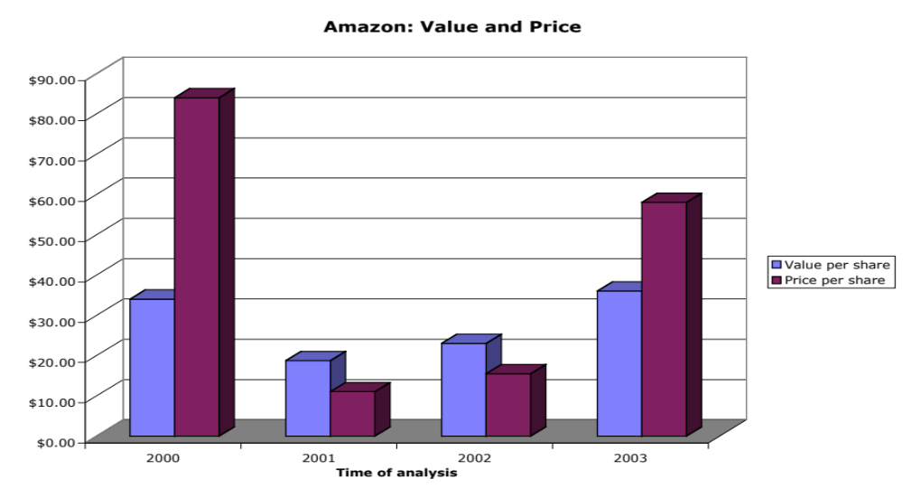
And the market is often “more wrong”….
Notes:
A valuation in September 2003 yielded an estimate of value per share of $36 but the stock had shot up to $ 58… Time to sell and start the cycle all over again… The more things change, the more they stay the same…

Slide 14
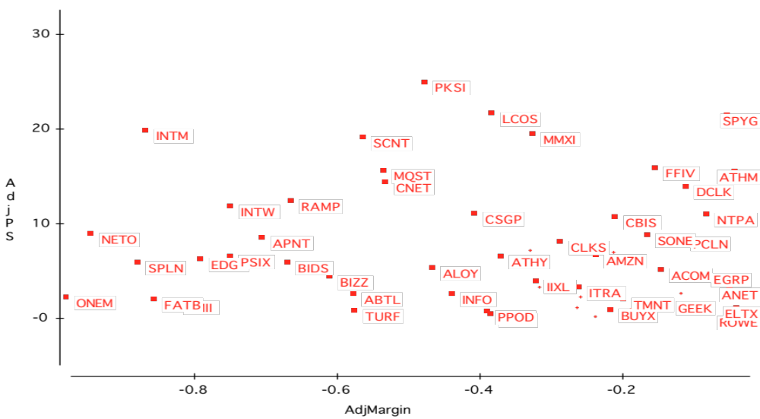
Pricing Young Companies: Amazon in 2000
Notes:
From March 2000… Little or no relationship between current margins and price to sales ratios.. Note that almost all of the firms have negative margins…

Slide 15
PS Ratios and Margins are not highly correlated
Regressing PS ratios against current margins yields the following
  PS = 81.36 - 7.54(Net Margin) R2 = 0.04
  (0.49)
This is not surprising. These firms are priced based upon expected margins, rather than current margins.
Notes:
The lack of the relationship in the graph is borne out by the regression. Not only is the R-squared low, but the relationship between price to sales ratio and net margins is negative - the more negative the margin, the higher the price to sales ratio.

Slide 16
Solution 1: Use proxies for survival and growth: Amazon in early 2000
Hypothesizing that firms with higher revenue growth and higher cash balances should have a greater chance of surviving and becoming profitable, we ran the following regression: (The level of revenues was used to control for size)
PS = 30.61 - 2.77 ln(Rev) + 6.42 (Rev Growth) + 5.11 (Cash/Rev)
(0.66) (2.63) (3.49)
R squared = 31.8%
Predicted PS = 30.61 - 2.77(7.1039) + 6.42(1.9946) + 5.11 (.3069) = 30.42
Actual PS = 25.63
Stock is undervalued, relative to other internet stocks.
Notes:
Internet firms with higher revenues, higher revenue growth and more cash holdings trade for higher price to sales ratios in March 2000.
If you plug the values for Amazon in March 2000 into this regression, you get a predicted value of 30.42, whereas the actual price to sales ratio for the firm is 25.63. Relative to other internet stocks, Amazon is slightly undervalued. (In the discounted cashflow valuation done at the same point in time, we came to the opposite conclusion. Amazon was overvalued based upon its fundamentals.)

Slide 17
Solution 2: Use forward multiples
Watch out for bumps in the road
Estimate an operating number a few years in the future.
You then estimate the multiple of market value (market cap or enterprise value) to this future operating number.
Your comparisons across companies will then be on these forward multiples.
Warning: These forward multiples assume that the chances of survival are the same for all firms and that the cash flow drain (from negative cash flows) are similar across firms.
Notes:
The conclusions can vary though both approaches have some intuitive appeal. The one thing that you cannot do is to be inconsistent. You cannot apply a current multiple to future earnings and not discount…

Slide 18
Solution 3: Let the market tell you what matters.. Social media in October 2013
Company | Market Cap | Enterprise value | Revenues | EBITDA | Net Income | Number of users (millions) | EV/User | EV/Revenue | EV/EBITDA | PE
Facebook | $173,540.00 | $160,090.00 | $7,870.00 | $3,930.00 | $1,490.00 | 1230.00 | $130.15 | 20.34 | 40.74 | 116.47
Linkedin | $23,530.00 | $19,980.00 | $1,530.00 | $182.00 | $27.00 | 277.00 | $72.13 | 13.06 | 109.78 | 871.48
Pandora | $7,320.00 | $7,150.00 | $655.00 | -$18.00 | -$29.00 | 73.40 | $97.41 | 10.92 | NA | NA
Groupon | $6,690.00 | $5,880.00 | $2,440.00 | $125.00 | -$95.00 | 43.00 | $136.74 | 2.41 | 47.04 | NA
Netflix | $25,900.00 | $25,380.00 | $4,370.00 | $277.00 | $112.00 | 44.00 | $576.82 | 5.81 | 91.62 | 231.25
Yelp | $6,200.00 | $5,790.00 | $233.00 | $2.40 | -$10.00 | 120.00 | $48.25 | 24.85 | 2412.50 | NA
Open Table | $1,720.00 | $1,500.00 | $190.00 | $63.00 | $33.00 | 14.00 | $107.14 | 7.89 | 23.81 | 52.12
Zynga | $4,200.00 | $2,930.00 | $873.00 | $74.00 | -$37.00 | 27.00 | $108.52 | 3.36 | 39.59 | NA
Zillow | $3,070.00 | $2,860.00 | $197.00 | -$13.00 | -$12.45 | 34.50 | $82.90 | 14.52 | NA | NA
Trulia | $1,140.00 | $1,120.00 | $144.00 | -$6.00 | -$18.00 | 54.40 | $20.59 | 7.78 | NA | NA
Tripadvisor | $13,510.00 | $12,860.00 | $945.00 | $311.00 | $205.00 | 260.00 | $49.46 | 13.61 | 41.35 | 65.90
 |  |  |  |  |  | Average | $130.01 | 11.32 | 350.80 | 267.44
 |  |  |  |  |  | Median | $97.41 | 10.92 | 44.20 | 116.47
Correlations
Market Cap & Revenues: 0.8933
Market Cap and EBITDA: 0.9709
Market Cap and Net Income: 0.8978
Market Cap and # Users: 0.9812

