Slide 1
Session 26: Valuing declining & distressed companies

Slide 2
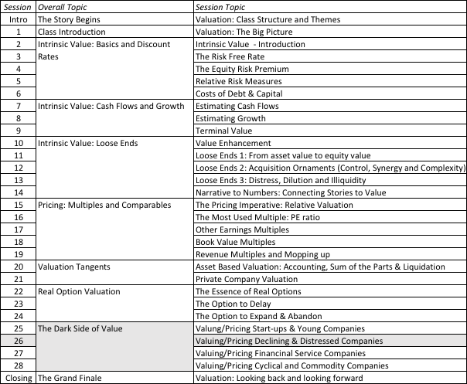
Valuing Declining & Distressed Companies

Slide 3
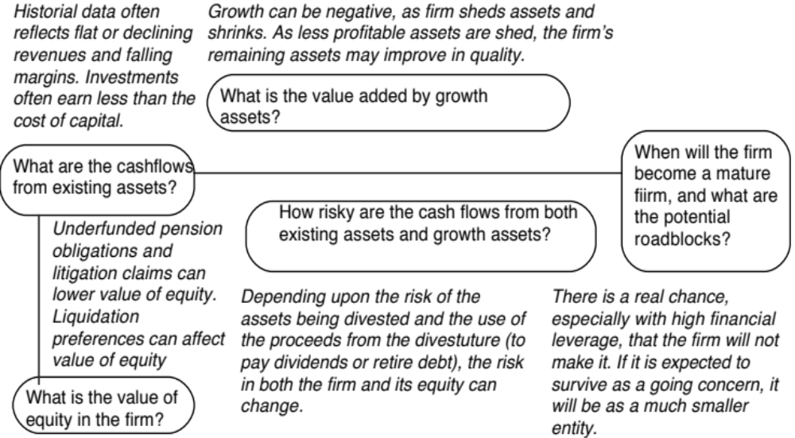
Dealing with decline and distress…

Slide 4
a. Dealing with Decline
In decline, firms often see declining revenues and lower margins, translating in negative expected growth over time.
If these firms are run by good managers, they will not fight decline. Instead, they will adapt to it and shut down or sell investments that do not generate the cost of capital. This can translate into negative net capital expenditures (depreciation exceeds cap ex), declining working capital and an overall negative reinvestment rate. The best case scenario is that the firm can shed its bad assets, make itself a much smaller and healthier firm and then settle into long-term stable growth.
As an investor, your worst case scenario is that these firms are run by managers in denial who continue to expand the firm by making bad investments (that generate lower returns than the cost of capital). These firms may be able to grow revenues and operating income but will destroy value along the way.
Notes:
DCF valuation tends to view distress rather cavalierly. We either assume that a firm will last forever, or that if even if runs into trouble, it will be able to sell its assets (both in-place and growth) for fair market value. In addition, we assume that our expected cashflows incorporate the possibility that a firm may not survive… In general, DCF valuation will give us an over-optimistic estimate of value for firms in significant financial trouble.
You can estimate the probability of default from a bond by using the price of the bond and solving for the probability of bankruptcy. You can use the distress.xls to make this estimate.

Slide 5
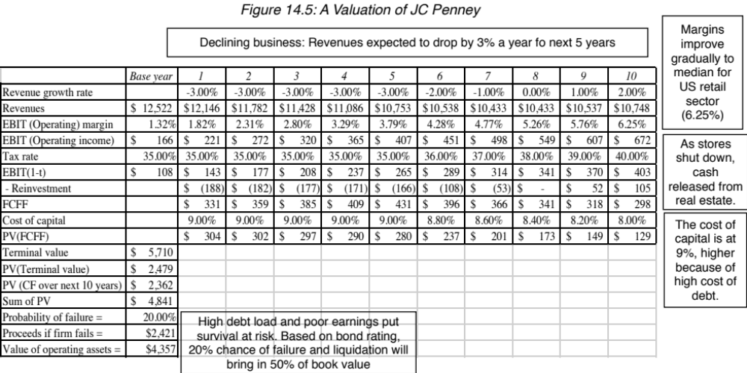
Notes:
Declining firms can have negative reinvestment rates (as they sell or divest assets) and negative growth. If they get rid of assets that are the cause for low ROC, they can still end up as reasonably healthy (smaller) firms in stable growth.

Slide 6
b. Dealing with the “downside” of Distress
A DCF valuation values a firm as a going concern. If there is a significant likelihood of the firm failing before it reaches stable growth and if the assets will then be sold for a value less than the present value of the expected cashflows (a distress sale value), DCF valuations will overstate the value of the firm.
Value of Equity= DCF value of equity (1 - Probability of distress) + Distress sale value of equity (Probability of distress)
There are three ways in which we can estimate the probability of distress:
  Use the bond rating to estimate the cumulative probability of distress over 10 years
  Estimate the probability of distress with a probit
  Estimate the probability of distress by looking at market value of bonds..
The distress sale value of equity is usually best estimated as a percent of book value (and this value will be lower if the economy is doing badly and there are other firms in the same business also in distress).
Notes:
DCF valuation tends to view distress rather cavalierly. We either assume that a firm will last forever, or that if even if runs into trouble, it will be able to sell its assets (both in-place and growth) for fair market value. In addition, we assume that our expected cashflows incorporate the possibility that a firm may not survive… In general, DCF valuation will give us an over-optimistic estimate of value for firms in significant financial trouble.
You can estimate the probability of default from a bond by using the price of the bond and solving for the probability of bankruptcy. You can use the distress.xls to make this estimate.

Slide 7
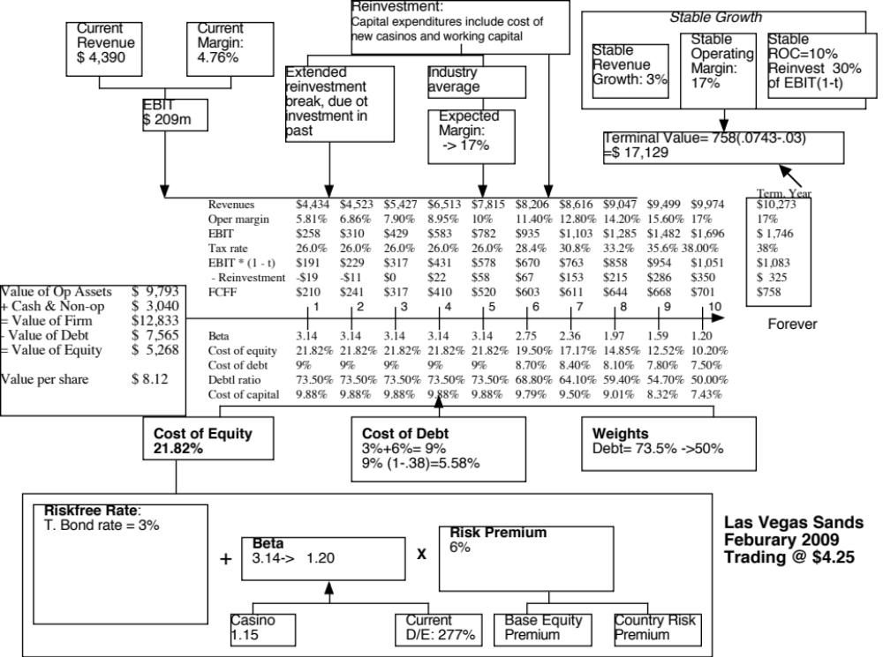

Slide 8
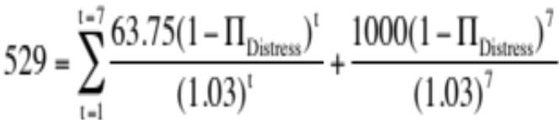
Adjusting the value of LVS for distress..
In February 2009, LVS was rated B+ by S&P. Historically, 28.25% of B+ rated bonds default within 10 years. LVS has a 6.375% bond, maturing in February 2015 (7 years), trading at $529. If we discount the expected cash flows on the bond at the riskfree rate, we can back out the probability of distress from the bond price:
Solving for the probability of bankruptcy, we get:
  π_{istress} = Annual probability of default = 13.54%
  Cumulative probability of surviving 10 years = (1 - .1354)¹⁰ = 23.34%
  Cumulative probability of distress over 10 years = 1 - .2334 = .7666 or 76.66%
If LVS is becomes distressed:
  Expected distress sale proceeds = $2,769 million < Face value of debt
  Expected equity value/share = $0.00
Expected value per share = $8.12 (1 - .7666) + $0.00 (.7666) = $1.92

Slide 9

The “sunny” side of distress: Equity as a call option to liquidate the firm

Slide 10
Application to valuation: A simple example
Assume that you have a firm whose assets are currently valued at $100 million and that the standard deviation in this asset value is 40%.
Further, assume that the face value of debt is $80 million (It is zero coupon debt with 10 years left to maturity).
If the ten-year treasury bond rate is 10%,
  how much is the equity worth?
  What should the interest rate on debt be?

Slide 11
Model Parameters & Valuation
The inputs
  Value of the underlying asset = S = Value of the firm = $ 100 million
  Exercise price = K = Face Value of outstanding debt = $ 80 million
  Life of the option = t = Life of zero-coupon debt = 10 years
  Variance in the value of the underlying asset = σ² = Variance in firm value = 0.16
  Riskless rate = r = Treasury bond rate corresponding to option life = 10%
The output
  The Black-Scholes model provides the following value for the call:
    d1 = 1.5994 N(d1) = 0.9451
    d2 = 0.3345 N(d2) = 0.6310
  Value of the call = 100 (0.9451) - 80 exp^{(-0.10)(10}) (0.6310) = $75.94 million
  Value of the outstanding debt = $100 - $75.94 = $24.06 million
  Interest rate on debt = ($ 80 / $24.06)^{1/10} -1 = 12.77%

Slide 12
Firm value drops..
Assume now that a catastrophe wipes out half the value of this firm (the value drops to $ 50 million), while the face value of the debt remains at $ 80 million.
The inputs
  Value of the underlying asset = S = Value of the firm = $ 50 million
  All the other inputs remain unchanged
The output
  Based upon these inputs, the Black-Scholes model provides the following value for the call:
    d1 = 1.0515 N(d1) = 0.8534
    d2 = -0.2135 N(d2) = 0.4155
  Value of the call = 50 (0.8534) - 80 exp^{(-0.10)(10)} (0.4155) = $30.44 million
  Value of the bond= $50 - $30.44 = $19.56 million

Slide 13

Equity value persists .. As firm value declines..

Slide 14
Valuing Equity in Eurotunnel as an Option
Inputs to Model
  Value of the underlying asset = S = Value of the firm = £2,312 million
  Exercise price = K = Face Value of outstanding debt = £8,865 million
  Life of the option = t = Weighted average duration of debt = 10.93 years
  Variance in the value of the underlying asset = σ² = Variance in firm value = 0.0335
  Riskless rate = r = Treasury bond rate corresponding to option life = 6%
Based upon these inputs, the Black-Scholes model provides the following value for the call:
  d1 = -0.8337 N(d1) = 0.2023
  d2 = -1.4392 N(d2) = 0.0751
Value of the call = 2312 (0.2023) - 8,865 exp^{(-0.06)(10.93)} (0.0751) = £122 million
Notes:
Very high probability of default = 92.5%, but equity still hangs in there.

