Slide 1
Session 27: Valuing financial service companies

Slide 2
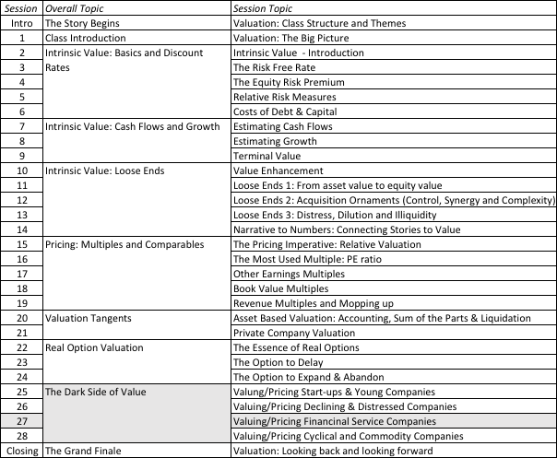
Valuing Financial Service Companies

Slide 3
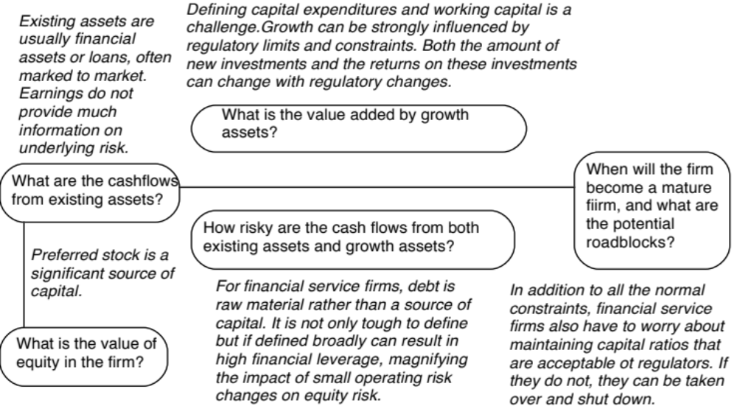
The Questions

Slide 4
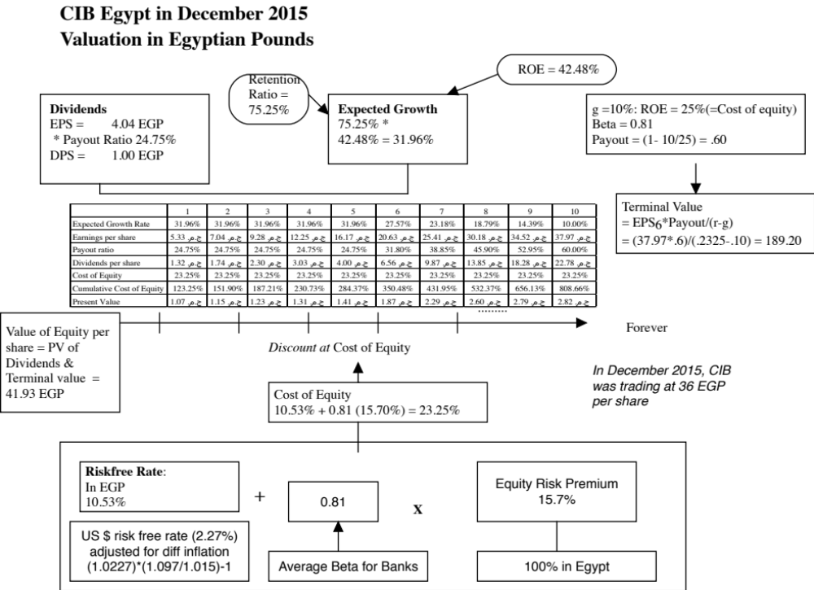
Notes:
A cop out… No doubt… You could try to estimate the free cashflow to equity for a bank but you will find yourself quickly stymied by how little information is revealed by firms. There is also the added rationale that equity retained in a bank increases equity capital which is required for the bank to expand (because of regulatory constraints on capital).
Key inputs:
I am assuming that the ROE and retention ratio will stay unchanged for first 5 years.
In year 6, the growth decreases and the payout ratio increases. You cannot take dividends in year 5 and grow them one year at 5% because of the change in the dividend payout ratio.
Note that the new cost of equity is used to estimate the terminal value, but the terminal value is discounted back at the current cost of equity.

Slide 5
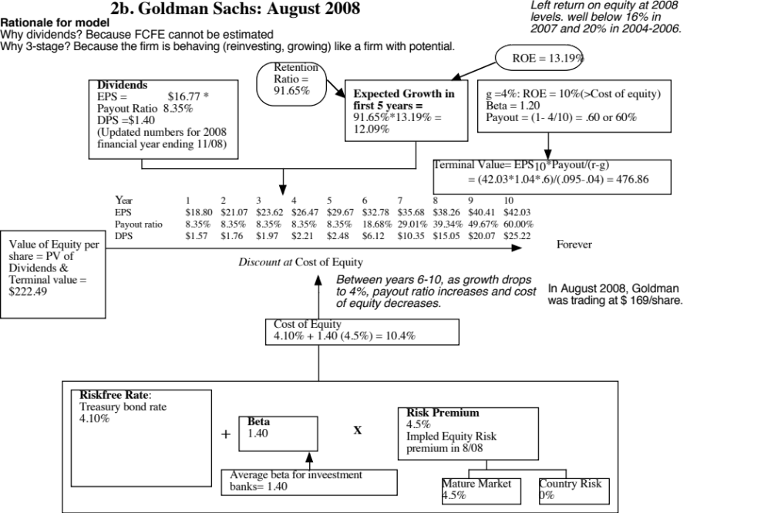
Notes:
A good measure of how the world can shift under you. Four weeks after this valuation, Lehman collapsed and the rest as they say is history. Here are some questions:
With the benefit of hindsight, which inputs for the company were over optimistic? (Base year earnings and expected ROE..)
What macro inputs should be changed, in hindsight again? (I think the ERP of 4.5% turned out to be too low..)

Slide 6
Lesson 1: Financial service companies are opaque…
The Faustian Bargain: Banks don’t provide much information about the quality of their assets but the salve that investors have is that accountants mark assets to market (presumably with information on their quality) and regulators keep banks in check.
What are cash flows? In addition, estimating cash flows for a financial service firm is difficult to do. So, we trust financial service firms to pay out their cash flows as dividends. Hence, the use of the dividend discount model.
Sensible Banks: During times of crises or when you don’t trust banks to pay out what they can afford to in dividends, using the dividend discount model may not give you a “reliable” value.

Slide 7
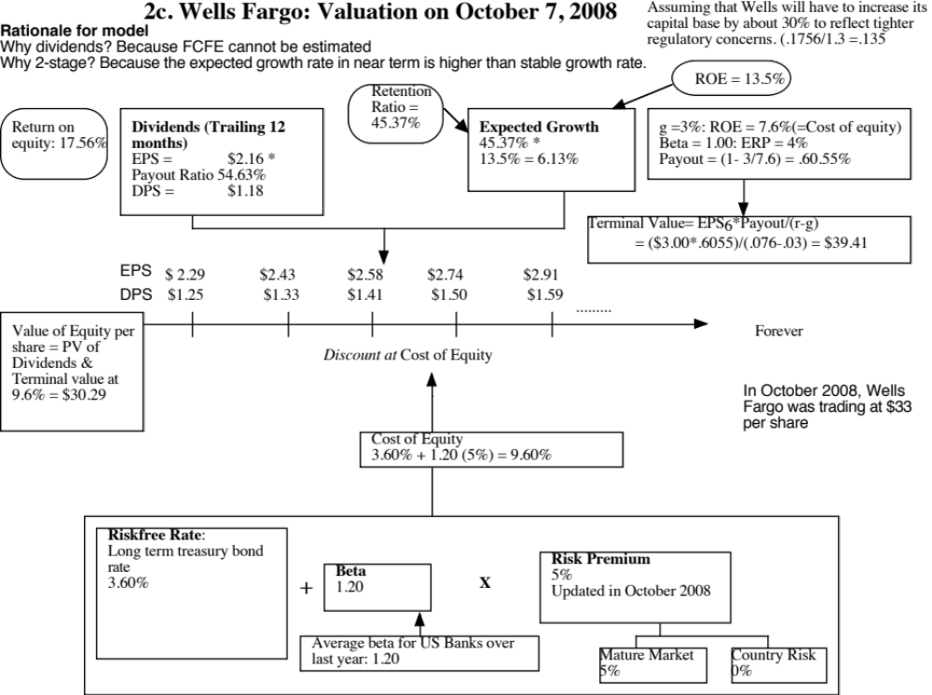
Notes:
Macro events can affect value. In this valuation of Wells Fargo, done about three weeks into the market crisis, you wee the effects of the crisis in a couple of places:
An increase in the equity risk premium from 4% (pre-Sept 12) to 5%
A decrease in the ROE, based upon the expectation that capital ratios will be raised as a consequence of the crisis.
The stock price dropped from $ 50 to $ 33 but the value also dropped from about $ 48 (pre-crisis) to $ 30 (in this valuation).

Slide 8
Lesson 2: For financial service companies, book value matters…
The book value of assets and equity is mostly irrelevant when valuing non-financial service companies. With financial service firms, book value of equity is relevant for two reasons:
  Since financial service firms mark to market, the book value is more likely to reflect what the firms own right now (rather than a historical value)
  The regulatory capital ratios are based on book equity. Thus, a bank with negative or even low book equity will be shut down by the regulators.
From a valuation perspective, it therefore makes sense to define reinvestment for a bank as the amount that it needs to add to book equity to sustain its growth ambitions and safety requirements:
  FCFE = Net Income – Reinvestment in regulatory capital (book equity)

Slide 9
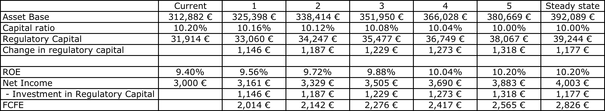
FCFE for a bank… Deutsche Bank in 2009
Deutsche Bank: FCFE

Slide 10
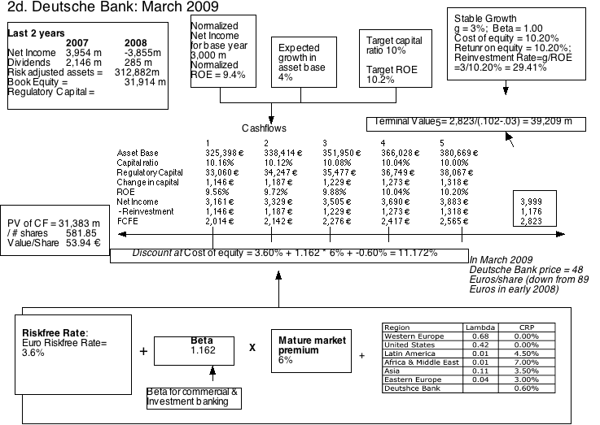

Slide 11
Pricing Financing Service Companies
Stay equity focused: Pricing should be based on the equity in the financial service firm.
Pay attention to book value: The book value for a bank is marked to market and has regulatory implications.
Refine risk: Your risk measure should incorporate regulatory risk.

Slide 12
An Eyeballing Exercise with P/BV Ratios
European Banks in 2010
Name | PBV Ratio | Return on Equity | Standard Deviation
BAYERISCHE HYPO-UND VEREINSB | 0.80 | -1.66% | 49.06%
COMMERZBANK AG | 1.09 | -6.72% | 36.21%
DEUTSCHE BANK AG -REG | 1.23 | 1.32% | 35.79%
BANCA INTESA SPA | 1.66 | 1.56% | 34.14%
BNP PARIBAS | 1.72 | 12.46% | 31.03%
BANCO SANTANDER CENTRAL HISP | 1.86 | 11.06% | 28.36%
SANPAOLO IMI SPA | 1.96 | 8.55% | 26.64%
BANCO BILBAO VIZCAYA ARGENTA | 1.98 | 11.17% | 18.62%
SOCIETE GENERALE | 2.04 | 9.71% | 22.55%
ROYAL BANK OF SCOTLAND GROUP | 2.09 | 20.22% | 18.35%
HBOS PLC | 2.15 | 22.45% | 21.95%
BARCLAYS PLC | 2.23 | 21.16% | 20.73%
UNICREDITO ITALIANO SPA | 2.30 | 14.86% | 13.79%
KREDIETBANK SA LUXEMBOURGEOI | 2.46 | 17.74% | 12.38%
ERSTE BANK DER OESTER SPARK | 2.53 | 10.28% | 21.91%
STANDARD CHARTERED PLC | 2.59 | 20.18% | 19.93%
HSBC HOLDINGS PLC | 2.94 | 18.50% | 19.66%
LLOYDS TSB GROUP PLC | 3.33 | 32.84% | 18.66%
Average | 2.05 | 12.54% | 24.99%
Median | 2.07 | 11.82% | 21.93%
Notes:
This was just before the crisis. Note that the banks that trade at low P/BV ratios also tend to have low ROEs…
The standard deviation in stock prices is a proxy for risk. If that is not a good measure, you may consider others that are specific to banks (toxic assets on the balance sheet, regulatory capital ratios, loan losses/write offs)

Slide 13
The median test…
One simple measure of what is par for the sector are the median values for each of the variables.
A simplistic decision rule on under and over valued stocks would therefore be:
  Undervalued stocks: Trade at price to book ratios below the median for the sector,(2.07), generate returns on equity higher than the sector median (11.82%) and have standard deviations lower than the median (21.93%).
  Overvalued stocks: Trade at price to book ratios above the median for the sector and generate returns on equity lower than the sector median.
Notes:
A simple way to look for mismatches….

Slide 14
How about this mechanism?
We are looking for stocks that trade at low price to book ratios, while generating high returns on equity. But what is a low price to book ratio? Or a high return on equity?
Taking the sample of 18 banks, we ran a regression of PBV against ROE and standard deviation in stock prices (as a proxy for risk).
  PBV = 2.27 + 3.63 ROE - 2.68 Std dev
  (5.56) (3.32) (2.33)
R squared of regression = 79%
Notes:
A slightly more sophisticated take which brings in more than one variable into the analysis…
Note how much of the variation in price to book ratios is explained by just ROE and standard deviation. The caveats about small samples and linear relationships continue to apply.

Slide 15

And these predictions?
Notes:
Using the regression to get predicted values, we can estimate what the PBV ratio should be for each bank, given its ROE and standard deviation.

