Slide 1
Session 28: Valuing commodity & cyclical companies

Slide 2
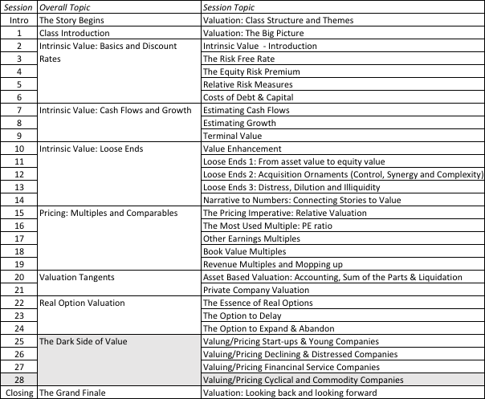
Valuing Commodity & Cyclical Companies

Slide 3
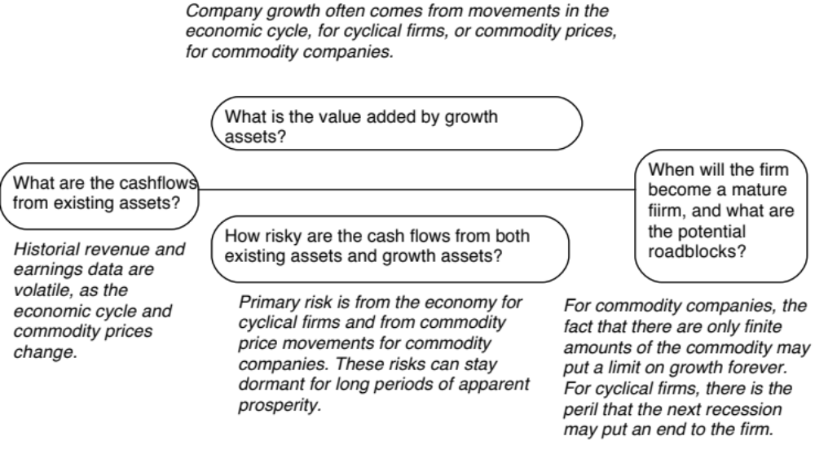
Valuing cyclical and commodity companies

Slide 4
Lesson 1: The Operating Numbers will ebb and flow
perating numbers (and earnings in particular) will be volatile, even for mature firms.
That volatility comes from economic cycles (for cyclical firms) and commodity price cycles (for commodity firms)
If you value these firms based on the most recent year’s numbers, you can over value the firm (following a peak year) or under value the firm (following a bottom year).
Normalize.

Slide 5
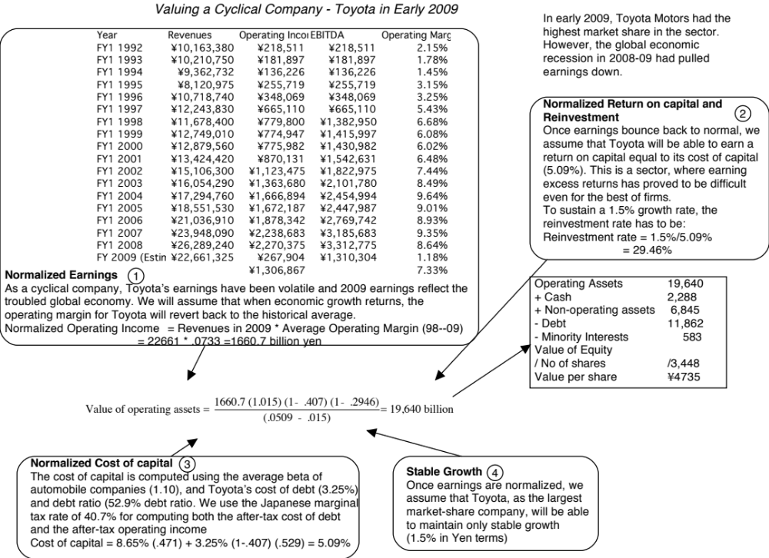

Slide 6
Lesson 2: With “macro” companies, it is easy to get lost in “macro” assumptions…
Value you arrive at will be affected by your views on the economy or the price of the commodity.
Value will reflect your views on macro variables and your views on the company, and it is difficult to separate the two.
Start with a macro-neutral valuation (where you don’t take a point of view) and then present your macro views separately.

Slide 8
Lesson 3: Use probabilistic tools to assess value as a function of macro variables…
Quantify the uncertainty about macro variables in a distribution (rather than a single price) and use that distribution in your valuation.
You will get a distribution of value for the company that provides richer information for your decision making.

Slide 9
Shell’s Revenues & Oil Prices
Revenues = 39,992.77 + 4,039.39 * Average Oil Price R squared = 96.44%

Slide 10
Notes:
With commodity companies, you ride the price of the commodity. As commodity prices rise, current earnings will rise, but what goes up will come down. The key is normalizing the commodity price, easier said than done, but necessary. Here are some strategies:
Look at the average price over a long period (10 years or more)
Estimate what a fair price would be, given demand and supply, for the commodity.

Slide 11
Pricing Commodity/Cyclical Companies – Three choices for standardization
Base year numbers: Cycles are affecting all companies in the sector.
Normalized numbers: Cycles are the only reason for operating number changes over time and that all companies will recover with the cycle.
Potential: Assume that all reserves/potential are equally valuable.

