Slide 1
Session 2: INTRINSIC VALUATION
Laying the Foundation
Aswath Damodaran

Slide 2
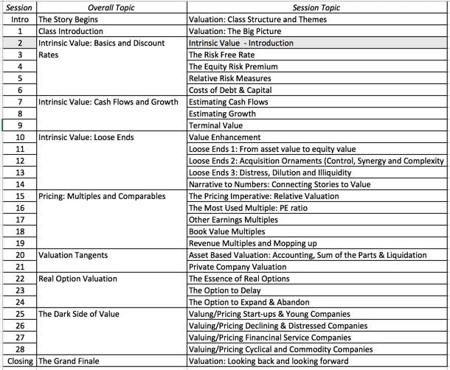
The Building Blocks for Value

Slide 3
The essence of intrinsic value
In intrinsic valuation, you value an asset based upon its fundamentals – its cash flows, its growth and its risk.
For cash flow generating assets, the intrinsic value will be a function of the magnitude of the expected cash flows on the asset over its lifetime and the uncertainty about receiving those cash flows.
Discounted cash flow valuation is a tool for estimating intrinsic value, where the expected value of an asset is written as the present value of the expected cash flows on the asset, with either the cash flows or the discount rate adjusted to reflect the risk.

Slide 4
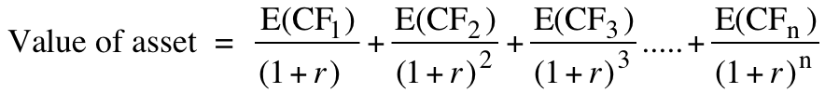
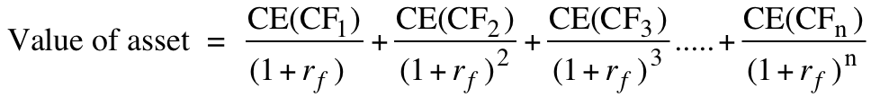
The two faces of discounted cash flow valuation
The value of a risky asset can be estimated by discounting the expected cash flows on the asset over its life at a risk-adjusted discount rate:
  where the asset has a n-year life, E(CFt) is the expected cash flow in period t and r is a discount rate that reflects the risk of the cash flows.
Alternatively, we can replace the expected cash flows with the guaranteed cash flows we would have accepted as an alternative (certainty equivalents) and discount these at the riskfree rate:
where CE(CFt) is the certainty equivalent of E(CFt) and rf is the riskfree rate.
Notes:
Both approaches have the same objective and done right should yield the same value.
Both require the same information.
In practice, analysts often intentionally or unintentionally use mixed approaches, adjusting both the cash flows and the discount rate for risk. In the process, they end up miscounting or double counting risk.

Slide 5
Risk Adjusted Value: Two Basic Propositions
Proposition 1: For an asset to have value, the expected cash flows have to be positive some time over the life of the asset.
Proposition 2: Assets that generate cash flows early in their life will be worth more than assets that generate cash flows later; the latter may however have greater growth and higher cash flows to compensate.
Notes:
Cash is king. A firm with negative cash flows today can be a very valuable firm but only if there is reason to believe that cash flows in the future will be large enough to compensate for the negative cash flows today. The riskier a firm and the longer you have to wait for the cash flows, the greater the cashflows eventually have to be….

Slide 6
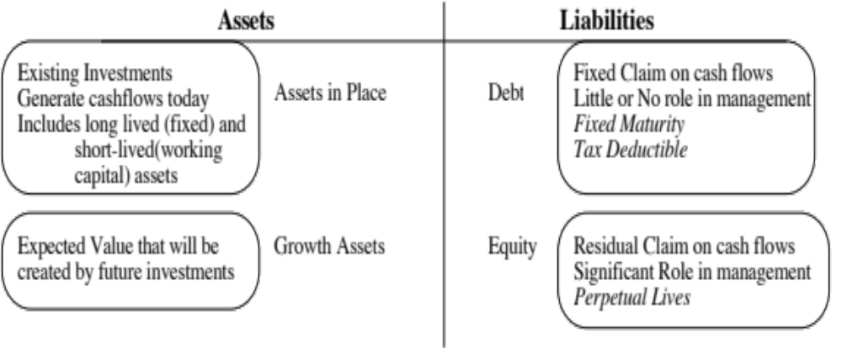
DCF Choices: Equity Valuation versus Firm Valuation
Firm Valuation: Value the entire business
Equity valuation: Value just the equity claim in the business
Notes:
A business and the equity in the business can be very different numbers…
A firm like GE in 2005 had a value of $ 500 billion for its business but its equity is worth only $ 300 billion - the difference is due to the substantial debt that GE has used to fund its expansion.
You can have valuable businesses, where the equity is worth nothing because the firm has borrowed too much….

Slide 7
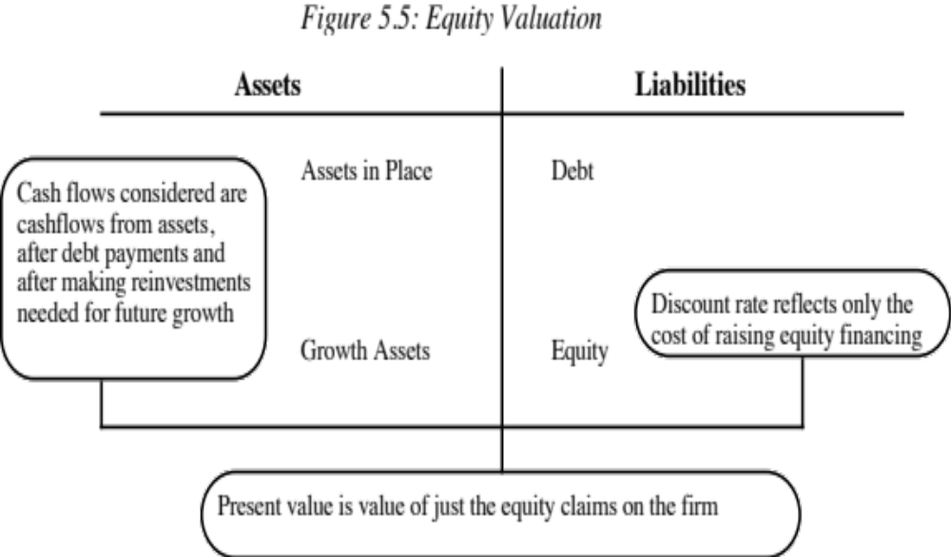
Equity Valuation
Notes:
The value of equity is the present value of cash flows to the equity investors discounted back at the rate of return that those equity investors need to make to break even (the cost of equity).
In the strictest sense of the word, the only cash flow stockholders in a publicly traded firm get from their investment is dividends, and the dividend discount model is the simplest and most direct version of an equity valuation model.

Slide 8
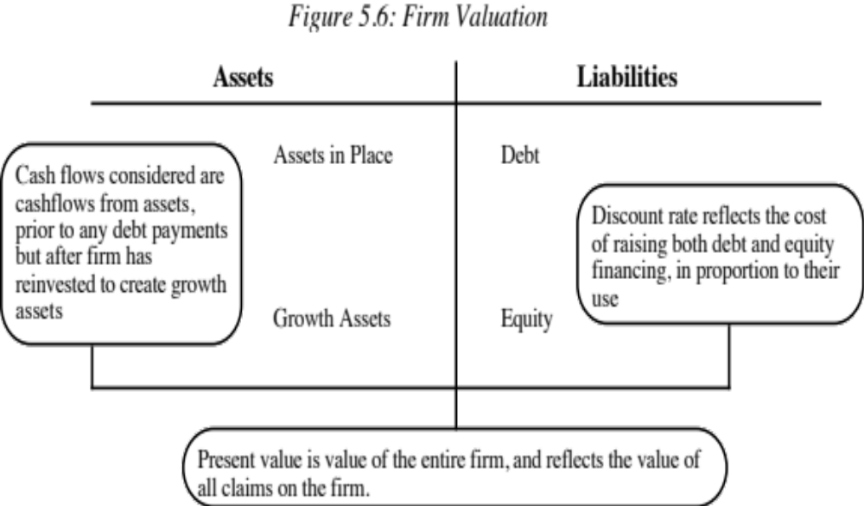
Firm Valuation
Notes:
A firm includes not just the equity, but all claim holders. The cash flow to the firm is the collective cash flow that all claim holders make from the firm, and it is discounted at the weighted average of their different costs.

Slide 9
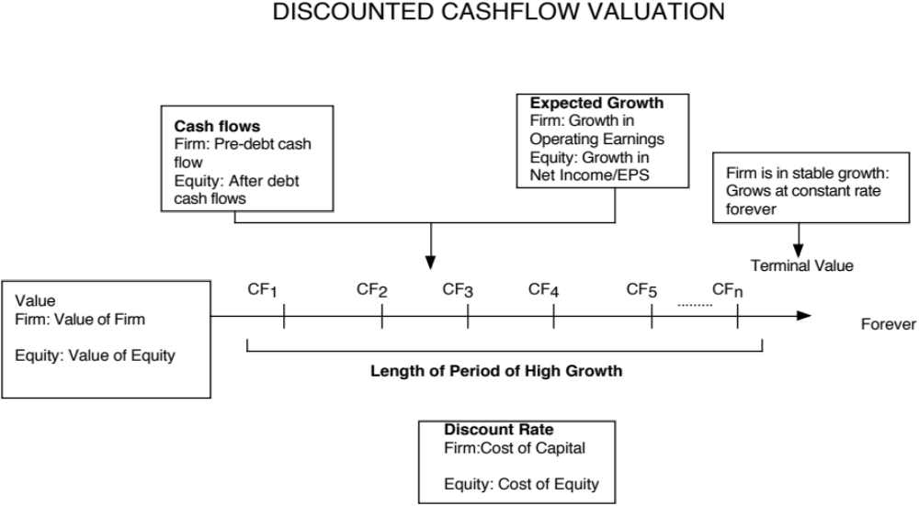
Generic DCF Valuation Model
Notes:
The four pillars of value:
Cashflows
Potential for high growth
Length of the high growth period (before the firm starts growing at the same rate as the economy)
Discount rate
Note the variations and the need for consistency:
With equity -> Cashflows to equity - > Growth rate in net income -> Discount at the cost of equity
With firm -> Cashflows to firm - > Growth rate in operating income -> Discount at the cost of capital

Slide 10
First Principle of Valuation
Consistency principle: Your discount rate should match up to your cash flows.
The key error to avoid is mismatching cashflows and discount rates:
  Discounting cash flows to equity at the weighted average cost of capital will lead to an upwardly biased estimate of the value of equity
  Discounting cash flows to the firm at the cost of equity will yield a downward biased estimate of the value of the firm.
Notes:
It is a principle that is often violated because we often talk about discount rates and cashflows loosely and costs of capital and equity interchangeably. We need to be more precise about words like free cash flow (to whom? The firm? Equity?) and discount rates to avoid these problems.

