Slide 1
Session 3: Discount rate basics the Risk free rate
Aswath Damodaran

Slide 2
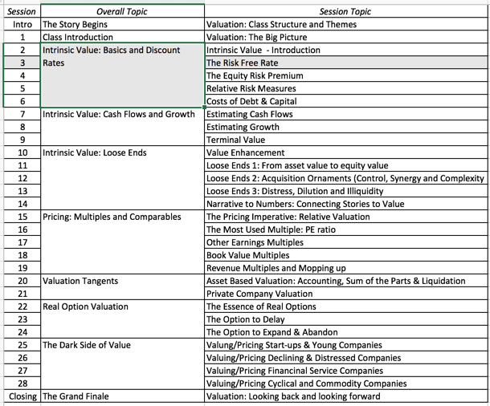
The Humble Beginnings

Slide 3
Estimating Inputs: Discount Rates
Critical ingredient in discounted cashflow valuation. Errors in estimating the discount rate or mismatching cashflows and discount rates can lead to serious errors in valuation.
At an intuitive level, the discount rate used should be consistent with both the riskiness and the type of cashflow being discounted.
  Equity versus Firm: If the cash flows being discounted are cash flows to equity, the appropriate discount rate is a cost of equity. If the cash flows are cash flows to the firm, the appropriate discount rate is the cost of capital.
  Currency: The currency in which the cash flows are estimated should also be the currency in which the discount rate is estimated.
  Nominal versus Real: If the cash flows being discounted are nominal cash flows (i.e., reflect expected inflation), the discount rate should be nominal
Notes:
While discount rates are a critical ingredient in discounted cashflow valuation, I think we spend far too much time on discount rates and far too little on cashflows. The most significant errors in valuation are often the result of failures to estimate cash flows correctly….
As companies increasingly become global, and multiple listings abound (Royal Dutch has six equity listings in different markets). the consistentcy principle becomes very important. The currency used in estimating cash flows should also be the currency in which you estimate discount rates - Euro discount rates for Euro cashflows and peso discount rates for peso cash flows.
Recently, I came across a valuation of a Mexican company, where the cashflows were in nominal pesos but the discount rate used was the dollar cost of capital of a U.S. acquirer…. As a result, the value was inflated by more than 300%….

Slide 4
Cost of Equity
The cost of equity should be higher for riskier investments and lower for safer investments.
No matter what model or theory you have for measuring risk and coming up with a premium, that premium has to be on top of what you would make on a guaranteed investment, where you know your returns with certainty.
That guaranteed rate of return is the risk free rate.
Notes:
Re-emphasizes a key assumption that we make in risk and return models in finance. It is not risk that matters, but non-diversifiable risk and the cost of equity will increase as the non-diversifiable risk in an investment increases.
This view of the world may pose a problem for us when valuing private companies or closely held, small publicly traded firms, where the marginal investor (owner, venture capitalist….) may not be diversified.

Slide 5
A Riskfree Rate
On a riskfree asset, the actual return is equal to the expected return. Therefore, there is no variance around the expected return.
For an investment to be riskfree, then, it has to have
  No default risk
  No reinvestment risk
Time horizon matters: Thus, the riskfree rates in valuation will depend upon when the cash flow is expected to occur and will vary across time. If your cash flows stretch out over the long term, your risk free rate has to be a long term risk free rate.
Currency matters: The risk free rate will vary across currencies, with higher inflation currencies having higher rates.
Not all government securities are riskfree: Some governments face default risk and the rates on bonds issued by them will not be riskfree.
Notes:
Treasury bills may be default free but there is reinvestment risk when they are used as riskless rates for longer-term cashflows. A 6-month T.Bill is not riskless when looking at a 5-year cashflow.
Would a 5-year treasury be riskfree? Not really. The coupons would still expose you to reinvestment risk. Only a 5-year zero-coupon treasury would be riskfree for a 5-year cash flow.
If you were a purist, you would need different riskfree rates for different cashflows. A pragmatic solution would be to estimate the duration of the cashflows in a valuation and use a treasury of similar duration. (Since the duration is the weighted average of when the cashflows come in, this should be fairly long, especially when you count in the fact that the terminal value is the present value of cashflows forever).

Slide 6
Let’s start easy
A Riskfree Rate in US dollars!
If you are valuing a company in US dollars, you need a US dollar risk free rate.
In practice, we have tended to use US treasury rates as risk free rates, but that is built on the presumption that the US treasury is default free.
  If you accept the premise that the US treasury is default free, you still have several choices, since the US treasury issues securities with differing maturities (ranging from 3 months to 30 years) as well in real or nominal terms (Inflation protected treasuries (TIPs) or nominal treasuries)
  In valuation, we estimate cash flows forever (or at least for very long time periods) and in nominal terms. The correct risk free rate to use should therefore be a long term, default-free rate. With US dollars, I use a 10-year treasury bond rate as the risk free rate.
Notes:
Since we are valuing cashflows for the long term, we want a long-term riskfree rate (so, rule out the 6-month T.Bill rate). Since the valuation is in US dollars (a nominal rate), we can also rule out the TIPS rate. In theory, the 30-year rate should be the best choice. In practice, I would go with the 20-year bond for the following reasons:
It is the most liquid of the treasuries and there is always a fresh auction rate from the previous Monday,
Getting other inputs such as equity risk premiums and default spreads is easier with a 10-year rate than a 30-year rate
The term structure flattens out by the time you get to the 10-year rate…..

Slide 7
A Riskfree Rate in Euros
Notes:
The only reason for differences in rates across these securities is default risk. Consequently, it makes sense to use the lowest of the rates (Germany) as the rsikfree rete, if you are valuing a company in Euros.

Slide 8
A Riskfree Rate in Indian Rupees
The Indian government had 10-year Rupee bonds outstanding, with a yield to maturity of about 7.73% on January 1, 2016.
In January 2016, the Indian government had a local currency sovereign rating of Baa3. The typical default spread (over a default free rate) for Baa3 rated country bonds in early 2016 was 2.44%.
The riskfree rate in Indian Rupees is therefore 5.29%.
  Risk free Rate in Indian Rupees = 7.73% - 2.44% = 5.29%
Notes:
The government bond rate is not riskfree. To get to a riskfree rate, you would subtract out the default spread of 2.55% from the bond rate to get to a riskfree rate of 8%.

Slide 9
How do you get a default spread for a country? Two paths
You can find a government bond, denominated in US dollars or Euros, by that country and subtract out the riskfree rate in US dollars or Euros. For instance, in January 2016, the Brazilian 10-year dollar denominated bond was trading to yield 7.25%. Subtracting out the US T.Bond rate of 2.17% that day would have yielded a default spread of 5.08% for Brazil.
Brazil has a sovereign CDS that is publicly traded. In January 2016, it was trading at 5.19%.

Slide 10
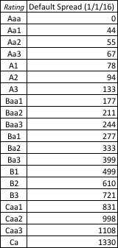
And a third – Average Default Spreads: January 2016

Slide 11
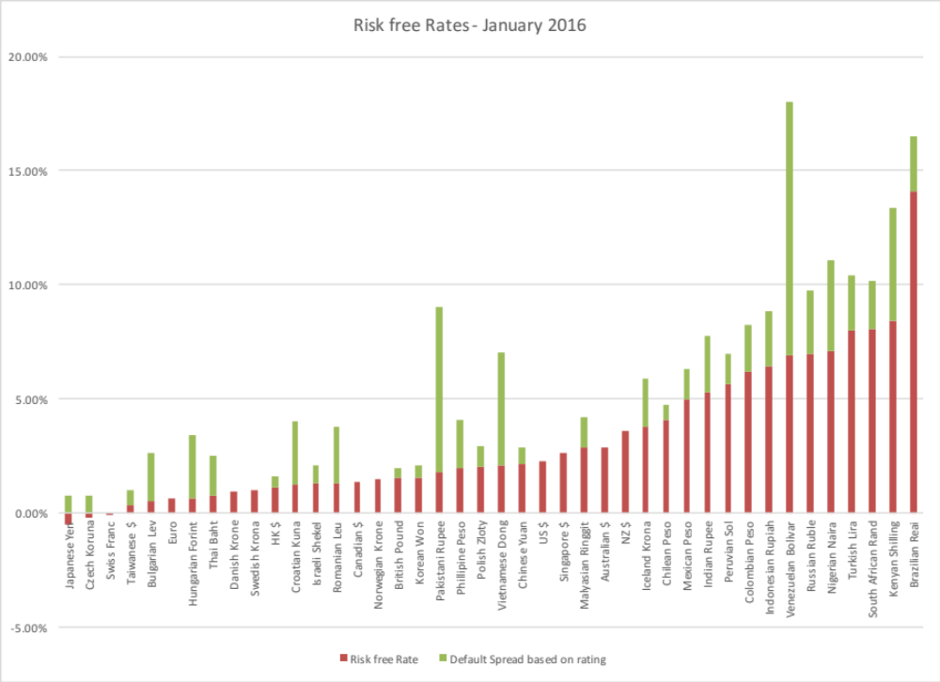
Risk free rates in different currencies: January 2016

