Slide 1
Session 3: Discount rate basics the Risk free rate
Aswath Damodaran

Slide 2
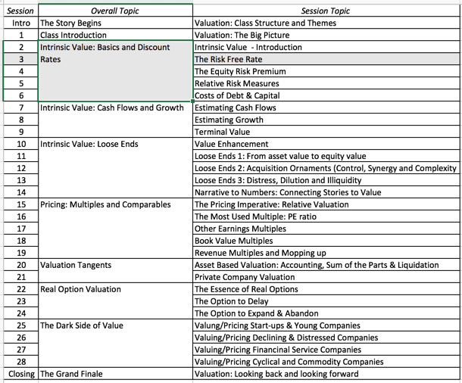
The Humble Beginnings

Slide 3
Estimating Inputs: Discount Rates
Critical ingredient, but not as critical as people think it is.
At an intuitive level, the discount rate used should be consistent with both the riskiness and the type of cash flow being discounted.
  Equity versus Firm.
  Currency
  Nominal versus Real
Notes:
While discount rates are a critical ingredient in discounted cashflow valuation, I think we spend far too much time on discount rates and far too little on cashflows. The most significant errors in valuation are often the result of failures to estimate cash flows correctly….
As companies increasingly become global, and multiple listings abound (Royal Dutch has six equity listings in different markets). the consistentcy principle becomes very important. The currency used in estimating cash flows should also be the currency in which you estimate discount rates - Euro discount rates for Euro cashflows and peso discount rates for peso cash flows.
Recently, I came across a valuation of a Mexican company, where the cashflows were in nominal pesos but the discount rate used was the dollar cost of capital of a U.S. acquirer…. As a result, the value was inflated by more than 300%….

Slide 4
Cost of Equity
The cost of equity should be higher for riskier investments and lower for safer investments.
To get the return on a risky investment, you have to start with what you would make on a guaranteed investment.
That guaranteed rate of return is the risk free rate.
Notes:
Re-emphasizes a key assumption that we make in risk and return models in finance. It is not risk that matters, but non-diversifiable risk and the cost of equity will increase as the non-diversifiable risk in an investment increases.
This view of the world may pose a problem for us when valuing private companies or closely held, small publicly traded firms, where the marginal investor (owner, venture capitalist….) may not be diversified.

Slide 5
A Riskfree Rate
On a riskfree asset, the actual return is equal to the expected return.
For an investment to be riskfree, then, it has to have
  No default risk
  No reinvestment risk
Implications
Time horizon matters
Currency matters
Not all government securities are riskfree
Notes:
Treasury bills may be default free but there is reinvestment risk when they are used as riskless rates for longer-term cashflows. A 6-month T.Bill is not riskless when looking at a 5-year cashflow.
Would a 5-year treasury be riskfree? Not really. The coupons would still expose you to reinvestment risk. Only a 5-year zero-coupon treasury would be riskfree for a 5-year cash flow.
If you were a purist, you would need different riskfree rates for different cashflows. A pragmatic solution would be to estimate the duration of the cashflows in a valuation and use a treasury of similar duration. (Since the duration is the weighted average of when the cashflows come in, this should be fairly long, especially when you count in the fact that the terminal value is the present value of cashflows forever).

Slide 6
Let’s start easy
A Riskfree Rate in US dollars!
If you are valuing a company in US dollars, you need a US dollar risk free rate.
If you assume that the US treasury is default free
  You can use the US treasury rate as your risk free rate in US dollars and the US Inflation-index treasury (TIPs) rate as the real risk free rate.
  Since you are valuing the company as a going concern, over the long term, you should use a long term treasury rate as the risk free rate.
  10 year versus 30 year?
Notes:
Since we are valuing cashflows for the long term, we want a long-term riskfree rate (so, rule out the 6-month T.Bill rate). Since the valuation is in US dollars (a nominal rate), we can also rule out the TIPS rate. In theory, the 30-year rate should be the best choice. In practice, I would go with the 20-year bond for the following reasons:
It is the most liquid of the treasuries and there is always a fresh auction rate from the previous Monday,
Getting other inputs such as equity risk premiums and default spreads is easier with a 10-year rate than a 30-year rate
The term structure flattens out by the time you get to the 10-year rate…..

Slide 7
A Riskfree Rate in Euros
Notes:
The only reason for differences in rates across these securities is default risk. Consequently, it makes sense to use the lowest of the rates (Germany) as the rsikfree rete, if you are valuing a company in Euros.

Slide 8
A Riskfree Rate in Indian Rupees
The Indian government had 10-year Rupee bonds outstanding, with a yield to maturity of about 7.73% on January 1, 2016.
In January 2016, the Indian government had a local currency sovereign rating of Baa3. The typical default spread (over a default free rate) for Baa3 rated country bonds in early 2016 was 2.44%.
The riskfree rate in Indian Rupees is therefore 5.29%.
  Risk free Rate in Indian Rupees = 7.73% - 2.44% = 5.29%
Notes:
The government bond rate is not riskfree. To get to a riskfree rate, you would subtract out the default spread of 2.55% from the bond rate to get to a riskfree rate of 8%.

Slide 9
How do you get a default spread for a country? Two paths
You can find a government bond, denominated in US dollars or Euros, by that country and subtract out the riskfree rate in US dollars or Euros. Example:
  Brazil Default Spread in Jan 2016 = Rate on Brazil US $ 10 year bond – 10 year US T.Bond = 7.25% - 2.17% = 5.08%.
Brazil has a sovereign CDS that is publicly traded. It is a market measure of default risk in the country.
  Brazil CDS Default Spread = 5.19%

Slide 10
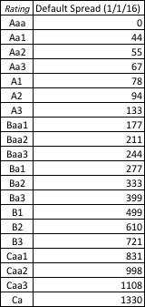
And a third – Average Default Spreads: January 2016
Brazil’s rating was Baa3 in January 2016

Slide 11
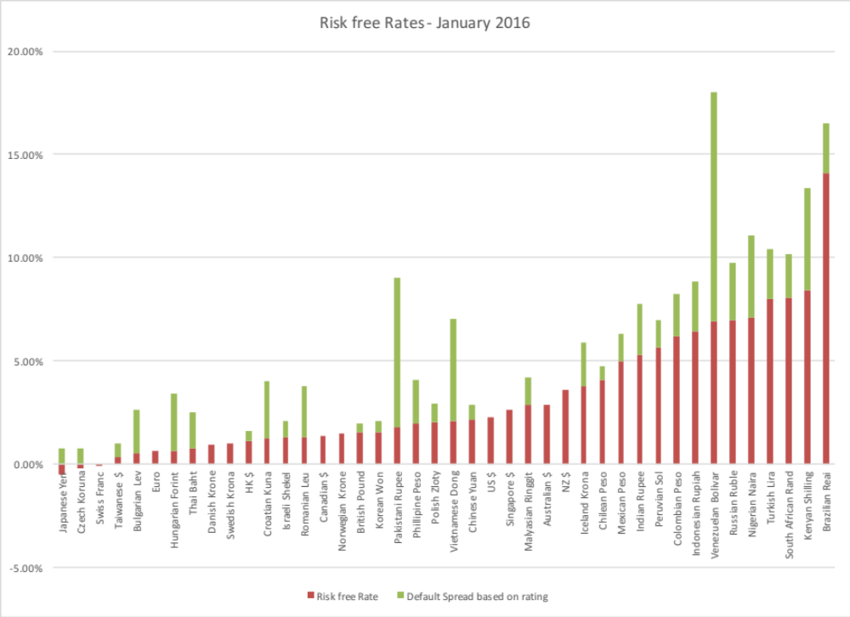
Risk free rates in different currencies: January 2016

