Slide 1
Session 4: Equity Risk Premiums
DCF Valuation

Slide 2
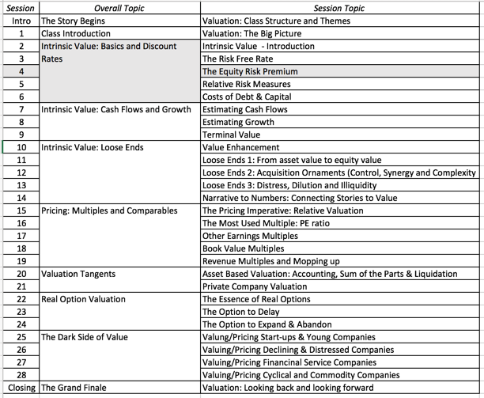
The Price of Equity Risk

Slide 3
Equity Risk Premiums: Intuition
The equity risk premium is the premium that investors charge for investing in the average equity. For lack of a better description, think of it as the price of bearing a unit of equity risk.
It is a function of
  How risk averse investors are collectively
  How much risk they see in the average equity
The level of the equity risk premium should vary over time as a function of:
  Changing macro economic risk (inflation & GDP growth)
  The fear of catastrophic risk
  The transparency or lack thereof of the companies issuing equity

Slide 4
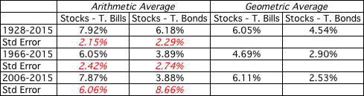
Equity Risk Premiums
The ubiquitous historical risk premium
The historical premium is the premium that stocks have historically earned over riskless securities.
While the users of historical risk premiums act as if it is a fact (rather than an estimate), it is sensitive to
  How far back you go in history…
  Whether you use T.bill rates or T.Bond rates
  Whether you use geometric or arithmetic averages.
Notes:
While everyone uses historical risk premiums, the actual premium in use can vary depending upon
How far back you go in time
Whether you T.Bills or T.Bonds
Whether you use arithmetic or geometric averages
This table was developed using data that is publicly accessible on the S&P 500, treasury bills and 10-year treasury bonds on the Federal Reserve of St. Louis web site.
Dataset: histretSP.xls
An interesting issue that has been raised by some researchers is that there may be a selection bias here. The U.S. stock market was undoubtedly the most successful equity market of the 20th century. Not surprisingly, you find that it earned a healthy premium over riskless rates. A more realistic estimate of the premium would require looking at the ten largest equity markets in the early part of the century and estimating the average premium you would have earned over all ten markets. A study at the London Business School that did this found an average equity risk premium of only 4% across these markets.

Slide 5
The perils of trusting the past…….
Noisy estimates: Even with long time periods of history, the risk premium that you derive will have substantial standard error. For instance, if you go back to 1928 (about 80 years of history) and you assume a standard deviation of 20% in annual stock returns, you arrive at a standard error of greater than 2%:
Standard Error in Premium = 20%/√80 = 2.26%
Survivorship Bias: Using historical data from the U.S. equity markets over the twentieth century does create a sampling bias. After all, the US economy and equity markets were among the most successful of the global economies that you could have invested in early in the century.
Notes:
The noise in stock prices is such that you need 100-150 years of data to arrive at reasonably small standard errors. It is pointless estimating risk premiums with 10-20 years of data.
The survivorship bias will push historical risk premiums up, if you use the US as the base market.

Slide 6
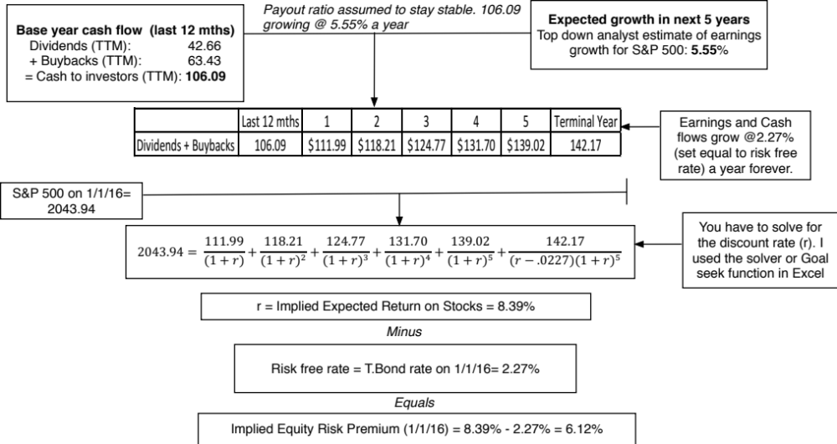
A Forward Looking, Dynamic ERP
Notes:
The key lesson I would take away is that equity risk premiums are unstable and that globalization has made them more unstable. The other is that there seems to be mean reversion in the process – implied premiums, when abnormally high or low, move back towards a longer term average.

Slide 7
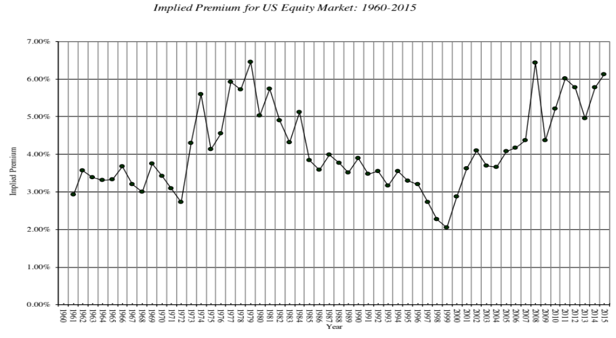
Implied Premiums in the US: 1960-2015
Notes:
As the index changes (and it is the input most likely to change by large amounts in short periods), the implied premium will change. Note that as premiums rise, stock prices drop. Notice two historical phenomena: (1) Equity risk premiums spiked in the 1970s as inflation increased in the US (2) Equity risk premiums bottomed out at 2% at the end of 1999 at the peak of the dot-com boom.
Would you settle for a 2% premium? If your answer is no, you believe that stocks are overvalued.

Slide 8
Estimating a risk premium for an emerging market
Approach 1: Default Spread as Country Risk Premium
Default spread for country: In this approach, the country equity risk premium is set equal to the default spread for the country, estimated in one of three ways:
  The default spread on a dollar denominated bond issued by the country. (In January 2016, that spread was 4.83% for the Brazilian $ bond)
  The sovereign CDS spread for the country. In January 2016, the ten year CDS spread for Brazil, adjusted for the US CDS, was 5.19%.
  The default spread based on the local currency rating for the country. Brazil’s sovereign local currency rating is Baa3 and the default spread for a Baa3 rated sovereign was about 2.44% in January 2016.
Add the default spread to a “mature” market premium: This default spread is added on to the mature market premium to arrive at the total equity risk premium for Brazil, assuming a mature market premium of 6.00%.
  Country Risk Premium for Brazil = 2.44%
  Total ERP for Brazil = 6.00% + 2.44% = 8.44%

Slide 9
Approach 2: A Relative Equity Volatility Approach
This approach draws on the standard deviation of two equity markets, the emerging market in question and a base market (usually the US). The total equity risk premium for the emerging market is then written as:
  Total equity risk premium = Risk Premium_{US}* _{Country Equity} / _{US Equity}
The country equity risk premium is based upon the volatility of the market in question relative to U.S market.
  Assume that the equity risk premium for the US is 6.00%.
  Assume that the standard deviation in the Bovespa (Brazilian equity) is 30% and that the standard deviation for the S&P 500 (US equity) is 18%.
  Total Equity Risk Premium for Brazil = 6.00% (30%/18%) = 10.0%
  Country equity risk premium for Brazil = 10.00% - 6.00% = 4.00%

Slide 10
Approach 3: A melded approach to estimating the additional country risk premium
Country ratings measure default risk. While default risk premiums and equity risk premiums are highly correlated, one would expect equity spreads to be higher than debt spreads.
Another is to multiply the bond default spread by the relative volatility of stock and bond prices in that market. Using this approach for Brazil in January 2016, you would get:
  Country Equity risk premium = Default spread on country bond* _{Country Equity} / _{Country Bond}
    Standard Deviation in Bovespa (Equity) = 30%
    Standard Deviation in Brazil government bond = 20%
    Default spread for Brazil= 2.44%
  Brazil Country Risk Premium = 2.44% (30%/20%) = 3.66%
  Brazil Total ERP = Mature Market Premium + CRP = 6.00% + 3.66% = 9.66%

Slide 11
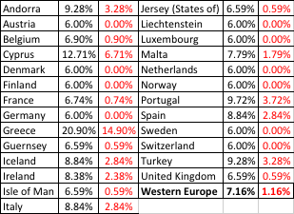
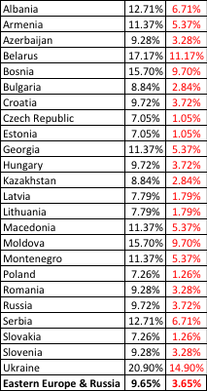
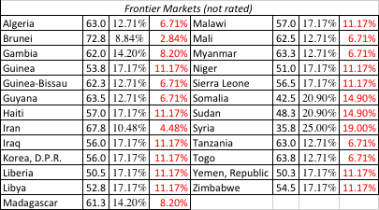

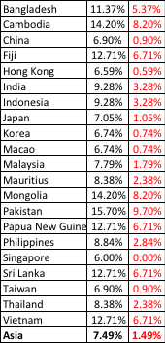

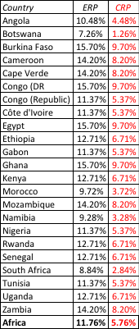
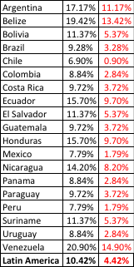
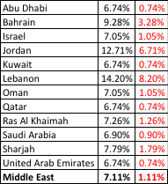

ERP : Jan 2016
Black #: Total ERP
Red #: Country risk premium
AVG: GDP weighted average
Notes:
Updated country risk premiums.

Slide 12
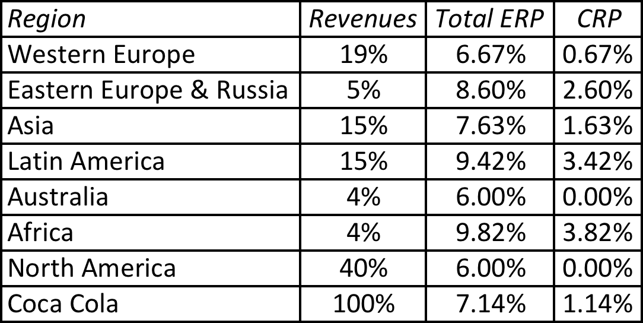
Extending to a multinational: Regional breakdown
Coca Cola’s revenue breakdown and ERP in 2012
Things to watch out for
Aggregation across regions. For instance, the Pacific region often includes Australia & NZ with Asia
Obscure aggregations including Eurasia and Oceania
Notes:
With a multinational, it is often too messy to do individual countries, either because of the logistics of computing dozens of CRP or because the information is not provided. You can use the regional breakdown to get an approximate ERP. I applied the GDP weighted average from the map to arrive at the ERPs and CRPs for each region.

Slide 13
A Richer Approach to Country Risk Exposure: Estimate a lambda for country risk
Source of revenues: Other things remaining equal, a company should be more exposed to risk in a country if it generates more of its revenues from that country.
Manufacturing facilities: Other things remaining equal, a firm that has all of its production facilities in a “risky country” should be more exposed to country risk than one which has production facilities spread over multiple countries. The problem will be accented for companies that cannot move their production facilities (mining and petroleum companies, for instance).
Use of risk management products: Companies can use both options/futures markets and insurance to hedge some or a significant portion of country risk.
Notes:
This is not meant to be an all inclusive list. While there are undoubtedly other factors to consider, you also have to be able to obtain this information not only on your firm but on other firms in the market. In fact, of the three items listed above, revenue sources may be the only publicly available information on companies.

Slide 14
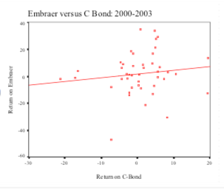
Estimating Lambda: Embraer in 2004
Revenue Approach
  % of Embraer’s revenues from Brazil in 2003 = 3%
  % of typical Brazilian company’s revenues from Brazil = 77%
  Embraer’s Lambda = 3%/77% = .04
Return_{Embraer} = 0.0195 + 0.2681 Return_{C Bond}
Embraer in 2004= 4.29% + 1.07 (4%) + 0.27 (3.66%) = 10.70%

