Slide 1
Session 4: Equity Risk Premiums
DCF Valuation

Slide 2
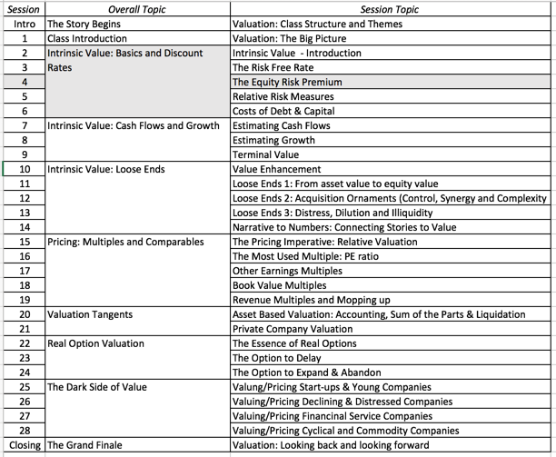
The Price of Equity Risk

Slide 3
Equity Risk Premiums: Intuition
The equity risk premium is the premium that investors charge for investing in the average equity.
It is a function of
  How risk averse investors are collectively
  How much risk they see in the average equity
The level of the equity risk premium should vary over time as a function of:
  Changing macro economic risk (inflation & GDP growth)
  The fear of catastrophic risk
  The transparency in financial statements and governance

Slide 4
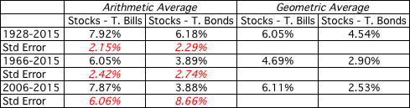
Equity Risk Premiums
The ubiquitous historical risk premium
Notes:
While everyone uses historical risk premiums, the actual premium in use can vary depending upon
How far back you go in time
Whether you T.Bills or T.Bonds
Whether you use arithmetic or geometric averages
This table was developed using data that is publicly accessible on the S&P 500, treasury bills and 10-year treasury bonds on the Federal Reserve of St. Louis web site.
Dataset: histretSP.xls
An interesting issue that has been raised by some researchers is that there may be a selection bias here. The U.S. stock market was undoubtedly the most successful equity market of the 20th century. Not surprisingly, you find that it earned a healthy premium over riskless rates. A more realistic estimate of the premium would require looking at the ten largest equity markets in the early part of the century and estimating the average premium you would have earned over all ten markets. A study at the London Business School that did this found an average equity risk premium of only 4% across these markets.

Slide 5
The perils of trusting the past…….
The estimates are noisy. Even with 80 years of data, the standard error in US stocks is 2.26%.
Standard Error in Premium = 20%/√80 = 2.26%
Using historical data from the U.S. equity markets over the twentieth century creates a sampling bias.
Notes:
The noise in stock prices is such that you need 100-150 years of data to arrive at reasonably small standard errors. It is pointless estimating risk premiums with 10-20 years of data.
The survivorship bias will push historical risk premiums up, if you use the US as the base market.

Slide 6
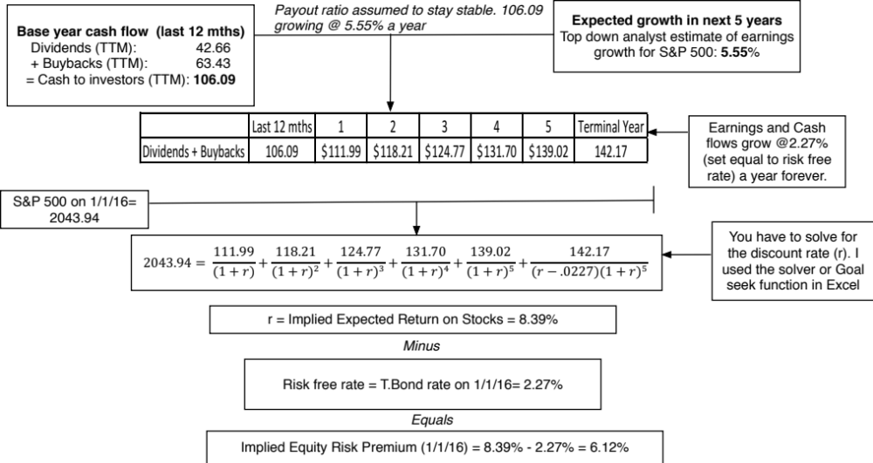
A Forward Looking, Dynamic ERP
Notes:
The key lesson I would take away is that equity risk premiums are unstable and that globalization has made them more unstable. The other is that there seems to be mean reversion in the process – implied premiums, when abnormally high or low, move back towards a longer term average.

Slide 7
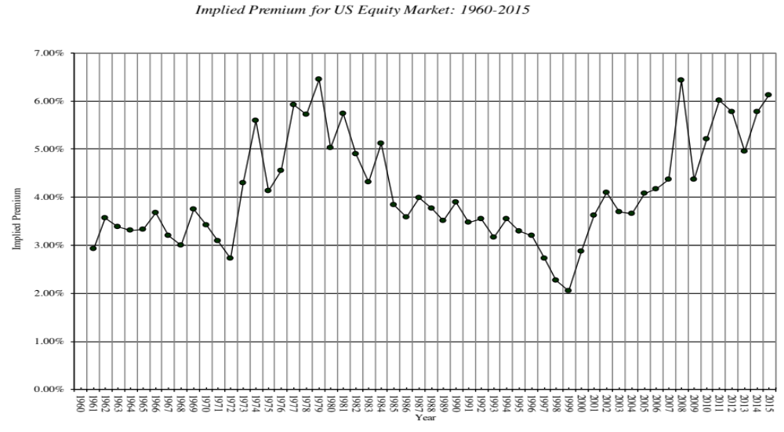
Implied Premiums in the US: 1960-2015
Notes:
As the index changes (and it is the input most likely to change by large amounts in short periods), the implied premium will change. Note that as premiums rise, stock prices drop. Notice two historical phenomena: (1) Equity risk premiums spiked in the 1970s as inflation increased in the US (2) Equity risk premiums bottomed out at 2% at the end of 1999 at the peak of the dot-com boom.
Would you settle for a 2% premium? If your answer is no, you believe that stocks are overvalued.

Slide 8
Estimating a risk premium for an emerging market
Approach 1: Default Spread as Country Risk Premium
Default spread for country: The country equity risk premium is set equal to the default spread for the country. Assume, for Brazil, that it is 2.44%.
Add the default spread to a “mature” market premium. If the US equity risk premium is the mature market premium, Brazil’s ERP is 8.44%.
  Country Risk Premium for Brazil = 2.44%
  Total ERP for Brazil = 6.00% + 2.44% = 8.44%

Slide 9
Approach 2: A Relative Equity Volatility Approach
The total equity risk premium for the emerging market is scaled up for the equity risk in its market.
  Total equity risk premium = Risk Premium_{US}* _{Country Equity} / _{US Equity}
Thus, if the US ERP is 6%, and the standard deviations in the Bovespa and S&P 500 are 30% and 18% respectively:
  Total Equity Risk Premium for Brazil = 6.00% (30%/18%) = 10.0%
  Country equity risk premium for Brazil = 10.00% - 6.00% = 4.00%

Slide 10
Approach 3: A melded approach to estimating the additional country risk premium
Country ratings measure default risk. Equity is riskier than the government bond.
Scale up default spread by the relative volatility of stock and bond prices in that market. Using this approach for Brazil in January 2016, you would get:
    Standard Deviation in Bovespa (Equity) = 30%
    Standard Deviation in Brazil government bond = 20%
    Default spread for Brazil= 2.44%
  Brazil Country Risk Premium = 2.44% (30%/20%) = 3.66%
  Brazil Total ERP = Mature Market Premium + CRP = 6.00% + 3.66% = 9.66%

Slide 11
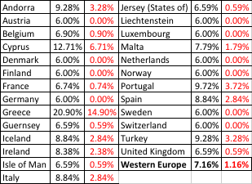
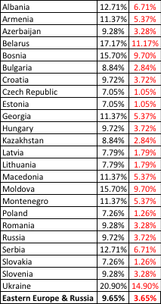
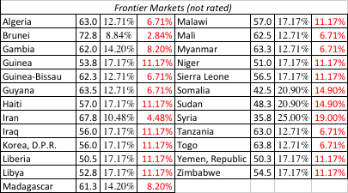

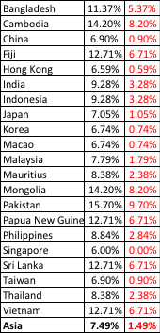

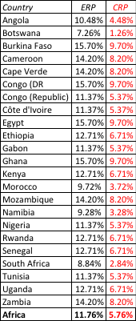
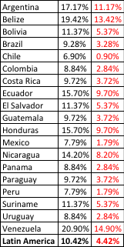
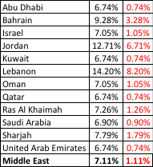

ERP : Jan 2016
Black #: Total ERP
Red #: Country risk premium
AVG: GDP weighted average
Notes:
Updated country risk premiums.

Slide 12
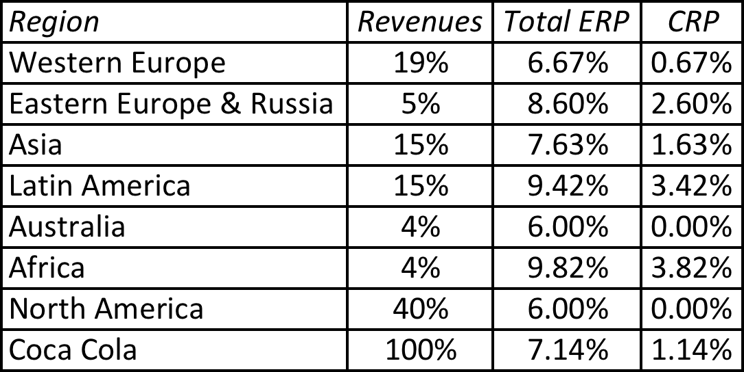
Extending to a multinational: Regional breakdown
Coca Cola’s revenue breakdown and ERP in 2012
Notes:
With a multinational, it is often too messy to do individual countries, either because of the logistics of computing dozens of CRP or because the information is not provided. You can use the regional breakdown to get an approximate ERP. I applied the GDP weighted average from the map to arrive at the ERPs and CRPs for each region.

Slide 13
A Richer Approach to Country Risk Exposure: Estimate a lambda for country risk
Drivers of country risk exposure
  Source of revenues
  Manufacturing facilities
  Use of risk management products
Ways of measuring exposure
  Revenues
  Operating Income
  Stock Prices
Notes:
This is not meant to be an all inclusive list. While there are undoubtedly other factors to consider, you also have to be able to obtain this information not only on your firm but on other firms in the market. In fact, of the three items listed above, revenue sources may be the only publicly available information on companies.

Slide 14
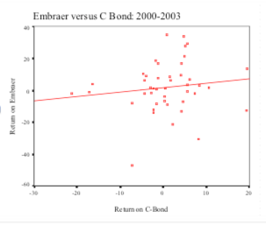
Estimating Lambda: Embraer in 2004
Revenues from Brazil
  Embraer = 3%
  Brazil company = 77%
  Lambda = 3%/77% = .04
Return_{Embraer} = 0.0195 + 0.2681 Return_{C Bond}
Embraer in 2004= 4.29% + 1.07 (4%) + 0.27 (3.66%) = 10.70%

