Slide 1
Session 6: Estimating cost of debt, debt ratios and cost of capital

Slide 2
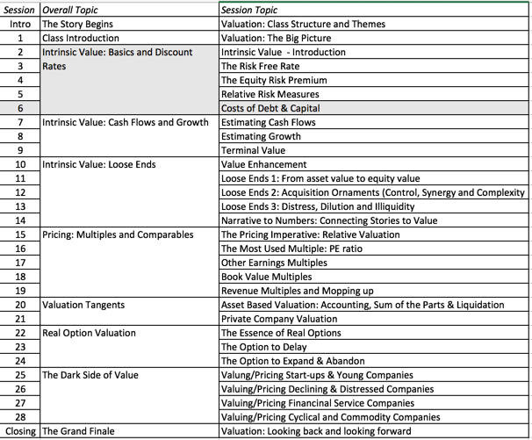
Bringing debt into the capital equation

Slide 3
What is debt?
For an item to be classified as debt, it has to meet three criteria:
  It has to give rise to a contractual commitment, that has to be met in good times or bad.
  That commitment usually is tax deductible
  Failure to make that commitment can cost you control over the business.
Using these criteria, all interest-bearing commitments, short term as well as long term, are clearly debt. So, are all lease commitments.
The items below can be debt, if they meet other conditions
  Accounts payable & supplier credit, but only if you are willing to make the implicit interest expenses (the discounts lost by using the credit) explicit.
  Under funded pension and health care obligations, but only if there is a legal requirement that you cover the underfunding with fixed payments in future years.

Slide 4
Estimating the Cost of Debt
The cost of debt is the rate at which you can borrow at currently, It will reflect not only your default risk but also the level of interest rates in the market.
The two most widely used approaches to estimating cost of debt are:
  Looking up the yield to maturity on a bond issued by the firm. The limitation of this approach is that few firms have long term straight bonds that are liquid and widely traded.
  Looking up the bond rating for the firm and estimating a default spread based upon the rating. While this approach is more robust, different bonds from the same firm can have different ratings. You have to use a median rating for the firm
When in trouble, either because you have no ratings or multiple ratings for a firm, estimate a synthetic rating for your firm and the cost of debt based upon that rating.
Notes:
The cost of debt is not the rate at which you borrowed money historically. That is why you cannot use the book cost of debt in the cost of capital calculation.
While many companies have bonds outstanding, corporate bonds often have special features attached to them and are not liquid, making it difficult to use the yield to maturity as the cost of debt.
While ratings are often useful tools for coming up with the cost of debt, there can be problems:
A firm can have multiple ratings. You need a rating across all of a firm’s debt, not just its safest…
A firm’s bonds can be structured in such a way that they can be safer than the rest of the firm’s debt - they can be more senior or secured than the other debt of the firm.

Slide 5
Estimating Synthetic Ratings
The rating for a firm can be estimated using the financial characteristics of the firm. In its simplest form, the rating can be estimated from the interest coverage ratio
  Interest Coverage Ratio = EBIT / Interest Expenses
For Embraer’s interest coverage ratio, we used the interest expenses from 2003 and the average EBIT from 2001 to 2003. (The aircraft business was badly affected by 9/11 and its aftermath. In 2002 and 2003, Embraer reported significant drops in operating income)
  Interest Coverage Ratio = 462.1 /129.70 = 3.56
Notes:
This is a simplistic approach but it uses the ratio that explains the largest proportion of the differences between ratings at non-financial service U.S. companies - I tried the 8 ratios that S&P said it depends upon the most to rate companies (which are available on its web site) and correlated them with bond ratings in 1999.
You could expand this approach to incorporate other ratios and create a score - similar to the Altman Z score - but you have to decide on whether the trade off is worth it - more complexity for less transparency.

Slide 6
Interest Coverage Ratios, Ratings and Default Spreads: 2003 & 2004
  If Interest Coverage Ratio is Estimated Bond Rating Default Spread(2003) Default Spread(2004)
  > 8.50 (>12.50) AAA 0.75% 0.35%
  6.50 - 8.50 (9.5-12.5) AA 1.00% 0.50%
  5.50 - 6.50 (7.5-9.5) A+ 1.50% 0.70%
  4.25 - 5.50 (6-7.5) A 1.80% 0.85%
  3.00 - 4.25 (4.5-6) A– 2.00% 1.00%
  2.50 - 3.00 (4-4.5) BBB 2.25% 1.50%
  2.25- 2.50 (3.5-4) BB+ 2.75% 2.00%
  2.00 - 2.25 ((3-3.5) BB 3.50% 2.50%
  1.75 - 2.00 (2.5-3) B+ 4.75% 3.25%
  1.50 - 1.75 (2-2.5) B 6.50% 4.00%
  1.25 - 1.50 (1.5-2) B – 8.00% 6.00%
  0.80 - 1.25 (1.25-1.5) CCC 10.00% 8.00%
  0.65 - 0.80 (0.8-1.25) CC 11.50% 10.00%
  0.20 - 0.65 (0.5-0.8) C 12.70% 12.00%
  < 0.20 (<0.5) D 15.00% 20.00%.
Notes:
The numbers in the first column are the ones I would use for larger market cap companies (> $ 5 billion), whereas the numbers in the brackets are the ones for smaller or riskier firms. The default spreads are as off 2003-04 and the most recent ones can be obtained from http://www.bondsonline.com. (This is the table from 2003. The one on my website now reflects current numbers….)

Slide 7
Cost of Debt computations
The cost of debt for a company is then the sum of the riskfree rate and the default spread:
  Pre-tax cost of debt = Risk free rate + Default spread
Companies in countries with low bond ratings and high default risk might bear the burden of country default risk, especially if they are smaller or have all of their revenues within the country.
    Pre-tax cost of debt = Risk free rate + Company Default Spread + Country Default Spread
  Larger companies that derive a significant portion of their revenues in global markets may be less exposed to country default risk. In other words, they may be able to borrow at a rate lower than the government.
The synthetic rating for Embraer is A-. Using the 2004 default spread of 1.00%, we estimate a cost of debt of 9.29% (using a risk free rate of 4.29% and adding in two thirds of the country default spread of 6.01%):
  Cost of debt
  = Riskfree rate + 2/3 (Brazil country default spread) + Company default spread =4.29% + 4.00%+ 1.00% = 9.29%
Notes:
When estimating the cost of debt for an emerging market company, you have to decide whether to add the country default spread to the company default spread when estimating the cost of debt.
For smaller, less well known firms, it is safer to assume that firms cannot borrow at a rate lower than the countries in which they are incorporated. For larger firms, you could make the argument that firms can borrow at lower rates. In practical terms, you could ignore the country default spread or add only a fraction of that spread.

Slide 8
Weights for the Cost of Capital Computation
In computing the cost of capital for a publicly traded firm, the general rule for computing weights for debt and equity is that you use market value weights.
That is not because the market is right but because that is what it would cost you to buy the company in the market today, even if you think that the price is wrong.
Notes:
The rationale for using market values is simple. You are considering how much someone who would buy the company today should be willing to pay for the company. Since he or she can buy equity and debt at today’s market value, you use those as weights. However, you could very well push the market values towards your estimated values in the process of buying the company. If this is a concern, you can iterate the weights in the cost of capital calculation to make the values used in the weights converge on the values estimated in the analysis.

Slide 9
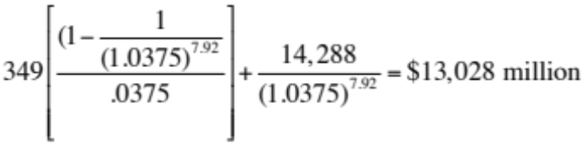
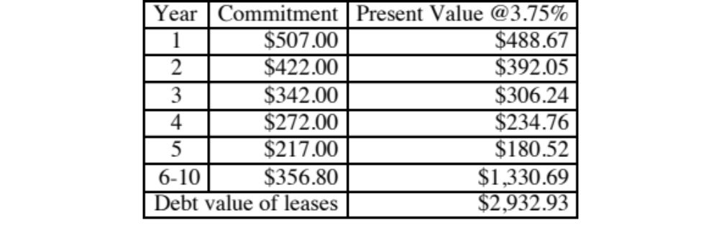
Getting a market value for debt: Disney
Convert book value of interest-bearing debt to market value, using a simple bond pricing equation. In 2013, Disney’s total debt due, in book value terms, on the balance sheet is $14,288 million, the total interest expense for the year was $349 million and the weighted maturity of its debt was 3.75%. Using 3.75% as the pre-tax cost of debt:
  Estimated MV of Disney Debt =
To convert leases into debt, you take the PV of lease commitments in the future @3.75%
Disney reported $1,784 million in commitments after year 5. Given that their average commitment over the first 5 years, we assumed 5 years @ $356.8 million each.

Slide 10
Estimating Cost of Capital: Embraer in 2004
Equity
  Cost of Equity = 4.29% + 1.07 (4%) + 0.27 (7.89%) = 10.70%
  Market Value of Equity =11,042 million BR ($ 3,781 million)
Debt
  Cost of debt = 4.29% + 4.00% +1.00%= 9.29%
  Market Value of Debt = 2,083 million BR ($713 million)
Cost of Capital
Cost of Capital = 10.70 % (.84) + 9.29% (1- .34) (0.16)) = 9.97%
Notes:
Most of Embraer’s debt is not traded. Many analysts assume that book value of debt is equal to market value. You can estimate the market value of debt fairly easily using the interest rate on the debt and the book value of debt.

Slide 11
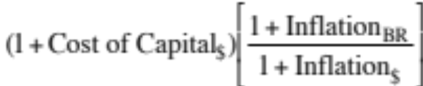
If you had to do it….Converting a Dollar Cost of Capital to a Nominal Real Cost of Capital
Approach 1: Use a BR riskfree rate in all of the calculations above. For instance, if the BR riskfree rate was 12%, the cost of capital would be computed as follows:
  Cost of Equity = 12% + 1.07(4%) + 27 (7.%) = 18.41%
  Cost of Debt = 12% + 1% = 13%
  (This assumes the riskfree rate has no country risk premium embedded in it.)
Approach 2: Use the differential inflation rate to estimate the cost of capital. For instance, if the inflation rate in BR is 8% and the inflation rate in the U.S. is 2%
Cost of capital=
= 1.0997 (1.08/1.02)-1 = 0.1644 or 16.44%
Notes:
The two approaches will give you different answers because they make different assumptions about the equity risk premium. In the first approach, the risk premium remains a constant as you switch from one currency to another. In the second, you scale up the risk premium for higher interest rate currencies. The second approach will give you more consistent valuations as you switch from currency to currency.

Slide 12
Dealing with Hybrids and Preferred Stock
When dealing with hybrids (convertible bonds, for instance), break the security down into debt and equity and allocate the amounts accordingly. Thus, if a firm has $ 125 million in convertible debt outstanding, break the $125 million into straight debt and conversion option components. The conversion option is equity.
When dealing with preferred stock, it is better to keep it as a separate component. The cost of preferred stock is the preferred dividend yield. (As a rule of thumb, if the preferred stock is less than 5% of the outstanding market value of the firm, lumping it in with debt will make no significant impact on your valuation).
Notes:
Keep your cost of capital simple. If possible, consolidate all of your capital into either debt or equity. With convertible bonds, this is fairly simple to do. With preferred, you do have a problem since its non-tax deductible status makes it unlike debt and it certainly is not equity. Here, you would make the exception and allow for a third source of capital. (In practice, I would do this only if preferred stock were more than 5% of capital in market value terms. Otherwise, I would ignore it for purposes of analysis).
The cost of preferred stock is the preferred dividend yield.

Slide 13
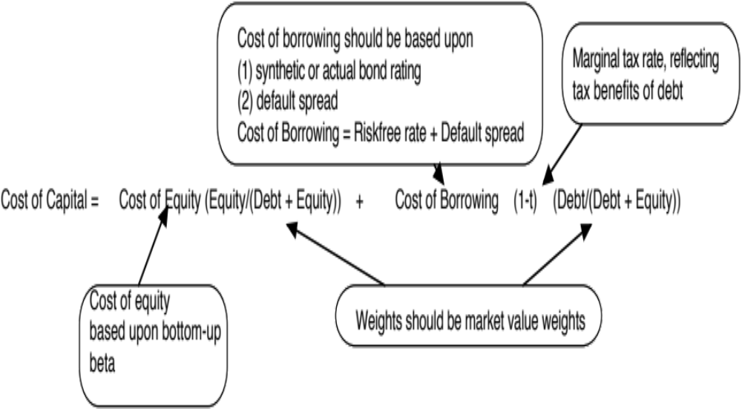
Recapping the Cost of Capital
Notes:
Big picture of the cost of capital.

