Slide 1
Session 6: Estimating cost of debt, debt ratios and cost of capital

Slide 2
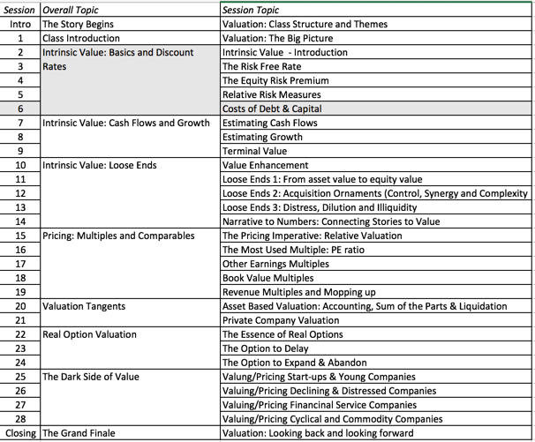
Bringing debt into the capital equation

Slide 3
What is debt?
Criteria for debt
  Contractual commitment
  Usually tax deductible
  Failure to meet leads to loss of control.
Meeting these criteria
  All interest bearing debt
  Lease commitments
Questionable
  Accounts payable & supplier credit
  Under funded pension and health care obligations

Slide 4
Estimating the Cost of Debt
Rate at which you can borrow money, long term & today.
Easy cases
  Liquid, traded straight bonds outstanding: Yield to maturity.
  Bond Rating for company: Default spread for rating
No bonds, no rating: Synthetic rating
Notes:
The cost of debt is not the rate at which you borrowed money historically. That is why you cannot use the book cost of debt in the cost of capital calculation.
While many companies have bonds outstanding, corporate bonds often have special features attached to them and are not liquid, making it difficult to use the yield to maturity as the cost of debt.
While ratings are often useful tools for coming up with the cost of debt, there can be problems:
A firm can have multiple ratings. You need a rating across all of a firm’s debt, not just its safest…
A firm’s bonds can be structured in such a way that they can be safer than the rest of the firm’s debt - they can be more senior or secured than the other debt of the firm.

Slide 5
Estimating Synthetic Ratings
Simplest synthetic rating based on:
  Interest Coverage Ratio = EBIT / Interest Expenses
For Embraer’s interest coverage ratio, we used the interest expenses from 2003 and the average EBIT from 2001 to 2003.
  Interest Coverage Ratio = 462.1 /129.70 = 3.56
Notes:
This is a simplistic approach but it uses the ratio that explains the largest proportion of the differences between ratings at non-financial service U.S. companies - I tried the 8 ratios that S&P said it depends upon the most to rate companies (which are available on its web site) and correlated them with bond ratings in 1999.
You could expand this approach to incorporate other ratios and create a score - similar to the Altman Z score - but you have to decide on whether the trade off is worth it - more complexity for less transparency.

Slide 6
Interest Coverage Ratios, Ratings and Default Spreads: 2003 & 2004
  If Interest Coverage Ratio is Estimated Bond Rating Default Spread(2003) Default Spread(2004)
  > 8.50 (>12.50) AAA 0.75% 0.35%
  6.50 - 8.50 (9.5-12.5) AA 1.00% 0.50%
  5.50 - 6.50 (7.5-9.5) A+ 1.50% 0.70%
  4.25 - 5.50 (6-7.5) A 1.80% 0.85%
  3.00 - 4.25 (4.5-6) A– 2.00% 1.00%
  2.50 - 3.00 (4-4.5) BBB 2.25% 1.50%
  2.25- 2.50 (3.5-4) BB+ 2.75% 2.00%
  2.00 - 2.25 ((3-3.5) BB 3.50% 2.50%
  1.75 - 2.00 (2.5-3) B+ 4.75% 3.25%
  1.50 - 1.75 (2-2.5) B 6.50% 4.00%
  1.25 - 1.50 (1.5-2) B – 8.00% 6.00%
  0.80 - 1.25 (1.25-1.5) CCC 10.00% 8.00%
  0.65 - 0.80 (0.8-1.25) CC 11.50% 10.00%
  0.20 - 0.65 (0.5-0.8) C 12.70% 12.00%
  < 0.20 (<0.5) D 15.00% 20.00%.
Notes:
The numbers in the first column are the ones I would use for larger market cap companies (> $ 5 billion), whereas the numbers in the brackets are the ones for smaller or riskier firms. The default spreads are as off 2003-04 and the most recent ones can be obtained from http://www.bondsonline.com. (This is the table from 2003. The one on my website now reflects current numbers….)

Slide 7
Cost of Debt computations
In general:
  Pre-tax cost of debt = Risk free rate + Default spread
With companies in risky (default) countries:
    Pre-tax cost of debt = Risk free rate + Company Default Spread + Country Default Spread
Embraer’s cost of debt in 2004
  = Riskfree rate + 2/3 (Brazil default spread) + Embraer default spread
  =4.29% + 2/3 (6%) + 1.00% = 9.29%
Notes:
When estimating the cost of debt for an emerging market company, you have to decide whether to add the country default spread to the company default spread when estimating the cost of debt.
For smaller, less well known firms, it is safer to assume that firms cannot borrow at a rate lower than the countries in which they are incorporated. For larger firms, you could make the argument that firms can borrow at lower rates. In practical terms, you could ignore the country default spread or add only a fraction of that spread.

Slide 8
Weights for the Cost of Capital Computation
Use market value weights.
Not Reasons
  Not because market is right
  Not because market values are easier to get
Real reason
  Cost of acquiring company today
Notes:
The rationale for using market values is simple. You are considering how much someone who would buy the company today should be willing to pay for the company. Since he or she can buy equity and debt at today’s market value, you use those as weights. However, you could very well push the market values towards your estimated values in the process of buying the company. If this is a concern, you can iterate the weights in the cost of capital calculation to make the values used in the weights converge on the values estimated in the analysis.

Slide 9
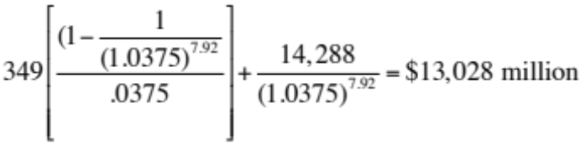
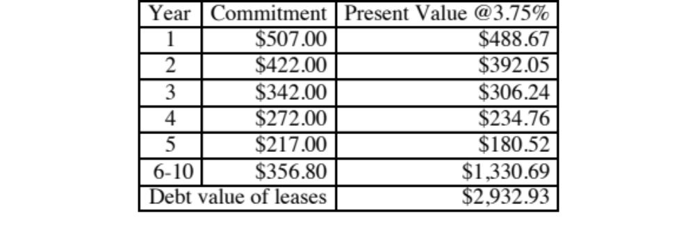
Getting a market value for debt: Disney
In 2013, Disney’s pre-tax cost of debt was 3.75%. To get the market value of interest bearing debt, act as if you are pricing a bond:
  Estimated MV of Disney Debt =
To convert leases into debt, you take the PV of lease commitments in the future @3.75%
Disney reported $1,784 million in commitments after year 5. Given that their average commitment over the first 5 years, we assumed 5 years @ $356.8 million each.

Slide 10
Estimating Cost of Capital: Embraer in 2004
Equity
  Cost of Equity = 4.29% + 1.07 (4%) + 0.27 (7.89%) = 10.70%
  Market Value of Equity =11,042 million BR ($ 3,781 million)
Debt
  Cost of debt = 4.29% + 4.00% +1.00%= 9.29%
  Market Value of Debt = 2,083 million BR ($713 million)
Cost of Capital
Cost of Capital = 10.70 % (.84) + 9.29% (1- .34) (0.16)) = 9.97%
Computing Market Value of debt
  Book Value = $1,953 m, Interest Expense = $222 m, Maturity = 4 years
  Market Value = 222 million (PV of annuity, 4 years, 9.29%) + $1,953 million/1.0929⁴ = 2,083 million BR
Notes:
Most of Embraer’s debt is not traded. Many analysts assume that book value of debt is equal to market value. You can estimate the market value of debt fairly easily using the interest rate on the debt and the book value of debt.

Slide 11
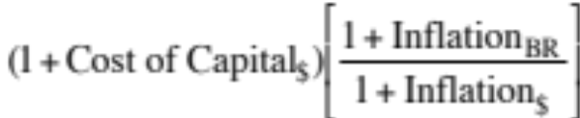
If you had to do it….Converting a Dollar Cost of Capital to a Nominal Real Cost of Capital
Approach 1: Use $R risk free rate and given inputs.
  Cost of Equity = 12% + 1.07(4%) + 27 (7.%) = 18.41%
  Cost of Debt = 12% + 1% = 13%
  Cost of Capital = 18.41% (.84) + 13%(1-.34)(.16) =16.84%
Approach 2: Use the differential inflation rate to estimate the cost of capital. Ifthe inflation rate in BR is 8% and the inflation rate in the U.S. is 2%:
Cost of capital=
= 1.0997 (1.08/1.02)-1 = 0.1644 or 16.44%
Notes:
The two approaches will give you different answers because they make different assumptions about the equity risk premium. In the first approach, the risk premium remains a constant as you switch from one currency to another. In the second, you scale up the risk premium for higher interest rate currencies. The second approach will give you more consistent valuations as you switch from currency to currency.

Slide 12
Dealing with Hybrids and Preferred Stock
With convertibles: Break down hybrids into debt and equity components.
With preferred stock: Keep as separate capital source, with yield as cost.
Notes:
Keep your cost of capital simple. If possible, consolidate all of your capital into either debt or equity. With convertible bonds, this is fairly simple to do. With preferred, you do have a problem since its non-tax deductible status makes it unlike debt and it certainly is not equity. Here, you would make the exception and allow for a third source of capital. (In practice, I would do this only if preferred stock were more than 5% of capital in market value terms. Otherwise, I would ignore it for purposes of analysis).
The cost of preferred stock is the preferred dividend yield.

Slide 13
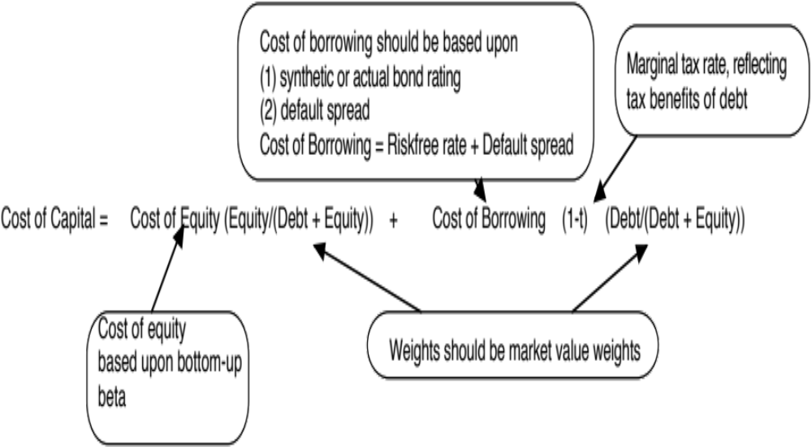
Recapping the Cost of Capital
Notes:
Big picture of the cost of capital.

