Slide 1
Session 8: Growth

Slide 2
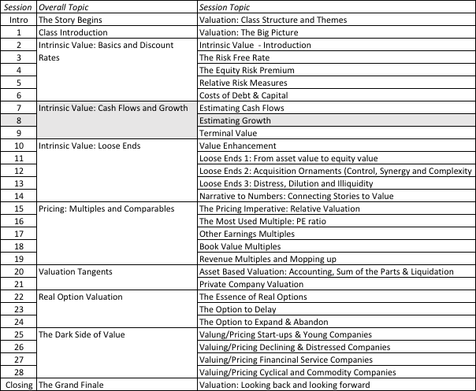
Growth and Value

Slide 3
Growth in Earnings
Look at the past
Look at what others are estimating
  Analyst forecasts
  Managerial forecasts
Look at fundamentals
  How much is the firm reinvesting?
  How well is it reinvesting?
Notes:
Three basic approaches for estimating growth. We tend to use all three but the degree to which we weight each in will depend upon the company that we are looking at.

Slide 4
I. Historical Growth in EPS
Historical growth rates can be estimated in a number of different ways
  Arithmetic versus Geometric Averages
  Simple versus Regression Models
Historical growth rates can be sensitive to
  the period used in the estimation
In using historical growth rates, the following factors have to be considered
  how to deal with negative earnings
  the effect of changing size
Notes:
Estimating historical growth rates may seem to be trivial, but there are a number of estimation issues that can lead different analysts to estimate different historical growth rates for the same firm.

Slide 5
II. Analyst Growth Rates
Proposition 1: There if far less private information and far more public information in most analyst forecasts than is generally claimed.
Proposition 2: The biggest source of private information for analysts remains the company.
Proposition 3: There is value to knowing what analysts are forecasting as earnings growth for a firm. There is, however, danger when they agree too much and when they agree to little.
Notes:
Use analyst forecasts with caution. They know less than you think they do, and much of what they know has little impact on long-term value.
Interesting issue:
How will the SEC’s Fair Disclosure rule (FD) that restricts companies from selectively revealing information to analysts have on analysts?

Slide 6
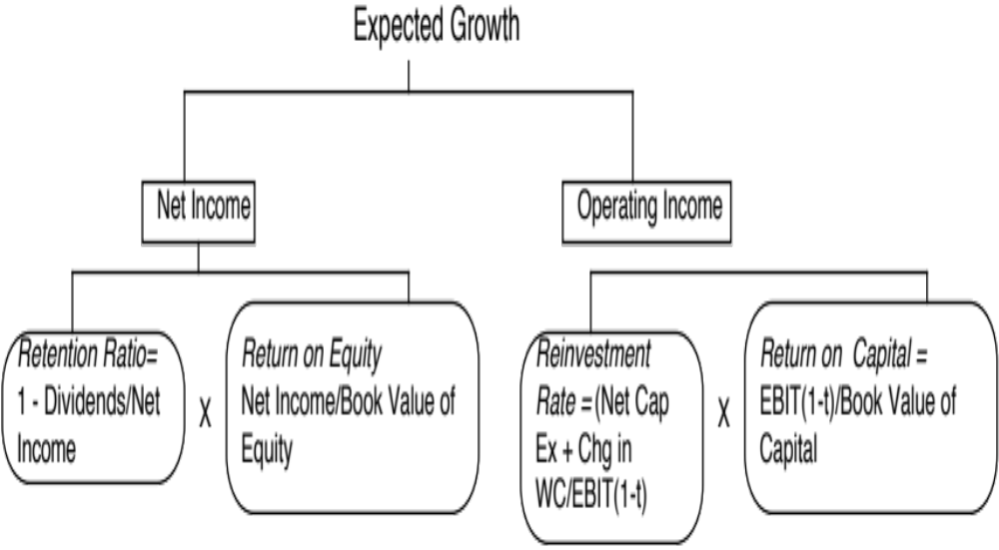
III. Fundamental or Intrinsic Growth
Notes:
Note that the approaches are similar, with the only difference being in how we define how much the firm reinvests and how well it reinvests.

Slide 7
Sustainable Growth in EPS: Wells Fargo in 2008
Return on equity (based on 2008 earnings)= 17.56%
Retention Ratio (based on 2008 earnings and dividends) = 45.37%
Expected growth rate in earnings per share for Wells Fargo, if it can maintain these numbers.
Expected Growth Rate = 0.4537 (17.56%) = 7.97%
Notes:
Implicitly, we are assuming that the current return on equity applies not only to existing investments but to marginal investments as well… In this case, the expected growth in earnings per share will be 7.97%.

Slide 8
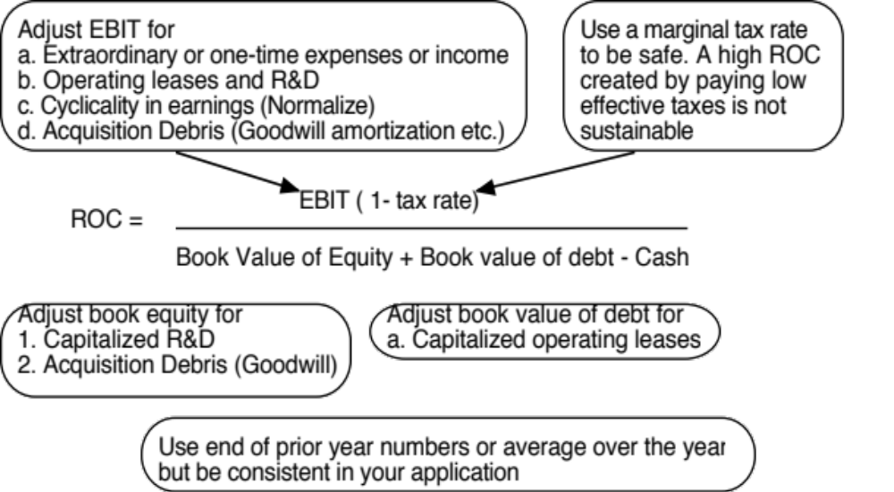
Measuring Return on Capital

Slide 9
Estimating Growth in Operating Income, if fundamentals stay unchanged
Cisco’s Fundamentals in 1999
  Reinvestment Rate = 106.81%
  Return on Capital =34.07%
  Expected Growth in EBIT =(1.0681)(.3407) = 36.39%
Motorola’s Fundamentals in 1999
  Reinvestment Rate = 52.99%
  Return on Capital = 12.18%
  Expected Growth in EBIT = (.5299)(.1218) = 6.45%
Notes:
Growth is earned.
Cisco had a high growth because it reinvested a lot and reinvested well. (To show how transient value creating growth is at companies, look at Cisco from 2001-2010, when its reinvestment rate stayed high but its return on capital dropped to single digits)
Motorola had a low growth rate because it reinvested less and earned a much lower return on capital.

Slide 10
IV. Top Down Growth – Revenues and Margins
All of the fundamental growth equations assume that the firm has a return on equity or return on capital it can sustain in the long term.
When operating income is negative or margins are expected to change over time, we use a three step process to estimate growth:
  Estimate growth rates in revenues over time
  Estimate expected operating margins each year
  Estimate the capital that needs to be invested to generate revenue growth and expected margins
Notes:
When a firm has negative operating income and low revenues, the sequence changes. Instead of assuming a reinvestment rate and return on capital first, and obtaining growth from these inputs, you should consider estimating revenue growth first and then asking what you would need to reinvest to generate this revenue growth. In conjunction, you will need to assume that your margins will improve over time towards stable (and positive) levels.

Slide 11
Tesla in July 2015: Growth and Profitability
Notes:
My story about Tesla is that it will be a successful high-end automaker, with its edge coming from its brand name and superior battery technology. My revenue growth and margins are built around that story and what I see as typical numbers (revenues and margins) for established high-end auto makers.

Slide 12
Tesla: Reinvestment and Profitability

