Slide 1
Session 9: Terminal Value

Slide 2
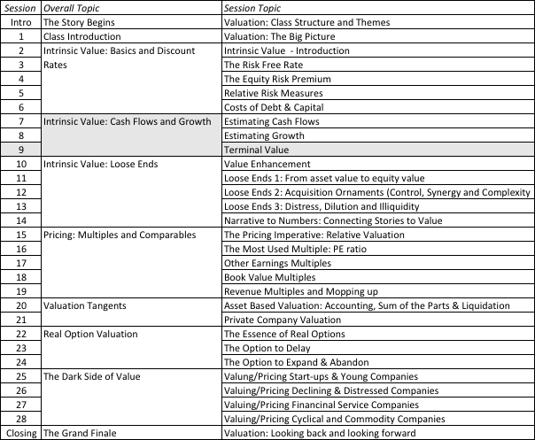
The Tail that wags the dog.

Slide 3
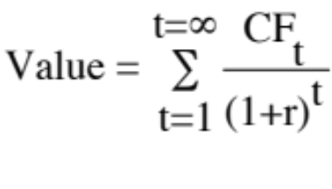
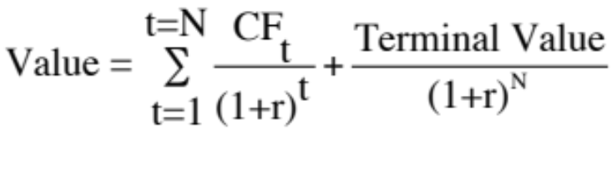
Getting Closure in Valuation
A publicly traded firm potentially has an infinite life. The value is therefore the present value of cash flows forever.
Since we cannot estimate cash flows forever, we estimate cash flows for a “growth period” and then estimate a terminal value, to capture the value at the end of the period:
Notes:
To put closure on valuation, we have to stop forecasting cashflows at some point in time and estimate a terminal value.
It is generally the biggest component of value and estimating it consistently is a key to good valuation.

Slide 4
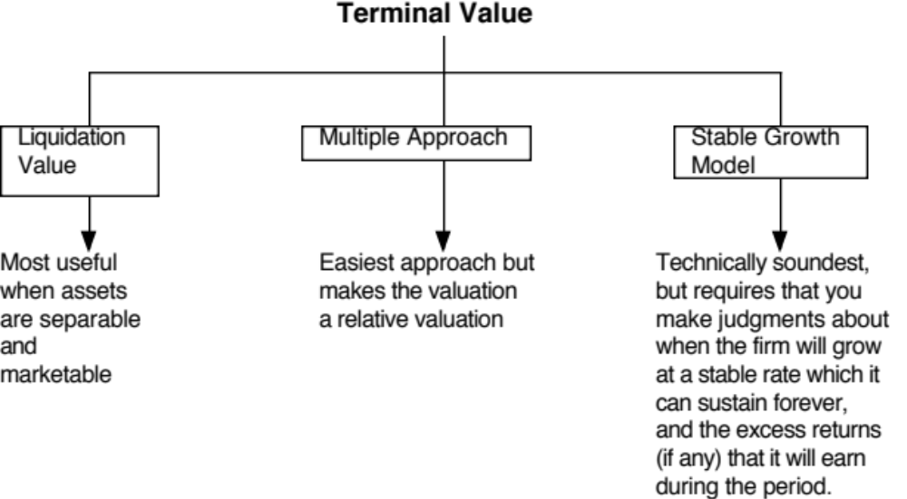
Ways of Estimating Terminal Value
Notes:
Firms have infinite lives. Since we cannot estimate cash flows forever, we assume a constant growth rate forever as a way of closing off the valuation.
A very commonly used variant is to use a multiple of the terminal year’s earnings. This brings an element of relative valuation into the analysis. In a pure DCF model, the terminal value has to be estimated with a stable growth rate.
The real choice is between stable growth models and liquidation value. One values the firm as a going concern and the other is based upon shutting the firm down and getting what you can for its assets. When valuing publicly traded firms, it is generally better practice to value them as going concerns (and use a stable growth rate). With private businesses or finite life public companies (a mining company with limited reserves…), liquidation value is a viable option.

Slide 5
Stable Growth and Terminal Value
When a firm’s cash flows grow at a “constant” rate forever, the present value of those cash flows can be written as:
  Value = Expected Cash Flow Next Period / (r - g)
  where,
  r = Discount rate (Cost of Equity or Cost of Capital)
  g = Expected growth rate
This “constant” growth rate is called a stable growth rate and cannot be higher than the growth rate of the economy in which the firm operates.
While companies can maintain high growth rates for extended periods, they will all approach “stable growth” at some point in time.
Notes:
In a stable growth model, the cashflows grow at a constant rate forever. Consequently, this growth rate cannot exceed the growth rate of the economy in which the firm operates - in nominal (real) terms, if you are doing a nominal (real) valuation. In fact, as a simple rule of thumb, the stable growth rate should not be higher than the riskfree rate, since the riskless rate can be viewed as the sum of expected inflation and real growth.

Slide 6
1. Obey the growth cap
When a firm’s cash flows grow at a “constant” rate forever, the present value of those cash flows can be written as:
  Value = Expected Cash Flow Next Period / (r - g)
  where,
  r = Discount rate (Cost of Equity or Cost of Capital)
  g = Expected growth rate
The stable growth rate cannot exceed the growth rate of the economy but it can be set lower.
  If you assume that the economy is composed of high growth and stable growth firms, the growth rate of the latter will probably be lower than the growth rate of the economy.
  The stable growth rate can be negative. The terminal value will be lower and you are assuming that your firm will disappear over time.
  If you use nominal cashflows and discount rates, the growth rate should be nominal in the currency in which the valuation is denominated.
One simple proxy for the nominal growth rate of the economy is the riskfree rate.
Notes:
If the overall economy is composed of high growth and mature companies, and is growing at 5%, the mature companies must be growing at a rate less than 5%. This is a mathematical constraint that cannot be eased. A firm that grows at a rate higher than that of the economy will become the economy.
Should this growth be nominal or real? It depends on how you have estimated all of your inputs prior to getting to the terminal value computation. If everything has been done in real terms (very unusual), then the growth rate has to be a real growth rate. If it is in nominal terms, the growth rate has to be nominal (in the currency chosen for the analysis).
While the stable growth rate cannot exceed the growth rate of the economy, it can be lower. In fact, it should be lower for most mature firms, since an economy is composed of both growth firms and mature firms. If every mature firms grows at the same rate as the economy, then where does the growth rate from growth firms go?
The stable growth rate can be a negative number. This is an intermediate solution between the infinite growth model and liquidation value. Using a negative stable growth rate will make your firm disappear gradually over time.
Riskfree rate = Expected inflation + Expected real interest rate
Nominal growth rate in economy = Expected inflation + Expected real growth
In the long term, expected real interest rate = expected real growth rate

Slide 7
Risk free Rates and Nominal GDP Growth
Risk free Rate = Expected Inflation + Expected Real Interest Rate
The real interest rate is what borrowers agree to return to lenders in real goods/services.
Nominal GDP Growth = Expected Inflation + Expected Real Growth
The real growth rate in the economy measures the expected growth in the production of goods and services.
The argument for Risk free rate = Nominal GDP growth
In the long term, the real growth rate cannot be lower than the real interest rate, since you have the growth in goods/services has to be enough to cover the promised rate.
In the long term, the real growth rate can be higher than the real interest rate, to compensate risk taking. However, as economies mature, the difference should get smaller and since there will be growth companies in the economy, it is prudent to assume that the extra growth comes from these companies.
Period | 10-Year T.Bond Rate | Inflation Rate | Real GDP Growth | Nominal GDP growth rate | Nominal GDP - T.Bond Rate
1954-2015 | 5.93% | 3.61% | 3.06% | 6.67% | 0.74%
1954-1980 | 5.83% | 4.49% | 3.50% | 7.98% | 2.15%
1981-2008 | 6.88% | 3.26% | 3.04% | 6.30% | -0.58%
2009-2015 | 2.57% | 1.66% | 1.47% | 3.14% | 0.57%
Notes:
Much time and effort is spent on estimating a growth rate in perpetuity, but that effort becomes entangled in estimating a long term, nominal growth rate for the entire economy. I use the risk free rate as my cap for long term growth in the economy, and while the theoretical underpinnings are weak, the practical reasoning for keeping the risk free rate as a cap on nominal GDP is strong.

Slide 8
A Practical Reason for using the Risk free Rate Cap – Preserve Consistency
You are implicitly making assumptions about nominal growth in the economy, with your risk free rate. Thus, with a low risk free rate, you are assuming low nominal growth in the economy (with low inflation and low real growth) and with a high risk free rate, a high nominal growth rate in the economy.
If you make an explicit assumption about nominal growth in cash flows that is at odds with your implicit growth assumption in the denominator, you are being inconsistent and bias your valuations:
  If you assume high nominal growth in the economy, with a low risk free rate, you will over value businesses.
  If you assume low nominal growth rate in the economy, with a high risk free rate, you will under value businesses.
Notes:
This can become a problem, when analysts are either faced with transitional moments (where the economy shifts from low inflation to high, as it did in the 1970s, or from high inflation to low, as it did post 2008. This is because nominal growth assumptions are obtained by looking at historical data and risk free rates are forward looking.

Slide 9
2. Don’t wait too long…
Assume that you are valuing a young, high growth firm with great potential, just after its initial public offering. How long would you set your high growth period?
  < 5 years
  5 years
  10 years
  >10 years
While analysts routinely assume very long high growth periods (with substantial excess returns during the periods), the evidence suggests that they are much too optimistic. Most growth firms have difficulty sustaining their growth for long periods, especially while earning excess returns.
Notes:
It is not uncommon to see analysts use growth periods of longer than 10 years for small, promising companies and even for larger, growth companies (Coke, Microsoft, Walmart..)

Slide 10
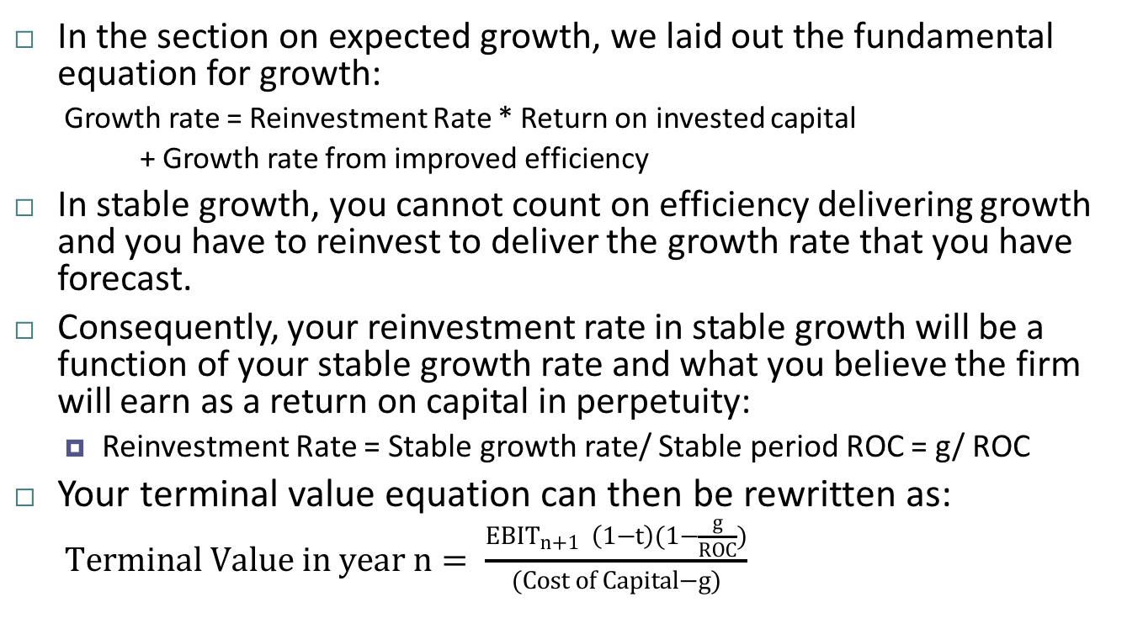
3. Don’t forget that growth has to be earned..
In the section on expected growth, we laid out the fundamental equation for growth:
  Growth rate = Reinvestment Rate * Return on invested capital
  + Growth rate from improved efficiency
In stable growth, you cannot count on efficiency delivering growth and you have to reinvest to deliver the growth rate that you have forecast.
Consequently, your reinvestment rate in stable growth will be a function of your stable growth rate and what you believe the firm will earn as a return on capital in perpetuity:
  Reinvestment Rate = Stable growth rate/ Stable period ROC = g/ ROC
Your terminal value equation can then be rewritten as:
  $Terminal Value in year n= \frac{{EBIT}_{n+1} \left(1−t\right)(1−\frac{g}{ROC})}{(Cost of Capital−g)}$
Notes:
This is the key balancing assumption that keeps terminal values from becoming unbounded. If you can change the growth rate without changing the reinvestment assumptions, you can make any firm worth any amount of money.
If you adopt this rule, the terminal value becomes a function of the return on capital:
Terminal value = EBIT (1-t) (1- g/ROC)/ (Cost of capital –g)
If ROC = Cost of capital,
Terminal value = EBIT (1-t)/ Cost of capital
The growth effect is neutralized entirely by the reinvestment requirement and the terminal value is invariant to the growth rate assumed.

Slide 11
The Big Assumption
 |  | Return on capital in perpetuity
 |  | 6% | 8% | 10% | 12% | 14%
Growth rate forever | 0.0% | $1,000 | $1,000 | $1,000 | $1,000 | $1,000
 | 0.5% | $965 | $987 | $1,000 | $1,009 | $1,015
 | 1.0% | $926 | $972 | $1,000 | $1,019 | $1,032
 | 1.5% | $882 | $956 | $1,000 | $1,029 | $1,050
 | 2.0% | $833 | $938 | $1,000 | $1,042 | $1,071
 | 2.5% | $778 | $917 | $1,000 | $1,056 | $1,095
 | 3.0% | $714 | $893 | $1,000 | $1,071 | $1,122
Terminal value for a firm with expected after-tax operating income of $100 million in year n+1 and a cost of capital of 10%.
Notes:
Note that when the return on capital is equal to the cost of capital, the terminal value is invariant to growth. If it is set above the cost of capital, terminal value increases with growth and if set below, it decreases. The big assumption in your terminal value calculation in the one you make about excess returns in perpetuity, not the growth rate.

Slide 12
4. Be internally consistent
Risk and costs of equity and capital: Stable growth firms tend to
  Have betas closer to one
  Have debt ratios closer to industry averages (or mature company averages)
  Country risk premiums (especially in emerging markets should evolve over time)
The excess returns at stable growth firms should approach (or become) zero. ROC -> Cost of capital and ROE -> Cost of equity
The reinvestment needs and dividend payout ratios should reflect the lower growth and excess returns:
  Stable period payout ratio = 1 - g/ ROE
  Stable period reinvestment rate = g/ ROC
Notes:
If you reduce the growth rate but leave the other characteristics of the firm unchanged, you will create internal inconsistencies in your valuation. This can happen if you forecast out the cash flow in your terminal year as the cash flow in the year prior augmented by the stable growth rate. (You are then locking in the reinvestment rate assumptions in the last year of high growth in perpetuity)

