Slide 1
Valuation: Closing Thoughts
Spring 2024
“It ain’t over till its over”

Slide 2
Back to the very beginning:
Approaches to Valuation
Discounted Cashflow Valuation, where we try (sometimes desperately) to estimate the intrinsic value of an asset by using a mix of theory, guesswork and prayer.
Relative valuation, where we pick a group of assets, attach the name “comparable” to them and tell a story.
Contingent claim valuation, where we take the valuation that we did in the DCF valuation and divvy it up between the potential thieves (equity) and the victims of this crime (lenders)

Slide 3
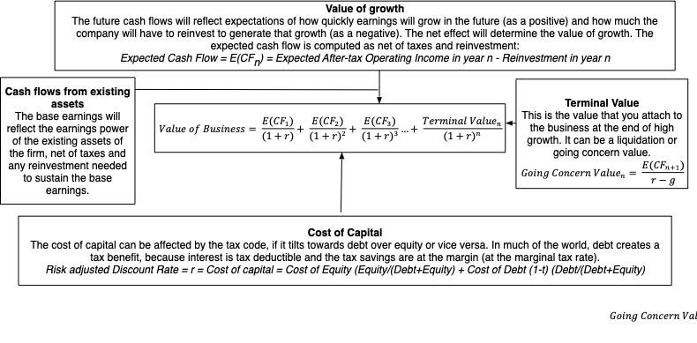
Intrinsic Valuation: The set up

Slide 4
The Value Drivers..

Slide 5
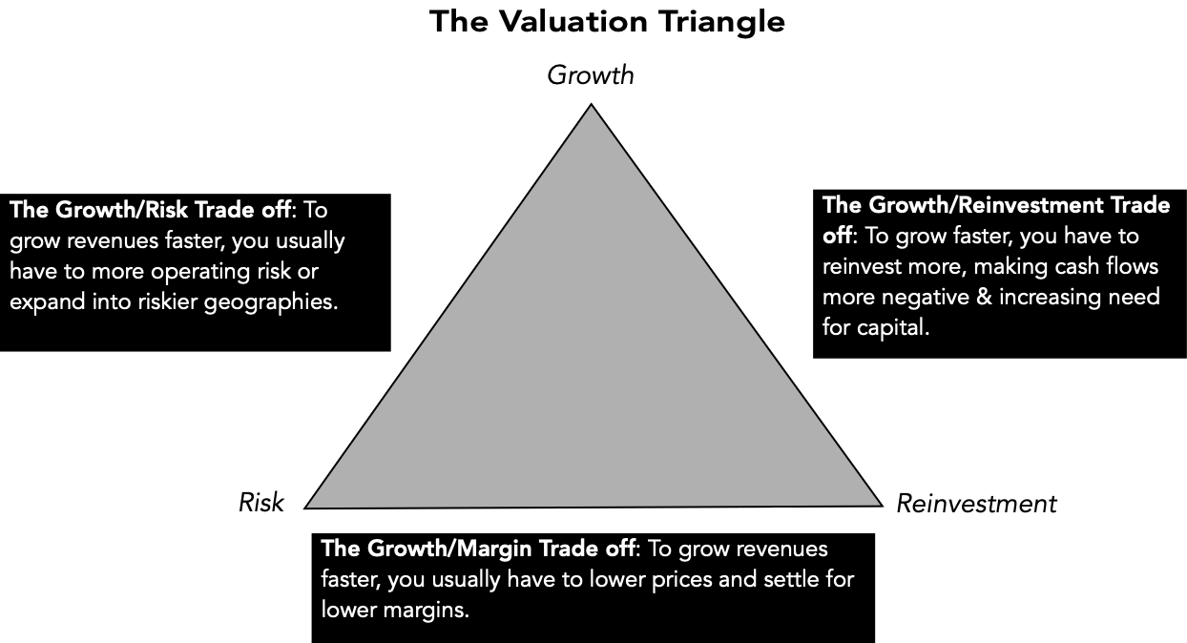
The Valuation Triangle

Slide 6
Your intrinsic valuation findings

Slide 7
The Most Valued Company (Companies)..
Company | Number of analyses
Nvidia | 6
Lululemon | 4
Novo Nordisk, Nike | 3
Five other firms | 2

Slide 8

And here is why its not a problem..

Slide 9
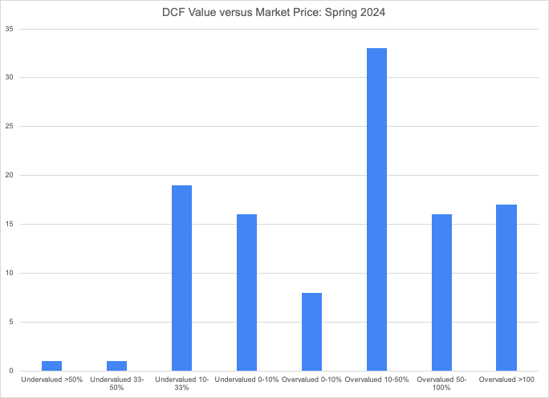

What you found…

Slide 10
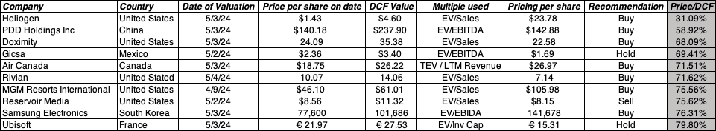
The most undervalued stocks…

Slide 11
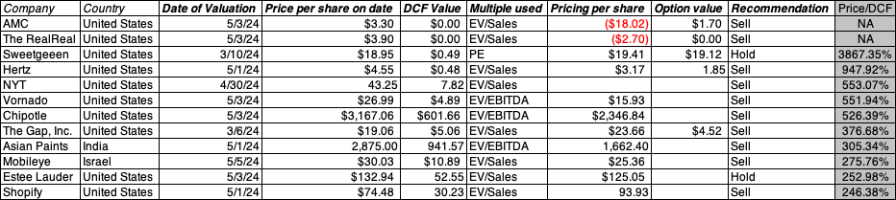
The Most Overvalued stocks are...

Slide 12
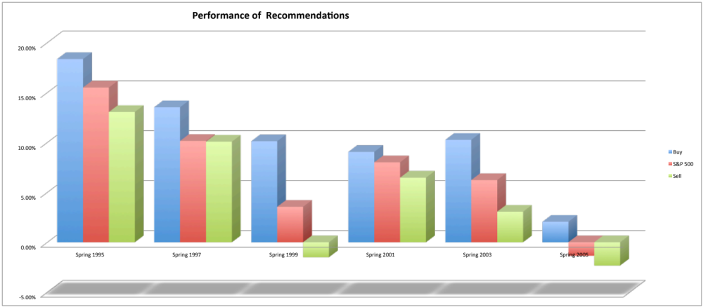
The ultimate test… Did undervalued stocks make money?

Slide 13
More on the winners...
On average, right: About 60% of all buy recommendations make money; about 45% of sell recommendations beat the market. The average return on buy recommendations was about 4% higher, on an annualized basis, than the average return on sell recommendations.
More so on some: The excess returns on buy recommendations on small cap and emerging market companies is higher than the excess returns on large market cap companies, with higher mistakes in both directions on the former.
Skewed payoffs: There are two or three big winners in each period, but the payoff was not always immediate. Buying Apple in 1999 would have led to negative returns for a year or more, before the turnaround occurred.
Double whammy: Stocks that are under valued on both a DCF and relative valuation basis do better than stocks that are under valued on only one approach.

Slide 14
The Value of Control

Slide 15
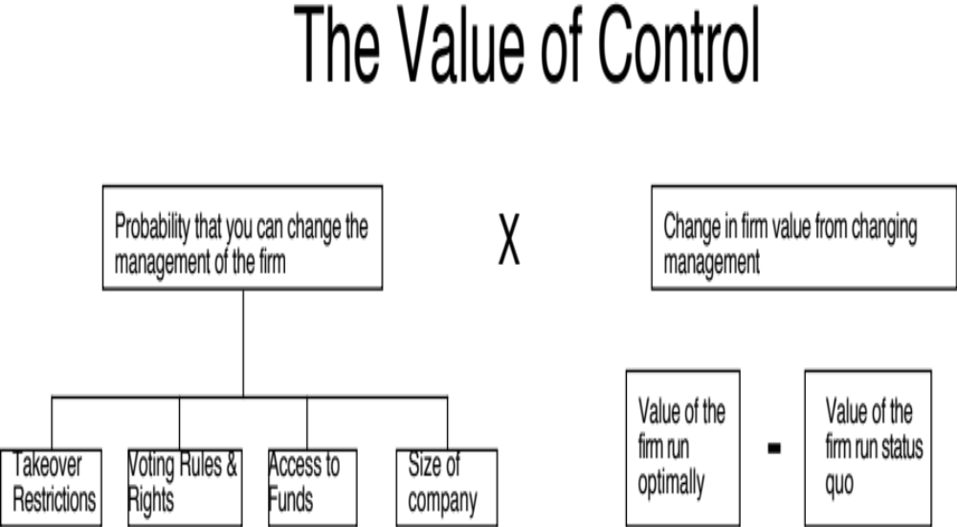
The Expected Value of Control
Notes:
Contrary to conventional wisdom, the value of control is not 20%… (That is a common rule of thumb used in acquisitions, and really reflects the average premium paid in acquisitions..) Even if bidders do not overpay, the premium on an acquisition can reflect lots of other motivations besides control (synergy, for example).

Slide 16
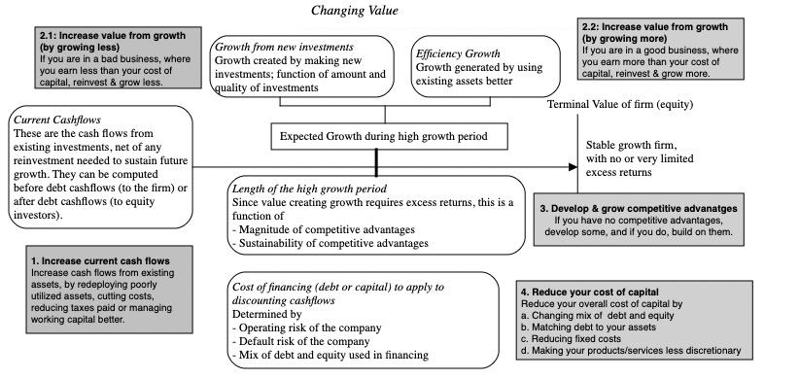

Slide 17
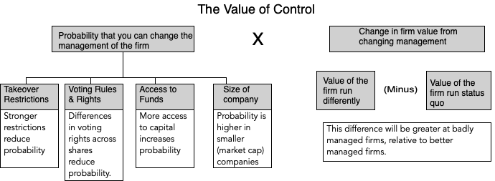
The Expected Value of Control
Notes:
Contrary to conventional wisdom, the value of control is not 20%… (That is a common rule of thumb used in acquisitions, and really reflects the average premium paid in acquisitions..) Even if bidders do not overpay, the premium on an acquisition can reflect lots of other motivations besides control (synergy, for example).

Slide 18
Why the probability of management changing shifts over time….
Corporate governance rules can change over time, as new laws are passed. If the change gives stockholders more power, the likelihood of management changing will increase.
Activist investing ebbs and flows with market movements (activist investors are more visible in down markets) and often in response to scandals.
Events such as hostile acquisitions can make investors reassess the likelihood of change by reminding them of the power that they do possess.
Notes:
The rules do keep changing, sometimes because of external pressure, When they change, the probability of management changing also shifts.
A hostile acquisition of one company or an activist investor can alter the probabilities for a wide range of companies…

Slide 19
Estimating the Probability of Change
You can estimate the probability of management changes by using historical data (on companies where change has occurred) and statistical techniques such as probits or logits.
Empirically, the following seem to be related to the probability of management change:
  Stock price and earnings performance, with forced turnover more likely in firms that have performed poorly relative to their peer group and to expectations.
  Structure of the board, with forced CEO changes more likely to occur when the board is small, is composed of outsiders and when the CEO is not also the chairman of the board of directors.
  Ownership structure, since forced CEO changes are more common in companies with high institutional and low insider holdings. They also seem to occur more frequently in firms that are more dependent upon equity markets for new capital.
  Industry structure, with CEOs more likely to be replaced in competitive industries.
Notes:
Getting a sense of whether it should be high or low is easy. Putting a number on it is more difficult to do. In recent years, there are researchers who have looked at firms where management has been changed (either by hostile acquisitions or through other means) and compared these firms to those where there has been no change to estimate the probability of change happening. Good approach, but has high standard errors…

Slide 20
Manifestations of the Value of Control
Publicly traded firms: The market price of every publicly traded firm has an embedded expected value of control in it, increasing with
  how well or badly the firm is perceived to be run
  the likelihood that there will be change in the firm
Hostile acquisitions: In hostile acquisitions which are motivated by control, the control premium should reflect the change in value that will come from changing management.
Voting and non-voting shares: The premium (if any) that you would pay for a voting share should increase with the expected value of control.
Minority Discounts in private companies: The minority discount (attached to buying less than a controlling stake) in a private business should be increase with the expected value of control.
Notes:
These are all scenarios where the value of control plays out, in one way or the other.

Slide 21
1. All publicly traded firms
When investors value a publicly traded firm, they are implicitly valuing (or pricing) two versions of the firm:
  Status Quo: The firm run by the existing management in place (with all of its pluses and minuses)
  With change: The firm run by someone else with different ideas on how best to run it
Value = Status Quo value (1 – Probability of change) + Change value (Probability of change

Slide 22
2. Hostile Acquisition: Example
In a hostile acquisition, you can ensure management change after you take over the firm. Consequently, you would be willing to pay up to the optimal value.
As an example, Blockbuster was trading at $9.50 per share in July 2005. The optimal value per share that we estimated as $ 12.47 per share. Assuming that this is a reasonable estimate, you would be willing to pay up to $2.97 as a premium in acquiring the shares.
Issues to ponder:
  Would you automatically pay $2.97 as a premium per share? Why or why not?
  What would your premium per share be if change will take three years to implement?
Notes:
If you pay the entire $2.97 as a premium, you get no value added as the acquirer…
Take the present value of $2.97 (at Blockbuster’s cost of equity) over 3 years.

Slide 23
3. Voting and Non-voting Shares: An Example
To value voting and non-voting shares, we will consider Embraer, the Brazilian aerospace company. As is typical of most Brazilian companies, the company has common (voting) shares and preferred (non-voting shares).
  Status Quo Value = 12.5 billion $R for the equity;
  Optimal Value = 14.7 billion $R, assuming that the firm would be more aggressive both in its use of debt and in its reinvestment policy.
There are 242.5 million voting shares and 476.7 non-voting shares in the company and the probability of management change is relatively low. Assuming a probability of 20% that management will change, we estimated the value per non-voting and voting share:
  Value per non-voting share = Status Quo Value/ (# voting shares + # non-voting shares) = 12,500/(242.5+476.7) = 17.38 $R/ share
  Value per voting share = Status Quo value/sh + Probability of management change * (Optimal value – Status Quo Value) = 17.38 + 0.2* (14,700-12,500)/242.5 = 19.19 $R/share
With our assumptions, the voting shares should trade at a premium of 10.4% over the non-voting shares.
Notes:
The voting share premium will increase with
The value of changing management (higher for badly managed firms)
The probability of changing management (higher for firms where voting shares are dispersed among investors)
The number of voting shares, relative to non-voting shares (higher when the number of voting shares is lower)

Slide 24
4. Minority Discount: An example
Assume that you are valuing Kristin Kandy, a privately owned candy business for sale in a private transaction. You have estimated a value of $ 1.6 million for the equity in this firm, assuming that the existing management of the firm continues into the future and a value of $ 2 million for the equity with new and more creative management in place.
  Value of 51% of the firm = 51% of optimal value = 0.51* $ 2 million = $1.02 million
  Value of 49% of the firm = 49% of status quo value = 0.49 * $1.6 million = $784,000
Note that a 2% difference in ownership translates into a large difference in value because one stake ensures control and the other does not.
Notes:
In a private business, a minority stake can trade at a much lower value than a majority stake… The reason is the expected value of control.

Slide 25
Alternative Approaches to Value Enhancement
Maximize a variable that is correlated with the value of the firm. There are several choices for such a variable. It could be
  an accounting variable, such as earnings or return on investment
  a marketing variable, such as market share
  a cash flow variable, such as cash flow return on investment (CFROI)
  a risk-adjusted cash flow variable, such as Economic Value Added (EVA)
The advantages of using these variables are that they
  Are often simpler and easier to use than DCF value.
The disadvantage is that the
  Simplicity comes at a cost; these variables are not perfectly correlated with DCF value.
Notes:
Firms prefer these alternative approaches because they seem less subjective and much simpler…

Slide 26
Value Alchemy: Acronyms and Shortcuts
The nature of value consulting is to add mystery and magic to the process, with a proprietary twist (to make the consultant indispensable)
In the 1990s, Stern Stewart soared by offering companies its variant, the Economic Value Added (EVA), measured as follows:
  EVA = (Return on Capital - Cost of Capital) (Capital Invested in Project)
  Firms were advised to focus on increasing EVA and tie top management compensation to EVA
In the 1980s, Holt Associates offered CFROI as a measure of the cash flow return made on capital
  It is computed as an IRR, based upon a base value of capital invested and the cash flow on that capital.
Notes:
Two widely used measures of value enhancement… The first is a dollar measure of excess returns.. The second is a percentage measure of excess return.

Slide 27
The bottom line…
The value of a firm is not going to change just because you use a different metric for value. All approaches that are discounted cash flow approaches should yield the same value for a business, if they make consistent assumptions.
If there are differences in value from using different approaches, they must be attributable to differences in assumptions, either explicit or implicit, behind the valuation.
When you use a shortcut (as you are with EVA or CFROI), you are making assumptions that firms can exploit to game the system.
Notes:
Value is a function of expected cash flows, growth and risk. All metrics build of this theme and require fundamentally the same information, and with the same assumptions about the numbers, give you the same values.

Slide 28
Your Pricing

Slide 29
Relative Valuation: The Four Steps to Understanding Multiples
Anna Kournikova knows PE…. Or does she?
  In use, the same multiple can be defined in different ways by different users. When comparing and using multiples, estimated by someone else, it is critical that we understand how the multiples have been estimated
8 times EBITDA is not always cheap…
  Too many people who use a multiple have no idea what its cross sectional distribution is. If you do not know what the cross sectional distribution of a multiple is, it is difficult to look at a number and pass judgment on whether it is too high or low.
You cannot get away without making assumptions
  It is critical that we understand the fundamentals that drive each multiple, and the nature of the relationship between the multiple and each variable.
There are no perfect comparables
  Defining the comparable universe and controlling for differences is far more difficult in practice than it is in theory.

Slide 30
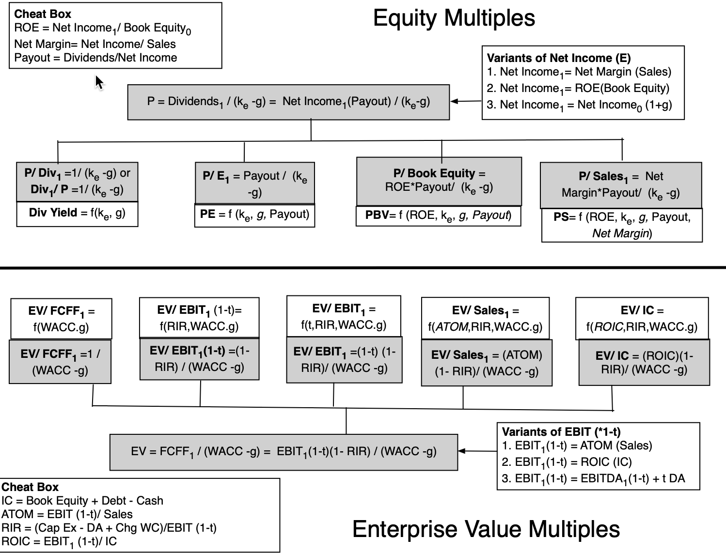
The Determinants of Multiples…
Notes:
Summarizing… the drivers of equity and enterprise value multiples

Slide 31
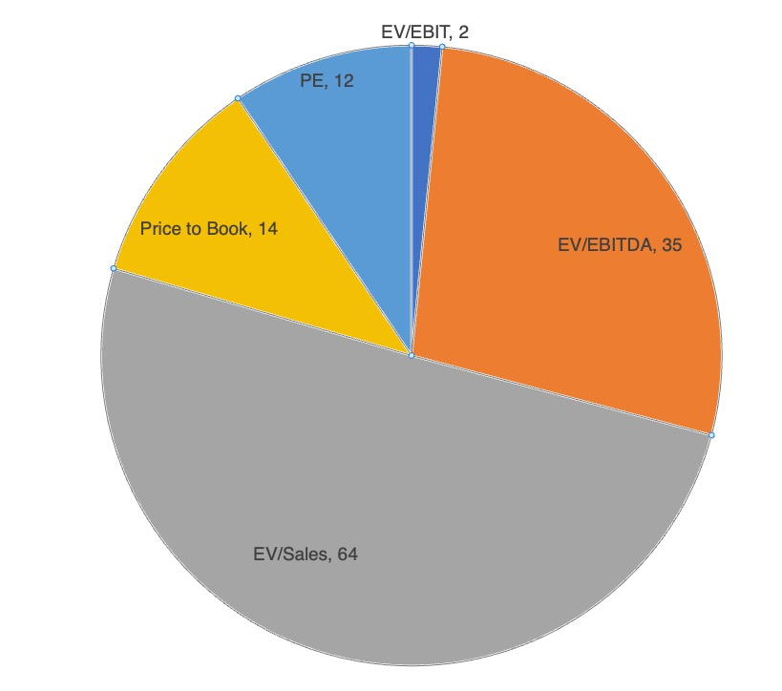
The Multiples you used were ...

Slide 32
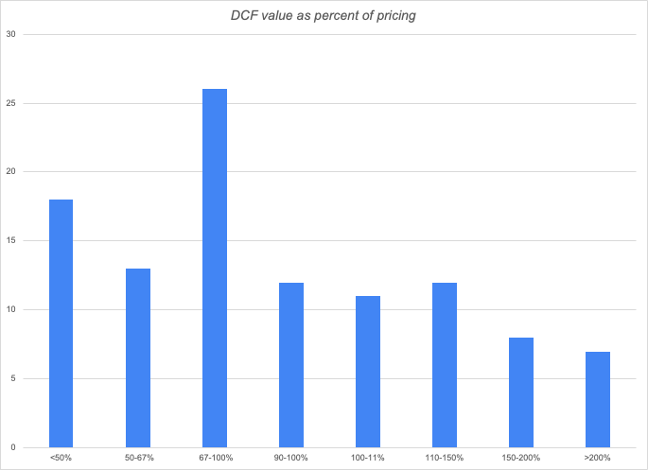

DCF vs Relative Valuation

Slide 33
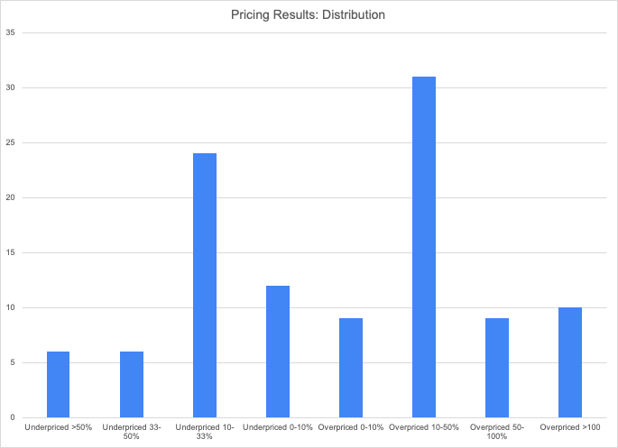

Pricing Results

Slide 34
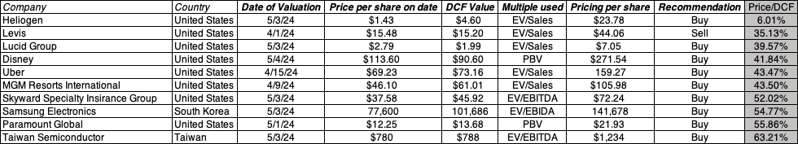
Most underpriced on a relative basis…

Slide 35
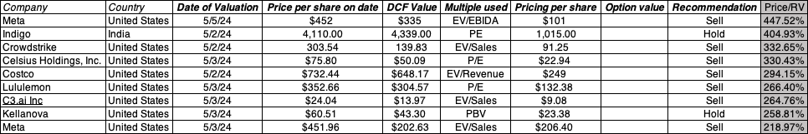
Most overpriced on a relative basis…

Slide 36
Contingent Claim (Option) Valuation
Options have several features
  They derive their value from an underlying asset, which has value
  The payoff on a call (put) option occurs only if the value of the underlying asset is greater (lesser) than an exercise price that is specified at the time the option is created. If this contingency does not occur, the option is worthless.
  They have a fixed life
Any security that shares these features can be valued as an option.
Number of firms valued using option models = 14
Median Percent increase in value over DCF value= 36.99%

Slide 37
Acting on valuation: It is not just an academic exercise
I am not sure yet: Uncertainty is not a shield against action. If you wait until you feel “certain” about your valuation, you will never act.
All believers now? Ultimately, you have to believe in some modicum of market efficiency. Markets have to correct their mistakes for your valuations to pay off.
The law of large numbers: Assuming your valuations carry heft, you are far more likely to be right across many companies than on any individual one.

Slide 38
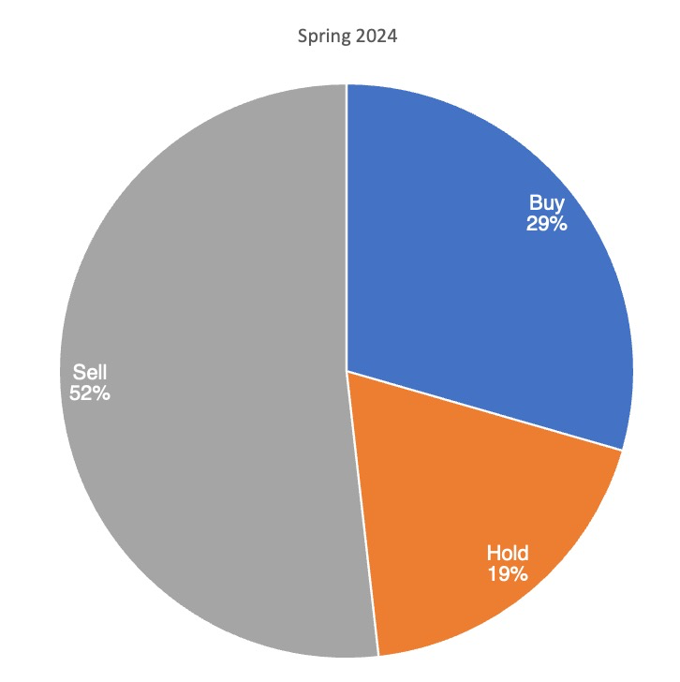
Your recommendations!
Buy to Sell ratio: 0.56

Slide 39
Prior semesters

Slide 40
Picking your valuation approach
Asset characteristics
  Marketability
  Cash flow generating capacity
  Uniqueness
Your characteristics
  Time horizon
  Reasons for doing the valuation
  Beliefs about markets

Slide 41
What approach would work for you?
As an investor, given your investment philosophy, time horizon and beliefs about markets (that you will be investing in), which of the the approaches to valuation would you choose?
Discounted Cash Flow Valuation
Relative Valuation
Neither. I believe that markets are efficient.

Slide 42
Story Tellers? Number Crunchers?
If you are a storyteller, I hope that you have
  More confidence in your number crunching
  More discipline in your stories
  Less intimidation, when confronted with number crunchers
If you are a number cruncher, I hope that you have
  More willingness to put stories behind your numbers
  More imagination in your number crunching
  More understanding, when confronted with story telling

Slide 43
Some Not Very Profound Advice
Its all in the fundamentals.
Focus on the big picture. Don’t sweat the small stuff and don’t get distracted.
Anecdotes mean little and experience does not equal knowledge.
Keep your perspective. It is only a valuation.
In investing, luck dominates skill and knowledge.
Do not forget to do your CFEs. Your ability to check your grade rests on it.

