Slide 1
THE FINAL REVIEW: THE REST OF THE MATERIAL
Aswath Damodaran

Slide 2
The final pieces of the puzzle
Real Options
  The three key questions
  The option to delay: Patents & Natural resources
  The options to expand & abandon
  The value of financial flexibility
  Equity in deeply troubled firms
Acquisition valuation
  Key principles on risk & discount rates
  The value of synergy & control
  Acquisition mechanics (Exchange offers)
Value Enhancement
  The drivers of value
  Value enhancement
  Voting & non-voting shares

Slide 3
Real Option: Key Questions
Is there an option embedded in this asset/ decision?
  Can you identify the underlying asset?
  Can you specify the contingency under which you will get payoff?
Is there exclusivity?
  If yes, there is option value.
  If no, there is none.
  If in between, you have to scale value.
Can you use an option pricing model to value the real option?
  Is the underlying asset traded?
  Can the option be bought and sold?
  Is the cost of exercising the option known and clear?

Slide 4

Option Pricing Model: Reading the Entrails
In the Black Scholes model the value of a call and put are estimated by creating and valuing replicating portfolios. In the dividend yield adjusted versions:
C = S e^{-yt} N(d1) - K e^{-rt} N(d2)
  where,
  and d2 = d1 -  √t
The value of a put can also be derived from the call
  P = K e^{-rt} (1-N(d2)) - S e^{-yt} (1-N(d1))
The model has embedded in it some key features:
  The dividend yield operates as a trigger pushing an investor to exercise early. More generically, you can think of it as the cost of delaying exercise, once an option becomes in the money.
  N(d2): Risk neutral probability that the option will end up in the money.
  N(d1): Also can be read as a probability and N(d1) – N(d2) can very loosely be thought off as the range of probability that the option will be in the money.

Slide 5
The Cost of Delay
The cost of delay is a measure of how much you will lose in the next period if you don't exercise the option now as a fraction of the current value of the underlying asset. There are three ways you can get it:
  Option 1: If you have a decent estimate of the cashflows you will receive each period from exercising the option, it is better to use that cashflow/ PV of the asset as the dividend yield. (Example: Cash flows on an oil reserve)
  Option 2: If your cashflows are uneven or if you do not know what the cashflow will be each period, you should use 1/n as your cost of delay. (Patent & life()
  Option 3: If you will lose nothing in terms of cashflows by waiting, you should have no cost of delay. (Olympics example)

Slide 6
The Option to Delay a Project
PV of Cash Flows
from Project
Initial Investment in
Project
Present Value of Expected
Cash Flows on Product
Project's NPV turns
Project has negative
positive in this section
NPV in this section
Notes:
This looks at the option to delay a project, to which you have exclusive rights.
The initial investment in the project is what you would need to invest to convert this project from a right to a real project.
The present value of the cash flows will change over time.
If the perceived present value of the cash flows stays below the investment needed, the project should never be taken.

Slide 7
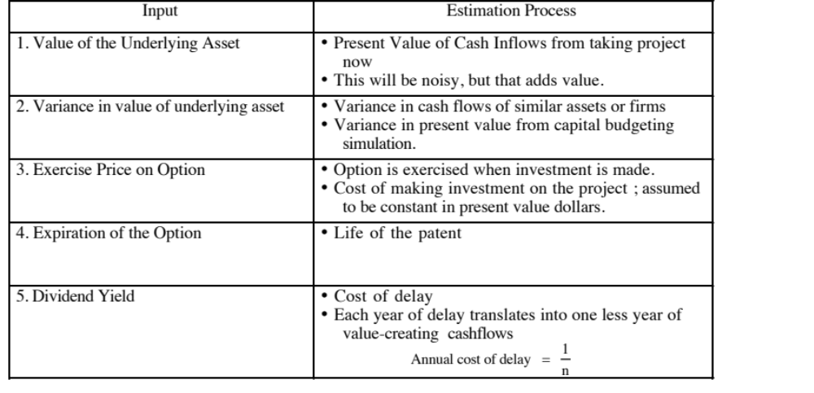
I. Valuing a Patent

Slide 8
Example: Problem 5, Spring 2008
You have been asked to value a new technology for producing and distributing solar power. You estimate that the technology will need an up-front investment of $ 1.5 billion and that the expected cash flows will depend on the price of oil. For every dollar that the oil price exceeds $ 100, the firm expects to generate $ 20 million in annual after-tax cash flow, each year for 10 years. The expected cash flows are risky and the appropriate discount rate for these cash flows is 12%. The current oil price is $ 110 and the standard deviation in ln (oil prices) is 30%. The riskless rate is 4%.
Estimate the net present value of the solar power investment at the current oil price.
Now assume that you can get the exclusive rights to this technology for the next 15 years. Estimate how much you would be willing to pay for these exclusive rights?

Slide 9
Solution
After=tax cash flow = | 200
PV over 10 years = | 1130.044606
Investment = | 1500
NPV = | -369.9553943
Option inputs
S = | 1130.044606
K = | 1500
t = | 15
Standard deviation = | 30%
Riskless rate = | 4%
Cost of delay = | 0% | if you assume that the project life will not be truncated
 | 10% | !if you assume that the project life will be truncated if taken after yr 5
Value of the option
With no cost of delay | $596 million | ! Rounding off will yield about $592 million
With 10% cost of delay | $38 million
With 17.7% cost of delay | $2 million

Slide 10
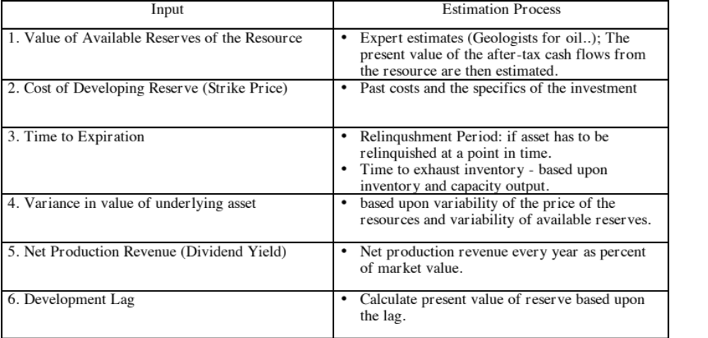
II. Valuing a Natural Resource Option

Slide 11
Example: Problem 5, Spring 2011
You are valuing an oil company with significant undeveloped reserves and have collected the following information on the company:
  The company has developed reserves of 100 million barrels. It is extracting 10 million barrels a year, and the marginal (variable) cost per barrel of oil extracted is $ 40/barrel. The price per barrel is $75/barrel. The tax rate is 40% and the company’s cost of capital is 9%. (You can assume that both oil prices and the cost per barrel are expected to stay at the same level for the foreseeable future.)
  The company has undeveloped reserves of 150 million barrels, and has 20 years to explore and develop them. The initial cost of developing all these reserves is $ 3 billion and the variable cost per barrel, once developed, will be 20% higher than it is for the current developed reserves.
  The standard deviation in oil prices is 30% and the riskfree rate is 4%.
  There is a one-year lag between the decision to develop the reserves and oil production commencing.
  Value the developed reserves for the company.
  Value the undeveloped reserves for the company, using option pricing.
  Now assume that you had valued this company using a conventional discounted cash flow model, using a growth rate and the expected oil price to incorporate the undeveloped reserves. Would the value per share that you obtain by doing so be higher than, lower than or equal to the value using the option pricing approach?

Slide 12
Solution
a. Developed reserves
Pre-tax cash flow/barrel | 35
Annual after-tax CF = | 210
PV of CF for 10 years = | 1347.708117
b. Undeveloped reserves
S = | 1224.217055 | ! Annual cash flow = 10*27*.6 = 162; PV over 15 year
K = | 3000
r = | 4%
t = | 20
Standard deviation = | 0.3
Cost of delay= | 0.066666667 | ! I am assuming that the extraction capacity is 10
 |  | million barrels. I also gave full credit if you assumed it
 |  | to be 7.5 million barrels (5% cost of delY)
d1 = | -0.3949 | N(d1) | 0.3465
d2 = | -17365 | N(d2) | 0.0412
Value of undeveloped reserves = |  | $56.20
c. DCF value will be lower than the option value, for any given oil price expectation.

Slide 13
B. The Option to Expand
PV of Cash Flows
from Expansion
Additional Investment
to Expand
Present Value of Expected
Cash Flows on Expansion
Expansion becomes
Firm will not expand in
attractive in this section
this section
Notes:
Here, the initial project gives you the option to invest an additional amount in the future which you will do only if the present value of the additional cash flows you will get by expanding are greater than the investment needed.
For this to work, you have to do the first project to be eligible for the option to expand.

Slide 14
C. The Option to Abandon
A firm may sometimes have the option to abandon a project, if the cash flows do not measure up to expectations.
If abandoning the project allows the firm to save itself from further losses, this option can make a project more valuable.
PV of Cash Flows
from Project
Cost of Abandonment
Present Value of Expected
Cash Flows on Project
Notes:
You would like to abandon a project, once you know that it will create only negative cash flows for you. This is not always possible, because of contracts you might have entered into with employees or customers.

Slide 15

The Value of Flexibility
Notes:
Shown as a payoff diagram..
Note that the cost of the option emanates from the fact that you borrow less than optimal (to preserve your debt capacity and financial flexibility) and thus have a higher cost of capital.

Slide 16

Payoff Diagram for Liquidation Option
Notes:
The option revolves around the outstanding debt; the face value of the debt is the strike price and the remaining life of the debt is the life of the option. The value of the assets in liquidation becomes the stock price.

Slide 17
Example: Problem 5, Spring 2010
You are helping a vulture investor decide whether he should be investing in the equity of Reza Steel. You have collected the following information on the firm:
  The firm is expected to report EBITDA of $ 25 million this year and a net income of -$10 million for the year.
  Mature steel companies trade at an EV/EBITDA multiple of 6. The standard deviation in firm value at these companies is approximately 30% and the standard deviation in equity value is 40%.
  Given the state of the market, you estimate that you will face an illiquidity discount of approximately 20% on the value of the assets liquidated.
  The firm has substantial debt outstanding. The firm has two zero coupon bonds outstanding, $ 120 million (face value) in five-year bonds and 80 million (face value) in ten-year bonds.
  The treasury bill rate is 2% and the long term treasury bond rate is 4%.
If you consider equity as an option (to liquidate), value the equity in the firm.
Estimate the “fair” interest rate for the debt in the company.

Slide 18
Solution
S = Liquidation value = | 120
K = Face value of debt = | 200
t = Weighted duration = | 7
r =Long term Tbond rate = | 4%
Standard deviation in firm value = | 30%
Valeu of equity as an option
N(d1) | 0.5422
N(d2) | 0.2458
Value of the call = | 27.91
Value of debt = | 92.09
Interest rate on debt = | 0.1172

Slide 19
Acquisition Valuation
Cost of equity: The cost of equity for a target company should always be based upon the risk of the target company (its unlevered beta).
Cost of debt & debt ratio: Should reflect what the target company can borrow at (either at its existing or target debt ratio)

Slide 20
The value of synergy
Synergy accrues to the combined company and can take the following forms:
  An increased capacity to carry debt, which manifests itself as a lower cost of capital
  Cost cutting, which shows up as higher margins and operating income
  More value from growth, which can be reflected in higher returns on capital, higher reinvestment rates or longer growth periods.
  Savings in taxes
The discount rate you apply to these cash flows should reflect the risk in these cash flows.

Slide 21
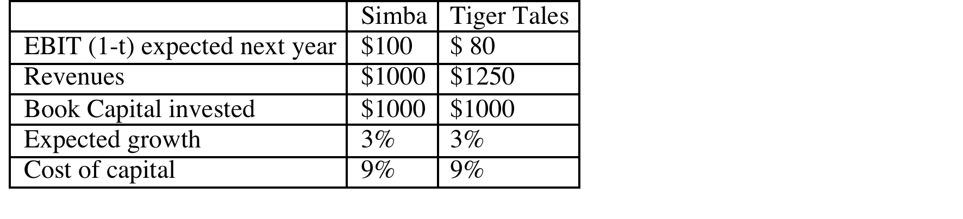
Example: Problem 3, Spring 2009
3. Simba Inc., an entertainment company, is considering an acquisition of Tiger Tales, a maker of animated movies. The information on the two companies is provided below ($ values are in millions):
  Estimate the value of the combined company, assuming no synergy in the merger. (2 points)
  Now assume that Simba Inc. believes that the combined company will be much stronger, relative to the competition, and will therefore be able to find more new investments in the next 4 years (doubling the reinvestment rate over that period for the combined firm) and earn a return on capital of 12% on new investments in perpetuity. (Existing investments at both firms will continue to generate their existing returns on capital) After year 4, the growth rate will drop back to 3% but the return on capital will stay at 12%. Estimate the value of synergy in this merger.

Slide 22
Solution
 | Simba | Tiger Tales | Combined firm
EBIT (1-t) expected next year | 100 | 80
Revenues | 1000 | 1250
Book Capital invested | 1000 | 1000
Expected growth | 3% | 3%
Cost of capital | 9% | 9%
Return on capital = | 0.1 | 0.08
Reinvestment Rate = | 30% | 38%
Value today = | 1166.666667 | 833.3333333 | 2000
$ Reinvestment | 30 | 30 | 120
Combined firm
Reinvestment rate = | 0.666666667
Return on capital = | 12%
Expected growth rate = | 0.08
 | 1 | 2 | 3 | 4 | Term year
EBIT (1-t) | $180.00 | $194.40 | $209.95 | $226.75 | $233.55
- Reinvestment | $120.00 | $129.60 | $139.97 | $151.17 | $58.39
FCFF | $60.00 | $64.80 | $69.98 | $75.58 | $175.16
Terminal value |  |  |  | $2,919.38
Present value | $55.05 | $54.54 | $54.04 | $2,121.71
Value of firm today = | $2,285.34
Value with no synergy = | $2,000.00
Value of synergy = | $285.34

Slide 23
The value of control
To value control in an acquisition, you have to value the company twice:
  In the status quo valuation, you value the company based on its current management policy on investing, financing and dividends.
  In the optimal valuation, you value the company based on the changes that you expect to make in these policies.
The value of control is the difference between the optimal and status quo values, discounted back to the present (assuming that it will take you time to make the changes).

Slide 24
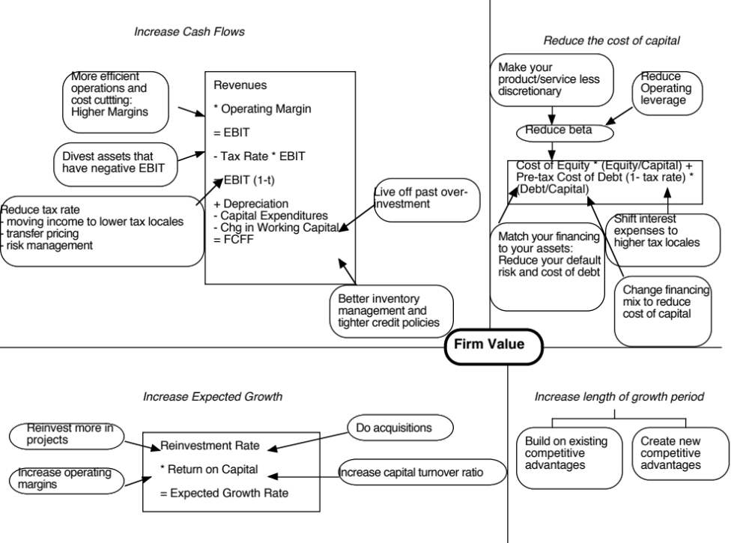

Slide 25
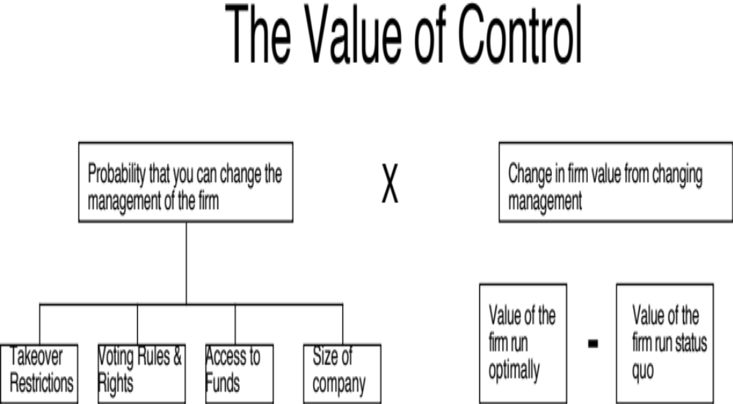
The Expected Value of Control
Notes:
Contrary to conventional wisdom, the value of control is not 20%… (That is a common rule of thumb used in acquisitions, and really reflects the average premium paid in acquisitions..) Even if bidders do not overpay, the premium on an acquisition can reflect lots of other motivations besides control (synergy, for example).

Slide 26
Example: Problem 3, Spring 2008
Marley Steel is a publicly traded steel company with 20 million shares outstanding, trading at $ 2 a share, and $ 60 million in outstanding debt. The cost of capital for the firm was 12%. The firm is expected to generate $ 16 million in after-tax operating income next year and is considered to be in stable growth, growing 4% a year in perpetuity.
Assuming that the firm is correctly valued by the market now, estimate the return on capital that the firm is expected to generate in perpetuity.
You believe that if you acquire control of the firm, you can sell idle assets (that are not generating operating income) for $ 40 million and pay down debt. If you do so, your cost of capital will decrease to 10%. Estimate the new value for the firm if you can restructure it.
How would your answer to b change, if your plan is not to pay down the debt but to redeploy the assets to more productive investments, which will increase the after-tax operating income to $ 25 million next year. The How expected growth rate will remain 4% a year in perpetuity and the cost of capital will continue to be 12%.

Slide 27
Solution
Problem 3
Firm Value = | 100 | ! 20*2 + 60
100 = 16 (1- .04/ROC)/ (.12-.04)
Solving for ROC
Return on capital = | 8%
b. Pay down debt option
If you assume that the write down of capital has no impact on future ROC
Reinvestmnet rate = | 50.00% | ! g/ ROC = 4/8
New firm value = | 133.3333333
If you assume that changes in the current ROC will also affect future ROC
Old capital = | 200 | ! EBIT (1-t)/ Old ROC
New capital = | 160 | ! Sold off idle assets and reduced capital
New ROC = | 10.00% | ! 16/160
New Reinvestment rate= | 40.00% | ! g/ ROC
Firm Value = | 160
c. Redeploy capital
New EBIT (1-t) = | 25
Capital = | 200
New ROC = | 0.125
New Reinvestment rate = | 0.32
Firm Value = | 212.5

Slide 28
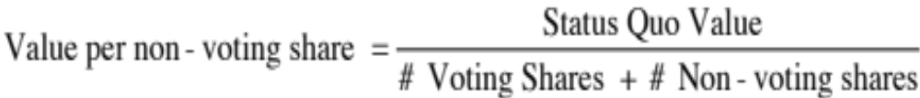
Implications
Publicly traded stock: The stock price of every publicly traded company should reflect the expected value of control in that company. Thus, anything that changes that expected value (changing corporate governance, activist investors) should change prices.
Voting and non-voting shares:
Notes:
This is based on the assumption that the entire value of control rests with the voting shareholders and that the non-voting shareholders are helpless bystanders. That may be a little unfair since many countries have laws protecting non-voting shareholders at least partially.
It is also likely to overstate the voting share premium, when non-voting shareholders can piggyback and benefit from changes made in the way the firm is run.

