Slide 1
My valuation journey: Have faith, you must!
January 2023
Aswath Damodaran
Notes:
It always helps to lay a philosophical foundation for what is to come. This presentation, which is usually my first session, attempts to do this. I use it not only as an opportunity to provide an overview of valuation approaches but also to link each to specific views about how markets work and what inefficiencies have to come into play for each approach to yield excess returns.

Slide 2
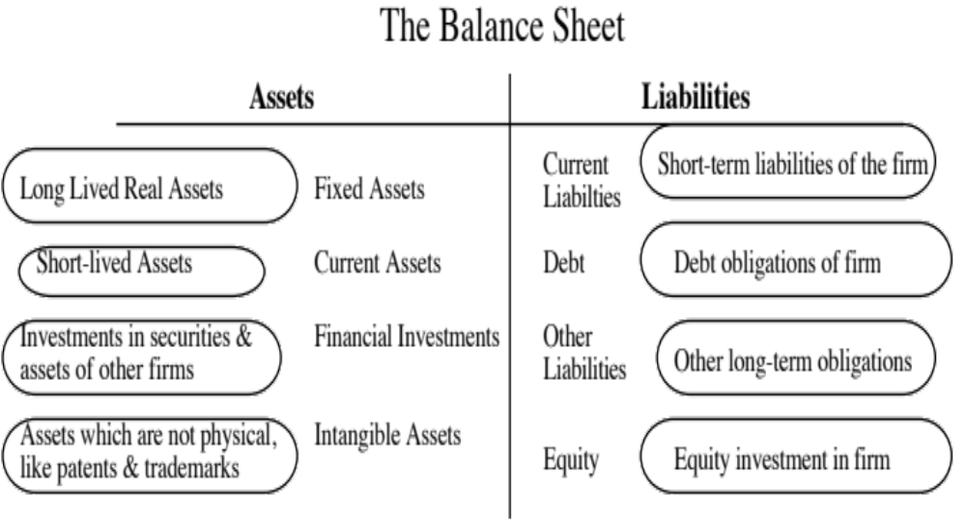
I. Don’t mistake accounting for finance
Valued based upon motive for investment – some marked to market, some recorded at cost and some at quasi-cost
Assets are recorded at original cost, adjusted for depreciation.
Equity reflects original capital invested and historical retained earnings.
True intangible assets like brand name, patents and customer did not show up. The only intangible asset of any magnitude (goodwill) is a plug variable that is of consequence only if you do an acquisition.
Notes:
The faults of the old balance sheet have been well chronicled. At its core, the old accounting balance is backward looking and not entirely consistent. But it is like the Dow 30… We know its faults, but we also know enough about it that we have developed coping mechanisms.

Slide 3
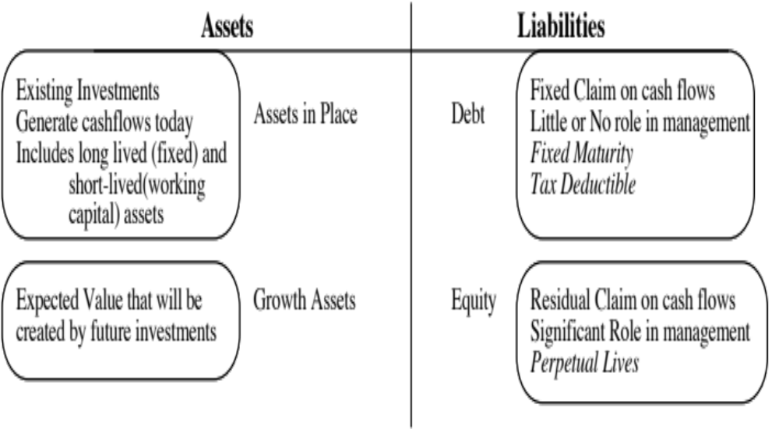
The financial balance sheet
Recorded at intrinsic value (based upon cash flows and risk), not at original cost
Value will depend upon magnitude of growth investments and excess returns on these investments
Intrinsic value of equity, reflecting intrinsic value of assets, net of true value of debt outstanding.
Notes:
This is a value balance sheet…. I use it to contrast the finance view of the world to the accounting view of the world.

Slide 4
And fair value accounting will not bridge the gap..
In the last two decades, accounting has decided (for better or worse) that it can bridge the gap between the two balance sheets by
  Marking up assets to fair value, though the accounting definition of value suggests that the rule writers are mixing up fair pricing with fair value.
  Bringing “intangibles” on to the books, by trying to capitalize everything from brand name to customer lists.
In my view, fair value accounting is an oxymoron, a hopeless attempt to bridge the difference that will do neither accounting nor valuation justice.

Slide 5
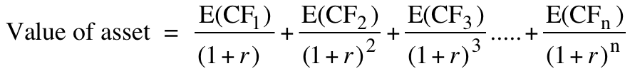
II. Don’t assume that D+CF = DCF
The value of a risky asset can be estimated by discounting the expected cash flows on the asset over its life at a risk-adjusted discount rate:
The IT Proposition: If “it” does not affect the cash flows or alter risk (thus changing discount rates), “it” cannot affect value.
The DUH Proposition: For an asset to have value, the expected cash flows have to be positive some time over the life of the asset.
The DON’T FREAK OUT Proposition: Assets that generate cash flows early in their life will be worth more than assets that generate cash flows later; the latter may however have greater growth and higher cash flows to compensate.

Slide 6
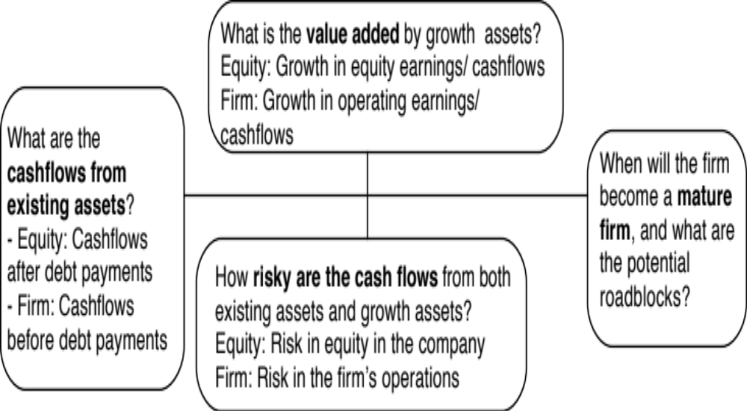
The Key Questions in valuation…
Notes:
The four pillars of value:
Cashflows
Potential for high growth
Length of the high growth period (before the firm starts growing at the same rate as the economy)
Discount rate
Note the variations and the need for consistency:
With equity -> Cashflows to equity - > Growth rate in net income -> Discount at the cost of equity
With firm -> Cashflows to firm - > Growth rate in operating income -> Discount at the cost of capital

Slide 7
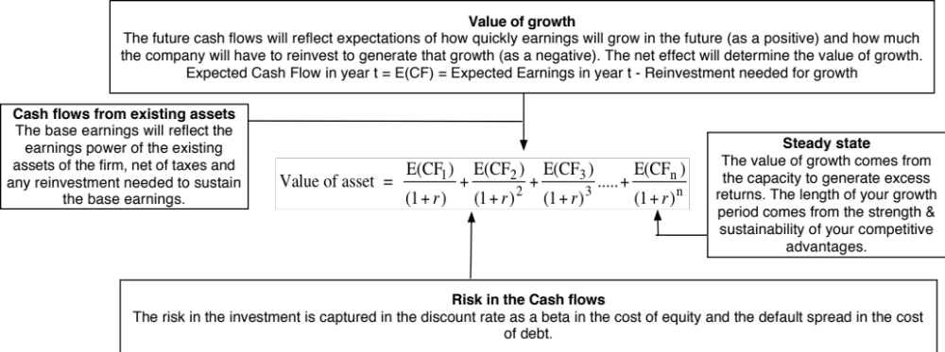
DCF as a tool for intrinsic valuation
Notes:
Cash is king. A firm with negative cash flows today can be a very valuable firm but only if there is reason to believe that cash flows in the future will be large enough to compensate for the negative cash flows today. The riskier a firm and the longer you have to wait for the cash flows, the greater the cashflows eventually have to be….

Slide 8
And Business Drivers that determine value…

Slide 9
1. Match your cash flows to your discount rates..

Slide 10
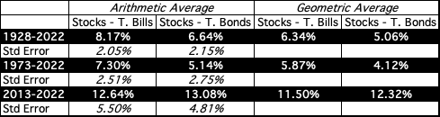
2. Risk is not in the past..
If you are going to use a historical risk premium, make it
  Long term (because of the standard error)
  Consistent with your risk free rate
  A “compounded” average
No matter which estimate you use, recognize that it is backward looking, is noisy and may reflect selection bias.

Slide 11
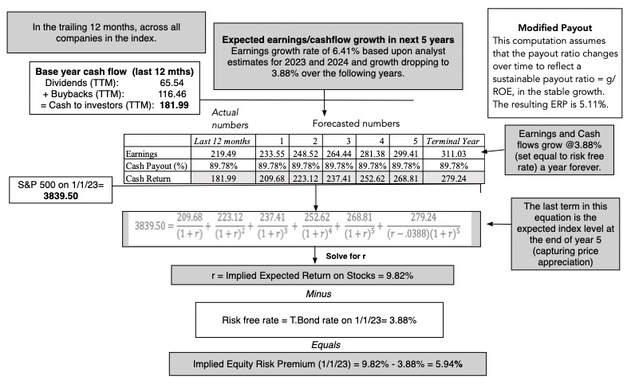
But in the future..

Slide 12
3. Globalization is not a buzz word
As companies get globalized, the valuations that we do have to reflect that globalization. In particular, we need to be wary of
  Currency mismatches: Multinationals derive their revenues in many currencies but you have to be currency-consistent.
  Beta gaming: When a company is listed in many markets, you can get very different betas, depending on how you set up and run a beta regression
  Equity Risk Premiums: The standard practice of estimating equity risk premiums based on your country of incorporation will lead to skewed valuations.

Slide 13
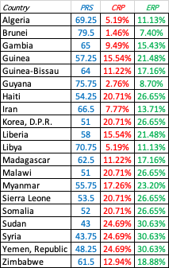
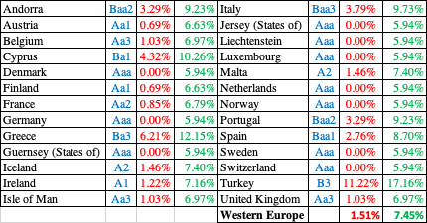
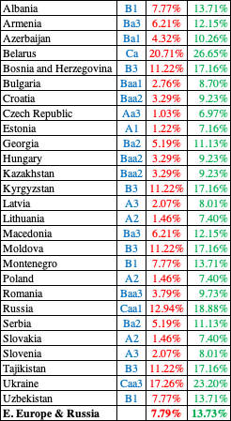


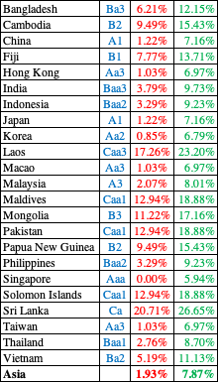
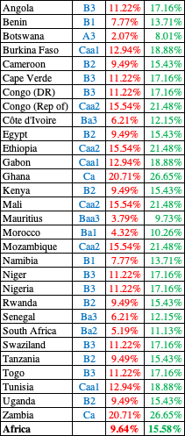
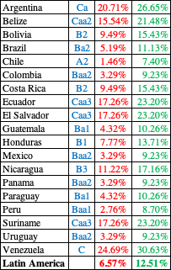
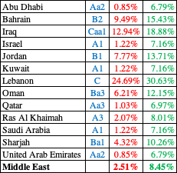

ERP : Jan 2023
Blue: Moody’s Rating
Red: Added Country Risk
Green #: Total ERP
Notes:
Updated country risk premiums.

Slide 14
And your country risk exposure comes from where you operate, not where you incorporate!
Region | Revenues | ERP | Weight | Weighted ERP
North America | ₹ 42,408 | 5.08% | 62.01% | 3.1499%
Europe | ₹ 15,302 | 6.01% | 22.37% | 1.3437%
Rest of the World | ₹ 8,504 | 6.21% | 12.43% | 0.7721%
India | ₹ 2,180 | 7.27% | 3.19% | 0.2317%
Total | ₹ 68,394 |  | 100.00% | 5.4974%
By focusing on revenues, are we misestimating country risk exposure?
As the company looks to grow in Latin America and Asia, how do you see this premium evolving?
Notes:
In the case of Embraer, its limited revenues in Brazil give it a low equity risk premium.
In the case of Ambev, the computation is messier because it has revenues in many Latin American markets. We use revenue weights to weight the CRP.

Slide 15
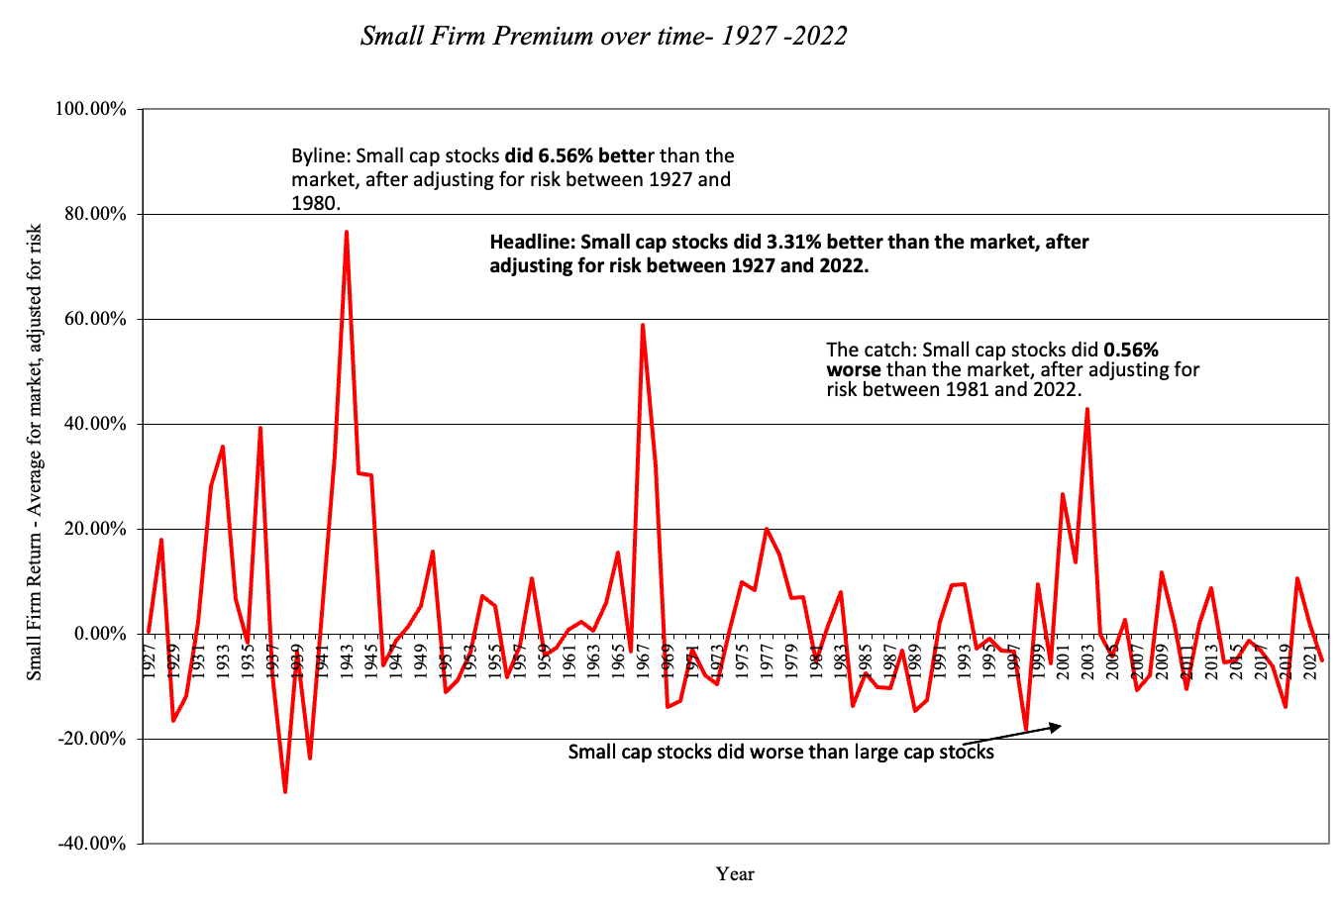
4. Everyone may do it, but that does not make it right.. The small cap premium

Slide 16
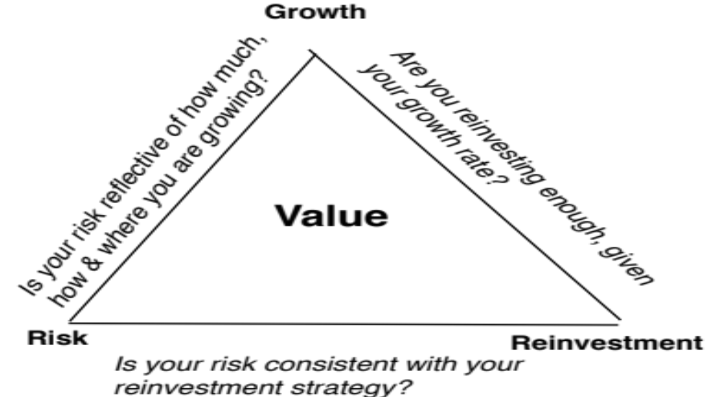
5. Don’t let your inputs be at war with each other..

Slide 17
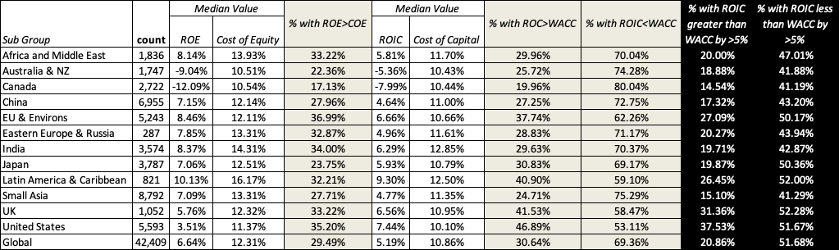
And consider the trade offs in 2022..

Slide 18
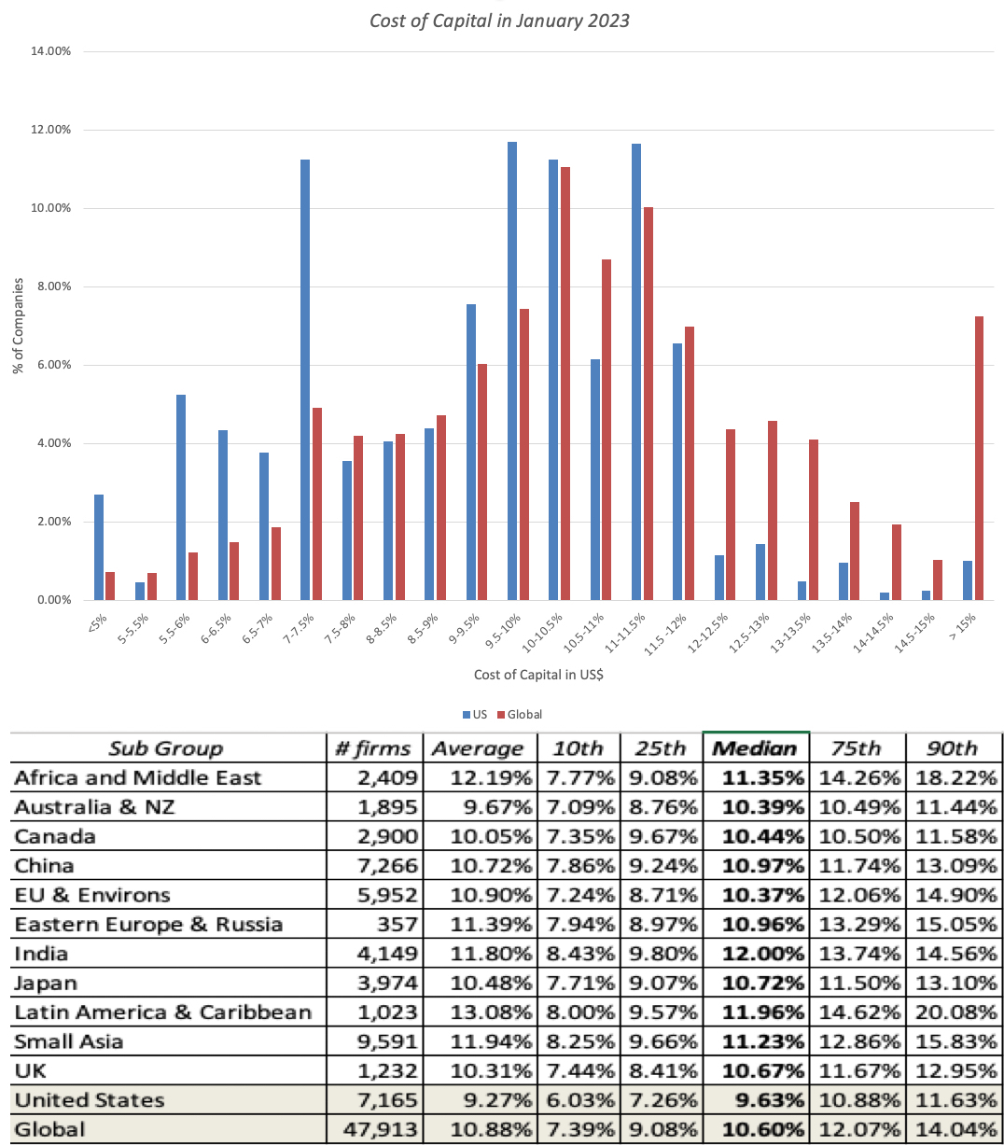
6. Don’t sweat the small stuff

Slide 19

7. Don’t let your terminal value run away with your valuation
In the terminal value equation, the growth seems to be the magic input, the key driver of value.
Since that growth rate has to be maintained in perpetuity, it cannot exceed the growth rate of the economy in which you operate:
  If your valuation is in nominal terms, it is the nominal growth rate of the economy. If it is is real terms, it is the real growth rate.
  If your company is purely domestic, it is the growth rate of the domestic economy. If it is global, it is the global economy.

Slide 20
Four simple truths about terminal value..
It is not the most influential number in your valuation (even though it is usually the biggest).
  The lead in assumptions that get you to your terminal year are more critical than what you assume in your terminal year.
  In your terminal year, you are constrained in what you can assume will happen forever.
You have more flexibility to bring in company differences into your terminal value than you realize:
    You don’t have to assume a perpetuity (it can be an annuity)
    Your growth rate in perpetuity can be negative.
There are no rules (none) on what percent of a good DCF comes from your terminal value. It can be 50%, 75%, 100% or even 150%.
  The percent of your current value that comes from your terminal value will reflect where your company is in the life cycle.
  It is a reflection of how you expect to make money on that company, as an equity investor.
Your company in your terminal year may have the same name as your company today, but it will be a very different company in terms of its fundamentals (risk, cash flows, accounting returns) than it is today.

Slide 21
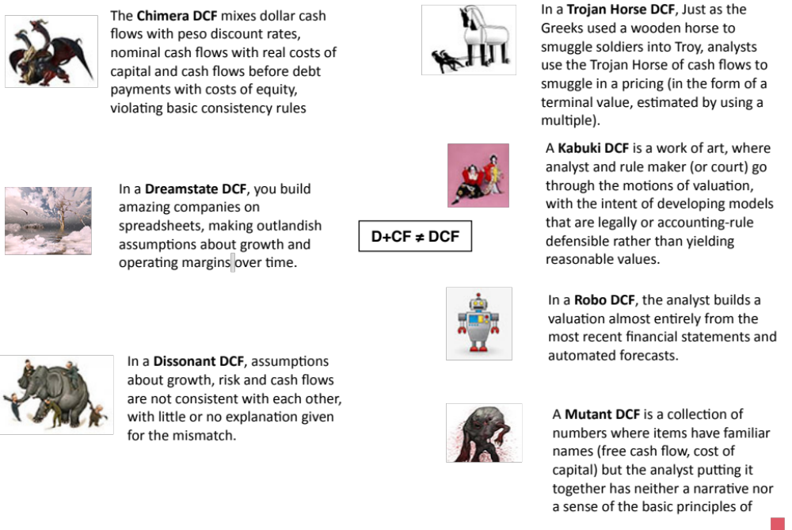

Slide 22
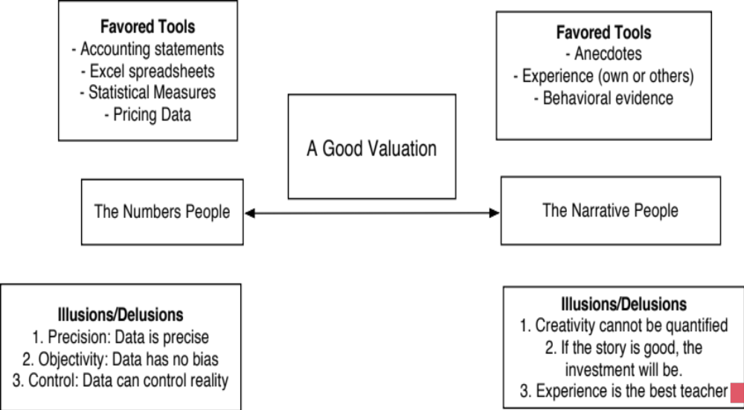
III. Don’t mistake modeling for valuation

Slide 23
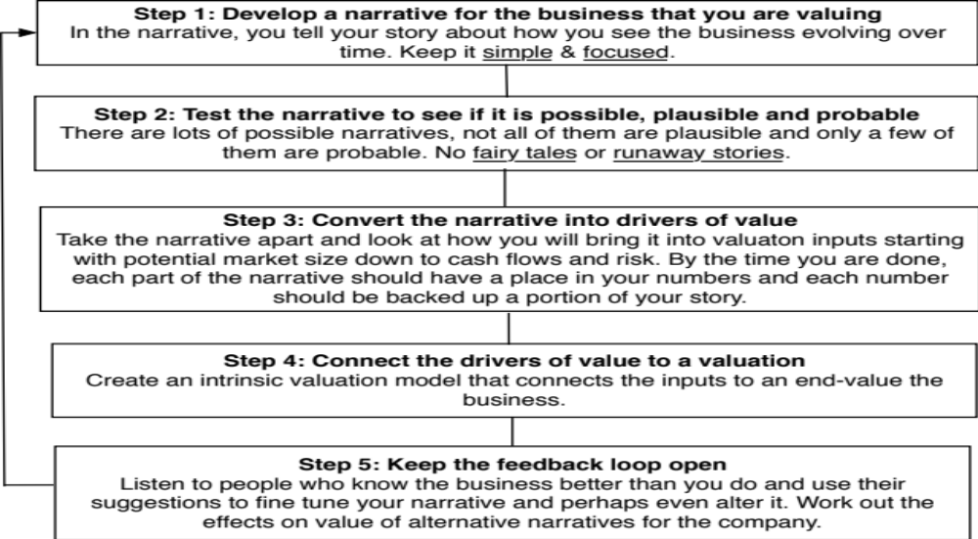
From story to numbers and beyond..

Slide 25
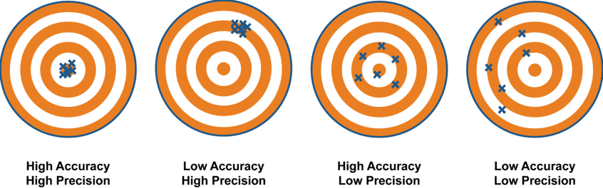
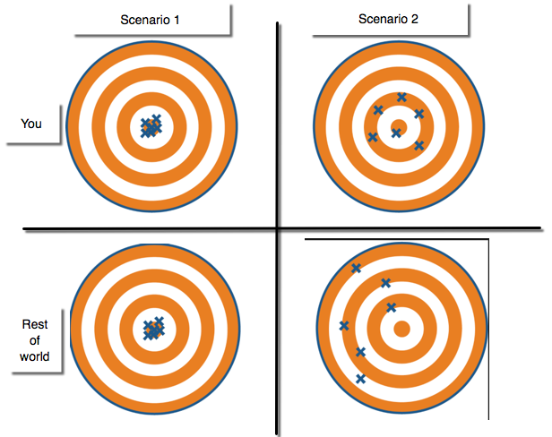
IV. Don’t mistake precision for accuracy.. And accuracy for payoff..
Better accurate than precise
It’s all relative

Slide 26
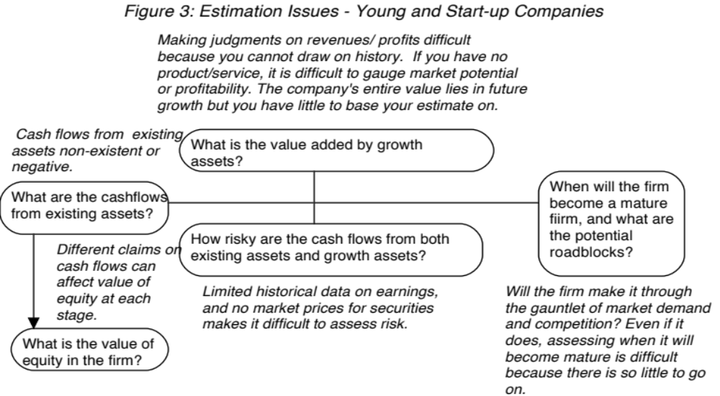
Valuing a start up or a young company is hard to do..

Slide 27
And the dark side will beckon..
With young start up companies, you will be told that it is “too difficult” or even “impossible” to value these companies, because there is so little history and so much uncertainty in the future.
Instead, you will be asked to come over to the “dark side”, where
  You will see value metrics that you have never seen before
  You will hear “macro” stories, justifying value
  You will be asked to play the momentum game
While all of this behavior is understandable, none of it makes the uncertainty go away. You have a choice. You can either hide from uncertainty or face up to it.

Slide 28
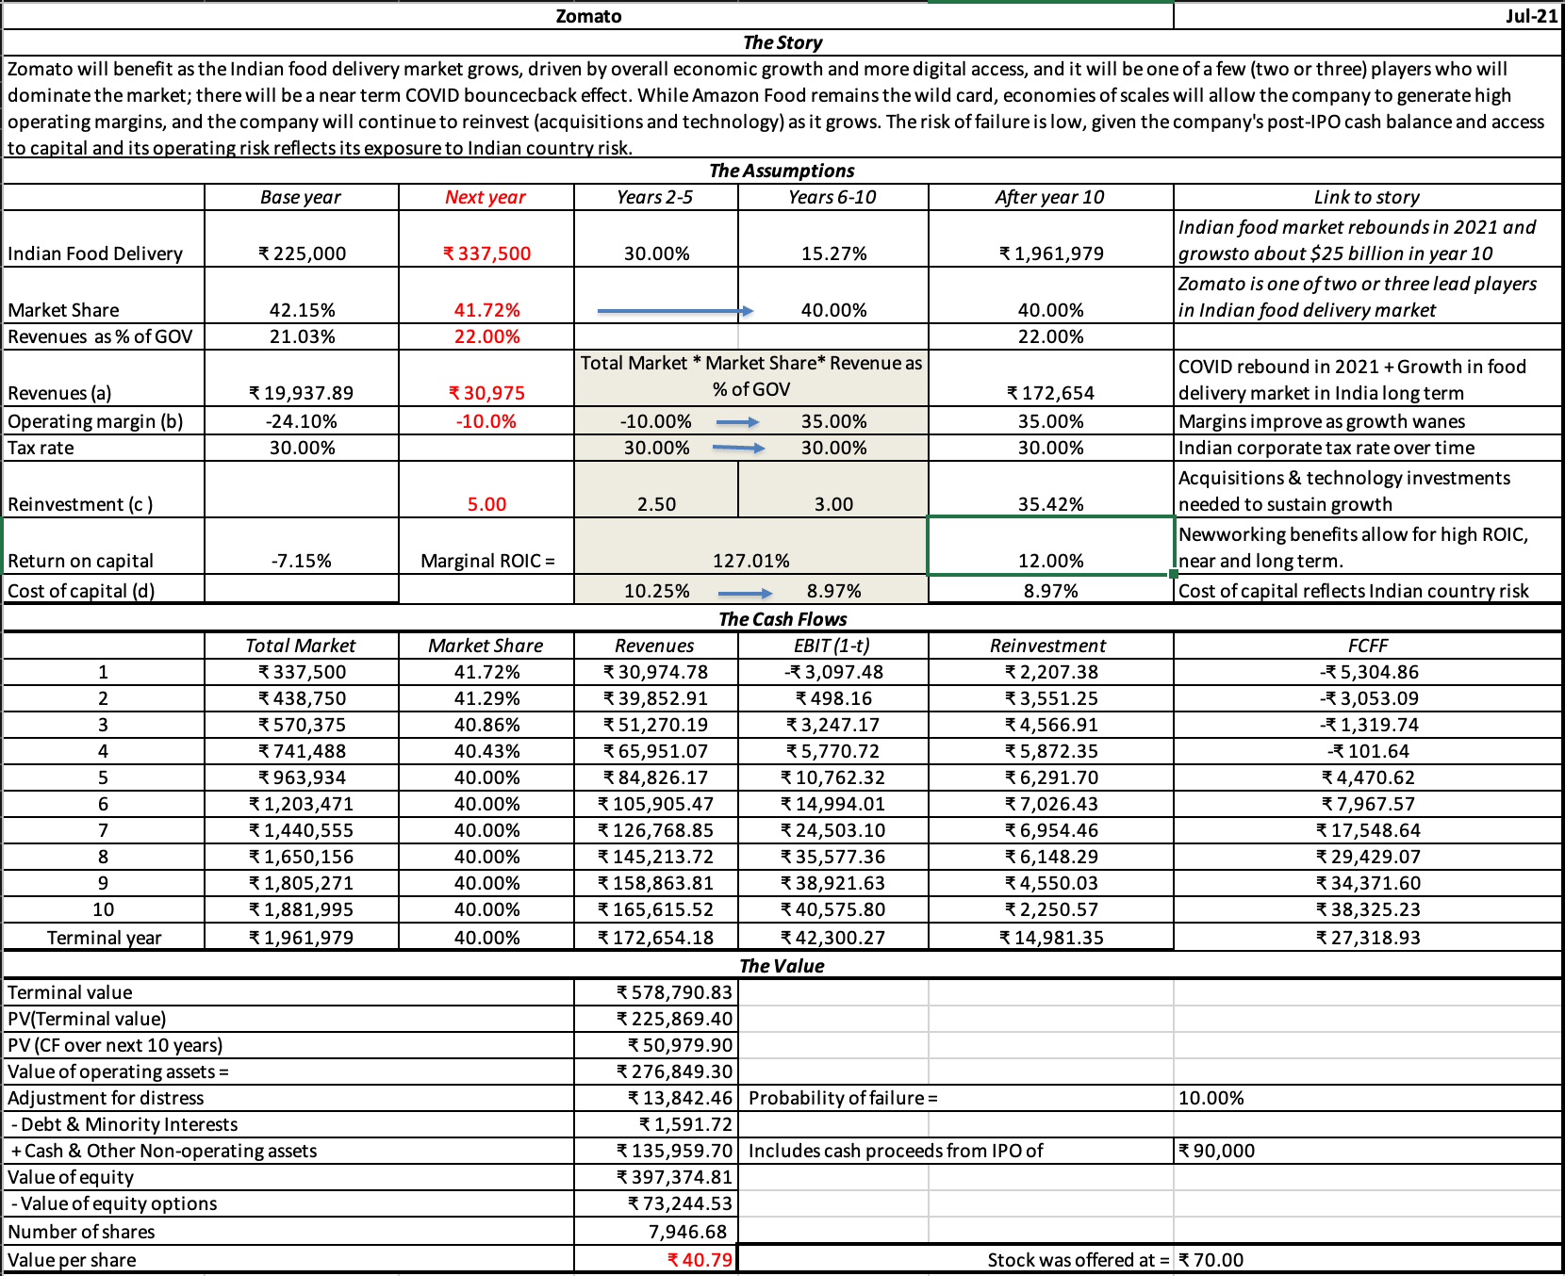

Slide 30
V. Valuation is a craft, and you should never stop learning
In a science, if you get the inputs right, you should get the output right. The laws of physics and mathematics are universal and there are no exceptions. Valuation is not a science.
In an art, there are elements that can be taught but there is also a magic that you either have or you do not. The essence of an art is that you are either a great artist or you are not. Valuation is not an art.
A craft is a skill that you learn by doing. The more you do it, the better you get at it. Valuation is a craft.

Slide 31
Uber’s Existing User Value

Slide 32
Uber’s New User Value

Slide 34
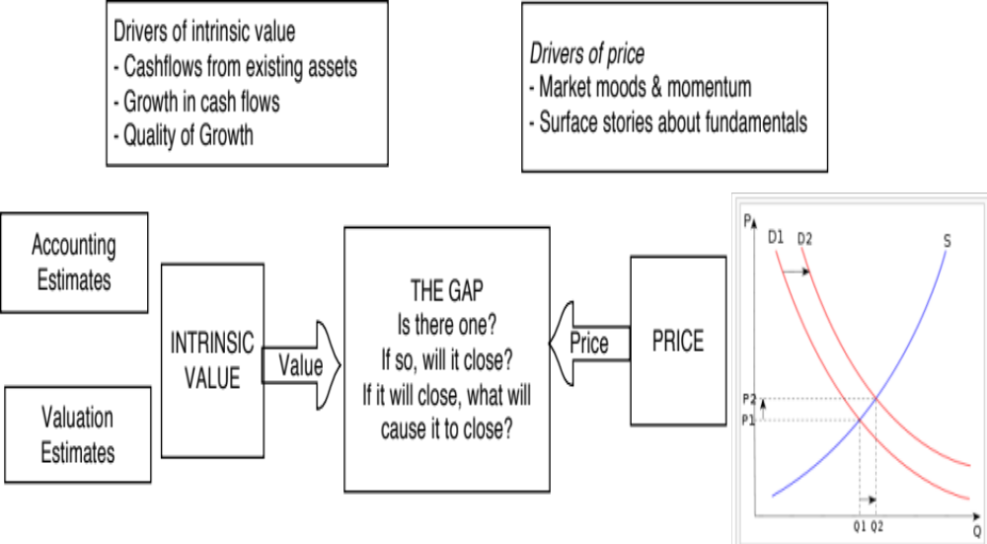
VI. Don’t mistake price for value!

Slide 35
Classifying Investments: Value versus Price
 | To value | To price
Assets | Can be valued based upon expected cashflows, with higher cashflows & lower risk = higher value. | Can be priced against similar assets, after controlling for cash flows and risk.
Commodity | Can be valued, based upon utilitarian demand and supply, but with long lags in both. | Can be priced against its own history (normalized price over time)
Currency | Cannot be valued | Can be priced against other currencies, with greater acceptance & more stable purchasing power = higher price.
Collectible | Cannot be valued | Can be priced based upon scarcity and desirability.

Slide 36
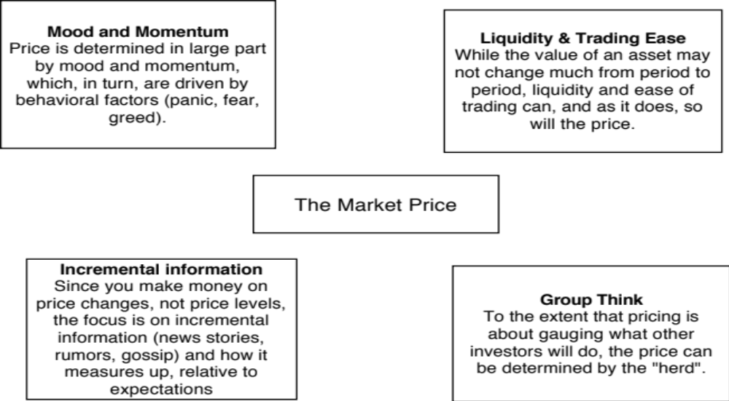
The determinants of price

Slide 37
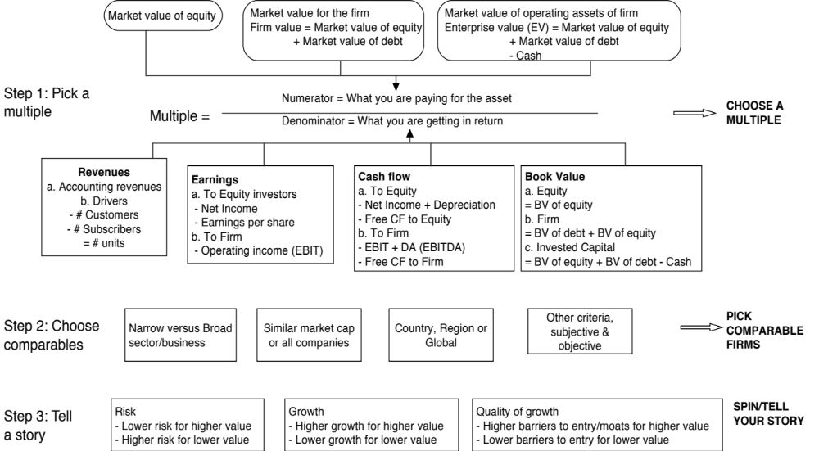
Multiples and Comparable Transactions

Slide 38
The Four Steps to Deconstructing Multiples
Define the multiple
  In use, the same multiple can be defined in different ways by different users. When comparing and using multiples, estimated by someone else, it is critical that we understand how the multiples have been estimated
Describe the multiple
  Too many people who use a multiple have no idea what its cross sectional distribution is. If you do not know what the cross sectional distribution of a multiple is, it is difficult to look at a number and pass judgment on whether it is too high or low.
Analyze the multiple
  It is critical that we understand the fundamentals that drive each multiple, and the nature of the relationship between the multiple and each variable.
Apply the multiple
  Defining the comparable universe and controlling for differences is far more difficult in practice than it is in theory.
Notes:
While we can rail about the fact that a valuation based upon multiples is not as detailed as a discounted cashflow valuation,, the reality is that analysts will continue to use multiples to value companies and that we will often have to use these valuations.
Given this reality, we have to think about how best to use multiples. These four steps represent a way in which we can deconstruct any multiple, understand how to use it well and discover when it is being misused.

Slide 39
US Banks in 2023 – Setting the table
Metric | What it measures | Under valued indicator
Price to Book ratio | Cheapness of the stock, measured by scaling market cap to accounting book value. | Low
Return on Equity | Return Profitability, measured by scaling profitability to shareholders equity | High
Interest spread | Profitability of banking model, measured as spread between interest earned on loans & investments and interest paid on deposits. | High
Deposit growth | Growth in bank deposit base, proxying for stickiness, with higher growth -> less stickiness | Low
Tier 1 Capital Ratio | Risk from Capitalization, with higher Tier 1 capitali ratios indicating more buffer and safety | High
% of Securities held to maturity | Risk from undisclosed write-downs from higher interest rates, since securities held to maturity are not marked to market | Low
Dividend Yiel | Cash yield on the stock, with dividends divided by market capitalization | High

Slide 40
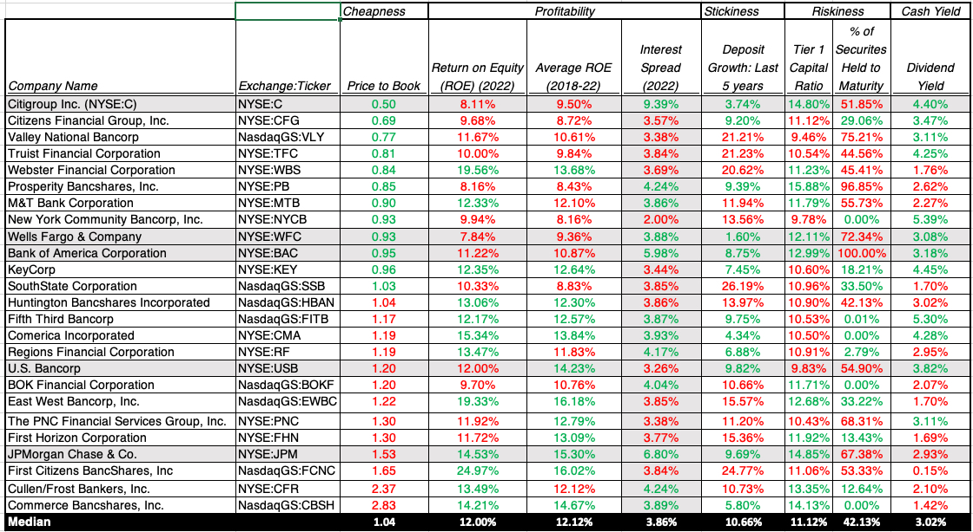
The Biggest US Banks

Slide 41
US Banks (all): A Scatter Plot!

Slide 42
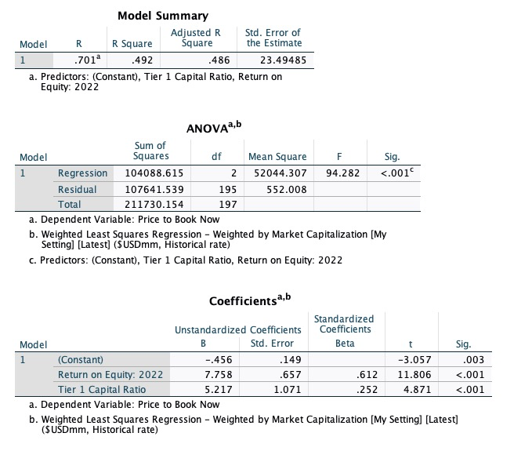
And a regression…
Plugging in Citi’s numbers
ROE( 2022) = 8.11%
Tier 1 Ratio = 14.8%
Predicted PBV
= -.46+7.758 (.0811) + 5.217 (.148)
= 0.94
Actual PBV = 0.50
% Under priced = 46.88%

Slide 43
VII. Investing is an act of faith..
When investing, we are often told that if you are virtuous (careful in your research, good at valuation, have a long time horizon), you will be rewarded (with high returns).
That pitch is amplified by anecdotal evidence of righteous ones, i.e., those who have followed the path to success.
Those who chose not to be virtuous are labeled as “speculators”, viewed as shallow and deserving of the fate that awaits them.
If you have faith in investing, you will be tested.

Slide 44
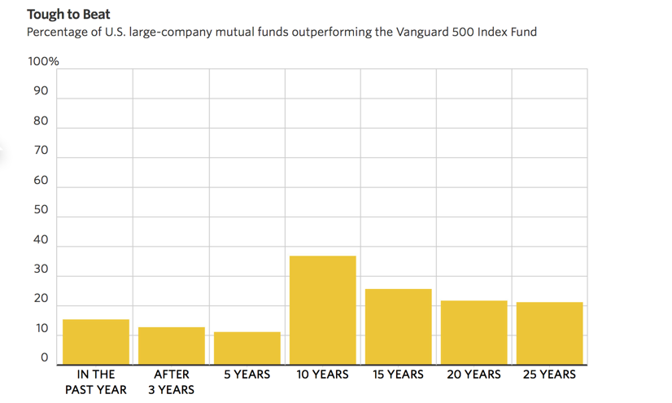
Active Investing is a loser’s game

Slide 45
Investment Heaven is a promise, not a guarantee..

Slide 46

Follow the yellow brick road..

