Slide 1
My valuation journey: Have faith, you must!
January 2018
Aswath Damodaran
Notes:
It always helps to lay a philosophical foundation for what is to come. This presentation, which is usually my first session, attempts to do this. I use it not only as an opportunity to provide an overview of valuation approaches but also to link each to specific views about how markets work and what inefficiencies have to come into play for each approach to yield excess returns.

Slide 2
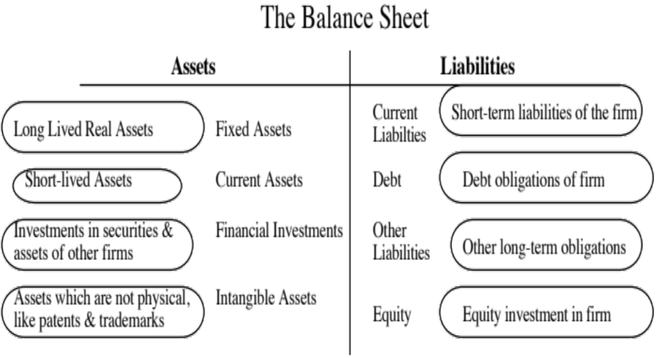
I. Don’t mistake accounting for finance
Valued based upon motive for investment – some marked to market, some recorded at cost and some at quasi-cost
Assets are recorded at original cost, adjusted for depreciation.
Equity reflects original capital invested and historical retained earnings.
True intangible assets like brand name, patents and customer did not show up. The only intangible asset of any magnitude (goodwill) is a plug variable that is of consequence only if you do an acquisition.
Notes:
The faults of the old balance sheet have been well chronicled. At its core, the old accounting balance is backward looking and not entirely consistent. But it is like the Dow 30… We know its faults, but we also know enough about it that we have developed coping mechanisms.

Slide 3
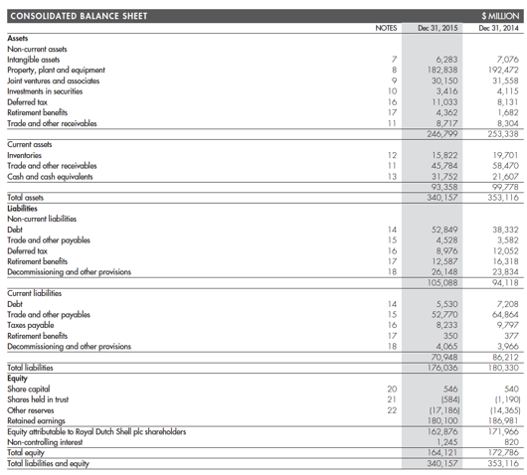
Shell’s accounting balance sheet: December 31, 2015

Slide 4
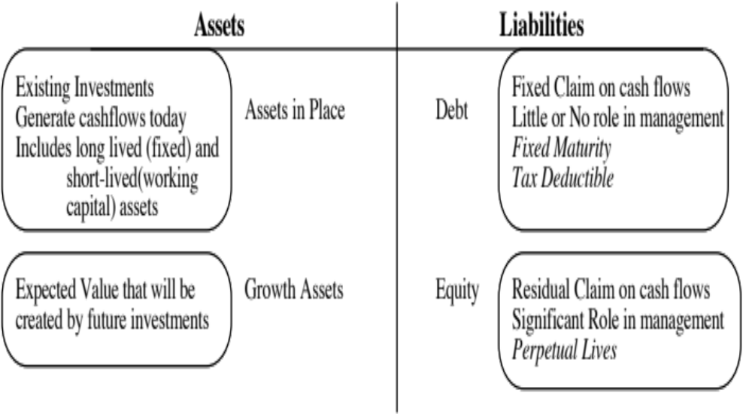
The financial balance sheet
Recorded at intrinsic value (based upon cash flows and risk), not at original cost
Value will depend upon magnitude of growth investments and excess returns on these investments
Intrinsic value of equity, reflecting intrinsic value of assets, net of true value of debt outstanding.
Notes:
This is a value balance sheet…. I use it to contrast the finance view of the world to the accounting view of the world.

Slide 5
Royal Dutch: Financial Balance Sheet on December 31, 2015
Assets | 31-Dec-15 | Liabilities | 31-Dec-15
Upstream Assets | $ 183,653 | Debt | $ 58,379
Downstream Assets |  | Minority Interests | $ 1,245
Subsidiary Holdings | $ 33,566 | Equity | $ 189,347
Cash | $ 31,752
 | $ 248,971 |  | $ 248,971

Slide 6
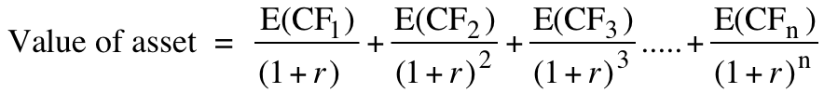
II. Don’t assume that D+CF = DCF
The value of a risky asset can be estimated by discounting the expected cash flows on the asset over its life at a risk-adjusted discount rate:
The IT Proposition: If “it” does not affect the cash flows or alter risk (thus changing discount rates), “it” cannot affect value.
The DUH Proposition: For an asset to have value, the expected cash flows have to be positive some time over the life of the asset.
The DON’T FREAK OUT Proposition: Assets that generate cash flows early in their life will be worth more than assets that generate cash flows later; the latter may however have greater growth and higher cash flows to compensate.

Slide 7
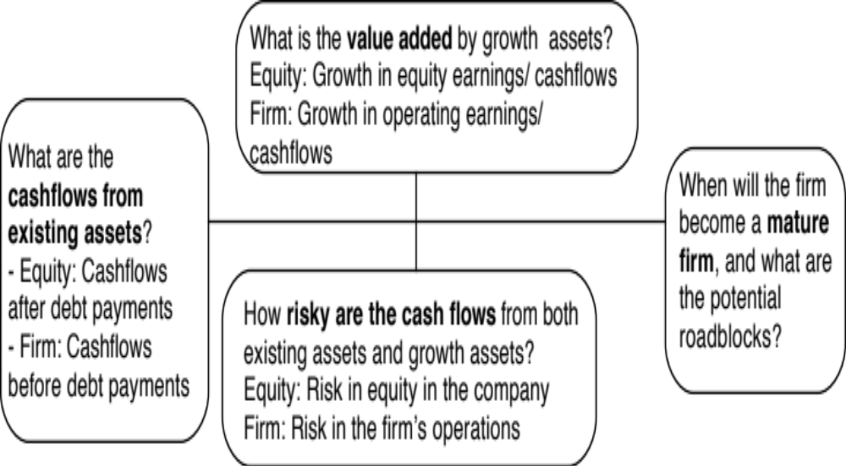
The drivers of value..
Notes:
The four pillars of value:
Cashflows
Potential for high growth
Length of the high growth period (before the firm starts growing at the same rate as the economy)
Discount rate
Note the variations and the need for consistency:
With equity -> Cashflows to equity - > Growth rate in net income -> Discount at the cost of equity
With firm -> Cashflows to firm - > Growth rate in operating income -> Discount at the cost of capital

Slide 8
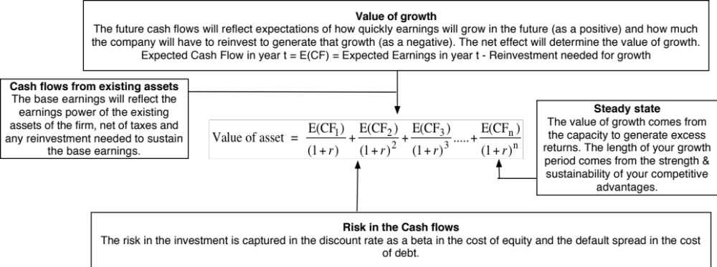
DCF as a tool for intrinsic valuation
Notes:
Cash is king. A firm with negative cash flows today can be a very valuable firm but only if there is reason to believe that cash flows in the future will be large enough to compensate for the negative cash flows today. The riskier a firm and the longer you have to wait for the cash flows, the greater the cashflows eventually have to be….

Slide 9
1. Cash Flows
To get to cash flow | Here is why
Operating Earnings | This is the earnings before interest & taxes you generate from your existing assets. Operating Earnings = Revenues * Operating Margin Measures the operating efficiency of your assets & can be grown either by growing revenues and/or improving margins.
(minus) Taxes | These are the taxes you would pay on your operating income and are a function of the tax code under which you operate & your fidelity to that code.
(minus) Reinvestment | Reinvestment is designed to generate future growth and can be in long term and short term assets. Higher growth usually requires more reinvestment, and the efficiency of growth is a function of how much growth you can get for your reinvestment.
Free Cash Flow to the Firm | This is a pre-debt cash flow that will be shared by lenders (as interest & principal payments) and by equity investors (as dividends & buybacks).

Slide 10
Shell: From Revenues to Cash flows
 | 2011 | 2012 | 2013 | 2014 | 2015
Revenues | $470,171 | $467,153 | $451,235 | $421,105 | $264,960
Operating Margin | 9.31% | 8.11% | 6.15% | 5.47% | -0.88%
Operating Income | $43,764 | $37,879 | $27,769 | $23,026 | $(2,322)
Effective tax rate | 42.07% | 44.02% | 46.63% | 50.80% | 47.98%
Operating Income after taxes | $25,352 | $21,205 | $14,821 | $11,328 | $(1,208)
Depreciation | $11,713 | $13,518 | $16,099 | $17,196 | $16,779
Cap Ex | $26,301 | $32,576 | $39,975 | $31,676 | $26,131
Change in WC | $6,471 | $(3,391) | $(2,988) | $(6,405) | $(5,521)
FCFF | $4,293 | $5,538 | $(6,067) | $3,253 | $(5,039)
Reinvestment | $21,059 | $15,667 | $20,888 | $8,075 | $3,831

Slide 11
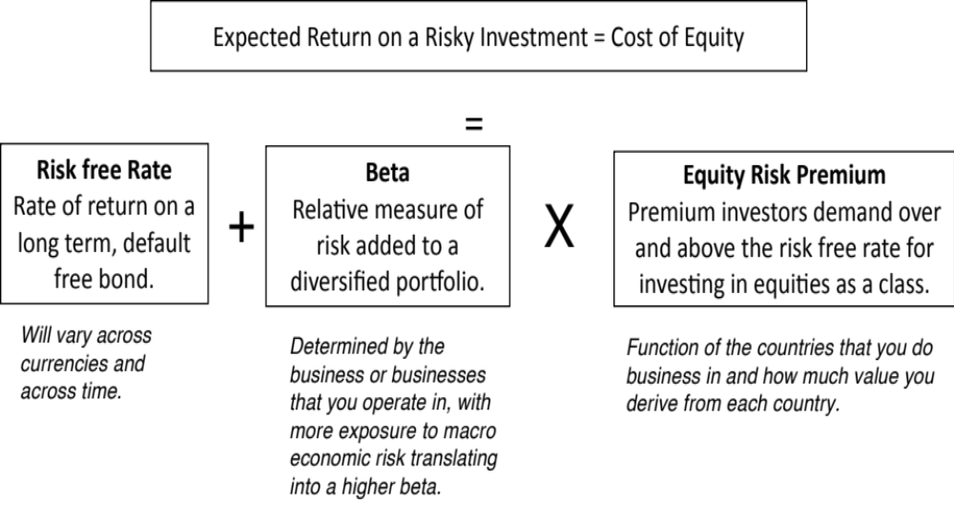
2. Discount rates

Slide 12
Shell’s cost of capital
Business | % of Company | Unlevered Beta | D/E Ratio | Beta | Cost of Equity (in US$)
Upstream | 56.56% | 1.13 | 30.63% | 1.39 | 13.47%
Downstream | 43.44% | 0.85 | 30.63% | 1.05 | 10.63%
Shell | 100.00% | 1.01 | 30.63% | 1.24 | 12.24%
Business | Cost of Equity | E/(D+E) | Pre-tax Cost of Debt | After-tax Cost of debt | D/(D+E) | Cost of Capital
Upstream | 13.47% | 76.55% | 3.10% | 2.33% | 23.45% | 10.86%
Downstream | 10.63% | 76.55% | 3.10% | 2.33% | 23.45% | 8.68%
Shell | 12.24% | 76.55% | 3.10% | 2.33% | 23.45% | 9.91%

Slide 13
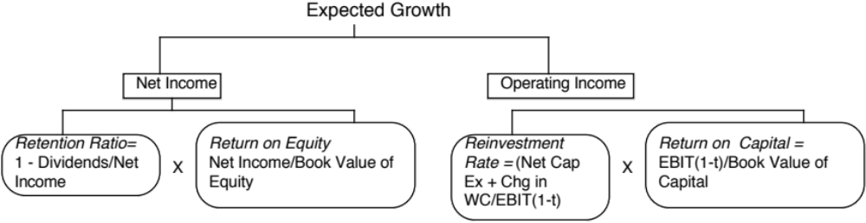
3. Expected Growth
Quality growth is rare and requires that a firm be able to reinvest a lot and reinvest well (earnings more than your cost of capital) at the same time.
The larger you get, the more difficult it becomes to maintain quality growth.
You can grow while destroying value at the same time.

Slide 14
Shell’s return on capital
Average ROIC between 1989-2015: 11.47%
Average ROIC between 2006-2015: 10.30%

Slide 15
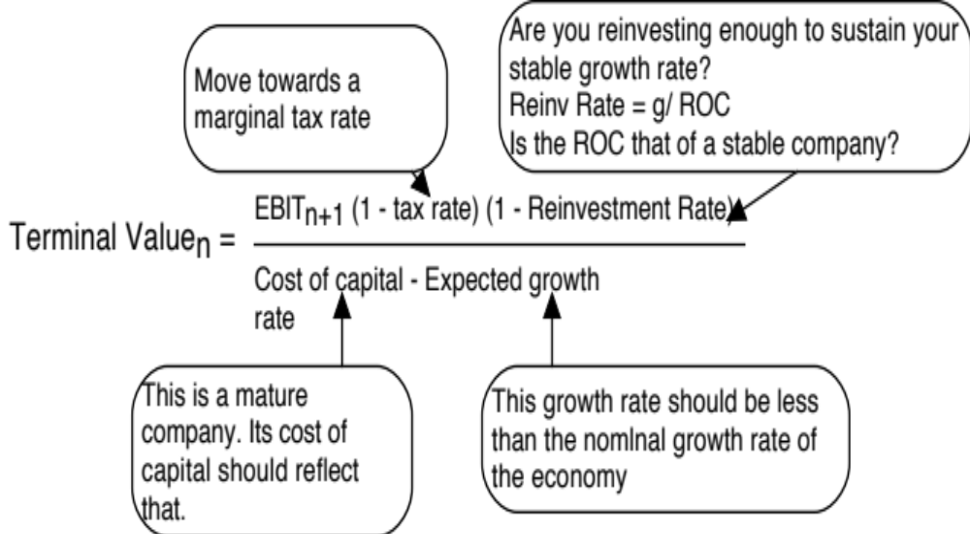
4. The Terminal Value

Slide 16
1. Match your cash flows to your discount rates..

Slide 17
The Currency Effect

Slide 18
2. Don’t let your “beta” dislike get in the way of assessing risk

Slide 19
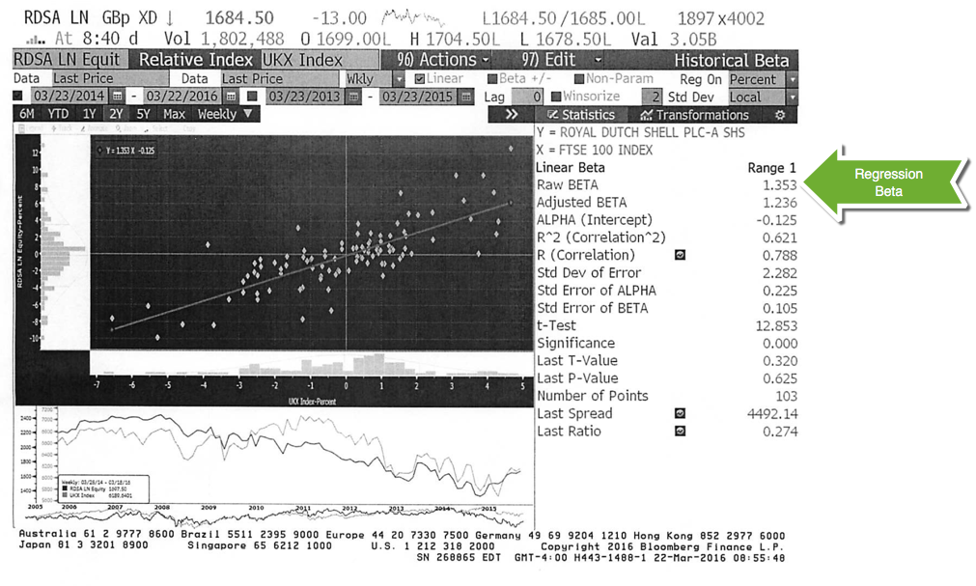
And if you do use betas, don’t use a regression beta

Slide 20
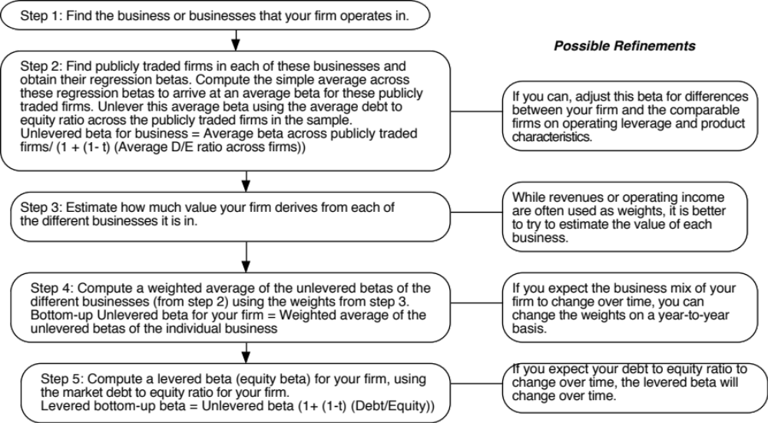
Bottom-up Betas
Notes:
Three measurement issues come up:
How broadly or narrowly do we define comparable firms?
We would argue for a broader rather than a narrow definition, because the savings in standard error increase with the number of firms.
Be willing to go global, if your sample size of domestic firms is too small
Be willing to also look up and down the food chain: in other words, if you cannot find comparable companies in the same business as the company you are analyzing, look for companies that are suppliers to the company or distributors of the company’s products.
How do we deal with differences in operating leverage and business mix that may persist across these firms?
Assume that there are no differences in operating leverage and business mix or that the differences average out.
Adjust for the differences quantitatively. For instance, you could decompose the unlevered beta further into a business beta and the operating leverage effect:
Unlevered beta = Business beta (1 + (Fixed Cost/Variable costs))
How do we compute an average - simple or weighted?
I prefer simple averages. Otherwise, your betas reflect those of the largest and most stable firms in the business.

Slide 21
3. Risk is not in the past..
 | Arithmetic Average |  | Geometric Average
 | Stocks - T. Bills | Stocks - T. Bonds | Stocks - T. Bills | Stocks - T. Bonds
1928-2017 | 8.09% | 6.38% | 6.26% | 4.77%
Std Error | 2.10% | 2.24%
1968-2017 | 6.58% | 4.24% | 5.28% | 3.29%
Std Error | 2.39% | 2.70%
2008-2017 | 9.85% | 5.98% | 8.01% | 4.56%
Std Error | 6.12% | 8.70%
If you are going to use a historical risk premium, make it
  Long term (because of the standard error)
  Consistent with your risk free rate
  A “compounded” average
No matter which estimate you use, recognize that it is backward looking, is noisy and may reflect selection bias.

Slide 22
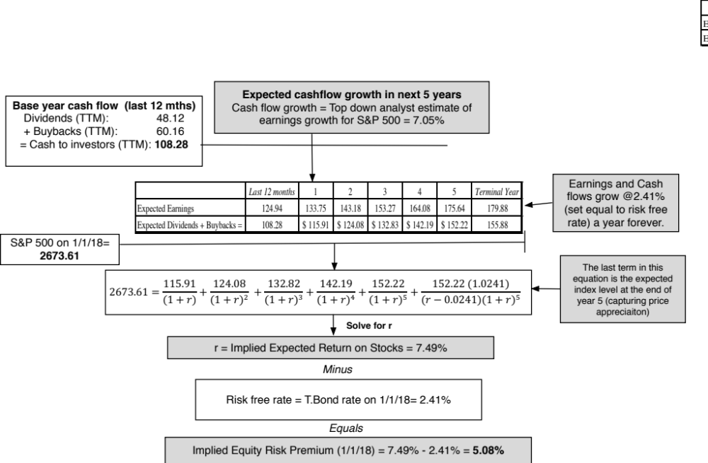
But in the future..

Slide 23
Implied ERP for the S&P 500: History

Slide 24
4. Globalization is not a buzz word
As companies get globalized, the valuations that we do have to reflect that globalization. In particular, we need to be wary of
  Currency mismatches: Multinationals derive their revenues in many currencies but you have to be currency-consistent.
  Beta gaming: When a company is listed in many markets, you can get very different betas, depending on how you set up and run a beta regression
  Equity Risk Premiums: The standard practice of estimating equity risk premiums based on your country of incorporation will lead to skewed valuations.

Slide 25
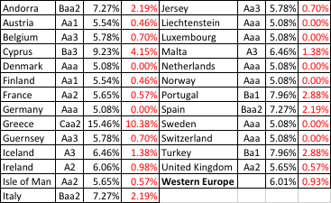
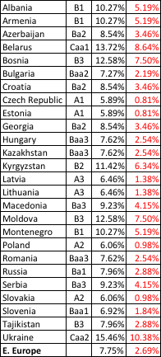
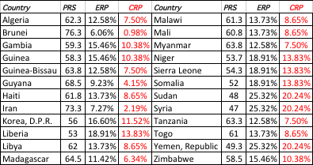
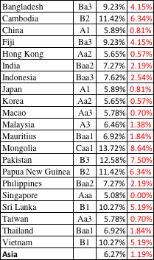
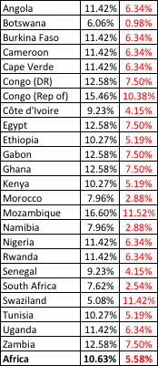

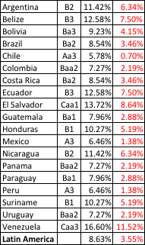
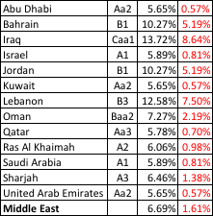

ERP : Jan 2018
Black #: Total ERP
Red #: Country risk premium
Regional #: GDP weighted average
Notes:
Country PRS ERP CRP Country PRS ERP CRP Algeria 62.3 12.58% 7.50% Malawi 61.3 13.73% 8.65% Brunei 76.3 6.06% 0.98% Mali 60.8 13.73% 8.65% Gambia 59.3 15.46% 10.38% Myanmar 63.8 12.58% 7.50% Guinea 58.3 15.46% 10.38% Niger 53.7 18.91% 13.83% Guinea-Bissau 63.8 12.58% 7.50% Sierra Leone 54.3 18.91% 13.83% Guyana 68.5 9.23% 4.15% Somalia 52 18.91% 13.83% Haiti 61.8 13.73% 8.65% Sudan 48 25.32% 20.24% Iran 73.3 7.27% 2.19% Syria 47 25.32% 20.24% Korea, D.P.R. 56 16.60% 11.52% Tanzania 63.3 12.58% 7.50% Liberia 53 18.91% 13.83% Togo 61 13.73% 8.65% Libya 62 13.73% 8.65% Yemen, Republic 49.3 25.32% 20.24% Madagascar 64.5 11.42% 6.34% Zimbabwe 58.5 15.46% 10.38% Updated country risk premiums.

Slide 26
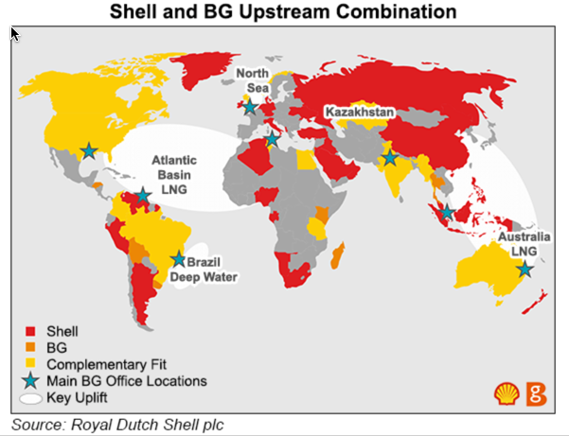
The geography of Shell’s reserves..

Slide 27
Shell: Equity Risk Premium- March 2016
Country | Oil & Gas Production | % of Total | ERP
Denmark | 17396 | 3.83% | 6.20%
Italy | 11179 | 2.46% | 9.14%
Norway | 14337 | 3.16% | 6.20%
UK | 20762 | 4.57% | 6.81%
Rest of Europe | 874 | 0.19% | 7.40%
Brunei | 823 | 0.18% | 9.04%
Iraq | 20009 | 4.40% | 11.37%
Malaysia | 22980 | 5.06% | 8.05%
Oman | 78404 | 17.26% | 7.29%
Russia | 22016 | 4.85% | 10.06%
Rest of Asia & ME | 24480 | 5.39% | 7.74%
Oceania | 7858 | 1.73% | 6.20%
Gabon | 12472 | 2.75% | 11.76%
Nigeria | 67832 | 14.93% | 11.76%
Rest of Africa | 6159 | 1.36% | 12.17%
USA | 104263 | 22.95% | 6.20%
Canada | 8599 | 1.89% | 6.20%
Brazil | 13307 | 2.93% | 9.60%
Rest of Latin America | 576 | 0.13% | 10.78%
Royal Dutch Shell | 454326 | 100.00% | 8.26%

Slide 28
5. Everyone may do it, but that does not make it right.. The small cap premium

Slide 29
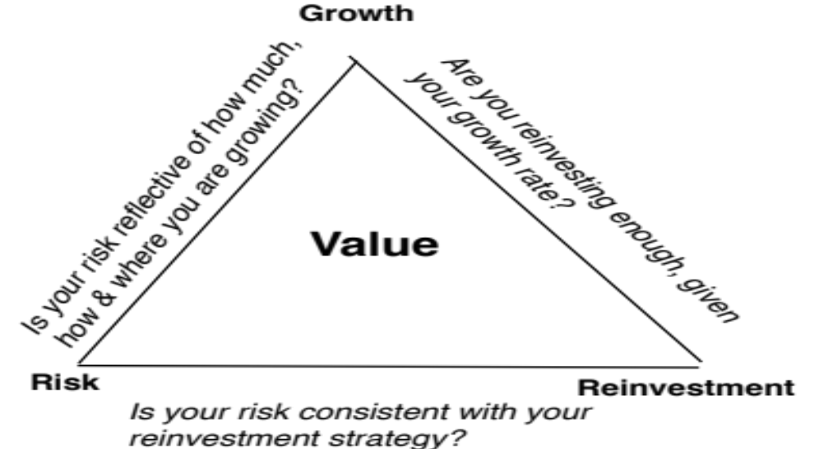
6. Don’t let your inputs be at war with each other..

Slide 30
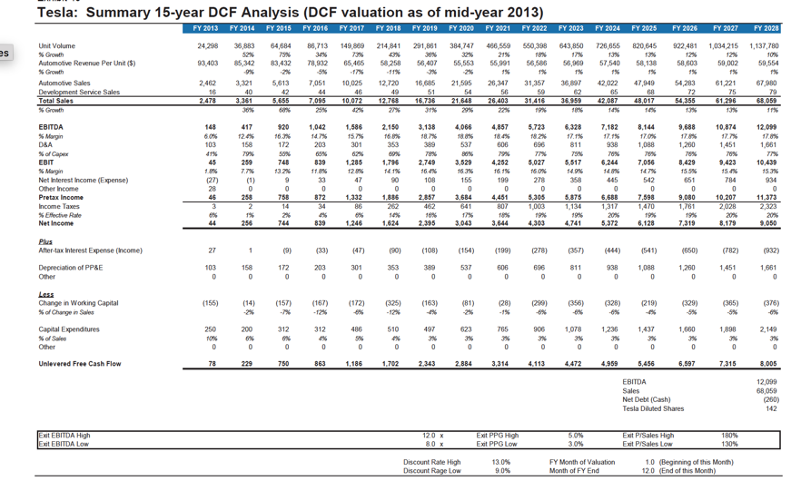
The Improbable: Willy Wonkitis

Slide 31
And consider the trade offs..

Slide 32
Shell and its peers
Company Name | ROIC | Cost of capital in US$ | ROIC - Cost of Capital
Exxon Mobil Corporation (NYSE:XOM) | 7.38% | 9.94% | -2.56%
PetroChina Co. Ltd. (SEHK:857) | 2.74% | 11.07% | -8.33%
Chevron Corporation (NYSE:CVX) | 0.55% | 9.69% | -9.14%
Royal Dutch Shell plc (ENXTAM:RDSA) | 0.67% | 9.91% | -9.24%
TOTAL S.A. (ENXTPA:FP) | 3.40% | 10.52% | -7.11%
BP p.l.c. (LSE:BP.) | -4.85% | 10.59% | -15.44%
China Petroleum & Chemical Corp. (SEHK:386) | 0.35% | 10.76% | -10.41%
Eni SpA (BIT:ENI) | 1.63% | 13.73% | -12.10%
Occidental Petroleum Corporation (NYSE:OXY) | -16.29% | 9.82% | -26.11%
BG Group plc (LSE:BG.) | 3.58% | 10.85% | -7.27%
Statoil ASA (OB:STL) | 3.93% | 9.57% | -5.64%
Public Joint Stock Company Gazprom (MICEX:GAZP) | 4.73% | 15.95% | -11.23%
Suncor Energy Inc. (TSX:SU) | 2.74% | 9.95% | -7.22%
Imperial Oil Ltd. (TSX:IMO) | 4.86% | 9.92% | -5.06%
Public Joint Stock Company Oil Company LUKOIL (MICEX:LKOH) | 2.19% | 15.51% | -13.32%
PTT Public Company Limited (SET:PTT) | 3.31% | 13.90% | -10.59%
Sasol Ltd. (JSE:SOL) | 17.16% | 13.68% | 3.48%
Open Joint Stock Company Surgutneftegas (MICEX:SNGS) | 4.92% | 15.36% | -10.43%
Repsol, S.A. (CATS:REP) | 1.79% | 13.99% | -12.20%
Ecopetrol SA (BVC:ECOPETROL) | 3.39% | 13.96% | -10.57%

Slide 33
7. Don’t sweat the small stuff – Costs of Capital histogram for the US

Slide 34
And for global companies

Slide 35
8. Don’t let your macro views drown out your micro views..
When you are asked to value a company, you should keep your focus on what drives that value. If you bring in your specific macro views into the valuation, the value that you obtain for a company will be a joint result of what you think about the company and your macro views.
Bottom line: If you have macro views, provide them separately. You should be as macro-neutral as you can be, in your company valuations.
Follow up: If you find macro risk dominating your thoughts, deal with it frontally.

Slide 36
The biggest driver for Shell (and no surprise) is..
Revenues = 39,992.77 + 4,039.39 * Average Oil Price R squared = 96.44%

Slide 37
Though they do have some power to alter your income..
Operating Income = 6,436.38 + 284.15 * Average Oil Price R squared = 59.55%

Slide 38
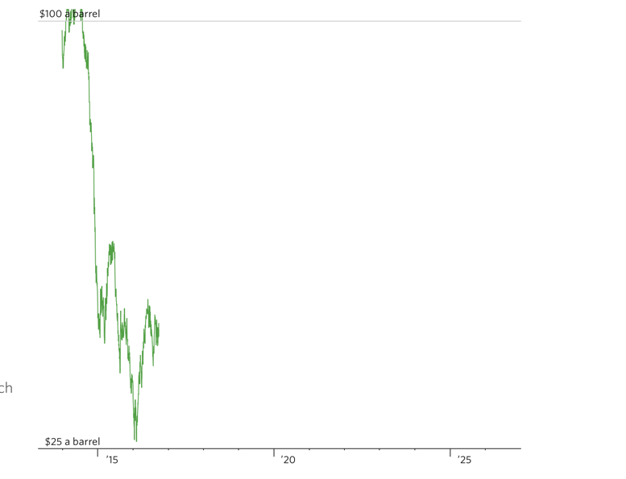
Oil Prices: An Epic Fall..

Slide 39
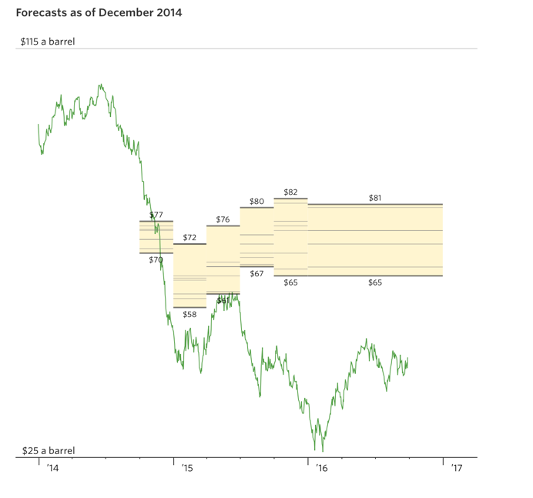
That no one foresaw in December 2014..

Slide 40
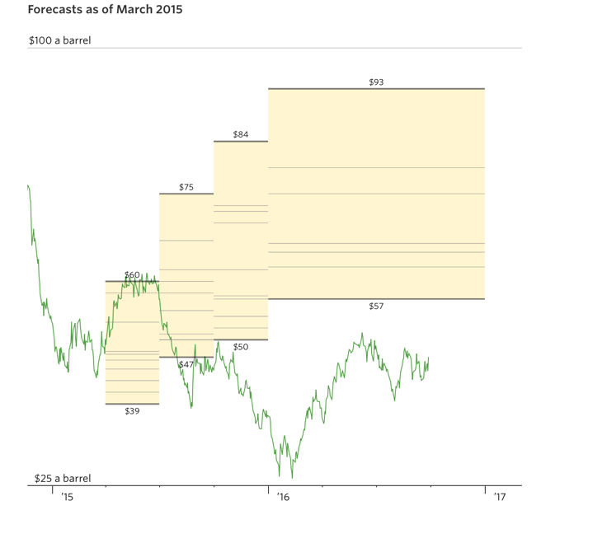
Or in March 2015

Slide 41
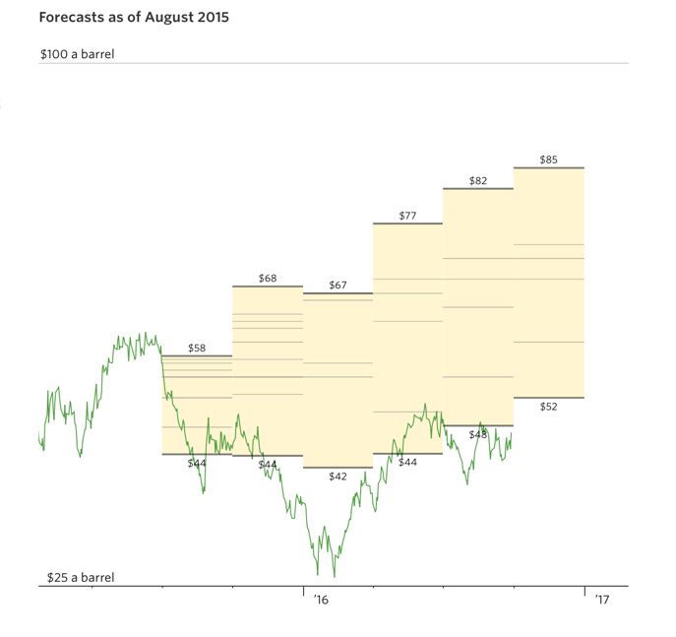
Or in August 2015

Slide 42
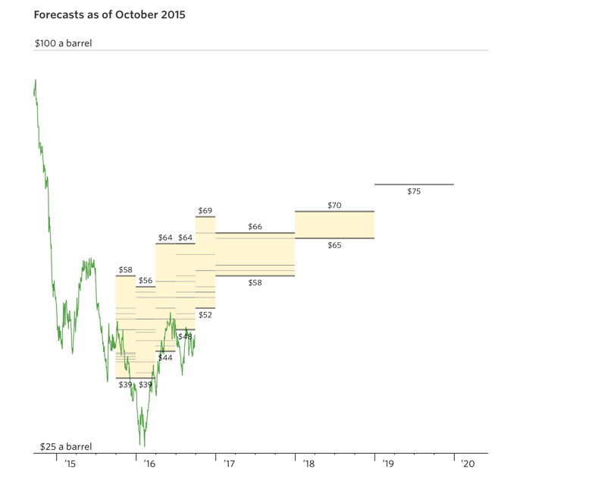
Or in October 2015

Slide 43
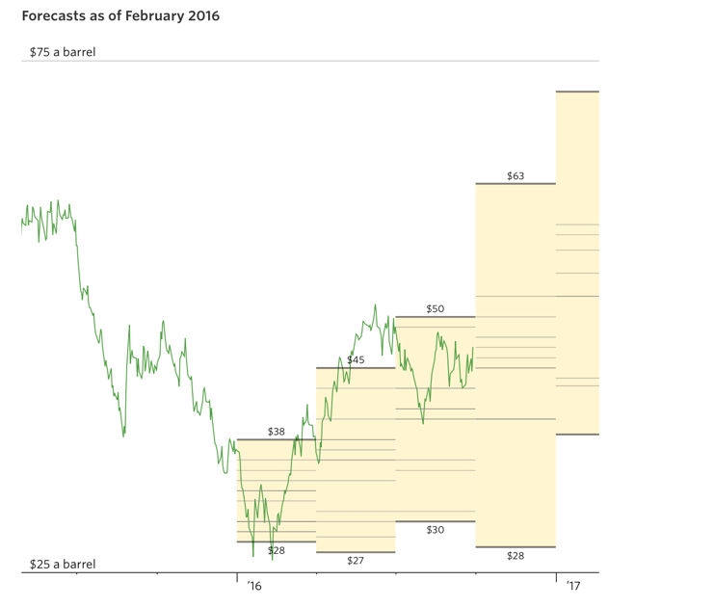
Perhaps in February 2016?

Slide 44
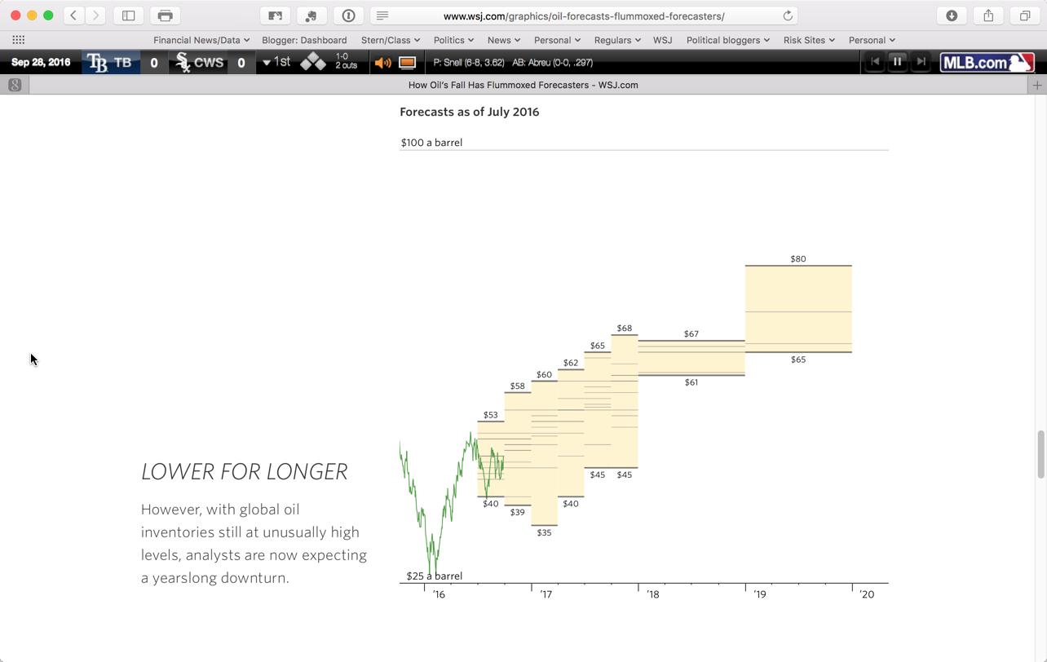
And the new consensus emerges..

Slide 45
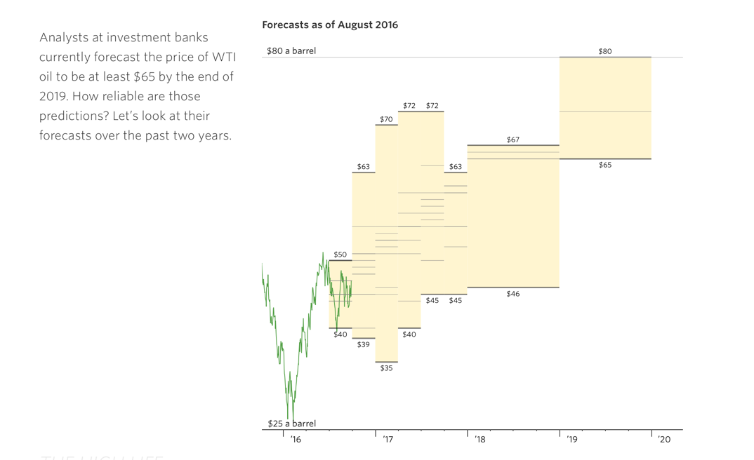
Here’s the August 2016 forecast..

Slide 46
Valuing Shell at April 2016 oil price ($40)

Slide 47
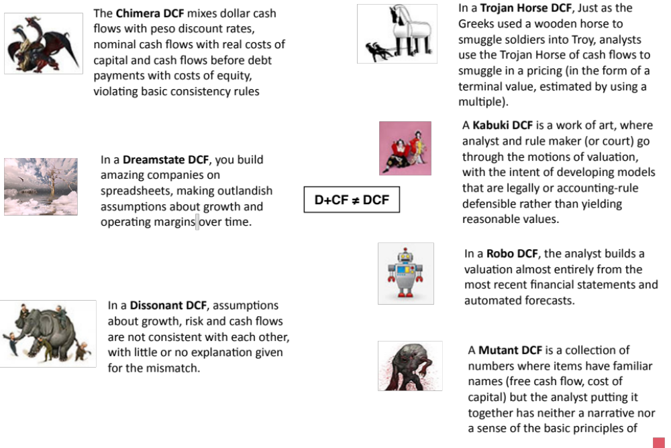

Slide 48
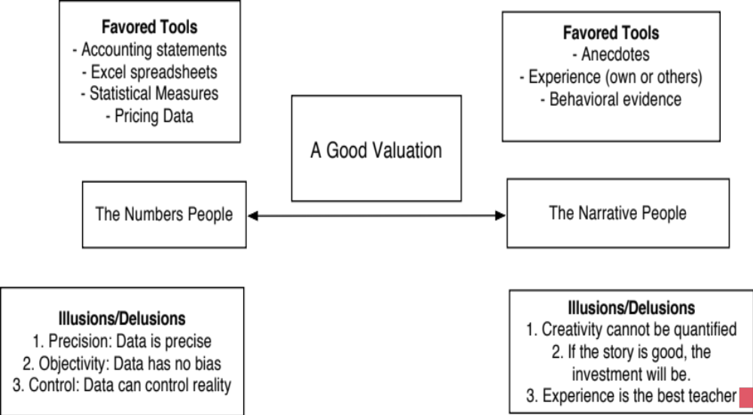
III. Don’t mistake modeling for valuation

Slide 49
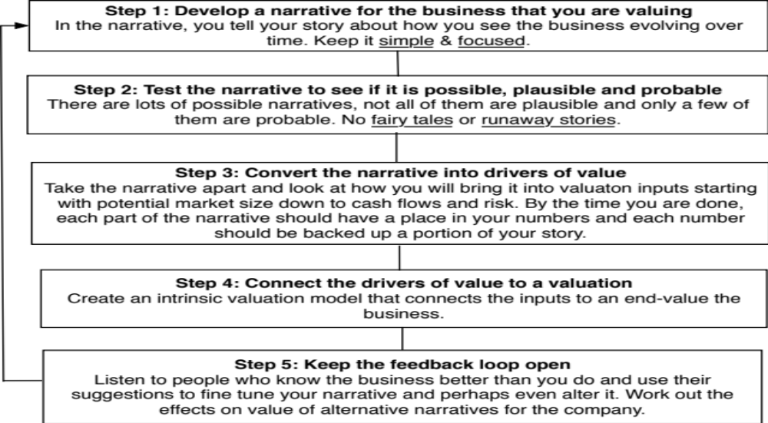
From story to numbers and beyond..

Slide 50
Step Zero: Survey the landscape
Every valuation starts with a narrative, a story that you see unfolding for your company in the future.
In developing this narrative, you will be making assessments of
  Your company (its products, its management and its history.
  The market or markets that you see it growing in.
  The competition it faces and will face.
  The macro environment in which it operates.

Slide 51
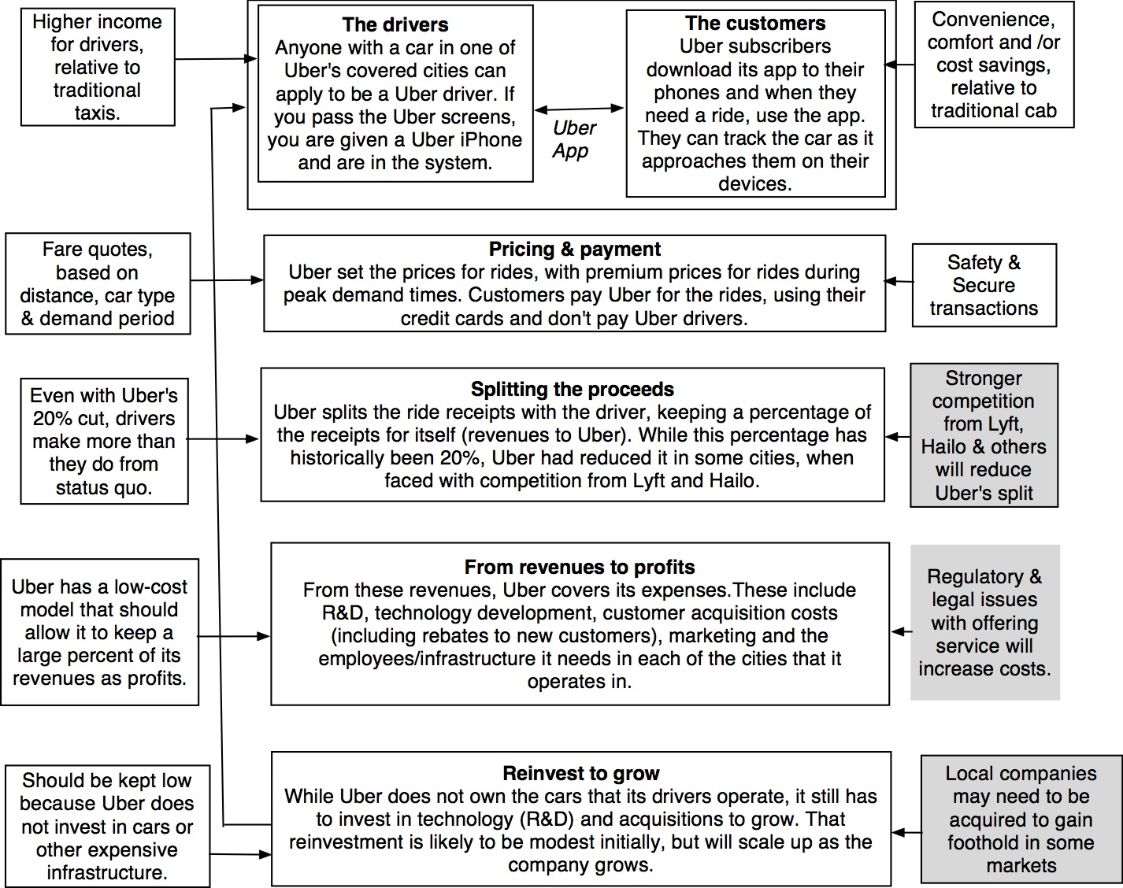
Understanding Uber

Slide 52
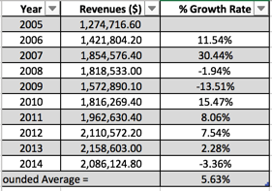
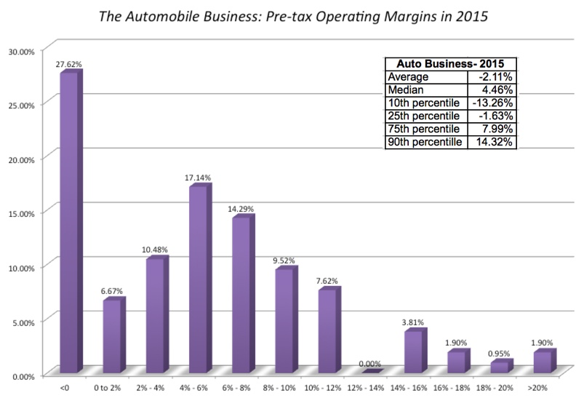
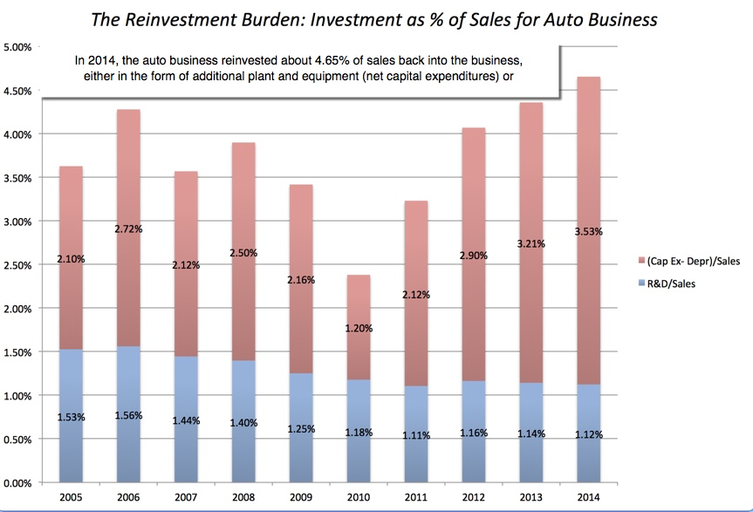
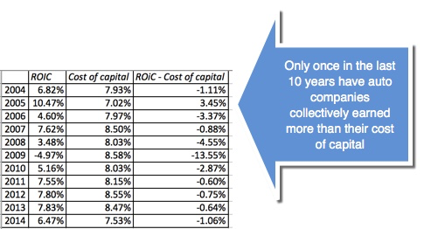
Low Growth
The Auto Business
Low Margins
+
High & Increasing Reinvestment
Bad Business
=

Slide 53
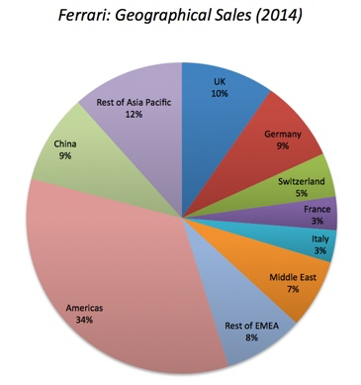
What makes Ferrari different?
Ferrari sold only 7,255 cars in all of 2014
Ferrari sales (in units) have grown very little in the last decade & have been stable
Ferrari had a profit margin of 18.2%, in the 95th percentile, partly because of its high prices and partly because it spends little on advertising.
Ferrari has not invested in new plants.

Slide 54
Shell: The Oil Business
Its collective fortunes rest almost entirely on commodity prices (oil & gas), which are volatile and impossible to predict. | The competitive advantages in this business come from Access to lower-cost reserves, which you either acquire or are endowed with. Survival skills, to weather the inevitable drops in oil prices, which will be a function of size and leverage Only marginally from management skills, to the extent that they affect the first two.
The risks in this business come from the swings in oil prices for all firms, but there is a risk of a collision with nature. Your supplies of fossil fuels are finite, and you have the added issue of global warming (whatever your views on it) and how it will play out as higher costs and more restrictions.

Slide 55
Shell: The Clean Energy Business
Its collective fortunes rest first on commodity prices (oil & gas), which are volatile and impossible to predict. It is aided and abetted by subsidies from governments and other entities. | The competitive advantages in this business come from Technology, to deliver energy at lower cost & higher output. Cost advantages, in established green energy businesses, either because you have a natural advantage or because of economies of scale. Playing the subsidy game better.
The risks in this business come from technological uncertainty (if you are playing the technology game), from your competitors being able to reduce costs more than you are or a tilting of the subsidy game away from you.

Slide 56
Step 1: Create a narrative for the future
Every valuation starts with a narrative, a story that you see unfolding for your company in the future.
In developing this narrative, you will be making assessments of your company (its products, its management), the market or markets that you see it growing in, the competition it faces and will face and the macro environment in which it operates.
  Rule 1: Keep it simple.
  Rule 2: Keep it focused.

Slide 57
The Uber Narrative in June 2014
In June 2014, my initial narrative for Uber was that it would be
An urban car service business: I saw Uber primarily as a force in urban areas and only in the car service business.
Which would expand the business moderately (about 40% over ten years) by bringing in new users.
With local networking benefits: If Uber becomes large enough in any city, it will quickly become larger, but that will be of little help when it enters a new city.
Maintain its revenue sharing (20%) system due to strong competitive advantages (from being a first mover).
And its existing low-capital business model, with drivers as contractors and very little investment in infrastructure.

Slide 58
The Ferrari Narrative at the time of its IPO in October 2015
Ferrari will stay an exclusive auto club, deriving its allure from its scarcity and the fact that only a few own Ferraris.
By staying exclusive, the company gets three benefits:
  It can continue to charge nose bleed prices for its cars and sell them with little or no advertising.
  It does not need to invest in new assembly plants, since it does not plan to ramp up production.
  It sells only to the super rich, who are unaffected by overall economic conditions or market crises.

Slide 59
The Shell Narrative in 2016
What business is Shell in?
  The Oil Business
  The Energy Business
What are its competitive advantages?
  How strong are they?
  How sustainable are they?
How do you see the company evolving in this business?
  Shrinking (If so, how?)
  Holding your own
  Growing (If so, how?)

Slide 60
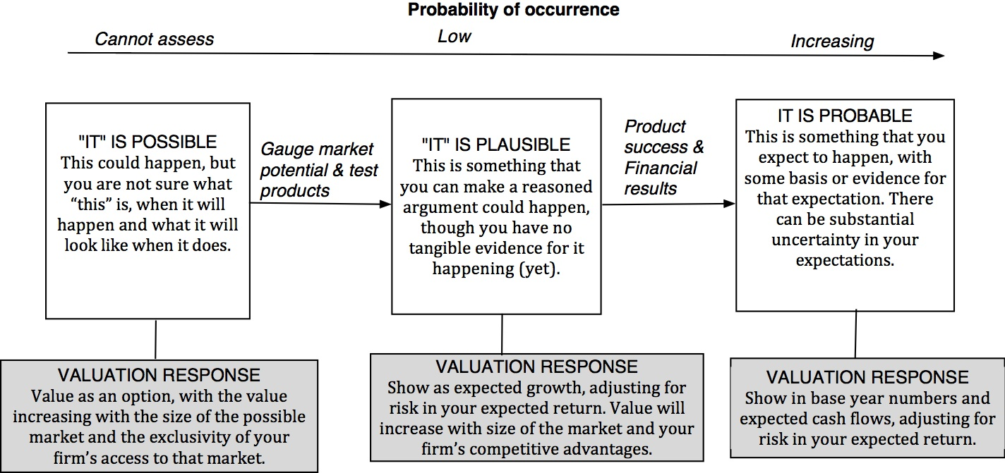
Step 2: Check the narrative against history, economic first principles & common sense

Slide 61
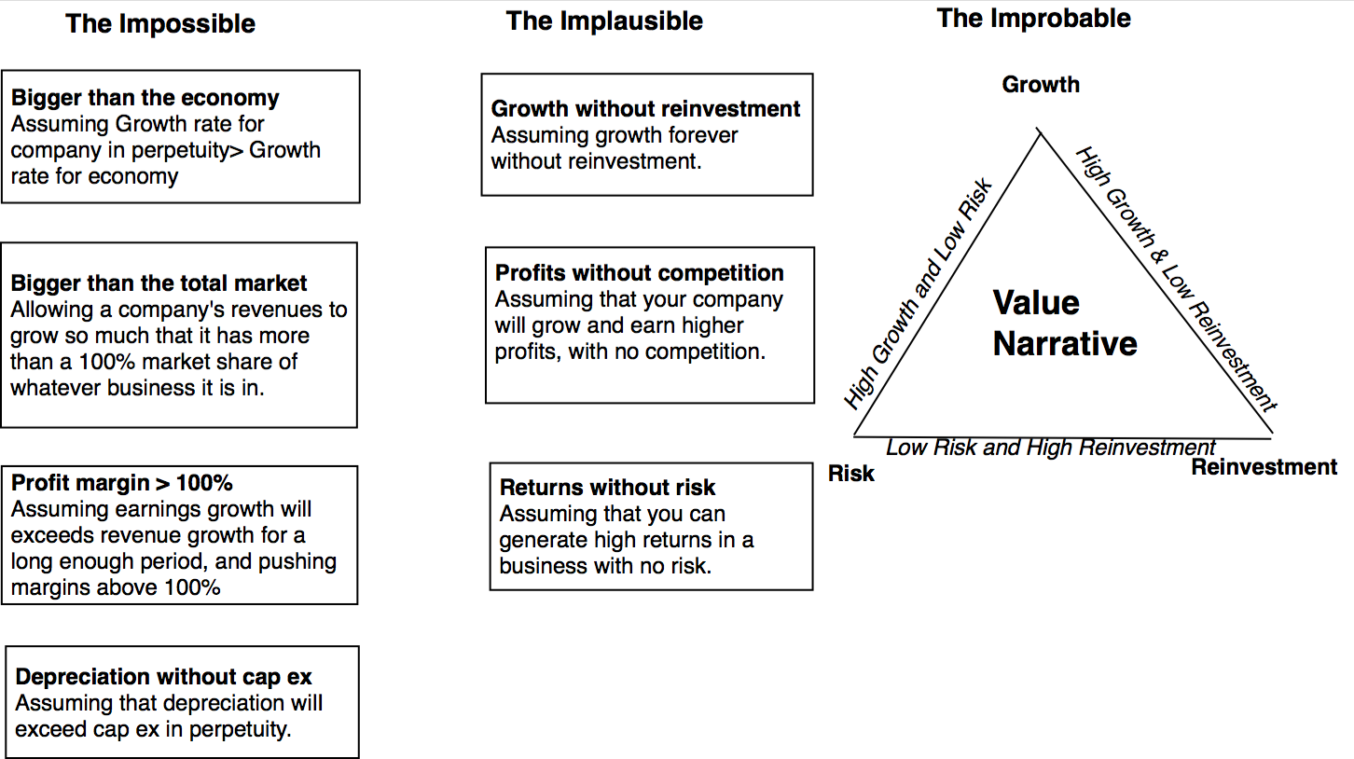
The Impossible, The Implausible and the Improbable

Slide 62
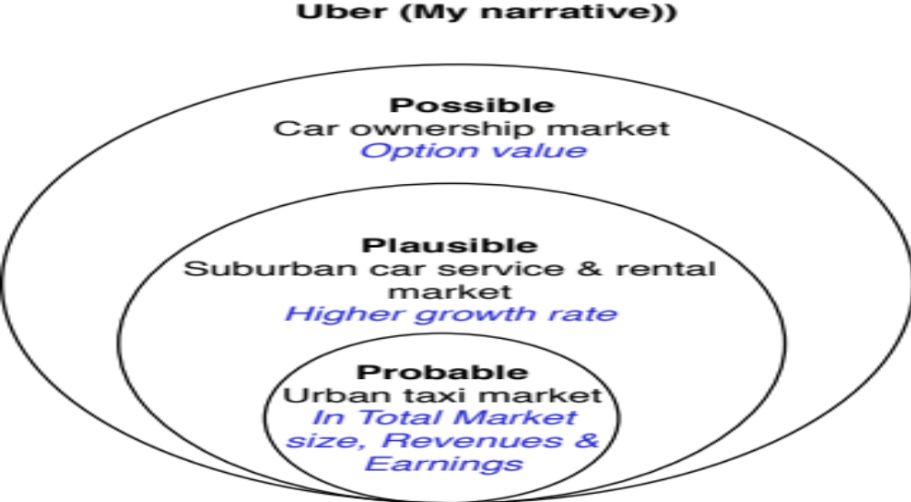
Uber: Possible, Plausible and Probable

Slide 63
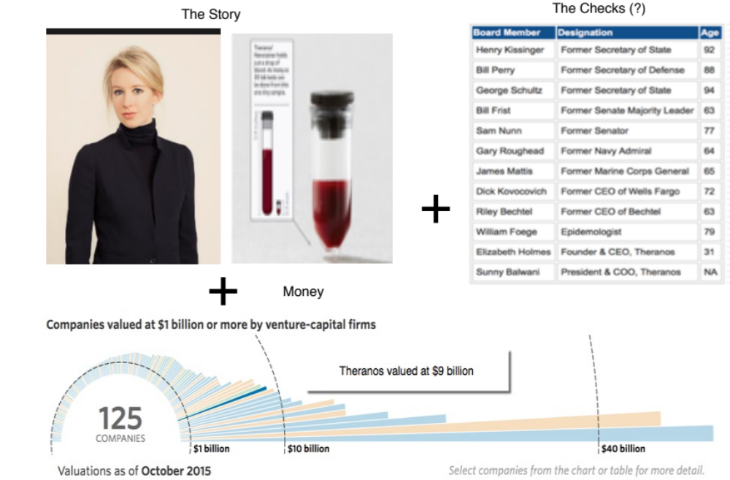
The Impossible: The Runaway Story

Slide 64
Step 3: Connect your narrative to key drivers of value

Slide 65
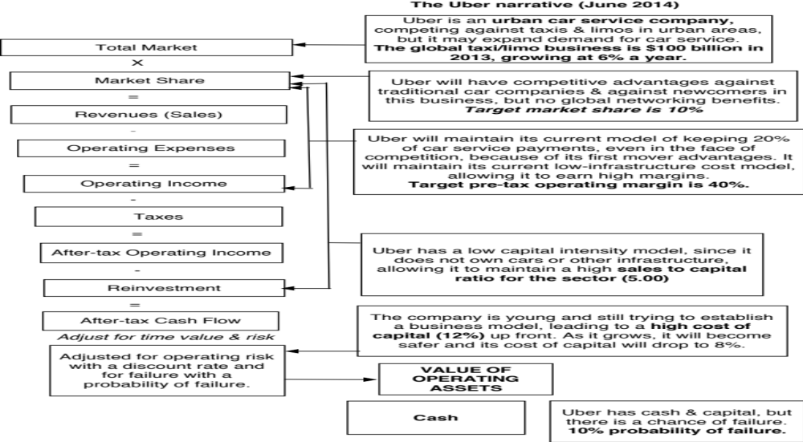
Uber: From Story to Numbers

Slide 66
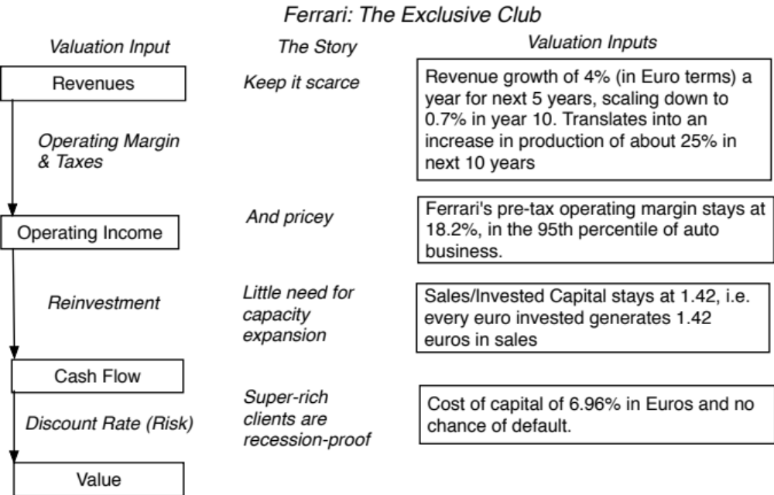
Ferrari: From story to numbers

Slide 67
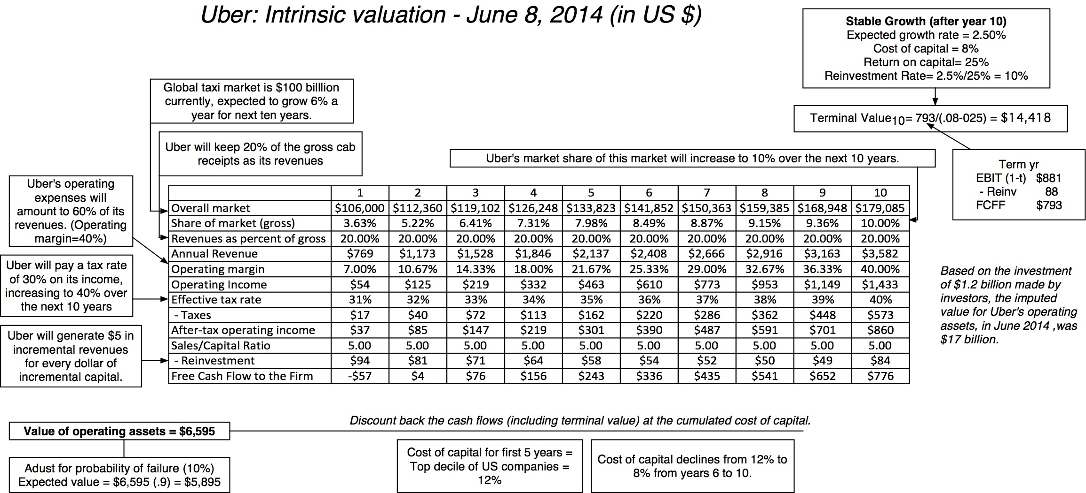
Step 4: Value the company (Uber)

Slide 68
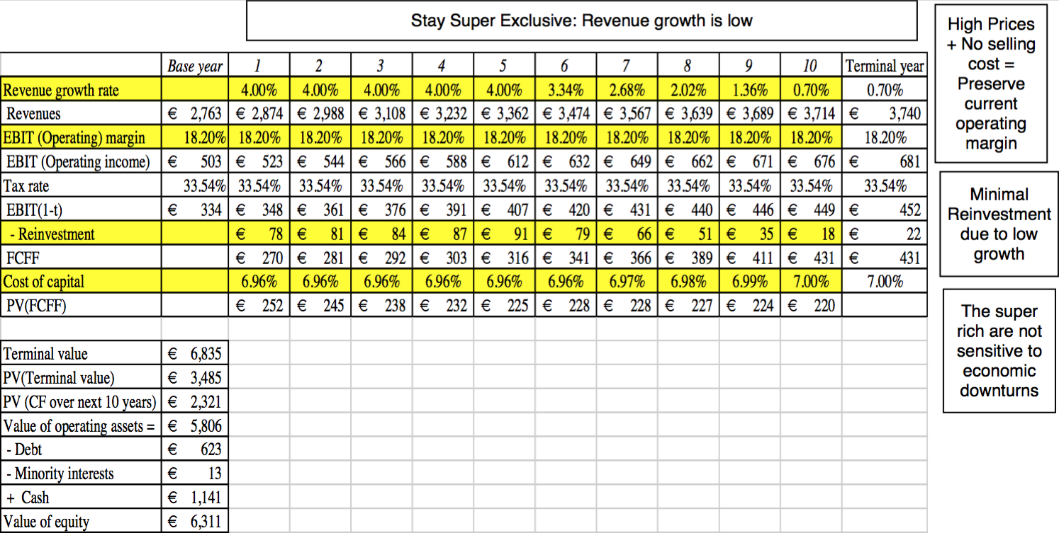
Ferrari: The “Exclusive Club” Value

Slide 69
Shell: The Oil Play

Slide 70
Step 5: Keep the feedback loop open
When you tell a story about a company (either explicitly or implicitly), it is natural to feel attached to that story and to defend it against all attacks. Nothing can destroy an investor more than hubris.
Being open to other views about a company is not easy, but here are some suggestions that may help:
  Face up to the uncertainty in your own estimates of value.
  Present the valuation to people who don’t think like you do.
  Create a process where people who disagree with you the most have a say.
  Provide a structure where the criticisms can be specific and pointed, rather than general.

Slide 71
The Gurley Pushback
Not just car service company.: Uber is a car company, not just a car service company, and there may be a day when consumers will subscribe to a Uber service, rather than own their own cars. It could also expand into logistics, i.e., moving and transportation businesses.
Not just urban: Uber can create new demands for car service in parts of the country where taxis are not used (suburbia, small towns).
Global networking benefits: By linking with technology and credit card companies, Uber can have global networking benefits.

Slide 72
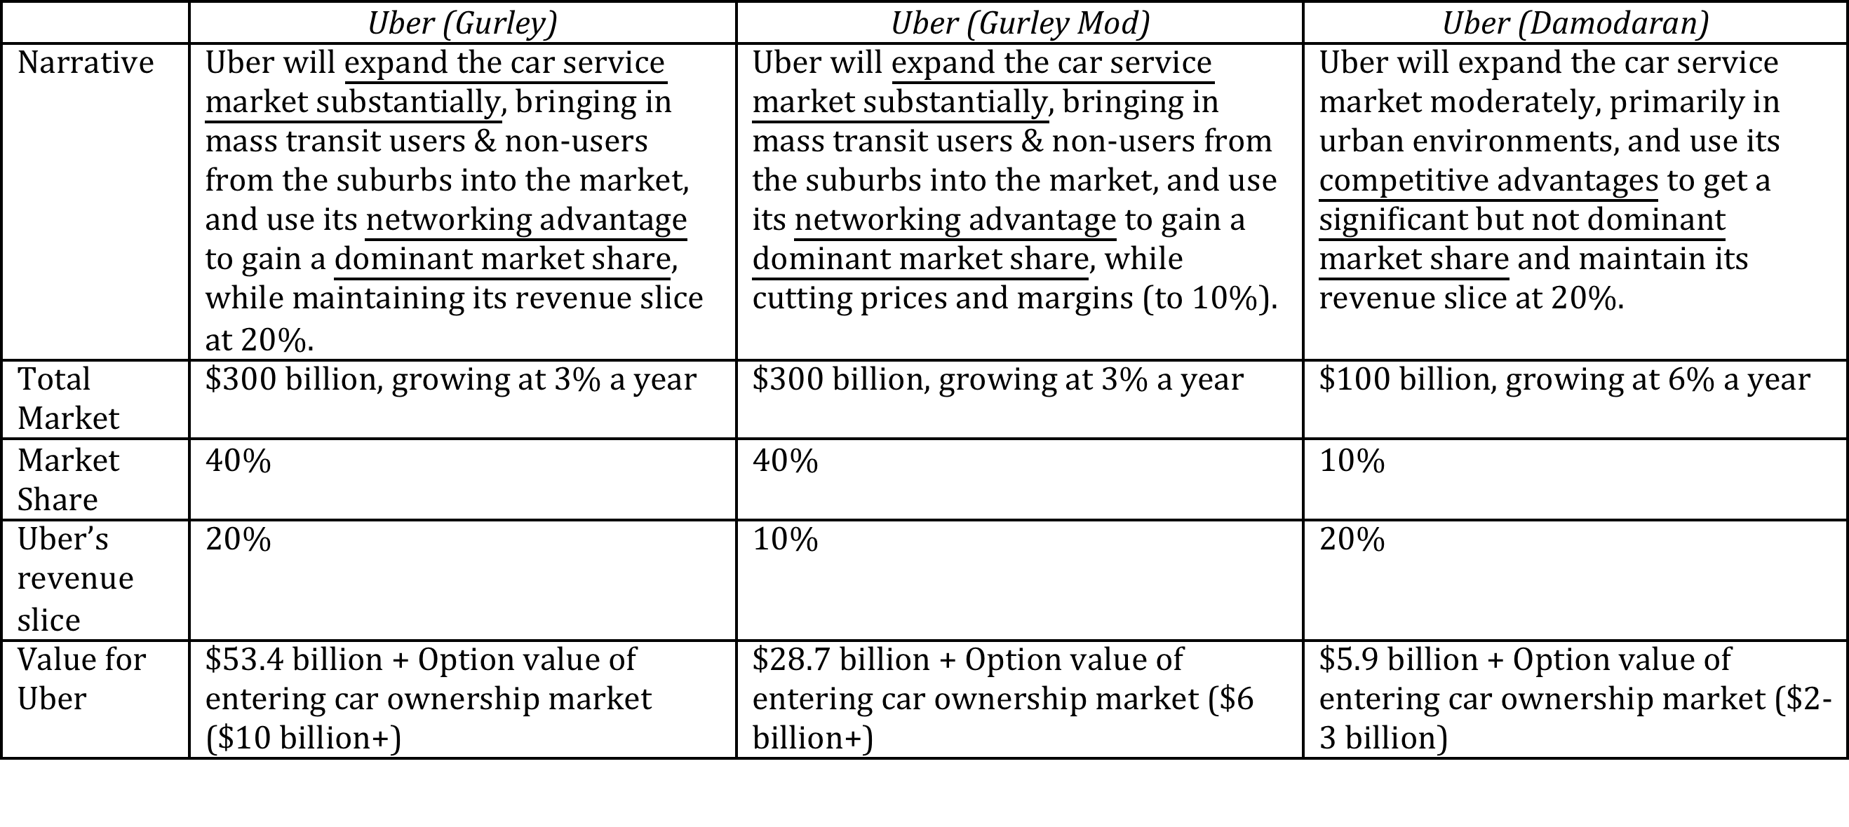
Valuing Bill Gurley’s Uber narrative

Slide 73
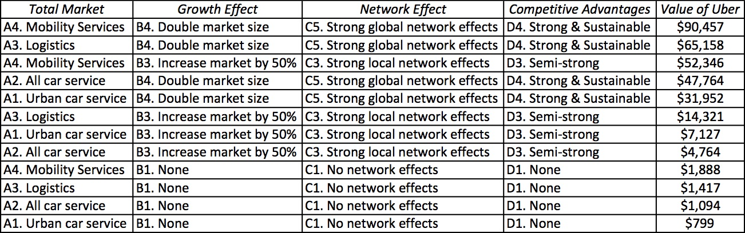
Different narratives, Different Numbers

Slide 74
The Real World Intrudes: Be ready to modify narrative as events unfold
Narrative Break/End | Narrative Shift | Narrative Change (Expansion or Contraction)
Events, external (legal, political or economic) or internal (management, competitive, default), that can cause the narrative to break or end. | Improvement or deterioration in initial business model, changing market size, market share and/or profitability. | Unexpected entry/success in a new market or unexpected exit/failure in an existing market.
Your valuation estimates (cash flows, risk, growth & value) are no longer operative | Your valuation estimates will have to be modified to reflect the new data about the company. | Valuation estimates have to be redone with new overall market potential and characteristics.
Estimate a probability that it will occur & consequences | Monte Carlo simulations or scenario analysis | Real Options

Slide 75
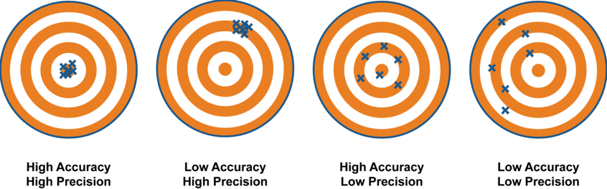

IV. Don’t mistake precision for accuracy.. And accuracy for payoff..
Better accurate than precise
It’s all relative

Slide 76

Valuing a start up is hard to do..

Slide 77
And the dark side will beckon..
With young start up companies, you will be told that it is “too difficult” or even “impossible” to value these companies, because there is so little history and so much uncertainty in the future.
Instead, you will be asked to come over to the “dark side”, where
  You will see value metrics that you have never seen before
  You will hear “macro” stories, justifying value
  You will be asked to play the momentum game
While all of this behavior is understandable, none of it makes the uncertainty go away. You have a choice. You can either hide from uncertainty or face up to it.

Slide 78
Twitter: Setting the table in October 2013
Income Statements
Balance Sheet

Slide 79




Twitter: Priming the Pump for Valuation
1. Make small revenues into big revenues
2. Make losses into profits
My estimate for Twitter: Operating margin of 25% in year 10
3. Reinvest for growth
My estimate for 2023: Overall online advertising market will be close to $200 billion and Twitter will have about 5.7% ($11.5 billion)
My estimate for Twitter: Sales/Capital will be 1.50 for next 10 years

Slide 80


The Cost of Capital for Twitter
Risk in the discount rate
My estimate for Twitter
Survival Risk
My assumption for Twitter

Slide 81


Slide 82
A sobering reminder: You will be “wrong” and it is okay
No matter how careful you are in getting your inputs and how well structured your model is, your estimate of value will change both as new information comes out about the company, the business and the economy.
As information comes out, you will have to adjust and adapt your model to reflect the information. Rather than be defensive about the resulting changes in value, recognize that this is the essence of risk.
Remember that it is not just your value that is changing, but so is the price, and the price will change a great deal more than the value.

Slide 83



And your value is not a fact, but an estimate..

Slide 84


Forecasting in the face of uncertainty. A test:
In which of these two cities would you find it easier to forecast the weather?

Slide 85



But the payoff is greatest where there is the most uncertainty…

Slide 86

V. Don’t mistake price for value!

Slide 87

Test 1: Are you pricing or valuing?

Slide 88

Test 2: Are you pricing or valuing?

Slide 89
Test 3: Are you pricing or valuing?
 | 1 | 2 | 3 | 4 | 5
EBITDA | $100.00 | $120.00 | $144.00 | $172.80 | $207.36
- Depreciation | $20.00 | $24.00 | $28.80 | $34.56 | $41.47
EBIT | $80.00 | $96.00 | $115.20 | $138.24 | $165.89
- Taxes | $24.00 | $28.80 | $34.56 | $41.47 | $49.77
EBIT (1-t) | $56.00 | $67.20 | $80.64 | $96.77 | $116.12
+ Depreciation | $20.00 | $24.00 | $28.80 | $34.56 | $41.47
- Cap Ex | $50.00 | $60.00 | $72.00 | $86.40 | $103.68
- Chg in WC | $10.00 | $12.00 | $14.40 | $17.28 | $20.74
FCFF | $16.00 | $19.20 | $23.04 | $27.65 | $33.18
Terminal Value |  |  |  |  | $1,658.88
Cost of capital | 8.25% | 8.25% | 8.25% | 8.25% | 8.25%
Present Value | $14.78 | $16.38 | $18.16 | $20.14 | $1,138.35
Value of operating assets today | $1,207.81
+ Cash | $125.00
- Debt | $200.00
Value of equity | $1,132.81

Slide 90

The determinants of price

Slide 91

Multiples and Comparable Transactions

Slide 92
To be a better pricer, here are four suggestions
Check your multiple or consistency/uniformity
  In use, the same multiple can be defined in different ways by different users. When comparing and using multiples, estimated by someone else, it is critical that we understand how the multiples have been estimated
Look at all the data, not just the key statistics
  Too many people who use a multiple have no idea what its cross sectional distribution is. If you do not know what the cross sectional distribution of a multiple is, it is difficult to look at a number and pass judgment on whether it is too high or low.
Don’t forget the fundamentals ultimately matter
  It is critical that we understand the fundamentals that drive each multiple, and the nature of the relationship between the multiple and each variable.
Don’t define comparables based only on sector
  Defining the comparable universe and controlling for differences is far more difficult in practice than it is in theory.
Notes:
While we can rail about the fact that a valuation based upon multiples is not as detailed as a discounted cashflow valuation,, the reality is that analysts will continue to use multiples to value companies and that we will often have to use these valuations.
Given this reality, we have to think about how best to use multiples. These four steps represent a way in which we can deconstruct any multiple, understand how to use it well and discover when it is being misused.

Slide 93
Pricing Twitter: Start with the “comparables”
Company | Market Cap | Enterprise value | Revenues | EBITDA | Net Income | Number of users (millions) | EV/User | EV/Revenue | EV/EBITDA | PE
Facebook | $173,540.00 | $160,090.00 | $7,870.00 | $3,930.00 | $1,490.00 | 1230.00 | $130.15 | 20.34 | 40.74 | 116.47
Linkedin | $23,530.00 | $19,980.00 | $1,530.00 | $182.00 | $27.00 | 277.00 | $72.13 | 13.06 | 109.78 | 871.48
Pandora | $7,320.00 | $7,150.00 | $655.00 | -$18.00 | -$29.00 | 73.40 | $97.41 | 10.92 | NA | NA
Groupon | $6,690.00 | $5,880.00 | $2,440.00 | $125.00 | -$95.00 | 43.00 | $136.74 | 2.41 | 47.04 | NA
Netflix | $25,900.00 | $25,380.00 | $4,370.00 | $277.00 | $112.00 | 44.00 | $576.82 | 5.81 | 91.62 | 231.25
Yelp | $6,200.00 | $5,790.00 | $233.00 | $2.40 | -$10.00 | 120.00 | $48.25 | 24.85 | 2412.50 | NA
Open Table | $1,720.00 | $1,500.00 | $190.00 | $63.00 | $33.00 | 14.00 | $107.14 | 7.89 | 23.81 | 52.12
Zynga | $4,200.00 | $2,930.00 | $873.00 | $74.00 | -$37.00 | 27.00 | $108.52 | 3.36 | 39.59 | NA
Zillow | $3,070.00 | $2,860.00 | $197.00 | -$13.00 | -$12.45 | 34.50 | $82.90 | 14.52 | NA | NA
Trulia | $1,140.00 | $1,120.00 | $144.00 | -$6.00 | -$18.00 | 54.40 | $20.59 | 7.78 | NA | NA
Tripadvisor | $13,510.00 | $12,860.00 | $945.00 | $311.00 | $205.00 | 260.00 | $49.46 | 13.61 | 41.35 | 65.90
 |  |  |  |  |  | Average | $130.01 | 11.32 | 350.80 | 267.44
 |  |  |  |  |  | Median | $97.41 | 10.92 | 44.20 | 116.47

Slide 94
Read the tea leaves: See what the market cares about
 | Market Cap | Enterprise value | Revenues | EBITDA | Net Income | Number of users (millions)
Market Cap | 1.
Enterprise value | 0.9998 | 1.
Revenues | 0.8933 | 0.8966 | 1.
EBITDA | 0.9709 | 0.9701 | 0.8869 | 1.
Net Income | 0.8978 | 0.8971 | 0.8466 | 0.9716 | 1.
Number of users (millions) | 0.9812 | 0.9789 | 0.8053 | 0.9354 | 0.8453 | 1.
Twitter had 240 million users at the time of its IPO. What price would you attach to the company?

Slide 95
Use the “market metric” and “market price”
The most important variable, in late 2013, in determining market value and price in this sector (social media, ill defined as that is) is the number of users that a company has.
Looking at comparable firms, it looks like the market is paying about $100/user in valuing social media companies, with a premium for “predictable” revenues (subscriptions) and user intensity.
Twitter has about 240 million users and can be valued based on the $100/user:
Enterprise value = 240 * 100 = $24 billion

Slide 96
VI. Investing is an act of faith..
When investing, we are often told that if you are virtuous (careful in your research, good at valuation, have a long time horizon), you will be rewarded (with high returns).
That pitch is amplified by anecdotal evidence of righteous ones, i.e., those who have followed the path to success.
Those who chose not to be virtuous are labeled as “speculators”, viewed as shallow and deserving of the fate that awaits them.
If you have faith in investing, you will be tested.

Slide 97

Active Investing is a loser’s game

Slide 98
And it stays that way across styles..
 | % of US Mutual Funds that beat their respective indices
 | Value | Growth | Core | All
Large | 82.17% | 86.54% | 88.26% | 84.15%
Mid-cap | 70.27% | 81.48% | 76.51% | 76.69%
Small | 92.31% | 91.89% | 91.44% | 90.13%
All Equity |  |  |  | 88.43%
Real Estate |  |  |  | 82.64%
S&P computes these percentages for the last year, the last 3 years & the last 10 years. There is not a single period or a single fund grouping where the number is <50%.

Slide 99

And the ”smart” money does not stay smart for very long

Slide 100
Investment Heaven is a promise, not a guarantee..

Slide 101

Follow the yellow brick road..

