Slide 1
Valuation: Packet 2
Relative Valuation, Asset-based valuation and Private Company Valuation
Aswath Damodaran
Updated: January 2024
Notes:
Most self proclaimed experts on valuation are really experts on pricing (which is what relative valuation is all about…)

Slide 2
The Essence of Relative Valuation (Pricing)
In relative valuation, the price of an asset is compared to the prices assessed by the market for similar or comparable assets.
To do relative valuation then,
  we need to identify comparable assets and obtain market pricing for these assets
  convert these market prices into standardized prices, since the absolute prices cannot be compared This process of standardizing creates price multiples.
  compare the standardized price or multiple for the asset being analyzed to the standardized prices for comparable assets, controlling for any differences between the firms that might affect the multiple, to judge whether the asset is under or over priced.
Notes:
These are the three ingredients you find in almost every equity research report - comparables, a multiple (or standardized price) and a story (which represents the attempt to control for differences).

Slide 3
Relative valuation is pervasive…
Most asset valuations are relative.
Most equity valuations on Wall Street are relative valuations.
  Almost 85% of equity research reports are based upon a multiple and comparables.
  More than 50% of all acquisition valuations are based upon multiples
  Rules of thumb based on multiples are not only common but are often the basis for final valuation judgments.
While there are more discounted cashflow valuations in consulting and corporate finance, they are often relative valuations masquerading as discounted cash flow valuations.
  The objective in many discounted cashflow valuations is to back into a number that has been obtained by using a multiple.
  The terminal value in a significant number of discounted cashflow valuations is estimated using a multiple.
Notes:
Much of what passes for valuation on Wall Street is really pricing.

Slide 4
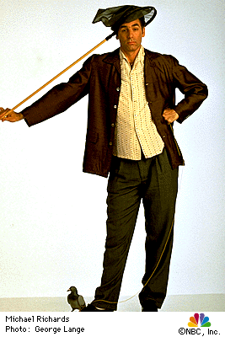
Why relative valuation?
“If you think I’m crazy, you should see the guy who lives across the hall”
Jerry Seinfeld talking about Kramer in a Seinfeld episode
“ A little inaccuracy sometimes saves tons of explanation”
H.H. Munro
“ If you are going to screw up, make sure that you have lots of company”
Ex-portfolio manager
Notes:
Most valuations that you see are relative valuations. There are three reasons why relative valuations are so popular:
If your objective is to buy or sell something, not matter what the price, you can justify your decision using relative valuation. There will always be some other assets out there which are more underpriced or overpriced than the asset you are buying or selling.
In contrast to the detail and time needed for discounted cashflow valuation, relative valuation is quicker and seems to require fewer (explicit) assumptions about the future.
Discounted cash flow valuation, by focusing on fundamentals, and ignoring the market mood, leads to contrarian valuations. While the odds of winning in the long term may be higher, there is also the danger that if you are wrong, you will be wrong alone.

Slide 5
The Market Imperative….
Relative valuation is much more likely to reflect market perceptions and moods than discounted cash flow valuation. This can be an advantage when it is important that the price reflect these perceptions as is the case when
  the objective is to sell a security at that price today (as in the case of an IPO)
  investing on “momentum” based strategies
With relative valuation, there will always be a significant proportion of securities that are under valued and over valued.
Since portfolio managers are judged based upon how they perform on a relative basis (to the market and other money managers), relative valuation is more tailored to their needs
Relative valuation generally requires less information than discounted cash flow valuation (especially when multiples are used as screens)
Notes:
Since relative valuation models more closely mirror the market, they are less likely to leave their adherents on the fringes. There is safety in numbers - a portfolio manages is less likely to lose his or her job if he or she makes the same mistake as other portfolio managers.
Unlike discounted cash flow models, you will always find under or over valued stocks using multiples.

Slide 6

Multiples are just standardized estimates of price…
Notes:
The distinction between price (representing equity value) and value (representing the combined market value of equity and debt) and enterprise value (representing firm value - cash and marketable securities) should be noted.
Note that the denominator can be a number from the income statement (revenues, earnings) or one from the balance sheet (book value). It can even be a non-financial input (number of employees or units of the product produced).

Slide 7
The Four Steps to Deconstructing Multiples
Define the multiple
  In use, the same multiple can be defined in different ways by different users. When comparing and using multiples, estimated by someone else, it is critical that we understand how the multiples have been estimated
Describe the multiple
  Too many people who use a multiple have no idea what its cross sectional distribution is. If you do not know what the cross sectional distribution of a multiple is, it is difficult to look at a number and pass judgment on whether it is too high or low.
Analyze the multiple
  It is critical that we understand the fundamentals that drive each multiple, and the nature of the relationship between the multiple and each variable.
Apply the multiple
  Defining the comparable universe and controlling for differences is far more difficult in practice than it is in theory.
Notes:
While we can rail about the fact that a valuation based upon multiples is not as detailed as a discounted cashflow valuation,, the reality is that analysts will continue to use multiples to value companies and that we will often have to use these valuations.
Given this reality, we have to think about how best to use multiples. These four steps represent a way in which we can deconstruct any multiple, understand how to use it well and discover when it is being misused.

Slide 8
Definitional Tests
Is the multiple consistently defined?
  Proposition 1: Both the value (the numerator) and the standardizing variable ( the denominator) should be to the same claimholders in the firm. In other words, the value of equity should be divided by equity earnings or equity book value, and firm value should be divided by firm earnings or book value.
Is the multiple uniformly estimated?
  The variables used in defining the multiple should be estimated uniformly across assets in the “comparable firm” list.
  If earnings-based multiples are used, the accounting rules to measure earnings should be applied consistently across assets. The same rule applies with book-value based multiples.
Notes:
Consistent definition:
Consider two widely used multiples that are consistently defined. In the price-earnings ratio (PE), the numerator is equity value per share and the denominator is equity earnings per share. In the enterprise value/ EBITDA multiple, the numerator is firm value and the denominator is a pre-tax cash flow to all claimholders in the firm. In contrast, the price to EBITDA multiple is inconsistent. Why is this a problem? If you are comparing firms with different debt ratios, the firms will more debt will look cheaper on a price to EBITDA basis.
Uniformally Estimated:
This is actually much more difficult than it looks. Even if accounting standards are the same across firms, you run into two problems:
The degree to which firms bend accounting rules for their own purposes varies across firms. Some firms are inherently more conservative in reporting earnings than others.
The financial year ends at different points for different firms. If the denominator is the earnings in the most recent financial year, the multiple may not be comparable if some firms have December year-ends and some have June year-ends.

Slide 9
Example 1: Price Earnings Ratio: Definition
PE = Market Price per Share / Earnings per Share
There are many variants on the basic PE ratio in use. They are based upon how the price and the earnings are defined.
  Price: is usually the current price
  is sometimes the average price for the year
  EPS: EPS in most recent financial year
  EPS in trailing 12 months
  Forecasted earnings per share next year
  Forecasted earnings per share in future year
Notes:
This is only the tip of the iceberg. You can have EPS before and after extraordinary items, primary and diluted EPS..
When you are negotiating with someone else and you are both using PE ratios to make your case, the first step is to make sure that you are using the same PE ratio.
There is also the tendency on the part of analysts to pick the definition of pE that best fits their biases. For instance, bullish analysts in the 1990s almost always used forward PE whereas bearish analysts used trailing PE. Since earnings were rising the former were generally much lower than the latter.

Slide 10
Example 2: Staying on PE ratios
Assuming that you are comparing the PE ratios across technology companies, many of which have options outstanding. What measure of PE ratio would yield the most consistent comparisons?
  Price/ Primary EPS (actual shares, no options)
  Price/ Fully Diluted EPS (actual shares + all options)
  Price/ Partially Diluted EPS (counting only in-the-money options)
  Other
Notes:
The answer is actually none of the above. You do have to control for the number of options outstanding… So using primary EPS is out of the question. The other three approaches treat all options as equivalent (even the one that counts in-the-money options only treats them all the same). To get consistency, you would have to value the options as options:
PE ratio = (Market Capitalization + Estimated Value of Options Outstanding)/ Net Income
Messy…

Slide 11
Example 3: Enterprise Value /EBITDA Multiple
The enterprise value to EBITDA multiple is obtained by netting cash out against debt to arrive at enterprise value and dividing by EBITDA.
Why do we net out cash from firm value?
What happens if a firm has cross holdings which are categorized as:
  Minority interests?
  Majority active interests?
Notes:
The problem with using firm value is that cash is included in the numerator but not in the denominator. That is why the enterprise value version makes more sense…
A broad problem is posed when firms have holdings in other firms. If such holdings are passive, Value to EBITDA multiples will be overstated, since the numerator will include the value of your holdings, while the EBITDA will not include any of the income from these holdings. If such holdings are majority active and consolidated, the value to EBITDA will be understated because the numerator will include only the portion of the equity you own in the subsidiary but the EBITDA will include all of the EBITDA in the subsidiary.
The safest thing to do (assuming you can do this) is to net out the market value of your holdings from the numerator (for both active and passive holdings) and the EBITDA of your holdings from the denominator ( for majority active holdings)

Slide 12
Example 4: A Housing Price Multiple
The bubbles and busts in housing prices has led investors to search for a multiple that they can use to determine when housing prices are getting out of line. One measure that has acquired adherents is the ratio of housing price to annual net rental income (for renting out the same house). Assume that you decide to compute this ratio and compare it to the multiple at which stocks are trading. Which valuation ratio would be the one that corresponds to the house price/rent ratio?
Price Earnings Ratio
EV to Sales
EV to EBITDA
EV to EBIT
Notes:
Net Rental income is closest to EBIT, as long as you don’t net out interest expenses and the house price is closest to EV. So. EV/EBIT is your best match.

Slide 13
Descriptive Tests
What is the average and standard deviation for this multiple, across the universe (market)?
What is the median for this multiple?
  The median for this multiple is often a more reliable comparison point.
How large are the outliers to the distribution, and how do we deal with the outliers?
  Throwing out the outliers may seem like an obvious solution, but if the outliers all lie on one side of the distribution (they usually are large positive numbers), this can lead to a biased estimate.
Are there cases where the multiple cannot be estimated? Will ignoring these cases lead to a biased estimate of the multiple?
How has this multiple changed over time?
Notes:
Before you use a multiple and develop rules of thumb (8 times EBITDA is cheap), you need to get a sense of the cross-sectional distribution.
Multiples have skewed distributions. Because a multiple cannot be less than zero but can potentially be infinite, the averages for multiples will be much higher than their medians, and the difference will increase as the outliers become larger. Many services cap outliers to prevent them from altering the averages too much, results…
The PE ratio cannot be estimated when the earnings per share are negative. Thus, if you have a sample of 20 firms and 10 have negative earnings, you will be able to compute the PE ratio for only the 10 that have positive earnings and will throw out the remaining firms. This will induce a bias in your sample. One way to avoid this is to take the cumulative values for market capitalization and net income for all 20 firms, and compute a PE ratio based upon the cumulated values. The resulting PE ratio will generally be much higher….

Slide 14
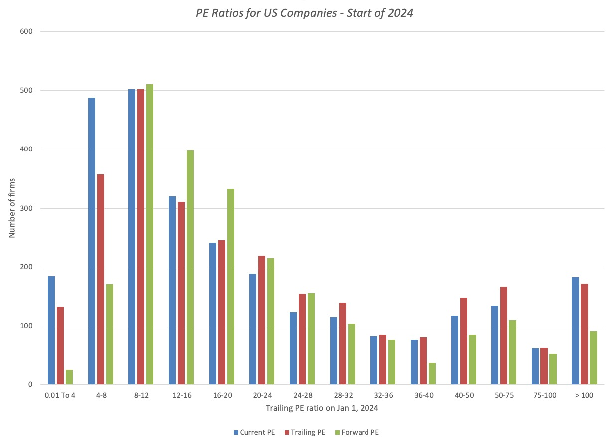
1. Multiples have skewed distributions… US company PE Ratios
Notes:
This graph for all U.S. firms with data available on the Value Line CD ROM (contains about 7200 firms in the overall sample). Notice that the distributions are skewed to the left and that we have capped the PE ratios at 100….

Slide 15
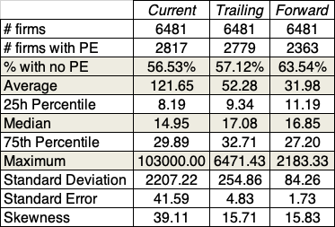
2. Making statistics “dicey”
US firms in January 2024
Notes:
Four things to note…
Notice the number of firms that we have lost in the sample as we compute PE ratios.
You lose even more firms as you go to forward PE, because you need analyst estimates of expected earnings per share to compute this. Any firms not followed by analysts will not have a forward PE…
The means were computed without capping the PE ratios… the outliers (notice the maximum values for the ratios) push the average to almost twice the median.
The median forward PE is higher than the trailing PE which is higher than the current PE…

Slide 16
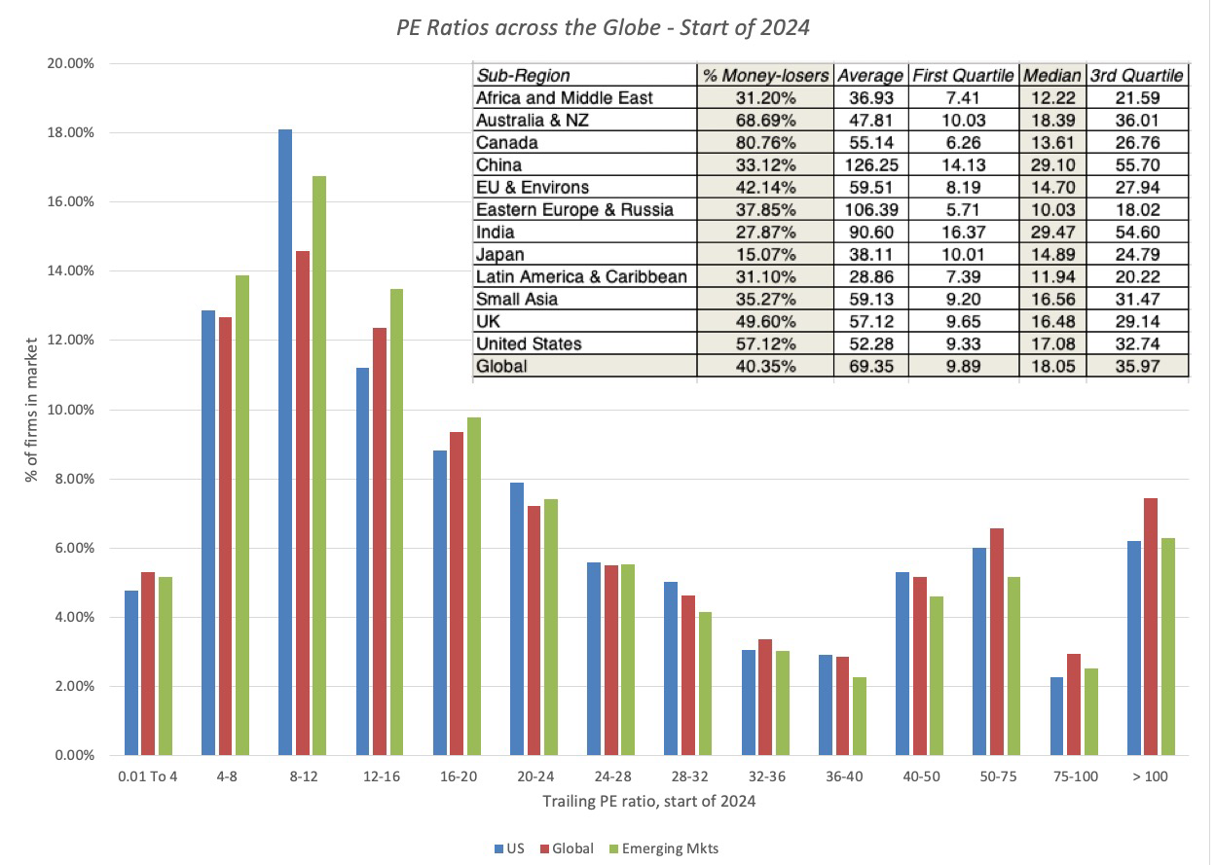
3. Markets have a lot in common : Comparing Global PEs
Notes:
This compares the percentages of firms in each market that trade in each PE ratio class… it is difficult to tell them apart. That is a change from a few years ago, when US and European stocks traded at much higher PE ratios than emerging market stocks. The convergence of PE ratios globally may reflect the blurring of the line between developed and emerging markets.

Slide 17
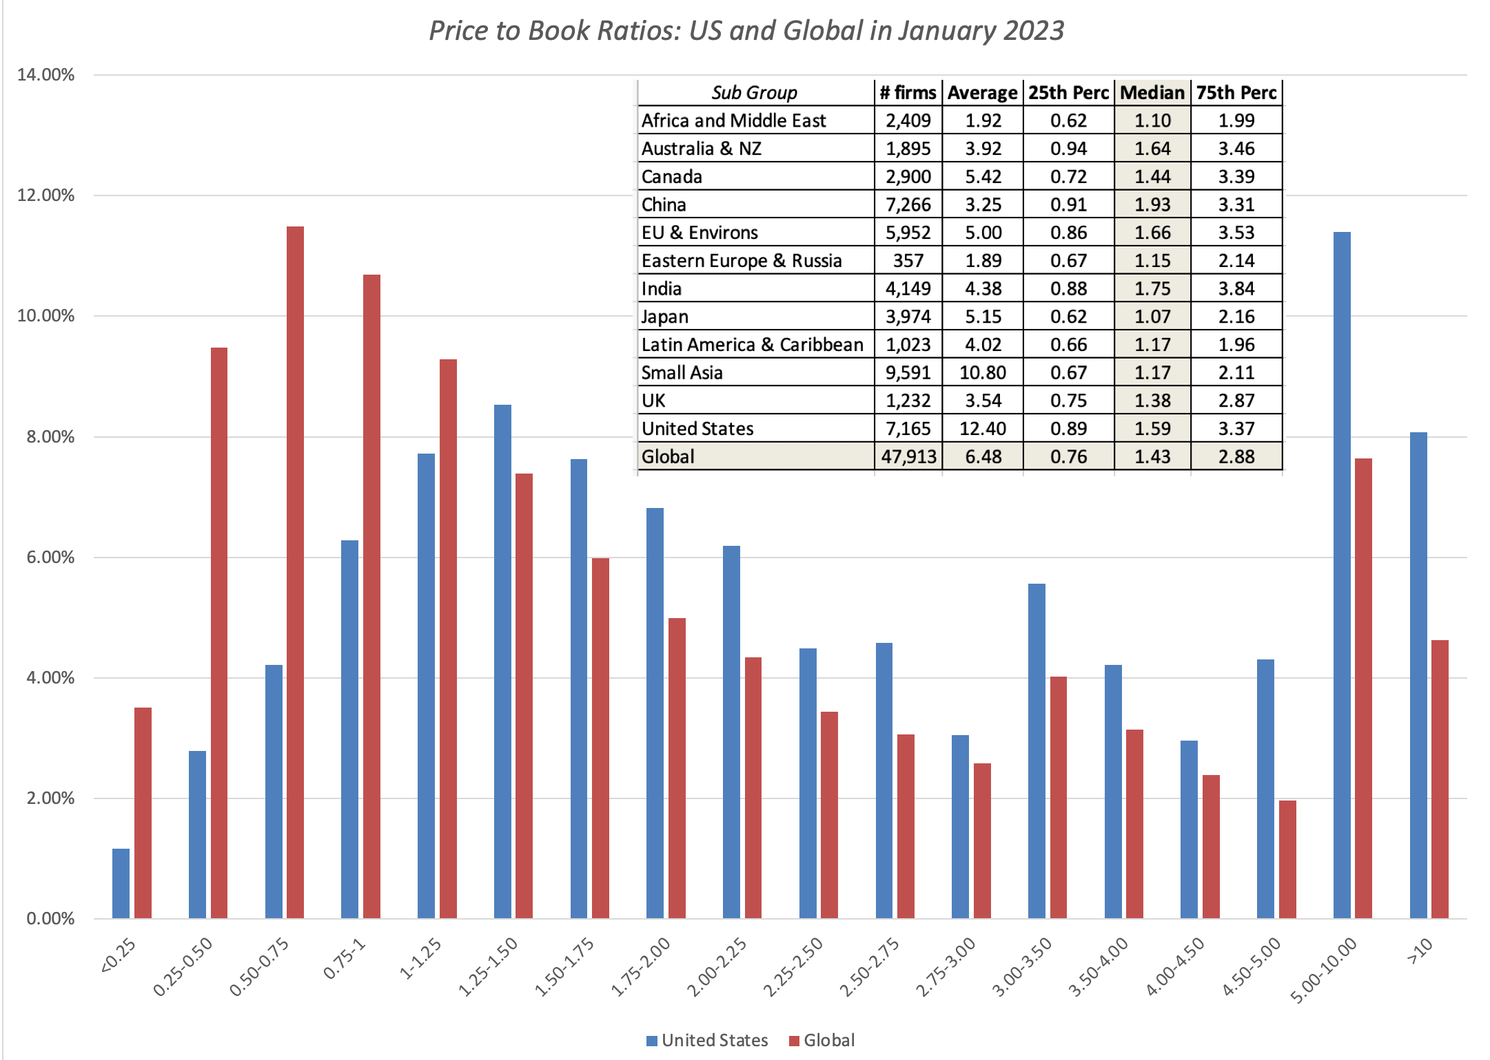
3a. And the differences are sometimes revealing…
Price to Book Ratios across globe – January 2013
Notes:
As with the other multiples, we see convergence across markets and remarkable similarities across the groups. (All of the distributions are skewed, with peaks to the left…)
Japan has the highest percentage of firms that trade at less than book value… It is not coincidence that Japanese firms also earn the lowest ROEs in the world.
The US has the highest price to book ratios in the world. It is no coincidence that stock buybacks (which reduce book equity) are most prevalent in the US.

Slide 18
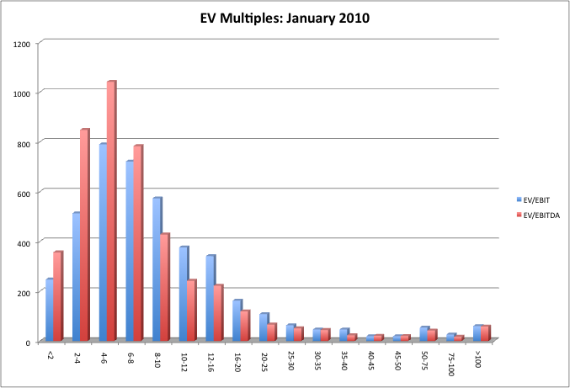
4. Simplistic rules almost always break down…6 times EBITDA was not cheap in 2010…
Notes:
As with the other multiples, a heavily skewed distribution. Suggests that the rule of thumb that is often used by Wall Street (EBITDA multiple less than 8 is cheap) should be used with caution.

Slide 19
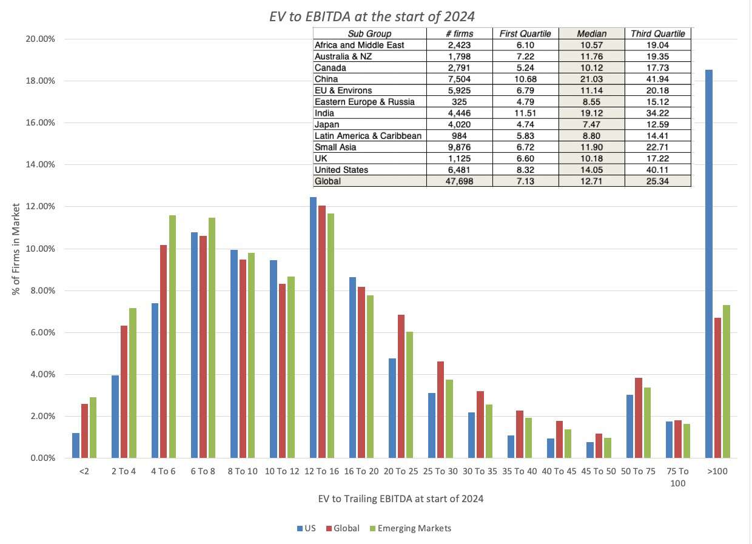
But it may work in 2024, unless you are in Japan or Russia..
Notes:
Having absolute values as cut offs for cheap and expensive across markets will get you into trouble because what is cheap in one market may not be cheap in another. One more reason to let the data determine what is cheap and what is expense.

Slide 20
Analytical Tests
What are the fundamentals that determine and drive these multiples?
  Proposition 2: Embedded in every multiple are all of the variables that drive every discounted cash flow valuation - growth, risk and cash flow patterns.
How do changes in these fundamentals change the multiple?
  The relationship between a fundamental (like growth) and a multiple (such as PE) is almost never linear.
  Proposition 3: It is impossible to properly compare firms on a multiple, if we do not know how fundamentals and the multiple move.
Notes:
Behind every multiple (PE of 22, Value to EBITDA of 9) are implicit assumptions about growth, risk and cash flows.. In fact, you make the same assumptions when you use multiples that you make in discounted cashflow valuation.. The difference is that your assumptions are explicit in the latter. The first step in understanding a multiple is determining its fundamental drives…
Not only is it important that you find the drivers for each multiple, but you need to understand how changes in these drivers change the multiple. For example, we all accept the intuition that a company with a 20% growth rate should have a higher PE than an otherwise similar company with a 10% growth rate, but how much higher? Twice as high (which would make the relationship linear), 2.5 times as high, 1.5 times as high…

Slide 21
A Simple Analytical device
Notes:
Starting with a basic DCF model (equity DCF for an equity multiple & firm DCF for a firm multiple), you can come up with intrinsic value equations for the multiples. Why bother? Because you can then ask the right questions or control for the right variables when using multiples.

Slide 22
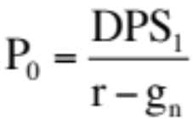
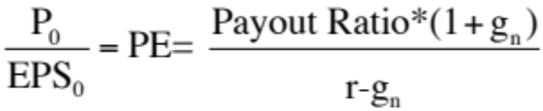
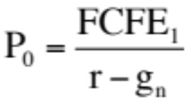
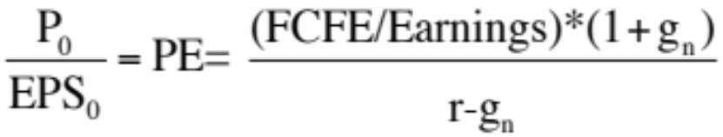
I . PE Ratios
To understand the fundamentals, start with a basic equity discounted cash flow model.
  With the dividend discount model,
  Dividing both sides by the current earnings per share,
  If this had been a FCFE Model,
Notes:
To get to the heart of equity multiples, we start with an equity DCF model. In this case, we consider the simplest equity valuation model - a stable growth dividend discount model. Restated in terms of the PE ratio, we find that the PE ratio fo a stable growth firm can be written in terms of three variables:
The expected growth rate in earnings per share
The riskiness of the equity, which determines the cost of equity
The efficiency with which the firm generates growth, which is measured by how much the firm can pay out or afford to pay out after reinvested to create the growth.

Slide 23
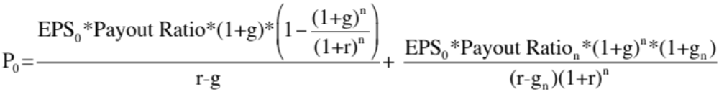
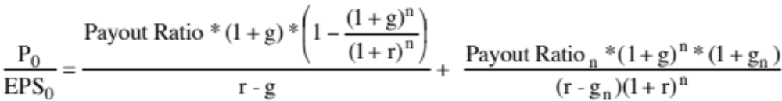
Using the Fundamental Model to Estimate PE For a High Growth Firm
The price-earnings ratio for a high growth firm can also be related to fundamentals. In the special case of the two-stage dividend discount model, this relationship can be made explicit fairly simply:
  For a firm that does not pay what it can afford to in dividends, substitute FCFE/Earnings for the payout ratio.
Dividing both sides by the earnings per share:
Notes:
The value of a stock in a two-stage dividend discount model is the sum of two present values:
The present value of dividends during the high growth phase - this is the first term in the equation above. It is the present value of a growing annuity. (There is no constraint on the growth rate. In fact, this equation will yield the present value of a growing annuity even if g>r… the denominator will become negative but so will the numerator)
The present value of the terminal price… this is the second term in the equation…
The PE ratio for a high growth firm is a function of the same three variables that determine the PE ratio for a stable growth firm, though you have to estimate the parameters twice, once for the high growth phase and once for the stable growth phase.

Slide 24
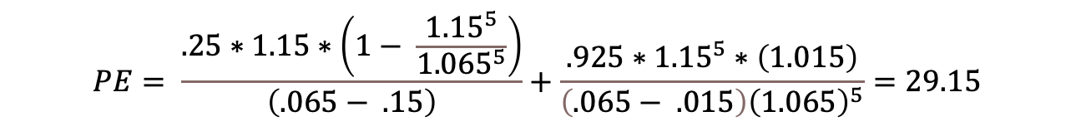
A Simple Example
Assume that you have been asked to estimate the PE ratio for a firm which has the following characteristics:
Variable High Growth Stable Growth
Expected Growth Rate 15% 1.5%
Payout Ratio 25% 92.5% (based on ROE = 20%)
Beta 1.00 1.00
Number of years 5 years Forever after year 5
Riskfree rate = Treasury Bond Rate = 1.5%, ERP = 5%
Required rate of return = 1.5% + 1(5%)= 6.5%
$$PE= \frac{.25∗1.15∗\left(1− \frac{{1.15}^{5}}{{1.065}^{5}}\right)}{\left(.065− .15\right)}+\frac{.925∗{1.15}^{5}∗\left(1.015\right)}{\left(.065− .015\right){\left(1.065\right)}^{5}}=29.15$$
Notes:
For a firm with these characteristics, 28.75 times earnings is a fair price to pay. In fact, if you valued this firm using a dividend discount model, you would get the identical value per share.

Slide 25
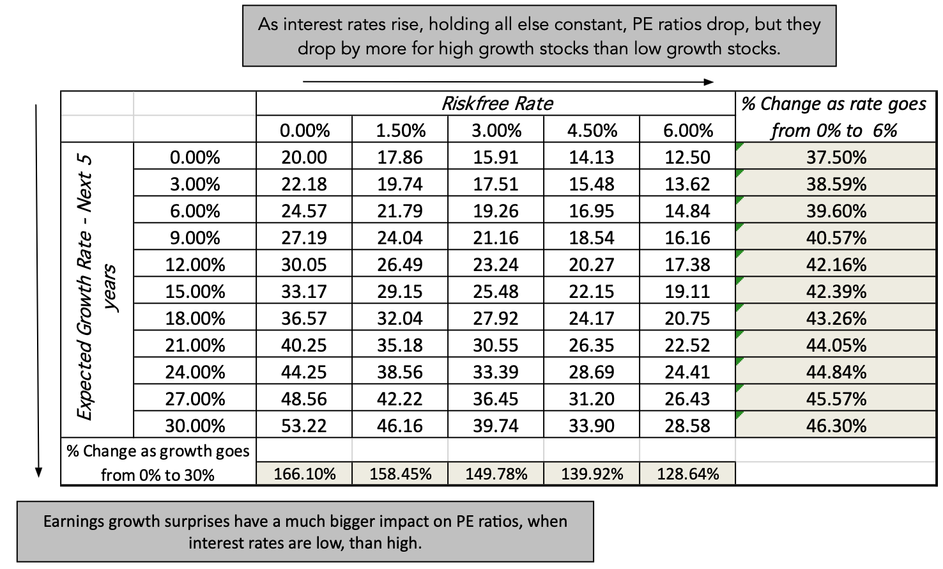
a. PE, Growth and Interest Rates
Notes:
As expected growth in the high growth period increases, the PE ratio increases, but the change in PE ratio for a given change in the growth rate is much greater when interest rates are low than when they are high. The reason is simple. The value of growth is a present value… If interest rates rise, the present value of growth decreases. If you consider that expected growth rates in earnings usually change as a result of an earnings surprise, this would suggest that a stock’s price and PE ratio will be most sensitive to earnings surprises when interest rates are low than when they are high.
On the other dynamic, as interest rates go up, the PE ratios for all stocks will decrease, but they will fall more for high growth firms than for low growth firms, for the same present value reason.

Slide 26
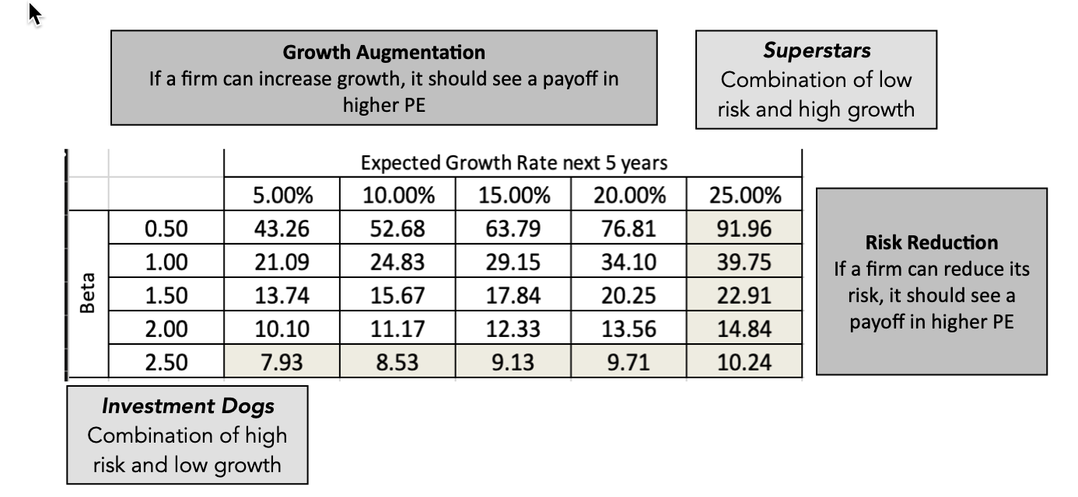
b. PE and Risk: A Follow up Example
Notes:
Holding all else constant, increasing risk will lower PE for any given growth rate. It also implies that high growth firms will reach a stage in their growth when they will find that it is more beneficial to them to reduce risk than go for higher growth.

Slide 27
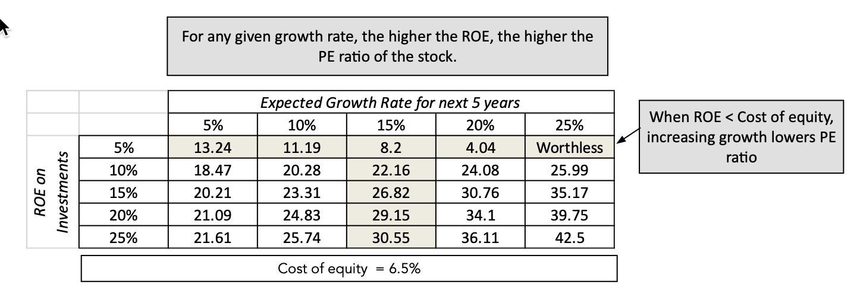
c. PE and Growth Quality: Value Addition and Destruction
Notes:
While many investors consider growth to be good, and assume that PE ratios increase with the growth rate, that is not true. If a firm grows by consistently earning a ROE which is less than the cost of equity, its PE ratios will decrease with growth. Thus, it is not just growth that determines PE, but the quality of that growth.

Slide 28
Example 1: The Cheapest Markets at the start of 2024
Country | # firms | median(EV/EBITDA) | median(Trailing PE)
Zambia | 15 | 3.75 | 4.31
Kenya | 50 | 3.70 | 4.43
Ghana | 23 | 2.74 | 5.34
Cyprus | 64 | 8.14 | 6.08
Pakistan | 424 | 5.14 | 6.24
Serbia | 17 | 5.64 | 6.69
Kazakhstan | 21 | 5.78 | 6.82
Isle of Man | 16 | 5.34 | 7.32
Sri Lanka | 262 | 7.09 | 7.49
Mauritius | 75 | 8.72 | 7.51
Tanzania | 15 | 6.27 | 7.52
Nigeria | 126 | 5.40 | 7.90
Macau | 16 | 4.87 | 8.30
Ivory Coast | 34 | 4.39 | 8.41
Tunisia | 76 | 7.73 | 8.68
Bermuda | 62 | 7.46 | 8.69
Malawi | 14 | 5.02 | 8.71
Colombia | 28 | 5.36 | 8.71
Chile | 122 | 6.80 | 8.84
Lithuania | 29 | 7.47 | 8.87

Slide 29
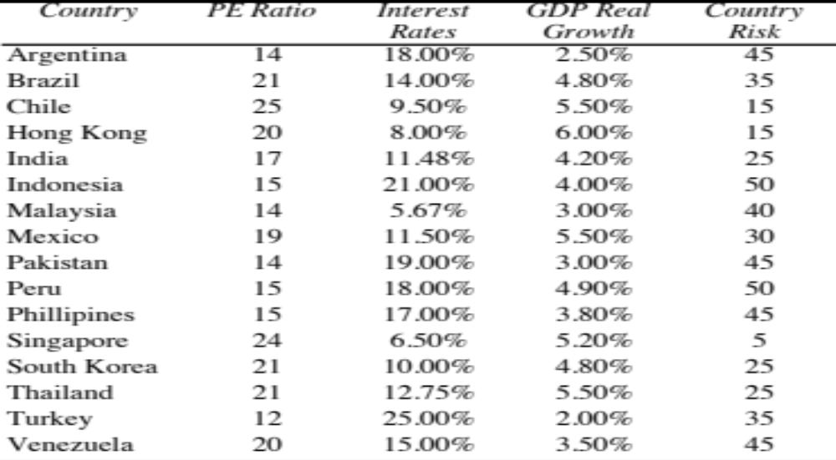
Example 2: Controlling for differences - An old Example with Emerging Markets: June 2000
Notes:
We used the Economist’s measure of country risk because it is numerical rather than the ratings, which are not. There are significant differences in country risk, at least as measured by the Economist.
The estimates of GDP real growth were for the next year and were obtained from the OECD.

Slide 30
Regression Results
The regression of PE ratios on these variables provides the following –
  PE = 16.16 - 7.94 Interest Rates
  + 154.40 Growth in GDP
  - 0.1116 Country Risk
  R Squared = 73%
What do the coefficients tell you about how each of these variables play into PE ratio differences across countries?
Notes:
The regression confirms our priors:
Higher interest rates translate into lower PE ratios.
Higher GDP growth results in higher PE ratios
Higher country risk results in lower PE ratios

Slide 31
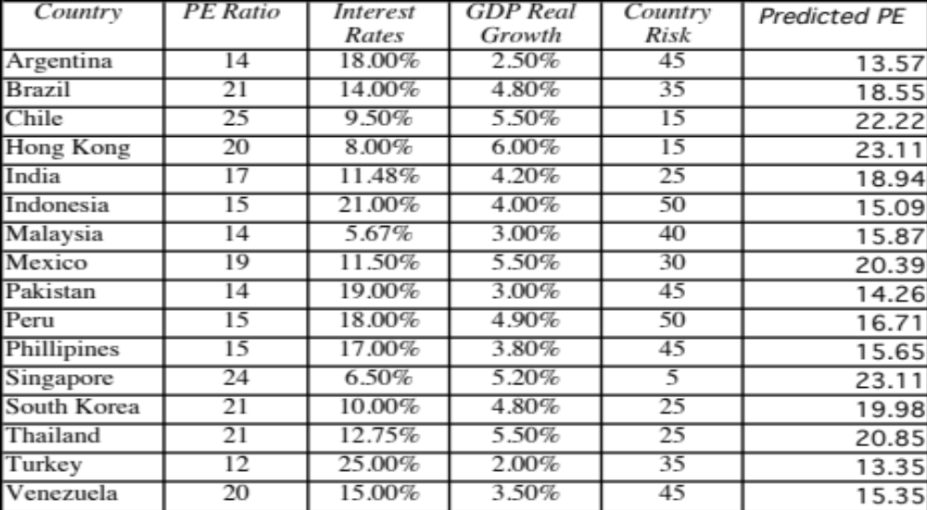
Predicted PE Ratios
Notes:
The predicted PE ratios are close to the actual PE ratios for most of the countries. Venezuela looks most overvalued…

Slide 32
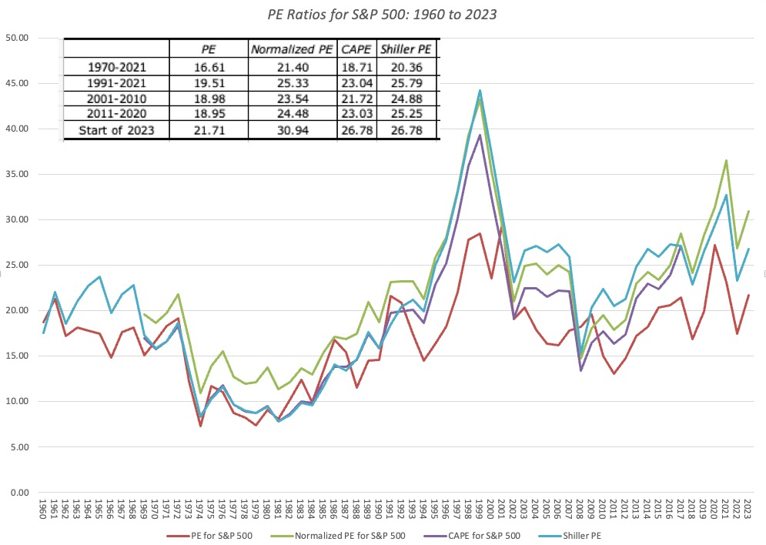
Example 3: US Stocks are expensive, just look at the PE ratio
Notes:
The graph of PE ratios for the S&P 500 show an increasing PE ratio in the 1980s and 1990s, a dip in the first few years thereafter, before rising again for the last decade. For most of the decade, we have been told that stocks are expensive because they are trading at higher values than their historic norms. A market strategist argues that stocks are expensive because the PE ratio in 2020 is high relative to the average PE ratio across time. Do you agree?
Yes
No
If you do not agree, what factors might explain the higher PE ratio today?
Would you respond differently if the market strategist has a Nobel Prize in Economics?

Slide 33
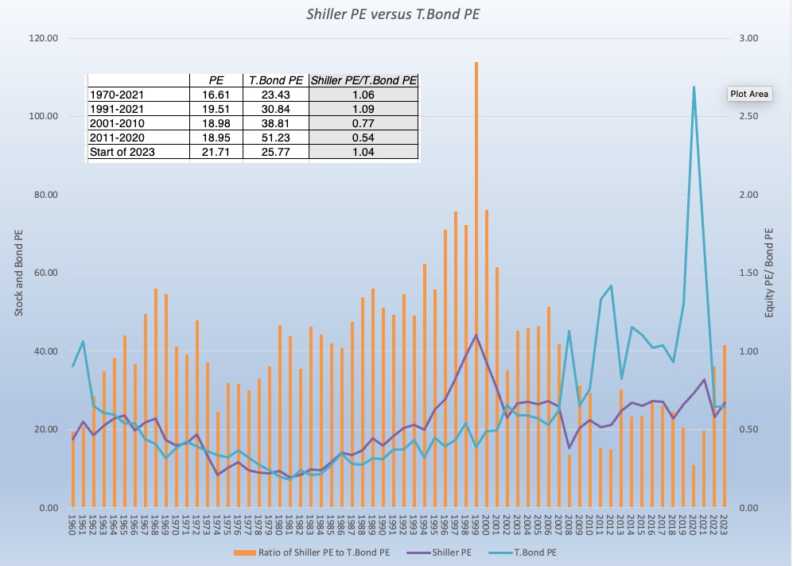
A Counter: No, they are cheap, relative to the alternatives..
Notes:
It is true that PE ratios are high, relative to history, but if you don’t invest in stocks, you presumably would invest in bonds at the T.Bond rate. Inverting the T.Bond rate gives you a PE for T.Bonds, and on that comparison, stocks look cheaper than they ever have in history.

Slide 34
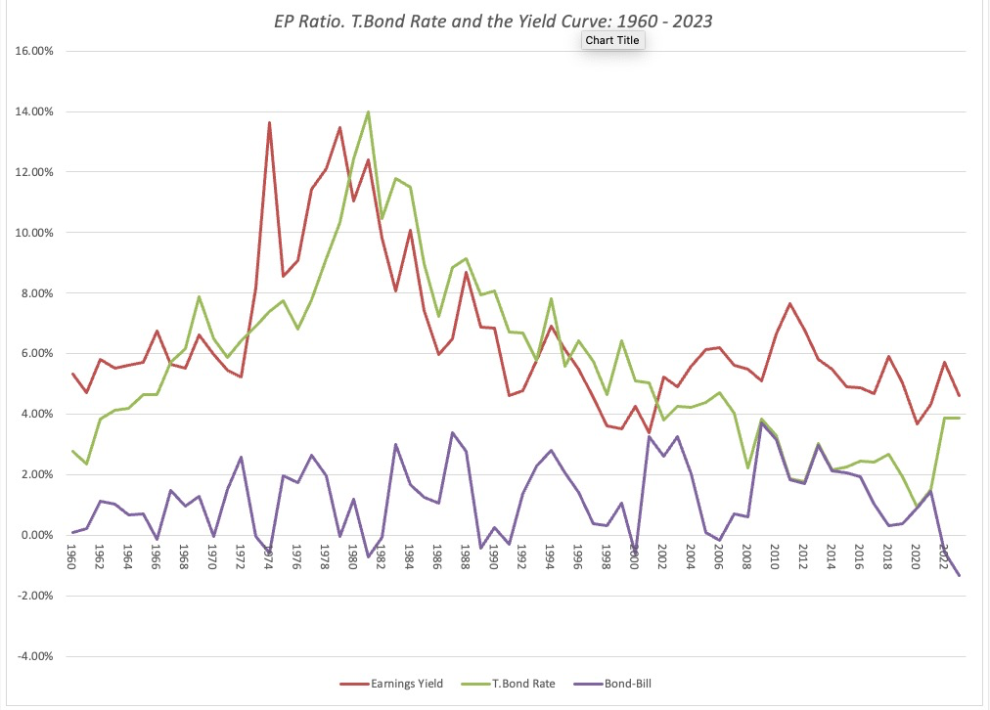
The Tie Breaker: E/P Ratios , T.Bond Rates and Term Structure
Notes:
Graphs out the inverse of the PE ratios (the earnings to price ratio or the earnings yield), the 10-year treasury bond rate and the difference between the 10-year T.Bond rate and the 6-month T.Bill rate. Even without any statistical analysis, the earnings yield and interest rates are highly correlated.

Slide 35

Regression Results
In the following regression, using 1960-2023 data, we regress E/P ratios against the level of T.Bond rates and a term structure variable (T.Bond - T.Bill rate)
  EP Ratio = 0.0350 + 0.5576 T.Bond Rate - 0.1161 (T.Bond Rate - T.Bill Rate) (6.57) (7.40) (-0.12)
  R squared = 45.78%
In 2008, this is what the regression looked like:
  E/P = 2.56% + 0.7044 T.Bond Rate – 0.3289 (T.Bond Rate-T.Bill Rate) (4.71) (7.10) (1.46)
  R squared = 50.71%
  The R-squared has dropped and the differential with the T.Bill rate has lost significance. How would you read this result?
Correlation between E/P and interest rates
Notes:
The regression yields the following conclusions:
Every 1% increase in the treasury bond rate increases the earnings yield by 0.52% (an increase in the earnings yield lowers the PE ratio). The effect on the PE ratio will therefore depend upon whether the T.Bond rate is increasing from 4% to 5% (the effect will be much larger) or from 9% to 10%..
Every 1% increase in the difference between long term and short term rates decreases the earnings yield by 0.17% (and increases PE ratios). As the yield curve becomes more upward sloping, expectations of real economic growth generally increase. This variable may therefore be a proxy for economic growth. Higher growth translates into higher PE ratios.
The last five years, where low interest rates have co-existed with low PE ratios have changed the relationship. Perhaps, the market is less trusting of a Fed effect (that the Fed can change the real growth in the economy) than it used to be…

Slide 36
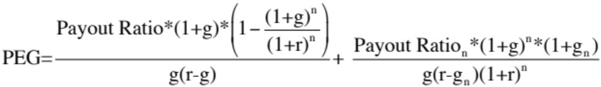
II. PEG Ratio
PEG Ratio = PE ratio/ Expected Growth Rate in EPS
  For consistency, you should make sure that your earnings growth reflects the EPS that you use in your PE ratio computation.
  The growth rates should preferably be over the same time period.
To understand the fundamentals that determine PEG ratios, let us return again to a 2-stage equity discounted cash flow model:
Dividing both sides of the equation by the earnings gives us the equation for the PE ratio. Dividing it again by the expected growth ‘g:
Notes:
Back to a two-stage dividend discount model (you could adapt it to make it a 2-stage FCFE model) ..
The PEG ratio is a function of risk, payout and expected growth. Thus, using the PEG ratio does not neutralize growth as a factor (which is the rationale presented by analysts who use it). Instead, it makes the relationship extremely complicated.

Slide 37
PEG Ratios and Fundamentals
Risk and payout, which affect PE ratios, continue to affect PEG ratios as well.
  Implication: When comparing PEG ratios across companies, we are making implicit or explicit assumptions about these variables.
Dividing PE by expected growth does not neutralize the effects of expected growth, since the relationship between growth and value is not linear and fairly complex (even in a 2-stage model)
Notes:
Analysts who use PEG ratios are making implicit assumptions about risk, growth and payout…

Slide 38
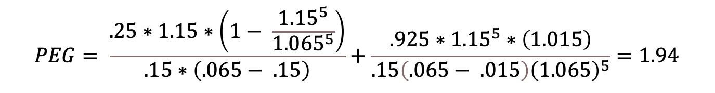
A Simple Example
Assume that you have been asked to estimate the PEG ratio for a firm which has the following characteristics:
Variable High Growth Phase Stable Growth Phase
Expected Growth Rate 15% 1.5%
Payout Ratio 25% 92.5%
Beta 1.00 1.00
Riskfree rate = Treasury Bond Rate = 1.5%, ERP = 5%
Required rate of return = 1.5% + 1(5%)= 6.5%
The PEG ratio for this firm can be estimated as follows
$$PEG= \frac{.25∗1.15∗\left(1− \frac{{1.15}^{5}}{{1.065}^{5}}\right)}{.15∗\left(.065− .15\right)}+\frac{.925∗{1.15}^{5}∗\left(1.015\right)}{.15\left(.065− .015\right){\left(1.065\right)}^{5}}=1.94$$
Notes:
Returns to the example used to illustrate PE ratios. The fair PEG ratio for this firm is 1.15. (Incidentally, the PE ratio we computed for this company earlier was 28.75.. Dividing 28.75 by the growth rate 25 yields 1.15.)

Slide 39
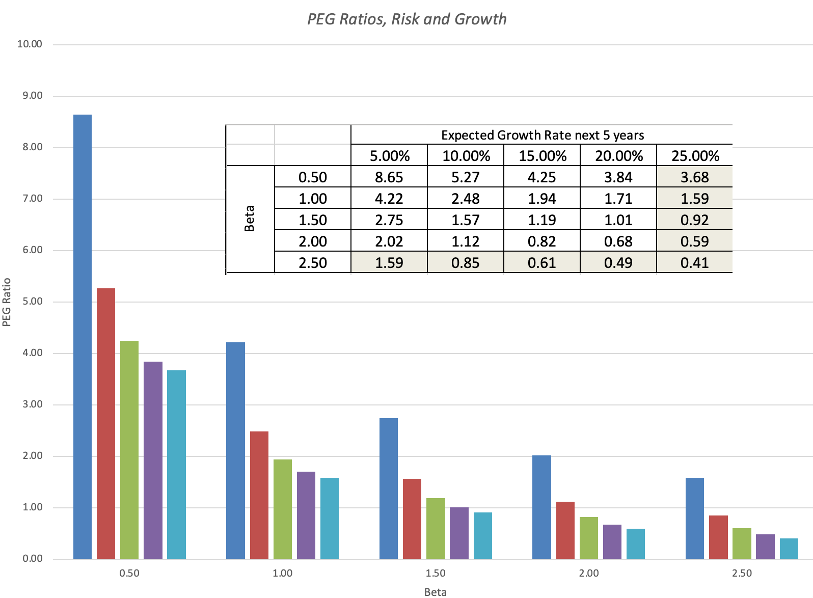
a. PEG Ratios are risk-sensitive
Notes:
Keeping all else constant, increasing risk lowers the PEG ratio for all firms - not matter what the growth rate. The effect tends to be greater for higher growth firms…
Implication: If you compare firms based upon PEG ratios and do not control for risk, riskier firms will look cheap…

Slide 40
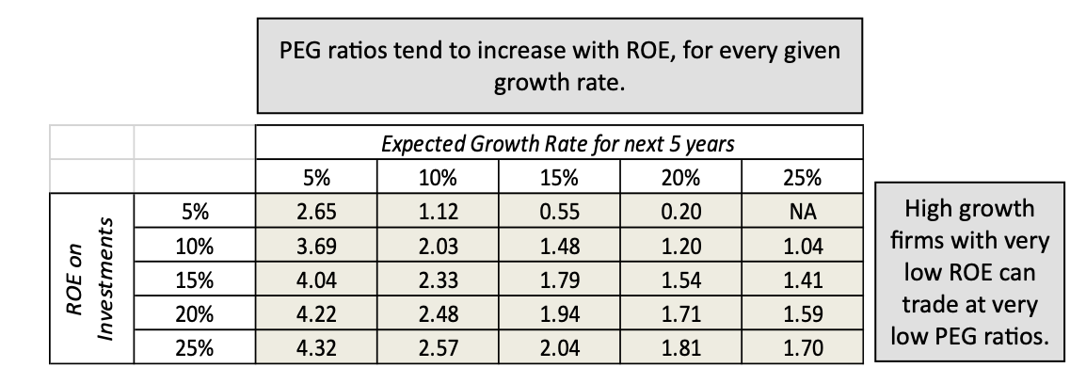
b. PEG Ratios are affected by the Quality of Growth
Notes:
The quality of growth matters. Note that keeping the growth fixed and raising the retention ratio is equivalent to raising the return on equity.
Implication: If you compare companies based upon PEG ratios and do not control for differences in return on equity, companies with lower returns on equity (and the same growth rate in earnings per share) will look cheap.

Slide 41
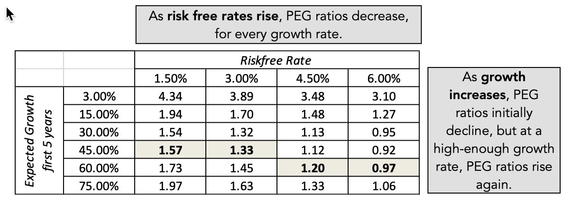
c. PEG Ratios are not growth neutral…
Notes:
Shows how complicated the relationship between growth and PEG ratio becomes. As growth increases initially, the PEG ratio decreases. At some point, however, the PEG ratio starts increasing again.. In fact, as the growth rate decreases towards 0%, the PEG ratio will approach infinity.. This is a direct consequence of the incorrect assumption that PE ratios and growth are linearly related. Consider a stock with earnings and dividends per share of $2.00 and assume that you can expect to earn this forever (no growth). The linearity assumption would lead you to conclude that the PE ratio should be 0 for this firm and that you would pay nothing for this stock….

Slide 42
PEG Ratios and Fundamentals: Propositions
Proposition 1: High risk companies will trade at much lower PEG ratios than low risk companies with the same expected growth rate.
  Corollary 1: The company that looks most under valued on a PEG ratio basis in a sector may be the riskiest firm in the sector
Proposition 2: Companies that can attain growth more efficiently by investing less in better return projects will have higher PEG ratios than companies that grow at the same rate less efficiently.
  Corollary 2: Companies that look cheap on a PEG ratio basis may be companies with high reinvestment rates and poor project returns.
Proposition 3: Companies with very low or very high growth rates will tend to have higher PEG ratios than firms with average growth rates. This bias is worse for low growth stocks.
  Corollary 3: PEG ratios do not neutralize the growth effect.
Notes:
Comparing PEG ratios across companies can be extremely complicated, not only because of the variables that affect it but because of the complicated relationship between growth and PEG ratios.

Slide 43
III. Book Value Multiples
With book value multiples, you scale the market value (which is what the market values your company at) to its book value (which is the accounting estimate of value. It can take two forms:
  Price to Book = Market Capitalization/ Book Value of Equity
  EV to Invested Capital = Enterprise Value/ (Book Value of Equity + Book Value of Debt – Cash)
To the extent that you believe that accountants have a better (or a more conservative) estimate of value, or that book value is a proxy for liquidation value, a company that trades at below its book value is cheap.

Slide 44
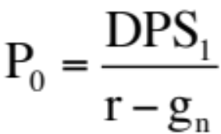
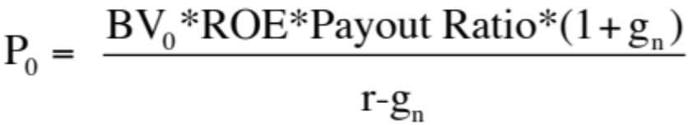
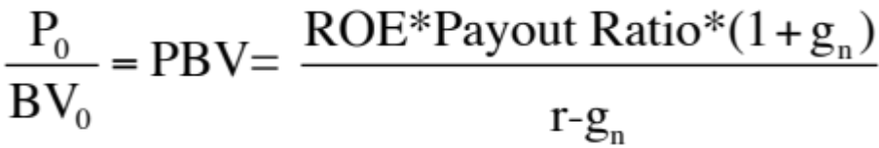
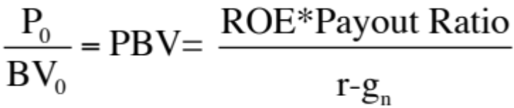
Price to Book Ratio: Determinants
Going back to a simple dividend discount model,
Defining the return on equity (ROE) = EPS0 / Book Value of Equity, the value of equity can be written as:
If the return on equity is based upon expected earnings in the next time period, this can be simplified to,
Notes:
Following a familiar route.. The price to book ratio is an equity multiple and you go back to an equity valuation model…
The price to book ratio is determined by the three variables that determine the PE ratio (growth, payout and risk) and one variable that is unique to it (the return on equity)
Every multiple has one variable that can be considered its key determinant - its companion variable, so to speak. For PE, it was growth.. For Value/EBITDA, it was the reinvestment rate. For price to book, it is return on equity.

Slide 45
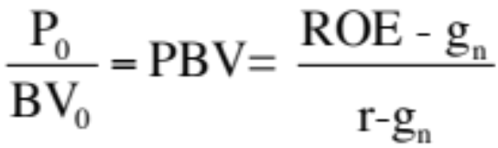
Price Book Value Ratio: Stable Growth Firm
Another Presentation
This formulation can be simplified even further by relating growth to the return on equity:
g = (1 - Payout ratio) * ROE
Substituting back into the P/BV equation,
The price-book value ratio of a stable firm is determined by the differential between the return on equity and the required rate of return on its projects.
Building on this equation, a company that is expected to generate a ROE higher (lower than, equal to) its cost of equity should trade at a price to book ratio higher (less than, equal to) one.
Notes:
Restates the price to book in terms of excess returns.. Firms that earn excess returns (on equity) will trade at high price to book ratios… If the return on equity is estimated using the expected earnings next year, the two equations will converge.. Otherwise, the first equation will be higher by a factor (1+g)….

Slide 46
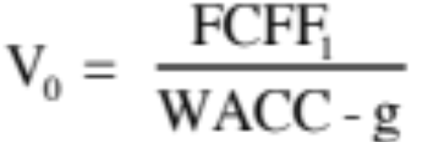
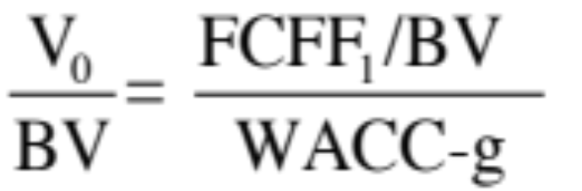
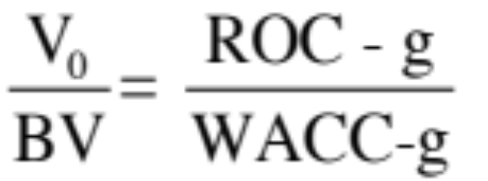
Now changing to an Enterprise value multiple
EV/ Book Capital
To see the determinants of the value/book ratio, consider the simple free cash flow to the firm model:
Dividing both sides by the book value, we get:
If we replace, FCFF = EBIT(1-t) - (g/ROC) EBIT(1-t),we get:
Notes:
To analyze a firm value ratio, we go back to a firm valuation. The determinant of the value to book ratio is the spread between the ROC and the cost of capital…

Slide 47
IV. EV to EBITDA multiples
With EV to EBITDA multiples, you scale enterprise value to earnings before interest, taxes, depreciation and amortization:
  EV to EBITDA = Enterprise Value/ EBITDA
  There are variants where even more gets added back, including stock-based compensation and R&D
EV to EBITDA multiples have become far more widely used in the last four decades than they used to be for both good and bad reasons:
  The good reasons include less sampling bias (since fewer companies have negative EBITDA) and that it is based on cash flows.
  The bad reason is that it will give you lower absolute numbers than PE ratios, and for those without perspective, that may signify cheapness.

Slide 48
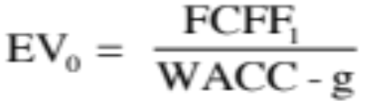
EV to EBITDA - Determinants
The value of the operating assets of a firm can be written as:
Now the value of the firm can be rewritten as
Dividing both sides of the equation by EBITDA,
The determinants of EV/EBITDA are:
  The cost of capital
  Expected growth rate
  Tax rate
  Reinvestment rate (or ROC)
Notes:
To delve into the fundamentals that determine EBITDA multiples, we return to a FCFF valuation model. We keep things simple by using a stable growth model.

Slide 49
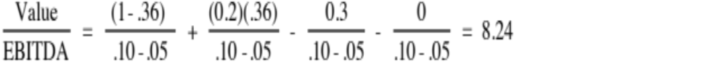
A Simple Example
Consider a firm with the following characteristics:
  Tax Rate = 36%
  Capital Expenditures/EBITDA = 30%
  Depreciation/EBITDA = 20%
  Cost of Capital = 10%
  The firm has no working capital requirements
  The firm is in stable growth and is expected to grow 5% a year forever.
In this case, the Value/EBITDA multiple for this firm can be estimated as follows:
Notes:
A hypothetical firm. Note that I am making assumptions about the reinvestment rate and growth rate. Implicitly, I am also making assumptions about the return on capital. In fact, I am assuming (whether I want to or not) that my return on capital will be 25.60%. Note that the return on capital implied in this growth rate can be calculated as follows:
g = ROC * Reinvestment Rate
.05 = ROC * Net Cap Ex/EBIT (1-t)
= ROC * (.30-.20)/[(1-.2)(1-.36)]
Solving for ROC, ROC = 25.60%

Slide 50



The Determinants of EV/EBITDA
^{Tax}
^{Rates}
^{Reinvestment}
^{Needs}
^{Excess}
^{Returns}
Notes:
Holding all else constant, we can back out the determinants of EV/EBITDA multiples:
Tax rate: The higher the tax rate, the lower the EV/EBITDA multiple. Firms that face low tax rates should trade at higher EV/EBITDA multiples than otherwise similar firms that face higher tax rates. (An Irish telecom company versus a German telecom company)
Reinvestment rate: Holding growth fixed, higher reinvestment rates should lead to lower EV/EBITDA multiples, since it implies that the growth is being delivered less efficiently.
Excess returns: Holding growth fixed, a higher return on capital (or a lower cost of capital) should lead to more valuable growth and higher EV/EBITDA multiples.
Firms that deliver low growth, with high reinvestment and substandard returns on capital deserve to trade at low multiples of EBITDA.

Slide 51
V. Revenue Multiples
With revenue multiples, you scale market value to the revenues generated by a firm. There are two variants in use:
  Price to Sales = Market Capitalization / Sales
  EV to Sales = Enterprise Value / Sales
The former, while widely used, is internally inconsistent and can be misleading for firms with significant debt loads and/or cash holdings.
The biggest selling point for revenue multiples is that you lose far fewer firms when computing the multiple, since revenues cannot be negative.

Slide 52

EV/Sales Ratio: Determinants
If pre-tax operating margins are used, the appropriate value estimate is that of the firm. In particular, if one makes the replaces the FCFF with the expanded version:
  Free Cash Flow to the Firm = EBIT (1 - tax rate) (1 - Reinvestment Rate)
Then the Value of the Firm can be written as a function of the after-tax operating margin= (EBIT (1-t)/Sales
    g = Growth rate in after-tax operating income for the first n years
    gn = Growth rate in after-tax operating income after n years forever (Stable growth rate)
    RIR _{Growth, Stable} = Reinvestment rate in high growth and stable periods
    WACC = Weighted average cost of capital
Notes:
The determinants of the value to sales ratio mirror the determinants of the price to sales ratio:
Price to Sales ratio -> Value to Sales Ratio
Net Margin (Net Income/Sales) Operating Margin (EBIT(1-t)/Sales
Payout ratio 1 - Reinvestment Rate
Cost of equity Cost of capital
Growth rate in Net Income Growth ate in Operating income

Slide 53
The value of a brand name
One of the critiques of traditional valuation is that is fails to consider the value of brand names and other intangibles.
  The approaches used by analysts to value brand names are often ad-hoc and may significantly overstate or understate their value.
  One of the benefits of having a well-known and respected brand name is that firms can charge higher prices for the same products, leading to higher profit margins and hence to higher price-sales ratios and firm value. The larger the price premium that a firm can charge, the greater is the value of the brand name.
In general, the value of a brand name can be written as:
  Value of brand name ={(V/S)_{b}-(V/S)_{g} }* Sales
  (V/S)_{b} = Value of Firm/Sales ratio with the benefit of the brand name
  (V/S)_{g} = Value of Firm/Sales ratio of the firm with the generic product
Notes:
The value of a brand name should be visible either in the margin (if the firm exercises pricing power) or the sales/capital ratio (if the firm uses brand name to sell in larger quantities..)

Slide 54
Valuing Brand Name
Coca Cola With Cott Margins
Current Revenues = $21,962.00 $21,962.00
Length of high-growth period 10 10
Reinvestment Rate = 50% 50%
Operating Margin (after-tax) 15.57% 5.28%
Sales/Capital (Turnover ratio) 1.34 1.34
Return on capital (after-tax) 20.84% 7.06%
Growth rate during period (g) = 10.42% 3.53%
Cost of Capital during period = 7.65% 7.65%
Stable Growth Period
Growth rate in steady state = 4.00% 4.00%
Return on capital = 7.65% 7.65%
Reinvestment Rate = 52.28% 52.28%
Cost of Capital = 7.65% 7.65%
Value of Firm = $79,611.25 $15,371.24
Value of brand name = $79,611 -$15,371 = $64,240 million
Notes:
This was an updated valuation in 2004. In the first column, Coca Cola is valued with its current characteristics - high margins, high returns, reasonably high growth - all of which can be traced to its brand name power. In the second column, we revalued Coke using the margins of a generic manufacturer (Cott). The ripple effects of the lower margins can be seen in lower return on capital (margin * sales to cap ratio) and lower growth. The net effect is a almost an 80% drop in value. That is the value of the brand name.
Alternative approaches:
Coke’s ROC = Generic ROC (instead of magins)
If no generic companies exist, the industry average can be used as a base to get a measure of relative brand name value.

Slide 55
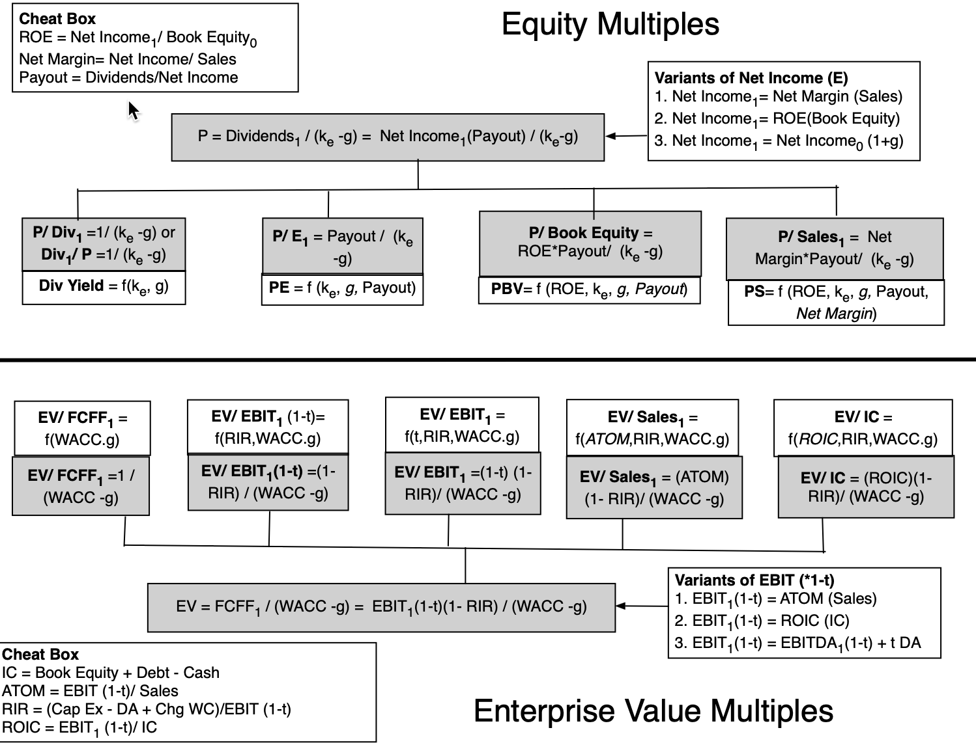
The Determinants of Multiples…
Notes:
Summarizing… the drivers of equity and enterprise value multiples

Slide 56
Application Tests
Given the firm that we are valuing, what is a “comparable” firm?
  While traditional analysis is built on the premise that firms in the same sector are comparable firms, valuation theory would suggest that a comparable firm is one which is similar to the one being analyzed in terms of fundamentals.
  There is no reason why a firm cannot be compared with another firm in a very different business, if the two firms have the same risk, growth and cash flow characteristics.
Given the comparable firms, how do we adjust for differences across firms on the fundamentals?
  It is impossible to find an exactly identical firm to the one you are valuing.
  You need to control for differences across firms.
Notes:
In practice, we all too often define comparable as a firm in the same industry or business. This is too narrow a definition. You can have firms in different businesses that have similar cashflow, growth and risk characteristics. These firms can be viewed as comparable firms.
You will never find two identical firms, no matter how hard you search. You therefore have to always control for the residual differences when making comparisons.

Slide 57
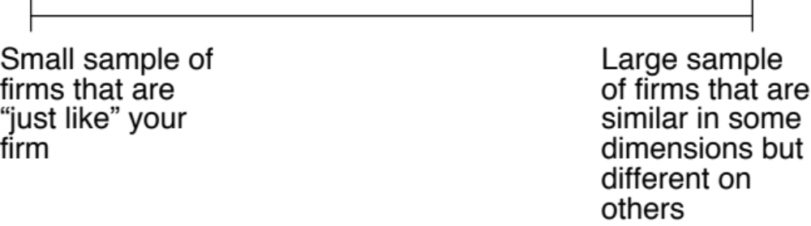
The Sampling Choice
Ideally, you would like to find lots of publicly traded firms that look just like your firm, in terms of fundamentals, and compare the pricing of your firm to the pricing of these other publicly traded firms. Since, they are all just like your firm, there will be no need to control for differences.
In practice, it is very difficult (and perhaps impossible) to find firms that share the same risk, growth and cash flow characteristics of your firm. Even if you are able to find such firms, they will very few in number. The trade off then becomes:
Notes:
At the limit, if you can find a company that looks exactly like your company on every dimension that is priced by the market, you can stop. However, no two stocks are exactly identical and you face a choice. You can define “comparable” narrowly and end up with a small sample of firms that look very much like your own… Or you can define comparable broadly and end up with a much larger (and diverse) sample.

Slide 58
The ”Control for Differences” Choices
Direct comparisons: If the comparable firms are “just like” your firm, you can compare multiples directly across the firms and conclude that your firm is expensive (cheap) if it trades at a multiple higher (lower) than the other firms.
Story telling: If there is a key dimension on which the firms vary, you can tell a story based upon your understanding of how value varies on that dimension.
    An example: This company trades at 12 times earnings, whereas the rest of the sector trades at 10 times earnings, but I think it is cheap because it has a much higher growth rate than the rest of the sector.
Modified multiple: You can modify the multiple to incorporate the dimension on which there are differences across firms.
Statistical techniques: If your firms vary on more than one dimension, you can try using multiple regressions (or variants thereof) to arrive at a “controlled” estimate for your firm.
Notes:
If you can find a company or two just like your company, you can make a direct comparison across the companies and decide which one to buy.
However, if there are differences between your company and the comparable firms, you will have to explain away the difference in fundamentals.
If the difference is on one key dimension (say the growth rate), you may be able to bring it into your computation of the multiple.
If the sample is large and there are differences on many dimensions, you should think about using statistics as a tool to control for differences.

Slide 59
1. Just Story Telling
Trailing PE across Beverage Companies
Company Name Trailing PE Expected Growth Standard Deviation
Coca-Cola Bottling 29.18 9.50% 20.58%
Molson Inc. Ltd. 'A' 43.65 15.50% 21.88%
Anheuser-Busch 24.31 11.00% 22.92%
Corby Distilleries Ltd. 16.24 7.50% 23.66%
Chalone Wine Group 21.76 14.00% 24.08%
Andres Wines Ltd. 'A' 8.96 3.50% 24.70%
Todhunter Int'l 8.94 3.00% 25.74%
Brown-Forman 'B' 10.07 11.50% 29.43%
Coors (Adolph) 'B' 23.02 10.00% 29.52%
PepsiCo, Inc. 33.00 10.50% 31.35%
Coca-Cola 44.33 19.00% 35.51%
Boston Beer 'A' 10.59 17.13% 39.58%
Whitman Corp. 25.19 11.50% 44.26%
Mondavi (Robert) 'A' 16.47 14.00% 45.84%
Coca-Cola Enterprises 37.14 27.00% 51.34%
Hansen Natural Corp 9.70 17.00% 62.45%
Notes:
Notice that while we consider this to be an industry group, these are very different firms in terms of expected growth and size.

Slide 60
A Question
You are reading an equity research report on this sector, and the analyst claims that Andres Wine and Hansen Natural are under valued because they have low PE ratios. Would you agree?
  Yes
  No
Why or why not?
Notes:
No. Andres Wine has one of the lowest expected growth rates of the firms in the group, which may explain the low PE ratio. Hansen Natural has a high growth rate but it also is the riskiest firm in the group, which may explain its low PE ratio. In other words, not all firms with low PE ratios are under valued. They may be low-growth, high-risk companies…

Slide 61

2: Statistical Controls
Comparing PE ratios across Telecom companies
Notes:
In this sample, note that some of the firms in the sample are emerging market firms any may be exposed to more risk (political risk, economic risk, inflation risk…)

Slide 62
PE, Growth and Risk
Dependent variable is: PE
R squared = 66.2% R squared (adjusted) = 63.1%
  Variable Coefficient SE t-ratio Probability
  Constant 13.1151 3.471 3.78 0.0010
  Growth rate 121.223 19.27 6.29 ≤ 0.0001
  Emerging Market -13.8531 3.606 -3.84 0.0009
Emerging Market is a dummy: 1 if emerging market
0 if not
Notes:
Higher growth telecomm companies have higher PE ratios..
One way to read this regression: If you have two companies - one with a growth rate of 10% and one with a growth rate of 20%, the latter should have a PE that is 12.1 higher..
If the firm happens to be an emerging market firm, though, you would expect its PE ratio to be 13.85 lower than a firm with similar growth in a developed market.

Slide 63
Is Telebras under valued?
Plugging in Telebras’s expected growth rate and the fact that it is an emerging market company into the regression:
  Predicted PE = 13.12 + 121.22 (.075) - 13.85 (1) = 8.35
  At an actual price to earnings ratio of 8.9, Telebras is slightly overvalued.
Bottom line: Just because a company trades at a low PE ratio does not make it cheap.
Notes:
With a 7.5% growth rate and being an emerging market company, Telebras is overvalued slightly, even though it has a low PE ratio.

Slide 64
3: An Eyeballing Exercise
PBV Ratios across European Banks in 2010
Name | PBV Ratio | Return on Equity | Standard Deviation
BAYERISCHE HYPO-UND VEREINSB | 0.80 | -1.66% | 49.06%
COMMERZBANK AG | 1.09 | -6.72% | 36.21%
DEUTSCHE BANK AG -REG | 1.23 | 1.32% | 35.79%
BANCA INTESA SPA | 1.66 | 1.56% | 34.14%
BNP PARIBAS | 1.72 | 12.46% | 31.03%
BANCO SANTANDER CENTRAL HISP | 1.86 | 11.06% | 28.36%
SANPAOLO IMI SPA | 1.96 | 8.55% | 26.64%
BANCO BILBAO VIZCAYA ARGENTA | 1.98 | 11.17% | 18.62%
SOCIETE GENERALE | 2.04 | 9.71% | 22.55%
ROYAL BANK OF SCOTLAND GROUP | 2.09 | 20.22% | 18.35%
HBOS PLC | 2.15 | 22.45% | 21.95%
BARCLAYS PLC | 2.23 | 21.16% | 20.73%
UNICREDITO ITALIANO SPA | 2.30 | 14.86% | 13.79%
KREDIETBANK SA LUXEMBOURGEOI | 2.46 | 17.74% | 12.38%
ERSTE BANK DER OESTER SPARK | 2.53 | 10.28% | 21.91%
STANDARD CHARTERED PLC | 2.59 | 20.18% | 19.93%
HSBC HOLDINGS PLC | 2.94 | 18.50% | 19.66%
LLOYDS TSB GROUP PLC | 3.33 | 32.84% | 18.66%
Average | 2.05 | 12.54% | 24.99%
Median | 2.07 | 11.82% | 21.93%
Notes:
This was just before the crisis. Note that the banks that trade at low P/BV ratios also tend to have low ROEs…
The standard deviation in stock prices is a proxy for risk. If that is not a good measure, you may consider others that are specific to banks (toxic assets on the balance sheet, regulatory capital ratios, loan losses/write offs)

Slide 65
The median test…
We are looking for stocks that trade at low price to book ratios, while generating high returns on equity, with low risk. But what is a low price to book ratio? Or a high return on equity? Or a low risk
One simple measure of what is par for the sector are the median values for each of the variables. A simplistic decision rule on under and over valued stocks would therefore be:
  Undervalued stocks: Trade at price to book ratios below the median for the sector,(2.07), generate returns on equity higher than the sector median (11.82%) and have standard deviations lower than the median (21.93%).
  Overvalued stocks: Trade at price to book ratios above the median for the sector and generate returns on equity lower than the sector median.
Notes:
A simple way to look for mismatches….

Slide 66
The Statistical Alternative
We are looking for stocks that trade at low price to book ratios, while generating high returns on equity. But what is a low price to book ratio? Or a high return on equity?
Taking the sample of 18 banks, we ran a regression of PBV against ROE and standard deviation in stock prices (as a proxy for risk).
  PBV = 2.27 + 3.63 ROE - 2.68 Std dev
  (5.56) (3.32) (2.33)
R squared of regression = 79%
Reading the regression tea leaves:
  Every 1% increase in the return on equity at a European bank increases its price to book ratio by 0.0363.
  Every 1% increase in the standard deviation in equity reduces the price to book ratio by 0.0268.
  The regression predictions will have a standard error, which is inversely proportionate to the R squared.
Notes:
A slightly more sophisticated take which brings in more than one variable into the analysis…
Note how much of the variation in price to book ratios is explained by just ROE and standard deviation. The caveats about small samples and linear relationships continue to apply.

Slide 67

And these predictions?
Notes:
Using the regression to get predicted values, we can estimate what the PBV ratio should be for each bank, given its ROE and standard deviation.

Slide 68

Example 4: More Statistics and a Larger Sample
Price to Book versus ROE: Largest firms in the US: January 2010
Notes:
Looks at the 100 largest market cap firms in the United States… Shows how strong the link is between price to book and return on equity. With a 90% confidence interval, a handful of stocks fall outside the range, but there may be good reasons for each:
The two stocks that fall below the undervalued line are MO (Altria or Philip Morris) and FNMA (because of recent accounting and management scandals.
Above the overvalued line are the high flyers - EBAY, Dell, SAP where presumable investors expect the return on equity to climb over time and high growth to continue…

Slide 69
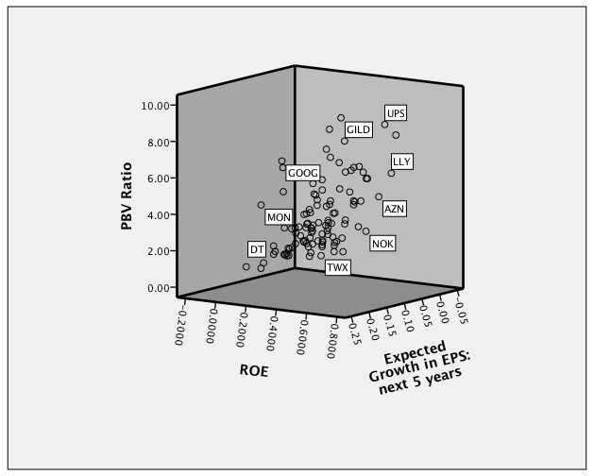
Missing growth?
Notes:
We control for growth differences. The most undervalued firm is MO…. And all of the overvalued firms drop off the list.

Slide 70
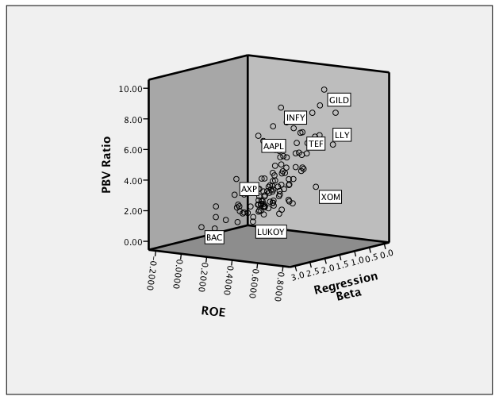
PBV, ROE and Risk: Large Cap US firms
Most overvalued
Cheapest
Most undervalued
Notes:
Graphs out the largest US market cap firms on a three dimensional graph with risk being the third dimension…
You could also try growth as the third dimension…

Slide 71


Bringing it all together… Largest US stocks in January 2010

Slide 72
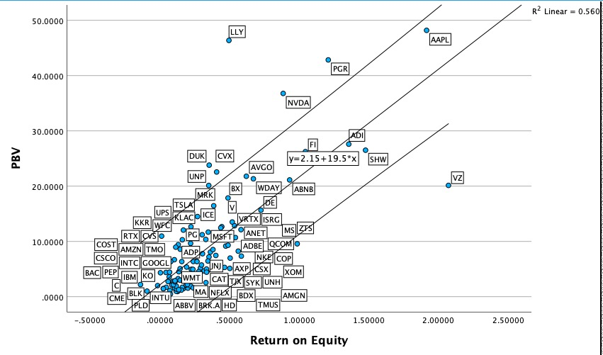
Updated PBV Ratios – Largest Market Cap US companies -Updated to January 2024
Notes:
The PBV/ROE scatter plot is a blunt instrument. The stocks that look over valued are among the best performers in the market. Buybacks have devastated book values for many, affecting both price to book and return on equity.

Slide 73

Example 5: Overlooked fundamentals?
EV/EBITDA Multiple for Trucking Companies
Notes:
Trucking companies have fleets that they replace every few years. Thus, the capital expenditures for these firms are often discontinuous, with a year of very heavy cap ex followed by a few years of almost no cap ex…

Slide 74
A Test on EBITDA
Ryder System looks very cheap on a Value/EBITDA multiple basis, relative to the rest of the sector. What explanation (other than misvaluation) might there be for this difference?
What general lessons would you draw from this on the EV/EBITDA multiples for infrastructure companies as their infrastructure ages?
Notes:
It could well be that Ryder Systems has the oldest fleet in this group. In that case, the firm may look cheap right now but it will soon have to make a large capital expenditure to replace the fleet.
(While cap ex is discontinuous, depreciation and amortization are smoothed out…)

Slide 75
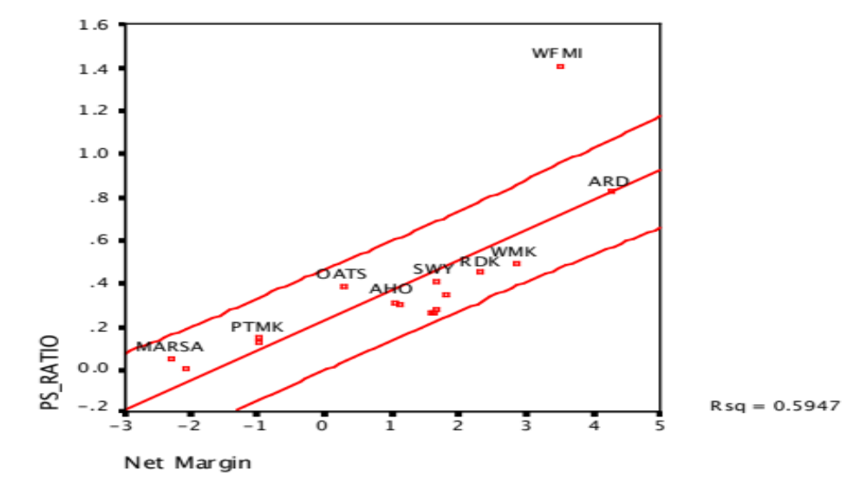
Example 6: Pricing across time - PS Ratios Grocery Stores - US in January 2007
Whole Foods: In 2007: Net Margin was 3.41% and Price/ Sales ratio was 1.41
Predicted Price to Sales = 0.07 + 10.49 (0.0341) = 0.43
Notes:
Whole Foods has the one of the highest margins in the business, but at 1.41 times revenues, it looks vastly over valued.

Slide 76
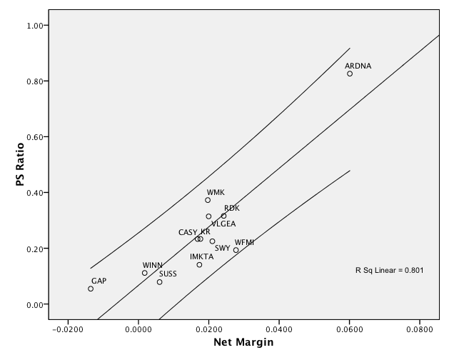
The difference two years can make: Grocery Stores - US in January 2009
Whole Foods: In 2009, Net Margin had dropped to 2.77% and Price to Sales ratio was down to 0.31.
  Predicted Price to Sales = 0.07 + 10.49 (.0277) = 0.36
Notes:
In two years, Whole Foods has gone from being one of the most over valued companies in the sector to one of the most under valued.

Slide 77
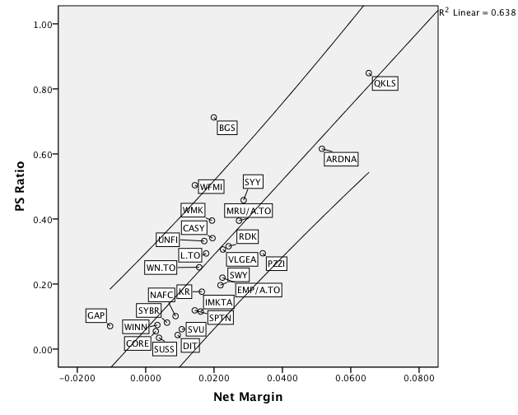
Is this steady State? In 2010..
Whole Foods: In 2010, Net Margin had dropped to 1.44% and Price to Sales ratio increased to 0.50.
  Predicted Price to Sales = 0.06 + 11.43 (.0144) = 0.22
Notes:
One year later, it is significantly over valued again.

Slide 78
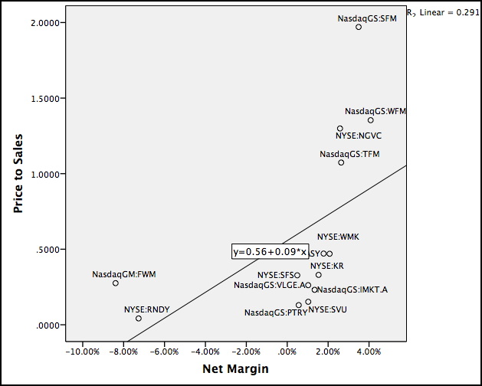
There is a new kid in town: January 2015
There is a new star in town (Sprouts)
PS = 0.557 + 0.085 Net Margin
Whole Foods = 0.557 + 8.50 (0.0408) = 0.90
At 1.35 times sales, Whole Foods is overvalued (again)
Notes:
In 2015, Whole Foods was an older firm that analysts understood. There is, however, a new player in the game in the form of Sprouts, an organic, upscale chain based on the West Coast. Is this the new Whole Foods?

Slide 79
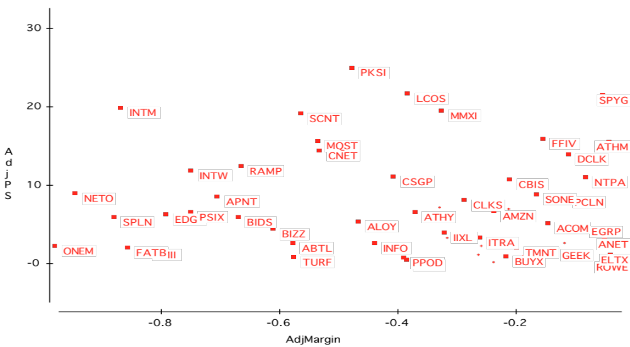
Example 7: Nothing’s working! Internet Stocks in early 2000..
Notes:
From March 2000… Little or no relationship between current margins and price to sales ratios.. Note that almost all of the firms have negative margins…

Slide 80
PS Ratios and Margins are not highly correlated
Regressing PS ratios against current margins yields the following
  PS = 81.36 - 7.54(Net Margin) R2 = 0.04
  (0.49)
This is not surprising. These firms are priced based upon expected margins, rather than current margins.
Notes:
The lack of the relationship in the graph is borne out by the regression. Not only is the R-squared low, but the relationship between price to sales ratio and net margins is negative - the more negative the margin, the higher the price to sales ratio.

Slide 81
Solution 1: Use proxies for survival and growth: Amazon in early 2000
Hypothesizing that firms with higher revenue growth and higher cash balances should have a greater chance of surviving and becoming profitable, we ran the following regression: (The level of revenues was used to control for size)
PS = 30.61 - 2.77 ln(Rev) + 6.42 (Rev Growth) + 5.11 (Cash/Rev)
(0.66) (2.63) (3.49)
R squared = 31.8%
Predicted PS = 30.61 - 2.77(7.1039) + 6.42(1.9946) + 5.11 (.3069) = 30.42
Actual PS = 25.63
Stock is undervalued, relative to other internet stocks.
Notes:
Internet firms with higher revenues, higher revenue growth and more cash holdings trade for higher price to sales ratios in March 2000.
If you plug the values for Amazon in March 2000 into this regression, you get a predicted value of 30.42, whereas the actual price to sales ratio for the firm is 25.63. Relative to other internet stocks, Amazon is slightly undervalued. (In the discounted cashflow valuation done at the same point in time, we came to the opposite conclusion. Amazon was overvalued based upon its fundamentals.)

Slide 82
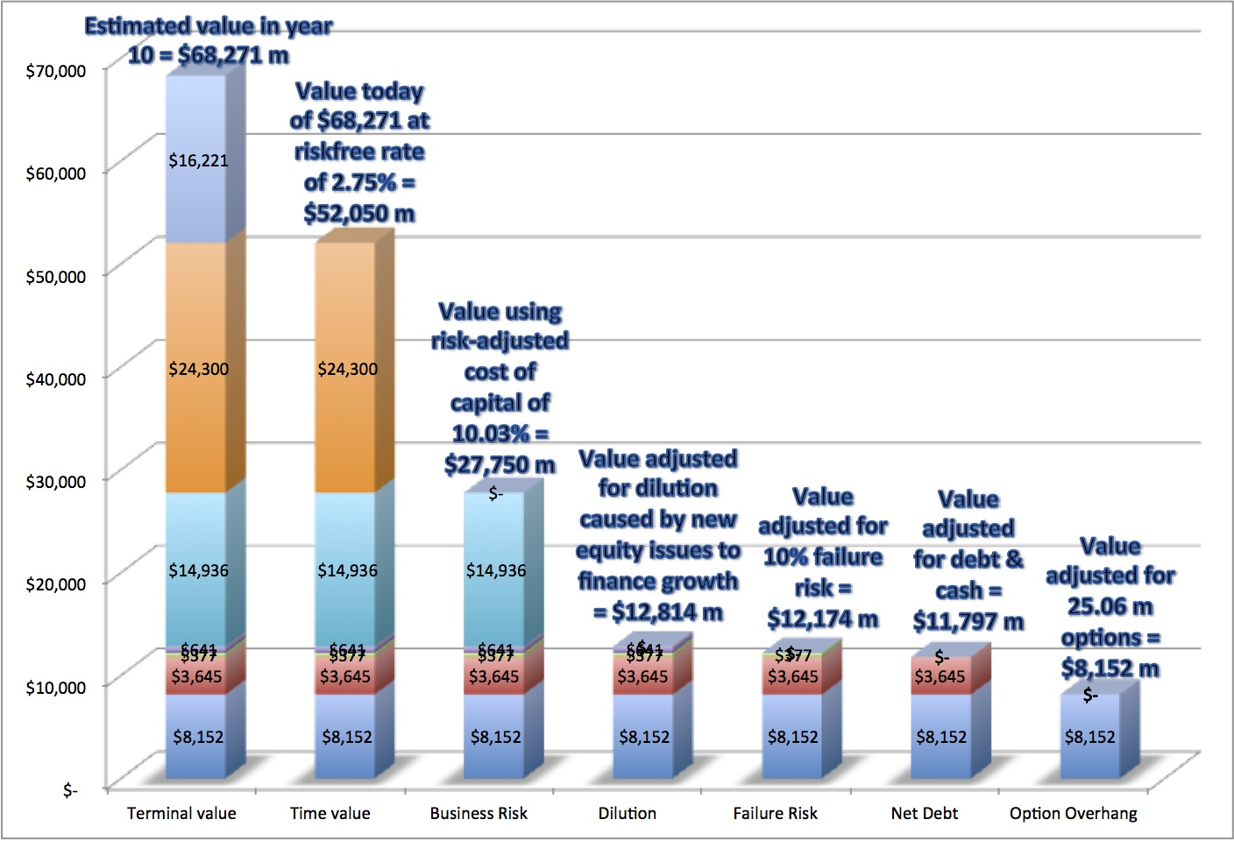
Solution 2: Use forward multiples
Watch out for bumps in the road (Tesla in 2013)
Notes:
The conclusions can vary though both approaches have some intuitive appeal. The one thing that you cannot do is to be inconsistent. You cannot apply a current multiple to future earnings and not discount…

Slide 83
The Market sets the rules…
While we can compute multiples based upon accounting numbers (revenues, earnings, EBITDA or book value), you can also compute the multiple that market are paying on any quantifiable variable.
  You can compute market cap or EV per employee, per subscriber, per customer etc.
  The question of whether you should do so is not a theoretical one. It is set by the market.
Ultimately, your job in pricing is to figure what the market cares about when pricing companies and replicate it.

Slide 84
An Example: Let the market tell you what matters.. Social media in October 2013
Company | Market Cap | Enterprise value | Revenues | EBITDA | Net Income | Number of users (millions) | EV/User | EV/Revenue | EV/EBITDA | PE
Facebook | $173,540.00 | $160,090.00 | $7,870.00 | $3,930.00 | $1,490.00 | 1230.00 | $130.15 | 20.34 | 40.74 | 116.47
Linkedin | $23,530.00 | $19,980.00 | $1,530.00 | $182.00 | $27.00 | 277.00 | $72.13 | 13.06 | 109.78 | 871.48
Pandora | $7,320.00 | $7,150.00 | $655.00 | -$18.00 | -$29.00 | 73.40 | $97.41 | 10.92 | NA | NA
Groupon | $6,690.00 | $5,880.00 | $2,440.00 | $125.00 | -$95.00 | 43.00 | $136.74 | 2.41 | 47.04 | NA
Netflix | $25,900.00 | $25,380.00 | $4,370.00 | $277.00 | $112.00 | 44.00 | $576.82 | 5.81 | 91.62 | 231.25
Yelp | $6,200.00 | $5,790.00 | $233.00 | $2.40 | -$10.00 | 120.00 | $48.25 | 24.85 | 2412.50 | NA
Open Table | $1,720.00 | $1,500.00 | $190.00 | $63.00 | $33.00 | 14.00 | $107.14 | 7.89 | 23.81 | 52.12
Zynga | $4,200.00 | $2,930.00 | $873.00 | $74.00 | -$37.00 | 27.00 | $108.52 | 3.36 | 39.59 | NA
Zillow | $3,070.00 | $2,860.00 | $197.00 | -$13.00 | -$12.45 | 34.50 | $82.90 | 14.52 | NA | NA
Trulia | $1,140.00 | $1,120.00 | $144.00 | -$6.00 | -$18.00 | 54.40 | $20.59 | 7.78 | NA | NA
Tripadvisor | $13,510.00 | $12,860.00 | $945.00 | $311.00 | $205.00 | 260.00 | $49.46 | 13.61 | 41.35 | 65.90
 |  |  |  |  |  | Average | $130.01 | 11.32 | 350.80 | 267.44
 |  |  |  |  |  | Median | $97.41 | 10.92 | 44.20 | 116.47

Slide 85
Read the tea leaves: See what the market cares about
 | Market Cap | Enterprise value | Revenues | EBITDA | Net Income | Number of users (millions)
Market Cap | 1.
Enterprise value | 0.9998 | 1.
Revenues | 0.8933 | 0.8966 | 1.
EBITDA | 0.9709 | 0.9701 | 0.8869 | 1.
Net Income | 0.8978 | 0.8971 | 0.8466 | 0.9716 | 1.
Number of users (millions) | 0.9812 | 0.9789 | 0.8053 | 0.9354 | 0.8453 | 1.
Twitter had 240 million users at the time of its IPO. What price would you attach to the company?

Slide 86
Pricing across the entire market: Why not?
In contrast to the 'comparable firm' approach, the information in the entire cross-section of firms can be used to predict PE ratios.
The simplest way of summarizing this information is with a multiple regression, with the PE ratio as the dependent variable, and proxies for risk, growth and payout forming the independent variables.
Notes:
There is information in how the market prices all firms that can be used to value any firm in that market.

Slide 87
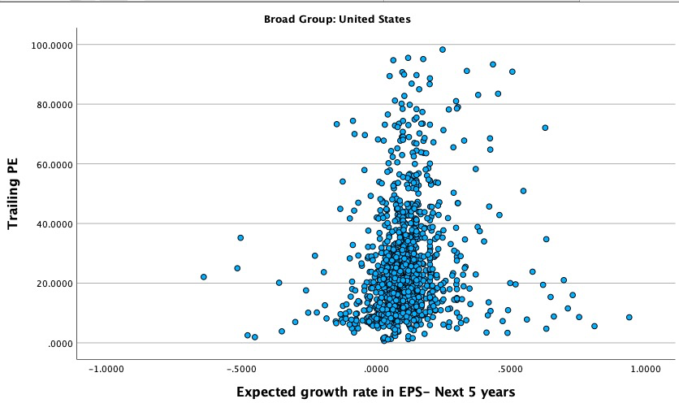
PE Ratio versus the market
PE versus Expected EPS Growth: January 2024
Notes:
The expected growth rate is the consensus estimate of growth in earnings per share over the next 5 years - this is available from services like Zacks and I/B/E/S.
The relationship between PE and expected growth is positive - the line fit through is the regression line - but it is noisy… The band represents one standard error from the regression line of PE versus growth…

Slide 88
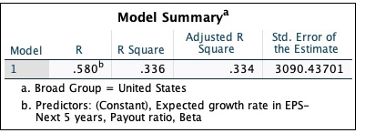

PE Ratio: Standard Regression for US stocks - January 2024
The regression is run with growth and payout entered as decimals, i.e., 25% is entered as 0.25)
Notes:
This regression has about 1600 firms. While the low R-squared may be troubling, it should not be unexpected, given the scatter plot on the previous page.
The signs of the coefficients are consistent with our priors for growth and higher growth have higher PE ratios. With risk and payout, though, the signs on the coefficient are wrong. Higher risk and lower payout firms firms seems to have higher (instead of lower) PE ratios.

Slide 89
Problems with the regression methodology
Non-linearity: The basic regression assumes a linear relationship between PE ratios and the financial proxies, and that might not be appropriate.
Non-stationarity: The basic relationship between PE ratios and financial variables itself might not be stable, and if it shifts from year to year, the predictions from the model may not be reliable. For instance, the 2022 regression has a markedly lower R-squared than the regressions in prior years, as the COVID effect on earnings plays out.
Multi-collinearity: The independent variables are correlated with each other. For example, high growth firms tend to have high risk. This multi-collinearity makes the coefficients of the regressions unreliable and may explain the large changes in these coefficients from period to period.
Notes:
Three problems with the regression. Each is fixable to some degree or the other.
You can either transform the variables (use the natural log of growth rates) to make the relationship linear or run non-linear regressions.
You can update the regressions frequently to allow for the instability in the coefficients.
You can use statistical techniques to minimize the effect of multi-collinearity.

Slide 90
Statistically insignificant?
If a coefficient in a regression is statistically insignificant, all it is doing is adding noise to the regression prediction.
  There are simple statistical tests of significance, such as the t statistics (>2 is very good, 1-2 is marginal, <1 is noise)
  With small samples, don’t overload the regression with independent variables.
Take the variable out of the regression, even if the fundamentals say it should matter. In pricing, it is the market that determines what matters.
Notes:
1. You may be tempted to throw in every variable into a regression, that you intuitively think should explain a multiple. While that me be a good starting point, leaving variables in the regression that are not statistically significant will make your predictions worse, not better. There is also the chance that nothing that you try is significant, in which case you should move on and consider this a red flag on pricing run amok in the sector.
2. If you have a small sample, overloading your regression may yield great looking R-squared, but your regressions are fatally flawed. As a general rule, you can add one additional independent variable for every 10-15 additional sample observations. With a sample of 20, stick with one and at the most two variables. With 50, you can have 3 and perhaps 4 variables.

Slide 91

The Negative Intercept Problem
When the intercept in a multiple regression is negative, there is the possibility that forecasted values can be negative as well.
One way (albeit imperfect) is to re-run the regression without an intercept. When the intercept in a multiple regression is negative, there is the possibility that forecasted values can be negative as well. One way (albeit imperfect) is to re-run the regression without an intercept.
Notes:
A negative intercept is not a statistical problem but the resulting regression can yield negative predicted values for multiples and that can be a problem (especially if the intercept is a big negative number). In those cases, rerunning the regression without an intercept can yield more useable regressions.

Slide 92

If a coefficient has the wrong sign: The Multicollinearity Problem
Notes:
In a multiple regression, the independent variables should be uncorrelated with each other - the correlations should be zero between growth and beta, growth and payout, payout and beta… As the correlation matrix above indicates, this is not the case in this regression… The “multicollinearity” will wreak havoc with the coefficients on the individual variables in the regression (though the overall regression can still be used for predictive purposes)

Slide 93
Using the PE ratio regression
Assume that you were given the following information for Disney. The firm has an expected growth rate of 15%, a beta of 0.90 and a 20% dividend payout ratio. Based upon the regression, the predicted PE ratio for Disney is:
  Predicted PE = 19.34 (0.9) + 10.37 (.20) ) + 68. 70 (.15) = 29.8
Disney is trading at 74.7 times earnings. What does the predicted PE tell you?
Assume now that you priced Disney against just its peer group. Will you come to the same pricing judgment as you did when you looked at it relative to the market? Why or why not?
Notes:
Plugging into the regression on page 84, we get
Predicted PE for Disney = = 33.33 – 7.11 (0.9) + 0.075(20) + 0.494 (15) = 35.84
At 38 times earnings, Disney is over priced, given how the market is pricing other stocks and Disney’s fundamentals.
However, note that the prediction from the regression comes with a range (which will be large because of the low R-squared). In fact, the regression prediction with 95% confidence is that Disney’s true PE lies between 20 -33 times earnings.

Slide 94

The value of growth
Notes:
The coefficient on the expected growth rate tells you something about how the market values growth and the scarcity of growth. Clearly, the value attached to growth decreased from January 2000 to July 2002. If you consider the implied equity risk premium as what you believe that the market charges for an extra unit of risk, you can see that a high growth, high risk firm will be valued very differently in July 2002 than in January 2000.
How would you explain the uptick in 2003? On one level, it may indicate that the slide in value for growth stocks has stopped. The other is that growth had become a scarcer resource (fewer companies have high expected growth rates) and the market is pricing it higher.
One of the interesting features of 2022 was the dramatic drop off in the explanatory power of growth. One reason, I think, is that coming out of COVID, expected growth lost its value as a dividing line between growth and mature companies, since many companies that were damaged by COVID, even though they were mature, were reporting sky high growth rates due to the COVID recovery.

Slide 95

II. PEG Ratio versus the market
PEG versus Growth
Notes:
This may be cloud-gazing, but the relationship looks decidedly non-linear.

Slide 96

PEG versus ln(Expected Growth)
Notes:
May be hopeful thinking, but relationship does look more linear. The overall relationship is negative.

Slide 97


PEG Ratio Regression - US stocks
January 2024
Notes:
The R-squared is still low but the coefficients make sense. Low growth, high payout and low risk companies have much higher PEG ratios..

Slide 98

I. PE ratio regressions across markets
g_{EPS}=Expected Growth: Expected growth in EPS or Net Income: Next 5 years (decimals)
Beta: Regression or Bottom up Beta
Payout ratio: Dividends/ Net income from most recent year. Set to zero, if net income < 0
Notes:
Note how much in common these regressions have… though the effects of growth, risk and quality of growth may vary across markets, the direction of the effect is the same.

Slide 99

II. PEG ratio regressions across markets
g_{EPS}=Expected Growth: Expected growth in EPS or Net Income: Next 5 years (decimals)
Beta: Regression or Bottom up Beta
Payout ratio: Dividends/ Net income from most recent year. Set to zero, if net income < 0
Notes:
Replaced growth with ln(growth) in this regression.

Slide 100

III. Price to Book Ratio:
Fundamentals hold in every market
g_{EPS}=Expected Growth: Expected growth in EPS/ Net Income: Next 5 years
Beta: Regression or Bottom up Beta
Payout ratio: Dividends/ Net income from most recent year. Set to zero, if net income < 0
ROE: Net Income/ Book value of equity in most recent year.
Notes:
Japan is the outlier. It is difficult to explain differences in price to book ratios across Japanese companies… May have something to do with Japanese accounting… and how it affects book value.

Slide 101

IV. EV/EBITDA across markets
g = Expected Revenue Growth: Expected growth in revenues: Near term (2 or 5 years)
DFR = Debt Ratio : Total Debt/ (Total Debt + Market value of equity)
Tax Rate: Effective tax rate in most recent year ROIC = Return on Capital
Notes:
Confirms our priors, looking at the entire market .. Higher growth and return on capital result in higher value to EBITDA multiples… A lower tax rate increases the EBITDA multiple as well… The debt to capital ratio cuts both ways: it can imply a high cost of capital or a low one, depending upon the company. (For a sensible company with low business risk, using more debt lowers the cost of capital… For a not-so-sensible company, using more debt increases risk and increases the cost of capital)

Slide 102

V. EV/Sales Regressions across markets…
g =Expected Revenue Growth: Expected growth in revenues: Near term (2 or 5 years)
Tax Rate: Effective tax rate in most recent year; Operating Margin: Operating Income/ Sales
Notes:
Operating margin dominates the regression in every market.

Slide 103

VI. EV/Invested Capital
g =Expected Revenue Growth: Expected growth in revenues: Near term (2 or 5 years)
DFR: Debt Ratio
ROIC = Return on Invested Capital
Notes:
Like price to book, but at the enterprise value level.

Slide 104
The Pricing Game: Choices
Measure | Choices | Considerations/ Questions
Value | Enterprise, Equity or Firm Value? | Is this a financial service business? Are there big differences in leverage?
Scalar | Revenues, Earnings, Cash Flows or Book Value? | How are you measuring value? Is the scaling number positive? How (and how much) do accounting choices affect the scaling measure?
Timing & Normalizing | Current, Trailing, Forward or Really Forward? | Where are you in the life cycle? How much cyclicality is there in the number? Can you get forecasted values?
Comparable | What is your peer group? (Global or local? Similar size or all firms? …) | How much do companies share in common globally? Does company size affect business economics? How big a sample of firms do you need? How do you plan to control for differences?
Notes:
When doing relative valuation, you can choose between potentially a dozen or more multiples. With each multiple, you will estimate a different value for your firm, leaving you with the unenviable task of reconciling these values.

Slide 105
Relative Valuation: Some closing propositions
Proposition 1: In a relative valuation, all that you are concluding is that a stock is under or over valued, relative to your comparable group.
  Your relative valuation judgment can be right and your stock can be hopelessly over valued at the same time.
Proposition 2: In asset valuation, there are no similar assets. Every asset is unique.
  If you do not control for fundamental differences in risk, cash flows and growth across firms when comparing how they are priced, your valuation conclusions will reflect your flawed judgments rather than market misvaluations.
Bottom line: Relative valuation is pricing, not valuation.
Notes:
Pricing is not valuation.

Slide 106
Reviewing: The Four Steps to Understanding Multiples
Define the multiple
  Check for consistency
  Make sure that they are estimated uniformly
Describe the multiple
  Multiples have skewed distributions: The averages are seldom good indicators of typical multiples
  Check for bias, if the multiple cannot be estimated
Analyze the multiple
  Identify the companion variable that drives the multiple
  Examine the nature of the relationship
Apply the multiple
Notes:
Reviews the four basic steps in relative valuation.

Slide 107
A Detour: Asset Based Valuation
Value assets, not cash flows?
Notes:
While I did not mention this as a separate approach, it is worth taking a look at in passing.

Slide 108
What is asset-based valuation?
In intrinsic valuation, you value a business based upon the cash flows you expect that business to generate over time.
In relative valuation, you value a business based upon how similar businesses are priced.
In asset-based valuation, you value a business by valuing its individual assets. These individual assets can be tangible or intangible.
Notes:
Perhaps the best way to contrast asset based valuation with intrinsic valuation, is that the latter is focused on the income and cash flow statements, the former is rooted in the balance sheet.

Slide 109
Why would you do asset-based valuation?
Liquidation: If you are liquidating a business by selling its assets piece meal, rather than as a composite business, you would like to estimate what you will get from each asset or asset class individually.
Accounting mission: As both US and international accounting standards have turned to “fair value” accounting, accountants have been called upon to redo balance sheet to reflect the assets at their fair rather than book value.
Sum of the parts: If a business is made up of individual divisions or assets, you may want to value these parts individually for one of two groups:
  Potential acquirers may want to do this, as a precursor to restructuring the business.
  Investors may be interested because a business that is selling for less than the sum of its parts may be “cheap”.
Notes:
There can be different motives for doing asset-based valuation. Most asset based valuations are accounting valuations that are more “show” than “do” valuations. Some are for transactions, either liquidation or acquisitions.

Slide 110
How do you do asset-based valuation?
Intrinsic value: Estimate the expected cash flows on each asset or asset class, discount back at a risk adjusted discount rate and arrive at an intrinsic value for each asset.
Relative value: Look for similar assets that have sold in the recent past and estimate a value for each asset in the business.
Accounting value: You could use the book value of the asset as a proxy for the estimated value of the asset.
Notes:
Here is the reason why I did not separate out asset based valuation as a third approach to valuation. You have to use either intrinsic or relative valuation to value each individual asset, or worse still, trust accounting estimates of value.

Slide 111
When is asset-based valuation easiest to do?
Separable assets: If a company is a collection of separable assets (a set of real estate holdings, a holding company of different independent businesses), asset-based valuation is easier to do. If the assets are interrelated or difficult to separate, asset-based valuation becomes problematic. Thus, while real estate or a long-term licensing/franchising contract may be easily valued, brand name (which cuts across assets) is more difficult to value separately.
Stand alone earnings/ cash flows: An asset is much simpler to value if you can trace its earnings/cash flows to it. It is much more difficult to value when the business generates earnings, but the role of individual assets in generating these earnings cannot be isolated.
Active market for similar assets: If you plan to do a relative valuation, it is easier if you can find an active market for “similar” assets which you can draw on for transactions prices.
Notes:
If a company is a collection of five real estate holdings, it is easy to do an asset based valuation. Each property can be valued separately and the values of the properties can be added together to get to the value of the company. If the same company is a brand name hotel with five properties, it will be more difficult to value the company using asset based valuation. Each property has a value that is attributable not only to it but to the hotel brand and other centralized services.

Slide 112
I. Liquidation Valuation
In liquidation valuation, you are trying to assess how much you would get from selling the assets of the business today, rather than the business as a going concern.
Consequently, it makes more sense to price those assets (i.e., do relative valuation) than it is to value them (do intrinsic valuation).
  For assets that are separable and traded (example: real estate), pricing is easy to do.
  For assets that are not, you often see book value used either as a proxy for liquidation value or as a basis for estimating liquidation value.
To the extent that the liquidation is urgent, you may attach a discount to the estimated value.
Notes:
While liquidation valuation requires you to assess what you can get if you sell the asset today, this can be more difficult to do for some assets than others.. Trusting book value as the basis for liquidation value is a dangerous practice.

Slide 113
II. Accounting Valuation: Glimmers from FAS 157
The ubiquitous “market participant”: Through FAS 157, accountants are asked to attach values to assets/liabilities that market participants would have been willing to pay/ receive.
Tilt towards relative value: “The definition focuses on the price that would be received to sell the asset or paid to transfer the liability (an exit price), not the price that would be paid to acquire the asset or received to assume the liability (an entry price).” The hierarchy puts “market prices”, if available for an asset, at the top with intrinsic value being accepted only if market prices are not accessible.
Split mission: While accounting fair value is titled towards relative valuation, accountants are also required to back their relative valuations with intrinsic valuations. Often, this leads to reverse engineering, where accountants arrive at values first and develop valuations later.
Notes:
Accounting fair value does not seem to have a clear focus both about what value accountants are supposed to estimate and why they are doing the estimation. On the first question, while FAS 157 seems to suggest that fair value is what a willing buyer will pay for an asset today, the rules seem to also require that accountants estimate intrinsic values that match this fair value. On the second, it is not clear whether the intent here is a balance sheet that reflects the fair value of all asset, including future growth opportunities, or one that reflects the fair value of only existing assets.

Slide 114
III. Sum of the parts valuation
You can value a company in pieces, using either relative or intrinsic valuation. Which one you use will depend on who you are and your motives for doing the sum of the parts valuation.
If you are long term, passive investor in the company, your intent may be to find market mistakes that you hope will get corrected over time. If that is the case, you should do an intrinsic valuation of the individual assets.
If you are an activist investor that plans to acquire the company or push for change, you should be more focused on relative valuation, since your intent is to get the company to split up and gain the increase in value.
Notes:
Sum of the parts valuation, in most cases, is haphazardly done. First, a firm is broken down into asset classes or businesses, even though there may be overlap across businesses or centralized support services. Second, the earnings or other operating metric for each asset class/business is converted to an estimated value, using the average multiple at which publicly traded companies in that business trade for. Third, the estimated values of the businesses are added up and compared the actual market value.

Slide 115

Let’s try this:
United Technologies: Raw Data - 2009
The company also had corporate expenses, unallocated to the divisions of $408 million in the most recent year.
Notes:
United Technologies is a multi business company. As with many multi-business companies, UT reports revenues and EBITDA by business, but it also provides information on cap ex, depreciation and total assets, unusual for a company.
The added item on corporate expenses is a typical one, since most multi-business companies have at least some corporate or G&A expense that is not allocated to the divisions.

Slide 116
United Technologies: Relative Valuation
Median Multiples
Division | Business | EBITDA | EV/EBITDA for sector | Value of Business
Carrier | Refrigeration systems | $1,510 | 5.25 | $7,928
Pratt & Whitney | Defense | $2,490 | 8.00 | $19,920
Otis | Construction | $2,680 | 6.00 | $16,080
UTC Fire & Security | Security | $780 | 7.50 | $5,850
Hamilton Sundstrand | Industrial Products | $1,277 | 5.50 | $7,024
Sikorsky | Aircraft | $540 | 9.00 | $4,860
Sum of the parts value for business = |  |  |  | $61,661
Notes:
Most sum of the parts valuations is fairly simplistic and represent approximate values. You are not controlling for differences between the company’s business and competitors (on margins, growth and risk) when you use the median value of the multiple. Also, using the same multiple for different businesses may not be optimal.

Slide 117


United Technologies: Relative Valuation Plus
Scaling variable & Choice of Multiples
Notes:
Allows not only for different multiples to be used for different businesses (you can either run regressions of multiples to see which ones work best or go with the multiple used most frequently in the sector) and looks at what causes these multiples to vary across companies in each sector.

Slide 118

United Technologies: Relative Valuation
Sum of the Parts value
Notes:
Plug in UT’s business specific values into the regression to get predicted value for the multiple and the business.
The sum of these values is a more complete version of relative valuation.

Slide 119

United Technologies: DCF parts valuation
Cost of capital, by business
Notes:
In this case, I chose to use the same debt to equity and capital ratios for all of the businesses, since UT had no distinct breakdown of debt. I could have tried allocating the debt, based upon the debt ratios of comparable companies…. But I did not bother…

Slide 120

United Technologies: DCF valuation
Fundamentals, by business
Notes:
Estimate the key numbers that drive growth for each business separately. I was able to do this only because UT broke down total capital and net cap ex by business. I scaled down the total assets line to reflect the ratio of capital invested for UT as a whole, relative to its total assets.

Slide 121

United Technologies, DCF valuation
Growth Choices
Notes:
Made different assumptions about growth period and growth rate for different businesses as well as what happens in stable growth to the ROC.

Slide 122

United Technologies, DCF valuation
Values of the parts
Notes:
Valued the operating assets for each business, by discounting cash flows to the firm at the cost of capital.

Slide 123


United Technologies, DCF valuation
Sum of the Parts
Value of the parts = $80,250
Value of corporate expenses
= $ 4,587
Value of operating assets (sum of parts DCF) = $75,663
Value of operating assets (sum of parts RV) = $74,230
Value of operating assets (company DCF) = $71,410
Enterprise value (based on market prices) = $52,261
Notes:
Comparison of the values for UT using the different approaches. Note that in the DCF approach, we have valued the corporate expenses as a perpetuity (with a growth rate of 3% a year forever) and the cost of capital for the company.

Slide 124

GE in 2018: The Parts

Slide 125
GE: Value of the Parts

Slide 126
GE: Pricing the Parts

Slide 127
Private Company Valuation
Aswath Damodaran
Notes:
Most valuations are of private businesses… but they don’t make big news.. And the appraisers of these companies are often not centered in the big financial capitals of the world…

Slide 128
Process of Valuing Private Companies
The process of valuing private companies is not different from the process of valuing public companies. You estimate cash flows, attach a discount rate based upon the riskiness of the cash flows and compute a present value. As with public companies, you can either value
  The entire business, by discounting cash flows to the firm at the cost of capital.
  The equity in the business, by discounting cashflows to equity at the cost of equity.
When valuing private companies, you face two standard problems:
  There is no market value for either debt or equity
  The financial statements for private firms are likely to go back fewer years, have less detail and have more holes in them.
Notes:
The process looks the same as it did for a publicly traded firm. The big difference is that the value can be different, depending upon who you do the valuation for…

Slide 129
1. No Market Value?
Market values as inputs: Since neither the debt nor equity of a private business is traded, any inputs that require them cannot be estimated.
  Debt ratios for going from unlevered to levered betas and for computing cost of capital.
  Market prices to compute the value of options and warrants granted to employees.
Market value as output: When valuing publicly traded firms, the market value operates as a measure of reasonableness. In private company valuation, the value stands alone.
Market price based risk measures, such as beta and bond ratings, will not be available for private businesses.
Notes:
Three fundamental problems with private businesses… You don’t realize how much you use market values in both intrinsic and relative valuation, until you don’t have them…

Slide 130
2. Cash Flow Estimation Issues
Shorter history: Private firms often have been around for much shorter time periods than most publicly traded firms. There is therefore less historical information available on them.
Different Accounting Standards: The accounting statements for private firms are often based upon different accounting standards than public firms, which operate under much tighter constraints on what to report and when to report.
Intermingling of personal and business expenses: In the case of private firms, some personal expenses may be reported as business expenses.
Separating “Salaries” from “Dividends”: It is difficult to tell where salaries end and dividends begin in a private firm, since they both end up with the owner.
Notes:
Especially with small, private businesses, accounting standards can vary widely and the reported earnings for a business may bear little resemblance to the true earnings. Many private business owners do not charge a salary for the significant services they render, thus overstating the profitability of their businesses.

Slide 131
Private Company Valuation: Motive matters..
You can value a private company for
  ‘Show’ valuations
    Curiosity: How much is my business really worth?
    Legal purposes: Estate tax and divorce court
  Transaction valuations
    Sale or prospective sale to another individual or private entity.
    Sale of one partner’s interest to another
    Sale to a publicly traded firm
  As prelude to setting the offering price in an initial public offering
You can value a division or divisions of a publicly traded firm
  As prelude to a spin off
  For sale to another entity
  To do a sum-of-the-parts valuation to determine whether a firm will be worth more broken up or if it is being efficiently run.
Notes:
The motive for a valuation can have significant effects on how you estimate cash flows and discount rates. In other words, the same private firm may be worth more to a publicly traded firm than to a private entity.

Slide 132
Private company valuations: Four broad scenarios
Private to private transactions: You can value a private business for sale by one individual to another.
Private to public transactions: You can value a private firm for sale to a publicly traded firm.
Private to IPO: You can value a private firm for an initial public offering.
Private to VC to Public: You can value a private firm that is expected to raise venture capital along the way on its path to going public.
Notes:
Four classes of transactions… can lead to four different valuations… for the same company.

Slide 133
I. Private to Private transaction
In private-to-private transactions, a private business is sold by one individual to another. There are three key issues that we need to confront in such transactions:
  Neither the buyer nor the seller is diversified. Consequently, risk and return models that focus on just the risk that cannot be diversified away will seriously under estimate the discount rates.
  The investment is illiquid. Consequently, the buyer of the business will have to factor in an “illiquidity discount” to estimate the value of the business.
  Key person value: There may be a significant personal component to the value. In other words, the revenues and operating profit of the business reflect not just the potential of the business but the presence of the current owner.
Notes:
With very small businesses, this is the most common transaction…
In service businesses (a doctor’s practice, a plumbing business), you generally see all of these problems come into play.

Slide 134
An example: Valuing a restaurant
Assume that you have been asked to value an upscale French restaurant for sale by the owner (who also happens to be the chef). Both the restaurant and the chef are well regarded, and business has been good for the last 3 years.
  The potential buyer is a former investment banker, who tired of the rat race, has decide to cash out all of his savings and use the entire amount to invest in the restaurant.
  You have access to the financial statements for the last 3 years for the restaurant. In the most recent year, the restaurant reported $ 1.2 million in revenues and $ 400,000 in pre-tax operating profit .
  While the firm has no conventional debt outstanding, it has a lease commitment of $120,000 each year for the next 12 years.
Notes:
The buyer here is going to be completely invested in this restaurant…. Hence, he will be undiversified….

Slide 135
Past income statements…
 | 3 years ago | 2 years ago | Last year
Revenues | $800 | $1,100 | $1,200 | Operating at full capacity
- Operating lease expense | $120 | $120 | $120 | (12 years left on the lease)
- Wages | $180 | $200 | $200 | (Owner/chef does not draw salary)
- Material | $200 | $275 | $300 | (25% of revenues)
- Other operating expenses | $120 | $165 | $180 | (15% of revenues)
Operating income | $180 | $340 | $400
- Taxes | $72 | $136 | $160 | (40% tax rate)
Net Income | $108 | $204 | $240
^{All numbers are in thousands}
Notes:
There is historical data,… and the restaurant does look profitable… but there are loose ends to tie up.. (the chef’s salary, for instance

Slide 136
Step 1: Estimating discount rates
Conventional risk and return models in finance are built on the presumption that the marginal investors in the company are diversified and that they therefore care only about the risk that cannot be diversified. That risk is measured with a beta or betas, usually estimated by looking at past prices or returns.
In this valuation, both assumptions are likely to be violated:
  As a private business, this restaurant has no market prices or returns to use in estimation.
  The buyer is not diversified. In fact, he will have his entire wealth tied up in the restaurant after the purchase.
Notes:
The risk and return models that we draw on so widely with public companies may not easily transfer to private to private transactions.
Intuitively, the buyer of this restaurant will care about all risk, not just market risk.

Slide 137
No market price, no problem… Use bottom-up betas to get the unlevered beta
The average unlevered beta across 75 publicly traded restaurants in the US is 0.86. Most of the publicly traded restaurants on this list are fast-food chains (McDonald’s, Burger King) or mass restaurants (Applebee’s, TGIF…). An upscale restaurant does not fit easily into this mix.
There is an argument to be made that the beta for an upscale restaurant is more likely to be reflect high-end specialty retailers than it is restaurants. The unlevered beta for 45 high-end retailers is 1.18.
Notes:
Note that the comparable companies have to be publicly traded to have regression betas.. So, this is where you have to start…

Slide 138

Notes:
Lays out the logic for why an undiversified investor will see more risk in investing in this company that a diversified investor…

Slide 139
Estimating a total beta
To get from the market beta to the total beta, we need a measure of how much of the risk in the firm comes from the market and how much is firm-specific.
Looking at the regressions of publicly traded firms that yield the bottom-up beta should provide an answer.
  The average R-squared across the high-end retailer regressions is 25%.
  Since betas are based on standard deviations (rather than variances), we will take the correlation coefficient (the square root of the R-squared) as our measure of the proportion of the risk that is market risk.
Total Unlevered Beta
= Market Beta/ Correlation with the market
= 1.18 / 0.5 = 2.36
Notes:
Scales up the market beta to reflect the total risk in the company, rather than just the market risk.

Slide 140
The final step in the beta computation: Estimate a Debt to equity ratio and cost of equity
With publicly traded firms, we re-lever the beta using the market D/E ratio for the firm. With private firms, this option is not feasible. We have two alternatives:
  Assume that the debt to equity ratio for the firm is similar to the average market debt to equity ratio for publicly traded firms in the sector.
  Use your estimates of the value of debt and equity as the weights in the computation. (There will be a circular reasoning problem: you need the cost of capital to get the values and the values to get the cost of capital.)
We will assume that this privately owned restaurant will have a debt to equity ratio (14.33%) similar to the average publicly traded restaurant (even though we used retailers to the unlevered beta).
  Levered beta = 2.36 (1 + (1-.4) (.1433)) = 2.56
  Cost of equity =4.25% + 2.56 (4%) = 14.50%
  (T Bond rate was 4.25% at the time; 4% is the equity risk premium)
Notes:
Since there is no market equity for a private business, you have to find a way to go around the estimation problem. (You cannot and should not use book debt to equity ratios…)
Assuming that the industry average (from publicly traded firms in the same business) applies to the private firm is not a bad assumption.

Slide 141
Estimating a cost of debt and capital
While the firm does not have a rating or any recent bank loans to use as reference, it does have a reported operating income and lease expenses (treated as interest expenses)
  Coverage Ratio = Operating Income/ Interest (Lease) Expense
  = 400,000/ 120,000 = 3.33
  Rating based on coverage ratio = BB+ Default spread = 3.25%
  After-tax Cost of debt = (Riskfree rate + Default spread) (1 – tax rate)
  = (4.25% + 3.25%) (1 - .40) = 4.50%
To compute the cost of capital, we will use the same industry average debt ratio that we used to lever the betas.
  Cost of capital = 14.50% (100/114.33) + 4.50% (14.33/114.33) = 13.25%
  (The debt to equity ratio is 14.33%; the cost of capital is based on the debt to capital ratio)
Notes:
The synthetic ratings process yields a rating. While it is true that most private businesses will never be rated, the rating is just a means to an end: measuring default risk and bringing it into the cost of debt.
One augmentation to consider is to add an extra spread to reflect the fact that this is a small, private business (and not a large public company).

Slide 142
Step 2: Clean up the financial statements
 | Stated | Adjusted
Revenues | $1,200 | $1,200
- Operating lease expenses | $120 |  | Leases are financial expenses
- Wages | $200 | $350 | ! Hire a chef for $150,000/year
- Material | $300 | $300
- Other operating expenses | $180 | $180
Operating income | $400 | $370
- Interest expnses | $0 | $69.62 | 7.5% of $928.23 (see below)
Taxable income | $400 | $300.38
- Taxes | $160 | $120.15
Net Income | $240 | $180.23
Debt | 0 | $928.23 | ! PV of $120 million for 12 years @7.5%
Notes:
The lease adjustment is a standard one (we did this for public companies as well)
The chef’s salary fills in a hole in the income statement and makes the earnings more relevant.

Slide 143
Step 3: Assess the impact of the “key” person
Part of the draw of the restaurant comes from the current chef. It is possible (and probable) that if he sells and moves on, there will be a drop off in revenues. If you are buying the restaurant, you should consider this drop off when valuing the restaurant.
For instance, if 20% of the patrons are drawn to the restaurant because of the chef’s reputation, the expected operating income will be lower if the chef leaves.
  Adjusted operating income (existing chef) = $ 370,000
  Operating income (adjusted for chef departure) = $296,000
As the owner/chef of the restaurant, what might you be able to do to mitigate this loss in value?
Notes:
This could even happen with public companies (In 2011, for instance, Steve Jobs announced that he was stepping down as CEO of Apple. The stock lost $ 30 billion in market value on the announcement)
As the owner/chef, you can do two things to minimize the impact: sign a non-compete clause (so that you don’t open a new restaurant next door) and agree to stay on as the transitional chef, to get customers used to the new owners.

Slide 144
Step 4: Don’t forget valuation fundamentals
To complete the valuation, you need to assume an expected growth rate. As with any business, assumptions about growth have to be consistent with reinvestment assumptions. In the long term,
  Reinvestment rate = Expected growth rate/Return on capital
In this case, we will assume a 2% growth rate in perpetuity and a 20% return on capital.
Reinvestment rate = g/ ROC = 2%/ 20% = 10%
Even if the restaurant does not grow in size, this reinvestment is what you need to make to keep the restaurant both looking good (remodeling) and working well (new ovens and appliances).
Notes:
Just because you are looking at a private business does not mean that you abandon the first principles of valuation. Growth still has to be earned.

Slide 145
Step 5: Complete the valuation
Inputs to valuation
  Adjusted EBIT most recent year = $ 296,000
  Tax rate = 40%
  Cost of capital (based on total beta) = 13.25%
  Expected growth rate = 2%
  Reinvestment rate (RIR) = 10%
Valuation
  Value of the restaurant = Expected FCFF next year / (Cost of capital –g)
  = Expected EBIT next year (1- tax rate) (1- RIR)/ (Cost of capital –g)
  = 296,000 (1.02) (1-.4) (1-.10)/ (.1325 - .02)
  = $1.449 million
  Value of equity in restaurant = $1.449 million - $0.928 million (PV of leases) b= $ 0.521 million
Notes:
Valued the firm as a stable growth firm, with consistent inputs…

Slide 146
Step 6: Consider the effect of illiquidity
In private company valuation, illiquidity is a constant theme. All the talk, though, seems to lead to a rule of thumb. The illiquidity discount for a private firm is between 20-30% and does not vary across private firms.
But illiquidity should vary across:
  Companies: Healthier and larger companies, with more liquid assets, should have smaller discounts than money-losing smaller businesses with more illiquid assets.
  Time: Liquidity is worth more when the economy is doing badly and credit is tough to come by than when markets are booming.
  Buyers: Liquidity is worth more to buyers who have shorter time horizons and greater cash needs than for longer term investors who don’t need the cash and are willing to hold the investment.
Notes:
There is a cost to buyers’ remorse. With a liquid, publicly traded stock, it will be small: reversing a transaction costs very little (the brokerage costs are negligible and the bid-ask spread is tiny)… With a less liquid, publicly traded costs, the bid-ask spread can increase the cost. With private businesses, you may have to take a very large discount to sell a business quickly.

Slide 147
The Standard Approach: Illiquidity discount based on illiquid publicly traded assets
Restricted stock: These are stock issued by publicly traded companies to the market that bypass the SEC registration process but the stock cannot be traded for one year after the issue.
Pre-IPO transactions: These are transactions prior to initial public offerings where equity investors in the private firm buy (sell) each other’s stakes.
In both cases, the discount is estimated the be the difference between the market price of the liquid asset and the observed transaction price of the illiquid asset.
  Discount Restricted stock = Stock price – Price on restricted stock offering
  Discount_{IPO} = IPO offering price – Price on pre-IPO transaction
Notes:
The advantage of using publicly traded companies is that the transactions price on a transaction that involves illiquidity can be compared to the market price to estimate the discount…

Slide 148
The Restricted Stock Discount
Aggregate discount studies
  Maher examined restricted stock purchases made by four mutual funds in the period 1969-73 and concluded that they traded an average discount of 35.43% on publicly traded stock in the same companies.
  Moroney reported a mean discount of 35% for acquisitions of 146 restricted stock issues by 10 investment companies, using data from 1970.
  In a study of restricted stock offerings from the 1980s, Silber (1991) finds that the median discount for restricted stock is 33.75%.
Silber related the size of the discount to characteristics of the offering:
  LN(RPRS) = 4.33 +0.036 LN(REV) - 0.142 LN(RBRT) + 0.174 DERN + 0.332 DCUST
  RPRS = Relative price of restricted stock (to publicly traded stock)
  REV = Revenues of the private firm (in millions of dollars)
  RBRT = Restricted Block relative to Total Common Stock in %
  DERN = 1 if earnings are positive; 0 if earnings are negative;
  DCUST = 1 if there is a customer relationship with the investor; 0 otherwise;
Notes:
With restricted stock, the illiquidity discount seems to be very large… and Silber notes that the discount varies across restricted stock: companies with lower revenues and negative earnings have bigger discounts… and the discount increases as the block size increases.

Slide 149

Cross sectional differences in Illiquidity: Extending the Silber regression
Notes:
Using the Silber regression, we quantified the effects on the discount of increasing revenues or making earnings negative. (We stated with a base of 25% discount for a company with $10 million in revenues and positive earnings… and then holding all else constant, adjusted that discount for difference in revenues and negative earnings)

Slide 150

The IPO discount: Pricing on pre-IPO transactions (in 5 months prior to IPO)
Notes:
These discounts are computed by looking at transactions between the holders of private company stock in the months before the IPO and comparing the prices to the IPO price… Again, the illiquidity discount seems very large.

Slide 151
The “sampling” problem
With both restricted stock and the IPO studies, there is a significant sampling bias problem.
  The companies that make restricted stock offerings are likely to be small, troubled firms that have run out of conventional financing options.
  The types of IPOs where equity investors sell their stake in the five months prior to the IPO at a huge discount are likely to be IPOs that have significant pricing uncertainty associated with them.
With restricted stock, the magnitude of the sampling bias was estimated by comparing the discount on all private placements to the discount on restricted stock offerings. One study concluded that the “illiquidity” alone accounted for a discount of less than 10% (leaving the balance of 20-25% to be explained by sampling problems).
Notes:
There is a statistical problem. These are small samples of strange firms – healthy companies don’t issue restricted stock and the owners of stock in private businesses that plan an IPO don’t sell their stock 8 weeks before the IPO, if things are going smoothly. These discounts reflect more than illiquidity.

Slide 152
An alternative approach: Use the whole sample
All traded assets are illiquid. The bid ask spread, measuring the difference between the price at which you can buy and sell the asset at the same point in time is the illiquidity measure.
We can regress the bid-ask spread (as a percent of the price) against variables that can be measured for a private firm (such as revenues, cash flow generating capacity, type of assets, variance in operating income) and are also available for publicly traded firms.
Using data from the end of 2000, for instance, we regressed the bid-ask spread against annual revenues, a dummy variable for positive earnings (DERN: 0 if negative and 1 if positive), cash as a percent of firm value and trading volume.
  Spread = 0.145 – 0.0022 ln (Annual Revenues) -0.015 (DERN) – 0.016 (Cash/Firm Value) – 0.11 ($ Monthly trading volume/ Firm Value)
  You could plug in the values for a private firm into this regression (with zero trading volume) and estimate the spread for the firm.
Notes:
The notion that private businesses are illiquid and public companies are liquid misses the point. Liquidity is a continuum, with some public stocks being very liquid and others not so much. The differences in bid-ask spreads across stocks captures this variation. The regression on this page is a little dated, but it does relate the spread (as a percent of the stock price) to observable fundamentals (that you should be able to get for a private business: just treat it as a publicly traded stock that almost never trades)

Slide 153
Estimating the illiquidity discount for the restaurant
Approach used | Estimated discount | Value of restaurant
Bludgeon (Fixed discount) | 25% | $0.521 (1- .25) = $0.391 million
Refined Bludgeon (Fixed discount with adjustment for revenue size/ profitability) | 28.75% (Silber adjustment for small revenues and positive profits to a base discount of 25%) | $0.521 (1-.2875) = $0.371 million
Bid-ask spread regression | = 0.145 – 0.0022 ln (1.2) -0.015 (1) – 0.016 (.05) – 0.11 (0)= 12.88% | $0.521 (1-.1288) = $0.454 million
Notes:
The illiquidity discount from the bid-ask spread approach is much smaller than the spreads from the other approaches… the fixed discount or bludgeon approach (where the discount is based on the average illiquidity discount on restricted stock or IPOs) or the refined bludgeon where it is adjusted to reflect the specifics of the company…

Slide 154
II. Private company sold to publicly traded company
The key difference between this scenario and the previous scenario is that the seller of the business is not diversified but the buyer is (or at least the investors in the buyer are). Consequently, they can look at the same firm and see very different amounts of risk in the business with the seller seeing more risk than the buyer.
The cash flows may also be affected by the fact that the tax rates for publicly traded companies can diverge from those of private owners.
Finally, there should be no illiquidity discount to a public buyer, since investors in the buyer can sell their holdings in a market.
Notes:
If the buyer is a public company, there should be no total beta effect (since investors in the company can diversify) or illiquidity effect (since investors can buy and sell shares of the company…) The valuation therefore will look very much like the valuation of a publicly traded company.

Slide 155
Revisiting the cost of equity and capital: Restaurant Valuation
 | Private | Public
Unlevred beta | 2.36 | 1.18
Debt to equity ratio | 14.33% | 14.33%
Tax rate | 40% | 40%
Pre-tax cost of debt | 7.50% | 7.50%
Levered beta | 2.56 | 1.28
Riskfree rate | 4.25% | 4.25%
Equity risk premium | 4% | 4%
Cost of equity | 14.5% | 9.38%
After-tax cost of debt | 4.50% | 4.50%
Cost of capital | 13.25% | 8.76%
Notes:
Re-computes the cost of capital for the restaurant, assuming that the buyer is a diversified investor.

Slide 156

Revaluing the restaurant to a “public” buyer
Notes:
With the total beta and liquidity effect removed, the value of equity in this business is almost $ 1 million higher.
Lessons if you own a private business
See if you can find a public buyer interested in your company
If it is a private buyer, try to find out more about what else he or she has in his or her portfolio

Slide 157
So, what price should you ask for?
Assume that you represent the chef/owner of the restaurant and that you were asking for a “reasonable” price for the restaurant. What would you ask for?
  $ 454,000
  $ 1.484 million
  Some number in the middle
If it is “some number in the middle”, what will determine what you will ultimately get for your business?
How would you alter the analysis, if your best potential bidder is a private equity or VC fund rather than a publicly traded firm?
Notes:
Depends on your bargaining power. If there is only one public buyer, you will end up closer to $454,000. If you can get more than one interested in your business, the value will move towards $1.484 million. Odds are that you have to accept some discount, even in the latter case…
If the best potential bidder is a private equity or VC fund, the buyer may fall somewhere between the two extremes – neither completely undiversifed nor completely diversified.
Adjusted Total Beta = Market Beta/ Correlation of the investors’ portfolio with the market

Slide 158
III. Private company for initial public offering
In an initial public offering, the private business is opened up to investors who clearly are diversified (or at least have the option to be diversified).
  There are control implications as well. When a private firm goes public, it opens itself up to monitoring by investors, analysts and market.
  The reporting and information disclosure requirements shift to reflect a publicly traded firm.
Notes:
Valuing a company for an IPO is a standard public company valuation, albeit without the market price crutch (you are trying to estimate it)…

Slide 159

Notes:
The value of Twitter for a public offering…Note that the inputs are those of a publicly traded firm because the investors in the public offering are assumed to be the marginal investors and well diversified.

Slide 160
The twists in an initial public offering
Valuation issues:
  Use of the proceeds from the offering: The proceeds from the offering can be held as cash by the firm to cover future investment needs, paid to existing equity investors who want to cash out or used to pay down debt.
  Warrants/ Special deals with prior equity investors: If venture capitalists and other equity investors from earlier iterations of fund raising have rights to buy or sell their equity at pre-specified prices, it can affect the value per share offered to the public.
Pricing issues:
  Institutional set-up: Most IPOs are backed by investment banking guarantees on the price, which can affect how they are priced.
  Follow-up offerings: The proportion of equity being offered at initial offering and subsequent offering plans can affect pricing.
Notes:
When a company does an IPO, it issues shares to the public and raises cash. What it does with the cash can affect the value/share.
Since the IPO of a private business is after a series of capital issues to venture capitalists, each of whom may have different arrangements with the company’s owners, you have to factor in the costs of these special deals.
In most IPOs, only a portion of the equity is issued to the public at the time of the IP). This can have consequences for pricing and valuation.

Slide 161
A. Use of the Proceeds
The proceeds from an initial public offering can be
  Taken out of the firm by the existing owners
  Used to pay down debt and other obligations
  Held as cash by the company to cover future reinvestment needs
How you deal with the issuance will depend upon how the proceeds are used.
  If taken out of the firm -> Ignore in valuation
  If used to pay down debt -> Change the debt ratio, which may change the cost of capital and the value of the firm
  If held as cash to cover future reinvestment needs -> Add the cash proceeds from the IPO to the DCF valuation of the company.
Notes:
In IPO valuation, much is made of pre-money and post-money valuations. One of the biggest reasons that there is so much disagreement among practitioners about the difference is that they make different assumptions about how the cash raised in the IPO is used.

Slide 162
The IPO Proceeds: Twitter
How much? News stories suggest that the company is planning on raising about $1 billion from the offering.
Use: In the Twitter prospectus filing, the company specifies that it plans to keep the proceeds in the company to meet future investment needs.
  In the valuation, I have added a billion to the estimated value of the operating assets because that cash infusion will augment the cash balance.
How would the valuation have been different if the owners announced that they planned to withdraw half of the offering proceeds?
Notes:
Pre-money valuation = $ 9.6 billion (operating assets) + 0.38 (cash) -0.21 (debt) = 9.77 bill
Post-money valuation = $ 9.77 billion + $1 billion = $10.77 billion
If the owners kept half the cash, the post-money valuation would be $10.27 billion

Slide 163
B. Claims from prior equity investors
When a private firm goes public, there are already equity investors in the firm, including the founder(s), venture capitalists and other equity investors. In some cases, these equity investors can have warrants, options or other special claims on the equity of the firm.
If existing equity investors have special claims on the equity, the value of equity per share has to be affected by these claims. Specifically, these options need to be valued at the time of the offering and the value of equity reduced by the option value before determining the value per share.
Notes:
To the extent that agreements with earlier capital providers (venture capitalists, for instance) give these providers more claims on the equity (options that can be exercised, shares with extra voting rights, veto powers over future capital issues), you have to value these claims and take them out of the value of equity before computing the equity value per share for the IPO.
A good example: Linkedin, the social media company, went public in May 2011 and reported that it had 94 million shares outstanding, 8 million of which had extra voting rights. In addition, the firm had 20 million options that were outstanding to managers, employees and venture capitalists. In estimating the value per share for the IPO, you would first have to factor in the equity options outstanding and then have to adjust for the fact that the IPO shares had lower voting rights.

Slide 164
The claims on Twitter’s equity
The overall value that we estimate for Twitter’s equity is $10,779 million. There are multiple claims on this equity.
  The owners of the company own the common shares in the company
  Twitter has seven classes of convertible, preferred stock on the company (from different VCs).
  Twitter has 86 million restricted stock units that it has used in employee compensation.
  Twitter has 44.16 million units of employee options, also used in compensation contracts. (Strike price=$1.82, life = 6.94 years)
  Twitter has agreed to pay MoPub stockholders with 14.791 million shares.
The convertible preferred shares will be converted at the time of the offering and the common shares outstanding will be 472.61 million, not counting RSUs and options. In the valuation:
  Number of commons shares= 574.44 million (all but options)
  Option value = $805 million (with maturity set to 3.47 years)
Notes:
Luckily, Twitter does not have two classes of shares with different voting rights, since that would have required further apportioning of equity value.

Slide 165
C. The investment banking guarantee…
Almost all IPOs are managed by investment banks and are backed by a pricing guarantee, where the investment banker guarantees the offering price to the issuer.
If the price at which the issuance is made is lower than the guaranteed price, the investment banker will buy the shares at the guaranteed price and potentially bear the loss.
Notes:
If you have guaranteed a price and the cost of setting too high a price is immense (you have to cover the difference with your capital) and the cost of setting too low a price is non-existent and fleeting (there may or may not be a reputation effect).. It is no surprise that most investment banks write in a 15% discount into their manuals on how to set the offering price for an IPO.

Slide 166

Pricing versus Value
Earlier I assessed the value of equity at Twitter to be $9.97 billion (with a value per share of $17.36/share).
Assume, however, that the market appetite for social media stocks is high and that you pull up the valuations of other publicly traded stocks in the market:
What would you base your offer price on? How would you sell it?
Notes:
Using the multiples that other companies trade at, you can estimate a price for Twitter that the market will pay:
If you use EV/Sales, that price would be about $8.5 billion (483 *17.45).
If you use Market Cap/User, you get about $22 billion
Your job is to price Twitter, not value it. Here is my cynical assessment. To decide whether that price should be closer to $8.5 billion or $22 billion, you will call institutional investors and try to get a measure of their mood/excitement. If it looks like they think that Twitter should be priced higher, you will push your price up towards the $22 billion and market it primarily based on the number of users. You will then reverse engineer both your DCF valuation and the revenues you talk about (use forward revenues, since they will be higher) to back up your number.
Once you have priced it, you will also build in a buffer for your risk and attach a discount (15% is conventional) to that price.

Slide 167

The evidence on IPO pricing
Notes:
And here is the proof that IPOs are underpriced: on the offering date, the stock price pops by 10-15% on most IPOs.

Slide 168
An investment opportunity?
Assume that investment banks try to under price initial public offerings by approximately 10-15%. As an investor, what strategy would you adopt to take advantage of this behavior?
Why might it not work?
Notes:
The problem with trying to make money off this is the following. If you are not discriminating and bid for 1000 shares of every IPO that comes along, you will get 1000 shares of every overpriced IPO and fewer shares in underpriced IPOs (even assuming that the shares are allocated fairly and on a proportionate basis to everyone who has asked for the shares). Your portfolio will therefore be overweighted with overvalued IPOs which will bring the return down…

Slide 169
D. The offering quantity
Assume now that you are the owner of Twitter and were offering 100% of the shares in company in the offering to the public? If investors are willing to pay $20 billion for the common stock, how much do you lose because of the under pricing (15%)?
Assume that you were offering only 10% of the shares in the initial offering and plan to sell a large portion of your remaining stake over the following two years? Would your views of the under pricing and its effect on your wealth change as a consequence?
Notes:
If you put all of the share to the public, you will lose $1.5 billion of your wealth.
If you are selling only 10%, you lose $150 million… but the positive press that your stock gets on the IPO date may allow you to sell the remaining 90% at a higher price down the road (or at least that is what you hope…)

Slide 170

The IPO Company: Profile over time

Slide 171

The IPO Process: Change over time!

Slide 172
Alternatives to IPOs
The traditional IPO model, with banks operating as intermediaries and setting offering prices, has come under assault for two reasons:
  Banking failures on the services (pricing & selling0 that they offer in return for the fees.
  Loss of the credibility effect of a banking guarantee, as bankers have fallen in public standing.
There have been two alternatives offered:
  In a direct listing, the listing company lists its shares directly on the exchange, and let’s demand and supply set the price.
  In a SPAC, a publicly traded entity collects money for a future (but unspecified) IPO, and uses the funds to buy out a private company (which now takes on the standing of the public company).
Notes:
As bankers have fallen in their standing, alternatives are opening up. The biggest limitation of a direct listing is not that there is not enough curating of companies (bankers don’t do a good job on that anyway, and these companies have to file prospectuses that have the same information) but that the proceeds on the offering day cannot be held by the company but used instead by owners to cash out. You can always follow up going public with a seasoned equity issuance, but it is more work. With a SPAC, not only are you trusting the SPAC to find the right company and negotiate the right price for you, but you are giving up a hefty slice of the money you invest to the SPAC promoter.

Slide 173

IV. An Intermediate Problem
Private to VC to Public offering…

Slide 174
A case study in transitions…
Assume that you have a private business operating in a sector, where publicly traded companies have an average beta of 1 and where the average correlation of firms with the market is 0.25. Consider the cost of equity at three stages (Riskfree rate = 4%; ERP = 5%):
Stage 1: The nascent business, with a private owner, who is fully invested in that business.
  Perceived Beta = 1/ 0.25 = 4
  Cost of Equity = 4% + 4 (5% ) = 24%
Stage 2: Angel financing provided by specialized venture capitalist, who holds multiple investments, in high technology companies. (Correlation of portfolio with market is 0.5)
  Perceived Beta = 1/0.5 = 2
  Cost of Equity = 4% + 2 (5%) = 14%
Stage 3: Public offering, where investors are retail and institutional investors, with diversified portfolios:
  Perceived Beta = 1
  Cost of Equity = 4% + 1 (5%) = 9%
Notes:
Most private businesses go through different phases of raising capital, and the investor profile (in terms of diversification) can change at each stage. Even if the underlying business does not change, your beta and cost of equity may…

Slide 175
To value this company…
Assume that this company will be fully owned by its current owner for two years, will access the technology venture capitalist at the start of year 3 and that is expected to either go public or be sold to a publicly traded firm at the end of year 5.
 | 1 | 2 | 3 | 4 | 5 | Terminal year
E(Cash flow) | $100 | $125 | $150 | $165 | $170 | $175
Market beta | 1 | 1 | 1 | 1 | 1 | 1
Correlation | 0.25 | 0.25 | 0.5 | 0.5 | 0.5 | 1
Beta used | 4 | 4 | 2 | 2 | 2 | 1
Cost of equity | 24.00% | 24.00% | 14.00% | 14.00% | 14.00% | 9.00%
Terminal value |  |  |  |  | $2,500
Cumulated COE | 1.2400 | 1.5376 | 1.7529 | 1.9983 | 2.2780 | 2.4830
PV | $80.65 | $81.30 | $85.57 | $82.57 | $1,172.07
Value of firm | $1,502 | (Correct value, using changing costs of equity)
Value of firm | $1,221 | (using 24% as cost of equity forever. You will undervalue firm)
Value of firm | $2,165 | (Using 9% as cost of equity forever. You will overvalue firm)
Growth rate 2% forever after year 5
^{175/}
^{(.09-.02)}
Notes:
I think that the fair value today for this company is $1.5 million.
Note, though, how much the value gets skewed if you do not adjust the cost of equity for the changes in the investor profile.

Slide 176
Implications
Proposition 1: The value of a private business that is expected to transition to a publicly traded company will be higher than the value of an otherwise similar private business that does not expect to make this transition.
  Private businesses in sectors that are “hot” in terms of going public (social media in 2014) will be worth more than private businesses in less sexy sectors.
  As IPOs boom (bust) private company valuations will increase (decrease).
  Private companies in countries that have easy access to public markets will have higher value than companies in countries without that access.
Proposition 2: The value of a private business that expects to make the transition to a public company sooner will be higher than the value of an otherwise similar company that will take longer.
  Private businesses will be worth more if companies are able to go public earlier in their life cycle.
Notes:
Private business valuations can vary depending on the end game for the business. If you see the end game as it becoming a public company, you will attach a higher value to the private business than if that exit strategy does not exist. Put simply, healthy public markets beget healthy private ones.

Slide 177
Private company valuation: Closing thoughts
The value of a private business will depend on the potential buyer.
If you are the seller of a private business, you will maximize value, if you can sell to
  An investor who has a long-time horizon
  Who is well diversified (or whose investors are)
  And does not think too highly of you (as a person)
If you are valuing a private business for legal purposes (tax or divorce court), the assumptions you use and the value you arrive at will depend on which side of the legal divide you are on.
As a final proposition, always keep in mind that the owner of a private business has the option of investing his wealth in publicly traded stocks. There has to be a relationship between what you can earn on those investments and what you demand as a return on your business.
Notes:
Private company valuations are a lot more complicated than public company valuations…

