Slide 1
Valuation: Packet 3
Real Options, Acquisition Valuation and Value Enhancement
Updated: January 2026
Notes:
The final frontier.. Perhaps, the only part of valuation that can claim to be new and advanced… applying option pricing models to value real businesses

Slide 2
Real Options: Fact and Fantasy
Notes:
A hot concept in corporate finance and valuation right now..

Slide 3
Underlying Theme: Searching for an Elusive Premium
Traditional discounted cashflow models underestimate the value of investments, where there are options embedded in the investments to
  Delay or defer making the investment (delay)
  Adjust or alter production schedules as price changes (flexibility)
  Expand into new markets or products at later stages in the process, based upon observing favorable outcomes at the early stages (expansion)
  Stop production or abandon investments if the outcomes are unfavorable at early stages (abandonment)
Put another way, real option advocates believe that you should be paying a premium on discounted cashflow value estimates.
Notes:
The allure of real options is that they allow you to add a premium to traditional value estimates (NPV, discounted cash flow value) and override what are generally considered hard and fast rules in finance. Thus, you can use the real options argument to take a negative NPV investment, bid for a non-viable patent or pay more than fair value (estimated from cashflows) on an acquisition.

Slide 4
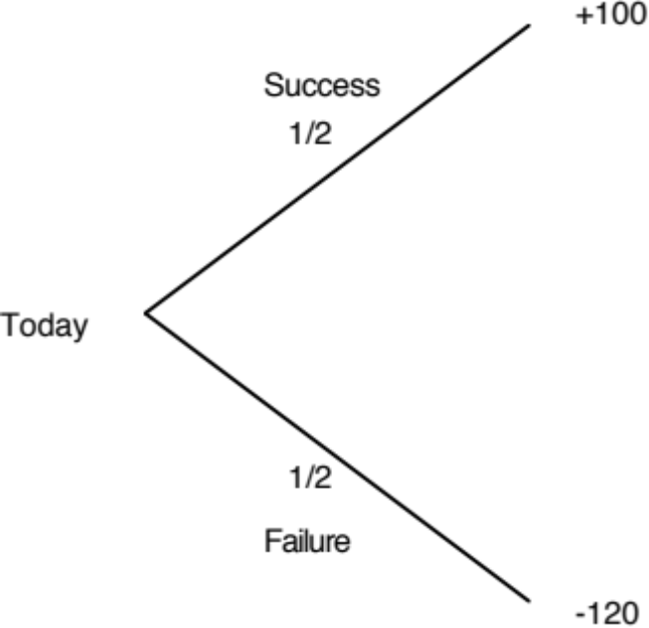
A bad investment…
Notes:
Expected value of this investment = -10

Slide 5
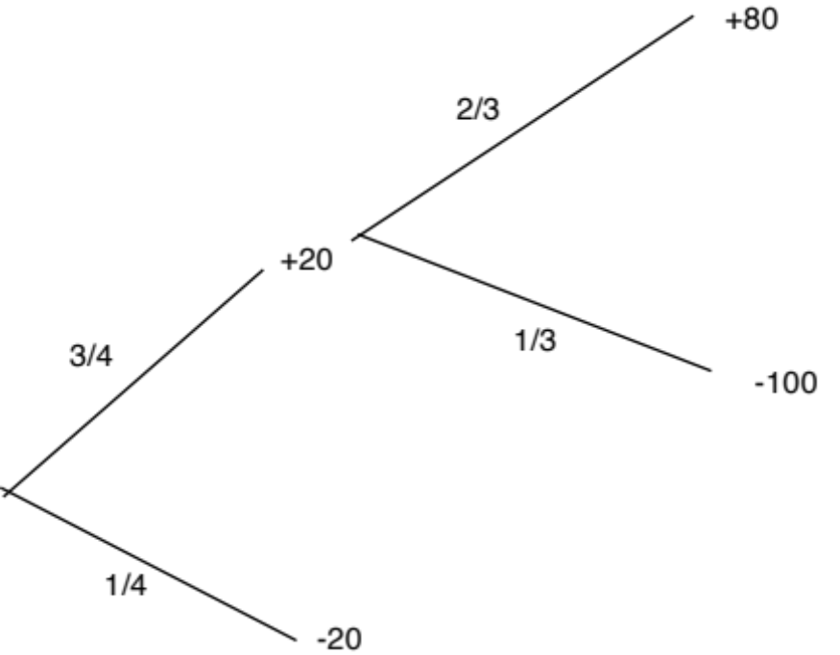
Becomes a good one…
Notes:
Expected value = 0.25 × (-20) + 0.75 × [20 + 2/3 × (80) + 1/3 × (-100)]
= $25 million
If you ignore time value, the cumulative probabilities of success and failure and the cumulative costs of each have not changed in this example but the expected value has become positive…
The gain comes from the fact that what you learn at the first stage allows you to make better decisions in the second. This learning is the essence of the value of real options and is what often gets ignored in conventional discounted cashflow valuation, where we take the expected cashflows from today’s vantage point without considering other pathways that the firm might choose given what happens in the first year, the second year etc.
The keys to real option value then come from learning and adaptive behavior.

Slide 6
Three Basic Questions
When is there a real option embedded in a decision or an asset?
When does that real option have significant economic value?
Can that value be estimated using an option pricing model?
Notes:
To prevent real options arguments from overwhelming common sense, we have to ensure that all three questions get answered in the affirmative before we use the argument in the first place.

Slide 7
When is there an option embedded in an action?
An option provides the holder with the right to buy or sell a specified quantity of an underlying asset at a fixed price (called a strike price or an exercise price) at or before the expiration date of the option.
There has to be a clearly defined underlying asset whose value changes over time in unpredictable ways.
The payoffs on this asset (real option) have to be contingent on a specified event occurring within a finite period.
Notes:
You are looking for all three to exist before you attach the option moniker on an asset:
There has to be an underlying asset
The payoff has to be contingent on an event happening
There has to be a finite life.

Slide 8
Payoff Diagram on a Call
Net Payoff
on Call
Strike
Price
Price of underlying asset
Notes:
Any asset with a cash flow payoff that resembles this has call option characteristics.
The key is that losses are limited and profits are not.

Slide 9
Payoff Diagram on Put Option
Net Payoff
On Put
Strike
Price
Price of underlying asset
Notes:
Any asset with a cash flow payoff that resembles this has put option characteristics.

Slide 10
When does the option have significant economic value?
For an option to have significant economic value, there has to be a restriction on competition in the event of the contingency. In a perfectly competitive product market, no contingency, no matter how positive, will generate positive net present value.
At the limit, real options are most valuable when you have exclusivity - you and only you can take advantage of the contingency. They become less valuable as the barriers to competition become less steep.
Notes:
Exclusivity is the defining variable determining whether an option has value. If you and only you can exercise the option, you get 100% of its value. If others also have the opportunity, you start losing value. In effect, opportunities that are available to every one are not options.

Slide 11
Determinants of option value
Variables Relating to Underlying Asset
  Value of Underlying Asset; as this value increases, the right to buy at a fixed price (calls) will become more valuable and the right to sell at a fixed price (puts) will become less valuable.
  Variance in that value; as the variance increases, both calls and puts will become more valuable because all options have limited downside and depend upon price volatility for upside.
  Expected dividends on the asset, which are likely to reduce the price appreciation component of the asset, reducing the value of calls and increasing the value of puts.
Variables Relating to Option
  Strike Price of Options; the right to buy (sell) at a fixed price becomes more (less) valuable at a lower price.
  Life of the Option; both calls and puts benefit from a longer life.
Level of Interest Rates; as rates increase, the right to buy (sell) at a fixed price in the future becomes more (less) valuable.
Notes:
These six variables are constants in all option pricing models. The one variable that is key is risk. Unlike every other asset, options gain value as the underlying asset becomes riskier, because the downside is limited (see limited losses in cash flow diagram).

Slide 12
When can you use option pricing models to value real options?
The notion of a replicating portfolio that drives option pricing models makes them most suited for valuing real options where
  The underlying asset is traded - this yield not only observable prices and volatility as inputs to option pricing models but allows for the possibility of creating replicating portfolios
  An active marketplace exists for the option itself.
  The cost of exercising the option is known with some degree of certainty.
When option pricing models are used to value real assets, we have to accept the fact that
  The value estimates that emerge will be far more imprecise.
  The value can deviate much more dramatically from market price because of the difficulty of arbitrage.
Notes:
The key insight that Black and Scholes had in the early 1970s (and which every option pricing model has used since) is that you can value options by just valuing a portfolio composed of the underlying asset and the riskfree asset that has exactly the same cash flows as the option. All option pricing models try to pinpoint this replicating portfolio and then use the arbitrage argument to justify why its value = option value.
To do replication, though, you have to be able to trade the underlying asset, trade the option and borrow/lend at the riskfree rate.

Slide 13
Creating a replicating portfolio
The objective in creating a replicating portfolio is to use a combination of riskfree borrowing/lending and the underlying asset to create the same cashflows as the option being valued.
  Call = Borrowing + Buying D of the Underlying Stock
  Put = Selling Short D on Underlying Asset + Lending
  The number of shares bought or sold is called the option delta.
The principles of arbitrage then apply, and the value of the option has to be equal to the value of the replicating portfolio.
Notes:
The mechanics of creating a replicating portfolio…

Slide 14
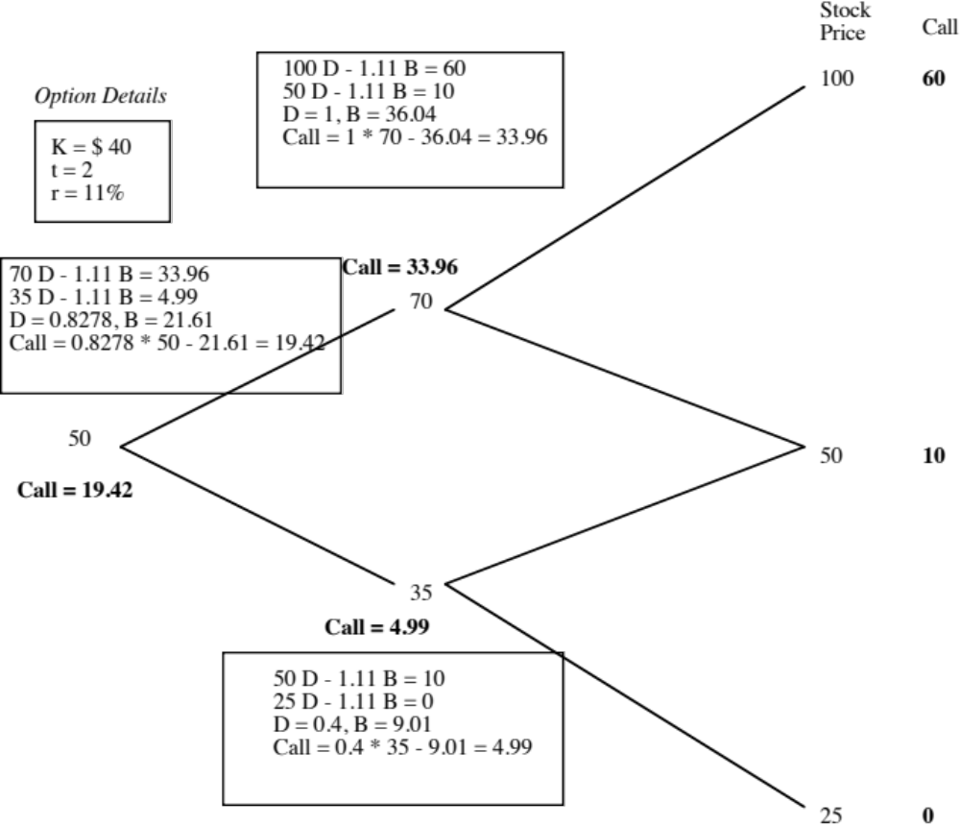
The Binomial Option Pricing Model
Notes:
Binomial models allow you to see arbitrage play out at each step in the process.
Here are the keys:
Start with the end node and work backwards (since the end node is the only time at which you know the cash flows on the option with certainty)
At each stage, compute the combination of the underlying asset and the riskless asset (lending/borrowing) you will need to get the same cash flows as the option
Estimate how much it will cost you to create this combination and make that the value of the option at that stage
Go to the prior stage and repeat the process.

Slide 15
The Limiting Distributions….
As the time interval is shortened, the limiting distribution, as t -> 0, can take one of two forms.
  If as t -> 0, price changes become smaller, the limiting distribution is the normal distribution and the price process is a continuous one.
  If as t->0, price changes remain large, the limiting distribution is the Poisson distribution, i.e., a distribution that allows for price jumps.
The Black-Scholes model applies when the limiting distribution is the normal distribution and explicitly assumes that the price process is continuous and that there are no jumps in asset prices.
Notes:
For most real-world options, the only chance you have of using a binomial is by making the time intervals really, really small (a minute or even a second). The catch is that your binomial will have thousands and thousands of branches…
The limiting distributions as time approaches zero are simple: if price changes also become small as the time interval becomes small, you end up with the normal distribution and the Black Scholes. If not, things are messier..

Slide 16
Black and Scholes…
The version of the model presented by Black and Scholes was designed to value European options, which were dividend-protected.
The value of a call option in the Black-Scholes model can be written as a function of the following variables:
  S = Current value of the underlying asset
  K = Strike price of the option
  t = Life to expiration of the option
  r = Riskless interest rate corresponding to the life of the option
  2 = Variance in the ln(value) of the underlying asset
Notes:
Fischer Black and Myron Scholes won the Nobel prize for this model to value options…
Notice the absence of dividends in the original BS… It was designed to value dividend protected options (if the stock paid a dividend, the exercise price would be lowered by the dividend as well to match the stock price drop.) It was also designed to value options that could be exercised only at expiration (European options rather than American options)

Slide 17
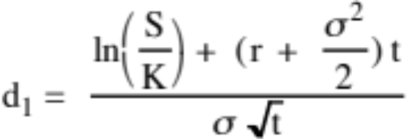
The Black Scholes Model
Value of call = S N (d1) - K e^{-rt} N(d2)
where
      d2 = d1 - σ √t
The replicating portfolio is embedded in the Black-Scholes model. To replicate this call, you would need to
  Buy N(d1) shares of stock; N(d1) is called the option delta
  Borrow K e^{-rt} N(d2)
Notes:
Note:
The entry of the normal distribution in the form of cumulative normal distribution variable (N(d1) and N(d2)
The replacement of the standard discount factor (1/(1+r)^n) with the continuous time version (e-rt)
The standard deviation input to capture the uncertainty about future value
The replicating portfolio is embedded in the equation. Almost every measure in option trading/pricing is built around this replicating portfolio.

Slide 18
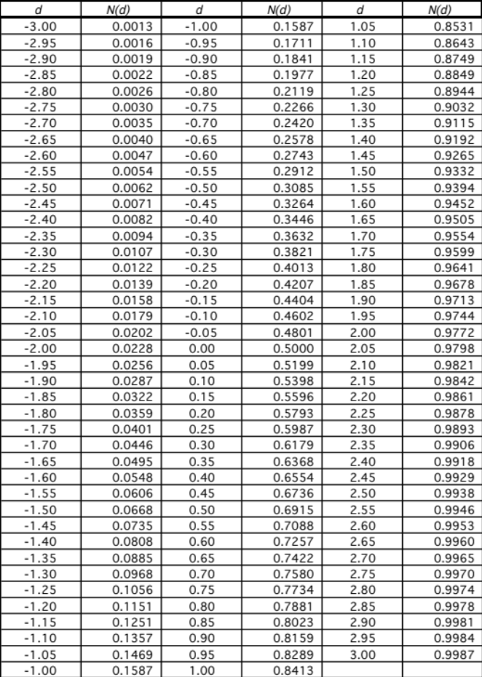
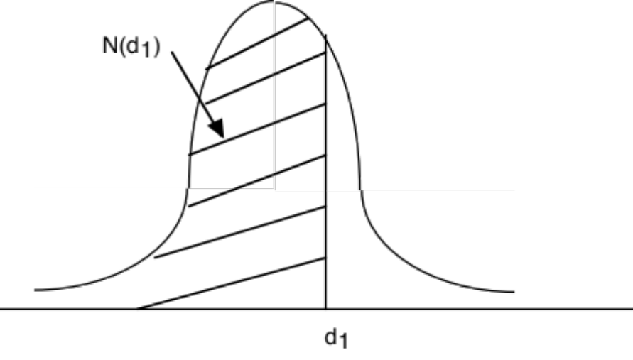
The Normal Distribution
Notes:
A standardized cumulative normal distribution yields values between 0 and 1… It looks and acts like a probability…
In face, N(d2) is the risk neutral probability that your option will end up in the money (S>K) over its lifetime.

Slide 19
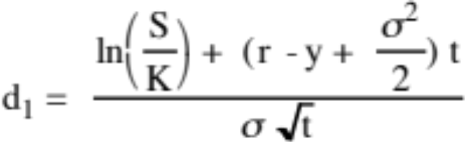
Adjusting for Dividends
If the dividend yield (y = dividends/ Current value of the asset) of the underlying asset is expected to remain unchanged during the life of the option, the Black-Scholes model can be modified to take dividends into account.
C = S e^{-yt} N(d1) - K e^{-rt} N(d2)
  where,
  d2 = d1 - σ √t
The value of a put can also be derived:
P = K e^{-rt} (1-N(d2)) - S e^{-yt} (1-N(d1))
Notes:
An adapted version of the Black Scholes, assuming that the dividend yield stays constant over the life of the option.
The carrying cost for the replicating portfolio is reduced by the dividend yield. (You pay the riskfree rate on your borrowing but the shares you buy will pay a dividend that offsets some of the interest expense)
The current stock price is reduced to reflect the effect of the dividend payments over the life of the option (It is discounted at the dividend yield…)

Slide 20
Dividend Yield = Cost of Delay
Options have time premiums, and when they are traded, you very seldom get early exercise, with one exception being calls before big ex-dividend dates. The trade off that drives early exercise is:
  Loss of the time premium of the option from exercising early (against)
  Dividends you will receive, if you exercise early
  If the dividend exceeds the time premium, you will see early exercise.
Put differently, the dividends foregone become the cost of delaying exercise and leaving the option live.
Thus, having a cost of delay in an option will require that you use a dividend-adjusted version of the option pricing model.

Slide 21
Choice of Option Pricing Models
Most practitioners who use option pricing models to value real options argue for the binomial model over the Black-Scholes and justify this choice by noting that
  Early exercise is the rule rather than the exception with real options
  Underlying asset values are generally discontinous.
If you can develop a binomial tree with outcomes at each node, it looks a great deal like a decision tree from capital budgeting. The question then becomes when and why the two approaches yield different estimates of value.
Notes:
Most real options are exercised early… True.. But it is also true that getting the inputs to a binomial model is cumbersome. So, it may still make sense to get at least a lower bound on value by using the Black Scholes.

Slide 22
The Decision Tree Alternative
Traditional decision tree analysis tends to use
  One cost of capital to discount cashflows in each branch to the present
  Probabilities to compute an expected value
  These values will generally be different from option pricing model values
If you modified decision tree analysis to
  Use different discount rates at each node to reflect where you are in the decision tree (This is the Copeland solution) (or)
  Use the riskfree rate to discount cashflows in each branch, estimate the probabilities to estimate an expected value and adjust the expected value for the market risk in the investment
Decision Trees could yield the same values as option pricing models
Notes:
Here is a less technical way to bring optionality into value.. Just outline the potential outcomes and estimate the probabilities… For multi-stage investments where you can do this, it is more transparent than using real options (a pharmaceutical drug, for instance)

Slide 23
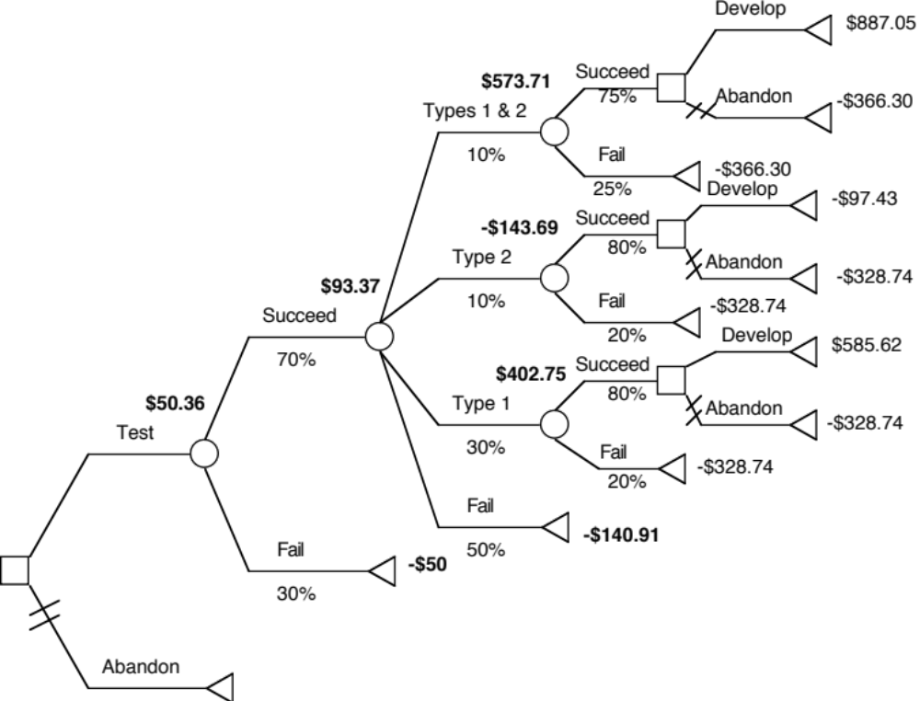
A decision tree valuation of a pharmaceutical company with one drug in the FDA pipeline…
Notes:
This company is assumed to have only one drug for treating diabetes working its way through the pipeline. At each stage in the approval process, we estimate the probabilities of success and failure (and different degrees of success… )
The value of the company today, with all the branches folded back is $50.36 million.

Slide 24
Key Tests for Real Options
Is there an option embedded in this asset/ decision?
  Can you identify the underlying asset?
  Can you specify the contingency under which you will get payoff?
Is there exclusivity?
  If yes, there is option value.
  If no, there is none.
  If in between, you have to scale value.
Can you use an option pricing model to value the real option?
  Is the underlying asset traded?
  Can the option be bought and sold?
  Is the cost of exercising the option known and clear?
Notes:
For every 100 “would be options”, perhaps 70 pass the first test (is it an option), maybe 10 pass the second test (that the option have significant economic value) and even fewer pass the third test (option pricing model can be used)

Slide 25
I. Options in Projects/Investments/Acquisitions
One of the limitations of traditional investment analysis is that it is static and does not do a good job of capturing the options embedded in investment.
  The first of these options is the option to delay taking a investment, when a firm has exclusive rights to it, until a later date.
  The second of these options is taking one investment may allow us to take advantage of other opportunities (investments) in the future
  The last option that is embedded in projects is the option to abandon an investment, if the cash flows do not measure up.
These options all add value to projects and may make a “bad” investment (from traditional analysis) into a good one.
Notes:
Most projects have one or more than one option embedded in them.

Slide 26
A. The Option to Delay
When a firm has exclusive rights to a project or product for a specific period, it can delay taking this project or product until a later date.
A traditional investment analysis just answers the question of whether the project is a “good” one if taken today.
Thus, the fact that a project does not pass muster today (because its NPV is negative, or its IRR is less than its hurdle rate) does not mean that the rights to this project are not valuable.
Notes:
Traditional investment analysis just looks at the question of whether a project is a good one, if taken today. It does not say the rights to this project are worthless.

Slide 27
Valuing the Option to Delay a Project
PV of Cash Flows
from Project
Initial Investment in
Project
Present Value of Expected
Cash Flows on Product
Project's NPV turns
Project has negative
positive in this section
NPV in this section
Notes:
This looks at the option to delay a project, to which you have exclusive rights.
The initial investment in the project is what you would need to invest to convert this project from a right to a real project.
The present value of the cash flows will change over time.
If the perceived present value of the cash flows stays below the investment needed, the project should never be taken.

Slide 28
Example 1: Valuing product patents as options
A product patent provides the firm with the right to develop the product and market it.
  It will do so only if the present value of the expected cash flows from the product sales exceed the cost of development.
  If this does not occur, the firm can shelve the patent and not incur any further costs.
If I is the present value of the costs of developing the product, and V is the present value of the expected cashflows from development, the payoffs from owning a product patent can be written as:
Payoff from owning a product patent = V - I if V> I
= 0 if V ≤ I
Notes:
The optionality comes from the fact that you have the right to develop a patent, not an obligation and you get that right through the life of the patent.

Slide 29
Payoff on Product Option
Net Payoff to
introduction
Cost of product
introduction
Present Value of
cashflows on product
Notes:
The payoff diagram on the patent as an option…

Slide 30
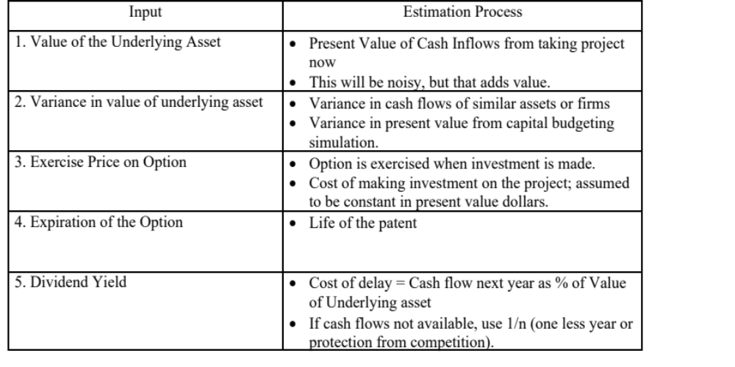
Obtaining Inputs for Patent Valuation
Notes:
The cash flows from developing the patent today may just be estimates (and you may be uncertain about them) but that is what makes the option valuable.
We introduce a cost to not developing the patent, once it becomes viable. (If you don’t do this, the option will never be exercised until the last moment of the last day, which makes no sense with a patent, since you are giving up the exclusivity) The cost is the cash flow you give up in the next year by not developing, as a percent of overall value. We use 1/n as an approximation of this value.

Slide 31
Valuing a Product Patent: Avonex
Biogen, a bio-technology firm, has a patent on Avonex, a drug to treat multiple sclerosis, for the next 17 years, and it plans to produce and sell the drug by itself.
The key inputs on the drug are as follows:
  PV of Cash Flows from Introducing the Drug Now = S = $ 3.422 billion
  PV of Cost of Developing Drug for Commercial Use = K = $ 2.875 billion
  Patent Life = t = 17 years Riskless Rate = r = 6.7% (17-year T.Bond rate)
  Variance in Expected Present Values =s2 = 0.224 (Industry average firm variance for bio-tech firms)
  Expected Cost of Delay = y = 1/17 = 5.89% (since no cash flows are available)
The output from the option pricing model
  d1 = 1.1362 N(d1) = 0.8720
  d2 = -0.8512 N(d2) = 0.2076
  Call Value= 3,422 exp^{(-0.0589)(17)} (0.8720) - 2,875 exp^{(-0.067)(17)} (0.2076)= $ 907 million
Notes:
An old example…. But one where I was able to get my hands on the original cash flow projections to get the PV of $3,422 million.
NPV of this project = 3422 – 2875 = $ 547 million
This is an in the money option (a viable patent) but this analysis suggests that Biogen will gain more from waiting (the value of the option of $907 million > NPV of $547 million from developing today)

Slide 32
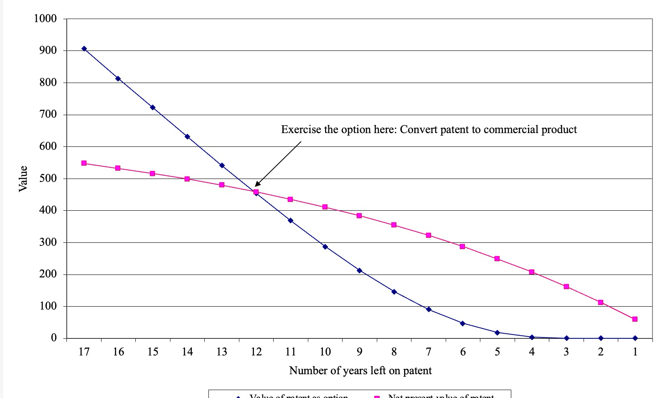
The Optimal Time to Exercise
Notes:
Drug should be developed with about 12 years left on the patent life……
Both the NPV and the option value change, but the logic of an optimal exercise period remains..
To compute the NPV each year, I start with the NPV today of $547 million, and convert it into an annuity of $64.02 million over seventeen years, using a 9% cost of capital
Next year, when there are sixteen years left on the project, NPV = PV of $64.02 million for 16 years at 9% cost of capital = $532 million…
In this case, though, the patent was developed almost immediately because there were other drug manufacturers working on their own drugs for treating MS…
The cost of delay was therefore much higher than 1/17… which in turn made the option less valuable.

Slide 33
Valuing a firm with patents
The value of a firm with a substantial number of patents can be derived using the option pricing model.
Value of Firm = Value of commercial products (using DCF value
+ Value of existing patents (using option pricing)
+ (Value of New patents that will be obtained in the future – Cost of obtaining these patents)
The last input measures the efficiency of the firm in converting its R&D into commercial products. If we assume that a firm earns its cost of capital from research, this term will become zero.
If we use this approach, we should be careful not to double count and allow for a high growth rate in cash flows (in the DCF valuation).
Notes:
In traditional DCF valuation, you incorporate the effects of patents (and the efficiency of R&D) into the expected growth rate… and value the company.
Here is the alternative. Value just the existing commercial products of the company over their finite life.
Add to this the value of patents that have not been developed yet, valued as options
Finally, incorporate the effect of R&D as expected future patents (really tough to do..)
Don’t double count by doing a conventional DCF valuation (with high growth) and then add on the option value on top.

Slide 34
Value of Biogen’s existing products
Biogen had two commercial products (a drug to treat Hepatitis B and Intron) at the time of this valuation that it had licensed to other pharmaceutical firms.
The license fees on these products were expected to generate $ 50 million in after-tax cash flows each year for the next 12 years.
To value these cash flows, which were guaranteed contractually, the pre-tax cost of debt of the guarantors was used:
  Present Value of License Fees = $ 50 million (1 – 1.07⁻¹²)/.07
  = $ 397.13 million
Notes:
alues the existing products. The payment is fixed and guaranteed… the only risk is that the licensees will default (thus, it is their default risk that matters)
If the license has been structured differently, say as a percent of revenues or earnings, there would have been more risk to Biogen and a cost of capital of mature pharmaceutical companies would have used as the discount rate.

Slide 35
Value of Biogen’s Future R&D
Biogen continued to fund research into new products, spending about $ 100 million on R&D in the most recent year. These R&D expenses were expected to grow 20% a year for the next 10 years, and 5% thereafter.
It was assumed that every dollar invested in research would create $ 1.25 in value in patents (valued using the option pricing model described above) for the next 10 years, and break even after that (i.e., generate $ 1 in patent value for every $ 1 invested in R&D).
There was a significant amount of risk associated with this component and the cost of capital was estimated to be 15%.
Notes:
Here is one way to arrive at the value added by future patents. If you assume that you will earn a return on capital of 20% on new patents and your cost of capital in developing the patents is 15%, with a 3% growth rate, your value added is as follows:
Value of a dollar invested in R&D = .2/(.15-.03) = $1.67
Value added by a dollar invested in R&D = $0.67
If you earn the cost of capital on your new patents, the value added goes to zero.

Slide 36
Value of Future R&D
Yr Value of Patents R&D Cost Excess Value PV (at 15%)
1 $ 150.00 $ 120.00 $ 30.00 $ 26.09
2 $ 180.00 $ 144.00 $ 36.00 $ 27.22
3 $ 216.00 $ 172.80 $ 43.20 $ 28.40
4 $ 259.20 $ 207.36 $ 51.84 $ 29.64
5 $ 311.04 $ 248.83 $ 62.21 $ 30.93
6 $ 373.25 $ 298.60 $ 74.65 $ 32.27
7 $ 447.90 $ 358.32 $ 89.58 $ 33.68
8 $ 537.48 $ 429.98 $ 107.50 $ 35.14
9 $ 644.97 $ 515.98 $ 128.99 $ 36.67
10 $ 773.97 $ 619.17 $ 154.79 $ 38.26
$ 318.30
Notes:
Note that the high uncertainty associated with generating new patents increases the discount rate and lowers the present value.

Slide 37
Value of Biogen
The value of Biogen as a firm is the sum of all three components – the present value of cash flows from existing products, the value of Avonex (as an option) and the value created by new research:
Value = Existing products + Existing Patents + Value: Future R&D
  = $ 397.13 million + $ 907 million + $ 318.30 million
  = $1622.43 million
Since Biogen had no debt outstanding, this value was divided by the number of shares outstanding (35.50 million) to arrive at a value per share:
  Value per share = $ 1,622.43 million / 35.5 = $ 45.70
Notes:
This approach makes sense only for young pharmaceutical companies that derive much of their value from a patent or two and not much from existing products. For larger, more mature pharmaceutical firms with significant cash flows from existing products and a portfolio of patents working their way through the system, the approach does not make much sense…..

Slide 38
The Real Options Test: Patents and Technology
The Option Test:
  Underlying Asset: Product that would be generated by the patent
  Contingency:
    If PV of CFs from development > Cost of development: PV - Cost
    If PV of CFs from development < Cost of development: 0
The Exclusivity Test:
  Patents restrict competitors from developing similar products
  Patents do not restrict competitors from developing other products to treat the same disease.
The Pricing Test
  Underlying Asset: Patents are not traded. Not only do you therefore have to estimate the present values and volatilities yourself, you cannot construct replicating positions or do arbitrage.
  Option: Patents are bought and sold, though not as frequently as oil reserves or mines.
  Cost of Exercising the Option: This is the cost of converting the patent for commercial production. Here, experience does help and drug firms can make fairly precise estimates of the cost.
Conclusion: Option exists but option pricing models are stretched.
Notes:
On the second test, the exclusivity comes almost entirely from the legal system. If you operate in a porous legal system, where property rights are violated with impunity, the exclusivity is lost. This is a problem that the pharmaceutical companies face as they grow in Asia, where the legal protection offered by patents tends to be weaker. Even in markets with strong legal systems, the exclusivity is weakened by the presence of strong competitors with active research departments working on their alternative cures for the same diseases…

Slide 39
Example 2: Valuing Natural Resource Options
In a natural resource investment, the underlying asset is the resource, and the value of the asset is based upon two variables - the quantity of the resource that is available in the investment and the price of the resource.
In most such investments, there is a cost associated with developing the resource, and the difference between the value of the asset extracted and the cost of the development is the profit to the owner of the resource.
Defining the cost of development as X, and the estimated value of the resource as V, the potential payoffs on a natural resource option can be written as follows:
  Payoff on natural resource investment = V - X if V > X
  = 0 if V≤ X
Notes:
Note that the option is strongest for undeveloped reserves. However, even after the reserves are developed, there is some optionality since production levels can be varied as a function of the price of the commodity.

Slide 40
Payoff Diagram on Natural Resource Firms
Net Payoff on
Extraction
Cost of Developing
Reserve
Value of estimated reserve of natural resource
Notes:
For an undeveloped reserve, the optionality revolves around the value of the undeveloped reserves, relative to the cost of developing these reserves. The exploration costs (or bidding cost) paid to get these reserves is the cost of the option.

Slide 41
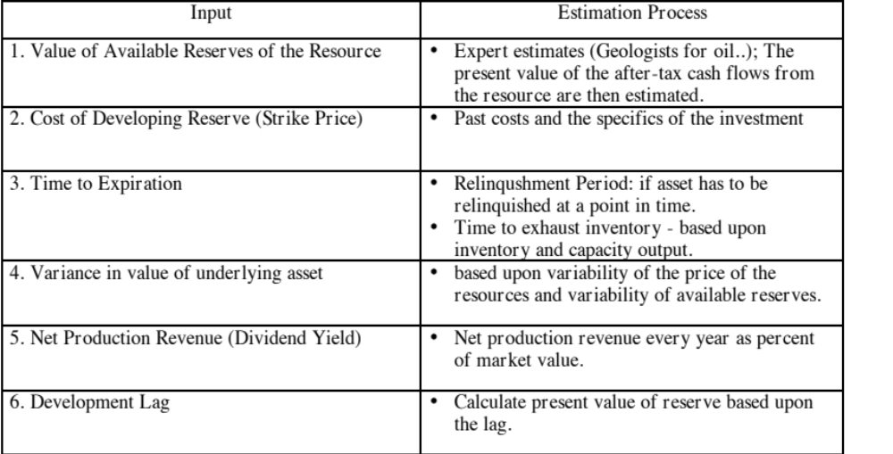
Estimating Inputs for Natural Resource Options
Notes:
For convenience and simplicity, we assume that the only variable that you are uncertain about is the oil price. In fact, you are probably also uncertain about the magnitude of your reserves and even your development costs. Adding that uncertainty to the process does not change the logic but it does make the option more difficult to value.
The net production revenue lost by not developing the reserve once it is viable is the prod that pushes towards developing reserves.
The longer the development lag, the less the value of the option (both because of time value and because the oil price may change…)

Slide 42
Valuing Gulf Oil
Gulf Oil was the target of a takeover in early 1984 at $70 per share (It had 165.30 million shares outstanding, and total debt of $9.9 billion).
  It had estimated reserves of 3038 million barrels of oil and the average cost of developing these reserves was estimated to be $10 a barrel in present value dollars (The development lag is approximately two years).
  The average relinquishment life of the reserves is 12 years.
  The price of oil was $22.38 per barrel, and the production cost, taxes and royalties were estimated at $7 per barrel.
  The treasury bond rate at the time of the analysis was 9.00%.
  Gulf was expected to have net production revenues each year of approximately 5% of the value of the developed reserves. The variance in oil prices is 0.03.
Notes:
Uses the real options approach to value an oil company.
Why go back in time? Because Gulf Oil was not only targeted for its undeveloped reserves but because information was provided on all reserves that the oil company had at that point in time.
Most oil companies report only “viable” reserves (i.e., options in the money)…

Slide 43
Valuing Undeveloped Reserves
Inputs for valuing undeveloped reserves
  Value of underlying asset = Value of estimated reserves discounted back for period of development lag= 3038 * ($ 22.38 - $7) / 1.052 = $42,380.44
  Exercise price = Estimated development cost of reserves = 3038 * $10 = $30,380 million
  Time to expiration = Average length of relinquishment option = 12 years
  Variance in value of asset = Variance in oil prices = 0.03
  Riskless interest rate = 9%
  Cost of delay = Expected CF next year/ Value of developed reserves = 5%
Based upon these inputs, the Black-Scholes model provides the following value for the call:
  d1 = 1.6548 N(d1) = 0.9510
  d2 = 1.0548 N(d2) = 0.8542
  Call Value= 42,380.44 exp^{(-0.05)(12)} (0.9510) -30,380 (exp^{(-0.09)(12)} (0.8542)
  = $ 13,306 million
Notes:
The value of the reserves on a pure DCF basis is $12 billion = $42.38 - $30.38 billion
The value of the option is $13.3 billion
The difference is the time premium created by the optionality…
Note that the reserves are, on average, viable and that there is a very high probability (N(d2) = 85.4%) that they will be developed.

Slide 44
Valuing Gulf Oil
In addition, Gulf Oil had free cashflows to the firm from its oil and gas production of $915 million from already developed reserves and these cashflows are likely to continue for ten years (the remaining lifetime of developed reserves).
The present value of these developed reserves, discounted at the weighted average cost of capital of 12.5%, yields:
  Value of already developed reserves = 915 (1 - 1.125⁻¹⁰)/.125 = $5065.83
Adding the value of the developed and undeveloped reserves
  Value of undeveloped reserves = $ 13,306 million
  Value of production in place = $ 5,066 million
  Total value of firm = $ 18,372 million
  Less Outstanding Debt = $ 9,900 million
  Value of Equity = $ 8,472 million
  Value per share = $ 8,472/165.3 = $51.25
Notes:
Add the option value of the undeveloped reserves to the DCF value of the developed reserves.
Note that you cannot a full DCF value of an oil company, with growth incorporating the undeveloped reserves, and add the value of the options on top of that.. That would be double counting.

Slide 45
B. The Option to Expand/Take Other Projects
Taking a project today may allow access to other valuable projects in the future.
Thus, even though a project may have a negative NPV, it may be a project worth taking if the option it provides the firm (to take other projects in the future) provides a more-than-compensating value.
These are the options that firms often call “strategic options” and use as a rationale for taking on “negative NPV” or even “negative return” projects.
Notes:
A project may be the first in a sequence.. With the first project providing an option to take a second one….

Slide 46
The Option to Expand
PV of Cash Flows
from Expansion
Additional Investment
to Expand
Present Value of Expected
Cash Flows on Expansion
Expansion becomes
Firm will not expand in
attractive in this section
this section
Notes:
Here, the initial project gives you the option to invest an additional amount in the future which you will do only if the present value of the additional cash flows you will get by expanding are greater than the investment needed.
For this to work, you have to do the first project to be eligible for the option to expand.

Slide 47
The option to expand: Valuing a young, start-up company
You have complete a DCF valuation of a small anti-virus software company, Secure Mail, and estimated a value of $115 million.
Assume that there is the possibility that the company could use the customer base that it develops for the anti-virus software and the technology on which the software is based to create a database software program sometime in the next 5 years.
  It will cost Secure Mail about $500 million to develop a new database program, if they decided to do it today.
  Based upon the information you have now on the potential for a database program, the company can expect to generate about $ 40 million a year in after-tax cashflows for ten years. The cost of capital for private companies that provide database software is 12%.
  The annualized standard deviation in firm value at publicly traded database companies is 50%.
  The five-year treasury bond rate is 3%.
Notes:
This is a negative net present value project, but it gives Disney the option to expand later. Implicitly, we are also saying that if Disney does not make the initial project investment (with a NPV of - $ 20 million), it cannot expand later into the rest of Latin America.

Slide 48
Valuing the Expansion Option
S = Value of entering the database software market
= PV of $40 million for 10 years @12% = $226 million
K = Exercise price
= Cost of entering the database software market = $ 500 million
t = Period over which you have the right to enter the market
= 5 years
s = Standard deviation of stock prices of database firms = 50%
r = Riskless rate = 3%
Call Value= $ 56 Million
DCF valuation of the firm = $ 115 million
Value of Option to Expand to Database market = $ 56 million
Value of the company with option to expand = $ 171 million
Notes:
This values the option, using the Black Scholes model.
The value from the model itself is affected not only by the assumptions made about volatility and value, but also by the asssumptions underlying the model.
The value itself is not the key output from the model. It is the fact that strategic options, such as this one, can be valued, and that they can make a significant difference to your decision.

Slide 49
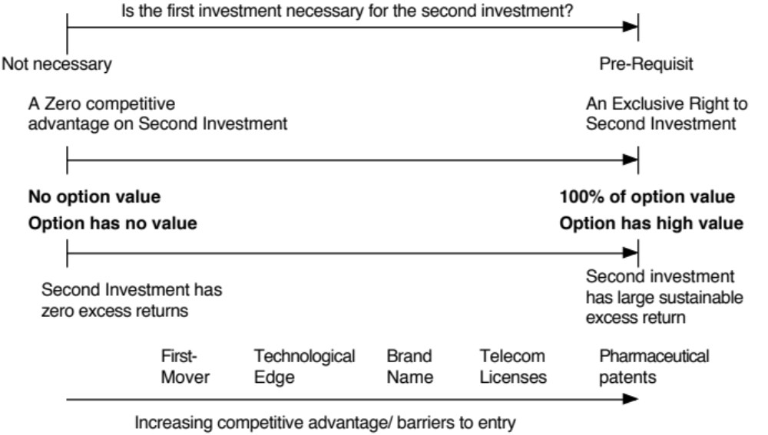
A note of caution: Opportunities are not options…

Slide 50
The Real Options Test for Expansion Options
The Options Test
  Underlying Asset: Expansion Project
  Contingency
  If PV of CF from expansion > Expansion Cost: PV - Expansion Cost
  If PV of CF from expansion < Expansion Cost: 0
The Exclusivity Test
  Barriers may range from strong (exclusive licenses granted by the government) to weaker (brand name, knowledge of the market) to weakest (first mover).
The Pricing Test
  Underlying Asset: As with patents, there is no trading in the underlying asset and you have to estimate value and volatility.
  Option: Licenses are sometimes bought and sold, but more diffuse expansion options are not.
  Cost of Exercising the Option: Not known with any precision and may itself evolve over time as the market evolves.
Using option pricing models to value expansion options will not only yield extremely noisy estimates, but may attach inappropriate premiums to discounted cashflow estimates.
Notes:
Many of these options flounder on the “exclusivity” test.
Opportunities are not options. (Just because China is a big market, it does not mean that you should be willing to lose money entering the market to learn about it…)

Slide 51
C. The Option to Abandon
A firm may sometimes have the option to abandon a project, if the cash flows do not measure up to expectations.
If abandoning the project allows the firm to save itself from further losses, this option can make a project more valuable.
PV of Cash Flows
from Project
Cost of Abandonment
Present Value of Expected
Cash Flows on Project
Notes:
You would like to abandon a project, once you know that it will create only negative cash flows for you. This is not always possible, because of contracts you might have entered into with employees or customers.

Slide 52
Valuing the Option to Abandon
Airbus is considering a joint venture with Lear Aircraft to produce a small commercial airplane (capable of carrying 40-50 passengers on short haul flights)
  Airbus will have to invest $ 500 million for a 50% share of the venture
  Its share of the present value of expected cash flows is 480 million.
Lear Aircraft, which is eager to enter into the deal, offers to buy Airbus’s 50% share of the investment anytime over the next five years for $ 400 million, if Airbus decides to get out of the venture.
A simulation of the cash flows on this time share investment yields a variance in the present value of the cash flows from being in the partnership is 0.16.
The project has a life of 30 years.
Notes:
We are assuming that Lear Aircraft will be in a position to honor his or her commitment to buy back Airbus’s share for $ 400 million.

Slide 53
Project with Option to Abandon
Value of the Underlying Asset (S)
  = PV of Cash Flows from Project = $ 480 million
Strike Price (K)
  = Salvage Value from Abandonment = $ 400 million
Variance in Underlying Asset’s Value = 0.16
Time to expiration = Life of the Project =5 years
Dividend Yield = 1/Life of the Project = 1/30 = 0.033
The five-year riskless rate is 6%.
Notes:
These are the inputs to the model. The likelihood of abandonment will increase over time, as the value of the project decreases.

Slide 54
Should Airbus enter into the joint venture?
Value of Put =Ke-rt (1-N(d2))- Se-yt (1-N(d1))
  =400 exp^{(-0.06)(5)} (1-0.4624) - 480 exp^{(-0.033)(5)} (1-0.7882)
  = $ 73.23 million
The value of this abandonment option has to be added on to the net present value of the project of -$ 20 million, yielding a total net present value with the abandonment option of $ 53.23 million.
While this is what Lear Aircraft wants from the deal, it has to have a large enough net present value of the cost of the put option.
Notes:
If you can negotiate this option into your investment projects, you increase their value. To the degree that you have to pay for this option, you would be willing to pay the price of the option.

Slide 55
Implications for Investment Analysis/ Valuation
Having a option to abandon a project can make otherwise unacceptable projects acceptable.
Other things remaining equal, you would attach more value to companies with
  More cost flexibility, that is, making more of the costs of the projects into variable costs as opposed to fixed costs.
  Fewer long-term contracts/obligations with employees and customers, since these add to the cost of abandoning a project.
These actions will undoubtedly cost the firm some value, but this has to be weighed off against the increase in the value of the abandonment option.
Notes:
Building in escape hatches and flexibility into investments, especially big ones (relative to your size as a company) is not a sign of weakness but one of prudences…

Slide 56
D. Options in Capital Structure
The most direct applications of option pricing in capital structure decisions is in the design of securities. In fact, most complex financial instruments can be broken down into some combination of a simple bond/common stock and a variety of options.
  If these securities are to be issued to the public, and traded, the options must be priced.
  If these are non-traded instruments (bank loans, for instance), they still have to be priced into the interest rate on the instrument.
The other application of option pricing is in valuing flexibility. Often, firms preserve debt capacity or hold back on issuing debt because they want to maintain flexibility.
Notes:
Most of the options in capital structure take the form of add-ons to financing – options granted to venture capitalists, conversion options in bonds, warrants… Those can all be valued with conventional option pricing models.
The option we will focus on is “financial flexibility”, a strength touted by some firms, and an argument used by others for not using debt capacity.

Slide 57
The Value of Flexibility
Firms maintain excess debt capacity or larger cash balances than are warranted by current needs, to meet unexpected future requirements.
While maintaining this financing flexibility has value to firms, it also has a cost; the excess debt capacity implies that the firm is giving up some value and has a higher cost of capital.
The value of flexibility can be analyzed using the option pricing framework; a firm maintains large cash balances and excess debt capacity in order to have the option to take projects that might arise in the future.
Notes:
If the argument for financial flexibility is that you need it in order to be able to raise debt financing to take that great project that may come along, you are talking about an option…

Slide 58
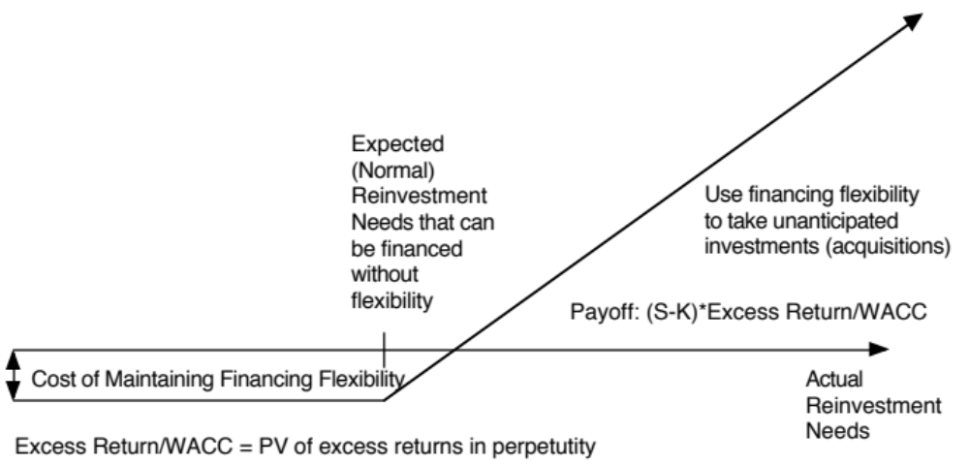
The Value of Flexibility
Notes:
Shown as a payoff diagram..
Note that the cost of the option emanates from the fact that you borrow less than optimal (to preserve your debt capacity and financial flexibility) and thus have a higher cost of capital.

Slide 59
Disney’s Optimal Debt Ratio
Debt Ratio Cost of Equity Cost of Debt Cost of Capital
0.00% 13.00% 4.61% 13.00%
10.00% 13.43% 4.61% 12.55%
Current:18% 13.85% 4.80% 12.22%
20.00% 13.96% 4.99% 12.17%
30.00% 14.65% 5.28% 11.84%
40.00% 15.56% 5.76% 11.64%
50.00% 16.85% 6.56% 11.70%
60.00% 18.77% 7.68% 12.11%
70.00% 21.97% 7.68% 11.97%
80.00% 28.95% 7.97% 12.17%
90.00% 52.14% 9.42% 13.69%
Notes:
An old example with Disney from 1998…. The optimal debt ratio, i.e., the debt ratio at which the cost of capital is minimized, is 40% and the company is at 18%. It is under levered and has a cost of capital of 12.22%, much higher than its optimal of 11.64%.

Slide 60
Inputs to Option Valuation Model- Disney
Model input | Estimated as | In general… | For Disney
S | Expected annual reinvestment needs (as % of firm value) | Measures magnitude of reinvestment needs | Average of Reinvestment/ Value over last 5 years = 5.3%
s² | Variance in annual reinvestment needs | Measures how much volatility there is in investment needs. | Variance over last 5 years in ln(Reinvestment/Value) =0.375
K | (Internal + Normal access to external funds)/ Value | Measures the capital constraint | Average over last 5 years = 4.8%
T | 1 year | Measures an annual value for flexibility | T =1
Notes:
Estimating the inputs for the option pricing model for Disney. To compute reinvestment = net capital expenditures + acquisitions – depreciation + change in non-cash WC. We divide by the market value of the firm each year to standardize.
The high variance reflects the acquisition of ABC in 1996, which pushed up the reinvestment in that year…
For normal access to external funds, we took the typical increase in debt over the period but assumed that Disney would not raise equity, unless it had to.

Slide 61
Valuing Flexibility at Disney
The value of an option with these characteristics is 1.6092%. You can consider this the value of the option to take a project, but the overall value of flexibility will still depend upon the quality of the projects taken.
Disney earns 18.69% on its projects has a cost of capital of 12.22%. The excess return (annually) is 6.47%. Assuming that they can continue to generate these excess returns in perpetuity:
  Value of Flexibility (annual)
  = 1.6092%(.0647/.1222) = 0.85 % of value
Disney’s cost of capital at its optimal debt ratio is 11.64%. The cost it incurs to maintain flexibility is therefore 0.58% annually (12.22%-11.64%). It therefore pays to maintain flexibility.
Notes:
This is done in two steps. First, we compute the value of the option to take a project (using the inputs from the last page) to be 1.6092% but that option has value only if Disney is expected to earn excess returns. If we assume that future projects will generate the same excess return as past investments, the value of financial flexibility is 0.85% of value (on an annual basis). That exceeds what the company is paying (as a higher cost of capital) to maintain the flexibility. Thus, it is justified in holding back on borrowing and staying below its optimal.

Slide 62
Determinants of the Value of Flexibility
Capital Constraints (External and Internal): The greater the capacity to raise funds, either internally or externally, the less the value of flexibility.
  1.1: Firms with significant internal operating cash flows should value flexibility less than firms with small or negative operating cash flows.
  1.2: Firms with easy access to financial markets should have a lower value for flexibility than firms without that access.
Unpredictability of reinvestment needs: The more unpredictable the reinvestment needs of a firm, the greater the value of flexibility.
Capacity to earn excess returns: The greater the capacity to earn excess returns, the greater the value of flexibility.
  1.3: Firms that do not have the capacity to earn or sustain excess returns get no value from flexibility.
Notes:
The value of flexibility should be greater for
Small firms over large firms
Private businesses over public companies
Emerging market over Developed market companies
During crisis than during periods of stability
The value of flexibility should be greater in young businesses, with significant uncertainties about the future (social media companies…)
The value of flexibility should be greater for firms with significant competitive advantages that will allow them to earn excess returns

Slide 63
E. Valuing Equity as an option
The equity in a firm is a residual claim, i.e., equity holders lay claim to all cashflows left over after other financial claim-holders (debt, preferred stock etc.) have been satisfied.
If a firm is liquidated, the same principle applies, with equity investors receiving whatever is left over in the firm after all outstanding debts and other financial claims are paid off.
The principle of limited liability, however, protects equity investors in publicly traded firms if the value of the firm is less than the value of the outstanding debt, and they cannot lose more than their investment in the firm.
Notes:
It is limited liability that creates the optionality. Thus, this may not hold for private businesses, where lenders can come after the owners’ assets….

Slide 64
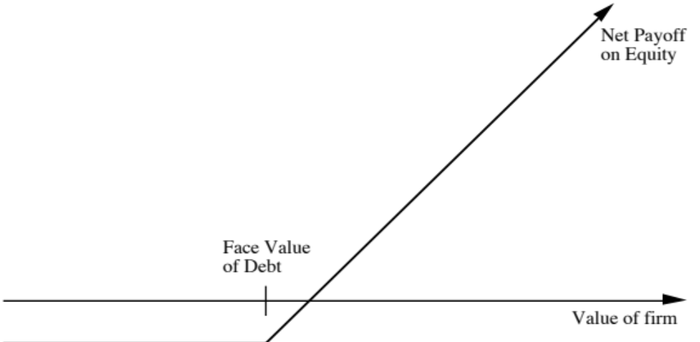
Payoff Diagram for Liquidation Option
Notes:
The option revolves around the outstanding debt; the face value of the debt is the strike price and the remaining life of the debt is the life of the option. The value of the assets in liquidation becomes the stock price.

Slide 65
Application to valuation: A simple example
Assume that you have a firm whose assets are currently valued at $100 million and that the standard deviation in this asset value is 40%.
Further, assume that the face value of debt is $80 million (It is zero coupon debt with 10 years left to maturity).
If the ten-year treasury bond rate is 10%,
  how much is the equity worth?
  What should the interest rate on debt be?
Notes:
I am assuming that if this firm is liquidated, I will get the $ 100 million as my sales proceeds.
Looks like there is insufficient information to answer either question.

Slide 66
Model Parameters
Value of the underlying asset = S
  Value of the firm = $ 100 million
Exercise price = K
  Face Value of outstanding debt = $ 80 million
Life of the option = t
  Life of zero-coupon debt = 10 years
Variance in the value of the underlying asset = σ²
  Variance in firm value = 0.16
Riskless rate = r
  Treasury bond rate corresponding to option life = 10%
Notes:
The reason why I chose a zero coupon bond now should be clear. Because it is a zero coupon bond (with no covenants), I as the equity investors get complete unfettered power for the next 9 years and 364 days, since I have no contractual payments to make.
If it were a coupon bond, the logic for treating equity as an option will still hold, but I will then have a series of options that build on top of each other, since I have to make coupon payments every 6 months or a year.

Slide 67
Valuing Equity as a Call Option
Based upon these inputs, the Black-Scholes model provides the following value for the call:
  d1 = 1.5994 N(d1) = 0.9451
  d2 = 0.3345 N(d2) = 0.6310
Value of the call = 100 (0.9451) - 80 exp^{(-0.10)(10)} (0.6310) = $75.94 million
Value of the outstanding debt = $100 - $75.94 = $24.06 million
Interest rate on debt = ($ 80 / $24.06)^{1/10} -1 = 12.77%
Notes:
Not only can I value the equity and give you the correct default spread for the company, I can also estimate the probability that the firm will go bankrupt as 37% (1- N(d2) =1- Probability that the value of assets > Face value of debt)
There are services such as KMV that use this approach to assess the likelihood of default for clients and their portfolios.

Slide 68
I. The Effect of Catastrophic Drops in Value
Assume now that a catastrophe wipes out half the value of this firm (the value drops to $ 50 million), while the face value of the debt remains at $ 80 million. What will happen to the equity value of this firm?
  It will drop in value to $ 25.94 million [ $ 50 million - market value of debt from previous page]
  It will be worth nothing since debt outstanding > Firm Value
  It will be worth more than $ 25.94 million
Notes:
While the value of the firm drops by $ 50 million, the value of equity will drop by less because the bondholders will bear (reluctantly) some of the loss

Slide 69
Valuing Equity in the Troubled Firm
Value of the underlying asset = S
  Value of the firm = $ 50 million
Exercise price = K
  Face Value of outstanding debt = $ 80 million
Life of the option = t
  Life of zero-coupon debt = 10 years
Variance in the value of the underlying asset = σ²
  Variance in firm value = 0.16
Riskless rate = r
  Treasury bond rate corresponding to option life = 10%
Notes:
I changed only S… All of the other inputs are unchanged. (Half the firm disappeared but the standard deviation should not change… )

Slide 70
The Value of Equity as an Option
Based upon these inputs, the Black-Scholes model provides the following value for the call:
  d1 = 1.0515 N(d1) = 0.8534
  d2 = -0.2135 N(d2) = 0.4155
Value of the call = 50 (0.8534) - 80 exp^{(-0.10)(10)} (0.4155) = $30.44 million
Value of the bond= $50 - $30.44 = $19.56 million
The equity in this firm drops by $45.50 million, less than the overall drop in value of $50 million, because of the option characteristics of equity.
This might explain why stock in firms, which are in Chapter 11 and essentially bankrupt, still has value.
Notes:
The probability of bankruptcy has shot up to 58.45%... Debt holders bear $4.5 million of the loss. Equity investors bear the rest..

Slide 71
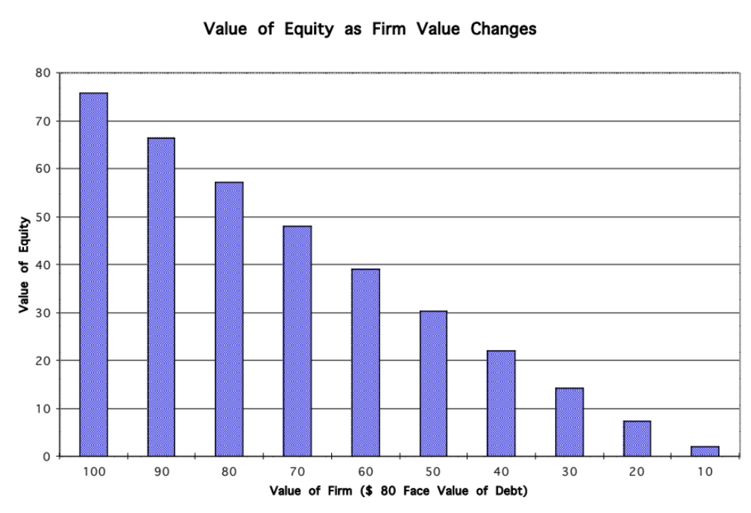
Equity value persists ..
Notes:
Equity is an incredibly stubborn instrument. Its value remains, at least in this case, even as firm value drops to a fraction of the outstanding debt. That is because, as an option, it has time value and you get to play (as the equity investor) for the next 10 years… maybe, something good will happen.

Slide 72
II. The conflict between stockholders and bondholders
Consider again the firm described in the earlier example , with a value of assets of $100 million, a face value of zero-coupon ten-year debt of $80 million, a standard deviation in the value of the firm of 40%. The equity and debt in this firm were valued as follows:
  Value of Equity = $75.94 million
  Value of Debt = $24.06 million
  Value of Firm == $100 million
Now assume that the stockholders have the opportunity to take a project with a negative net present value of -$2 million, but assume that this project is a very risky project that will push up the standard deviation in firm value to 50%. Would you invest in this project?
  Yes
  No
Notes:
Everything that we have been taught in corporate finance and capital budgeting suggests that a negative net present value project is bad, and a risky, negative net present value project may be even worse…

Slide 73
Valuing Equity after the Project
Value of the underlying asset = S
  Value of the firm = $ 100 million - $2 million = $ 98 million (The value of the firm is lowered because of the negative net present value project)
Exercise price = K
  Face Value of outstanding debt = $ 80 million
Life of the option = t
Life of zero-coupon debt = 10 years
Variance in the value of the underlying asset = = σ²
  Variance in firm value = 0.25
Riskless rate = r
  Treasury bond rate corresponding to option life = 10%
Notes:
Looks at equity as an option… Note the drop in S and the increase in variance…

Slide 74
Option Valuation
Option Pricing Results for Equity and Debt Value
  Value of Equity = $77.71
  Value of Debt = $20.29
  Value of Firm = $98.00
The value of equity rises from $75.94 million to $ 77.71 million , even though the firm value declines by $2 million. The increase in equity value comes at the expense of bondholders, who find their wealth decline from $24.06 million to $20.19 million.
Notes:
Some value magic or is it? Equity as an optilon gains more from the increase in risk than it loses in firm value.. The real losers are the bondholders.
What lessons can bondholders draw from this?
Take an equity stake in deeply troubled firms.
Take an active role in the way the companies are run.
Write in restrictive covenants on new investments and monitor existing investments to prevent risk shifting.

Slide 75
Effects of an Acquisition
Assume that you are the manager of a firm and that you buy another firm, with a fair market value of $ 150 million, for exactly $ 150 million. In an efficient market, the stock price of your firm will
  Increase
  Decrease
  Remain Unchanged
Notes:
Again, it seems like a pretty straightforward question. A fair value acquisition should be value neutral…

Slide 76
Effects on equity of a conglomerate merger
You are provided information on two firms, which operate in unrelated businesses and hope to merge.
  Firm A Firm B
  Value of the firm $100 million $ 150 million
  Face Value of Debt (10 yr zeros) $ 80 million $ 50 million
  Maturity of debt 10 years 10 years
  Std. Dev. in value 40 % 50 %
  Correlation between cashflows 0.4
  The ten-year bond rate is 10%.
The variance in the value of the firm after the acquisition can be calculated as follows:
  Variance in combined firm value
  = w1² σ1² + w2² σ2² + 2 w1 w2 ρ¹² σ1σ2
  = (0.4)2 (0.16) + (0.6)2 (0.25) + 2 (0.4) (0.6) (0.4) (0.4) (0.5)
  = 0.154
Notes:
It is value neutral for overall value, but the firm is becoming a safer firm (a pure diversification effect).

Slide 77
Valuing the Combined Firm
The values of equity and debt in the individual firms and the combined firm can then be estimated using the option pricing model:
Firm A Firm B Combined firm
Value of equity in the firm $75.94 $134.47 $ 207.43
Value of debt in the firm $24.06 $ 15.53 $ 42.57
Value of the firm $100.00 $150.00 $ 250.00
  The combined value of the equity prior to the merger is $ 210.41 million and it declines to $207.43 million after.
  The wealth of the bondholders increases by an equal amount.
There is a transfer of wealth from stockholders to bondholders, as a consequence of the merger. Thus, conglomerate mergers that are not followed by increases in leverage are likely to see this redistribution of wealth occur across claim holders in the firm.
Notes:
Note tat equity investors lose about $ 3 million, because of the drop in variance. To prevent this from happening, you would need to
Increase the debt ratio after conglomerate mergers to take advantage of the lower risk and higher debt capacity
Renegotiate with existing lenders to reduce interest rates that they charge to reflect the lower risk of the firm.

Slide 78
Obtaining option pricing inputs - Some real world problems
The examples that have been used to illustrate the use of option pricing theory to value equity have made some simplifying assumptions. Among them are the following:
  There were only two claim holders in the firm - debt and equity.
  There is only one issue of debt outstanding, and it can be retired at face value.
  The debt has a zero coupon and no special features (convertibility, put clauses etc.)
  The value of the firm and the variance in that value can be estimated.
Notes:
There is no chance that you will find a troubled firm with only one zero coupon bond outstanding, where you are given the value of the underlying assets and standard deviation on a platter.

Slide 79
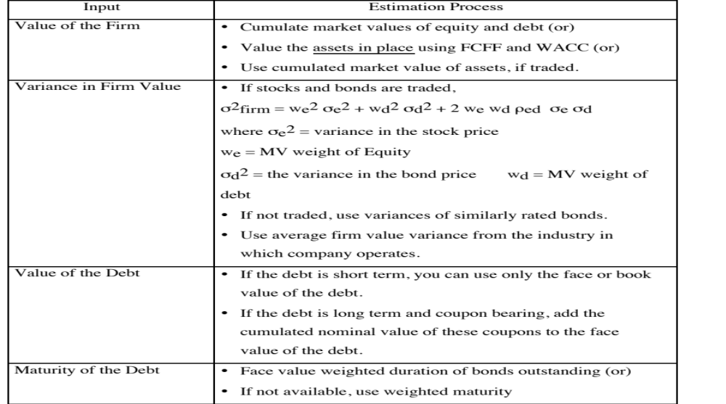
Real World Approaches to Valuing Equity in Troubled Firms: Getting Inputs
Notes:
When estimating the value of the firm, remember that you are estimating how much you will get, if you liquidate the firm. So, in a DCF, focus only on assets in place and don’t incorporate growth since it is unlikely to be monetized in the event of default.
For the standard deviation, try the industry average. It is more reliable than trusting stock and bond prices of a troubled firm.
With the debt, we are playing a game of replacing its existing complicated debt with one zero coupon bond, of equivalent effect.

Slide 80
Valuing Equity as an option - Eurotunnel in early 1998
Eurotunnel has been a financial disaster since its opening
  In 1997, Eurotunnel had earnings before interest and taxes of -£56 million and net income of -£685 million
  At the end of 1997, its book value of equity was -£117 million
It had £8,865 million in face value of debt outstanding
  The weighted average duration of this debt was 10.93 years
  Debt Type Face Value Duration
  Short term 935 0.50
  10 year 2435 6.7
  20 year 3555 12.6
  Longer 1940 18.2
  Total £8,865 mil 10.93 years
Notes:
Deeply troubled firm with lots of long term debt… perfect for real options.

Slide 81
The Basic DCF Valuation
The value of the firm estimated using projected cashflows to the firm, discounted at the weighted average cost of capital was £2,312 million.
This was based upon the following assumptions –
  Revenues will grow 5% a year in perpetuity.
  The COGS which is currently 85% of revenues will drop to 65% of revenues in yr 5 and stay at that level.
  Capital spending and depreciation will grow 5% a year in perpetuity.
  There are no working capital requirements.
  The debt ratio, which is currently 95.35%, will drop to 70% after year 5. The cost of debt is 10% in high growth period and 8% after that.
  The beta for the stock will be 1.10 for the next five years, and drop to 0.8 after the next 5 years.
  The long term bond rate is 6%.
Notes:
This is a conventional DCF valuation, where we have assumed some improvement in margins over time and a recovery to operating health. Even with this optimistic set up, the value that we get for the assets is well below the face value of the debt.

Slide 82
Other Inputs
The stock has been traded on the London Exchange, and the annualized std deviation based upon ln (prices) is 41%.
There are Eurotunnel bonds, that have been traded; the annualized std deviation in ln(price) for the bonds is 17%.
  The correlation between stock price and bond price changes has been 0.5. The proportion of debt in the capital structure during the period (1992-1996) was 85%.
  Annualized variance in firm value
  = (0.15)² (0.41)² + (0.85)² (0.17)² + 2 (0.15) (0.85)(0.5)(0.41)(0.17)= 0.0335
The 15-year bond rate is 6%. (I used a bond with a duration of roughly 11 years to match the life of my option)
Notes:
Difficult to get firms that are comparable to Eurotunnel. So, we use stock and bond price variances, weighted by the proportions of each in Eurotunnel’s capital structure (and factoring in the covariance between the two) to get to the variance in firm value.

Slide 83
Valuing Eurotunnel Equity and Debt
Inputs to Model
  Value of the underlying asset = S = Value of the firm = £2,312 million
  Exercise price = K = Face Value of outstanding debt = £8,865 million
  Life of the option = t = Weighted average duration of debt = 10.93 years
  Variance in the value of the underlying asset = s2 = Variance in firm value = 0.0335
  Riskless rate = r = Treasury bond rate corresponding to option life = 6%
Based upon these inputs, the Black-Scholes model provides the following value for the call:
  d1 = -0.8337 N(d1) = 0.2023
  d2 = -1.4392 N(d2) = 0.0751
Value of the call = 2312 (0.2023) - 8,865 exp^{(-0.06)(10.93)} (0.0751) = £122 million
Appropriate interest rate on debt = (8865/2190)(1/10.93)-1= 13.65%
Notes:
Very high probability of default = 92.5%, but equity still hangs in there.

Slide 84
In Closing…
There are real options everywhere.
Most of them have no significant economic value because there is no exclusivity associated with using them.
When options have significant economic value, the inputs needed to value them in a binomial model can be used in more traditional approaches (decision trees) to yield equivalent value.
The real value from real options lies in
  Recognizing that building in flexibility and escape hatches into large decisions has value
  Insights we get on understanding how and why companies behave the way they do in investment analysis and capital structure choices.
Notes:
Real options are exciting and allow us to estimate the value for some companies (young biotechnology companies, deeply troubled companies) where we otherwise would give up.
But two notes of caution. First, they should be restricted in their use… Second, the insights you get from treating an asset as an option (that risk is now your ally, for example) are greater than the actual numbers from an option pricing model.

Slide 85
Acquirers Anonymous: Seven Steps back to Sobriety…
Notes:
The original title I had was “Acquirer’s Anonymous: Seven Steps to Sobriety” but I decided that it showed my biases a little too strongly.

Slide 86
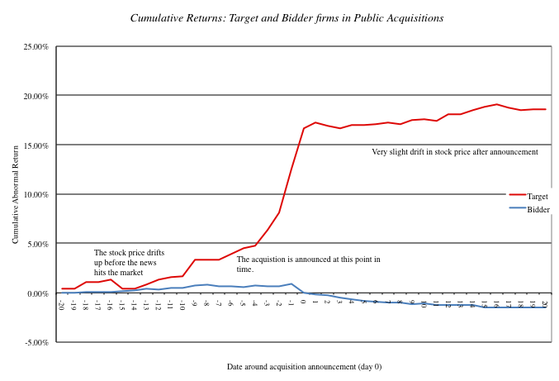
Great for target companies but not for acquiring company stockholders…
Notes:
Easy to tell who the winners in this game are…

Slide 87
And the long-term follow up is not positive either..
Managers often argue that the market is unable to see the long term benefits of mergers that they can see at the time of the deal. If they are right, mergers should create long term benefits to acquiring firms.
The evidence does not support this hypothesis:
  McKinsey and Co. has examined acquisition programs at companies on
    Did the return on capital invested in acquisitions exceed the cost of capital?
    Did the acquisitions help the parent companies outperform the competition?
    Half of all programs failed one test, and a quarter failed both.
  Synergy is elusive. KPMG in a more recent study of global acquisitions concludes that most mergers (>80%) fail - the merged companies do worse than their peer group.
  Regret is common: A large number of acquisitions that are reversed within fairly short time periods. About 20% of the acquisitions made between 1982 and 1986 were divested by 1988. In studies that have tracked acquisitions for longer time periods (ten years or more) the divestiture rate of acquisitions rises to almost 50%.
Notes:
And for those who argue that markets don’t quite understand or see all the good stuff (synergy…) that can come from mergers, there is little evidence that it does show up in these long term follow up studies.

Slide 88
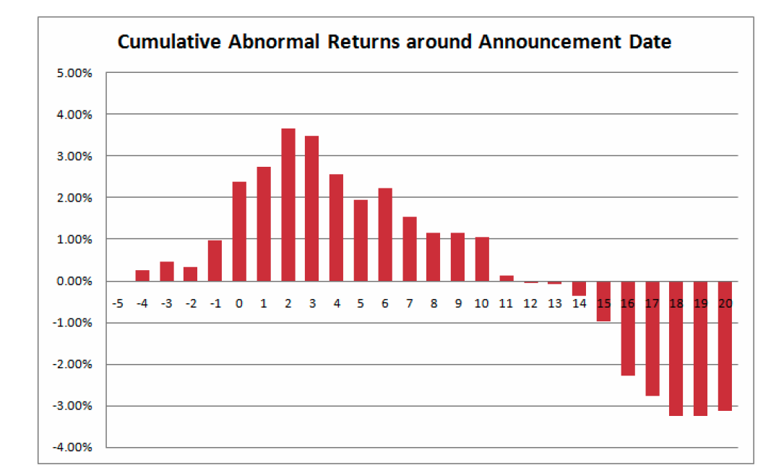
The disease is spreading: Indian firms acquiring US targets – 1999 - 2005
Months around takeover
Notes:
Emerging market companies used to be targets. Now that they have become more powerful, they are proud to be the acquirers. But is that a good thing?

Slide 89
Growing through acquisitions is a “loser’s game”
Firms that grow through acquisitions have generally had far more trouble creating value than firms that grow through internal investments.
In general, acquiring firms tend to
  Pay too much for target firms
  Over estimate the value of “synergy” and “control”
  Have a difficult time delivering the promised benefits
Worse still, there seems to be very little learning built into the process. The same mistakes are made over and over again, often by the same firms with the same advisors.
Conclusion: There is something structurally wrong with the process for acquisitions which is feeding into the mistakes.
Notes:
To understand why acquisitions fail, we have to break the process apart to see what part of it is not working…

Slide 90
The seven sins in acquisitions…
Risk Transference: Attributing acquiring company risk characteristics to the target firm.
Debt subsidies: Subsiding target firm stockholders for the strengths of the acquiring firm.
Auto-pilot Control: The “20% control premium” and other myth…
Elusive Synergy: Misidentifying and mis-valuing synergy.
Its all relative: Transaction multiples, exit multiples…
Verdict first, trial afterwards: Price first, valuation to follow
It’s not my fault: Holding no one responsible for delivering results.
Notes:
These are seven parts of the acquisition process where errors proliferate. In this presentation, we will focus on each one…

Slide 91
Testing sheet
Test | Passed/Failed | Rationalization
Risk transference
Debt subsidies
Control premium
The value of synergy
Comparables and Exit Multiples
Bias
A successful acquisition strategy
Notes:
Keep a running tab…

Slide 92
Let’s start with a target firm
The target firm has the following income statement:
Assume that this firm will generate this operating income forever (with no growth) and that the cost of equity for this firm is 20%. The firm has no debt outstanding. What is the value of this firm?
 | Next Year
Revenues | $ 100.00
Operating Expenses (includes depreciation of $20 million) | $ 80.00
Pre-tax Operating Income | $ 20.00
Taxes | $ 8.00
After-tax Operating Income | $ 12.00
Notes:
Could not be simpler:
Value of the firm = 12/.20 = 60 million

Slide 93
Test 1: Risk Transference…
Assume that as an acquiring firm, you are in a much safer business and have a cost of equity of 10%. What is the value of the target firm to you?
  $60 million
  $90 million
  $120 million
  Other
Notes:
Does not change. You cannot make the argument (though many do) that since it is your equity that is being used to fund the acquisition, you can use your cost of equity (which would lead you to double the value of the target firm).

Slide 94
Lesson 1: Don’t transfer your risk characteristics to the target firm
Let’s start with a basic capital budgeting principle, which is often ignored: The discount rate used for an investment should reflect the risk of the investment and not the risk characteristics of the investor who raised the funds.
  Risky businesses cannot become safe just because the buyer of these businesses is in a safe business.
  The right cost of equity to use in valuation is the one that reflects the risk in equity in the target firm.
Notes:
The reason lies in a basic principle in capital budgeting - that a project’s discount rate should reflect the risk of the project and not of the entity taking the project. (Of course, this would also imply that you would use project specific costs of equity and capital….)
If you fail on this principle, safe companies will end up overvaluing and overpaying for risky companies (as many did in the late 1990s)

Slide 95
Test 2: Cheap debt?
Assume as an acquirer that you have both excess debt capacity (because you have not chosen to borrow as much as you could have, given your assets) and access to cheap debt.
You plan to borrow money at 4% (in after-tax terms) and that you plan to fund half the acquisition with debt. How much would you be willing to pay for the target firm?
Notes:
This is a tougher one and you may be tempted to argue that the new cost of capital for the target firm will be:
Cost of capital = 20% (.5) + 4% (.5) = 12%
This would lead you to value the target firm at 100.
What is the problem with doing this? Remember that the reason you are able to borrow money is because you as the acquiring firm have excess debt capacity and you are able to borrow at low rates because you have no default risk. If you use this lower cost of capital, you are in effect subsidizing the target firm stockholders with your excess debt capacity.
How about if the target firm could have afforded to have a 50% debt ratio and a 4% cost of debt? That is a different question and can be considered a value for control. If you pay 100, though, you do all the work of bringing them to their optimal debt ratio and the target firm stockholders walk away with all of the benefits.

Slide 96
Lesson 2: Render unto the target firm that which is the target firm’s but not a penny more..
As an acquiring firm, it is entirely possible that you can borrow much more than the target firm can on its own and at a much lower rate.
If you build these characteristics into the valuation of the target firm, you are essentially transferring wealth from your firm’s stockholder to the target firm’s stockholders.
When valuing a target firm, use a cost of capital that reflects the debt capacity and the cost of debt that would apply to the firm.
Notes:
The minute you start building into the valuation strengths that flow from you (as the acquiring firm), you start giving target firm stockholders premiums that they do not deserve.

Slide 97
Test 3: Control Premiums
Assume that you are now told that it is conventional to pay a 20% premium for control in acquisitions.
That premium is justified by pointing to historical studies that show that this is what acquirers pay for control, i.e., pay roughly a 20% premium over the market price.
  How much would you be willing to pay for the target firm?
  Assuming that you are paying a control premium, how would you justify it?
Notes:
Wrong on both counts. Control can be worth nothing (or 50%) and rules of thumb are useless.

Slide 98
Lesson 3: Beware of rules of thumb…
Valuation is cluttered with rules of thumb. After painstakingly valuing a target firm, using your best estimates, you will be often be told that
  It is common practice to add arbitrary premiums for brand name, quality of management, control etc…
  These premiums will be often be backed up by data, studies and services. What they will not reveal is the enormous sampling bias in the studies and the standard errors in the estimates.
  If you have done your valuation right, those premiums should already be incorporated in your estimated value. Paying a premium will be double counting.
Notes:
Rules of thumb in billion dollar valuations are signs of laziness and indicate an unwillingness to actually estimate the value of control or what a reasonable value to EBITDA multiple is for a firm.

Slide 99
Test 4: Synergy….
Assume that you are told that the combined firm will be less risky than the two individual firms and that it should have a lower cost of capital (and a higher value). Is this likely?
  Yes
  No
Assume now that you are told that there are potential growth and cost savings synergies in the acquisition. Would that constitute value added?
  Yes
  No
Should you pay this as a premium?
  Yes
  No
Notes:
Answer to part a
Not unless I am given specifics. Buzz words are worth nothing.
Answer to part b
By the present value of the cashflows that will be generated by the synergy
Answer to part c
Since synergy requires both the acquiring firm and the target firm’s strengths to be pooled, you (as the acquirer) should demand your fair share of that synergy. If there are literally dozens of firms that have the strength you bring to the merger, odds are that you will end up with very little of the synergy.

Slide 100
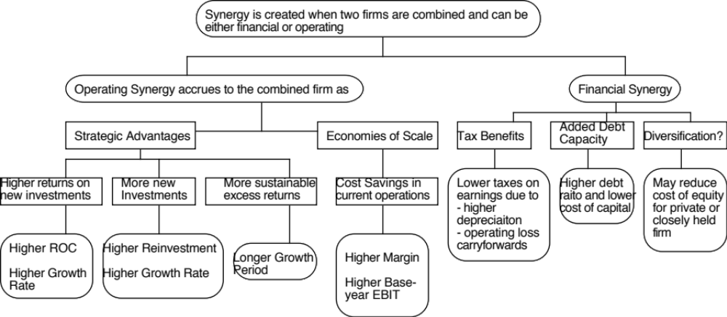
The Value of Synergy
Notes:
The value of synergy has to show up in one or more of the inputs into a DCF valuation. In this picture, I look at different types of synergy (operating and financial) and where they will show up in terms of the inputs…

Slide 101
Valuing Synergy
(1) the firms involved in the merger are valued independently, by discounting expected cash flows to each firm at the weighted average cost of capital for that firm.
(2) the value of the combined firm, with no synergy, is obtained by adding the values obtained for each firm in the first step.
(3) The effects of synergy are built into expected growth rates and cashflows, and the combined firm is re-valued with synergy.
  Value of Synergy = Value of the combined firm, with synergy - Value of the combined firm, without synergy
Notes:
You have to do three valuations to value synergy and you have to quantify the impact of synergy into valuation inputs.

Slide 102
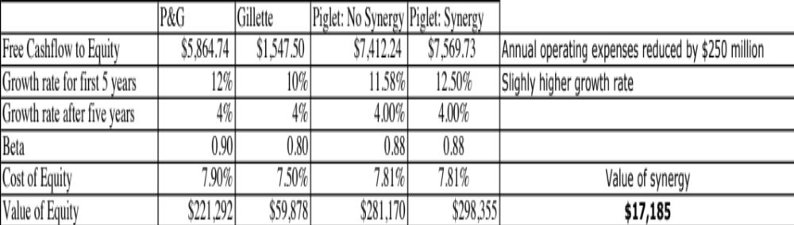
Synergy - Example 1
Higher growth and cost savings
Notes:
If you can cut costs and/or increase growth, synergy can be worth a lot.
In this example, P&G has synergy of almost $ 17 billion in the acquisition of Gillette.
This is probably a best case valuation, since it is based on assuming that everything managers claimed would happen actually happened and did so instantaneously.
A Follow up question
What would happen to the value of synergy if the cost savings were over estimated by $ 100 million/year? (Drop by 40%)
What if you have to wait 5 years for synergy to show up? (You would have to discount the value of synergy back 5 years, using the cost of capital of the combined firm)

Slide 103
Synergy: Example 2
Tax Benefits?
Assume that you are Best Buy, the electronics retailer, and that you would like to enter the hardware component of the market. You have been approached by investment bankers for Zenith, which while still a recognized brand name, is on its last legs financially. The firm has net operating losses of $ 2 billion. If your tax rate is 36%, estimate the tax benefits from this acquisition.
If Best Buy had only $500 million in taxable income, how would you compute the tax benefits?
If the market value of Zenith is $800 million, would you pay this tax benefit as a premium on the market value?
Notes:
If you can get the tax savings immediately, it is 36% of 2000 = $720 million
If you have to save only $ 180 million a year (36% of $500 million), the value would be = PV of $ 180 million each year for 4 years at the cost of capital of Best Buys (the risk is in the operating income of Best Buys)…
And I would not necessarily pay it as a premium, since the market price may already incorporate some or much of this value.

Slide 104
Lesson 4: Don’t pay for buzz words
You have to value synergy, before you decide how much to pay (not after): Synergy will be the buzzword that explains away the premium that you are paying.
To value synergy, you need specifics: Before you value synergy, you need to be specific about what synergies you see in a merger and where they will show up in a valuation.
Don’t mistake control for synergy: If the benefits can be generated by just one of the two entities in the merger, it is not synergy.
Negotiate for your fair share: As the acquiring firm, you should negotiate for your share of the synergy, not pay it all off as a premium.
Notes:
To value synergy, you would need to do the following:
Value the two firms independently
Define how synergy will show up in the combined firm. It can take the form of higher growth (with growth synergies), higher margins (with cost saving synergies), longer growth period (with strategic synergies).
Value the combined firm with the synergy built it.
Value of synergy = Value of combined firm (from step c) - Sum of the values of the independent companies from step a.

Slide 105
Test 5: Comparables and Exit Multiples
Now assume that you are told that an analysis of other acquisitions reveals that acquirers have been willing to pay 5 times EBIT.. Given that your target firm has EBIT of $ 20 million, would you be willing to pay $ 100 million for the acquisition?
What if I estimate the terminal value using an exit multiple of 5 times EBIT?
As an additional input, your investment banker tells you that the acquisition is accretive. (Your PE ratio is 20 whereas the PE ratio of the target is only 10… Therefore, you will get a jump in earnings per share after the acquisition…)
Notes:
Two basic problems here:
Sampling bias: Looking at transaction multiples (on other acquisitions), you are looking a sample of firms that are likely to have over paid. If you are going to do relative valuation, at least look at how other publicly traded companies in the sector are trading at. Better still, try to control for differences between your firm and these comparable firms.
If the market is, on average, wrong and overpaying for stocks in a sector, you will end up overpaying as well. This problem becomes even worse when you use the industry average to estimate terminal value in acquisition valuations. If the market is wrong, it is likely to correct well before you get to your terminal year.

Slide 106
Biased samples = Poor results
Biased samples yield biased results. Basing what you pay on what other acquirers have paid is a recipe for disaster. After all, we know that acquirer, on average, pay too much for acquisitions. By matching their prices, we risk replicating their mistakes.
Even when we use the pricing metrics of other firms in the sector, we may be basing the prices we pay on firms that are not truly comparable.
When we use exit multiples, we are assuming that what the market is paying for comparable companies today is what it will continue to pay in the future.
Notes:
With transaction multiples, you get a sample of firms that pay too much, and you too will pay too much.

Slide 107
Lesson 5: If you are going to price a target firm, do it right..
Pick your game: If you are acquiring other companies not for the cash flows but because you think that you can sell them to someone else at a higher price, it is perfectly okay to play the pricing game. If you are acquiring a firm for its cash flows, you have to play the value game.
Don’t get distracted: If you are playing the pricing game, dispense with the DCF and do an honest pricing. If you are playing the value game, stop looking at what other people are paying.
To do an honest pricing, you have to be unbiased in your choice of multiple and comparable firms, and control for differences between your firm & the peer group.
Notes:
The fact that everyone else in the sector is doing bad acquisitions and over paying for them is not a good reason to join the group. It is entirely possible that you are operating in a value destroying sector and it may be time for you to consider shrinking while everyone else is expanding or better still become a target of their acquisitions.

Slide 108
Test 6: The CEO really wants to do this… or there are competitive pressures…
Now assume that you know that the CEO of the acquiring firm really, really wants to do this acquisition and that the investment bankers on both sides have produced fairness opinions that indicate that the firm is worth $ 150 million. Would you be willing to go along?
  Yes
  No
Now assume that you are told that your competitors are all doing acquisitions and that if you don’t do them, you will be at a disadvantage? Would you be willing to go along?
  Yes
  No
Notes:
Fairness opinions are not worth the paper they are written on. When the deal makers (investment bankers) also pass judgment on whether the deal makes sense (which is what the fairness opinion provides), you have a huge conflict of interest.

Slide 109
CEO Egos and Overconfidence: The Dirty Secret in Mergers
The Deal Rules: The premiums paid on acquisitions often have nothing to do with synergy, control or strategic considerations (though they may be provided as the reasons). They are just what you have to pay to get the deals done, because management really, really wants it done.
The Ego Problem: They may just reflect the egos of the CEOs of the acquiring firms. There is evidence that “over confident” CEOs are more likely to make acquisitions and that they leave a trail across the firms that they run.

Slide 110
Defensive Mergers: Signs of a Deeper Rot?
Me-tooism: Pre-emptive or defensive acquisitions, where you over pay, either because everyone else is overpaying or because you are afraid that you will be left behind if you don’t acquire are dangerous.
Weak businesses? If the only way you can stay competitive in a business is by making bad investments, it may be best to think about shrinking or even getting out of the business.
There is no glory in survival, for the sake of survival. Corporate sustainability, as a corporate objective, is not just a joke, but an expensive one.

Slide 111
Lesson 6: Don’t let egos or investment bankers get the better of common sense…
If you define your objective in a bidding war as winning the auction at any cost, you will win. But beware the winner’s curse!
The premiums paid on acquisitions often have nothing to do with synergy, control or strategic considerations. They may just reflect the egos of the CEOs of the acquiring firms. There is evidence that “overconfident” CEOs are more likely to make acquisitions and that they leave a trail across the firms that they run.
Pre-emptive or defensive acquisitions, where you over pay, either because everyone else is overpaying or because you are afraid that you will be left behind if you don’t acquire are dangerous. If the only way you can stay competitive in a business is by making bad investments, it may be best to think about getting out of the business.
Notes:
This is not a macho game. CEOs are all too willing to fight out acquisitions with other people’s money. Investment bankers are all too willing to go along. In a typical acquisition, who is watching out for the stockholders of the acquiring firm?

Slide 112
Test 7: When deals fall apart..
When deals fall apart, as many do, there seems to be little or no accountability in the system, and the larger the deal, the less accountability there is for mistakes.
Breaking it down:
  The managers who initiate these bad deals seem to face few consequences and often move up the ranks.
  The boards that okay these deals protect themselves by claiming that the did due diligence and listened to experts.
  The bankers keep their fees, arguing that their missed forecasts were just mistakes.

Slide 113
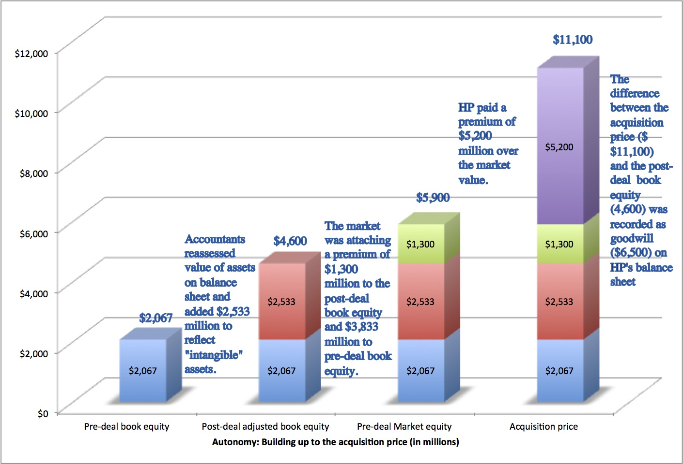
To illustrate: A bad deal is made, and justified by accountants & bankers!
Notes:
HP acquired Autonomy, a UK-based business software company, for $11.1 billion in 2011. At the time, almost everyone except for HP’s management thought that they were paying too much. Leo Apotheker, HP’s CEO at the time, claimed that they had done their homework and that the investment bankers had done a DCF and found the deal to be an accretive, good deal. The board of HP went along with the deal… and Meg Whitman was on the board. This is the same board that a year earlier had been caught sleeping on the job as the previous CEO, Mark Hurd, was found to have been involved in personal misconduct… And guess what…. This board met all of the Sarbanes Oxley requirements for independence.

Slide 114
The CEO steps in… and digs a hole…
Leo Apotheker was the CEO of HP at the time of the deal, brought in to replace Mark Hurd, the previous CEO who was forced to resign because of a “sex” scandal.
In the face of almost universal feeling that HP had paid too much for Autonomy, Mr. Apotheker addressing a conference at the time of the deal: “We have a pretty rigorous process inside H.P. that we follow for all our acquisitions, which is a D.C.F.-based model,” he said, in a reference to discounted cash flow, a standard valuation methodology. “And we try to take a very conservative view.”
Apotheker added, “Just to make sure everybody understands, Autonomy will be, on Day 1, accretive to H.P….. “Just take it from us. We did that analysis at great length, in great detail, and we feel that we paid a very fair price for Autonomy. And it will give a great return to our shareholders.

Slide 115
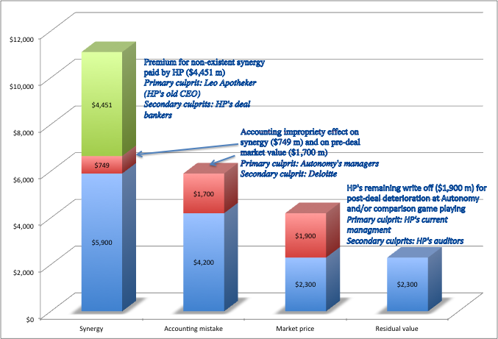
A year later… HP admits a mistake…and explains it…
Notes:
About a year later, HP announced that it was writing off almost $8.9 billion off its original deal value and claimed that Autonomy had cooked the books. This was my attempt to break down the write off, even with the presumption of accounting impropriety. The CEO of HP, Meg Whitman, claimed no responsibility…

Slide 116
A Measured assessment: Is it hopeless?
The odds seem to be clearly weighted against success in acquisitions. If you were to create a strategy to grow, based upon acquisitions, which of the following offers your best chance of success?
This | Or this
Sole Bidder | Bidding War
Public target | Private target
Pay with cash | Pay with stock
Small target | Large target
Cost synergies | Growth synergies
Notes:
Not necessarily…

Slide 117
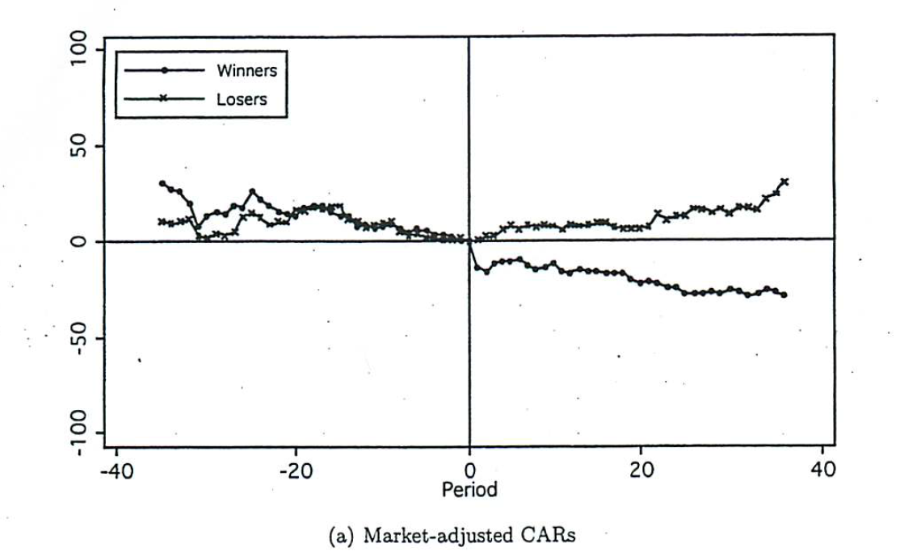
Better to lose a bidding war than to win one…
Returns in the 40 months before & after bidding war
Source: Malmendier, Moretti & Peters (2011)
Notes:
This graph looks at the stock returns a forty-month period after a bidding war to the “winner” and “loser” of the bidding war… Seems like no contest. The losing firm in the bidding war significantly outperforms the winning firm by almost 50%. The results are invariant to different measures of risk and correcting for sector performance.

Slide 118
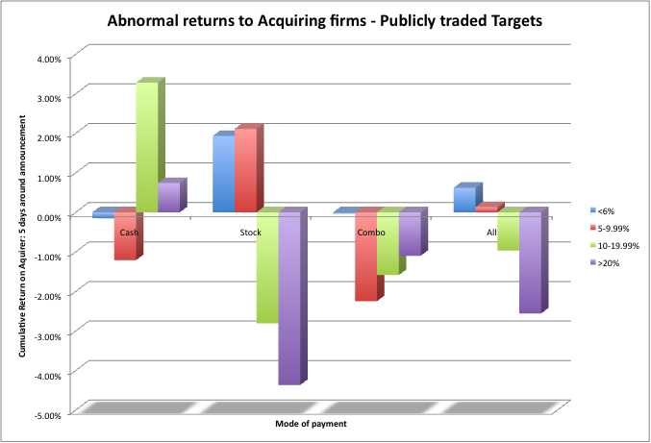
Better off buying small rather than large targets… with cash rather than stock
Notes:
Note that the larger the target, the greater the negative returns…
And cash acquisitions tend to do better than stock acquisitions, at least for big acquisitions. For small acquisitions, the reverse is true.. (Perhaps, target company stockholders in big acquisitions are more likely to be suspicious about the use of stock as currency)

Slide 119
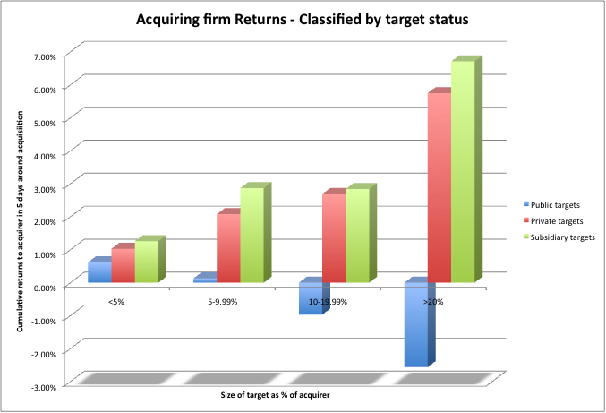
And focusing on private firms and subsidiaries, rather than public firms…
Notes:
Better to target private businesses and subsidiaries, where you don’t have to pay market price plus…

Slide 120
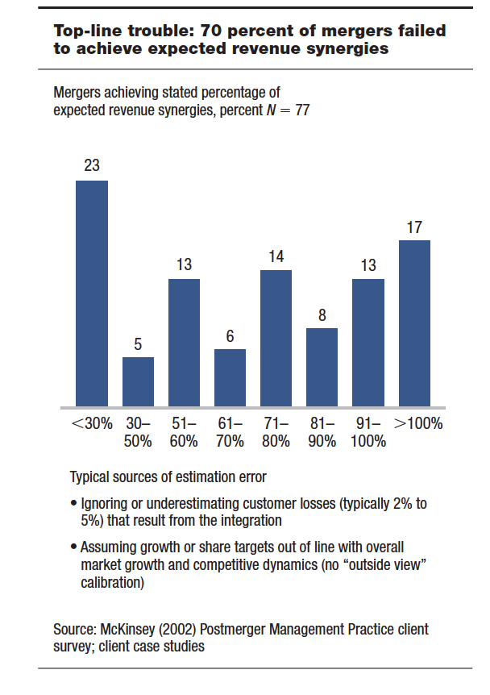
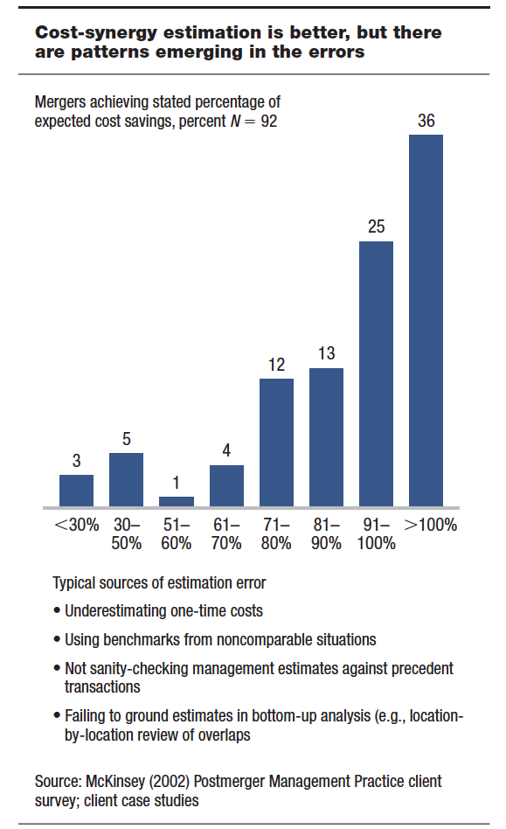
Growth vs Cost Synergies
Notes:
Cost savings synergies are more likely to be realized than growth synergies. Here are some reasons why:
They are more concrete and more likely to therefore be put down on paper
It is easier to hold some one responsible for delivering cost savings
It is easier to track how close you are to your forecasts

Slide 121
The Bottom line: For acquisitions to create value, you have to stay disciplined..
If you have a successful acquisition strategy, stay focused on that strategy. Don’t let size or hubris drive you to “expand” the strategy.
Realistic plans for delivering synergy and control have to be put in place before the merger is completed. By realistic, we have to mean that the magnitude of the benefits have to be reachable and not pipe dreams and that the time frame should reflect the reality that it takes a while for two organizations to work as one.
The best thing to do in a bidding war is to drop out.
Someone (preferably the person pushing hardest for the merger) should be held to account for delivering the benefits.
The compensation for investment bankers and others involved in the deal should be tied to how well the deal works rather than for getting the deal done.
Notes:
This is a very tough game to win at. When you decide to grow through acquisitions, especially of publicly traded firms, the odds are against you because you always have to pay the market price plus a premium. It is not who you buy that determines the success of an acquisition, it is how much you pay.
The odds are better when you grow by buying private companies, where you assess the value and you are less likely to get into bidding wars. In addition, there are real constraints on private firms that my be removed when you take them over. This offers potential for increasing value.

Slide 122
Value Enhancement and the Expected Value of Control: Back to Basics
Notes:
Move from passive valuation (where you an investor looking at the company) to active valuation (where you can change the levers of value…)

Slide 123
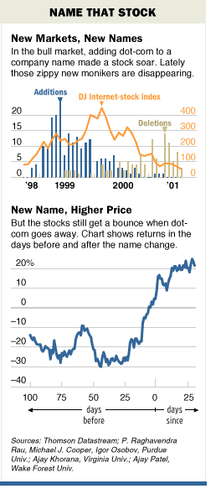
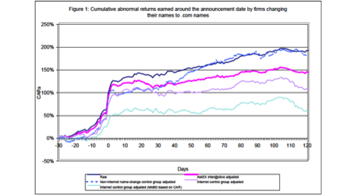
Price Enhancement versus Value Enhancement
The market gives…
And takes away….
Notes:
Value enhancement and price enhancement are equivalent in an efficient market. In a market that does not always reward long-term decision making and behaves irrationally,

Slide 124
The Paths to Value Creation
Using the DCF framework, there are four basic ways in which the value of a firm can be enhanced:
  The cash flows from existing assets to the firm can be increased, by either
    increasing after-tax earnings from assets in place or
    reducing reinvestment needs (net capital expenditures or working capital)
  The value from growth in these cash flows can be increased by either
    Reinvesting more and increasing growth in good businesses
    Reinvesting less or even divesting in bad businesses
  The length of the high growth period can be extended to allow for more years of high growth.
  The cost of capital can be reduced by
    Reducing the operating risk in investments/assets
    Changing the financial mix
    Changing the financing composition
Notes:
To create value, you have to change one or more of the above inputs…

Slide 125
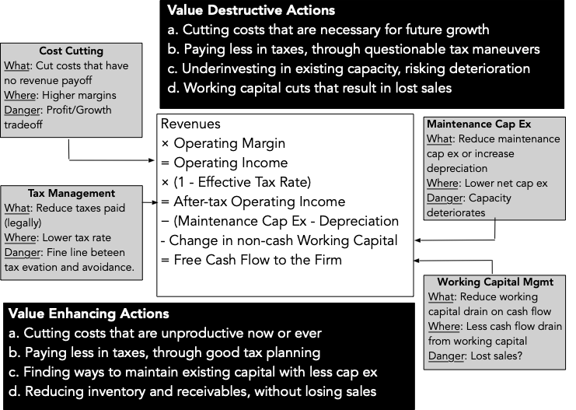
Value Creation 1: Increase Cash Flows from Assets in Place
Notes:
The key is that there is a trade off between current cashflows and future growth. If you increase current cashflows at the expense of future growth, you may destroy value rather than add to it.

Slide 126
Divest, Abandon or Hold on: The Math!
The conventional wisdom, when you are put in charge of a troubled firm, is to sell or abandon the worst-performing assets, usually ones that earn less than the cost of capital.
Every asset/business that a company owns has three values:
  Continuation value: the value of the expected cash flows from continuing to own and operate the asset
  Abandonment value: the salvage value of the asset or assets in the business
  Divestiture value: the value that the best buyer will pay for the asset or business.
For value enhancement, you pick the highest of the three values, and ironically, the ones that you may most benefit from divesting are your best-regarded, rather than your worst performing, assets.

Slide 127
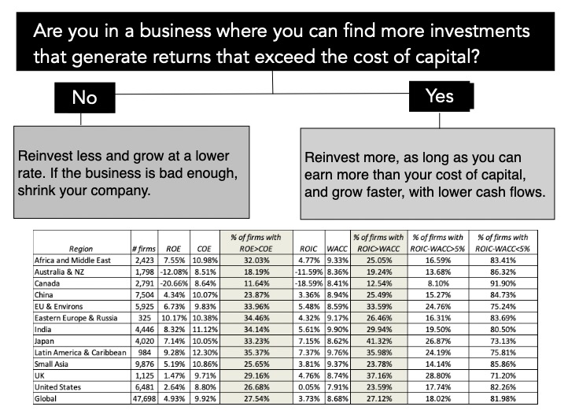
Value Creation 2: Increase Value from Expected Growth

Slide 128
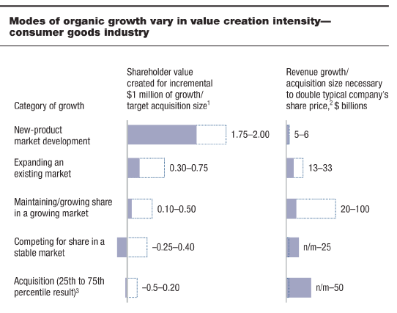
Value Creating Growth… Evaluating the Alternatives..
Notes:
This is from a study by McKinsey, looking at the odds of succeeding with different growth strategies, extracted by looking at their proprietary data base over time. They are ranked in terms of their history in delivering value.
Best strategy in terms of value creation: Develop a new product (Think of Apple during the 2001-2010 time period). The downside is that it is tough to do (Think of Microsoft trying and failing repeatedly over that same period)
Next best: Either find new uses for an existing product (aspirin as heart medicine) or new markets for existing product (Coca Cola going global in the 1980s…)
Maintaining/Growing share of a growing market: If the overall market is growing, maintaining market shares can still be lucrative.
Competing for share in a stable market: Biggest likelihood of losing money, partly because you have to cut prices to get market share..
Acquisitions offer you the least upside and also require much larger investments to deliver the same growth…

Slide 129
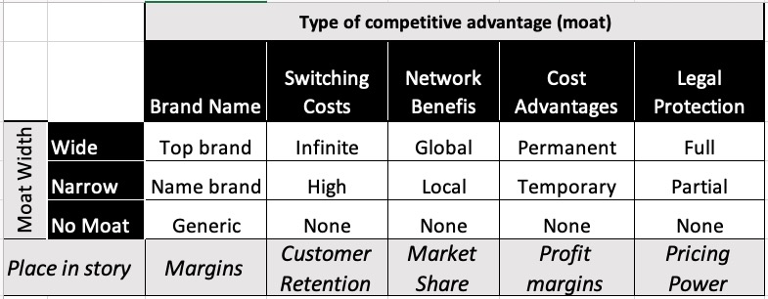
Value Creation 3: Building Competitive Advantages: Increase length of the growth period
Value comes from earning returns that exceed your cost of capital, and those excess returns, in turn, come from competitive advantages.
Stronger competitive advantages (moats) increase how long you can add value from growth.
Notes:
For high growth to have value, it has to be accompanied by high excess returns… and for high excess returns to exist, there have to be significant competitive advantages…
So, if you have a competitive advantage, nurture it and strengthen it (How you do it will depend on the competitive advantage)
If you don’t have a competitive advantage, work on creating one.. Not easy to do, but the payoff can be immense.
Examples:
Brand name: Xerox, Eastman Kodak examples of companies that let great brand names slip away, Harley Davidson and Levi’s example of company that rediscovered their brand name, Apple an example of a company that lost and then regained its brand name
Legal protection: Not patented. Xerox invented the mouse and the graphical interface at the PARC (Palo Alto Research Center ) Lab. Steve Jobs & Wozniak saw it and used it as the basis for the Apple. They did not protect themselves fully either, allowing MSFt to create windows. Pharma companies work hard at not only patenting their drugs but extending those patents. Example would be Pfizer that combined a blood pressure drug (Norvasc) and a cholestrol drug (Lipitor) to create Caduet. This mashup will allow Pfizer protection from anyone else creating this combination even though both Norvasc (2007) and Lipitor (2011) are off patent.
Switching costs: Microsoft with the computer software business, cell phone companies with their long term contracts
Cost advantages: Dell over Compaq in 1999; the game has changed. Now, it is Lenovo over Dell….
Network benefits: In most businesses, it gets more difficult go gain market share, as you get bigger, partly because you get your easiest customers first. With network benefits, it gets easier to acquire customers as you get bigger. Thus, in online advertising, you want to advertise where everyone else is advertising, making Google and Facebook dominant. Businesses with networking benefits quickly become winner take all businesses, with two or three companies dominating.

Slide 130
Measuring the Moat
The only financial measure of the moat is the difference between the return you earn on existing assets and the cost of capital. Unfortunately, there are three problems;
  The return on equity (and capital) is an accounting number, and may not be reflective of the true return.
  It can be volatile, shifting over time.
  It is for past investments, not future ones.
The truth is that moat reading remains subjective, with a multitude of factors going into it.

Slide 131
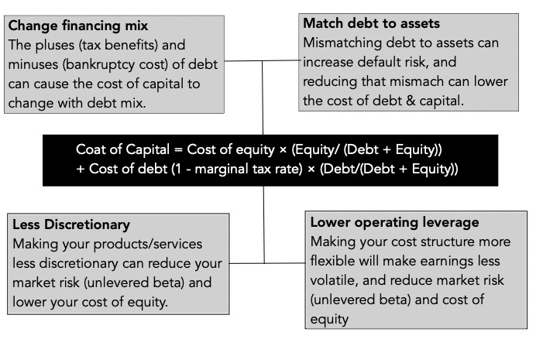
Value Creation 4: Reduce Cost of Capital
Notes:
Reducing the cost of capital, holding cashflows constant, increases firm value. Note that while people tend to focus on changing the mix of debt and equity to reduce cost of capital, you can reduce cost of capital by reducing fixed costs and by making your product/service less discretionary to your customers…

Slide 132
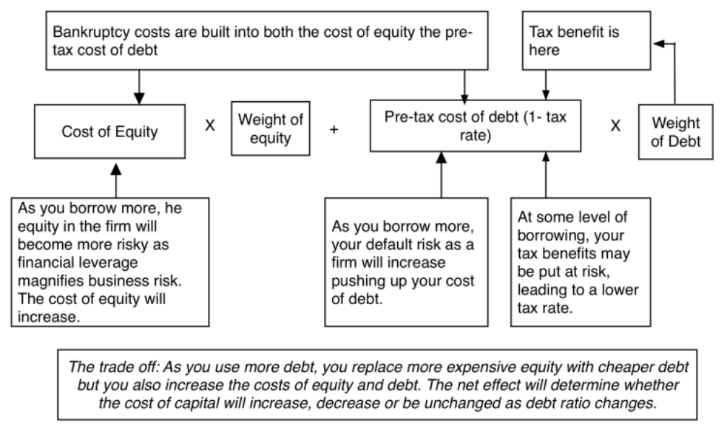
Myth: Borrowing money always lowers your cost of capital
Notes:
Reducing the cost of capital, holding cashflows constant, increases firm value. Note that while people tend to focus on changing the mix of debt and equity to reduce cost of capital, you can reduce cost of capital by reducing fixed costs and by making your product/service less discretionary to your customers…

Slide 133
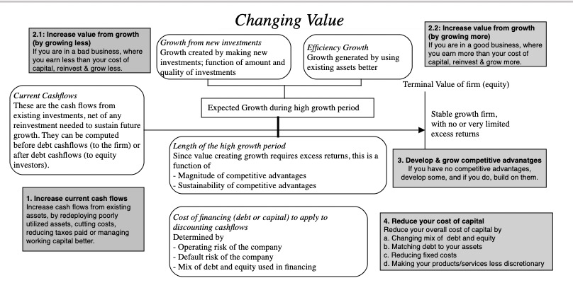

Slide 134
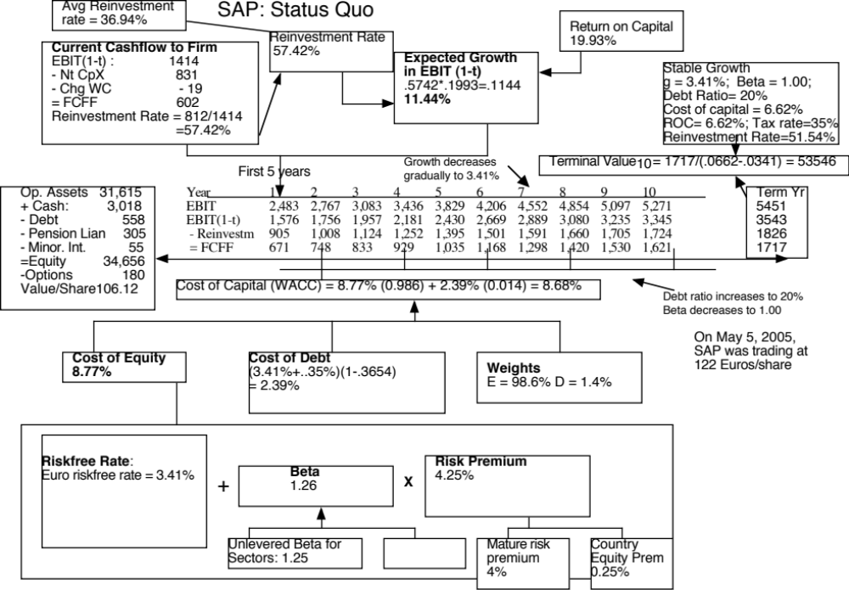
Notes:
A status quo valuation of SAP, the German technology company, yields a value of 106.12 Euros/share.
If you were the new CEO of this company, what would you change about how this company is run?
Is there potential for cost cutting? (Compare the margins to industry averages; SAP earns higher margins than the sector)
Is there potential for higher and more value creating growth? (Reinvestment rate is fairly high and return on capital is excellent)
Is there potential for a longer high growth period? (Are there new competitive advantages that SAP can create.. Does not look like it)
Can it lower its cost of capital? (Only dimension where there seems to be good potential…)

Slide 135
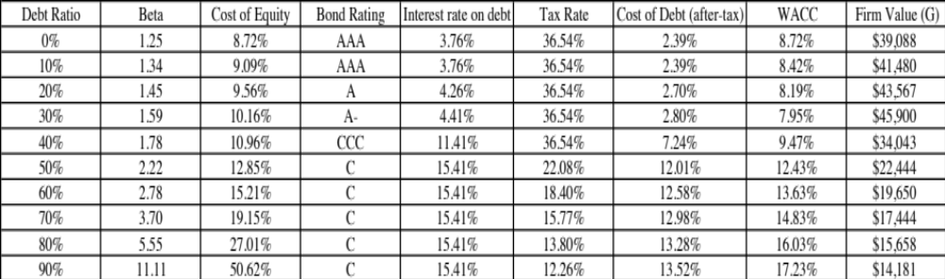
SAP : Optimal Capital Structure
Notes:
Looks like SAP can have a much lower cost of capital, if it moves to a 30% debt ratio…

Slide 136
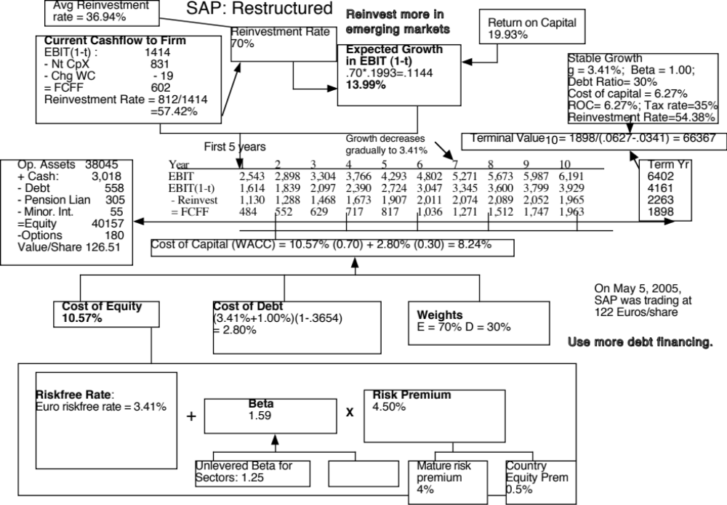
Notes:
With the two changes, the value per share rises to 126.51 Euros/share…. About 20 Euros per share higher than under the status quo..

Slide 137
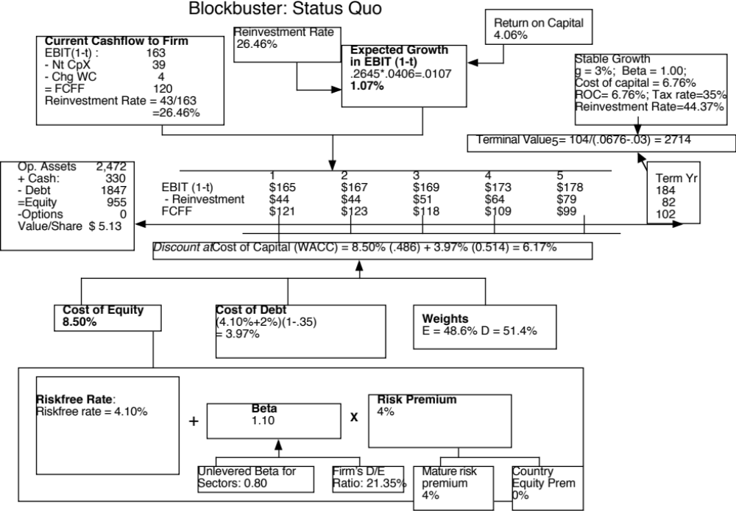
Notes:
Plenty of opportunity for change here. The return on capital is well below the cost of capital and the firm keeps opening new stores (reinvesting)… and the firm seems over levered…

Slide 138

Notes:
Not asking for miracles. Just assuming that they can bring the return on capital to roughly the cost of capital.
Value/share more than doubles…

Slide 139
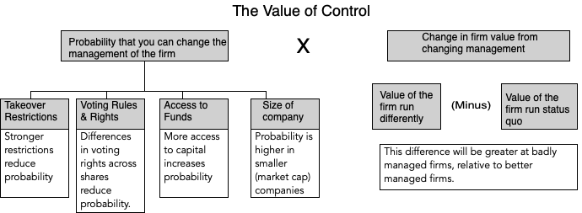
The Expected Value of Control
Notes:
Contrary to conventional wisdom, the value of control is not 20%… (That is a common rule of thumb used in acquisitions, and really reflects the average premium paid in acquisitions..) Even if bidders do not overpay, the premium on an acquisition can reflect lots of other motivations besides control (synergy, for example).

Slide 140
Why the probability of management changing shifts over time….
Corporate governance rules can change over time, as new laws are passed. If the change gives stockholders more power, the likelihood of management changing will increase.
Activist investing ebbs and flows with market movements (activist investors are more visible in down markets) and often in response to scandals.
Events such as hostile acquisitions can make investors reassess the likelihood of change by reminding them of the power that they do possess.
Notes:
The rules do keep changing, sometimes because of external pressure, When they change, the probability of management changing also shifts.
A hostile acquisition of one company or an activist investor can alter the probabilities for a wide range of companies…

Slide 141
Estimating the Probability of Change
You can estimate the probability of management changes by using historical data (on companies where change has occurred) and statistical techniques such as probits or logits.
Empirically, the following seem to be related to the probability of management change:
  Stock price and earnings performance, with forced turnover more likely in firms that have performed poorly relative to their peer group and to expectations.
  Structure of the board, with forced CEO changes more likely to occur when the board is small, is composed of outsiders and when the CEO is not also the chairman of the board of directors.
  Ownership structure, since forced CEO changes are more common in companies with high institutional and low insider holdings. They also seem to occur more frequently in firms that are more dependent upon equity markets for new capital.
  Industry structure, with CEOs more likely to be replaced in competitive industries.
Notes:
Getting a sense of whether it should be high or low is easy. Putting a number on it is more difficult to do. In recent years, there are researchers who have looked at firms where management has been changed (either by hostile acquisitions or through other means) and compared these firms to those where there has been no change to estimate the probability of change happening. Good approach, but has high standard errors…

Slide 142
Manifestations of the Value of Control
Hostile acquisitions: In hostile acquisitions which are motivated by control, the control premium should reflect the change in value that will come from changing management.
Valuing publicly traded firms: The market price for every publicly traded firm should incorporate an expected value of control, as a function of the value of control and the probability of control changing.
  Market value = Status quo value + (Optimal value – Status quo value)* Probability of management changing
Voting and non-voting shares: The premium (if any) that you would pay for a voting share should increase with the expected value of control.
Minority Discounts in private companies: The minority discount (attached to buying less than a controlling stake) in a private business should be increase with the expected value of control.
Notes:
These are all scenarios where the value of control plays out, in one way or the other.

Slide 143
1. Hostile Acquisition: Example
In a hostile acquisition, you can ensure management change after you take over the firm. Consequently, you would be willing to pay up to the optimal value.
As an example, Blockbuster was trading at $9.50 per share in July 2005. The optimal value per share that we estimated as $ 12.47 per share. Assuming that this is a reasonable estimate, you would be willing to pay up to $2.97 as a premium in acquiring the shares.
Issues to ponder:
  Would you automatically pay $2.97 as a premium per share? Why or why not?
  What would your premium per share be if change will take three years to implement?
Notes:
If you pay the entire $2.97 as a premium, you get no value added as the acquirer…
Take the present value of $2.97 (at Blockbuster’s cost of equity) over 3 years.

Slide 144
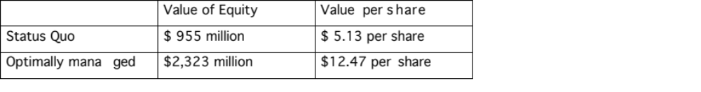
2. Market prices of Publicly Traded Companies: An example
The market price per share at the time of the valuation (May 2005) was roughly $9.50.
  Expected value per share = Status Quo Value + Probability of control changing * (Optimal Value – Status Quo Value)
  $ 9.50 = $ 5.13 + Probability of control changing ($12.47 - $5.13)
The market is attaching a probability of 59.5% that management policies can be changed. This was after Icahn’s successful challenge of management. Prior to his arriving, the market price per share was $8.20, yielding a probability of only 41.8% of management changing.
Notes:
This assumes that your estimates of status quo and optimal value are right…
But this may explain why the market price pops for firms, when an activist investor pops up on the horizon.

Slide 145
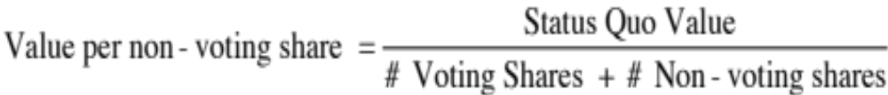
Value of stock in a publicly traded firm
When a firm is badly managed, the market still assesses the probability that it will be run better in the future and attaches a value of control to the stock price today:
With voting shares and non-voting shares, a disproportionate share of the value of control will go to the voting shares. In the extreme scenario where non-voting shares are completely unprotected:
Notes:
This is based on the assumption that the entire value of control rests with the voting shareholders and that the non-voting shareholders are helpless bystanders. That may be a little unfair since many countries have laws protecting non-voting shareholders at least partially.
It is also likely to overstate the voting share premium, when non-voting shareholders can piggyback and benefit from changes made in the way the firm is run.

Slide 146
3. Voting and Non-voting Shares: An Example
To value voting and non-voting shares, we will consider Embraer, the Brazilian aerospace company. As is typical of most Brazilian companies, the company has common (voting) shares and preferred (non-voting shares).
  Status Quo Value = 12.5 billion $R for the equity;
  Optimal Value = 14.7 billion $R, assuming that the firm would be more aggressive both in its use of debt and in its reinvestment policy.
There are 242.5 million voting shares and 476.7 non-voting shares in the company and the probability of management change is relatively low. Assuming a probability of 20% that management will change, we estimated the value per non-voting and voting share:
  Value per non-voting share = Status Quo Value/ (# voting shares + # non-voting shares) = 12,500/(242.5+476.7) = 17.38 $R/ share
  Value per voting share = Status Quo value/sh + Probability of management change * (Optimal value – Status Quo Value) = 17.38 + 0.2* (14,700-12,500)/242.5 = 19.19 $R/share
With our assumptions, the voting shares should trade at a premium of 10.4% over the non-voting shares.
Notes:
The voting share premium will increase with
The value of changing management (higher for badly managed firms)
The probability of changing management (higher for firms where voting shares are dispersed among investors)
The number of voting shares, relative to non-voting shares (higher when the number of voting shares is lower)

Slide 147
4. Minority Discount: An example
Assume that you are valuing Kristin Kandy, a privately owned candy business for sale in a private transaction. You have estimated a value of $ 1.6 million for the equity in this firm, assuming that the existing management of the firm continues into the future and a value of $ 2 million for the equity with new and more creative management in place.
  Value of 51% of the firm = 51% of optimal value = 0.51* $ 2 million = $1.02 million
  Value of 49% of the firm = 49% of status quo value = 0.49 * $1.6 million = $784,000
Note that a 2% difference in ownership translates into a large difference in value because one stake ensures control and the other does not.
Notes:
In a private business, a minority stake can trade at a much lower value than a majority stake… The reason is the expected value of control.

Slide 148
Alternative Approaches to Value Enhancement
Maximize a variable that is correlated with the value of the firm. There are several choices for such a variable. It could be
  an accounting variable, such as earnings or return on investment
  a marketing variable, such as market share
  a cash flow variable, such as cash flow return on investment (CFROI)
  a risk-adjusted cash flow variable, such as Economic Value Added (EVA)
The advantages of using these variables are that they
  Are often simpler and easier to use than DCF value.
The disadvantage is that the
  Simplicity comes at a cost; these variables are not perfectly correlated with DCF value.
Notes:
Firms prefer these alternative approaches because they seem less subjective and much simpler…

Slide 149
Economic Value Added (EVA) and CFROI
The Economic Value Added (EVA) is a measure of surplus value created on an investment.
  Define the return on capital (ROC) to be the “true” cash flow return on capital earned on an investment.
  Define the cost of capital as the weighted average of the costs of the different financing instruments used to finance the investment.
  EVA = (Return on Capital - Cost of Capital) (Capital Invested in Project)
The CFROI is a measure of the cash flow return made on capital
  It is computed as an IRR, based upon a base value of capital invested and the cash flow on that capital.
Notes:
Two widely used measures of value enhancement… The first is a dollar measure of excess returns.. The second is a percentage measure of excess return.

Slide 150
The bottom line…
The value of a firm is not going to change just because you use a different metric for value. All approaches that are discounted cash flow approaches should yield the same value for a business, if they make consistent assumptions.
If there are differences in value from using different approaches, they must be attributable to differences in assumptions, either explicit or implicit, behind the valuation.
Notes:
Value is a function of expected cash flows, growth and risk. All metrics build of this theme and require fundamentally the same information, and with the same assumptions about the numbers, give you the same values.

Slide 151
A Simple Illustration
Assume that you have a firm with a book value value of capital of $ 100 million, on which it expects to generate a return on capital of 15% in perpetuity with a cost of capital of 10%.
This firm is expected to make additional investments of $ 10 million at the beginning of each year for the next 5 years. These investments are also expected to generate 15% as return on capital in perpetuity, with a cost of capital of 10%.
After year 5, assume that
  The earnings will grow 5% a year in perpetuity.
  The firm will keep reinvesting back into the business but the return on capital on these new investments will be equal to the cost of capital (10%).
Notes:
This firm is expected to earn excess returns on current projects and on new projects taken for the next 5 years. The excess returns are expected to last forever on these projects.

Slide 152
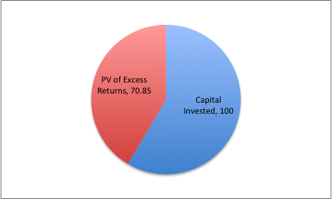
Firm Value using EVA Approach
Capital Invested in Assets in Place = $ 100
EVA from Assets in Place = (.15 – .10) (100)/.10= $ 50
+ PV of EVA from Investments in Year 1 = [(.15 -– .10)(10)/.10]= $ 5
+ PV of EVA from Investments in Year 2 = [(.15 -– .10)(10)/.10]/1.1= $ 4.55
+ PV of EVA from Investments in Year 3 = [(.15 -– .10)(10)/.10]/1.12= $ 4.13
+ PV of EVA from Investments in Year 4 = [(.15 -– .10)(10)/.10]/1.13= $ 3.76
+ PV of EVA from Investments in Year 5 = [(.15 -– .10)(10)/.10]/1.14= $ 3.42
Value of Firm = $ 170.85
Notes:
Note that there is no value added after year 5.. The new projects taken after that earn no excess returns..
We are also assuming that the projects are taken at the beginning of each year… Hence the present value is discounted back by (n-1) years.

Slide 153
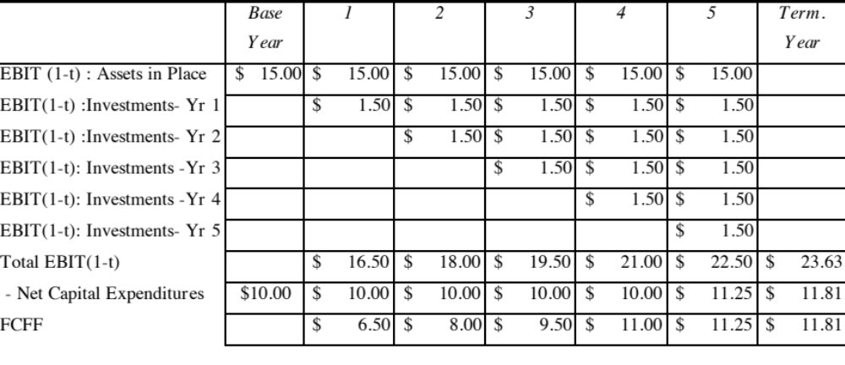
Firm Value using DCF Valuation: Estimating FCFF
After year 5, the reinvestment rate is 50% = g/ ROC
Notes:
Traditional FCFF… Note that the new investment is shown as net cap ex. The net cap ex in year 5 is estimated based upon the expected growth in earnings in year 6 ($1.125) and the assumption of the return on capital in stable growth of 10%.
Investment in year 5 = 1.125/.10 = $11.25 million

Slide 154
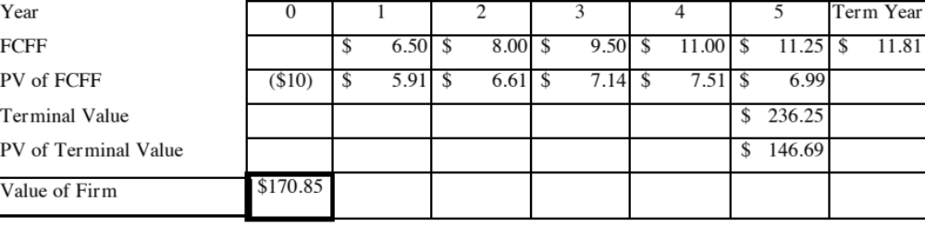
Firm Value: Present Value of FCFF
Notes:
The cashflows get discounted back at the cost of capital. Value of the firm is identical to what we obtained with EVA calculation.

Slide 155
Implications
Growth, by itself, does not create value. It is growth, with investment in excess return projects, that creates value.
  The growth of 5% a year after year 5 creates no additional value.
The “market value added” (MVA), which is defined to be the excess of market value over capital invested is a function of the excess value created.
  In the example above, the market value of $ 170.85 million exceeds the book value of $ 100 million, because the return on capital is 5% higher than the cost of capital.
Notes:
EVA’s biggest contribution is the focus on excess returns rather than growth….Note that the MVA correlation with EVA is very similar to the correlation between value to book ratios and returns on capital.

Slide 156
Year-by-year EVA Changes
Firms are often evaluated based upon year-to-year changes in EVA rather than the present value of EVA over time.
  The advantage of this comparison is that it is simple and does not require the making of forecasts about future earnings potential.
  Another advantage is that it can be broken down by any unit - person, division etc., as long as one is willing to assign capital and allocate earnings across these same units.
While it is simpler than DCF valuation, using year-by-year EVA changes comes at a cost. In particular, it is entirely possible that a firm which focuses on increasing EVA on a year-to-year basis may end up being less valuable.
Notes:
All too often, firms that use EVA judge managers by comparing the EVA generated to what it was last year… In fact, very seldom is the present value of EVA considered when compensating managers.

Slide 157
Gaming the system: Delivering high current EVA while destroying value…
The Growth trade off game: Managers may give up valuable growth opportunities in the future to deliver higher EVA in the current year.
The Risk game: Managers may be able to deliver a higher dollar EVA but in riskier businesses. The value of the business is the present value of EVA over time and the risk effect may dominate the increased EVA.
The Capital Invested game: The key to delivering positive EVA is to make investments that do not show up as part of capital invested. That way, your operating income will increase while capital invested will decrease.
Notes:
If you reward managers based on the level of EVA that they generate during a period, they can game the system. In effect, they can deliver higher EVA, while destroying value by giving up growth opportunities, shifting to risker businesses or playing accounting games that reduce capital invested (Use leases instead of buying assets)

Slide 158
Delivering a high EVA may not translate into higher stock prices…
The relationship between EVA and Market Value Changes is more complicated than the one between EVA and Firm Value.
The market value of a firm reflects not only the Expected EVA of Assets in Place but also the Expected EVA from Future Projects
To the extent that the actual economic value added is smaller than the expected EVA the market value can decrease even though the EVA is higher.
Notes:
This is much tougher because you have to assess what markets expect before you can judge how they will react to a given EVA.

Slide 159
When focusing on year-to-year EVA changes has least side effects
1. Most or all of the assets of the firm are already in place; i.e, very little or none of the value of the firm is expected to come from future growth.
  This minimizes the risk that increases in current EVA come at the expense of future EVA
2. The leverage is stable and the cost of capital cannot be altered easily by the investment decisions made by the firm.
  This minimizes the risk that the higher EVA is accompanied by an increase in the cost of capital
3. The firm is in a sector where investors anticipate little or not surplus returns; i.e., firms in this sector are expected to earn their cost of capital.
  This minimizes the risk that the increase in EVA is less than what the market expected it to be, leading to a drop in the market price.
Notes:
EVA tends to work best for mature firms with little or no growth potential.

Slide 160
Dante meets DCF: valuation sins and redemption
“It ain’t over till its over” Yogi Berra

Slide 161
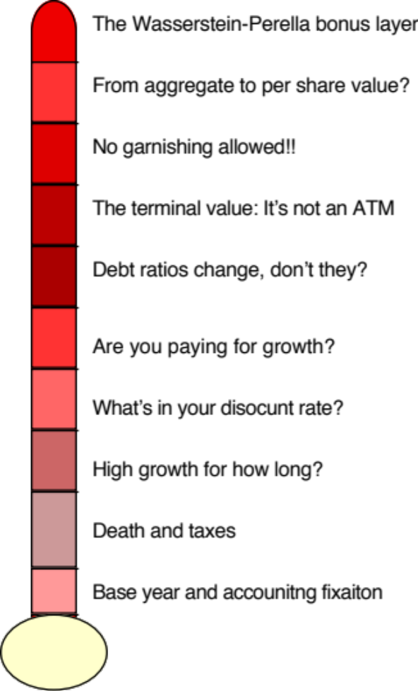
Dante meets Intrinsic Valuation: Nine layers of valuation hell.. And a bonus layer..
Notes:
There are some who suggest that there is a fourth way to approach valuation, which is to value the assets of a firm individually. Asset based valuation, however, requires that you use either discounted cash flow or relative valuation models to value the individual assets. Consequently, we view it as a subset of these approaches.

Slide 162
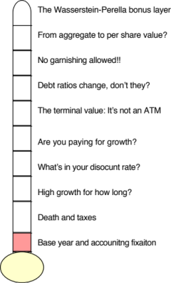
Layer 1: Base Year fixation….
You are valuing Exxon Mobil, using the financial statements of the firm from 2008. The following provides the key numbers:
  Revenues $477 billion
  EBIT (1-t) $ 58 billion
  Net Cap Ex $ 3 billion
  Chg WC $ 1 billion
  FCFF $ 54 billion
The cost of capital for the firm is 8% and you use a very conservative stable growth rate of 2% to value the firm. The market cap for the firm is $373 billion and it has $ 10 billion in debt outstanding.
  a. How under or over valued is the equity in the firm?
  b. Would you buy the stock based on this valuation? Why or why not?

Slide 163
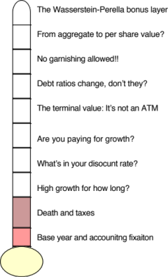
Layer 2: Taxes and Value
Assume that you have been asked to value a company and have been provided with the most recent year’s financial statements:
EBITDA 140
- DA 40
EBIT 100
Interest exp 20
Taxable income 80
Taxes 32
Net Income 48
Assume also that cash flows will be constant and that there is no growth in perpetuity. What is the free cash flow to the firm?
  88 million (Net income + Depreciation)
  108 million (EBIT – taxes + Depreciation)
  100 million (EBIT (1-tax rate)+ Depreciation)
  60 million (EBIT (1- tax rate))
  48 million (Net Income)
  68 million (EBIT – Taxes)
Free Cash flow to firm
EBIT (1- tax rate)
(Cap Ex – Depreciation)
- Change in non-cash WC
=FCFF

Slide 164
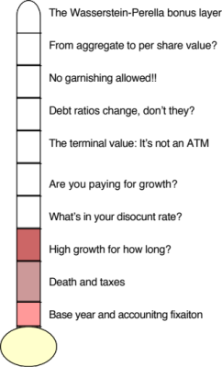

Layer 3: High Growth for how long…
Assume that you are valuing a young, high growth firm with great potential, just after its initial public offering. How long would you set your high growth period?
< 5 years
5 years
10 years
>10 years

Slide 165



Layer 4: The Cost of Capital
The cost of capital for Chippewa Technologies, a US technology firm with 20% of its revenues from Brazil, has been computed using the following inputs:

Slide 166

The Correct Cost of Capital for Chippewa

Slide 167


Layer 5: The price of growth..
You are looking at the projected cash flows provided by the management of the firm, for use in valuation
What questions would you raise about the forecasts?

Slide 168

Layer 6: The “fixed debt ratio” assumption
You have been asked to value Hormel Foods, a firm which currently has the following cost of capital:
  Cost of capital = 7.31% (.9) + 2.36% (.1) = 6.8%
You believe that the target debt ratio for this firm should be 30%. What will the cost of capital be at the target debt ratio?
Which debt ratio (and cost of capital) should you use in valuing this company?

Slide 169

Layer 7: The Terminal Value
The best way to compute terminal value is to
Use a stable growth model and assume cash flows grow at a fixed rate forever
Use a multiple of EBITDA or revenues in the terminal year
Use the estimated liquidation value of the assets
You have been asked to value a business. The business expects to $ 120 million in after-tax earnings (and cash flow) next year and to continue generating these earnings in perpetuity. The firm is all equity funded and the cost of equity is 10%; the riskfree rate is 3% and the ERP is 7%. What is the value of the business?
Assume now that you were told that the firm can grow earnings at 2% a year forever. Estimate the value of the business.

Slide 170

All good things come to an end..And the terminal value is not an ATM…

Slide 171

Layer 8. From firm value to equity value: The Garnishing Effect…
For a firm with consolidated financial statements, you have discounted free cashflows to the firm at the cost of capital to arrive at a firm value of $ 100 million. The firm has
  A cash balance of $ 15 million
  Debt outstanding of $ 20 million
  A 5% holding in another company: the book value of this holding is $ 5 million. (Market value of equity in this company is $ 200 million)
  Minority interests of $ 10 million on the balance sheet
What is the value of equity in this firm?
How would your answer change if you knew that the firm was the target of a lawsuit it is likely to win but where the potential payout could be $ 100 million if it loses?

Slide 172

Layer 9. From equity value to equity value per share
You have valued the equity in a firm at $ 200 million. Estimate the value of equity per share if there are 10 million shares outstanding..
How would your answer change if you were told that there are 2 million employee options outstanding, with a strike price of $ 20 a share and 5 years left to expiration?

Slide 173


Layer 10. The final circle of hell…

