Slide 1
Valuation: Quiz 1
Review
Aswath Damodaran
Updated: March 2013
Notes:
While most valuations that you see in practice are not intrinsic valuations, understanding intrinsic value is a key first step to using either relative or contingent claim valuation.

Slide 2
Key topics covered
Valuation Approaches
  What are the three approaches to valuation?
  From a big picture perspective, what are the key differences between the different valuation approaches?
  What are the broad factors that determine which approach to use?
Basics of DCF valuation
  The essence of intrinsic value
  Equity versus Firm valuation
  DCF consistency
Discount Rates
  Risk free rates: How to estimate and why they vary across currencies
  Equity Risk Premium: Historical vs Implied, Mature & Country Risk Premiums
  Company risk exposure to country risk
  Company risk exposure to macro risk (beta and other relative risk measures)
  Cost of debt and capital
Cash flows
  Updating and normalizing earnings
  Cleaning up earnings for accounting inconsistencies (leases & R&D)
  Tax rates and taxes
  Capital expenditures, working capital and reinvestment
  From cash flow to the firm to cash flow to equity
Notes:
In the eyes of many, discounted cash flow valuation and intrinsic valuation are equivalent but that is not the case. Not all intrinsic valuations are discounted cash flow valuations. There are ways of valuing an asset based on its cash flows, risk and growth without ever using (or even knowing about present value)…. After all, DCF as a technique has been around for less than a century and people have been valuing assets and businesses for much longer. By the same token, there are DCF models that are not intrinsic valuations because much of the value is not a function of an asset’s characteristics (but of others perceptions of the asset’s value).

Slide 3
Valuation Approaches
There are three approaches to valuation: intrinsic valuation, relative valuation and contingent claim valuation.
In intrinsic valuation
  You assume that there is an intrinsic value for every asset and that you can estimate it based on its cash flows, growth and risk
  Markets make mistakes and they correct themselves over time (you need a long time horizon)
In relative valuation,
  You value an asset based on how similar assets are priced
  Markets are right on average, but they make mistakes on individual assets
In contingent claim valuation,
  You assume that the asset derives its value from an underlying asset and that cash flows are contingent on a specified event happening.
  Risk then becomes your ally, rather than your enemy.

Slide 4
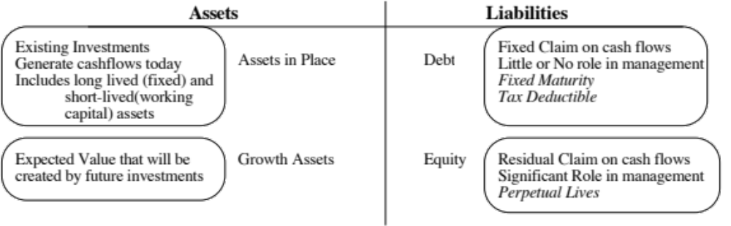
DCF Choices: Equity Valuation versus Firm Valuation
Firm Valuation: Value the entire business
Equity valuation: Value just the equity claim in the business
Notes:
The value of a business and the value of equity can not only be very different numbers but they can move in different directions…
A firm like GE has a value for its business that is vastly in excess of its value for equity, because of the substantial debt that it carries. In contrast, the value of the business and the value of equity for a firm like Apple that has no debt will converge.
You can have valuable businesses, where the equity is worth nothing because the firm has borrowed too much….

Slide 5
Quiz problem: Consistency
You have been asked to review the valuation of Santiago Cement, a small Peruvian cement company, by an M&A analyst, for acquisition by a US cement company. The analyst has estimated a value of 1 billion Peruvian Sol for the equity, based upon the expectation that the firm will generate 50 million Peruvian sol in cash flows (to equity) next year, growing at 5% (in sol) a year forever; mistakenly, he used the US company’s dollar cost of equity in the valuation. To correct the valuation, you have been provided with the following information:
The US T.Bond rate is 3% and Peruvian US$ denominated bond rate is 5%; Peruvian equities are 1.5 times more volatile than the Peruvian $ bond.
The expected inflation rate in Peruvian sol is 6% and the expected inflation rate in US dollars is 2%.
The typical Peruvian company generates 80% of its revenues in Peru, but Santiago Cement generates all of its revenues in Peru.
Estimate the correct value of equity in Santiago Cement.

Slide 6
Solution
First, solve for the US $ cost of equity used by the analyst:
  Equity value = FCFE next year / (Cost of equity -g)
  1000 = 50/ (Cost of equity - .05)
  Cost of equity in US $ terms = 10%
Next, estimate the US $ cost of equity, including country risk
  CRP for Peru = 2% *1.5 = 3%
  Lambda for company = 100/80 = 1.25
  US $ cost of equity = 10% + 1.25 (3%) = 13.75%
Convert into a Peruvian sol cost of equity, using expected inflation rates
  Cost of equity in sol = 1.1375 (1.06/1.02)-1 = 18.21%
Recalculate the value using this cost of equity
  Corrected value = 50/ (.1821- .05) = 378.47 million sol

Slide 7
Inputs to cost of equity: The Macro numbers
Riskfree rate: For an investment to be riskfree, then, it has to have
  No default risk
  No reinvestment risk
Equity Risk Premium: This is the premium that you charge for investing in equities as a class. While it is often estimated looking at history, these historical premiums tend to have high standard errors. An alternative is to estimate an implied premium by looking at how stocks are priced today.
Country Risk Premium: To the extent that you are investing in countries which are not mature, you should charge an extra risk premium, which can be estimated by
  The default spread for the country
  The default spread scaled up for the additional risk of equities

Slide 8
Inputs to cost of equity: The company specific numbers
Company exposure to country risk: There are three approaches that can be used:
  Country of Incorporation: This is a sloppy (but easy) approach, where you use the ERP of the country of incorporation for the company.
  Weighted average total ERP: Take a weighted average of the ERPs of the countries in which you operate, with the weights based upon value (or a proxy like revenues)
  Lambda: If you can estimate what the average company in each country generates in revenues from that country, you can use it to estimate a lambda for the company against each country it operates in.
Company exposure to business risk: This is captured in the beta, which again can be estimated either from
  a regression (backward looking and with noise)
  a bottom up approach, by taking a value-weighted average of the betas of the businesses that the company is in, adjusted for the company’s financial leverage.

Slide 9
Quiz problem 1: Implied ERP
You have been asked to assess the implied risk premium on the Timbuktu Stock Exchange (TSE). The index is trading at 1050, and the dividend yield is 3%. The current long term bond rate is 6.5%, and the expected long term nominal growth rate in the economy is 6%. Estimate the implied risk premium for equities.
  Expected dividends next year = .03*1050= 31.50
  Value of index = 1050 = 31.50/ (r -.06)
  Solving for r (the expected return on equity), we get
  r = Expected return on equity = 31.50/1050 + 0.06 = .09
  Implied ERP = .09 - .065 = .025 or 2.5%

Slide 10
Quiz problem 2: Risk free rates & Equity Risk Premiums
You are reviewing the cost of equity computation that an analyst has made for Luo Tang, a Vietnamese company. The analyst has estimated a cost of equity of 18% for the company in Vietnamese Dong (VND). In making this estimate, the analyst used the following information:
  The ten-year Vietnamese government bond rate, in VND, is 9%, and was used by the analyst as the riskfree rate. However Vietnam has a local currency rating of Baa3 and the default spread for Baa3 rated bonds is 3%.
  The analyst used a total equity risk premium of 7.5% for Vietnam (obtained by adding 3% to the US risk premium of 4.5%) and a beta of 1.2 for the company.
Here is the rest of the information
  The volatility in the Vietnamese equity index is twice the volatility in the Vietnamese government bond.
  Only 30% of Luo Tang’s revenues come from Vietnam and that the rest come from mature markets, while the average Vietnamese company gets 90% of its revenues from Vietnam.

Slide 11
Estimating the cost of equity
To get to a risk free rate, you should net out the default spread for Vietnam (it is a local currency rating) from the Vietnamese government bond rate
  Riskfree rate = 9% -3% = 6%
To get the country risk premium for Vietnam, I will use the same default spread and multiply by the relative volatility of equity to debt for Vietnam.
  Country risk premium = 3% (2) = 6%
To get the company exposure to this country risk, you divide its proportion of revenues in Vietnam by the proportion of revenues that the average Vietnamese company gets:
  Lambda = 0.30/0.90 = 0.33
Bring it all together in the cost of equity
  Cost of equity = 6% + 1.20 (4.5%) + 0.333 (6%) = 13.40%
If you had not been given the proportion that the average Vietnamese firm makes in Vietnam
  Cost of equity = 6% + 1.20 (4.5%*.70 + 10.5% *.30) = 13.56%

Slide 12
Debt and the Cost of Debt
The debt in a firm should be defined broadly to include both conventional debt and lease commitments. If you have operating lease commitments, you have to convert them into debt:
  The present value of the future lease commitments, discounted back at the pre-tax cost of debt is the debt value of leases
  Operating income has to be adjusted
    Adjusted Operating Income = Stated Operating income + Current year’s lease expense – Depreciation on leased asset
The cost of debt is the rate at which you can borrow money, long term & today.
  If you have traded bonds that represent the company’s default risk, you can use the yield to maturity on the bonds.
  If you have an actual rating, you can use the rating to estimate a default spread to add to the risk free rate
  If you do not have a rating, you can use an interest coverage ratio to estimate a synthetic rating, a default spread and a cost of debt.
Notes:
The cost of debt is not the rate at which you borrowed money at historically. That is why you cannot use the book cost of debt in the cost of capital calculation.
While many companies have bonds outstanding, corporate bonds often have special features attached to them and are not liquid, making it difficult to use the yield to maturity as the cost of debt.
While ratings are often useful tools for coming up with the cost of debt, there can be problems:
A firm can have multiple ratings. You need a rating across all of a firm’s debt, not just its safest…
A firm’s bonds can be structured in such a way that they can be safer than the rest of the firm’s debt - they can be more senior or secured than the other debt of the firm.

Slide 13
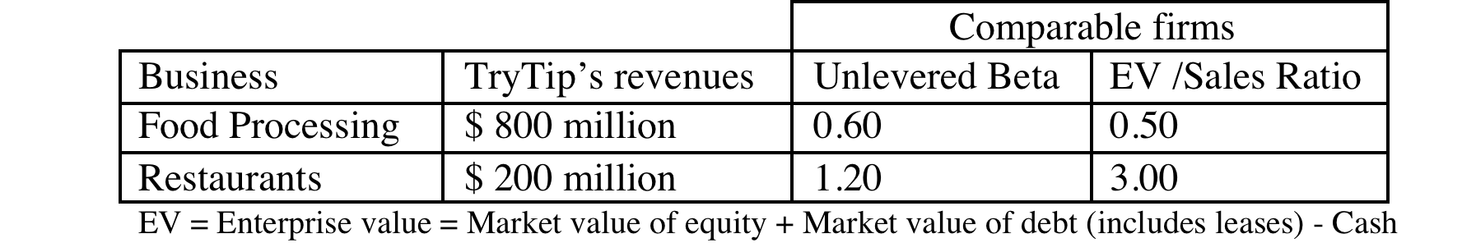
Quiz problem 3: Bottom up Betas and Debt
TryTips Inc., a food processing company, has come to you for some help in estimating a beta for their equity. The firm has been publicly traded for two years and the regression beta is 0.45. The firm is in two businesses, and you have collected the following information on them:
  TryTips has 100 million shares outstanding, trading at $6 a share, $ 100 million in debt and lease commitments of $ 50 million each year for the next 8 years.
  The riskfree rate is 3.5%, the equity risk premium is 4.5% and the firm has a rating of BBB (with a default spread of 1.5%). The marginal tax rate for all firms is 40%.
Estimate the cost of equity and capital for TryTips.

Slide 14
Solution
Estimate values of the two businesses
  Value of food processing = 800*.5 = 400
  Value of restaurant = 200*3 = 600
  Unlevered beta = 0.60 (400/1000) + 1.20 (600/1000) = 0.96
Next, estimate the value of debt
  Pre-tax cost of debt = 3.5% +1.5% =5%
  PV of leases = PV of $50 million for 8 years @5% = $323 m
  Total debt = $100 + $323 = $423 m
Finally, estimate the levered beta
  D/E ratio = 423/ 600 = 70.53%
  Levered beta= 0.96 (1+ (1-.4) (.7053)) = 1.366234212
  Cost of equity = 3.5% + 1.366 (4.5%) = 9.65%
  Cost of capital = (600/1023) (9.65%) + (423/1023) (5%(1-.4)) = 6.90%

Slide 15
Earnings checklist
Update the cash flows: Use trailing 12 month numbers instead of the most recent annual report.
Normalize the numbers: If there are unusual or truly extraordinary items, remove them from the analysis.
Correct for accounting inconsistencies:
  Capitalize any financial expenses (such as leases) that are being treated as operating expenses.
  Move R&D and like expenses from the operating to the capital expense column
Choose a tax rate: You can use the effective tax rate for cash flows for the near term but you should move towards a marginal tax rate.

Slide 16
R&D Expenses: Operating or Capital Expenses
Accounting standards require us to consider R&D as an operating expense even though it is designed to generate future growth. It is more logical to treat it as capital expenditures.
To capitalize R&D,
  Specify an amortizable life for R&D (2 - 10 years)
  Collect past R&D expenses for as long as the amortizable life
  Sum up the unamortized R&D over the period. (Thus, if the amortizable life is 5 years, the research asset can be obtained by adding up 1/5th of the R&D expense from five years ago, 2/5th of the R&D expense from four years ago...:
Notes:
The argument used by accountants - that R&D yields uncertain benefits - is specious. You could make the same argument about other investments - investing in a factory in an emerging market, deciding to build a concept car - and you are forced to treat these as capital expenditures.
To capitalize R&D, you need to specify
On average, how long it takes between the time you do research and a commercial product emerges from the research. (This is the amortizable life)
R&D expenses from the past (for a period equivalent to the amortizable life). If your firm has not been in existence for that long, you would go back for as many years as you can.
Depreciation schedules - stick with the simplest which is straight line depreciation.

Slide 17
Cash flow checklist
Net Capital Expenditures: Define these broadly to include not only the stated cap ex in the statement of cash flows but R&D expenses and acquisition costs.
Working capital: Count only non-cash working capital investments. You may have to normalize this number, if it is volatile.

Slide 18
Cash flow to equity
In general, here is how you compute FCFE
  Net Income
  - (Capital Expenditures - Depreciation)
  - Changes in non-cash Working Capital
  - (Principal Repayments - New Debt Issues)
  = Free Cash flow to Equity
If leverage is stable, you can use this short cut:
  Net Income
  - (1- ) (Capital Expenditures - Depreciation)
  - (1- ) Working Capital Needs
  = Free Cash flow to Equity
   = Debt/Capital Ratio
Notes:
Note the differences between this and Free cashflow to firm:
Start with net income (equity earnings) rather than operating earnings. Interest expenses are subtracted out from earnings and the tax benefits are reflected.
Net out net debt payments. If a firm raises more new debt than it pays off, this can be a positive number which, if large enough can make the free cashflow to equity higher than the free cashflow to the firm.

Slide 19
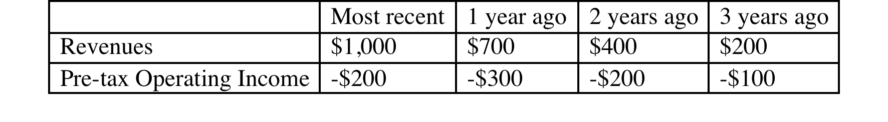
Quiz problem: R&D adjustment
You have been asked to review the numbers for TalkTones, a social media company that is planning to go public. The company reported the following revenues and operating income (in millions):
The cost of acquiring new customers accounted for half of all operating expenses in each of the period and the company offers strong evidence that acquired customers stay on as customers for three years. The company reported book equity of $100 million at the end of the most recent year and had no debt. If you capitalize customer acquisition costs and the corporate tax rate is 40%, estimate
The corrected after-tax operating income for the company for the most recent year.
The corrected after-tax return on capital for the most recent year.

Slide 20
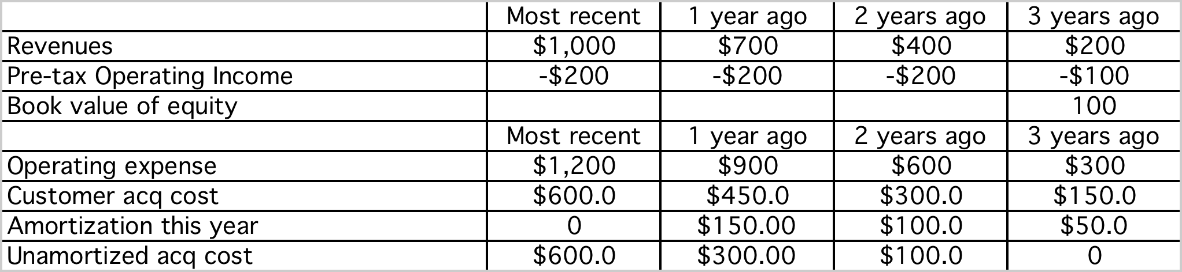
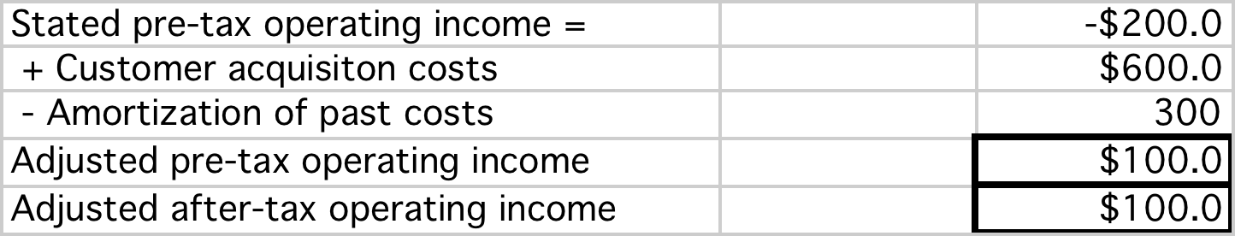
Solution
Corrected Book value of equity (capital) = 100 + 1000 = 1100
Corrected after-tax return on capital = 100/1100 = 9.09%

