Slide 1
Quiz 2: Review session
Aswath Damodaran

Slide 2
This quiz will cover…
The last two ingredients into DCF valuation
  Expected Growth: Historical, analyst & particularly fundamental growth (to EPS, net income, operating income and when margins are changing)
  Terminal value
The loose ends of DCF valuation
  Cash and cross holdings
  Assets that have not been counted yet
  Debt and other potential liabilities
  Employee options and restricted stock
The mechanics of DCF valuation
  Estimating FCFF and FCFE
  Dealing with changing discount rates
  Checking inputs for consistency

Slide 3
Fundamental Growth
Earnings Measure | Reinvestment Measure | Return Measure
Earnings per share | Retention Ratio = % of net income retained by the company = 1 – Payout ratio | Return on Equity = Net Income/ Book Value of Equity
Net Income from non-cash assets | Equity reinvestment Rate = (Net Cap Ex + Change in non-cash WC – Change in Debt)/ (Net Income) | Non-cash ROE = Net Income from non-cash assets/ (Book value of equity – Cash)
Operating Income | Reinvestment Rate = (Net Cap Ex + Change in non-cash WC)/ After-tax Operating Income | Return on Capital or ROIC = After-tax Operating Income/ (Book value of equity + Book value of debt – Cash)

Slide 4
Terminal Value: The Cardinal Rules
Obey the cap: Don’t let the growth rate exceed the growth rate in the economy (and use the risk free rate as your proxy)
Adjust the cost of capital to reflect “stability): Move betas towards one, debt ratios towards stable firm levels)
Think about the return on capital in perpetuity and where it will be, relative to the cost of capital.
And use the return on capital to back into a reinvestment rate:
Reinvestment rate = g/ ROIC

Slide 5
Example: Terminal value calculation
Problem 1, part a: Fall 2011
Limroth Enterprises is a family-run, publicly traded company that expects to generate $ 60 million in after-tax operating income next year on capital invested of $ 1 billion. The firm has a cost of capital of 10% and expects to maintain its current return on capital, while growing 2% a year in perpetuity. What is the value of the operating assets?

Slide 6
Solution
Expected EBIT (1-t) = 60
Capital invested = 1000
Return on capital = 60/1000 = 6%
Cost of capital = 10%
Expected growth rate = 2%
Expected Reinvestment rate = 2%/6% =33.33%
Value of operating assets = 60 (1-.33)/ (.10-.02) = = 500

Slide 7
Loose End 1: Cash
Cash, by itself, if usually a neutral asset, earning a low but fair rate of return.
However, the market may discount the cash holdings of a company, if it feels that the managers will waste the cash (by investing at less than the cost of capital).
Conversely, the market may attach a premium to the cash in some companies, if it feels that cash is a strategic weapon that can help the company make it through hard times or buy distressed company assets.

Slide 8
Example: Part b of problem 1, Fall 2011
Assume that Limroth Enterprises has $ 100 million in cash and marketable securities and that you believe that there is a 60% chance that management will reinvest this cash to generate returns to similar to what they are earning on their existing operating assets (in investments with a similar risk profile); there is a 40% probability that the cash will remain invested in commercial paper and T.Bills, earning 1%. How much value would you attach to the cash?

Slide 9
Solution
Assuming that the cash does not get wasted
Probability of happening = | 40%
Value of cash = $100 = | 100
Assuming that cash gets wasted on projects making 6% (cost of capital of 10%
Probability of happening = | 60%
Value of cash = 100 *.06/.10 = | 60
Expected value of cash = | 76

Slide 10
Loose End 2: Cross Holdings
Cross holdings can broadly be classified into “minority” holdings in other companies and “majority” holdings.
With minority holdings, the operating income will generally not include the income from the holdings and you should be adding the value of these holdings to a conventional DCF
With majority holdings, the analysis will depend upon whether you are using the consolidated financials or the parent only financials.
  With consolidated financials, the financials will reflect 100% of the subsidiary’s revenues & operating income. If you do your DCF valuation with these numbers, you have to subtract out the value of the portion of the subsidiary that does not belong to you.
  With parent financials, you have not valued any of the subsidiary. You have to add the portion of the subsidiary that belongs to you to your DCF value.

Slide 11
Example: Quiz from Spring 2007
You have been asked to analyze Smithtown Works, a company with a 60% holding in Kroger Appliances (which is fully consolidated into Smithtown Works) and 10% of Haverford Steel (which is reported as a minority passive investment). All three companies are in stable growth (2% forever), have a return on capital of 10% and share a cost of capital of 8%.
  Smithtown Works has 500 million shares outstanding, trading at $30 a share, and the consolidated balance sheet reports debt outstanding of $ 6 billion, a cash balance of $ 2 billion and $ 1 billion in minority interests. The consolidated after-tax operating income reported by the company the most recent year was $ 1.5 billion.
  Kroger Appliances is not publicly traded and there little information on its after-tax operating income, debt or cash balance, but appliance companies typically trade at 3 times book value.
  Haverford Steel reported after-tax operating income of $ 800 million in the most recent year.
Evaluate whether the stock in Smithtown Works is fairly priced.

Slide 12
The solution
Reinvestment rate (for all 3 firms) = 2% / 10% = | 20.00%
Value of Smithtown + Kroger = 1500 (1-.2)(1.02)/(.08-.02) = | $20,400.00
Value of Haverford Steel = 800 (1-.2) (1.02)/(.08-.02) = | $10,880.00
Value of Smithtown + Kroger | $20,400.00
+ 10% of Haveford steel (Estimated value) | $1,088.00
+ Cash (consolidated) | 2000
- Debt (consolidated) | 6000
- Minority Interests (Estimated market value) | 3000
Value of Equity in Smithtown | $14,488.00
Market Value of Equity in Smithtown | 15000
Stock is overvalued by $512 million

Slide 13
Loose End 3: Other Assets
Basic rule: If an asset is being used to generate the cash flows that you are discounting, you have already valued the asset. You cannot add the “estimated” or “market” value of that asset to your DCF valuation.
If you have an unutilized or vacant asset that has value but is not contributing to cash flows, you can value it and add it to your DCF valuation.

Slide 14
Loose End 4: Employee Options
 | Information required/provided | Approach | Bottom line
Fully Diluted Approach | Number of options outstanding | DCF value of equity/ (Number of shares + Number of options) | You will under value shares, because you are ignoring option exercise proceeds.
Treasury Stock Approach | Number of options outstanding, Exercise price | (DCF value of equity+ Exercise price*Options)/ (Number of shares + Number of options) | You will over value shares, since you are ignoring time premium on options.
Option value approach | Options characteristics needed to estimate value | (DCF value of equity – Value of options)/ Number of shares | Value per share reflects reality

Slide 15
Problem 2, part c: Spring 2008 Quiz
Now assume that the firm has 10 million shares outstanding today, and has granted 2 million options to its top management; the exercise price of the options is $ 2/share. Furthermore, analysts are predicting that they will have to issue 8 million additional shares over the next 2 years (to cover their reinvestment needs). Using the treasury stock approach, estimate the value of equity per share today.

Slide 16
Solution
 | 1 | 2 | 3
FCFE | -$20.00 | -$10.00 | $5.00
Terminal value |  |  | $86.67
Compounded cost of equity | 1.2 | 1.392 | 1.55904
Present value | -$16.67 | -$7.18 | $58.80
Value of equity today = | $34.95
Exercise proceeds = | $4.00
Number of shares = 10 + 2 = | 12.00
Value per share = | $3.25

Slide 17
DCF Mechanics : Cash flows
Cash flows: When estimating cash flows, first check on whether you are estimating cash flows to the firm or to equity.
The cash flows should always be after
  Taxes
  Reinvestment needs, with information given in
    Ingredient parts as cap ex, depreciation and working capital)
    Return on capital and a growth rate (g/ ROC)
    Sales to Capital ratio

Slide 18
DCF Mechanics 2: Discounting
Match up the risk of the cash flow to the discount rate. Thus, if you are given a guaranteed cash flow to a risky firm, you should use the risk free rate as your discount rate.
Match the discount rate up to the cash flow
  In the same currency
  If CF to equity (capital), use cost of equity (capital)
When your cost of capital changes over time, remember that you should discount at the cumulated cost of equity/capital, not that specific year’s cost of equity/capital.

Slide 19
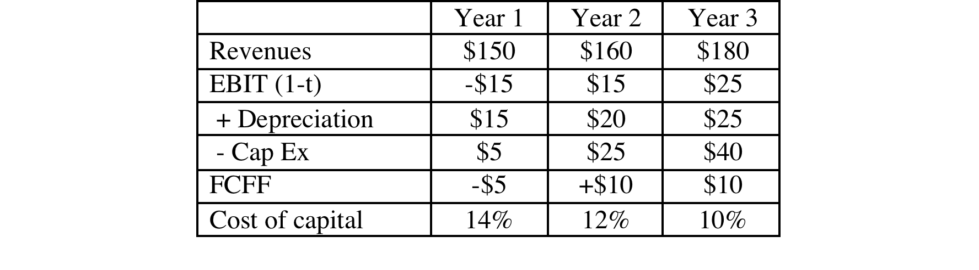
Example: Problem 1a, Fall 2010
Maple Telecom is in significant financial trouble. It reported operating losses of $ 20 million in the most recent year on revenues of $ 100 million. The total book value of capital invested in the firm today is $ 190 million. Assuming that the firm will revert back to health in 3 years, you have forecast revenues, after-tax operating income and reinvestment, as well as the cost of capital:

Slide 20
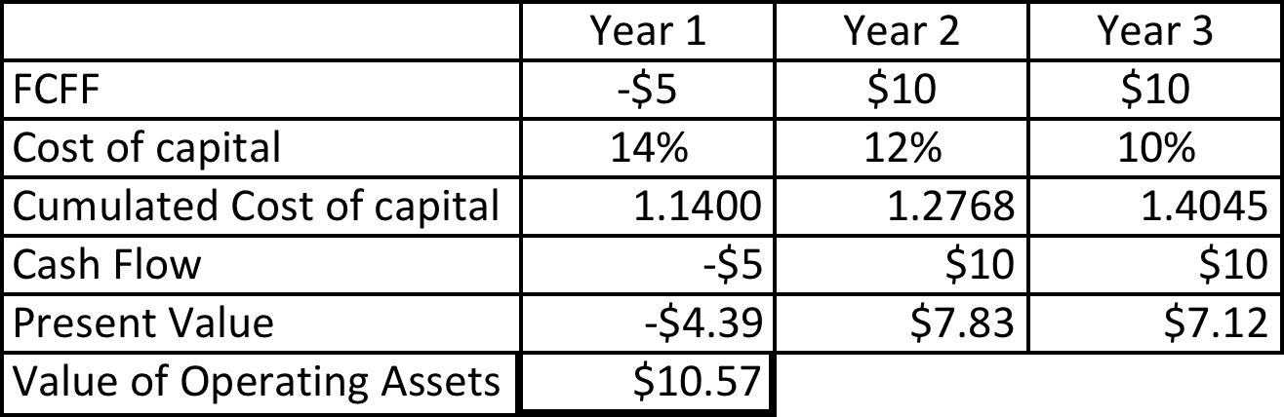
Solution: Value of operating assets
(1.14* 1.12) = 1.2768

