Slide 1
Quiz 3: Review session
Aswath Damodaran

Slide 2
This quiz will cover…
Relative Valuation
  Definitional consistency checks
  Distributional characteristics
  Drivers of multiples
  Application tweaks
Private company valuation
  Discount rate adjustments
  Cash flow adjustments
  Post-valuation adjustments

Slide 3

Multiples: The variations

Slide 4
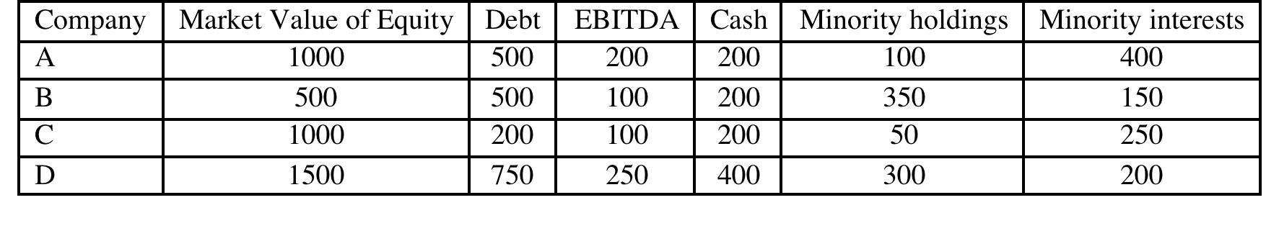
Example: Spring 2009 (Problem 1)
You have been asked to assess the relative valuations of four companies, with significant cross holdings. You have been provided with the following information on the companies:
The accounting numbers (including debt) come from the firm’s consolidated financial statements, and you can assume that both minority holdings and minority interests are in market value terms. Based on the EV/EBITDA ratio, which of these firms is the cheapest on a consolidated basis, assuming that they are equivalent on risk and growth characteristics?

Slide 5
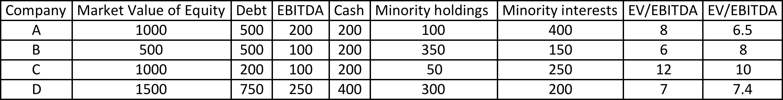
Solution
Since EBITDA does not reflect income from minority holdings, subtract minority holdings.
Since EBITDA reflects 100% of consolidated subsidiary’s income, add minority interests.
Company B is the cheapest company.

Slide 6
Distributional properties
Asymmetric distributions: The distribution for a multiple across companies will not be symmetric, since multiples cannot be negative.
Summary statistics can be misleading: Since all the outliers lie on one side of the distribution, the average will be skewed well above the average.
Absolute rules of thumb break down: The shifts in the values of multiples across time will mean that what is a low value in one period may not be a low one in the next period.
Multiples have no currency attached to them: You can compare values for multiples across markets, though you may have to control for differences across firms.

Slide 7
Example: Spring 2011, Problem 2
Tele Media Inc. is a telecom company that reported EBITDA of -$15 million in the last fiscal year and is expected to have a cost of capital of 12% for the next 5 years. You estimate that the firm will be a healthy telecom firm and generate $25 million in EBITDA in year 5.
  If healthy telecoms trade at 6 times current EBITDA and have a cost of capital of 9%, estimate the enterprise value for Tele Media today, assuming that the firm makes it to health.
  Now assume that Tele Media has issued a 5-year zero coupon bond, currently trading at 60% of face value. If the riskfree rate is 3%, estimate the probability that the firm will survive until year 5 and the survival-adjusted enterprise value for Tele Media today.

Slide 8
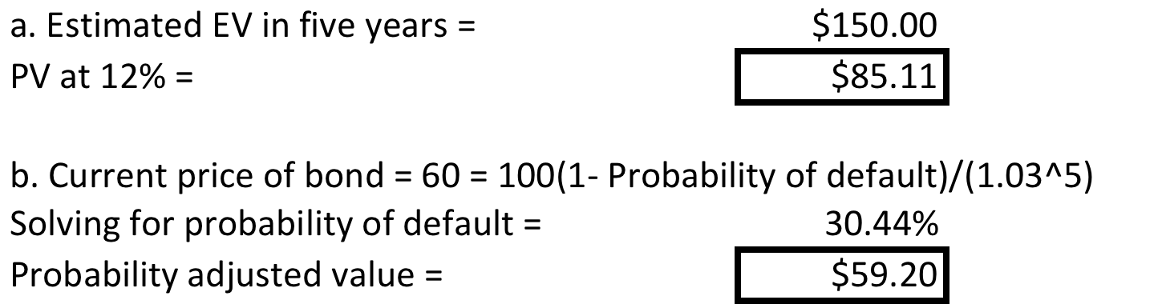
Solution

Slide 9
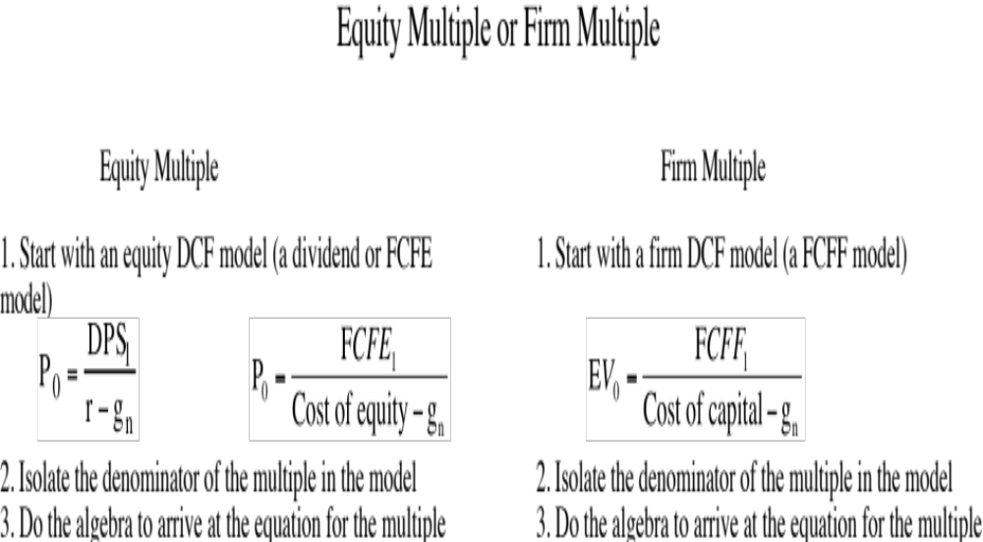
Analysis: Determinants of multiples

Slide 10
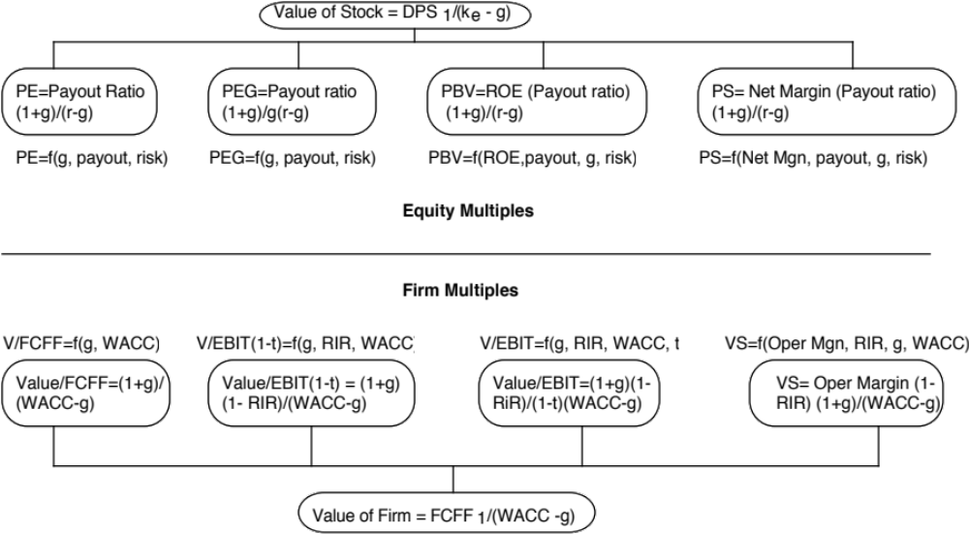
The Determinants of Multiples…

Slide 11
Example: Spring 2011, Problem 1
Dylan Inc. is a all-equity funded, publicly traded firm that trades at a price to book ratio of 1.40. The firm is in stable growth, growing 3% a year and has a cost of equity of 8%.
Estimate the return on equity for Dylan Inc., assuming that the firm is correctly priced at the moment.
The firm is looking to restructure itself, by selling off its worst performing division for half of book value and buying back stock with the proceeds; the division accounted for 25% of the book value of the company but only 10% of the net income. If the cost of equity and growth rate remain unchanged, estimate the price to book ratio after the transaction.

Slide 12
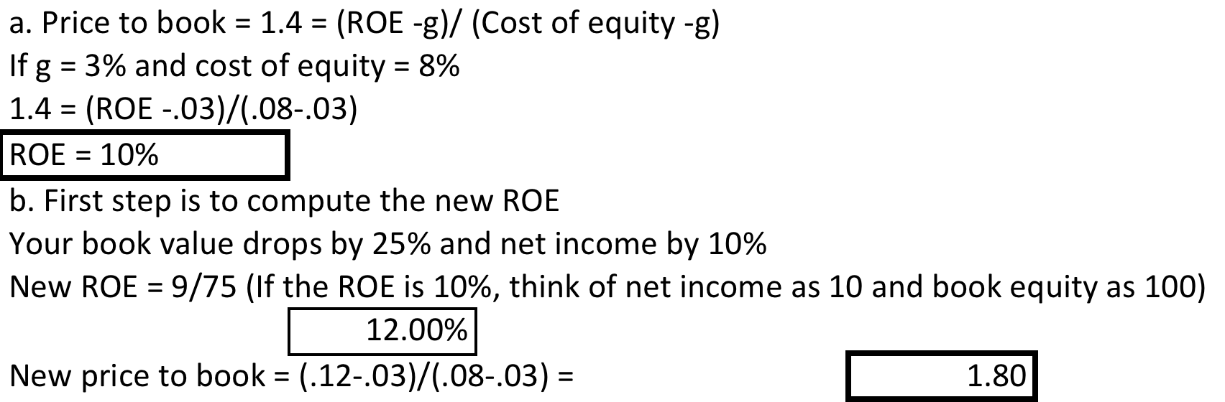
Solution

Slide 13
Analysis: Controlling for differences
Direct comparisons: If the comparable firms are “just like” your firm, you can compare multiples directly across the firms and conclude that your firm is expensive (cheap) if it trades at a multiple higher (lower) than the other firms.
Story telling: If there is a key dimension on which the firms vary, you can tell a story based upon your understanding of how value varies on that dimension.
    An example: This company trades at 12 times earnings, whereas the rest of the sector trades at 10 times earnings, but I think it is cheap because it has a much higher growth rate than the rest of the sector.
Modified multiple: You can modify the multiple to incorporate the dimension on which there are differences across firms.
Statistical techniques: If your firms vary on more than one dimension, you can try using multiple regressions (or variants thereof) to arrive at a “controlled” estimate for your firm.
Notes:
If you can find a company or two just like your company, you can make a direct comparison across the companies and decide which one to buy.
However, if there are differences between your company and the comparable firms, you will have to explain away the difference in fundamentals.
If the difference is on one key dimension (say the growth rate), you may be able to bring it into your computation of the multiple.
If the sample is large and there are differences on many dimensions, you should think about using statistics as a tool to control for differences.

Slide 14
Example: Spring 2012, Problem 1
Serengeti Hotels is a multinational hotel company that generated $60 million in after-tax operating income (after taxes of 40%) and reported depreciation of $ 80 million in the most recent year. The firm also reported $ 300 million in book value of equity, $ 300 million in book value of debt and a cash balance of $ 100 million. Serengeti has 100 million shares trading at $ 7/share and its book value of debt is equal to its market value.
  Estimate the EV/EBITDA multiple for Serengeti Hotels. (1 point)
  You have run a regression of EV/EBITDA for multinational hotels and arrived at the following output:
  EV/EBITDA = 1.60 – 1.50 (Tax rate) + 36.00 (Return on invested capital) – 0.50 (Debt to Equity ratio)
    (All independent variables are entered as decimals. Thus, a 40% tax rate is entered as 0.40)
  If Serengeti is fairly priced, relative to the sector, estimate the debt to equity ratio for the firm.

Slide 15
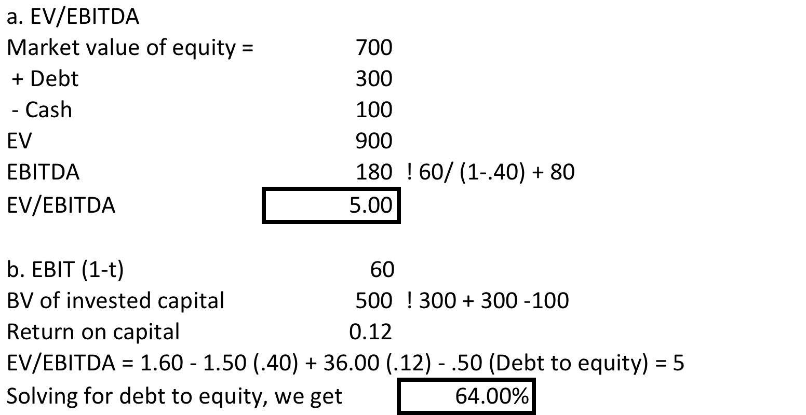
Solution

Slide 16
Private Company Valuation: Discount Rate Adjustments
Cost of equity: The biggest issue that you will face in valuing private businesses is that the cost of equity will depend upon how diversified the potential buyer of the business is, with less diversified businesses seeing more risk and demanding higher costs of equity.
Debt ratio: A secondary issue is that private businesses have no market values and using a market D/E ratio can be problematic.

Slide 17
The Beta Continuum & Debt Solution
Diversified buyer
Public company or IPO
Partially diversified investor: VC or PE firm
Buyer invested only on this business
Market Beta
Usually obtained from publicly traded companies in business
Total Beta = Market Beta/ Correlation of VC portfolio versus market
Total Beta = Market Beta/ Correlation of typical firm in the sector versus market
Once you have an unlevered beta or total beta, you can either use the industry average debt ratio, a target debt ratio or an iterated debt ratio (based on your values).
Notes:
Buyer invested only on this business

Slide 18
Private firms: The Cash flow checks
Is the owner involved in the business but not paying himself/herself a salary?
Are there any “ghost” or “personal” expenses intermingled with business expenses?
Do the reporting books match the tax books?
Is there a key person discount?
Is there a possibility of a tax rate shift after the transaction?

Slide 19
Example: Spring 2012, Problem 3
You are CEO of a publicly traded company, Protix Media, and the company is currently all equity-funded and has a beta of 1.20; the correlation of the stock with the market is 0.40. Protix Media is expected to generate net income of $60 million next year on book equity of $ 1 billion; it is a stable growth company that expects to grow 3% a year in perpetuity. If you invest the rest of your personal wealth in it, you believe that you could take the company back to being a private business and could double its net income (without changing the book equity invested or the expected growth rate). Assuming that you plan to keep the business as a privately owned business in the aftermath, evaluate whether this transaction makes sense. (The risk free rate is 3% and the equity risk premium is 6%)

Slide 20
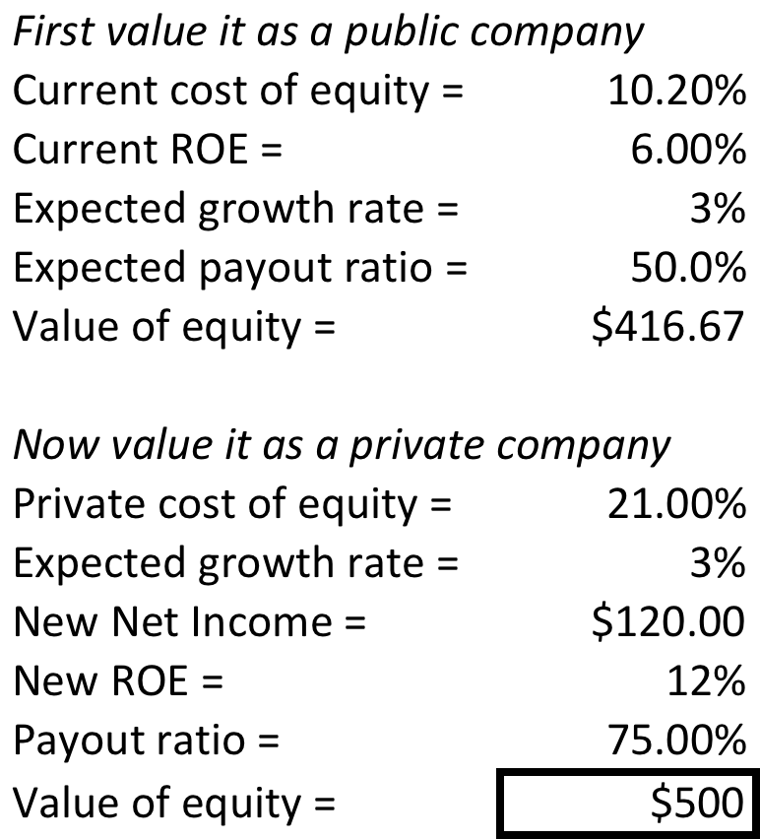
Solution

