Slide 1
Valuation
June 2016
Aswath Damodaran
Notes:
It always helps to lay a philosophical foundation for what is to come. This presentation, which is usually my first session, attempts to do this. I use it not only as an opportunity to provide an overview of valuation approaches but also to link each to specific views about how markets work and what inefficiencies have to come into play for each approach to yield excess returns.

Slide 2
The Agenda
Valuation Basics: Understanding the drivers of value and why not all DCF valuations are made equal.
Stories and Numbers: How to connect stories about companies to their values.
Dealing with Uncertainty: Healthy and unhealthy ways of dealing with uncertainty.
Value versus Pricing: A contrast of intrinsic and relative valuation and why they may give you different numbers.
Acquisition Valuation: Lessons to remember when valuing acquisitions.

Slide 3
Valuation basics: D + CF≠ DCF

Slide 4
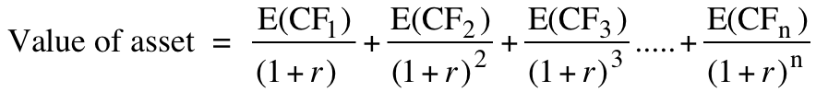
The basics of DCF
The value of a risky asset can be estimated by discounting the expected cash flows on the asset over its life at a risk-adjusted discount rate:
The IT Proposition: If “it” does not affect the cash flows or alter risk (thus changing discount rates), “it” cannot affect value.
The DUH Proposition: For an asset to have value, the expected cash flows have to be positive some time over the life of the asset.
The DON’T FREAK OUT Proposition: Assets that generate cash flows early in their life will be worth more than assets that generate cash flows later; the latter may however have greater growth and higher cash flows to compensate.

Slide 5
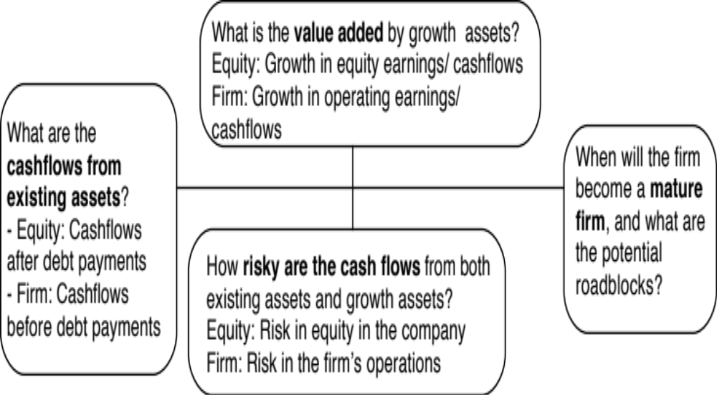
The drivers of value..
Notes:
The four pillars of value:
Cashflows
Potential for high growth
Length of the high growth period (before the firm starts growing at the same rate as the economy)
Discount rate
Note the variations and the need for consistency:
With equity -> Cashflows to equity - > Growth rate in net income -> Discount at the cost of equity
With firm -> Cashflows to firm - > Growth rate in operating income -> Discount at the cost of capital

Slide 6
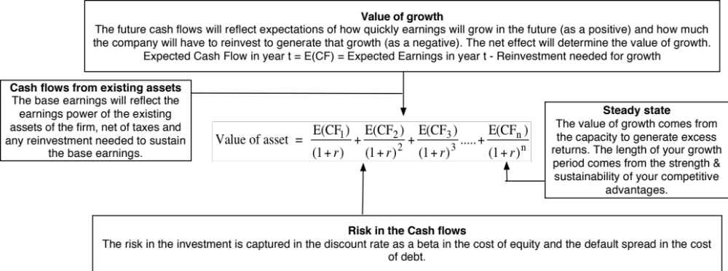
DCF as a tool for intrinsic valuation
Notes:
Cash is king. A firm with negative cash flows today can be a very valuable firm but only if there is reason to believe that cash flows in the future will be large enough to compensate for the negative cash flows today. The riskier a firm and the longer you have to wait for the cash flows, the greater the cashflows eventually have to be….

Slide 7
1. Cash Flows
To get to cash flow | Here is why
Operating Earnings | This is the earnings before interest & taxes you generate from your existing assets. Operating Earnings = Revenues * Operating Margin Measures the operating efficiency of your assets & can be grown either by growing revenues and/or improving margins.
(minus) Taxes | These are the taxes you would pay on your operating income and are a function of the tax code under which you operate & your fidelity to that code.
(minus) Reinvestment | Reinvestment is designed to generate future growth and can be in long term and short term assets. Higher growth usually requires more reinvestment, and the efficiency of growth is a function of how much growth you can get for your reinvestment.
Free Cash Flow to the Firm | This is a pre-debt cash flow that will be shared by lenders (as interest & principal payments) and by equity investors (as dividends & buybacks).

Slide 8
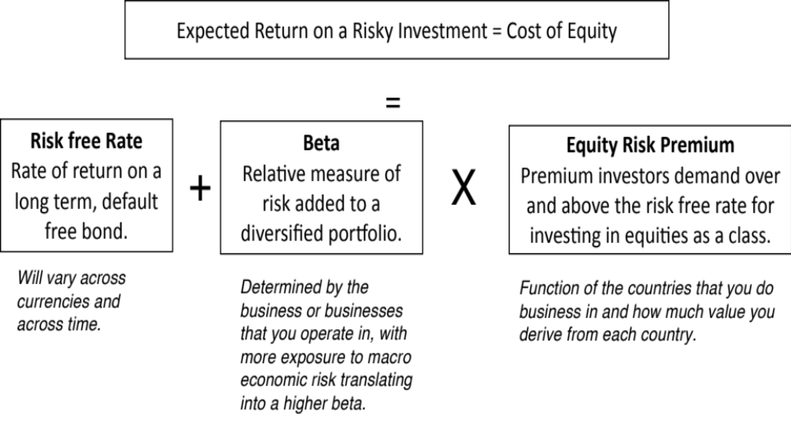
2. Discount rates

Slide 9
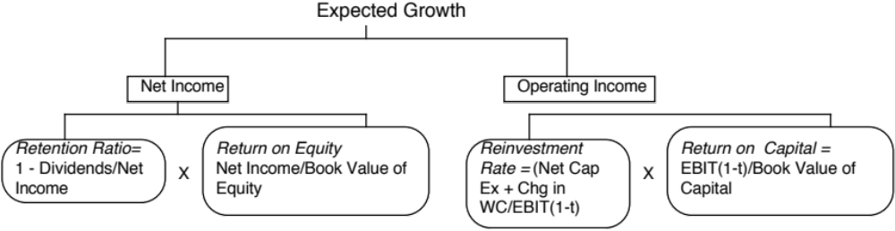
3. Expected Growth
Quality growth is rare and requires that a firm be able to reinvest a lot and reinvest well (earnings more than your cost of capital) at the same time.
The larger you get, the more difficult it becomes to maintain quality growth.
You can grow while destroying value at the same time.

Slide 10
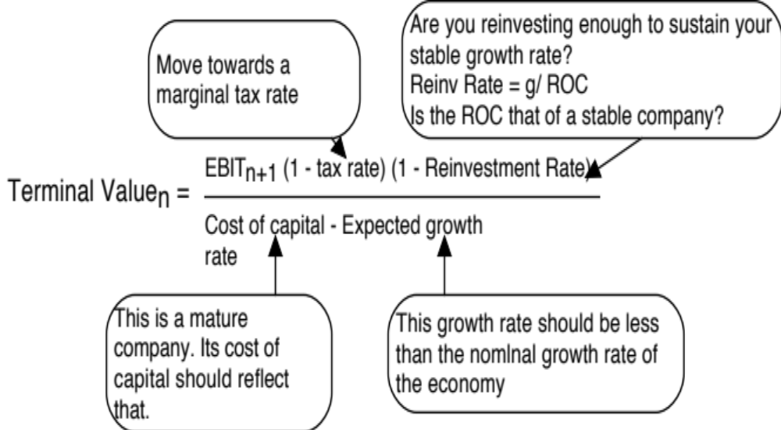
4. The Terminal Value

Slide 11
And consider the trade offs..

Slide 12
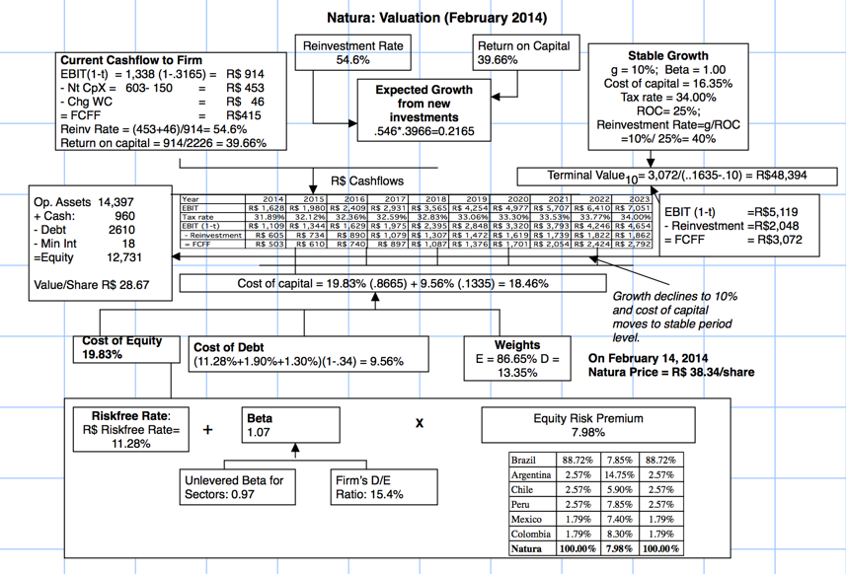
The End Game: Maturity & Closure
Cash flows from Existing Assets
Value of growth
Risk

Slide 13
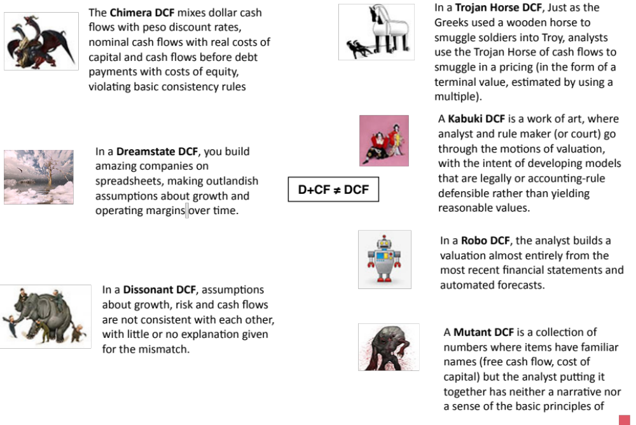

Slide 14
Narrative and Numbers
Connecting stories to numbers

Slide 15
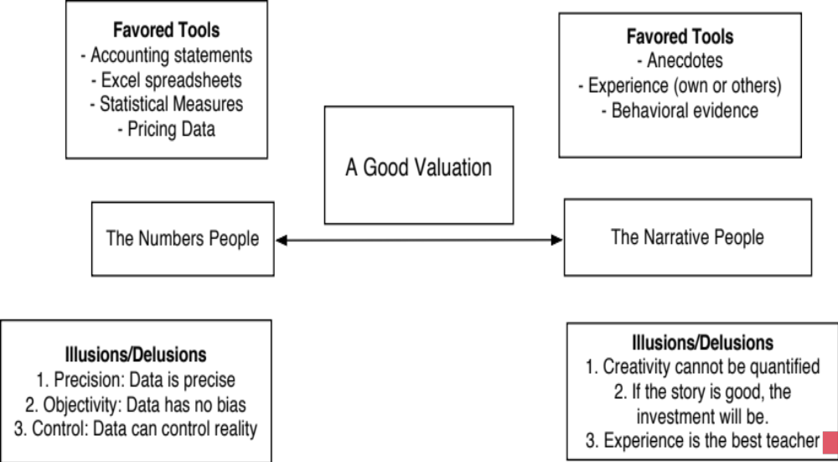
Don’t mistake modeling for valuation

Slide 16
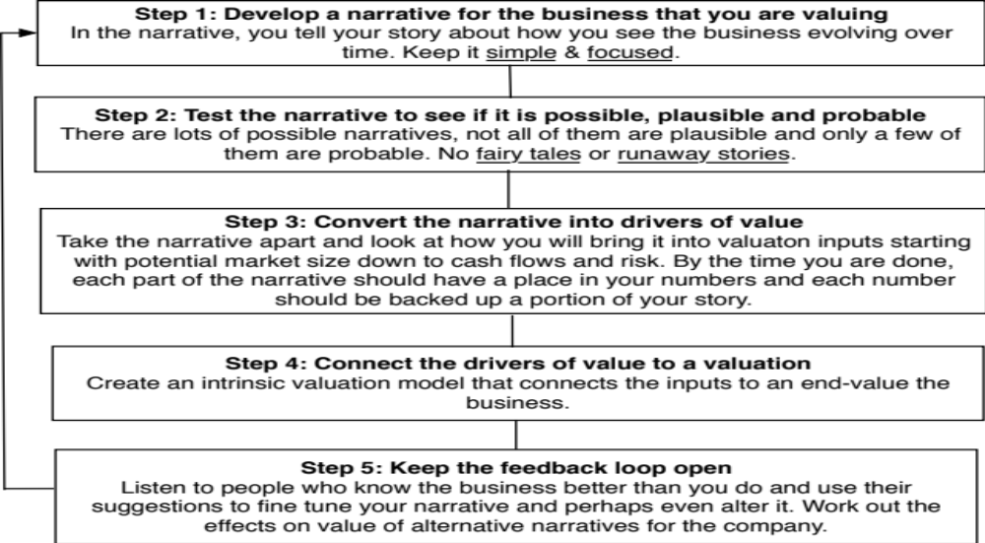
From story to numbers and beyond..

Slide 17
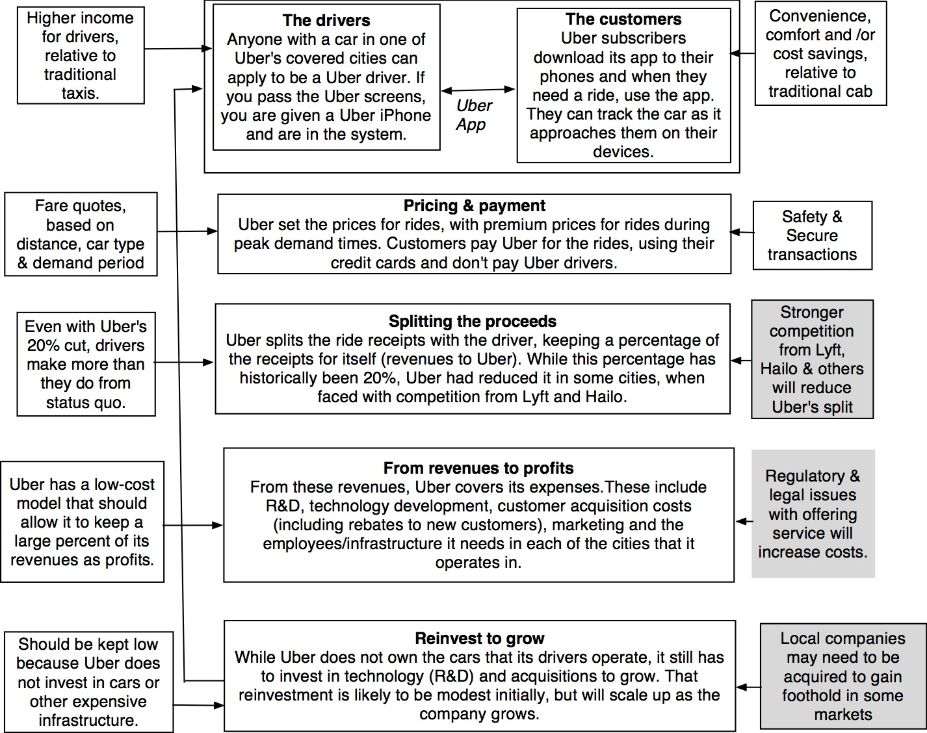
Understanding Uber

Slide 18
Step 1: Survey the landscape
Every valuation starts with a narrative, a story that you see unfolding for your company in the future.
In developing this narrative, you will be making assessments of
  Your company (its products, its management and its history.
  The market or markets that you see it growing in.
  The competition it faces and will face.
  The macro environment in which it operates.

Slide 20
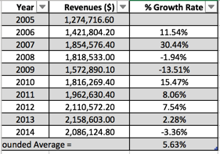
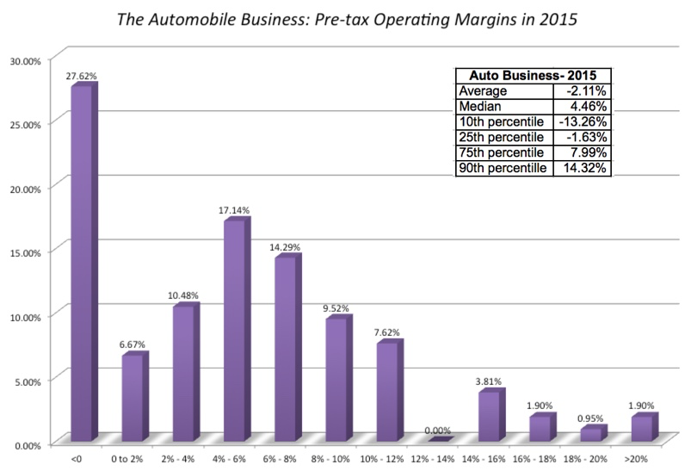
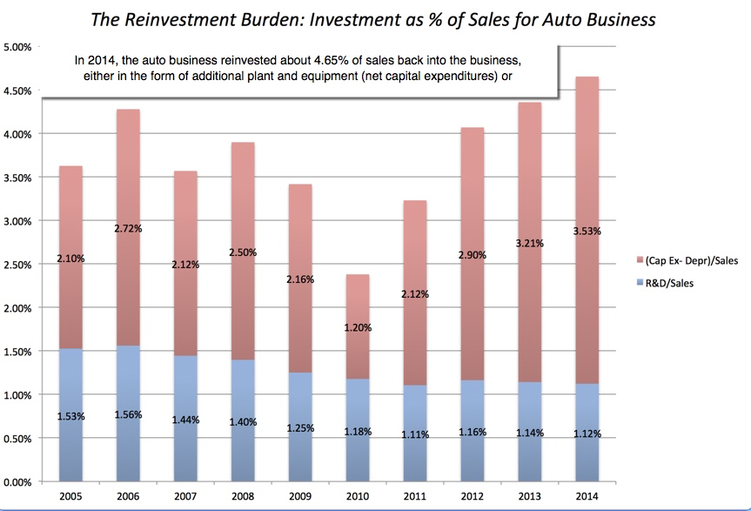
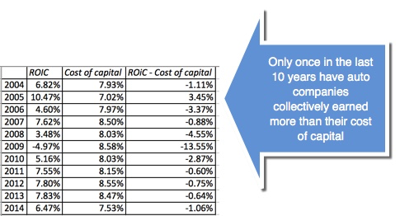
Low Growth
The Auto Business
Low Margins
+
High & Increasing Reinvestment
Bad Business
=

Slide 21
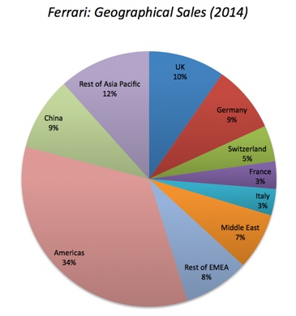
What makes Ferrari different?
Ferrari sold only 7,255 cars in all of 2014
Ferrari sales (in units) have grown very little in the last decade & have been stable
Ferrari had a profit margin of 18.2%, in the 95th percentile, partly because of its high prices and partly because it spends little on advertising.
Ferrari has not invested in new plants.

Slide 22
Step 2: Create a narrative for the future
Every valuation starts with a narrative, a story that you see unfolding for your company in the future.
In developing this narrative, you will be making assessments of your company (its products, its management), the market or markets that you see it growing in, the competition it faces and will face and the macro environment in which it operates.
  Rule 1: Keep it simple.
  Rule 2: Keep it focused.

Slide 23
The Uber Narrative
In June 2014, my initial narrative for Uber was that it would be
An urban car service business: I saw Uber primarily as a force in urban areas and only in the car service business.
Which would expand the business moderately (about 40% over ten years) by bringing in new users.
With local networking benefits: If Uber becomes large enough in any city, it will quickly become larger, but that will be of little help when it enters a new city.
Maintain its revenue sharing (20%) system due to strong competitive advantages (from being a first mover).
And its existing low-capital business model, with drivers as contractors and very little investment in infrastructure.

Slide 24
The Ferrari Narrative
Ferrari will stay an exclusive auto club, deriving its allure from its scarcity and the fact that only a few own Ferraris.
By staying exclusive, the company gets three benefits:
  It can continue to charge nose bleed prices for its cars and sell them with little or no advertising.
  It does not need to invest in new assembly plants, since it does not plan to ramp up production.
  It sells only to the super rich, who are unaffected by overall economic conditions or market crises.

Slide 25
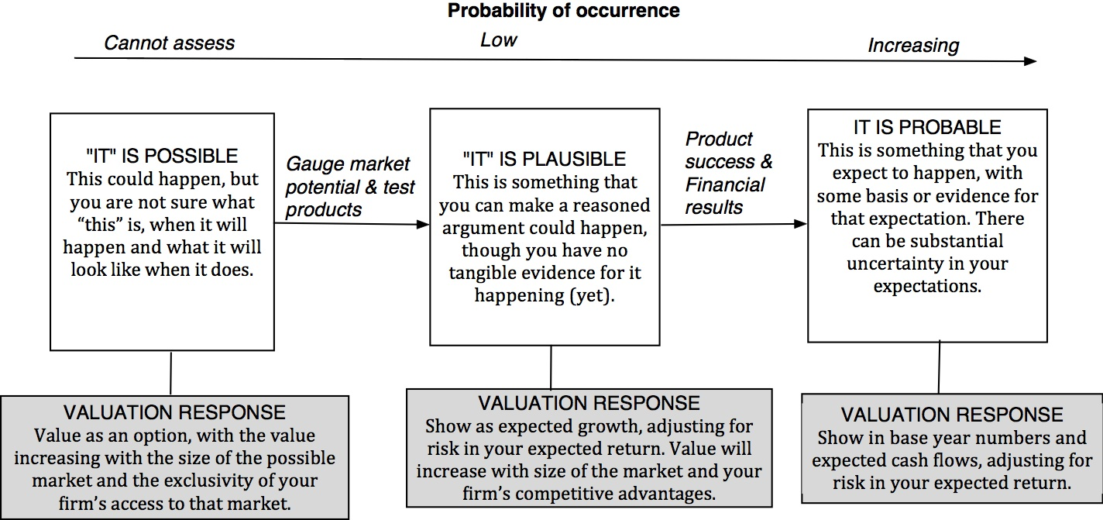
Step 3: Check the narrative against history, economic first principles & common sense

Slide 26
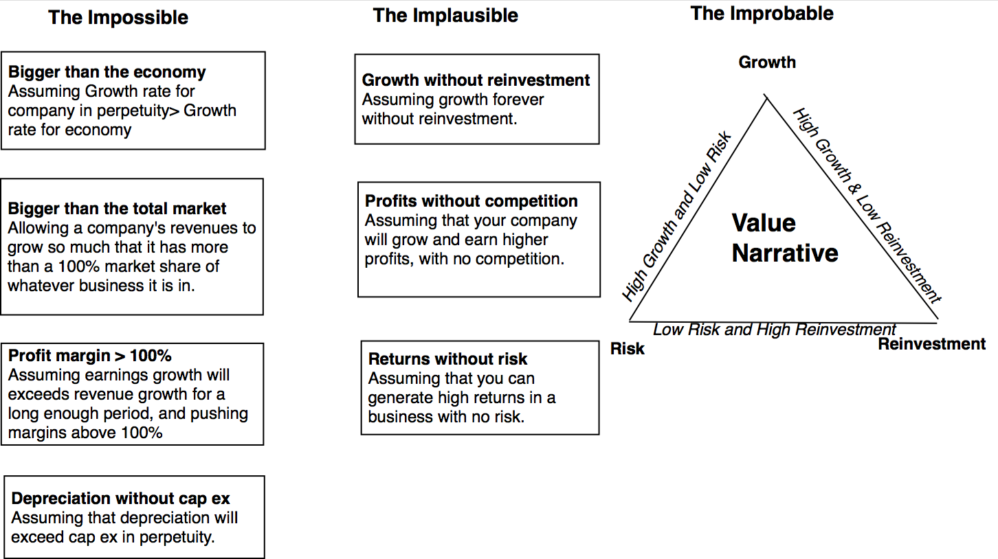
The Impossible, The Implausible and the Improbable

Slide 27
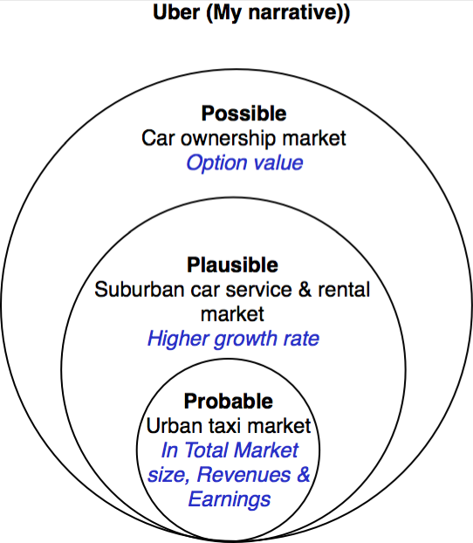
Uber: Possible, Plausible and Probable

Slide 28
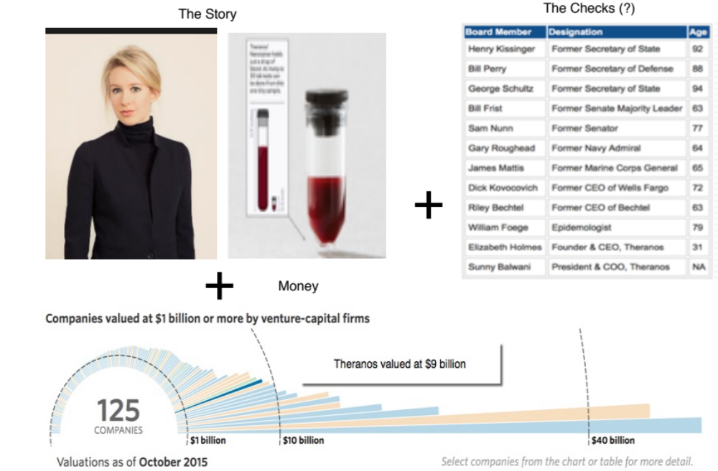
The Impossible: The Runaway Story

Slide 29
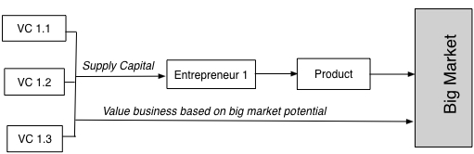
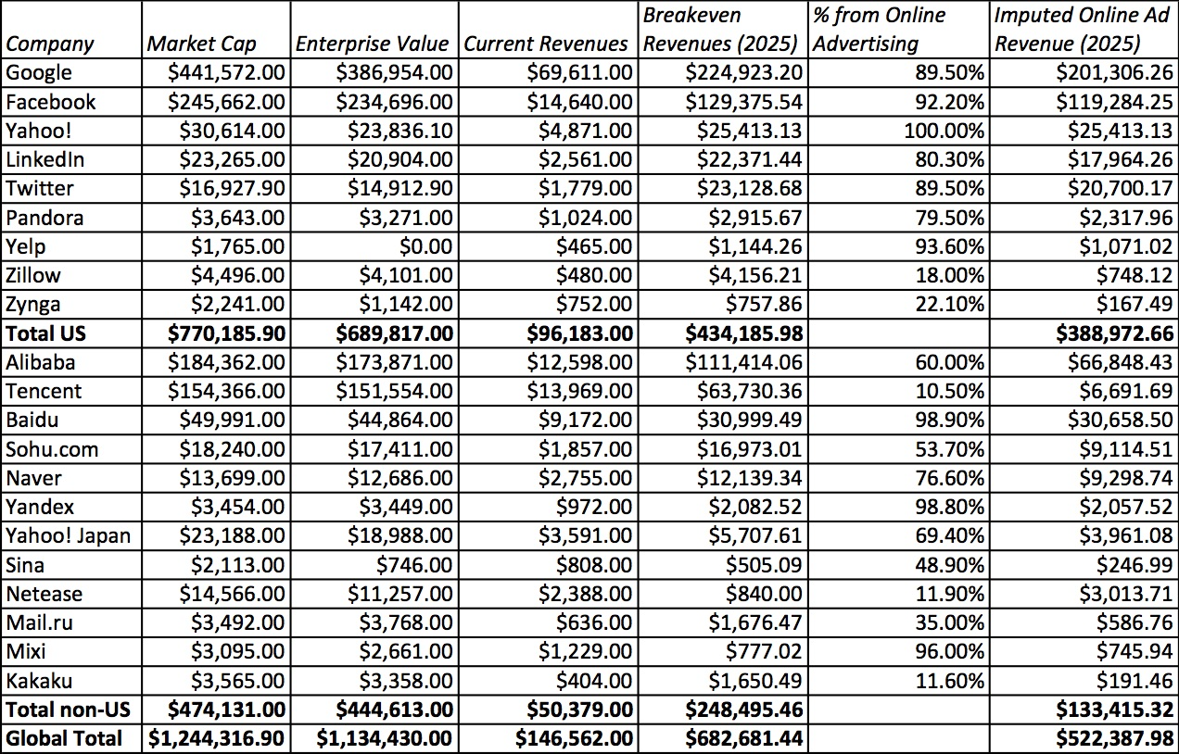
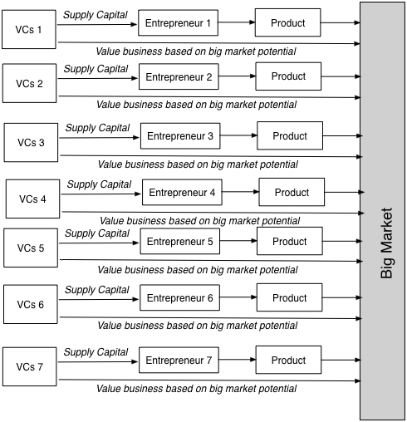
The Implausible: The Big Market Delusion

Slide 30
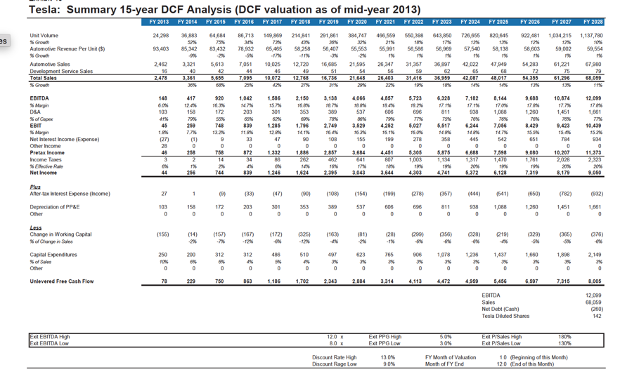
The Improbable: Willy Wonkitis

Slide 31
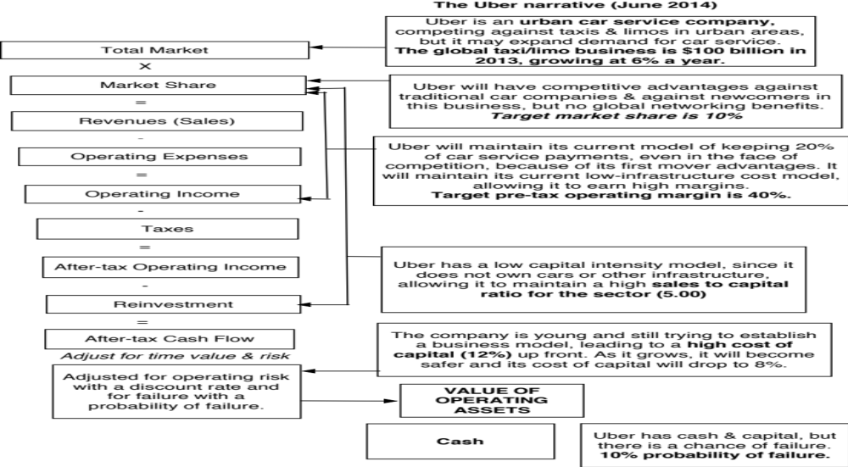
Step 4: Connect your narrative to key drivers of value

Slide 32
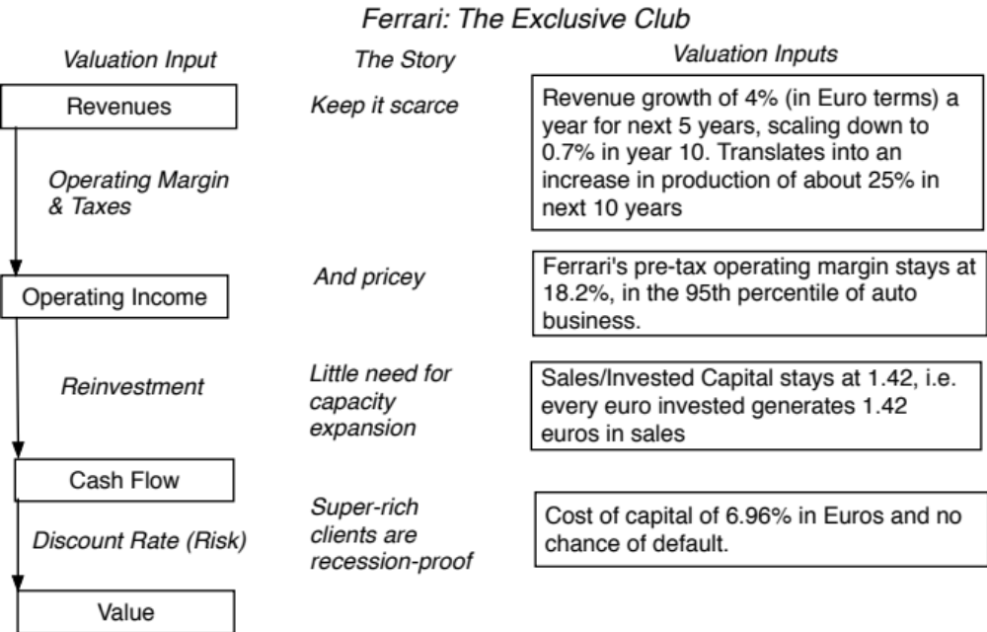
Ferrari: From story to numbers

Slide 33
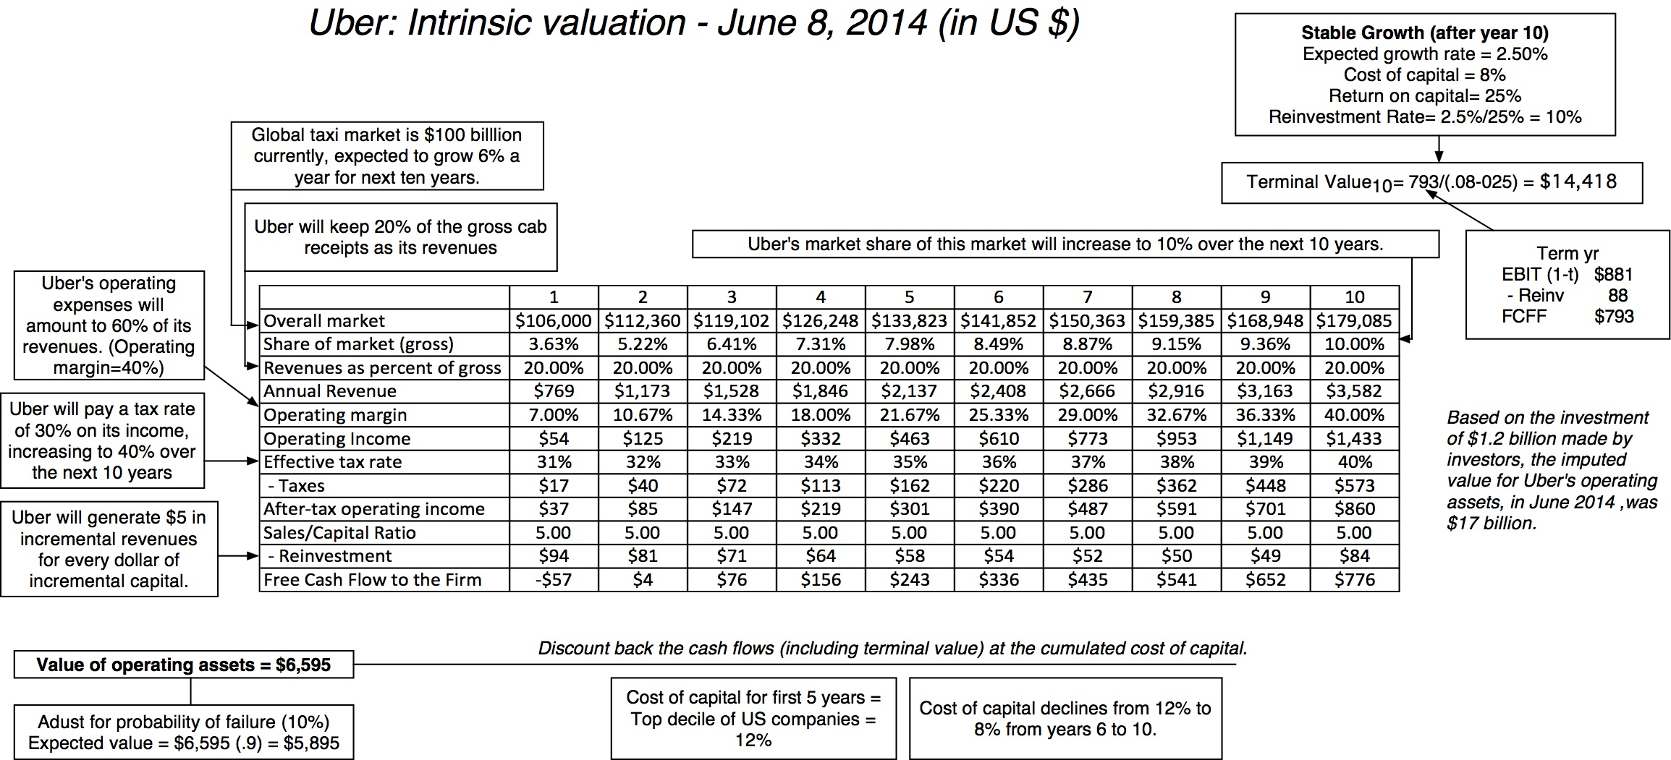
Step 4: Value the company (Uber)

Slide 34
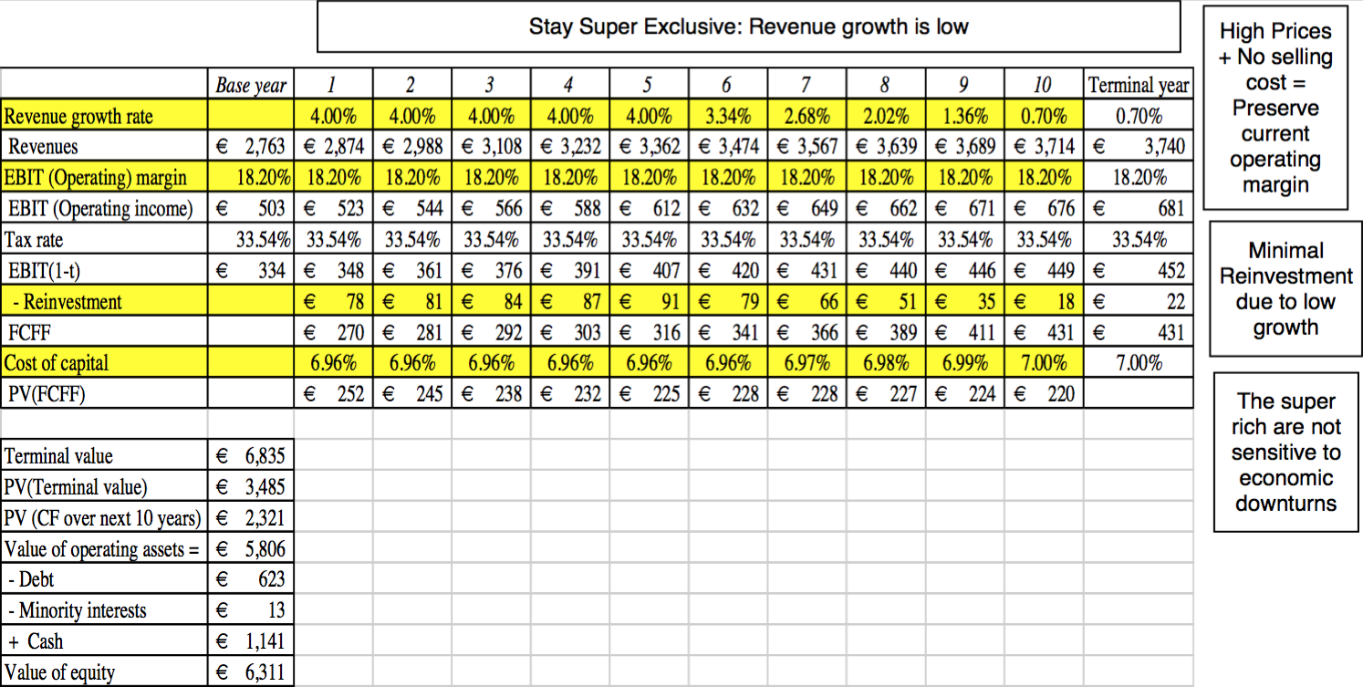
Ferrari: The “Exclusive Club” Value

Slide 35
Step 5: Keep the feedback loop open
When you tell a story about a company (either explicitly or implicitly), it is natural to feel attached to that story and to defend it against all attacks. Nothing can destroy an investor more than hubris.
Being open to other views about a company is not easy, but here are some suggestions that may help:
  Face up to the uncertainty in your own estimates of value.
  Present the valuation to people who don’t think like you do.
  Create a process where people who disagree with you the most have a say.
  Provide a structure where the criticisms can be specific and pointed, rather than general.

Slide 36
The Uber Feedback Loop: Bill Gurley
Not just car service company.: Uber is a car company, not just a car service company, and there may be a day when consumers will subscribe to a Uber service, rather than own their own cars. It could also expand into logistics, i.e., moving and transportation businesses.
Not just urban: Uber can create new demands for car service in parts of the country where taxis are not used (suburbia, small towns).
Global networking benefits: By linking with technology and credit card companies, Uber can have global networking benefits.

Slide 37
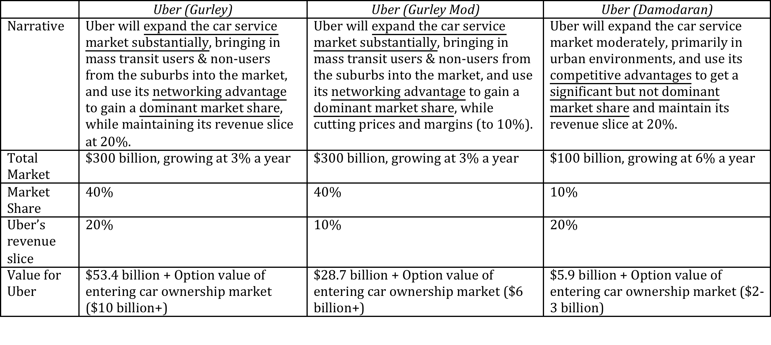
Valuing Bill Gurley’s Uber narrative

Slide 38
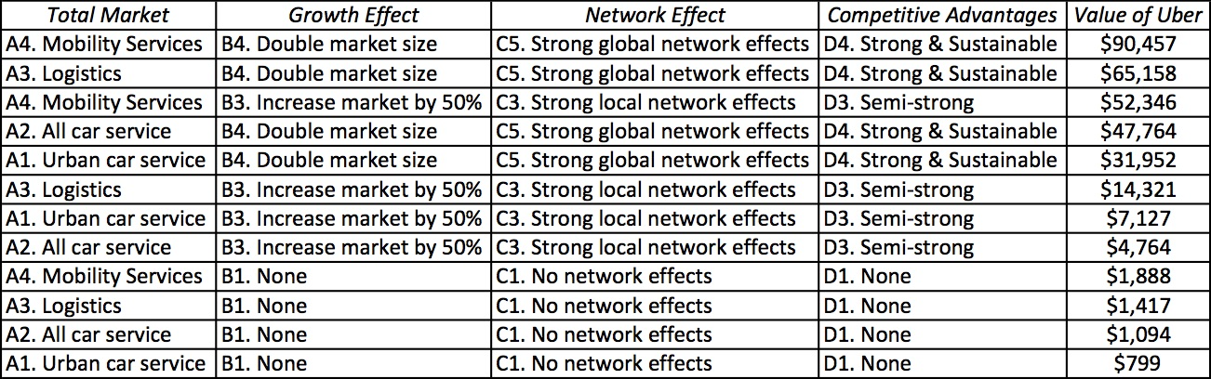
Different narratives, Different Numbers

Slide 39
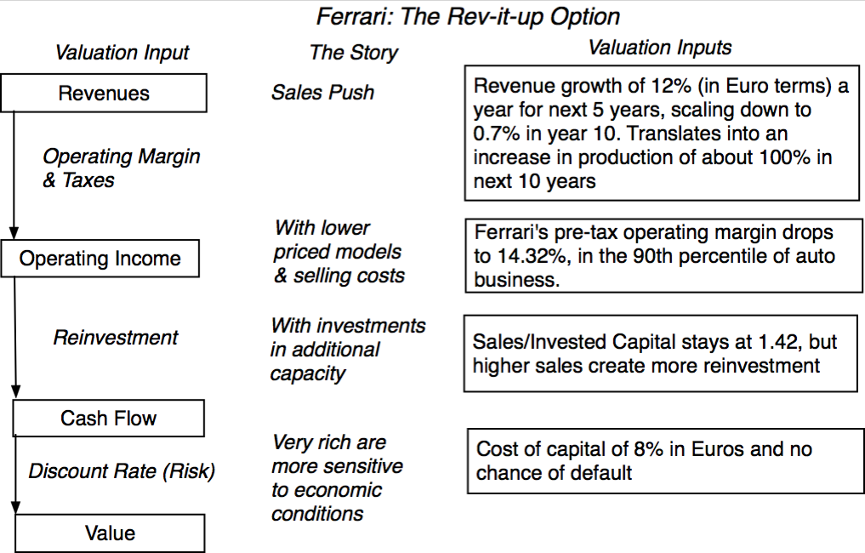
The Ferrari Counter Narrative

Slide 40
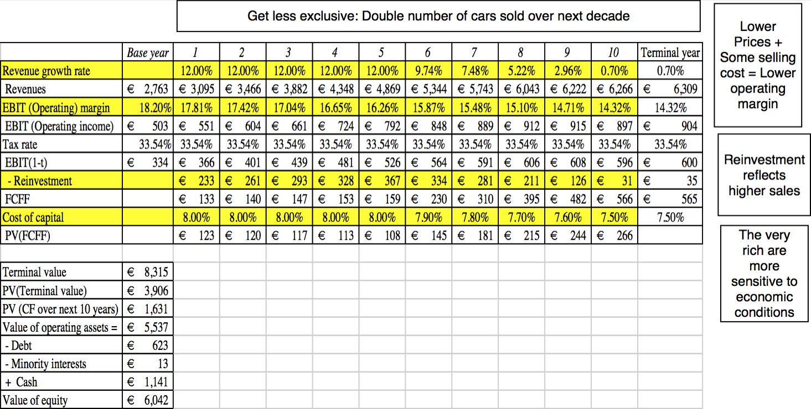
Ferrari: The “Rev-it-up” Alternative

Slide 41

And the world is full of feedback.. My Ferrari afterthought!

Slide 42
Step 6: If the world changes, your narrative has to change with it..
Narrative Break/End | Narrative Shift | Narrative Change (Expansion or Contraction)
Events, external (legal, political or economic) or internal (management, competitive, default), that can cause the narrative to break or end. | Improvement or deterioration in initial business model, changing market size, market share and/or profitability. | Unexpected entry/success in a new market or unexpected exit/failure in an existing market.
Your valuation estimates (cash flows, risk, growth & value) are no longer operative | Your valuation estimates will have to be modified to reflect the new data about the company. | Valuation estimates have to be redone with new overall market potential and characteristics.
Estimate a probability that it will occur & consequences | Monte Carlo simulations or scenario analysis | Real Options

Slide 43
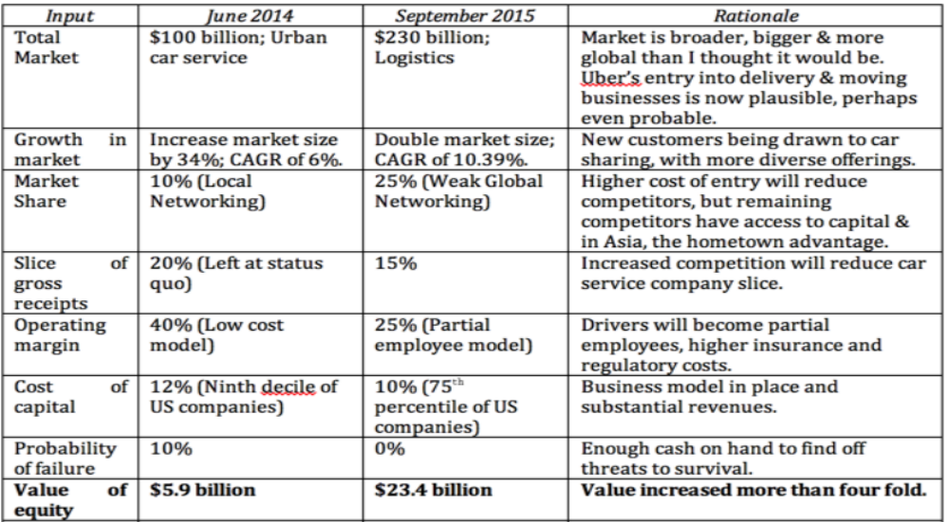
Uber: The September 2015 Update

Slide 44
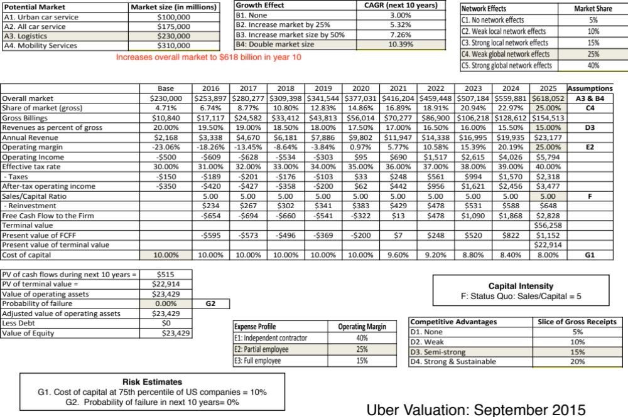

Slide 45
Dealing with noise
Uncertainty is a feature, not a bug

Slide 46

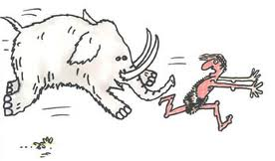
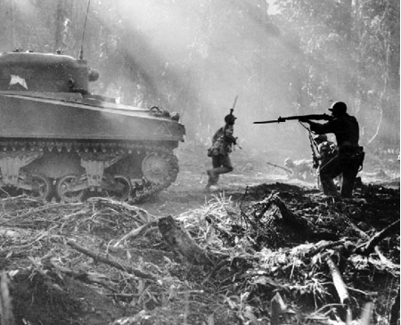
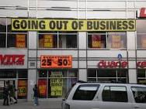

Uncertainty is a feature, not a bug.

Slide 47
And we deal with uncertainty as humans always have…
Divine Intervention: Praying for intervention from a higher power is the oldest and most practiced risk management system of all.
Paralysis & Denial: When faced with uncertainty, some of us get paralyzed. Accompanying the paralysis is the hope that if you close your eyes to it, the uncertainty will go away
Mental short cuts (rules of thumb): Behavioral economists note that investors faced with uncertainty adopt mental short cuts that have no basis in reality. And here is the clincher. More intelligent people are more likely to be prone to this.
Herding: When in doubt, it is safest to go with the crowd.. The herding instinct is deeply engrained and very difficult to fight.
Outsourcing: Assuming that there are experts out there who have the answers does take a weight off your shoulders, even if those experts have no idea of what they are talking about.

Slide 48
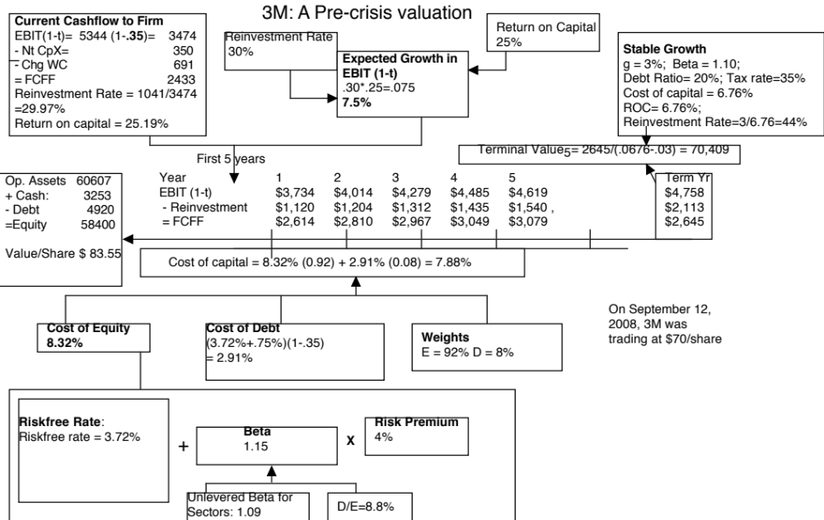

Slide 50
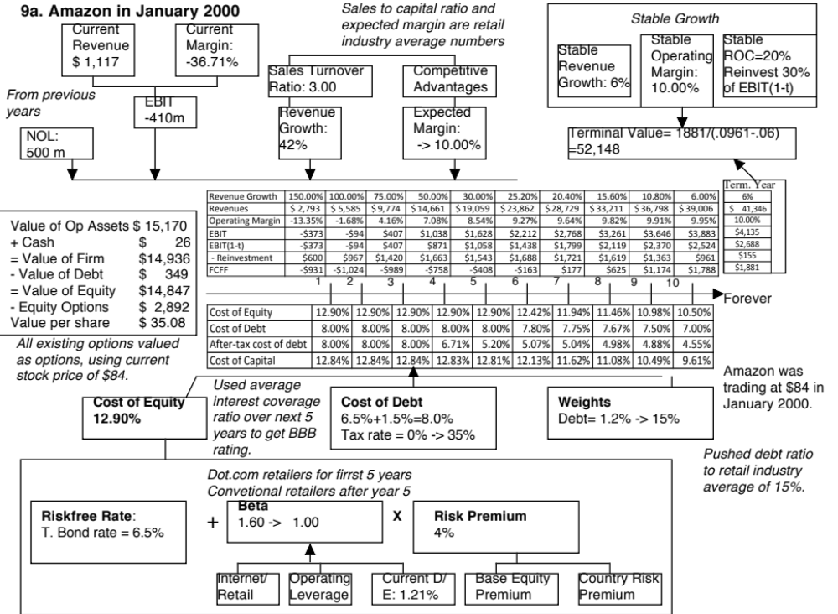
Notes:
To estimate a bottom-up beta for Amazon in January 2000, we used the average beta of internet retailers for the first five years as the bottom-up beta but assume that the beta will move towards the average beta for specialty retailers over time. The high operating leverage that is typical of an internet retailer (high infrastructure and technology costs) provides an intuitive explanation for why they should have higher betas than their brick-and-mortar counterparts.
When a firm has operating losses, the interest coverage ratio is negative. Using the interest coverage ratio table on the next page would yield a D rating for the firm. In January 2000, this seemed a little harsh. For better or worse, bondholders and lenders to the firm seemed to be lending based upon expected operating income in the future rather than past operating income. The interest coverage ratio was therefore defined as follows:
Interest coverage ratio = Average EBIT next 5 years/ Current interest expense
The interest coverage ratio yielded a synthetic rating of BBB and a default spread of 1.50% in January 2000.
3. The pre-tax cost of debt is equal to the after-tax cost for the next 2 years because the firm is expected to keep losing money. In year 3, Amazon is expected to make an operating profit, but it wil have net operating losses that shelter the income leading to no taxes. In year 4, Amazon is able to partially cover the operating income with carried-forward net operating losses… Starting in year 6, we lower the cost of debt since the firm is expected to become a profitable firm with substantial increases in operating income in the subsequent years.
Year 1 2 3 4 5
EBIT -$373 -$94 $407 $1,038 $1,628
Taxes $0 $0 $0 $167 $570
EBIT(1-t) -$373 -$94 $407 $871 $1,058
Tax rate 0% 0% 0% 16.13% 35%
NOL $500 $873 $967 $560 $0
The value per share in January 2000 is $ 34. This valuation was done with all of the inputs at the high end of my expectations and can be considered optimistic. Notwithstanding this, the stock is still overvalued. In fact, the optimism shows when you see that the free cashflows to the firm are negative for the first 6 years… I am assuming that Amazon will have no trouble raising the capital to fund these cashflows…

Slide 51
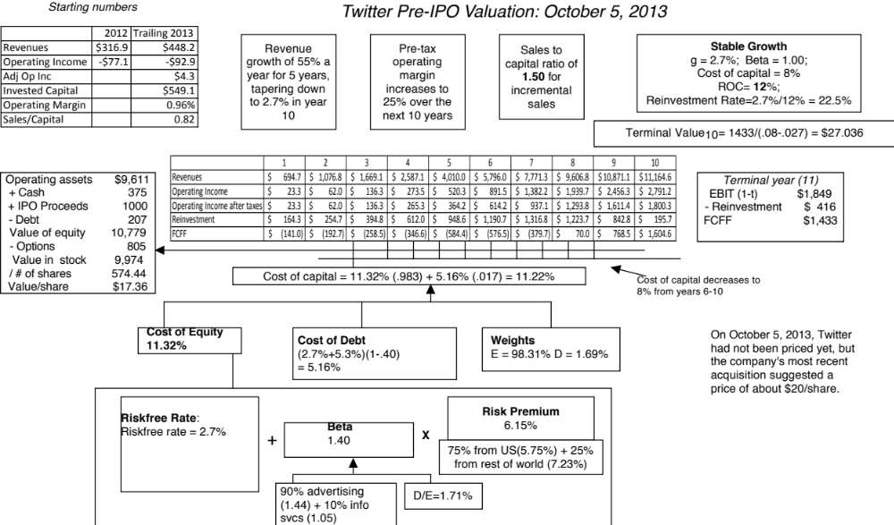

Slide 52
The sources of uncertainty
Estimation versus Economic uncertainty
  Estimation uncertainty reflects the possibility that you could have the “wrong model” or estimated inputs incorrectly within this model.
  Economic uncertainty comes the fact that markets and economies can change over time and that even the best medals will fail to capture these unexpected changes.
Micro uncertainty versus Macro uncertainty
  Micro uncertainty refers to uncertainty about the potential market for a firm’s products, the competition it will face and the quality of its management team.
  Macro uncertainty reflects the reality that your firm’s fortunes can be affected by changes in the macro economic environment.
Discrete versus continuous uncertainty
  Discrete risk: Risks that lie dormant for periods but show up at points in time. (Examples: A drug working its way through the FDA pipeline may fail at some stage of the approval process or a company in Venezuela may be nationalized)
  Continuous risk: Risks changes in interest rates or economic growth occur continuously and affect value as they happen.

Slide 53
Assessing uncertainty…
Rank the four firms in terms of uncertainty (least to most) in your estimate:
  3M in 2007
  Vale in September 2015
  Amazon in 2000
  Twitter in 2013
With each company, specify the type of uncertainty that you face:
Company | Estimation or Economic | Micro or Macro | Discrete or Continuous
3M (2007)
Vale (Sept 2015)
Amazon (2000)
Twitter (2013)

Slide 54
Ten suggestions for dealing with uncertainty…
Less is more (the rule on detail….) (Revenue & margin forecasts)
Build in internal checks on reasonableness… (reinvestment and ROC)
Use the offsetting principle (risk free rates & inflation at Tata Motors)
Draw on economic first principles (Terminal value at all the companies )
Use the “market” as a crutch (equity risk premiums, country risk premiums)
Use the law of large numbers (Beta for all companies
Don’t let the discount rate become the receptacle for all uncertainties.
Confront uncertainty, if you can
Don’t look for precision
You can live with mistakes, but bias will defeat you.

Slide 55
1. Less is more
The principle of parsimony: When faced with uncertainty, go for less detail, rather than more. That may sound counterintuitive, but here is why it makes sense:
  You have a better shot at estimating an aggregate number, rather than individual numbers (Examples: Forecast the operating margin rather than individual operating expenses, total working capital instead of individual working capital items)
  Estimation requires information and trying to estimate individual items, in the absence of information, is not only frustrating but an exercise in futility.
Auto pilot rules: The uncertainty you face will increase as you go forward in time (it is much more difficult to estimate year 5 than year 1). Thus, it is best to create simple algorithms that estimate year-specific numbers as you go further out in time.

Slide 56
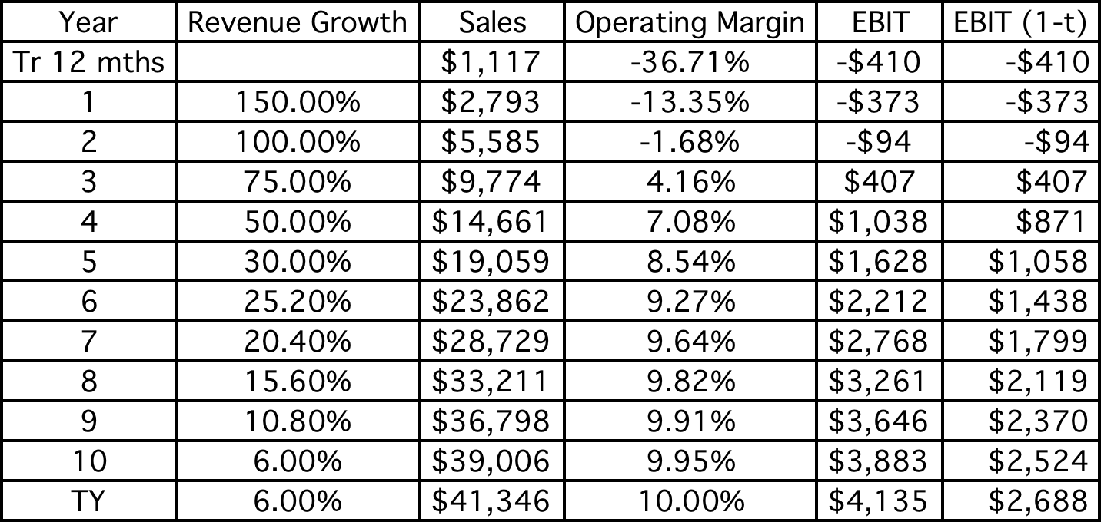
To illustrate: Revenues & Margins for Amazon

Slide 57
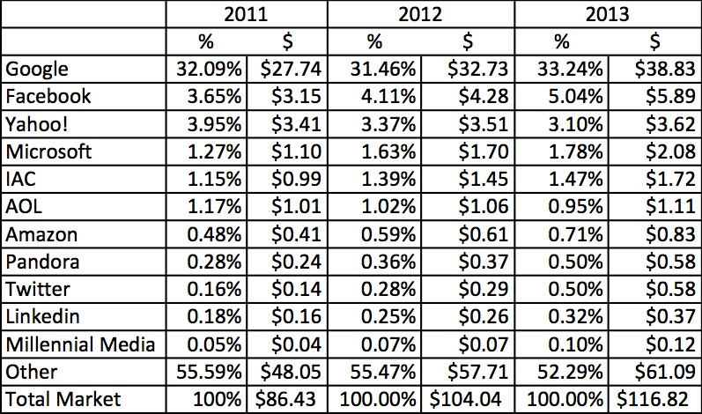
A tougher task at Twitter
My estimate for 2023: Overall market will be close to $200 billion and Twitter will about 5.7% ($11.5 billion)

Slide 58
2. Build in “internal” checks for reasonableness
While you may be forecasting individual items in valuation, and you are uncertain about each item, you can create internal checks to make sure that your assumptions are not at war with each other.
In particular, you should make sure that as you approach your terminal year, the company that you are creating on your spreadsheet is one that is feasible and viable in terms of
  Size, relative to the market that it serves… Your market share obviously cannot exceed 100% but there may be tighter constraints (your market share cannot exceed that of the largest company in the sector)
  Profitability, as measured in terms of operating margins and returns on capital. In particular, the return on capital should be supportable, given the industry average return on capital and the cost of capital.

Slide 59
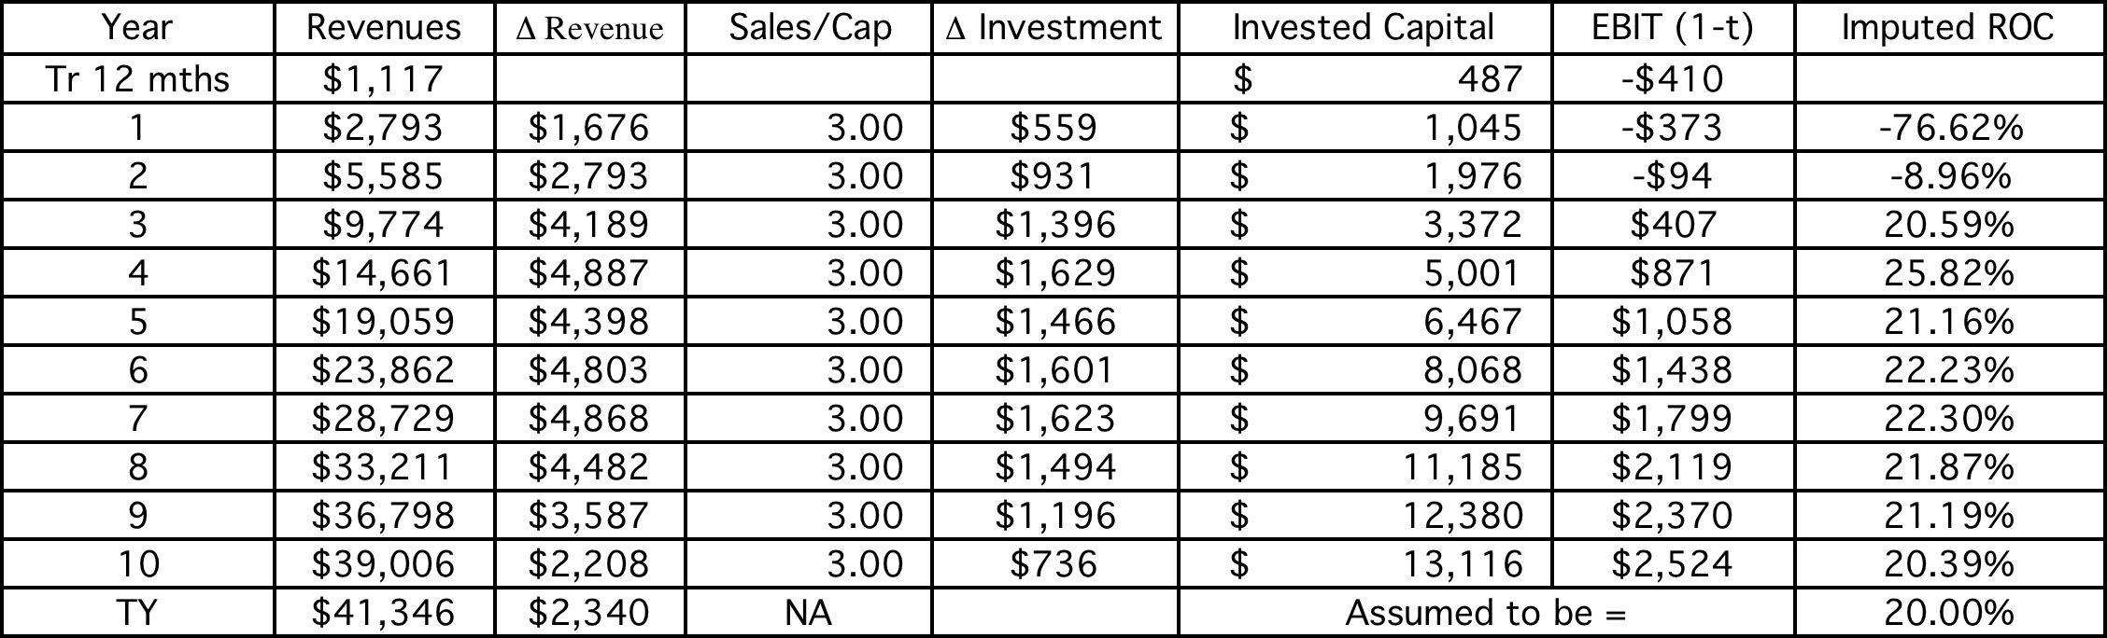
To illustrate: The reinvestment in Amazon

Slide 60
3. Use consistency tests…
While you can not grade a valuation on “correctness” (since different analysts can make different assumptions about growth and risk), you can grade it on consistency.
For a valuation to be consistent, your estimates of cash flows have to be consistent with your discount rate definition.
  Equity versus Firm: If the cash flows being discounted are cash flows to equity, the appropriate discount rate is a cost of equity. If the cash flows are cash flows to the firm, the appropriate discount rate is the cost of capital.
  Currency: The currency in which the cash flows are estimated should also be the currency in which the discount rate is estimated.
  Nominal versus Real: If the cash flows being discounted are nominal cash flows (i.e., reflect expected inflation), the discount rate should be nominal

Slide 61
4. Draw on first principles
When doing valuation, you are free to make assumptions about how your company will evolve over time in the market that it operates, but you are not free to violate first principles in economics and mathematics.
Put differently, there are assumptions in valuation that are either mathematically impossible or violate first laws of economics and cannot be ever justified.

Slide 62
To illustrate: The growth rate in terminal value
When a firm’s cash flows grow at a “constant” rate forever, the present value of those cash flows can be written as:
  Value = Expected Cash Flow Next Period / (r - g)
The stable growth rate cannot exceed the growth rate of the economy but it can be set lower.
  If you assume that the economy is composed of high growth and stable growth firms, the growth rate of the latter will probably be lower than the growth rate of the economy.
  The stable growth rate can be negative. The terminal value will be lower and you are assuming that your firm will disappear over time.
  If you use nominal cashflows and discount rates, the growth rate should be nominal in the currency in which the valuation is denominated.
One simple proxy for the nominal growth rate of the economy is the riskfree rate:
  Riskfree rate = Expected inflation + Expected real interest rate
  Nominal growth rate in GDP = Expected inflation + Expected real growth rate

Slide 63
And the “excess return” effect…
Stable growth rate | 3M | Vale | Amazon | Twitter
0% | $70,409 | $48,451 | $26,390 | $23,111
1% | $70,409 | $48,451 | $28,263 | $24,212
2% | $70,409 | $48,451 | $30,595 | $25,679
3% | $70,409 |  | $33,594
4% |  |  | $37,618
5% |  |  | $43,334
 |  |  | $52,148
Riskfree rate | 3.72% | 2.00% | 6.60% | 2.70%
ROIC | 6.76% | 12.18% | 20% | 12.00%
Cost of capital | 6.76% | 12.18% | 9.61% | 8.00%

Slide 64
5. Use the market as a crutch…
In intrinsic valuation, you start with the presumption that the market is not always right and that your value may yield a better estimate of the “true” value of a business than the market’s estimate of that value.
While that is a reasonable (albeit debatable) belief, you can still use market values either as inputs for some variables or as checks on your inputs. That will allow you to value your company in a more bounded environment, where you are not making assumptions about variables that you either should not be bringing in your point of view on and/or are unequipped to do so.

Slide 65
Where the market rules..
Risk free Rates: Much as you may feel that current interest rates are too high or too low, you should draw on those current rates when valuing companies. Don’t normalize risk free rates.
Equity Risk Premiums & Default Spreads: Rather than use historical data, use the market prices for equity risk (implied premium) and default risk (default spreads in the market0
Exchange Rates: Again, you may feel that exchange rates are too low or too high but in your valuations, you should use market-set exchange rates.

Slide 66
With Vale, here were the big unknowns..

Slide 67
6. Draw on the law of large numbers…
The law of large numbers: The "law of large numbers" is one of several theorems expressing the idea that as the number of trials of a random process increases, the percentage difference between the expected and actual values goes to zero.
The average is your friend: In pragmatic terms, when faced with uncertainty on an input, you are better off using an average (over time or across companies) than using the actual number.

Slide 68
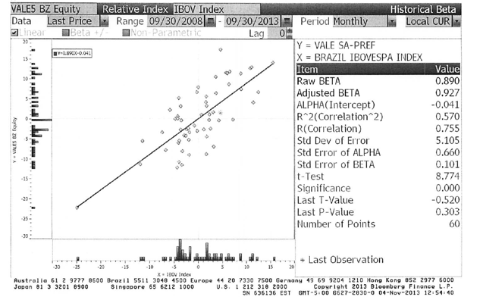
To illustrate: A single regression beta is noisy…

Slide 69
But an average beta across companies is not…
Business | Number of firms | Unlevered beta | Proportion of value | D/E ratio | Levered beta
Metals & Mining | 52 | 0.86 | 16.65% | 126.36% | 1.5772
Iron Ore | 86 | 0.83 | 76.20% | 126.36% | 1.5222
Fertilizers | 655 | 0.99 | 5.39% | 126.36% | 1.8156
Logistics | 215 | 0.75 | 1.76% | 126.36% | 1.3755
Vale Operations |  | 0.84 | 100% | 126.36% | 1.5405

Slide 70
7. Don’t let the discount rate become the receptacle for all your uncertainty…
In discounted cash flow valuation, it is true that risk is incorporated into the discount rate. Taking that principle to its logical limits, analysts often “hike” the discount rate to reflect any uncertainty they feel about value.
There are several dangers with doing so:
  You may be building in risks that will disappear in a portfolio and thus unnecessarily lowering the value of some risky investments. If you are valuing a company for a diversified investor, it is macro risks that you should be capturing in the discount rate, not micro risks.
  Adding to the proposition, adjusting discount rates is easier to do with continuous risk (that earnings will be volatile or exchange rates will change) than for discontinuous risk.

Slide 71
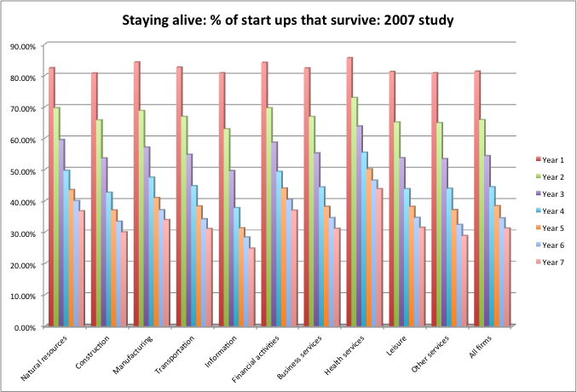
To illustrate: Survival risk at young firms…

Slide 72
Contrasting ways of dealing with survival risk…
The Venture Capital approach: In the venture capital approach, you hike the “discount rate” well above what would be appropriate for a going concern and then use this “target” rate to discount your “exit value” (which is estimated using a multiple and forward earnings).
  Value = (Forward Earnings in year n * Exit multiple)/ (1+ target rate)^{n}
The decision tree approach:
  Value the business as a “going concern”, with a rate of return appropriate for a “going concern”.
  Estimate the probability of survival (and failure) and the value of the business in the event of failure.
  Value = Going concern value (Probability of survival) + Liquidation value (Probability of failure)

Slide 73
Generalizing to other “truncation” risks
Default risk for a “distressed” company: For firms that have substantial debt, there is the possibility of default. In default, you will receive a liquidation value for your assets in place, that may not reflect their going concern value, and will lose any “growth asset” value.
  Value = Going concern value (1- Probability of default) + Liquidation value (Probability of default)
Nationalization risk: The primary cost of being nationalized is that what you receive for your business from the nationalizing authority is less than the fair value of the business.
  Value = Going concern value (1- Probability of nationalization) + Liquidation value (Probability of nationalization)

Slide 74
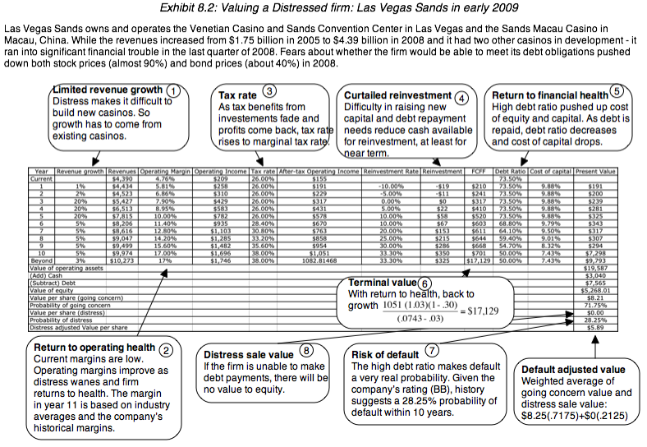

Slide 75
8. Confront uncertainty, if you can…
In standard valuation, you are forced to make point estimates for inputs where you are uncertain about values. In statistical terms, you are being asked to compress a probability distribution about a variable into an expected value. You then obtain a single estimate of value, based upon your base case or expected values.
In a simulation, you can enter distributions for variables, rather than point estimates. Rather than obtain a single estimate of value, you get a distribution of values, which can provide you with substantially more information than a single valuation.

Slide 76
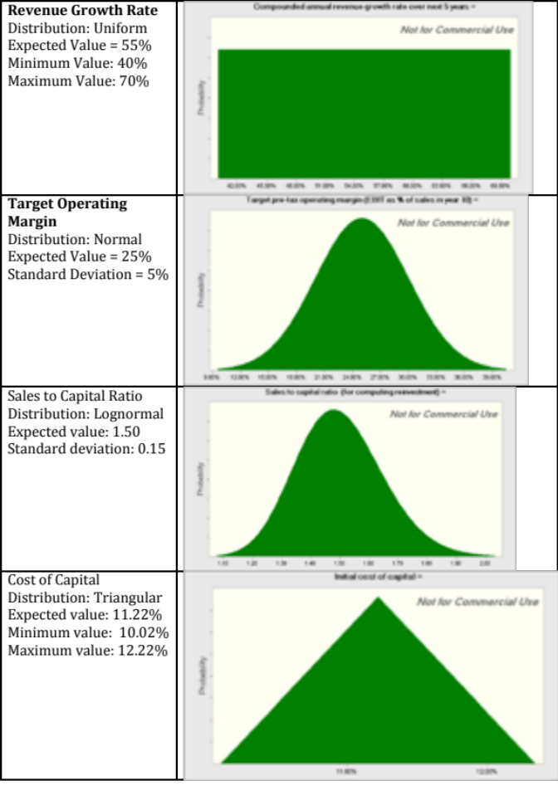
To illustrate: Revisiting the Twitter valuation…

Slide 77
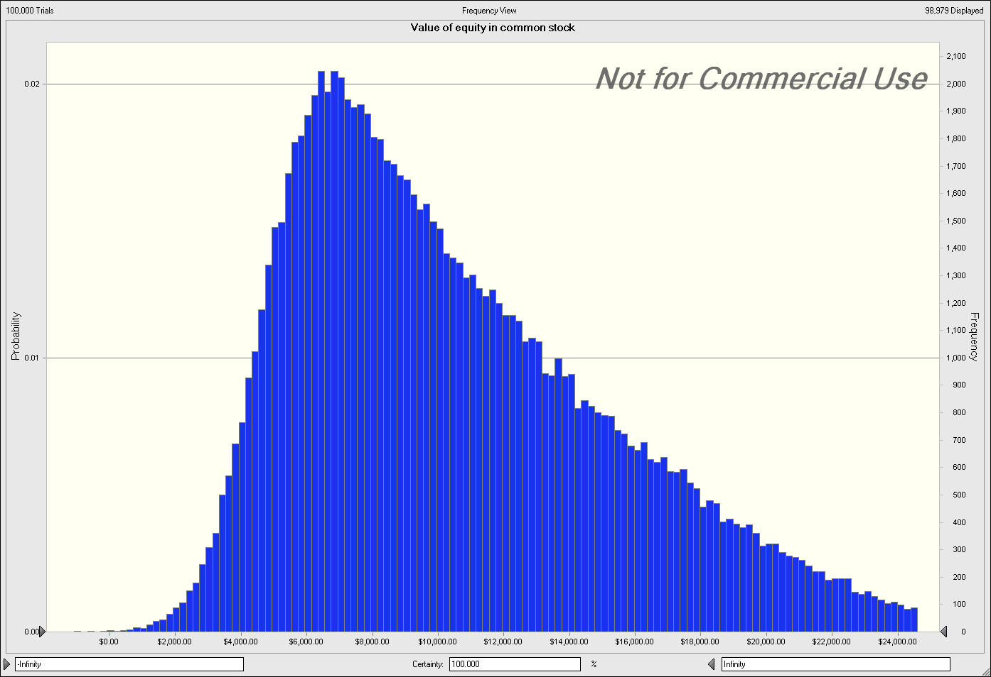
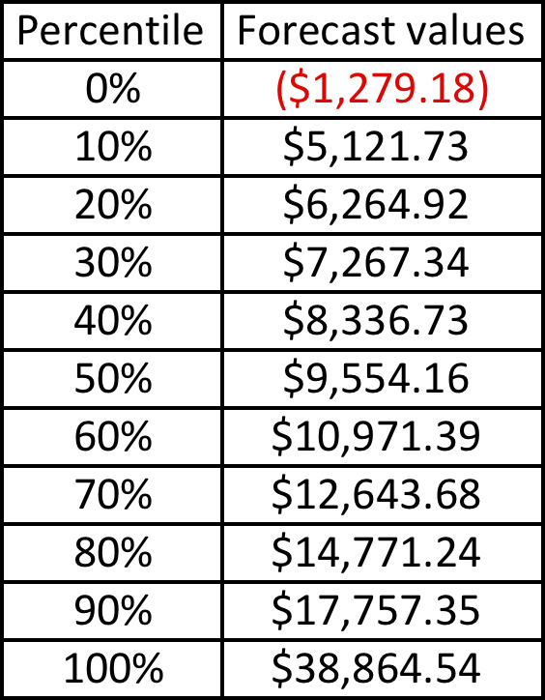
With the consequences for equity value…

Slide 78
9. Don’t look for precision..
No matter how careful you are in getting your inputs and how well structured your model is, your estimate of value will change both as new information comes out about the company, the business and the economy.
As information comes out, you will have to adjust and adapt your model to reflect the information. Rather than be defensive about the resulting changes in value, recognize that this is the essence of risk.

Slide 79
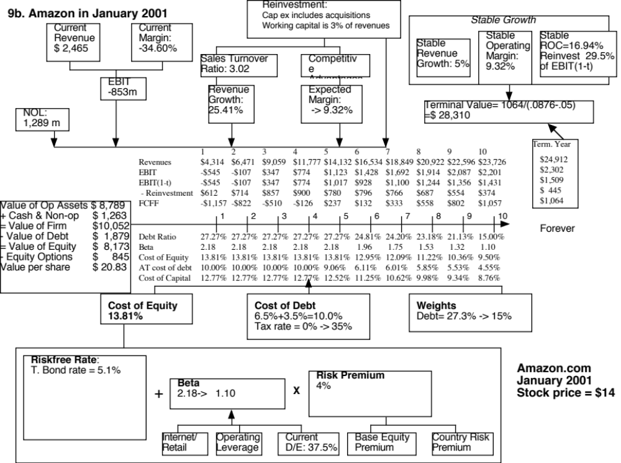
Notes:
This is a valuation in January 2001, one year after the first valuation. The difference wrought by the intervening year is remarkable. The economy slowed, e-commerce lost its sheen and Amazon reported disappointingly large operating losses in the period. The big changes in this valuation can be seen in
The base year numbers - the revenues increase by about 130% but operating losses more than doubled.
More conservative revenue estimates for the future - a lower compounded revenue growth rate and lower revenues 10 years out
A slightly lower margin based upon a subset of specialty retailers that look more like Amazon
A surge in the beta, because of an increase in financial leverage - Amazon increased its debt and its market value of equity dropped by about 80%.
The value of the operating assets drops by about 40%, there is a drop in the value of the options to $748 million and the value per share decreases to $18.74….
This assumes that Amazon does not re-price its options… What would happen if it did?

Slide 80

To illustrate: Your mistakes versus market mistakes..

Slide 81
10. You can make mistakes, but try to keep bias out..
When you are wrong on individual company valuations, as you inevitably will be, recognize that while those mistakes may cause the value to be very different from the price for an individual company, the mistakes should average out across companies.
  Put differently, if you are an investor, you have can make the “law of large numbers” work for you by diversifying across companies, with the degree of diversification increasing as uncertainty increases.
If you are “biased” on individual company valuations, your mistakes will not average out, no matter how diversified you get.
Bottom line: You are better off making large mistakes and being unbiased than making smaller mistakes, with bias.

Slide 82
Value versus Price
Are you valuing or are you pricing?

Slide 83

Value Process versus Pricing Process

Slide 84

Test 1: Are you pricing or valuing?

Slide 85

Test 2: Are you pricing or valuing?

Slide 86
Test 3: Are you pricing or valuing?
 | 1 | 2 | 3 | 4 | 5
EBITDA | $100.00 | $120.00 | $144.00 | $172.80 | $207.36
- Depreciation | $20.00 | $24.00 | $28.80 | $34.56 | $41.47
EBIT | $80.00 | $96.00 | $115.20 | $138.24 | $165.89
- Taxes | $24.00 | $28.80 | $34.56 | $41.47 | $49.77
EBIT (1-t) | $56.00 | $67.20 | $80.64 | $96.77 | $116.12
+ Depreciation | $20.00 | $24.00 | $28.80 | $34.56 | $41.47
- Cap Ex | $50.00 | $60.00 | $72.00 | $86.40 | $103.68
- Chg in WC | $10.00 | $12.00 | $14.40 | $17.28 | $20.74
FCFF | $16.00 | $19.20 | $23.04 | $27.65 | $33.18
Terminal Value |  |  |  |  | $1,658.88
Cost of capital | 8.25% | 8.25% | 8.25% | 8.25% | 8.25%
Present Value | $14.78 | $16.38 | $18.16 | $20.14 | $1,138.35
Value of operating assets today | $1,207.81
+ Cash | $125.00
- Debt | $200.00
Value of equity | $1,132.81

Slide 87

The determinants of price

Slide 88

Multiples and Comparable Transactions

Slide 89
To be a better Pricer, here are four suggestions..
Check your multiple or consistency/uniformity
  In use, the same multiple can be defined in different ways by different users. When comparing and using multiples, estimated by someone else, it is critical that we understand how the multiples have been estimated
Look at all the data, not just the key statistics
  Too many people who use a multiple have no idea what its cross sectional distribution is. If you do not know what the cross sectional distribution of a multiple is, it is difficult to look at a number and pass judgment on whether it is too high or low.
Don’t forget the fundamentals ultimately matter
  It is critical that we understand the fundamentals that drive each multiple, and the nature of the relationship between the multiple and each variable.
Don’t define comparables based only on sector
  Defining the comparable universe and controlling for differences is far more difficult in practice than it is in theory.
Notes:
While we can rail about the fact that a valuation based upon multiples is not as detailed as a discounted cashflow valuation,, the reality is that analysts will continue to use multiples to value companies and that we will often have to use these valuations.
Given this reality, we have to think about how best to use multiples. These four steps represent a way in which we can deconstruct any multiple, understand how to use it well and discover when it is being misused.

Slide 90
I. Check the Multiple
Is the multiple consistently defined?
  The consistency principle: Both the value (the numerator) and the standardizing variable ( the denominator) should be to the same claimholders in the firm. In other words, the value of equity should be divided by equity earnings or equity book value, and firm value should be divided by firm earnings or book value.
  The cost of mismatching: Assets that are not cheap(expensive) will look cheap (expensive), because your mismatch will skew the numbers.
Is the multiple uniformly estimated?
  The uniformity rule: The variables used in defining the multiple should be estimated uniformly across assets in the “comparable firm” list.
  The cost of ignoring this rule: You will be comparing non-comparable numbers and drawing all the wrong conclusions.
Notes:
Consistent definition:
Consider two widely used multiples that are consistently defined. In the price-earnings ratio (PE), the numerator is equity value per share and the denominator is equity earnings per share. In the enterprise value/ EBITDA multiple, the numerator is firm value and the denominator is a pre-tax cash flow to all claimholders in the firm. In contrast, the price to EBITDA multiple is inconsistent. Why is this a problem? If you are comparing firms with different debt ratios, the firms will more debt will look cheaper on a price to EBITDA basis.
Uniformally Estimated:
This is actually much more difficult than it looks. Even if accounting standards are the same across firms, you run into two problems:
The degree to which firms bend accounting rules for their own purposes varies across firms. Some firms are inherently more conservative in reporting earnings than others.
The financial year ends at different points for different firms. If the denominator is the earnings in the most recent financial year, the multiple may not be comparable if some firms have December year-ends and some have June year-ends.

Slide 91
II. Play Moneyball: Let the numbers talk (not the analysts)
What is the average and standard deviation for this multiple, across the universe (market)?
What is the median for this multiple?
  The median for this multiple is often a more reliable comparison point.
How large are the outliers to the distribution, and how do we deal with the outliers?
  Throwing out the outliers may seem like an obvious solution, but if the outliers all lie on one side of the distribution (they usually are large positive numbers), this can lead to a biased estimate.
Are there cases where the multiple cannot be estimated? Will ignoring these cases lead to a biased estimate of the multiple?
How has this multiple changed over time?
Notes:
Before you use a multiple and develop rules of thumb (8 times EBITDA is cheap), you need to get a sense of the cross-sectional distribution.
Multiples have skewed distributions. Because a multiple cannot be less than zero but can potentially be infinite, the averages for multiples will be much higher than their medians, and the difference will increase as the outliers become larger. Many services cap outliers to prevent them from altering the averages too much, results…
The PE ratio cannot be estimated when the earnings per share are negative. Thus, if you have a sample of 20 firms and 10 have negative earnings, you will be able to compute the PE ratio for only the 10 that have positive earnings and will throw out the remaining firms. This will induce a bias in your sample. One way to avoid this is to take the cumulative values for market capitalization and net income for all 20 firms, and compute a PE ratio based upon the cumulated values. The resulting PE ratio will generally be much higher….

Slide 92
a. Multiples have skewed distributions…
Notes:
This graph for all U.S. firms with data available on the Value Line CD ROM (contains about 7200 firms in the overall sample). Notice that the distributions are skewed to the left and that we have capped the PE ratios at 100….

Slide 93
Making statistics “dicey”
 | Current PE | Trailing PE | Forward PE
Number of firms | 7480 | 7480 | 7480
Number with PE | 3,344. | 3,223. | 2,647.
Average | 59.42 | 46.04 | 29.63
Median | 18.53 | 18.29 | 16.98
Minimum | 0.11 | 0.28 | 0.15
Maximum | 32,269.00 | 6,900.00 | 2,748.00
Standard deviation | 777.02 | 256.06 | 81.27
Standard error | 13.44 | 4.51 | 1.58
Skewness | 37.27 | 19.9 | 18.74
25th percentile | 11.88 | 12.32 | 13.1
75th percentile | 30.25 | 29.52 | 24.28
US firms in January 2016
Notes:
Four things to note…
Notice the number of firms that we have lost in the sample as we compute PE ratios.
You lose even more firms as you go to forward PE, because you need analyst estimates of expected earnings per share to compute this. Any firms not followed by analysts will not have a forward PE…
The means were computed without capping the PE ratios… the outliers (notice the maximum values for the ratios) push the average to almost twice the median.
The median forward PE is higher than the trailing PE which is higher than the current PE…

Slide 94
b. Markets have a lot in common
 | Average | 25th perc. | Median | 75th perc.
United States | 46.04 | 12.32 | 18.29 | 29.52
Europe | 57.57 | 10.27 | 16.69 | 26.76
Japan | 29.83 | 9.96 | 15.08 | 24.93
Emerging Markets | 91.08 | 9.57 | 16.77 | 39.69
Aus, NZ & Canada | 67.42 | 8.87 | 15.69 | 27.52
Global | 71.16 | 10.00 | 16.69 | 32.07
Notes:
This compares the percentages of firms in each market that trade in each PE ratio class… In 2012, it is difficult to tell them apart. That is a change from a few years ago, when US and European stocks traded at much higher PE ratios than emerging market stocks. The convergence of PE ratios globally may reflect the blurring of the line between developed and emerging markets.

Slide 95
III. Understand your “implicit” assumptions
What are the fundamentals that determine and drive these multiples?
  Proposition 1: Embedded in every multiple are all of the variables that drive every discounted cash flow valuation - growth, risk and cash flow patterns.
  In fact, using a simple discounted cash flow model and basic algebra should yield the fundamentals that drive a multiple
How do changes in these fundamentals change the multiple?
  The relationship between a fundamental (like growth) and a multiple (such as PE) is seldom linear. For example, if firm A has twice the growth rate of firm B, it will generally not trade at twice its PE ratio
  Proposition 2: It is impossible to properly compare firms on a multiple, if we do not know the nature of the relationship between fundamentals and the multiple.

Slide 96

PE Ratio: Understanding the Fundamentals
Notes:
To get to the heart of equity multiples, we start with an equity DCF model. In this case, we consider the simplest equity valuation model - a stable growth dividend discount model. Restated in terms of the PE ratio, we find that the PE ratio fo a stable growth firm can be written in terms of three variables:
The expected growth rate in earnings per share
The riskiness of the equity, which determines the cost of equity
The efficiency with which the firm generates growth,which is measured by how much the firm can pay out or afford to pay out after reinvested to create the growth.

Slide 97

The Determinants of Multiples…

Slide 98
IV. Define “comparable” broadly & control for differences
Given the firm that we are valuing, what is a “comparable” firm?
  While traditional analysis is built on the premise that firms in the same sector are comparable firms, valuation theory would suggest that a comparable firm is one which is similar to the one being analyzed in terms of fundamentals.
  Proposition: There is no reason why a firm cannot be compared with another firm in a very different business, if the two firms have the same risk, growth and cash flow characteristics.
Given the comparable firms, how do we adjust for differences across firms on the fundamentals?
  Proposition: It is impossible to find an exactly identical firm to the one you are valuing.
Notes:
In practice, we all too often define comparable as a firm in the same industry or business. This is too narrow a definition. You can have firms in different businesses that have similar cashflow, growth and risk characteristics. These firms can be viewed as comparable firms.
You will never find two identical firms, no matter how hard you search. You therefore have to always control for the residual differences when making comparisons.

Slide 99
Pricing Twitter: Start with the “comparables”
Company | Market Cap | Enterprise value | Revenues | EBITDA | Net Income | Number of users (millions) | EV/User | EV/Revenue | EV/EBITDA | PE
Facebook | $173,540.00 | $160,090.00 | $7,870.00 | $3,930.00 | $1,490.00 | 1230.00 | $130.15 | 20.34 | 40.74 | 116.47
Linkedin | $23,530.00 | $19,980.00 | $1,530.00 | $182.00 | $27.00 | 277.00 | $72.13 | 13.06 | 109.78 | 871.48
Pandora | $7,320.00 | $7,150.00 | $655.00 | -$18.00 | -$29.00 | 73.40 | $97.41 | 10.92 | NA | NA
Groupon | $6,690.00 | $5,880.00 | $2,440.00 | $125.00 | -$95.00 | 43.00 | $136.74 | 2.41 | 47.04 | NA
Netflix | $25,900.00 | $25,380.00 | $4,370.00 | $277.00 | $112.00 | 44.00 | $576.82 | 5.81 | 91.62 | 231.25
Yelp | $6,200.00 | $5,790.00 | $233.00 | $2.40 | -$10.00 | 120.00 | $48.25 | 24.85 | 2412.50 | NA
Open Table | $1,720.00 | $1,500.00 | $190.00 | $63.00 | $33.00 | 14.00 | $107.14 | 7.89 | 23.81 | 52.12
Zynga | $4,200.00 | $2,930.00 | $873.00 | $74.00 | -$37.00 | 27.00 | $108.52 | 3.36 | 39.59 | NA
Zillow | $3,070.00 | $2,860.00 | $197.00 | -$13.00 | -$12.45 | 34.50 | $82.90 | 14.52 | NA | NA
Trulia | $1,140.00 | $1,120.00 | $144.00 | -$6.00 | -$18.00 | 54.40 | $20.59 | 7.78 | NA | NA
Tripadvisor | $13,510.00 | $12,860.00 | $945.00 | $311.00 | $205.00 | 260.00 | $49.46 | 13.61 | 41.35 | 65.90
 |  |  |  |  |  | Average | $130.01 | 11.32 | 350.80 | 267.44
 |  |  |  |  |  | Median | $97.41 | 10.92 | 44.20 | 116.47

Slide 100
Read the tea leaves: See what the market cares about
 | Market Cap | Enterprise value | Revenues | EBITDA | Net Income | Number of users (millions)
Market Cap | 1.
Enterprise value | 0.9998 | 1.
Revenues | 0.8933 | 0.8966 | 1.
EBITDA | 0.9709 | 0.9701 | 0.8869 | 1.
Net Income | 0.8978 | 0.8971 | 0.8466 | 0.9716 | 1.
Number of users (millions) | 0.9812 | 0.9789 | 0.8053 | 0.9354 | 0.8453 | 1.
Twitter had 240 million users at the time of its IPO. What price would you attach to the company?

Slide 101
Use the “market metric” and “market price”
The most important variable, in late 2013, in determining market value and price in this sector (social media, ill defined as that is) is the number of users that a company has.
Looking at comparable firms, it looks like the market is paying about $100/user in valuing social media companies, with a premium for “predictable” revenues (subscriptions) and user intensity.
Twitter has about 240 million users and can be valued based on the $100/user:
Enterprise value = 240 * 100 = $24 billion

Slide 102
ACQUIRERS’ ANONYMOUS: SEVEN STEPS TO SOBRIETY
Aswath Damodaran
Notes:
The original title I had was “Acquirer’s Anonymous: Seven Steps to Sobriety” but I decided that it showed my biases a little too strongly.

Slide 103

Acquisitions are great for target companies but not always for acquiring company stockholders…
Notes:
Easy to tell who the winners in this game are…

Slide 104
And the long-term follow up is not positive either..
Managers often argue that the market is unable to see the long term benefits of mergers that they can see at the time of the deal. If they are right, mergers should create long term benefits to acquiring firms.
The evidence does not support this hypothesis:
  McKinsey and Co. has examined acquisition programs at companies on
    Did the return on capital invested in acquisitions exceed the cost of capital?
    Did the acquisitions help the parent companies outperform the competition?
    Half of all programs failed one test, and a quarter failed both.
  Synergy is elusive. KPMG in a more recent study of global acquisitions concludes that most mergers (>80%) fail - the merged companies do worse than their peer group.
  A large number of acquisitions that are reversed within fairly short time periods. About 20% of the acquisitions made between 1982 and 1986 were divested by 1988. In studies that have tracked acquisitions for longer time periods (ten years or more) the divestiture rate of acquisitions rises to almost 50%.
Notes:
And for those who argue that markets don’t quite understand or see all the good stuff (synergy…) that can come from mergers, there is little evidence that it does show up in these long term follow up studies.

Slide 105

A scary thought… The disease is spreading…
Indian firms acquiring US targets – 1999 - 2005
Months around takeover
Notes:
Emerging market companies used to be targets. Now that they have become more powerful, they are proud to be the acquirers. But is that a good thing?

Slide 106
Growing through acquisitions seems to be a “loser’s game”
Firms that grow through acquisitions have generally had far more trouble creating value than firms that grow through internal investments.
In general, acquiring firms tend to
  Pay too much for target firms
  Over estimate the value of “synergy” and “control”
  Have a difficult time delivering the promised benefits
Worse still, there seems to be very little learning built into the process. The same mistakes are made over and over again, often by the same firms with the same advisors.
Conclusion: There is something structurally wrong with the process for acquisitions which is feeding into the mistakes.
Notes:
To understand why acquisitions fail, we have to break the process apart to see what part of it is not working…

Slide 107
The seven sins in acquisitions…
Risk Transference: Attributing acquiring company risk characteristics to the target firm.
Debt subsidies: Subsiding target firm stockholders for the strengths of the acquiring firm.
Auto-pilot Control: The “20% control premium” and other myth…
Elusive Synergy: Misidentifying and mis-valuing synergy.
Its all relative: Transaction multiples, exit multiples…
Verdict first, trial afterwards: Price first, valuation to follow
It’s not my fault: Holding no one responsible for delivering results.
Notes:
These are seven parts of the acquisition process where errors proliferate. In this presentation, we will focus on each one…

Slide 108
Testing sheet
Test | Passed/Failed | Rationalization
Risk transference
Debt subsidies
Control premium
The value of synergy
Comparables and Exit Multiples
Bias
A successful acquisition strategy
Notes:
Keep a running tab…

Slide 109
Lets start with a target firm
The target firm has the following income statement:
  Revenues 100
  Operating Expenses 80
  = Operating Income 20
  Taxes 8
  = After-tax OI 12
Assume that this firm will generate this operating income forever (with no growth) and that the cost of equity for this firm is 20%. The firm has no debt outstanding. What is the value of this firm?
Notes:
Could not be simpler:
Value of the firm = 12/.20 = 60 million

Slide 110
Test 1: Risk Transference…
Assume that as an acquiring firm, you are in a much safer business and have a cost of equity of 10%. What is the value of the target firm to you?
Notes:
Does not change. You cannot make the argument (though many do) that since it is your equity that is being used to fund the acquisition, you can use your cost of equity (which would lead you to double the value of the target firm).

Slide 111
Lesson 1: Don’t transfer your risk characteristics to the target firm
The cost of equity used for an investment should reflect the risk of the investment and not the risk characteristics of the investor who raised the funds.
Risky businesses cannot become safe just because the buyer of these businesses is in a safe business.
Notes:
The reason lies in a basic principle in capital budgeting - that a project’s discount rate should reflect the risk of the project and not of the entity taking the project. (Of course, this would also imply that you would use project specific costs of equity and capital….)
If you fail on this principle, safe companies will end up overvaluing and overpaying for risky companies (as many did in the late 1990s)

Slide 112
Test 2: Cheap debt?
Assume as an acquirer that you have access to cheap debt (at 4%) and that you plan to fund half the acquisition with debt. How much would you be willing to pay for the target firm?
Notes:
This is a tougher one and you may be tempted to argue that the new cost of capital for the target firm will be:
Cost of capital = 20% (.5) + 4% (.5) = 12%
This would lead you to value the target firm at 100.
What is the problem with doing this? Remember that the reason you are able to borrow money is because you as the acquiring firm have excess debt capacity and you are able to borrow at low rates because you have no default risk. If you use this lower cost of capital, you are in effect subsidizing the target firm stockholders with your excess debt capacity.
How about if the target firm could have afforded to have a 50% debt ratio and a 4% cost of debt? That is a different question and can be considered a value for control. If you pay 100, though, you do all the work of bringing them to their optimal debt ratio and the target firm stockholders walk away with all of the benefits.

Slide 113
Lesson 2: Render unto the target firm..
As an acquiring firm, it is entirely possible that you can borrow much more than the target firm can on its own and at a much lower rate. If you build these characteristics into the valuation of the target firm, you are essentially transferring wealth from your firm’s stockholder to the target firm’s stockholders.
When valuing a target firm, use a cost of capital that reflects the debt capacity and the cost of debt that would apply to the firm.
Notes:
The minute you start building into the valuation strengths that flow from you (as the acquiring firm), you start giving target firm stockholders premiums that they do not deserve.

Slide 114
Test 3: Control Premiums
Assume that you are now told that it is conventional to pay a 20% premium for control in acquisitions (backed up by Mergerstat). How much would you be willing to pay for the target firm?
Would your answer change if I told you that you can run the target firm better and that if you do, you will be able to generate a 30% pre-tax operating margin (rather than the 20% margin that is currently being earned).
What if the target firm were perfectly run?
Notes:
Wrong on both counts. Control can be worth nothing (or 50%) and rules of thumb are useless.

Slide 115
Lesson 3: Beware of rules of thumb…
Valuation is cluttered with rules of thumb. After painstakingly valuing a target firm, using your best estimates, you will be often be told that
  It is common practice to add arbitrary premiums for brand name, quality of management, control etc…
  These premiums will be often be backed up by data, studies and services. What they will not reveal is the enormous sampling bias in the studies and the standard errors in the estimates.
  If you have done your valuation right, those premiums should already be incorporated in your estimated value. Paying a premium will be double counting.
Notes:
Rules of thumb in billion dollar valuations are signs of laziness and indicate an unwillingness to actually estimate the value of control or what a reasonable value to EBITDA multiple is for a firm.

Slide 116
Test 4: Synergy….
Assume that you are told that the combined firm will be less risky than the two individual firms and that it should have a lower cost of capital (and a higher value). Is this likely?
Assume now that you are told that there are potential growth and cost savings synergies in the acquisition. Would that increase the value of the target firm?
Should you pay this as a premium?
Notes:
Answer to part a
Not unless I am given specifics. Buzz words are worth nothing.
Answer to part b
By the present value of the cashflows that will be generated by the synergy
Answer to part c
Since synergy requires both the acquiring firm and the target firm’s strengths to be pooled, you (as the acquirer) should demand your fair share of that synergy. If there are literally dozens of firms that have the strength you bring to the merger, odds are that you will end up with very little of the synergy.

Slide 117

The Value of Synergy
Notes:
The value of synergy has to show up in one or more of the inputs into a DCF valuation. In this picture, I look at different types of synergy (operating and financial) and where they will show up in terms of the inputs…

Slide 118
Valuing Synergy
(1) the firms involved in the merger are valued independently, by discounting expected cash flows to each firm at the weighted average cost of capital for that firm.
(2) the value of the combined firm, with no synergy, is obtained by adding the values obtained for each firm in the first step.
(3) The effects of synergy are built into expected growth rates and cashflows, and the combined firm is re-valued with synergy.
  Value of Synergy = Value of the combined firm, with synergy - Value of the combined firm, without synergy
Notes:
You have to do three valuations to value synergy and you have to quantify the impact of synergy into valuation inputs.

Slide 119
Lesson 4: Don’t pay for buzz words
Through time, acquirers have always found ways of justifying paying for premiums over estimated value by using buzz words - synergy in the 1980s, strategic considerations in the 1990s and real options in this decade.
While all of these can have value, the onus should be on those pushing for the acquisitions to show that they do and not on those pushing against them to show that they do not.
Notes:
To value synergy, you would need to do the following:
Value the two firms independently
Define how synergy will show up in the combined firm. It can take the form of higher growth (with growth synergies), higher margins (with cost saving synergies), longer growth period (with strategic synergies).
Value the combined firm with the synergy built it.
Value of synergy = Value of combined firm (from step c) - Sum of the values of the independent companies from step a.

Slide 120
Test 5: Comparables and Exit Multiples
Now assume that you are told that an analysis of other acquisitions reveals that acquirers have been willing to pay 5 times EBIT.. Given that your target firm has EBIT of $ 20 million, would you be willing to pay $ 100 million for the acquisition?
What if I estimate the terminal value using an exit multiple of 5 times EBIT?
As an additional input, your investment banker tells you that the acquisition is accretive. (Your PE ratio is 20 whereas the PE ratio of the target is only 10… Therefore, you will get a jump in earnings per share after the acquisition…)
Notes:
Two basic problems here:
Sampling bias: Looking at transaction multiples (on other acquisitions), you are looking a sample of firms that are likely to have over paid. If you are going to do relative valuation, at least look at how other publicly traded companies in the sector are trading at. Better still, try to control for differences between your firm and these comparable firms.
If the market is, on average, wrong and overpaying for stocks in a sector, you will end up overpaying as well. This problem becomes even worse when you use the industry average to estimate terminal value in acquisition valuations. If the market is wrong, it is likely to correct well before you get to your terminal year.

Slide 121
Biased samples = Poor results
Biased samples yield biased results. Basing what you pay on what other acquirers have paid is a recipe for disaster. After all, we know that acquirer, on average, pay too much for acquisitions. By matching their prices, we risk replicating their mistakes.
Even when we use the pricing metrics of other firms in the sector, we may be basing the prices we pay on firms that are not truly comparable.
When we use exit multiples, we are assuming that what the market is paying for comparable companies today is what it will continue to pay in the future.
Notes:
With transaction multiples, you get a sample of firms that pay too much, and you too will pay too much.

Slide 122
Lesson 5: Don’t be a lemming…
All too often, acquisitions are justified by using one of the following two arguments:
  Every one else in your sector is doing acquisitions. You have to do the same to survive.
  The value of a target firm is based upon what others have paid on acquisitions, which may be much higher than what your estimate of value for the firm is.
With the right set of comparable firms, you can justify almost any price.
EPS accretion is a meaningless measure. After all, buying an company with a PE lower than yours will lead mathematically to EPS accretion.
Notes:
The fact that everyone else in the sector is doing bad acquisitions and over paying for them is not a good reason to join the group. It is entirely possible that you are operating in a value destroying sector and it may be time for you to consider shrinking while everyone else is expanding or better still become a target of their acquisitions.

Slide 123
Test 6: The CEO really wants to do this… & everyone else is doing it..
Now assume that you know that the CEO of the acquiring firm really, really wants to do this acquisition and that the investment bankers on both sides have produced fairness opinions that indicate that the firm is worth $ 100 million. Would you be willing to go along?
Now assume that you are told that your competitors are all doing acquisitions and that if you don’t do them, you will be at a disadvantage? Would you be willing to go along?
Notes:
Fairness opinions are not worth the paper they are written on. When the deal makers (investment bankers) also pass judgment on whether the deal makes sense (which is what the fairness opinion provides), you have a huge conflict of interest.

Slide 124
Lesson 6: Don’t let egos or investment bankers get the better of common sense…
If you define your objective in a bidding war as winning the auction at any cost, you will win. But beware the winner’s curse!
The premiums paid on acquisitions often have nothing to do with synergy, control or strategic considerations (though they may be provided as the reasons). They may just reflect the egos of the CEOs of the acquiring firms. There is evidence that “over confident” CEOs are more likely to make acquisitions and that they leave a trail across the firms that they run.
Pre-emptive or defensive acquisitions, where you over pay, either because everyone else is overpaying or because you are afraid that you will be left behind if you don’t acquire are dangerous. If the only way you can stay competitive in a business is by making bad investments, it may be best to think about getting out of the business.
Notes:
This is not a macho game. CEOs are all too willing to fight out acquisitions with other people’s money. Investment bankers are all too willing to go along. In a typical acquisition, who is watching out for the stockholders of the acquiring firm?

Slide 125
Test 7: Is it hopeless?
The odds seem to be clearly weighted against success in acquisitions. If you were to create a strategy to grow, based upon acquisitions, which of the following offers your best chance of success?
This | Or this
Sole Bidder | Bidding War
Public target | Private target
Pay with cash | Pay with stock
Small target | Large target
Cost synergies | Growth synergies
Notes:
Not necessarily…

Slide 126

Better to lose a bidding war than to win one…
Returns in the 40 months before & after bidding war
Source: Malmendier, Moretti & Peters (2011)
Notes:
This graph looks at the stock returns a forty-month period after a bidding war to the “winner” and “loser” of the bidding war… Seems like no contest. The losing firm in the bidding war significantly outperforms the winning firm by almost 50%. The results are invariant to different measures of risk and correcting for sector performance.

Slide 127

Better off buying small rather than large targets… with cash rather than stock..
Notes:
Note that the larger the target, the greater the negative returns…
And cash acquisitions tend to do better than stock acquisitions, at least for big acquisitions. For small acquisitions, the reverse is true.. (Perhaps, target company stockholders in big acquisitions are more likely to be suspicious about the use of stock as currency)

Slide 128

And focusing on private firms and subsidiaries, rather than public firms…
Notes:
Better to target private businesses and subsidiaries, where you don’t have to pay market price plus…

Slide 129


Growth vs Cost Synergies
Notes:
Cost savings synergies are more likely to be realized than growth synergies. Here are some reasons why:
They are more concrete and more likely to therefore be put down on paper
It is easier to hold some one responsible for delivering cost savings
It is easier to track how close you are to your forecasts

Slide 130
Synergy: Odds of success
Studies that have focused on synergies have concluded that you are far more likely to deliver cost synergies than growth synergies.
Synergies that are concrete and planned for at the time of the merger are more likely to be delivered than fuzzy synergies.
Synergy is much more likely to show up when someone is held responsible for delivering the synergy.
You are more likely to get a share of the synergy gains in an acquisition when you are a single bidder than if you are one of multiple bidders.
Notes:
Bottom line. Even if they synergies exist, the bulk of the gains end up with the target company stockholders…

Slide 131
Lesson 7: For acquisitions to create value, you have to stay disciplined..
If you have a successful acquisition strategy, stay focused on that strategy. Don’t let size or hubris drive you to “expand” the strategy.
Realistic plans for delivering synergy and control have to be put in place before the merger is completed. By realistic, we have to mean that the magnitude of the benefits have to be reachable and not pipe dreams and that the time frame should reflect the reality that it takes a while for two organizations to work as one.
The best thing to do in a bidding war is to drop out.
Someone (preferably the person pushing hardest for the merger) should be held to account for delivering the benefits.
The compensation for investment bankers and others involved in the deal should be tied to how well the deal works rather than for getting the deal done.
Notes:
This is a very tough game to win at. When you decide to grow through acquisitions, especially of publicly traded firms, the odds are against you because you always have to pay the market price plus a premium. It is not who you buy that determines the success of an acquisition, it is how much you pay.
The odds are better when you grow by buying private companies, where you assess the value and you are less likely to get into bidding wars. In addition, there are real constraints on private firms that my be removed when you take them over. This offers potential for increasing value.

Slide 132

A Really Big Deal!

Slide 133

The Acquirer (ABInBev)

Slide 134
The Target (SABMiller)
Capital Mix |  | Operating Metrics
Interest-bearing Debt | $12,550 | Revenues | $22,130.00
Lease Debt | $368 | Operating Income (EBIT) | $4,420.00
Market Capitalization | $75,116 | Operating Margin | 19.97%
Debt to Equity ratio | 17.20% | Effective tax rate | 26.40%
Debt to Capital ratio | 14.67% | After-tax return on capital | 10.32%
Bond Rating | A3 | Reinvestment Rate = | 16.02%

Slide 135
Setting up the challenge
SAB Miller’s market capitalization was $75 billion on September 15, 2015, the day ABInBev announced its intent to acquire SABMiller.
The deal was completed (pending regulatory approval) a month later, with ABInBev agreeing to pay $104 billion for SABMiller.
Can ABInBev create $29 billion in additional value from this acquisition and if so where will it find the value?
  The market seems to think so, adding $33 billion in market value to the combined company.

Slide 136
The Three (Value) Reasons for Acquisitions
Undervaluation: You buy a target company because you believe that the market is mispricing the company and that you can buy it for less than its "fair" value.
Control: You buy a company that you believe is badly managed, with the intent of changing the way it is run. If you are right on the first count and can make the necessary changes, the value of the firm should increase under your management
Synergy: You buy a company that you believe, when combined with a business (or resource) that you already own, will be able to do things that you could not have done as separate entities. This synergy can be
  Offensive synergy: Higher growth and increased pricing power
  Defensive synergy: Cost cutting, consolidation & preempting competitors.
  Tax synergy: Directly from tax clauses or indirectly through dent

Slide 137
Four numbers to watch
Acquisition Price: This is the price at which you can acquire the target company. If it is a private business, it will be negotiated and probably based on what others are paying for similar businesses. If it is a public company, it will be at a premium over the market price.
Status Quo Value: Value of the target company, run by existing management.
Restructured Value: Value of the target company, with changes to investing, financing and dividend policies.
Synergy value: Value of the combined company (with the synergy benefits built in) – (Value of the acquiring company, as a stand alone entity, and the restructured value of the target company)
The Acid Test
  Undervaluation: Price for target company < Status Quo Value
  Control: Price for target company < Restructured Value
  Synergy: Price for target company < Restructured Value + Value of Synergy

Slide 138
SAB Miller Status Quo Value
 | SAB Miller | + Coors JV | + Share of Associates | SAB Miller Consolidated
Revenues | $22,130.00 | $5,201.00 | $6,099.00
Operating Margin | 19.97% | 15.38% | 10.72%
Operating Income (EBIT) | $4,420.00 | $800.00 | $654.00
Invested Capital | $31,526.00 | $5,428.00 | $4,459.00
Beta | 0.7977 | 0.6872 | 0.6872
ERP | 8.90% | 6.00% | 7.90%
Cost of Equity = | 9.10% | 6.12% | 7.43%
After-tax cost of debt = | 2.24% | 2.08% | 2.24%
Debt to Capital Ratio | 14.67% | 0.00% | 0.00%
Cost of capital = | 8.09% | 6.12% | 7.43%
After-tax return on capital = | 10.33% | 11.05% | 11.00%
Reinvestment Rate = | 16.02% | 40.00% | 40.00%
Expected growth rate= | 1.65% | 4.42% | 4.40%
Number of years of growth | 5 | 5 | 5
Value of firm
PV of FCFF in high growth = | $11,411.72 | $1,715.25 | $1,351.68
Terminal value = | $47,711.04 | $15,094.36 | $9,354.28
Value of operating assets today = | $43,747.24 | $12,929.46 | $7,889.56 | $64,566.26
+ Cash |  |  |  | $1,027.00
- Debt |  |  |  | $12,918.00
- Minority Interests |  |  |  | $1,183.00
Value of equity |  |  |  | $51,492.26
Price on September 15, 2015: $75 billion > $51.5 billion

Slide 139
SABMiller: Potential for Control
 | SABMiller | ABInBev | Global Alcoholic Beverage Sector
Pre-tax Operating Margin | 19.97% | 32.28% | 19.23%
Effective Tax Rate | 26.36% | 18.00% | 22.00%
Pre-tax ROIC | 14.02% | 14.76% | 17.16%
ROIC | 10.33% | 12.10% | 13.38%
Reinvestment Rate | 16.02% | 50.99% | 33.29%
Debt to Capital | 14.67% | 23.38% | 18.82%

Slide 140
SABMiller: Value of Control
 | Status Quo Value | Optimal value
Cost of Equity = | 9.10% | 9.37%
After-tax cost of debt = | 2.24% | 2.24%
Cost of capital = | 8.09% | 8.03%
After-tax return on capital = | 10.33% | 12.64%
Reinvestment Rate = | 16.02% | 33.29%
Expected growth rate= | 1.65% | 4.21%
Value of firm
PV of FCFF in high growth = | $11,411.72 | $9,757.08
Terminal value = | $47,711.04 | $56,935.06
Value of operating assets today = | $43,747.24 | $48,449.42
+ Cash | $1,027.00 | $1,027.00
+ Minority Holdings | $20,819.02 | $20,819.02
- Debt | $12,918.00 | $12,918.00
- Minority Interests | $1,183.00 | $1,183.00 | Value of Control
Value of equity | $51,492.26 | $56,194.44 | $4,702.17
Price on September 15, 2015: $75 billion > $51.5 + $4.7 billion

Slide 141
The Synergies?
 | Inbev | SABMiller | Combined firm (status quo) | Combined firm (synergy)
Levered Beta | 0.85 | 0.8289 | 0.84641 | 0.84641
Pre-tax cost of debt | 3.0000% | 3.2000% | 3.00% | 3.00%
Effective tax rate | 18.00% | 26.36% | 19.92% | 19.92%
Debt to Equity Ratio | 30.51% | 23.18% | 29.71% | 29.71%
Revenues | $45,762.00 | $22,130.00 | $67,892.00 | $67,892.00
Operating Margin | 32.28% | 19.97% | 28.27% | 30.00%
Operating Income (EBIT) | $14,771.97 | $4,419.36 | $19,191.33 | $20.368
After-tax return on capital | 12.10% | 12.64% | 11.68% | 12.00%
Reinvestment Rate = | 50.99% | 33.29% | 43.58% | 50.00%
Expected Growth Rate | 6.17% | 4.21% | 5.09% | 6.00%

Slide 142
The value of synergy
 | Inbev | SABMiller | Combined firm (status quo) | Combined firm (synergy)
Cost of Equity = | 8.93% | 9.37% | 9.12% | 9.12%
After-tax cost of debt = | 2.10% | 2.24% | 2.10% | 2.10%
Cost of capital = | 7.33% | 8.03% | 7.51% | 7.51%
After-tax return on capital = | 12.10% | 12.64% | 11.68% | 12.00%
Reinvestment Rate = | 50.99% | 33.29% | 43.58% | 50.00%
Expected growth rate= | 6.17% | 4.21% | 5.09% | 6.00%
Value of firm
PV of FCFF in high growth = | $28,733 | $9,806 | $38,539 | $39,151
Terminal value = | $260,982 | $58,736 | $319,717 | $340,175
Value of operating assets = | $211,953 | $50,065 | $262,018 | $276,610
Value of synergy = 276,610 – 262,018 = 14,592 million

Slide 143
Passing Judgment
If you add up the restructured firm value of $56.2 billion to the synergy value of $14.6 billion, you get a value of about $70.8 billion.
That is well below the $104 billion that ABInBev is planning to pay for SABMiller.
One of the following has to be true:
  I have massively under estimated the potential for synergy in this merger (either in terms of higher margins or higher growth).
  ABInBev has over paid significantly on this deal. That would go against their history as a good acquirer and against the history of 3G Capital as a good steward of capital.

Slide 144

Follow the yellow brick road..

