Slide 1
Population Trends and Development
John Bongaarts
Population Council

Slide 2
Outline
Background: population and fertility trends
Consequences of demographic trends
Policy options

Slide 6
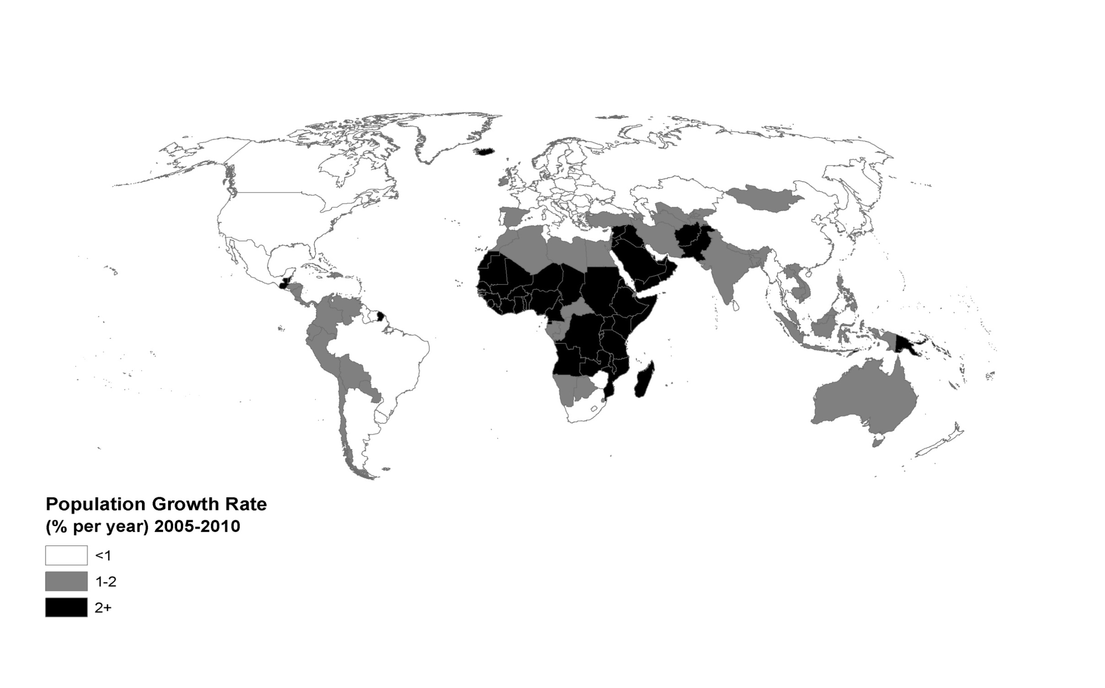
Population growth rates 2005-2010

Slide 8
1.High fertility/growth
2. Intermediate fertility/growth
3. Low fertility/growth

Slide 9
Group 1
Demographic consequences of high fertility
  Rapid population growth
  Young age structure

Slide 12
Group1: Consequences of
High fertility and rapid population growth
• Economic:
Low wages, unemployment, poverty
• Environmental:
Depletion of natural resources, pollution
• Health:
High maternal and child mortality
• Governmental:
Lagging investment in education, health services and infrastructure
• Political:
Rising political unrest and crime

Slide 13
Group 2: Intermediate/ declining fertility
Declining population growth rates
Fewer young people, more workers
Demographic dividend

Slide 14
Population by age: Mexico

Slide 15
Demographic Dividend:
Boosts growth in GDP/cap by raising
1) Relative size of workforce
2) Women’s participation in paid labor force
3) Investments in human and physical capital

Slide 16
Developed world
Demographic
Dividend
Developing world

Slide 18
Group 2: Consequences of
Intermediate/declining fertility
• Economic:
Demographic dividend
• Environmental:
Depletion of natural resources,
air, water and soil pollution
• Health:
Declining maternal and child mortality
• Governmental:
Large investments in education, health services and infrastructure
• Political:
Inequality and disaffected voters

Slide 19
Group 3: Low fertility
Near zero or negative population growth rates
Rapid population aging

Slide 20
Population by age: Italy

Slide 22
Group 3: Consequences of low fertility
• Economic
Slower economic growth
Slower growth in GDP/cap
Slower growth in worker productivity (?)
• Environmental
High GHG emissions and consumption of natural resources
• Governmental
Unsustainable health and pension costs
Rising governmental budget deficits
• Political
Rising voting power of the elderly

Slide 23
Developing world
Developed world

Slide 24
Policy options :
  High fertility countries
  Very low fertility countries

Slide 25
A. Policy options in high fertility countries:
Family planning programs to reduce unplanned pregnancies
Investments in human capital (e.g. girls education)

Slide 28
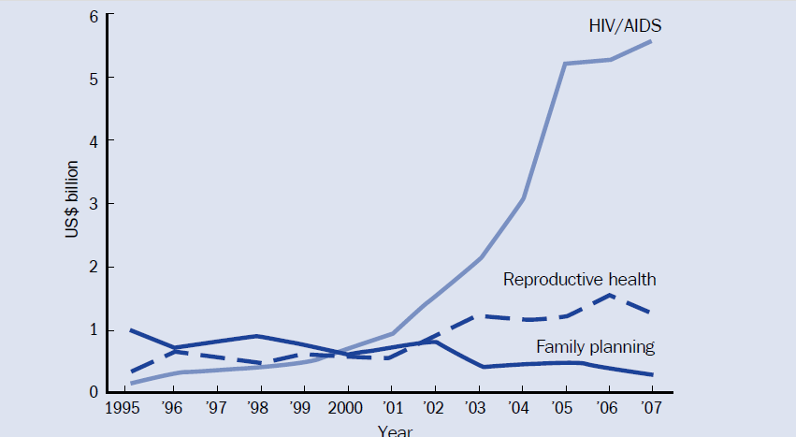
Trends in international assistance for population activities
?

Slide 29
Recent return of interest in Population and FP
Population of Sub-Saharan Africa expected to double by 2040 despite AIDS epidemic
2) Environmental concerns return: global warming, spikes in food and energy prices
Economists (re)discover the demographic dividend
Concern about political and socio-economic consequences of large number of unemployed youth

Slide 30
B. Policy options in aging societies
Pension system options
Reduce benefits; raise contributions; raise age at eligibility; encourage private savings.
Labor force options
Encourage higher labor force participation and later age at retirement.
Demographic options
Encourage childbearing; permit more immigration.

Slide 33
Conclusions
Very high and very low fertility have net adverse effects
Declining high fertility brings multiple benefits for human welfare and the environment
Policies are available to maximize positive effects and minimize negative effects
World is moving from demographic dividend to demographic burden

