Slide 1

Introduction to Operations

Slide 2
Outline
Intro to Operations Management
Administrative Issues
Basic Definitions
Historical Development of OM
Scientific Management
Current Issues in OM
Operations Strategy
Measures of Productivity
Notes:
2

Slide 3
About the Class
Web site
  Mission
  Description
  Syllabus (note special dates)
  Downloads
Textbook
TAs
Notes:
2

Slide 4
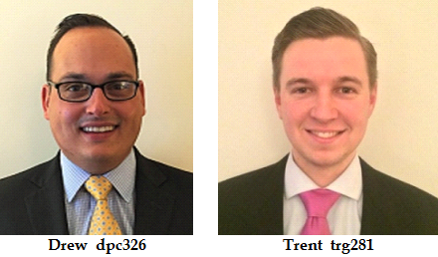

Slide 5
Littlefield Technologies
Setting Up the Game
Round 1
Round 2

Slide 6
1. Order the Littlefield Technologies Access Code
Each student needs an individual access code.
http://mgr.responsive.net/Manager/ShowClient
Institution name: "New York University"
Product: "Littlefield Code for Professor Juran“
Price: $18 (MC, Visa, Discover, AmEx)

Slide 7
2. Register your team at
http://op.responsive.net/lt/nyu/start.html
To register, you need BOTH the individual codes and the course code ''stern''.
Max team size 6 people.
Make up a team name and a team password,
No apostrophes!
Deadline to register: 11:59 PM Wednesday Jan. 3

Slide 8
Playing Round 1
Juran “initializes” the game by 6:00 PM Thursday, January 4, generating 50 days of data and then pausing the game.
Once the simulator has started, access your factory from
http://op.responsive.net/lt/nyu/entry.html
While the game is paused, you can view your factory and analyze the first 50 days of data, but you can’t make changes yet.
Juran starts the game ~2:00 PM Sunday, January 7.
The game ends automatically after 4 days, 22 hours, and 35 minutes (~12:35 PM Friday, January 12).

Slide 9
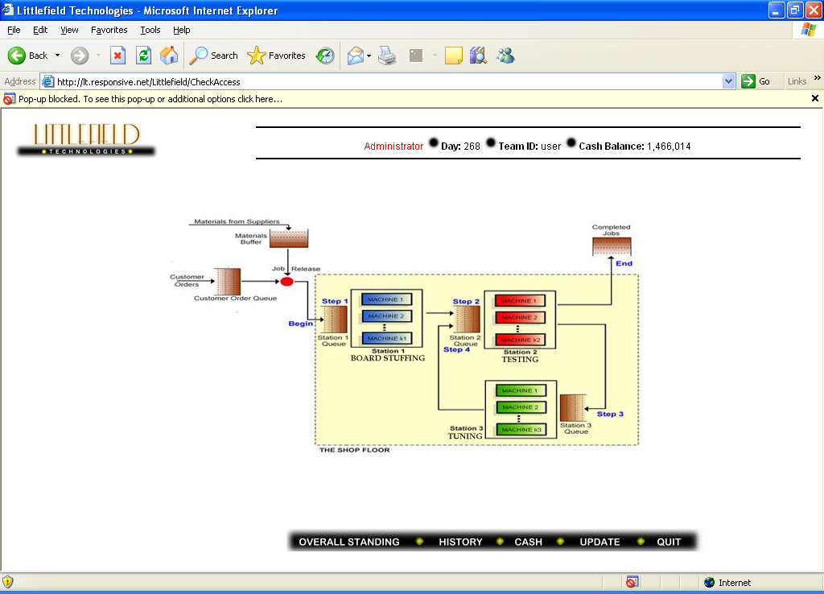

Slide 10
Playing Round 1
Objective: Finish the game with the most cash
Decision variables: Purchases/sales of machines at three manufacturing stations
Written deliverable #1: What decisions did you make? What analysis led you to make those decisions? What did you learn from this game? 2 pages max.

Slide 11
Record Holders (Round 1)
juranjuran
$1,428,756
Shaurav Datta
Gus Giacoman
Jordin Greene
Julia Lamm
Paulo Souza
(all MBA’11)

Slide 12
Record Holders (Round 2)
synergy5
$1,604,719
Neil Mayer
Douglas Monaster
Yothin Peanpanich
Jeff Shiue
Diana Tsirlina
(all MBA’10)

Slide 13
Record Holders (Total)
synergy5
$2,984,853
Neil Mayer
Douglas Monaster
Yothin Peanpanich
Jeff Shiue
Diana Tsirlina
(all MBA’10)

Slide 14
What is Operations Management?
The design, control, and improvement of the systems that create and deliver the firm’s primary products and services

Slide 15
What is a Production System?
A user of resources to transform inputs into some desired outputs

Slide 16
Important Measures of Performance
Efficiency: Using a minimum of resources
Effectiveness: Creating value for some customer

Slide 17
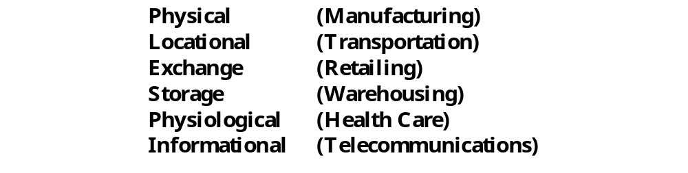
Transformations
Notes:
7

Slide 18
Manufacturing vs. Services
What differentiates manufacturing operations from service operations?
J&C proposition: All businesses are services
Notes:
7

Slide 19
Historical Development of OM
Craft System
Industrial Revolution
Scientific Management
Organizational Science
Operations Research
JIT and TQM
Supply Chain Management
Internet Commerce
Notes:
14

Slide 20
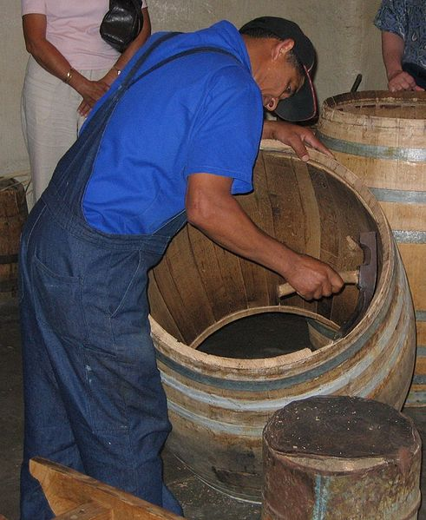
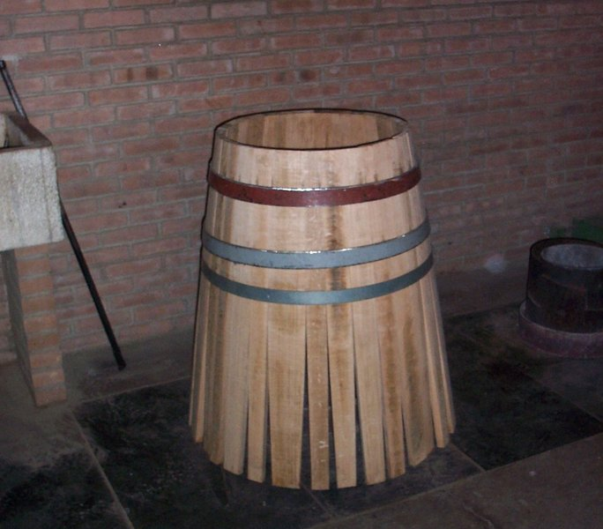
Craft System
Notes:
14

Slide 21
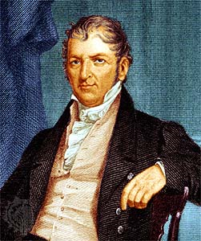


Industrial Revolution
Eli Whitney
(1765 – 1825)

Slide 22
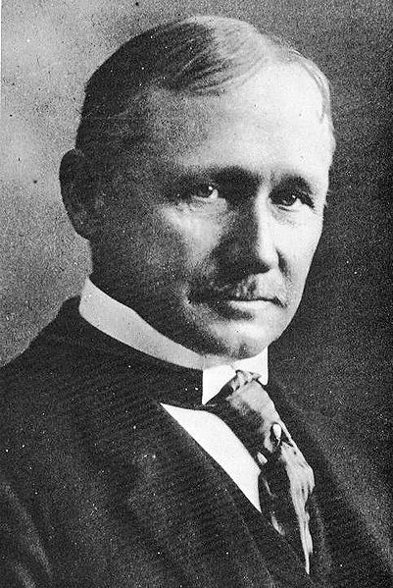

Scientific Management
Frederick W. Taylor
(1856 – 1915)

Slide 23
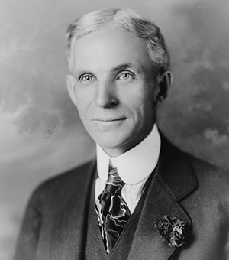

Industrial Revolution
Henry Ford
(1863 – 1947)

Slide 24
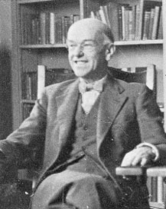

Organizational Science
Elton Mayo
(1880 - 1949)

Slide 25
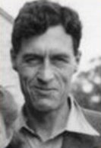

Operations Research
Patrick Blackett
(1897 - 1974)

Slide 26

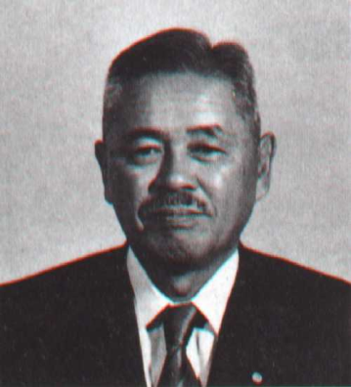
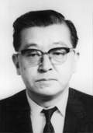
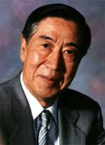
JIT and TQM
Taiichi Ohno
(1912 – 1990)
Kaoru Ishikawa
(1915 – 1989)
Genichi Taguchi
(1924 – 2012)

Slide 27
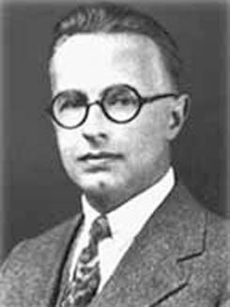
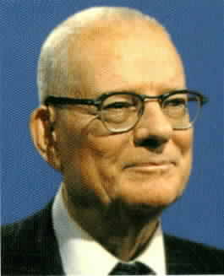
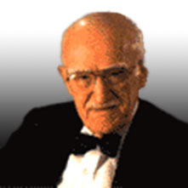



JIT and TQM
Walter Shewhart
(1891 – 1967)
W. Edwards Deming
(1900 – 1993)
Joseph M. Juran
(1904 – 2008)

Slide 28
Current Issues in OM
Effectively consolidating the operations resulting from mergers
Developing flexible supply chains to enable mass customization of products and services
Managing global supplier, production and distribution networks
Increased “commoditization” of suppliers
Notes:
14

Slide 29
Current Issues in OM (cont’d)
Achieving the “Service Factory”
Enhancing value added services
Making efficient use of Internet technology
Achieving good service from service firms
Operational risk
Reduced environmental impact
Reduced energy consumption
Notes:
15

Slide 30
Operations Strategy
J&C: Setting broad policies and plans for using the resources of the firm to best support its long-term competitive strategy
Juran: Deciding how the firm’s competitive strategy will actually happen, in terms of processes that are more efficient and/or more effective than the competition’s processes.
Notes:
3

Slide 31
Operations Strategy
Key questions:
What business are we in?
Who are the customers?
What do the customers need?
How can we meet those needs more efficiently/effectively than the competition?
How is all of this going to change over time?
Notes:
3

Slide 32
Competitive Dimensions
Cost
Product Quality and Reliability
Delivery Speed
Delivery Reliability
Coping with Changes in Demand
Flexibility and New Product Introduction Speed
Other Product-Specific Criteria
Notes:
4

Slide 33
Dealing with Trade-offs
Cost vs. Quality
Flexibility vs. Speed
Etc.
Notes:
5

Slide 34
Strategic Frameworks
Kaplan and Norton:
Financial
Customer
Internal
Learning and Growth
Notes:
3

Slide 35
Strategic Frameworks
Michael Porter:
Rivalry
Threat of Substitutes
Buyer Power
Supplier Power
Barriers to Entry / Threat of Entry
Notes:
3

Slide 36
What is Productivity?
Productivity is a common measure on how well resources are being used. In the broadest sense, it can be defined as the following ratio:
Outputs
Inputs

Slide 37
Total Measure Productivity
Total Measure Productivity = Outputs
  Inputs
or
= Goods and services produced
All resources used
Notes:
17

Slide 38
Partial Measure Productivity
Output or Output or Output or Output
  Labor Capital Materials Energy
Notes:
17

Slide 39
Multifactor Measure Productivity
Output .
  Labor + Capital + Energy
  or
Output .
  Labor + Capital + Materials
Notes:
17

Slide 40
Summary
Intro to Operations Management
Administrative Issues
Basic Definitions
Historical Development of OM
Scientific Management
Current Issues in OM
Operations Strategy
Measures of Productivity
Notes:
2

