Slide 1

Process Analysis II

Slide 2
Outline
Types of Processes
Kristin
Benihana
Scientific Management
Notes:
2

Slide 3
Few
Major
Products,
Higher
Volume
High
Volume,
High
Standard-
ization
Low
Volume,
One of a
Kind
Multiple
Products,
Low
Volume
I.
Job
Shop
Commercial
Printer
French Restaurant
Flexibility (High)
Unit Cost (High)
II.
Batch
Heavy
Equipment
These are the major stages of product and process life cycles
III.
Assembly
Line
Automobile
Assembly
Burger King
IV.
Continuous
Flow
Sugar
Refinery
Flexibility (Low)
Unit Cost (Low)
Notes:
13

Slide 4
Process Flow Structures
Continuous Flow (ex. Petroleum manufacturer)
Assembly Line (ex. Automobile manufacturer)
Batch shop (ex. Copy center making 10,000 copies of an ad piece for a business)
Job shop (ex. Copy center making a single copy of a student term paper)
Extreme Case: Project (ex. Legal Counsel for a Criminal Trial)
Notes:
12

Slide 5
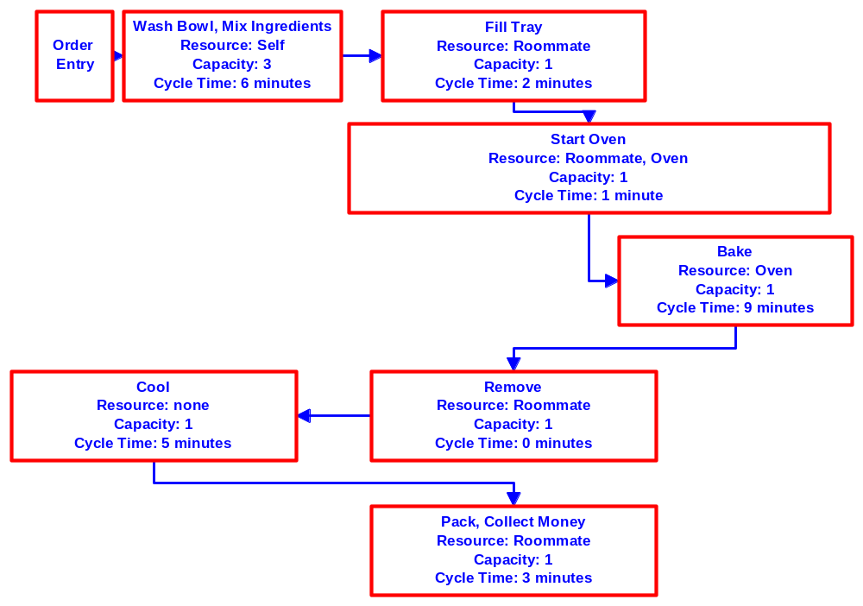
Kristin’s Cookies
Notes:
2

Slide 6
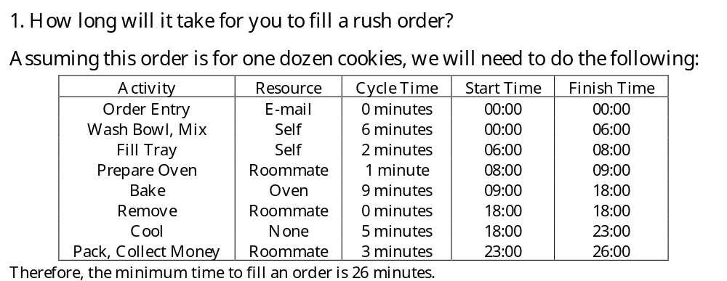

Slide 7
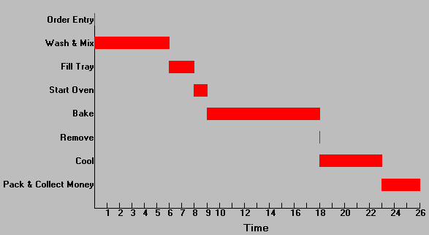

Slide 8
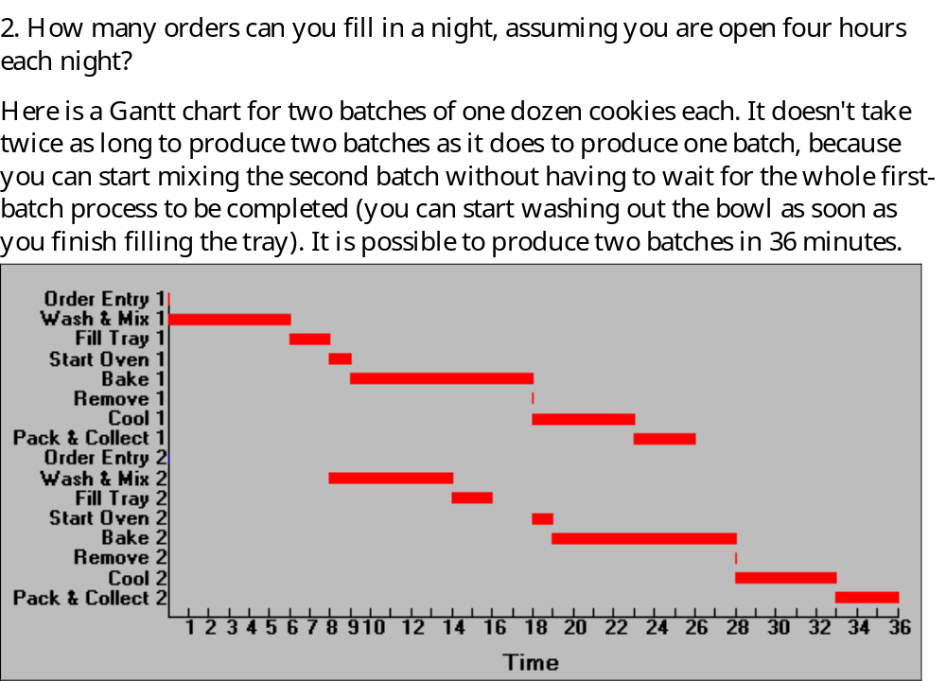

Slide 9

In general, a formula for the number of minutes to produce n one-dozen batches is given by this expression:

Slide 10
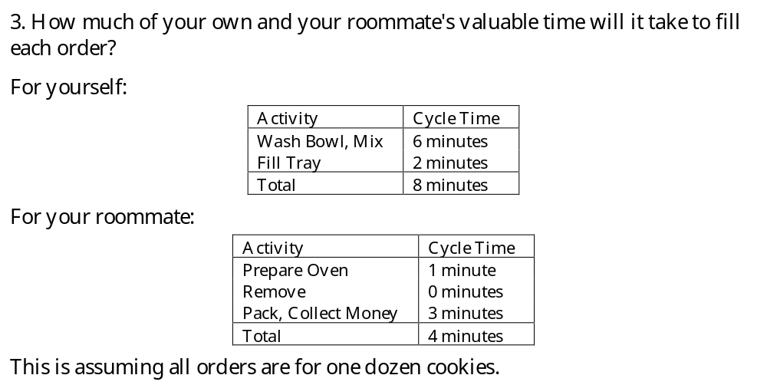

Slide 11
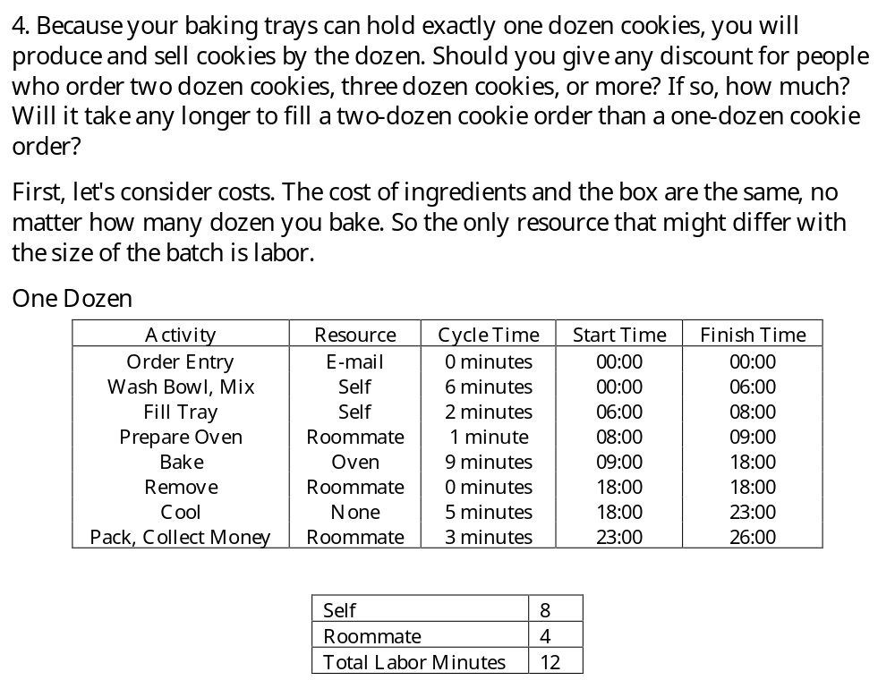

Slide 12
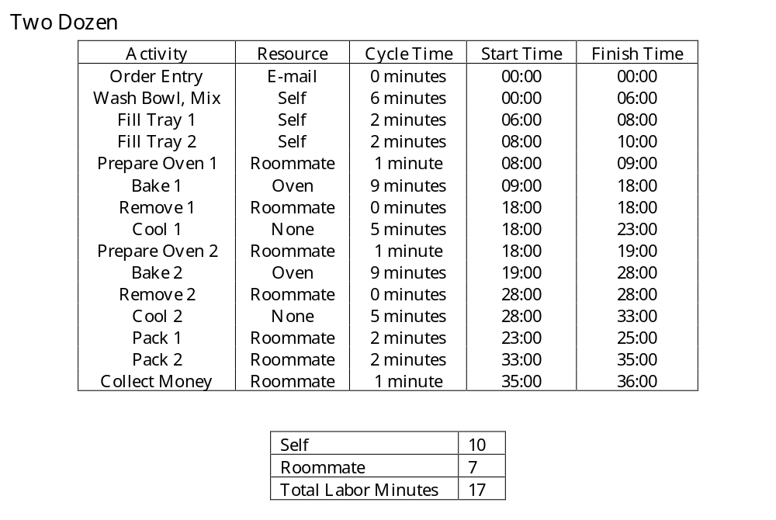

Slide 13
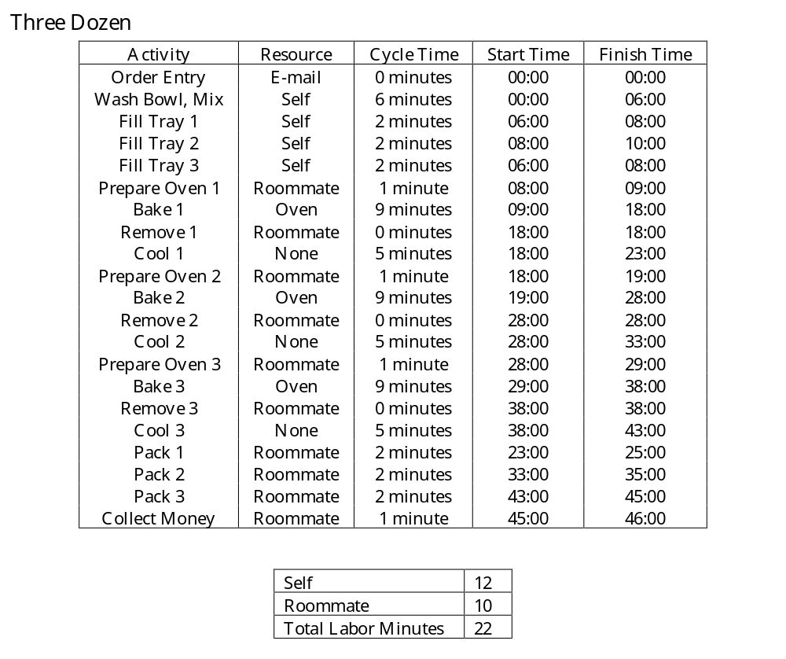

Slide 14
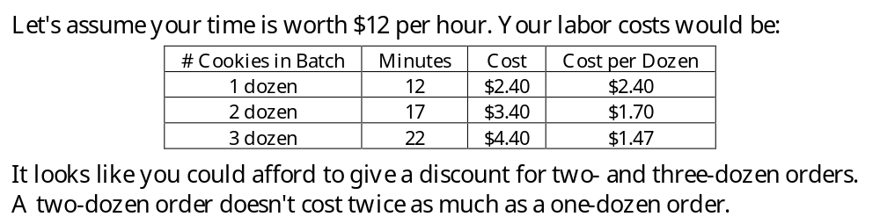

Slide 15
5. How many food processors and baking trays will you need?
The food processor is only used in the mixing stage, and we ought to be able to see that the processor is idle for long periods of time, and that the real bottleneck is the oven. Buying another food processor won't improve the productivity of the system at all.
The number of baking trays ought to equal the maximum number of trays you will be using at any one time. Three is probably enough.

Slide 16
6. Are there any changes you can make in your production plans that will allow you to make better cookies or more cookies in less time or at lower cost? For example, is there a bottleneck operation in your production process that you can expand cheaply? What is the effect of adding another oven? How much would you be willing to pay for an additional oven?

Slide 17
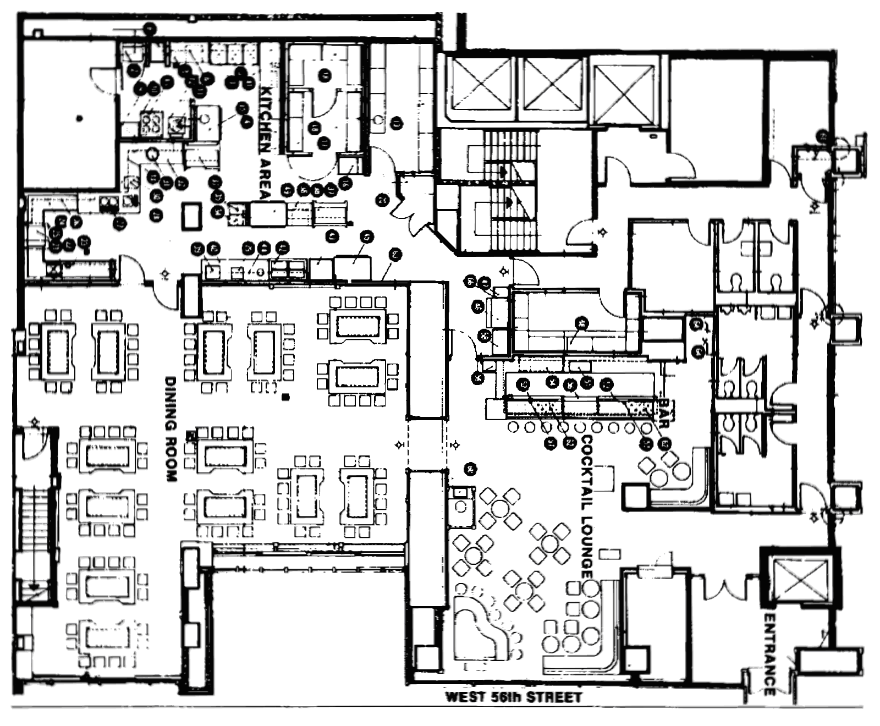
Benihana Restaurant
Notes:
2

Slide 18
Benihana: Process Analysis
Important parameters:
How many chefs and waitresses there are
How frequently customers arrive at the restaurant
How quickly customers are seated, either in the bar or in the dining area
How frequently the customers order and consume drinks
How quickly drinks are served
How long it takes to prepare the meal at the grill
How long it takes for the customers to eat their meal
How long it takes for customers to pay and leave the dining area.

Slide 19
Benihana: Process Analysis
Assume that the dining process takes 60 minutes, and that we want customers in the bar for 24 minutes.
Consider three scenarios:
Bar - 8 seats; Dining area - 40 seats
Bar - 16 seats; Dining Area - 80 seats
Bar - 48 seats; Dining Area - 120 seats

Slide 20
Benihana: Process Analysis
Bar - 8 seats; Dining area - 40 seats
It takes 60 minutes for one customer to eat dinner, and there are 40 seats in the dining area. Therefore 40 people eat every 60 minutes (throughput).
On the average a dinner cycle is completed every 60 minutes/40 people = 1.5 minutes per person (cycle time).
We know that dinners are processed in batches of 8, so on the average a table of 8 finishes every 12 minutes.

Slide 21
Benihana: Process Analysis
Bar - 8 seats; Dining area - 40 seats
This means that the 8-seat bar must empty every 12 minutes.
The "ideal" time for someone to remain in the bar is about double that time (because this will be just after the second drink has reached the table).
Therefore, it would appear that the ratio of 0.2 (8 bar seats to 40 dining seats) is too small.

Slide 22
Benihana: Process Analysis
Bar - 16 seats; Dining Area - 80 seats
It takes 60 minutes for one customer to eat dinner, and there are 80 seats in the dining area. Therefore 80 people eat every 60 minutes (throughput).
On the average a dinner cycle is completed every 60 minutes/80 people = 0.75 minutes per person (cycle time).
We know that dinners are processed in batches of 8, so on the average a table of 8 finishes every 6 minutes.

Slide 23
Benihana: Process Analysis
Bar - 16 seats; Dining Area - 80 seats
This means that the 16-seat bar must empty every 12 minutes.
Therefore, it would appear that the ratio of 0.2 (16 bar seats to 80 dining seats) is too small.
In fact, all this does is double the restaurant’s capacity, and the bar time remains at 12 minutes.
The only benefit is that 16 seats might allow the host or hostess to do a better job of assembling groups of eight.

Slide 24
Benihana: Process Analysis
Bar - 48 seats; Dining Area - 120 seats
It takes 60 minutes for one customer to eat dinner, and there are 120 seats in the dining area. Therefore 120 people eat every 60 minutes (throughput).
On the average a dinner cycle is completed every 60 minutes/120 people = 0.5 minutes per person (cycle time).
We know that dinners are processed in batches of 8, so on the average a table of 8 finishes every 4 minutes.

Slide 25
Benihana: Process Analysis
Bar - 48 seats; Dining Area - 120 seats
To send 8 people into the dining area every 4 minutes means that the 48-seat bar must empty every 24 minutes.
Perfect!
Given our assumptions regarding the cycle times of the bar and the dining area, it would appear that a ratio of bar seats to grill seats of 0.4 is about right.
(In our case 120:48, but the ratio is more important than the specific numbers.)

Slide 26
Historical Development of OM
Craft System
Industrial Revolution
Scientific Management
Organizational Science
Operations Research
JIT and TQM
Supply Chain Management
Internet Commerce
Notes:
14

Slide 27
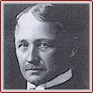
Scientific Management
Frederick Winslow Taylor, (1856-1915), American industrial engineer.
In 1878, he began working at the Midvale Steel Company.
Developed measures of productivity based on time & motion studies.
Became rich from 100+ patents including tempered steel.

Slide 28
Taylor’s Industrial Environment
Large numbers of unskilled workers
Many immigrants who often didn’t speak English
Homogeneous markets meant great returns to scale (e.g, Model T dropped in price from $1000 to $360)
Management not viewed as a general or learnable skill

Slide 29
Scientific Management
Defined by Frederick Taylor, late 1800s.
The systematic study of the relationships between people and tasks to redesign the work for higher efficiency.
  Taylor sought to reduce the time a worker spent on each task by optimizing the way the task was done.
Significant improvements in productivity
Notes:
n Defined by Frederick Taylor, during the late 1800’s.
n Many students seem to feel that the drive for higher efficiency is a recent concept in business. Not true!
n Taylor sought efficiency gains over a century ago. He studied the relationships between people and tasks and then redesigned the task for higher efficiency.
n For example, Taylor would try to reduce the time a worker spent on each task by optimizing the way the task was done. Perhaps he would change the position of the tools used or the way the parts were arranged during assembly.

Slide 30

Taylor’s 4 Principles
Develop a science for each element of work
Select, train, and develop workers
Cooperate with workers (share the savings – more $$$ for better performance)
Divide work and responsibility equally
2-6
Notes:
6

Slide 31
Resistance to Taylor
Separation of work from planning destroyed the traditional craft system – ‘money substituted for pride’
Unions mistrusted – Taylor reduced work force from 450 to 150 on first job
Some firms cut rates after changes
Legislation to prevent time studies in government jobs.

Slide 32
Frank & Lillian Gilbreth
Time and Motion Studies
Film
Therbligs
Cheaper by the Dozen
Henry L. Gantt
Engineer; worked with Taylor
Gantt Chart

Slide 33
The Gilbreths
Frank and Lillian Gilbreth refined Taylor’s methods.
  Made many improvements to time and motion studies.
Time and motion studies:
  1. Break down each action into components.
  2. Find better ways to perform it.
  3. Reorganize each action to be more efficient.
Gilbreths also studied fatigue problems, lighting, heating and other worker issues.
Notes:
n The Gilbreths made many improvements to time and motion studies that were implied by Taylor.
n Exactly what are Time and motion studies?
› Break down each action into components.
› Find better ways to perform it.
› Reorganize each action to be more efficient.
› Example: Ask a student to take out a piece of paper from a notebook, enter four numbers in columns, and then replace the paper. Have another time the student during each element.
n The Gilbreths were also early leaders in the study of fatigue problems, lighting, heating and other worker issues.

Slide 34
Summary
Types of Processes
Kristin
Benihana
Scientific Management
Notes:
2

