Slide 1

Process Analysis III

Slide 2
Outline
Set-up times
Lot sizes
Effects on capacity
Effects on process choice
Notes:
2

Slide 3
Set-up Times
Many processes can be described (at least approximately) in terms of
  a fixed set-up time and
  a variable time per unit (a.k.a. cycle time)
Capacity of a single activity is a function of lot size, set-up time, and cycle time
Overall capacity of a system depends on these factors and the resulting bottlenecks across multiple activities
Notes:
2

Slide 4
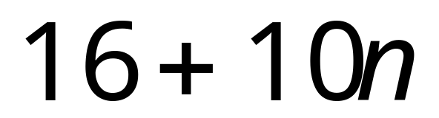
Example: Kristen
In general, a formula for the number of minutes to produce n one-dozen batches is given by this expression:
Set-up time
Cycle time per 1-dozen batch
This views the cookie operation as a single activity. We arrived at these numbers through analysis of individual sub-activities at a more detailed level.
Notes:
2

Slide 5
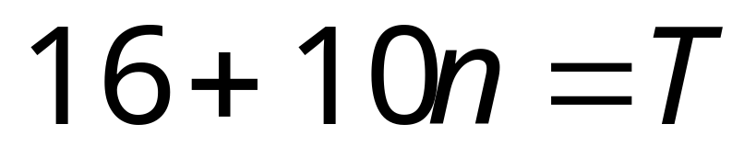
Example: Kristen
Note that Kristen’s effective cycle time is 10 minutes per 12 cookies, or 0.8333 minutes per cookie, assuming a lot size of 12 cookies.
We can determine the capacity of the system in a specific period of time T by solving for n:
Notes:
2

Slide 6

Example 1
We can determine the capacity of the system in a specific period of time T by solving for n.
How many 1-dozen batches could Kristen produce in 4 hours?
In this situation, the capacity of the system is a linear function of the time available.
Notes:
2

Slide 7
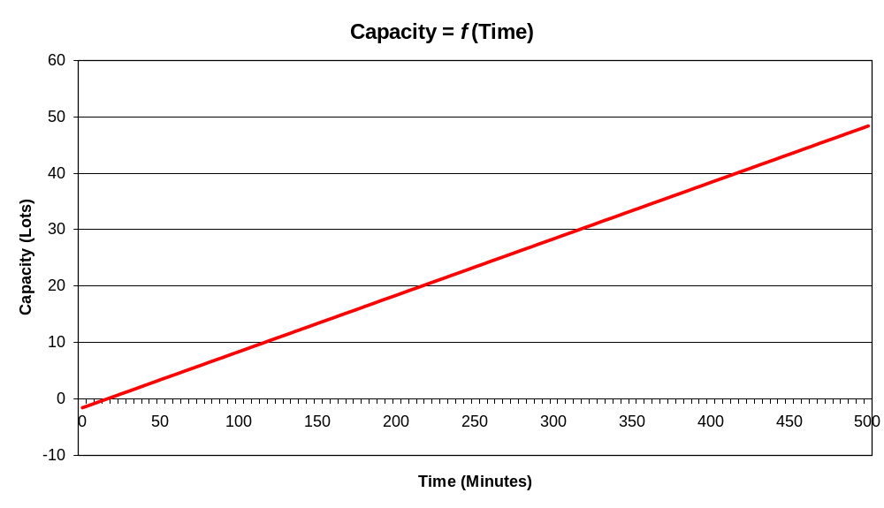

Slide 8
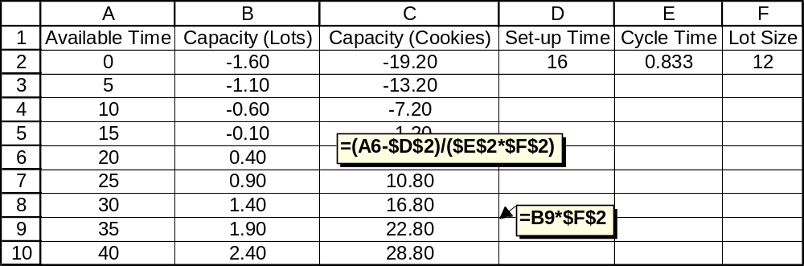
Notes:
2

Slide 9

Example 2
This assumes that the set-up only needs to be done once.
What if there were a 16-minute set-up for every lot?
This effectively makes the set-up time zero, and the cycle time 26 minutes per 12-cookie lot.
Capacity is still a linear function of the time available.
Notes:
2

Slide 10
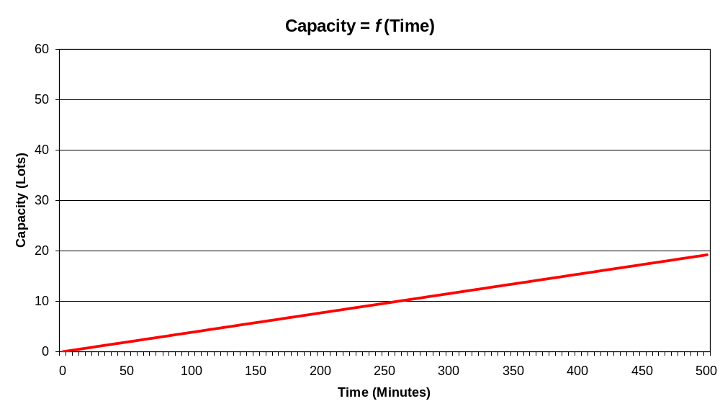

Slide 11
Let’s make some assumptions; a system similar (but not identical) to the Kristen system:
Produce individual units (cookies)
The cycle time is 0.8333 minutes per cookie
The set-up time is s minutes, and needs to be performed again for every “lot” of 12 cookies
The capacity of this system (in “lots”) over 240 minutes is:
240/(s + 0.8333 * 12)
The capacity of this system (in “lots”) with a 16-minute set-up is:
240/(s + 0.8333 * 12) = 9.23
(or 9.23 * 12 = 110.77 cookies)
Notes:
2

Slide 12
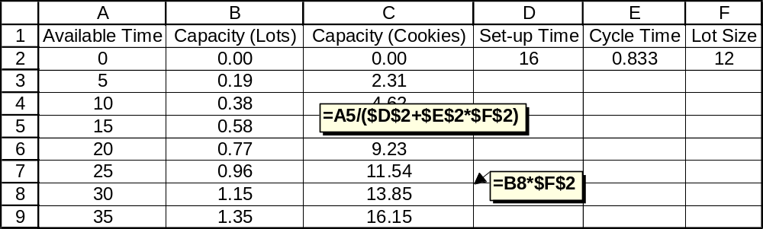
Notes:
2

Slide 13
Example 3
Now let’s assume the time available is fixed at 240 minutes, and study the effect on capacity that results from changing the set-up time.
The capacity of this system (in “lots”) with an s-minute set-up is:
240/(s + 0.8333 * 12)
(a nonlinear function of the set-up time)
Notes:
2

Slide 14
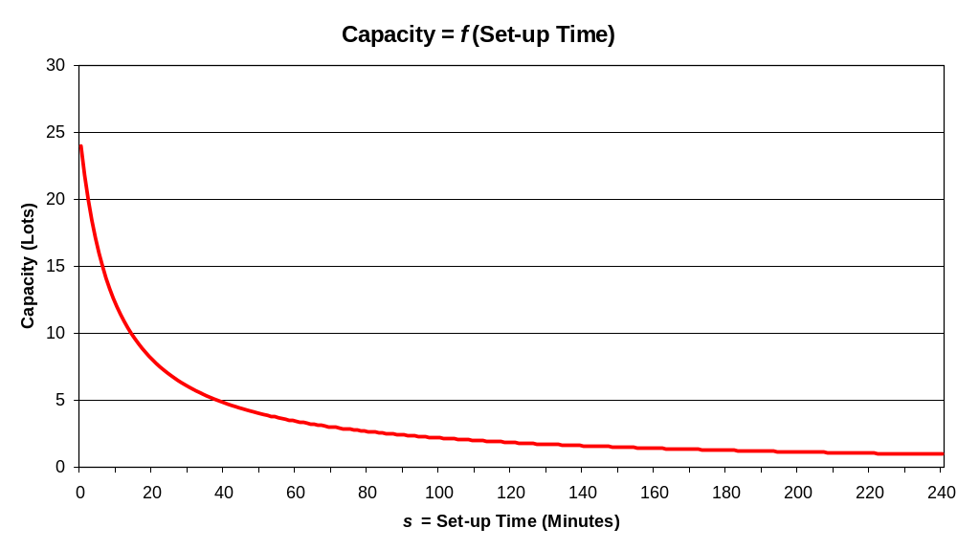
Notes:
2

Slide 15
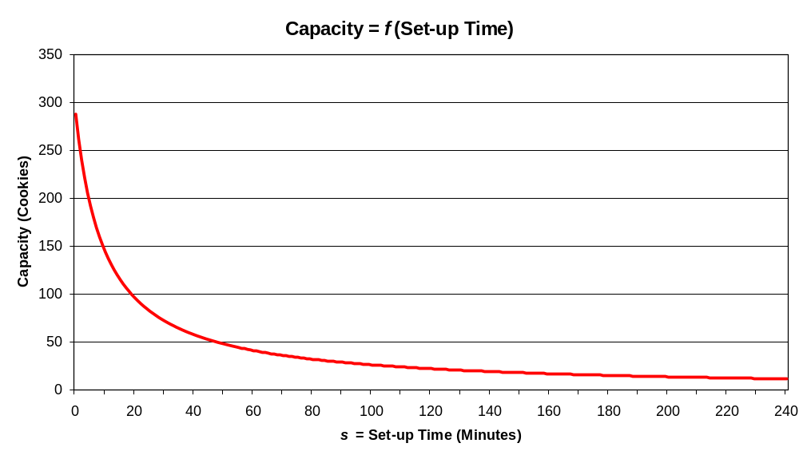
Capacity could also be measured in “cookies” instead of “12-cookie lots”:
Notes:
2

Slide 16
Extreme Case 1:
If the set-up time is zero, then the capacity of this system (in “lots”) over 240 minutes is:
240/(0 + 0.8333 * 12) = 24 lots
Extreme Case 2:
If the set-up time is 240, then the capacity of this system (in “lots”) over 240 minutes is zero (because all of the time is consumed by setting up)
Notes:
2

Slide 17
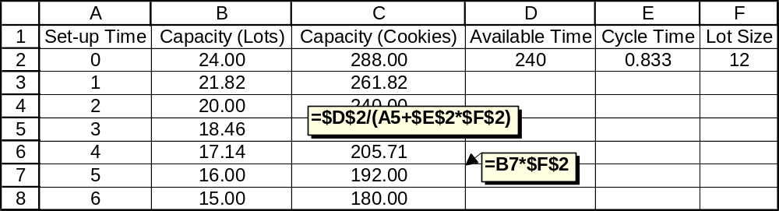
Notes:
2

Slide 18
Example 4
Now let’s assume the time available is fixed at 240 minutes, AND fix the set-up time at 16 minutes, to study the effect on capacity that results from changing the lot size.
The capacity of this system (in “cookies”) with an s-minute set-up is:
240/(16 + 0.8333 * Q)
(another nonlinear function)
Notes:
2

Slide 19
Extreme Case 1:
240/16 = 15 gives an upper bound to the number of lots; in that case we would use up all of our time setting up, and never make any cookies.
Extreme Case 2:
If we assume only one set-up, then the capacity is
240 - 16/0.8333 = 268.8 cookies
The largest lot that can be completed in 240 minutes is 268.
Extreme Case 3:
If we assume no set-up, then the capacity is
240/0.8333 = 288 cookies
The largest lot that can be completed in 240 minutes is 288.
Notes:
2

Slide 20
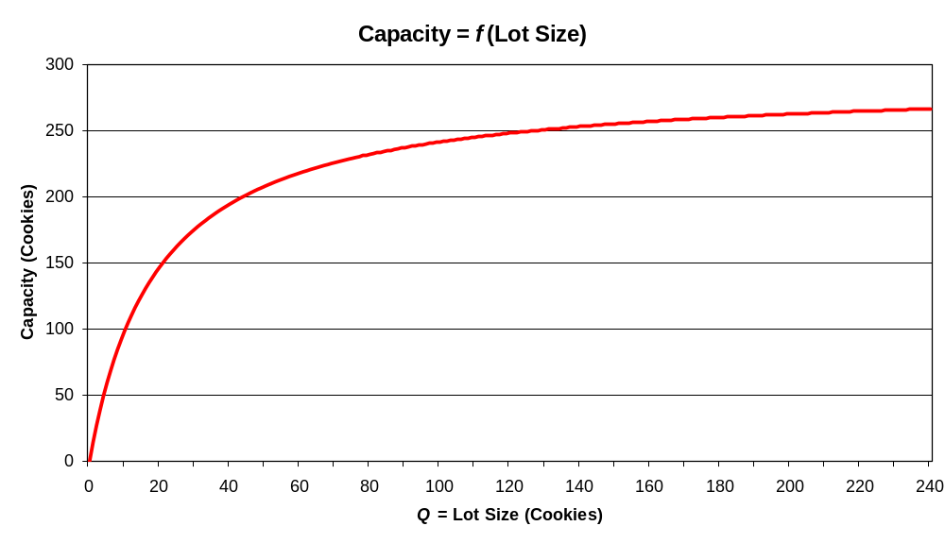
Notes:
2

Slide 21
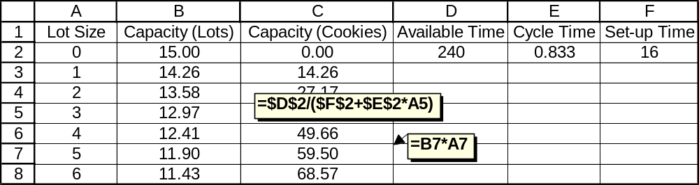
Notes:
2

Slide 22
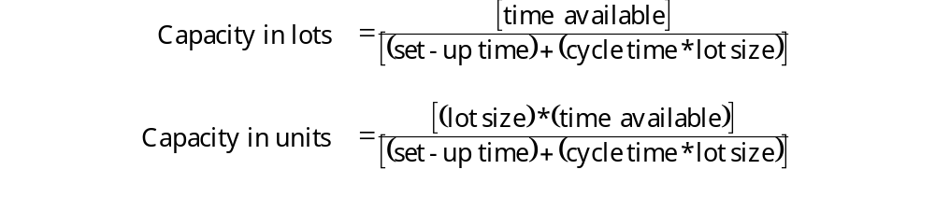
Example 5
What if the lot size AND the set-up time are variables?
We can determine the capacity of the system in a specific period of time using this complicated function of lot size, cycle time, set-up time, and the time available for production:
Notes:
2

Slide 23
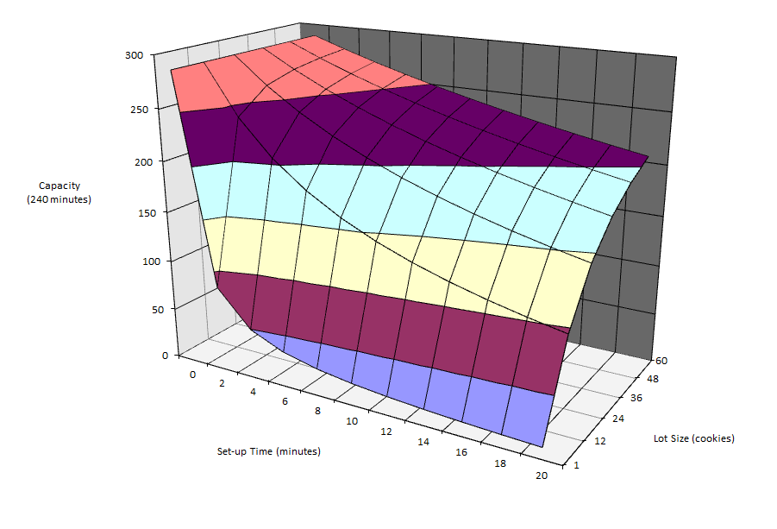
Assume 240 minutes available, and 0.8333 minute cycle time:
Notes:
2

Slide 24
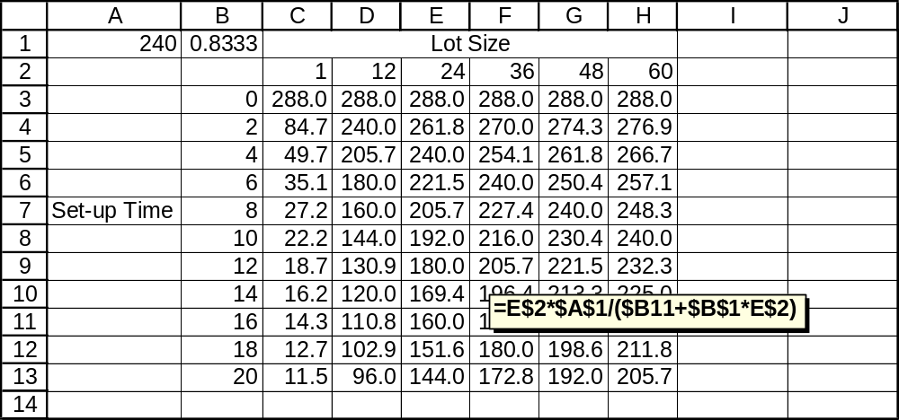
Notes:
2

Slide 25
Why Do We Care?
It might be on the quiz
Needed for cases like Kristen
Drives major decisions regarding operations strategy, technology choice, process design, and capital investment
Notes:
2

Slide 26
Process Choice
Sometimes we get to choose among several possible technologies
One important factor is capacity: Which technology can meet demand fastest?
This may depend on lot size
Similar to make-vs-buy decisions
Notes:
2

Slide 27
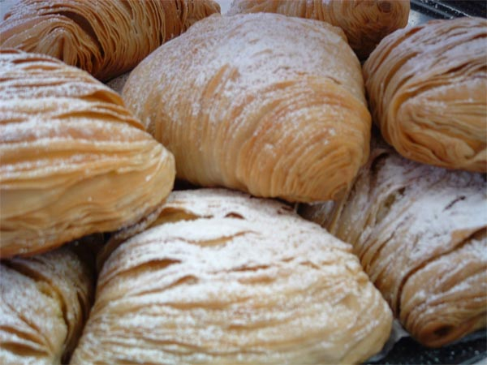

Slide 28
Example: Make vs. Buy
Colarusso Confectioners needs to fill an order for 500 sfogliatelle (a famous Italian pastry) for one of their clients.
Colarusso has the in-house capability to produce sfogliatelle, but this is an unusually large order for them and they are considering whether to outsource the job to Tumminelli Industries, Inc. (a regional pastry supplier with equipment designed for greater volume).
The customer service rep from Tumminelli quotes a rate for sfogliatelle as follows: a fixed order cost of $135 plus $0.25 per sfogliatella. Colarusso’s in-house costs are $75.00 to set up production and $0.39 per unit.
Notes:
2

Slide 29
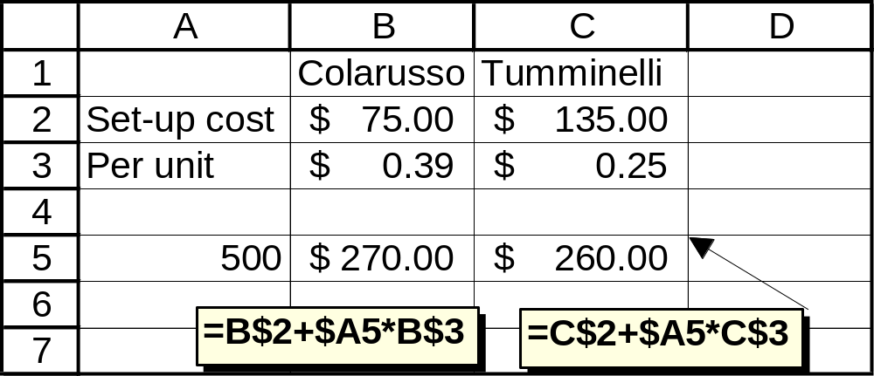
What should Colarusso do with this order for 500 svogliatelle?
The total cost of the order will be lower if Colarusso outsources this job to Tumminelli.
Notes:
2

Slide 30
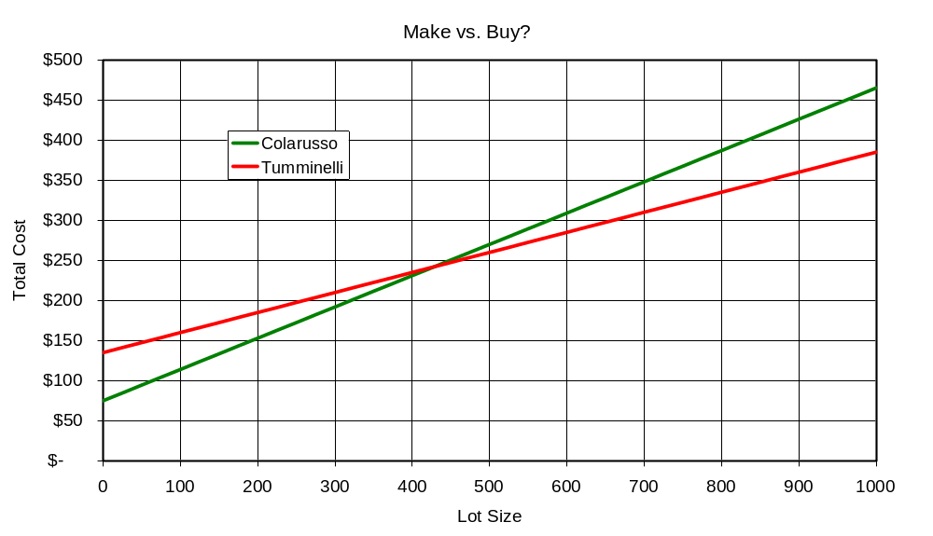
Obviously Colarusso has an advantage for small lot sizes, and Tumminelli has an advantage for large lot sizes. What is the break-even point?
Notes:
2

Slide 31

Finding the break-even point algebraically:
Notes:
2

Slide 32

Process Choice Example
All-American Industries is considering which of two machines to purchase:
If the typical lot size is 200 units, which machine should they buy?
What is the capacity of that machine in a 480-minute shift?
What is the break-even lot size for these two machines?
Notes:
2

Slide 33

If the typical lot size is 200 units, which machine should they buy?
Notes:
2

Slide 34
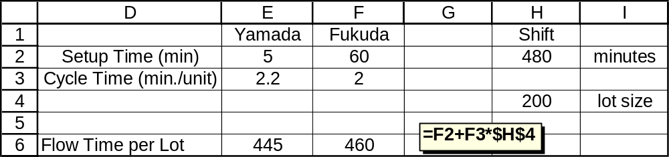
Notes:
2

Slide 35
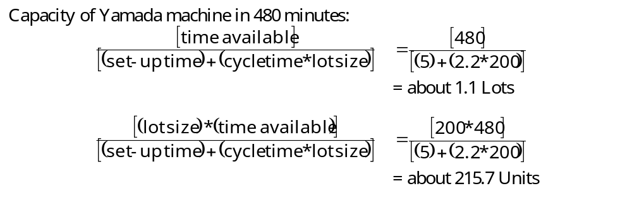
What is the capacity of that machine in a 480-minute shift?
Notes:
2

Slide 36
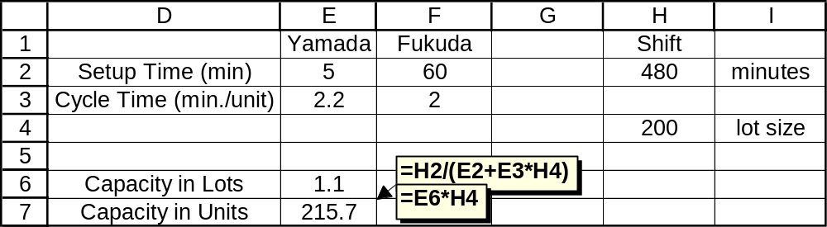
Notes:
2

Slide 37
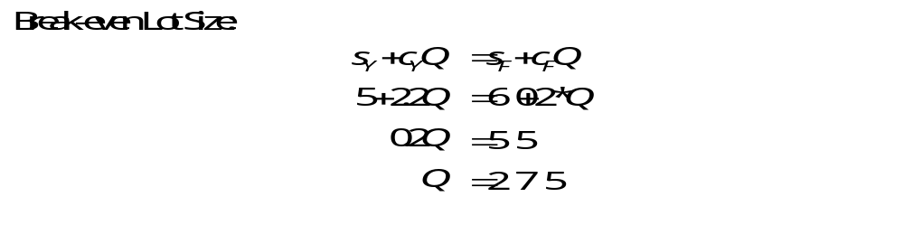
What is the break-even lot size for these two machines?
Notes:
2

Slide 38
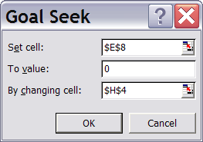
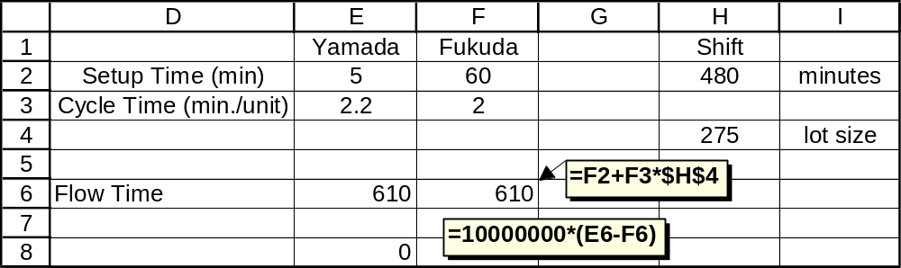
Notes:
2

Slide 39
Summary
Set-up times
Lot sizes
Effects on capacity
Effects on process choice
Notes:
2

