Slide 1

Optimization I

Slide 2
Outline
Basic Optimization: Linear programming
  Graphical method
  Spreadsheet Method
Extension: Nonlinear programming
  Portfolio optimization

Slide 3
What is Optimization?
A model with a “best” solution
Strict mathematical definition of “optimal”
Usually unrealistic assumptions
Useful for managerial intuition

Slide 4
Elements of an Optimization Model
Formulation
  Decision Variables
  Objective
  Constraints
Solution
  Algorithm or Heuristic
Interpretation

Slide 5
Optimization Example:
Extreme Downhill Co.

Slide 6
1. Managerial Problem Definition
Michele Taggart needs to decide how many sets of skis and how many snowboards to make this week.

Slide 7
2. Formulation
a. Define the choices to be made by the manager (decision variables).
b. Find a mathematical expression for the manager's goal (objective function).
c. Find expressions for the things that restrict the manager's range of choices (constraints).

Slide 8
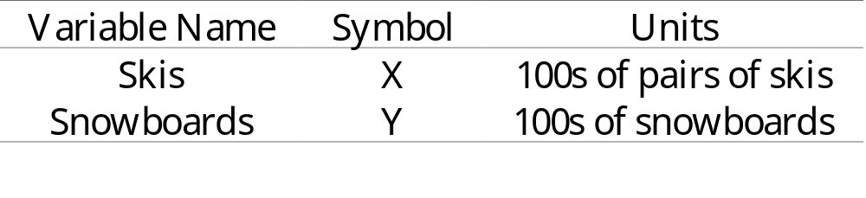
2a: Decision Variables

Slide 9
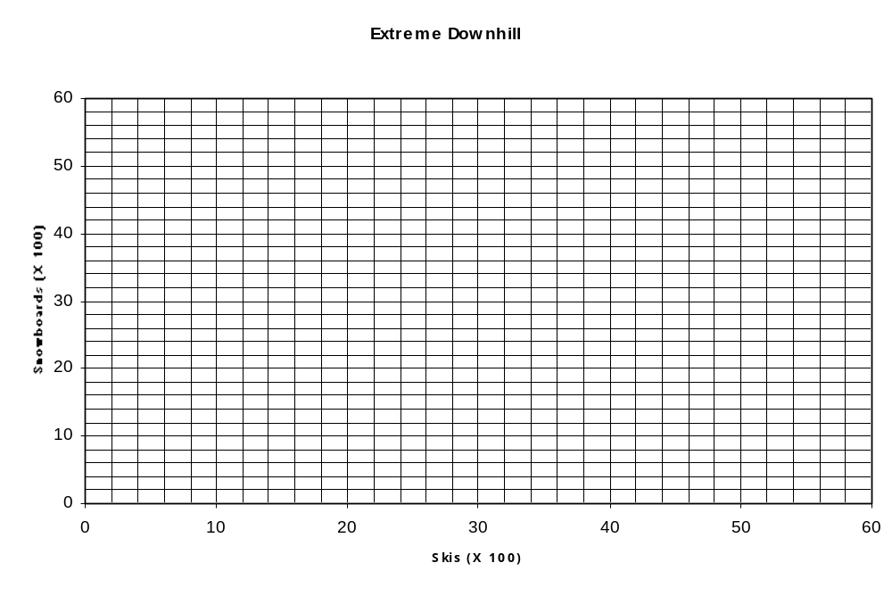

Slide 10
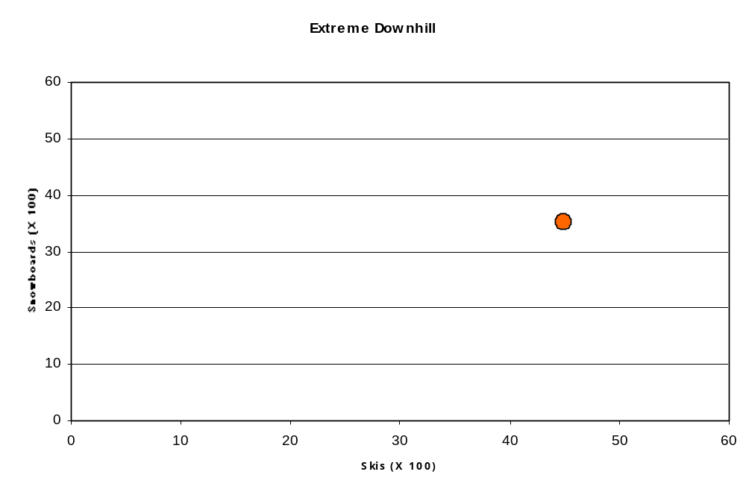

Slide 11
2b: Objective Function
Find a mathematical expression for the manager's goal (objective function).

Slide 12
EDC makes $40 for every snowboard it sells, and $60 for every pair of skis. Michele wants to make sure she chooses the right mix of the two products so as to make the most money for her company.

Slide 13
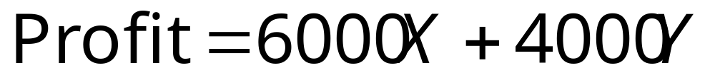
What Is the Objective?

Slide 14
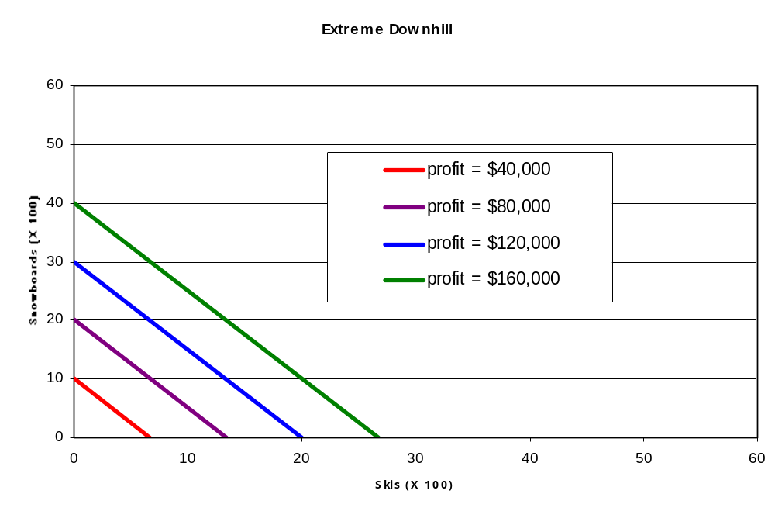

Slide 15
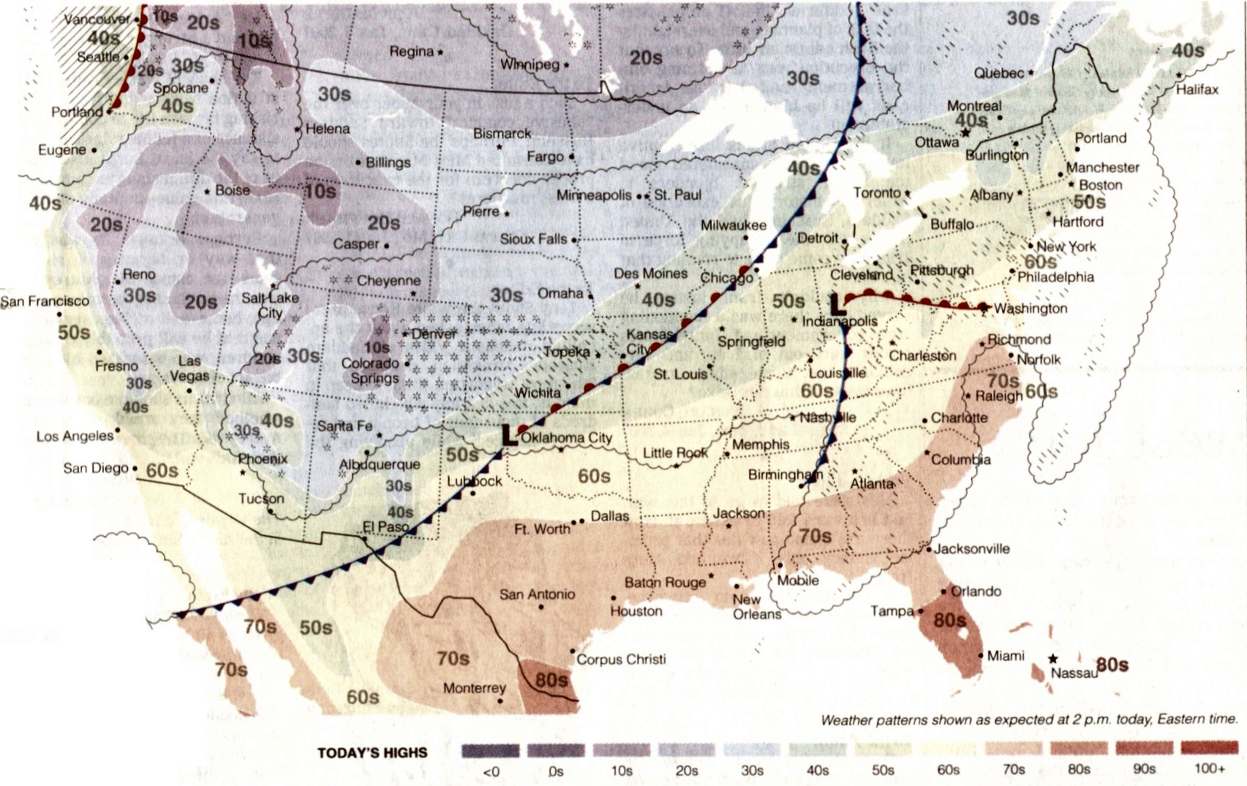

Slide 16
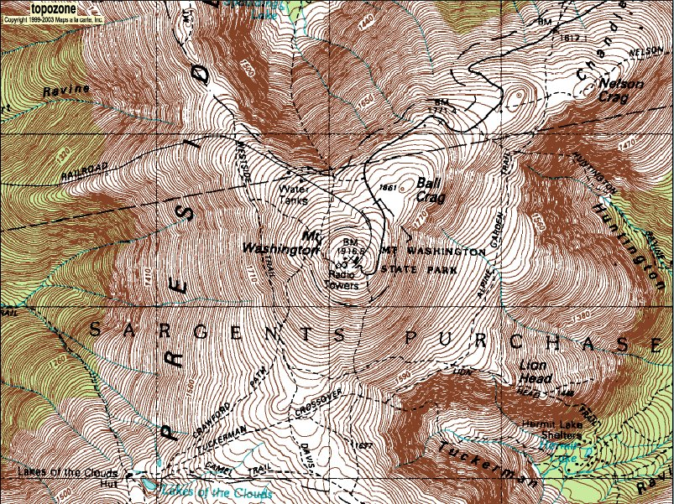

Slide 18
2c: Constraints
Find expressions for the things that restrict the manager's range of choices (constraints).

Slide 19
Molding Machine Constraint
The molding machine takes three hours to make 100 pairs of skis, or it can make 100 snowboards in two hours, and the molding machine is only running 115.5 hours every week.
The total number of hours spent molding skis and snowboards cannot exceed 115.5.

Slide 20
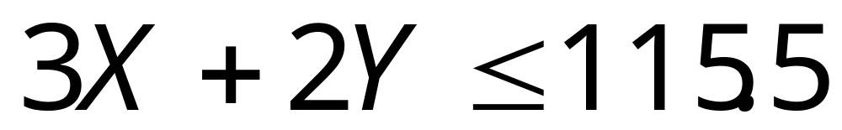
Molding Machine Constraint

Slide 21
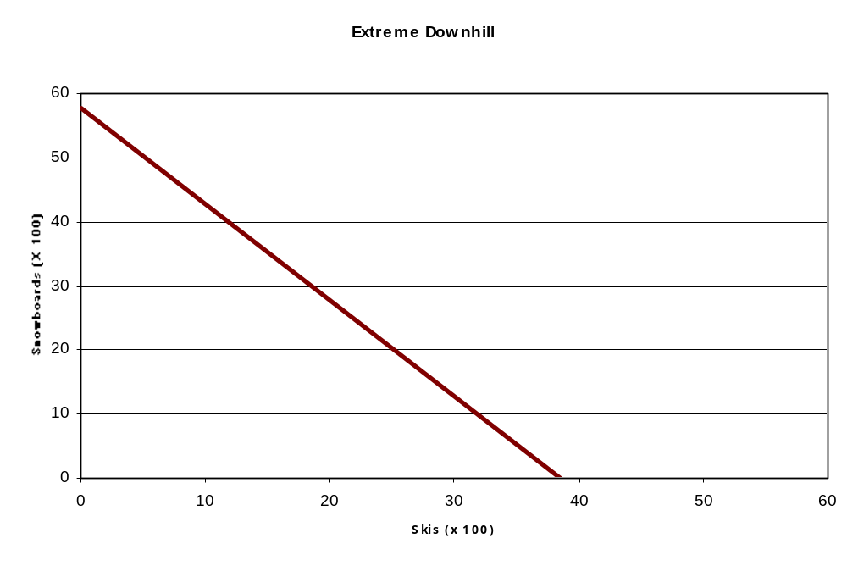

Slide 22
Cutting Machine Constraint
Michele only gets to use the cutting machine 51 hours per week. The cutting machine can process 100 pairs of skis in an hour, or it can do 100 snowboards in three hours.

Slide 23
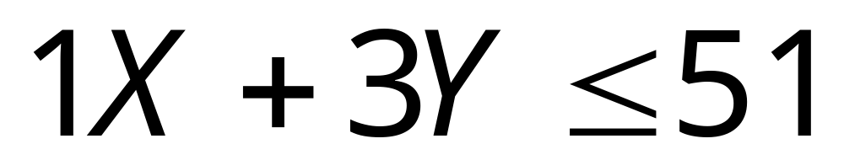
Cutting Machine Constraint

Slide 24
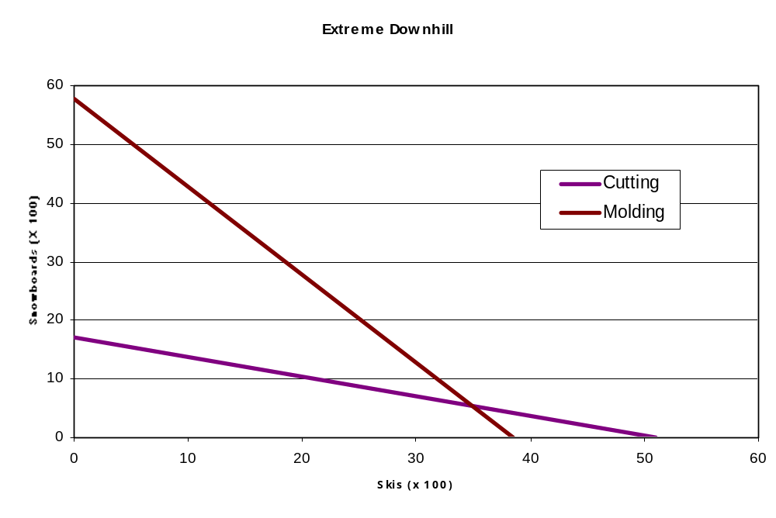

Slide 25
Delivery Van Constraint
There isn't any point in making more products in a week than can fit into the van The van has a capacity of 48 cubic meters. 100 snowboards take up one cubic meter, and 100 sets of skis take up two cubic meters.

Slide 26
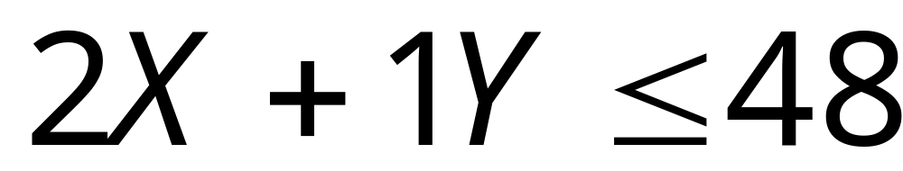
Delivery Van Constraint

Slide 27
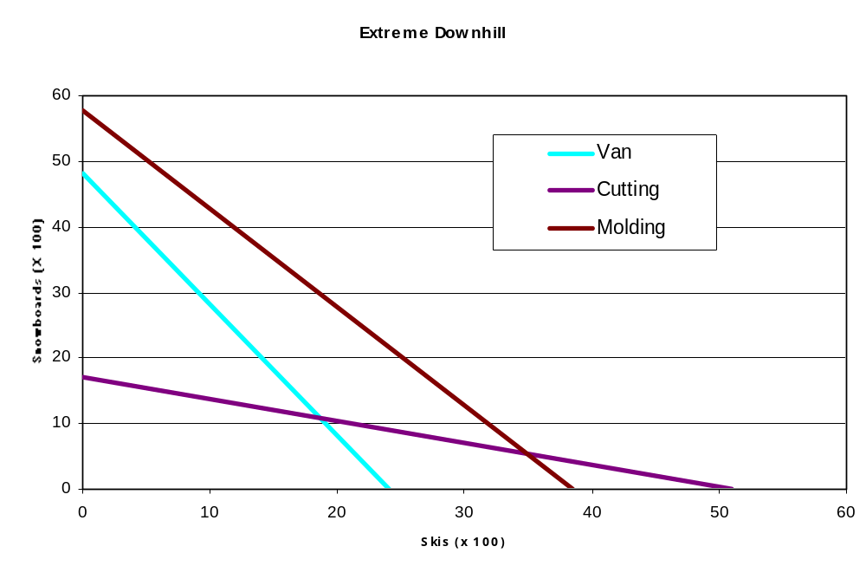

Slide 28
Demand Constraint
Michele has decided that she will never make more than 1,600 snowboards per week, because she won't be able to sell any more than that.

Slide 29
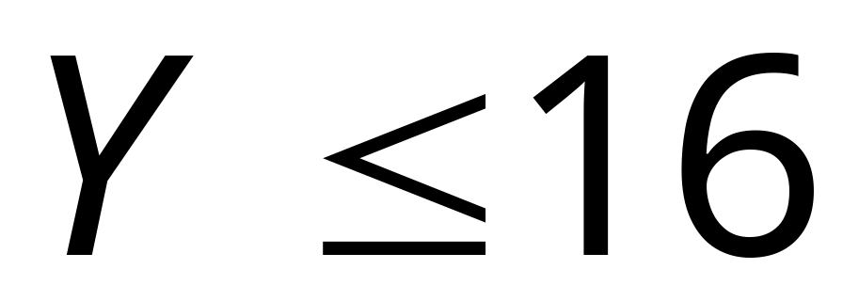
Demand Constraint

Slide 30
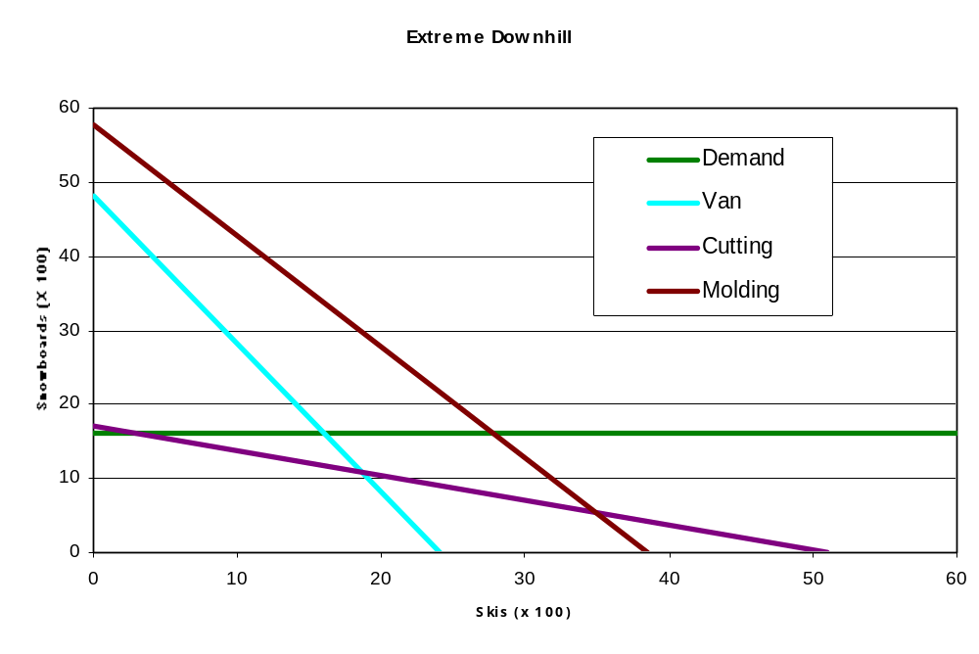

Slide 31
Non-negativity Constraints
Michele can't make a negative number of either product.

Slide 32


Non-negativity Constraints

Slide 33
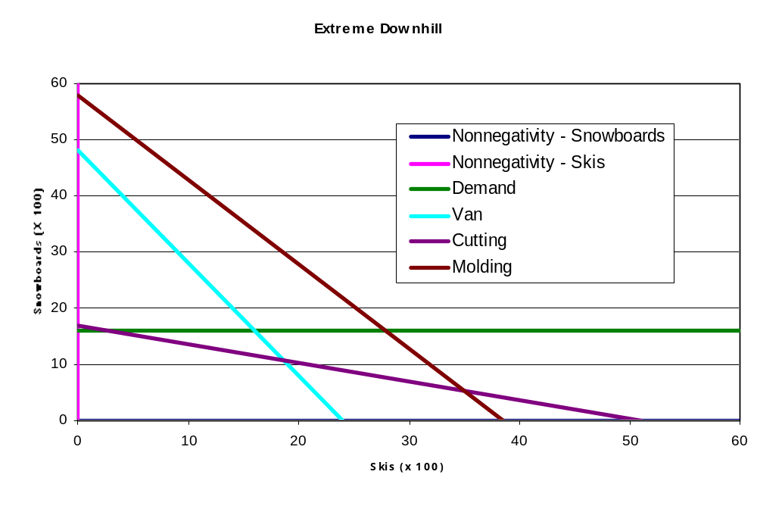

Slide 34
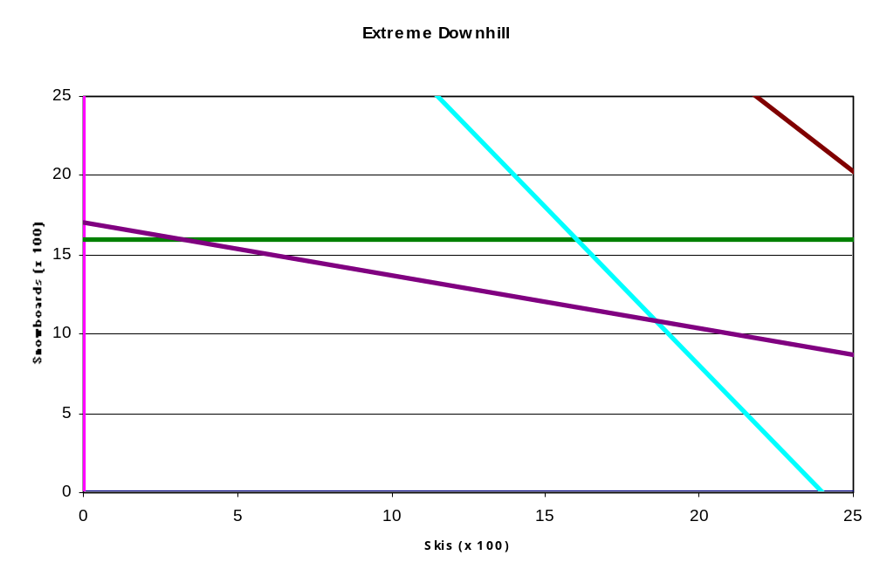

Slide 35
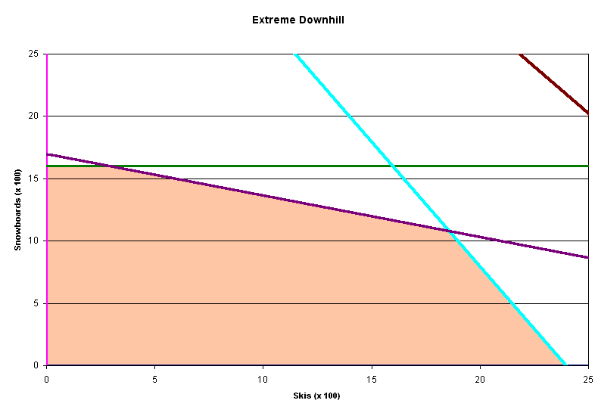

Slide 36

Solution Methodology
Use algebra to find the best solution.
(Simplex algorithm)

Slide 38
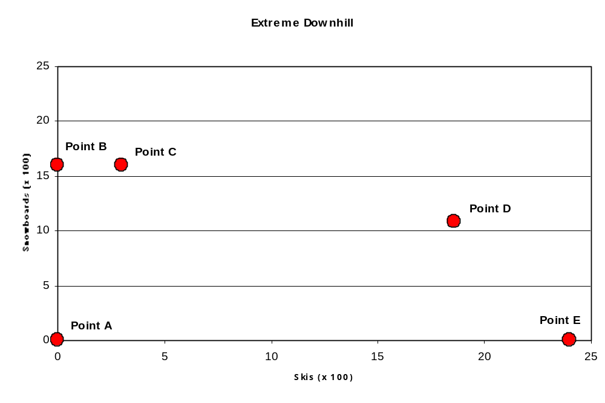

Slide 39
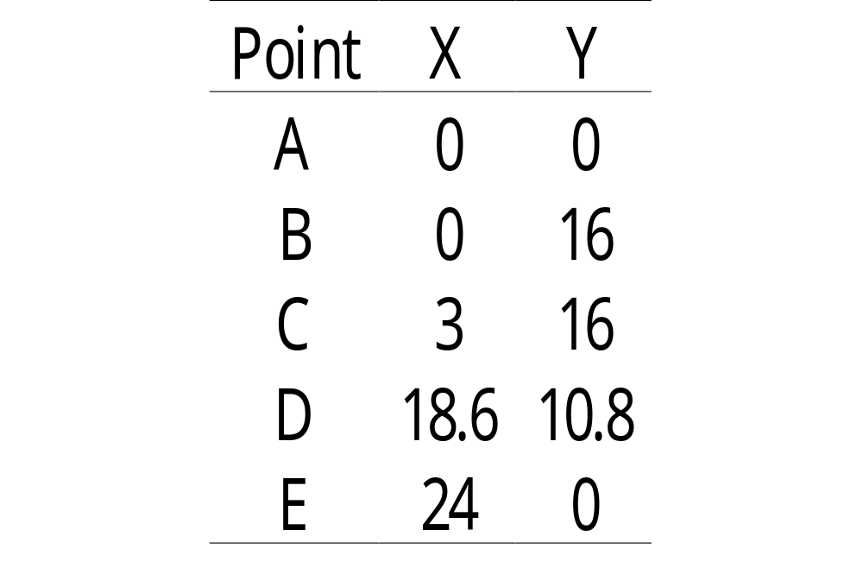

Slide 40
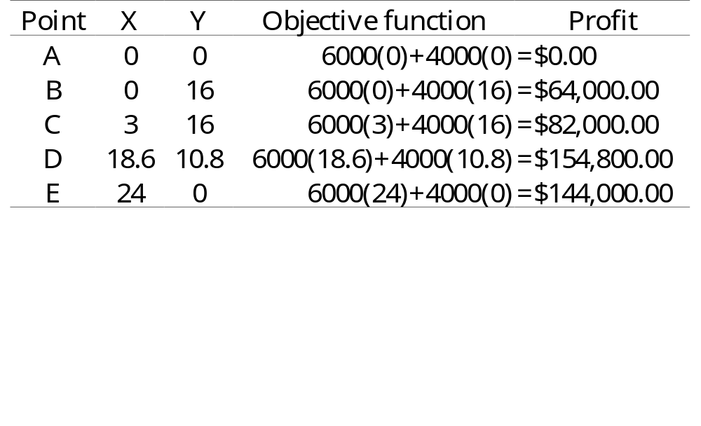
Calculating Profits

Slide 41
The Optimal Solution
Make 1,860 sets of skis and 1,080 snowboards.
Earn $154,800 profit.

Slide 42
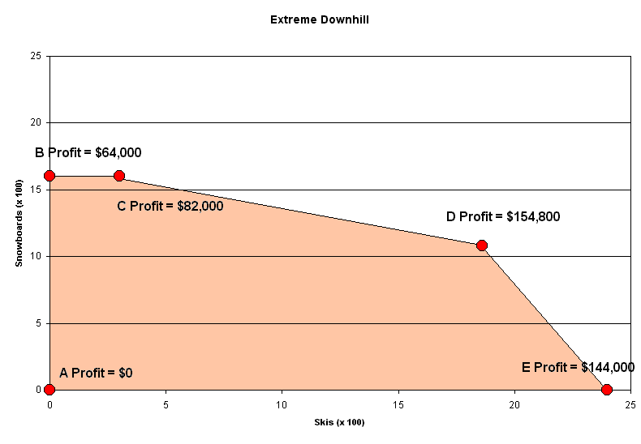

Slide 43
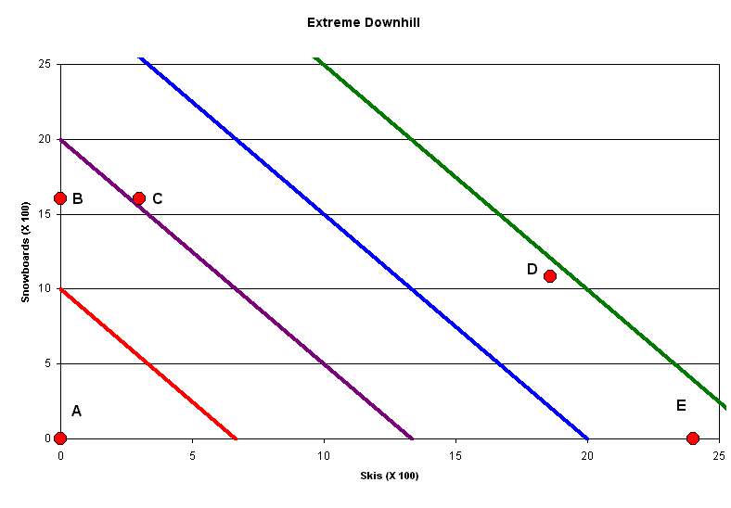

Slide 44
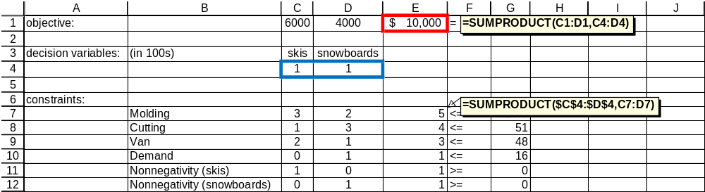
Spreadsheet Optimization

Slide 45
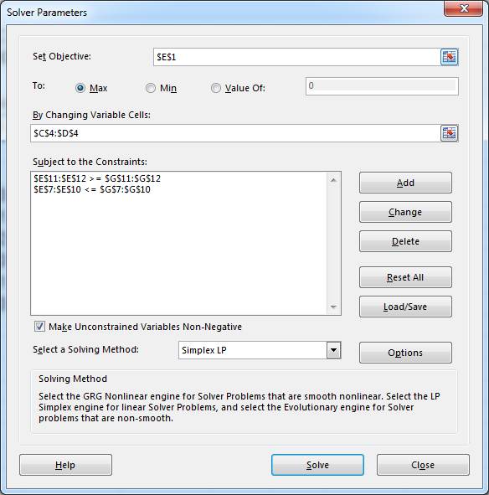

Slide 46
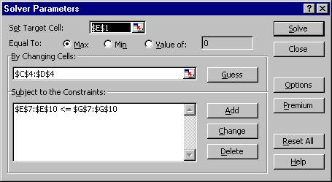
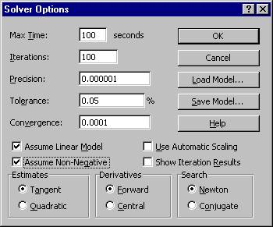

Slide 47
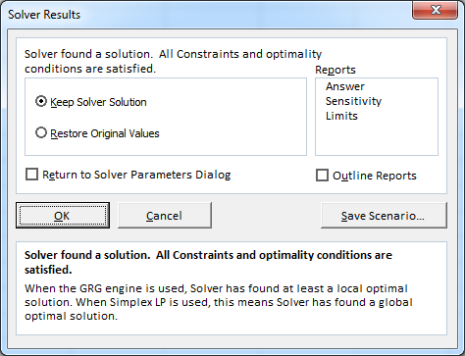

Slide 48
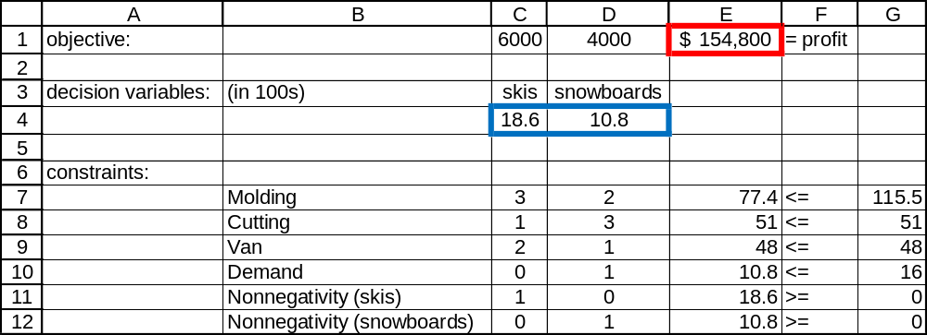

Slide 49
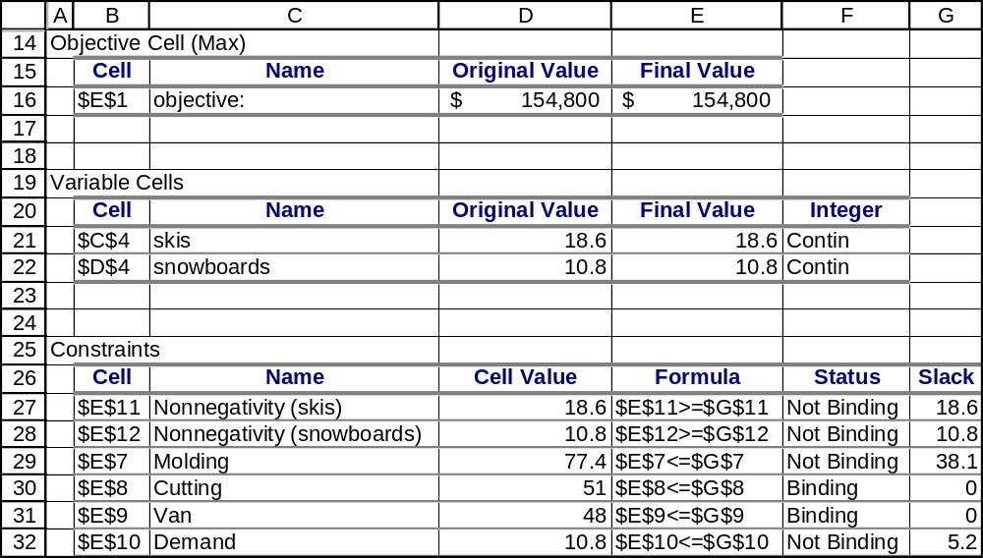

Slide 50
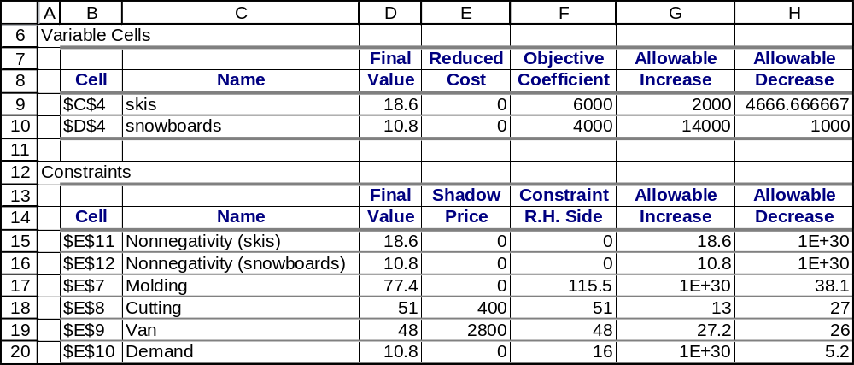
Most important number: Shadow Price
The change in the objective function that would result from
a one-unit increase in the right-hand side of a constraint

Slide 51
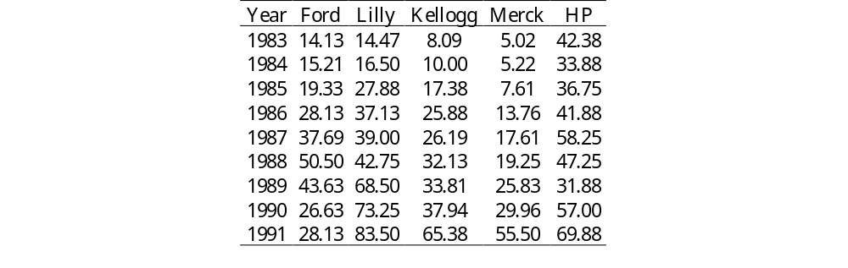
Nonlinear Example:
Scenario Approach to Portfolio Optimization
Use the scenario approach to determine the minimum-risk portfolio of these stocks that yields an expected return of at least 22%, without shorting.

Slide 52
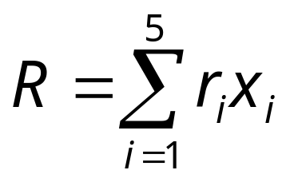
The percent return on the portfolio is represented by the random variable R.
In this model, x_{i} is the proportion of the portfolio (i.e. a number between zero and one) allocated to investment i.
Each investment i has a percent return under each scenario j, which we represent with the symbol r_{ij}.

Slide 53
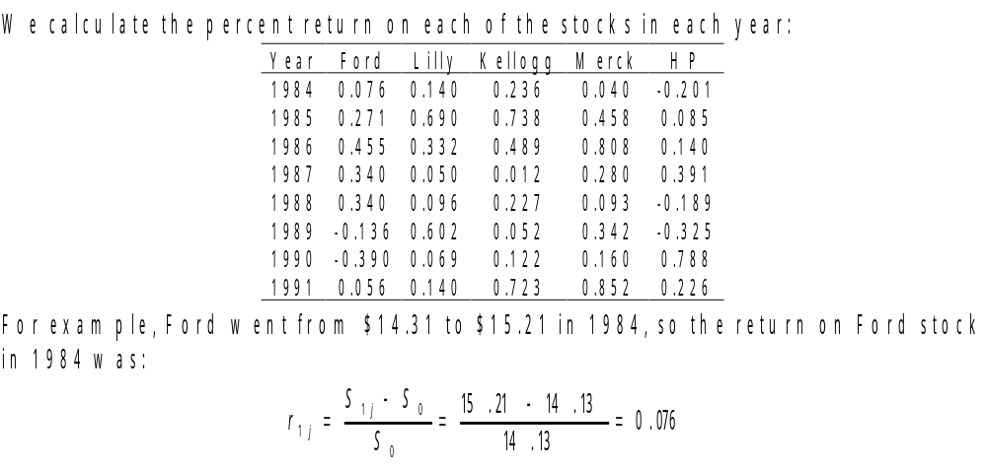

Slide 54
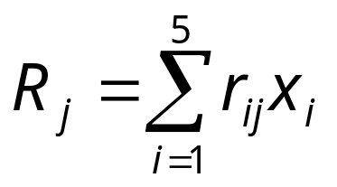
The portfolio return under any scenario j is given by:

Slide 55
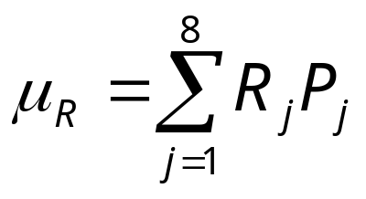
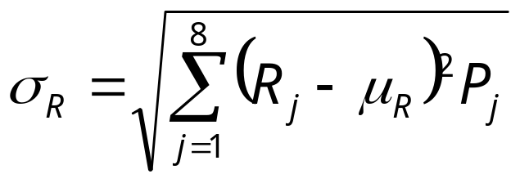
Let P_{j} represent the probability of scenario j occurring.
The expected value of R is given by:
The standard deviation of R is given by:

Slide 56
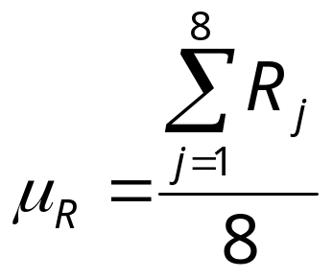
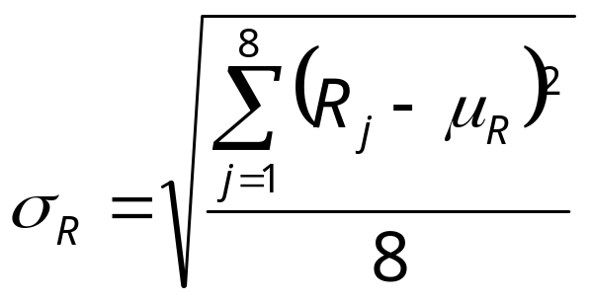
In this model, each scenario is considered to have an equal probability of occurring, so we can simplify the two expressions:

Slide 57
Managerial Formulation
Decision Variables
We need to determine the proportion of our portfolio to invest in each of the five stocks.
Objective
Minimize risk.
Constraints
All of the money must be invested. (1)
The expected return must be at least 22%. (2)
No shorting. (3)

Slide 58
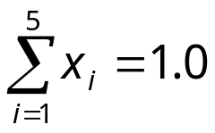
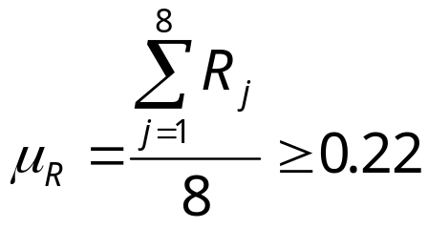
Mathematical Formulation
Decision Variables
x₁, x₂, x₃, x₄, and x₅ (corresponding to Ford, Lilly, Kellogg, Merck, and HP).
Objective
Minimize Z =
Constraints
(1)
(2)
For all i, x_{i} ≥ 0 (3)

Slide 59
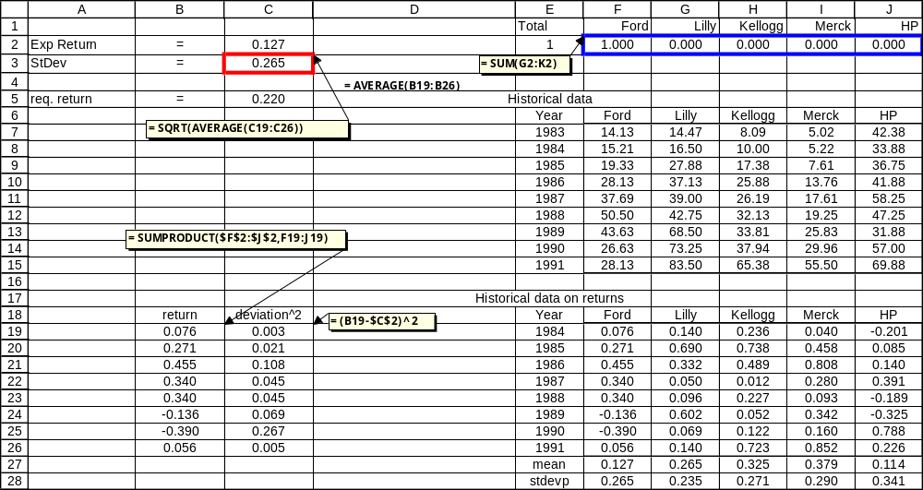

Slide 60
The decision variables are in F2:J2.
The objective function is in C3.
Cell E2 keeps track of constraint (1).
Cells C2 and C5 keep track of constraint (2).
Constraint (3) can be handled by checking the “Unconstrained Variables Non-negative” box.

Slide 61
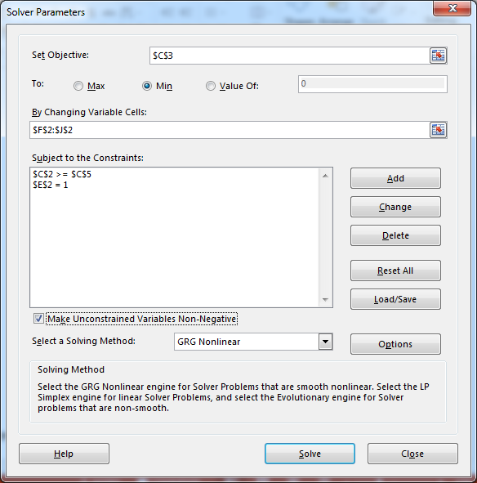

Slide 62
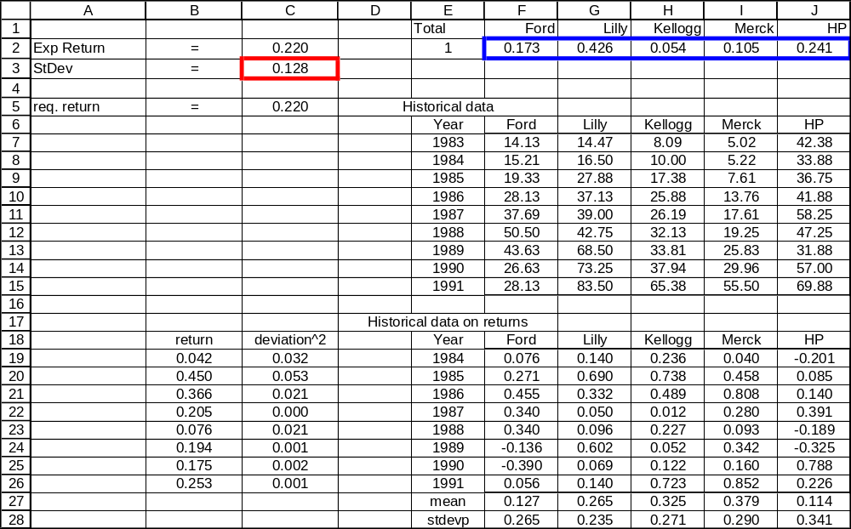

Slide 63
Conclusions
Invest 17.3% in Ford, 42.6% in Lilly, 5.4% in Kellogg, 10.5% in Merck, and 24.1% in HP.
The expected return will be 22%, and the standard deviation will be 12.8%.

Slide 64
2. Show how the optimal portfolio changes as the required return varies.

Slide 65
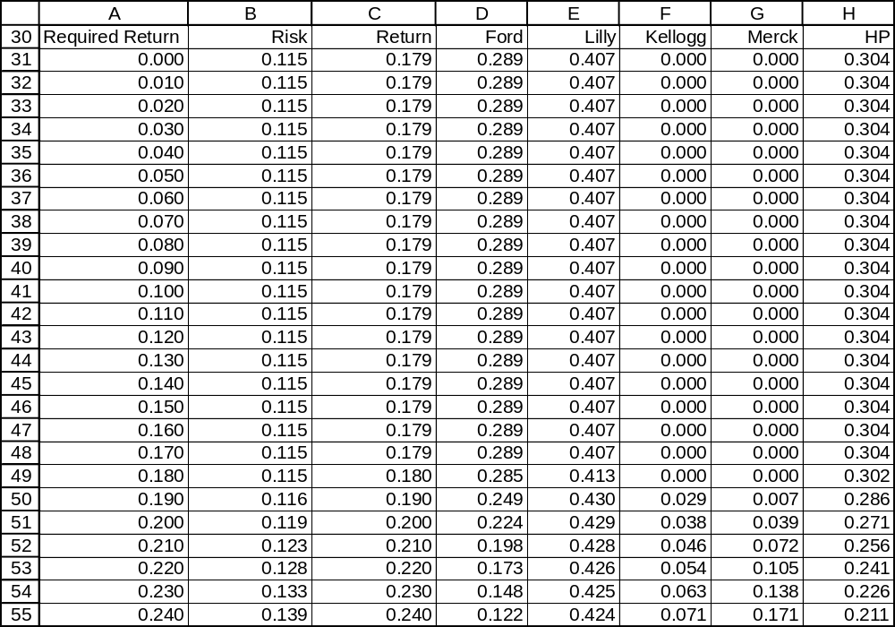

Slide 66
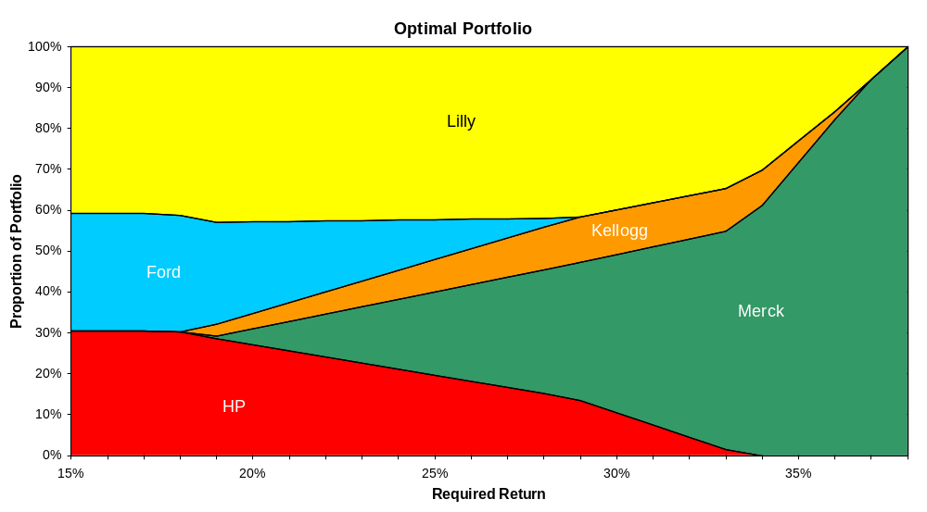

Slide 67
3. Draw the efficient frontier for portfolios composed of these five stocks.

Slide 68
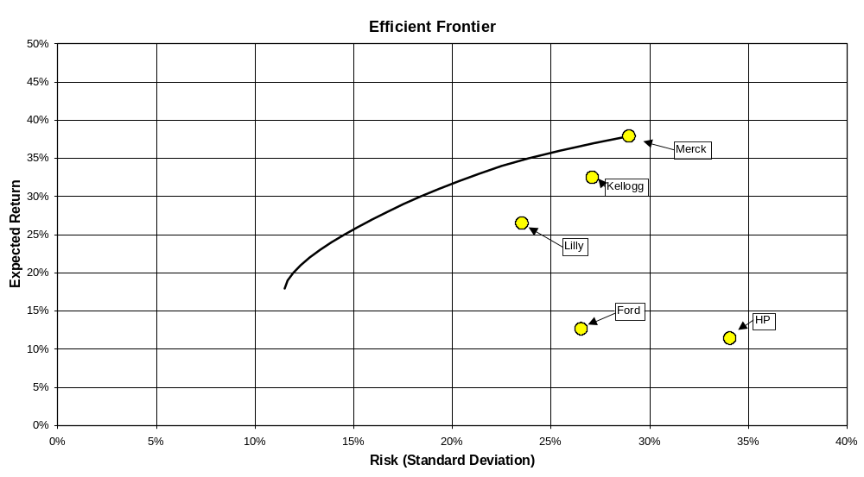

Slide 69
Repeat Part 2 with shorting allowed.

Slide 70
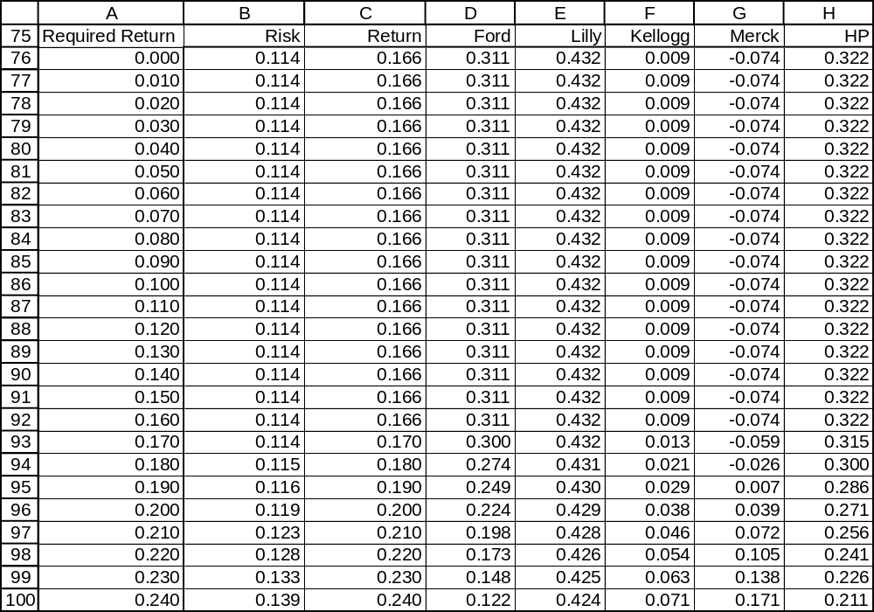

Slide 71
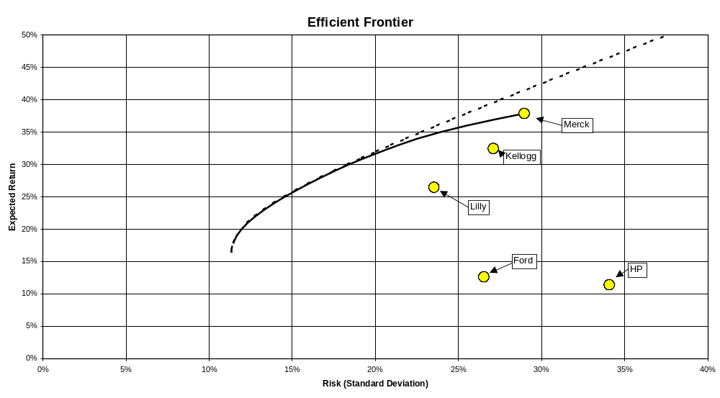

Slide 72
Juran’s Lazy Portfolio
Invest in Vanguard mutual funds under university retirement plan
No shorting
Max 8 mutual funds
Rebalance once per year
Tools used:
  Excel Solver
  Basic Stats (mean, stdev, correl, beta, crude version of CAPM)
72

Slide 73
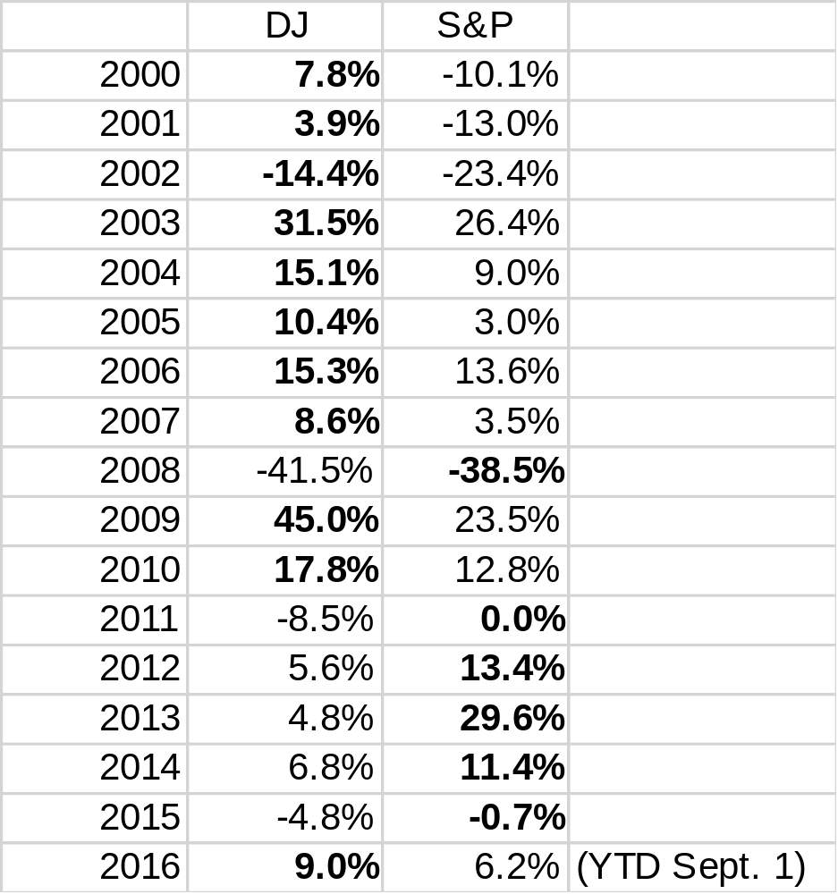
73

Slide 74


74

Slide 75
Summary
Basic Optimization: Linear programming
  Graphical method
  Spreadsheet Method
Extension: Nonlinear programming
  Portfolio optimization
Notes:
2

