Slide 1

Optimization II

Slide 2
Outline
Optimization Extensions
Multiperiod Models
  Operations Planning: Sailboats
Network Flow Models
  Transportation Model: Beer Distribution
  Assignment Model: Contract Bidding

Slide 3
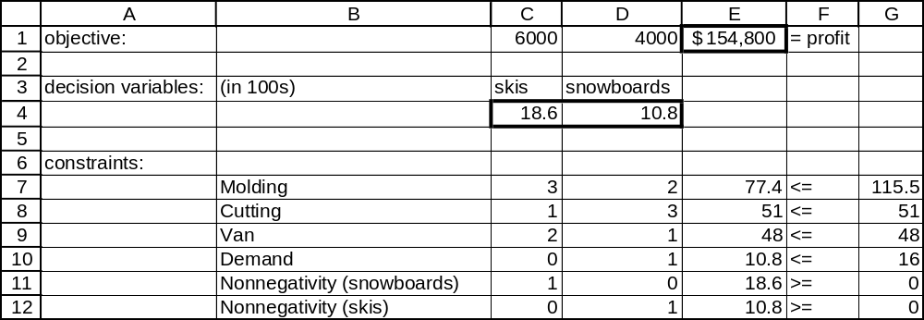

Slide 4
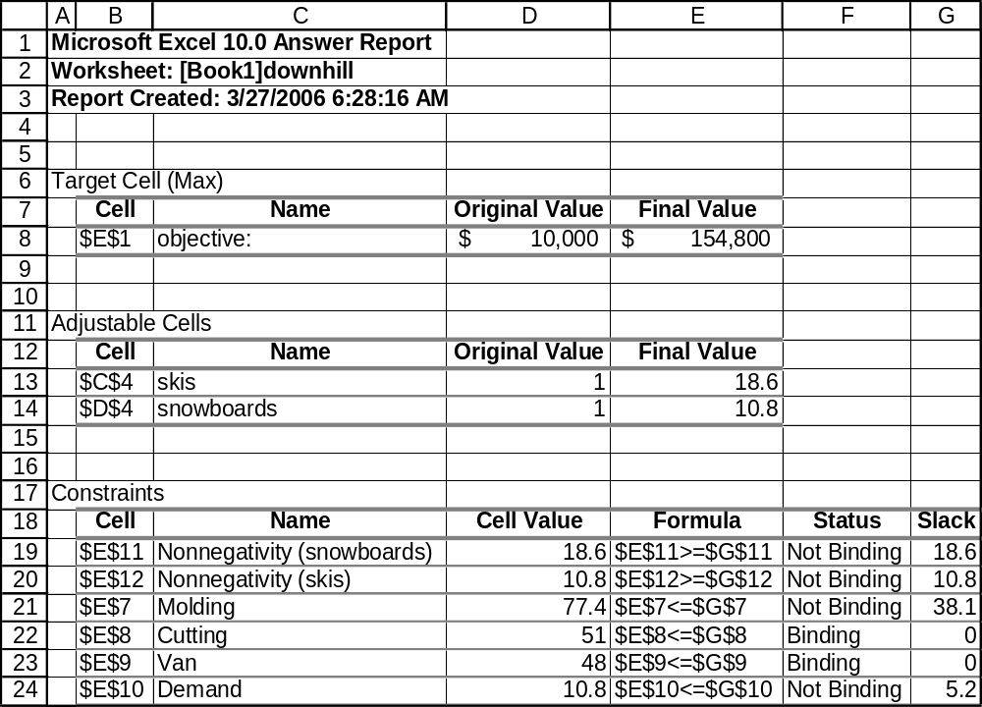

Slide 5
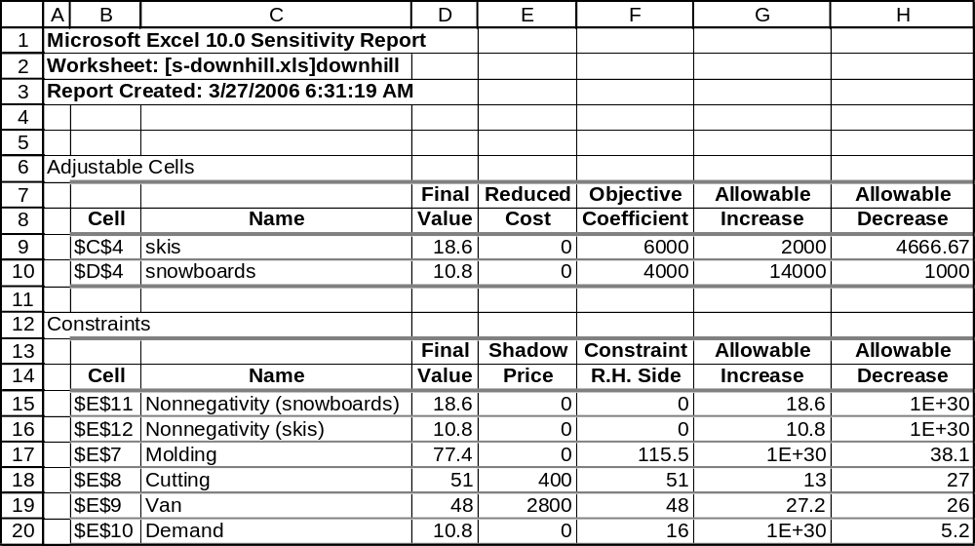
Most important number: Shadow Price
The change in the objective function that would result from
a one-unit increase in the right-hand side of a constraint

Slide 6
Sailboat Problem
Sailco must determine how many sailboats to produce during each of the next four quarters.
At the beginning of the first quarter, Sailco has an inventory of 10 sailboats.
Sailco must meet demand on time. The demand during each of the next four quarters is as follows:

Slide 7
Sailboat Problem
Assume that sailboats made during a quarter can be used to meet demand for that quarter.
During each quarter, Sailco can produce up to 50 sailboats with regular-time employees, at a labor cost of $400 per sailboat.
By having employees work overtime during a quarter, Sailco can produce unlimited additional sailboats with overtime labor at a cost of $450 per sailboat.
At the end of each quarter (after production has occurred and the current quarter’s demand has been satisfied), a holding cost of $20 per sailboat is incurred.
Problem: Determine a production schedule to minimize the sum of production and inventory holding costs during the next four quarters.

Slide 8
Managerial Formulation
Decision Variables
We need to decide on production quantities, both regular and overtime, for four quarters (eight decisions).
Note that on-hand inventory levels at the end of each quarter are also being decided, but those decisions will be implied by the production decisions.

Slide 9
Managerial Formulation
Objective Function
We’re trying to minimize the total labor cost of production, including both regular and overtime labor.

Slide 10
Managerial Formulation
Constraints
There is an upper limit on the number of boats built with regular labor in each quarter.
No backorders are allowed. This is equivalent to saying that inventory at the end of each quarter must be at least zero.
Production quantities must be non-negative.

Slide 11
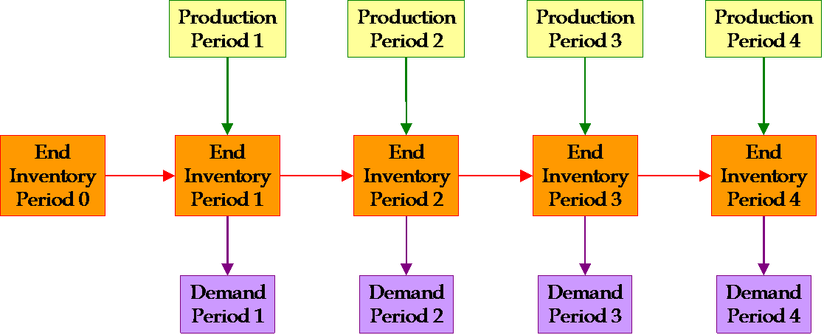
Managerial Formulation
Note that there is also an accounting constraint: Ending Inventory for each period is defined to be:
Beginning Inventory + Production – Demand
This is not a constraint in the usual Solver sense, but useful to link the quarters together in this multi-period model.

Slide 12
Mathematical Formulation
Decision Variables
P_{ij} = Production of type i in period j.
Let i index labor type; 0 is regular and 1 is overtime.
Let j index quarters; 1 through 4

Slide 13
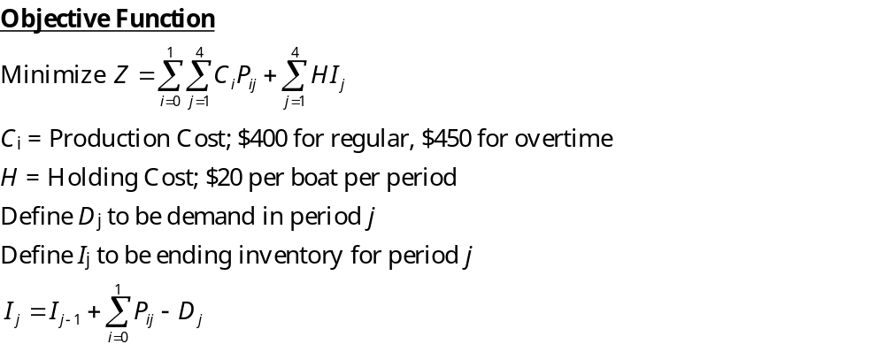
Mathematical Formulation

Slide 14
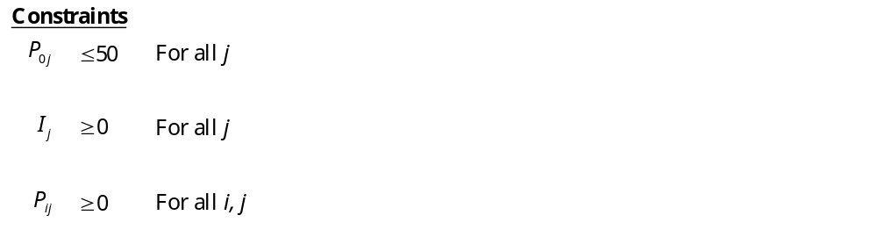
Mathematical Formulation

Slide 15
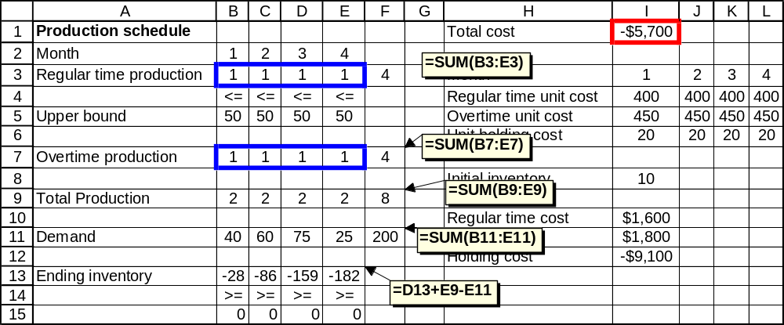
Solution Methodology

Slide 16
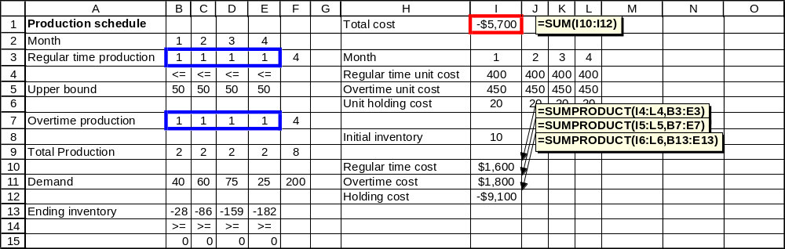
Solution Methodology

Slide 17
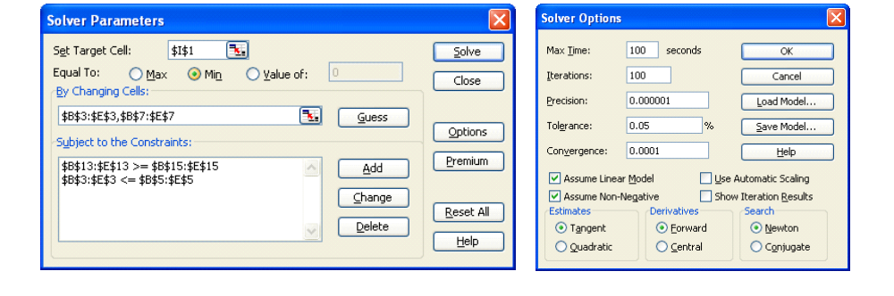
Solution Methodology

Slide 18
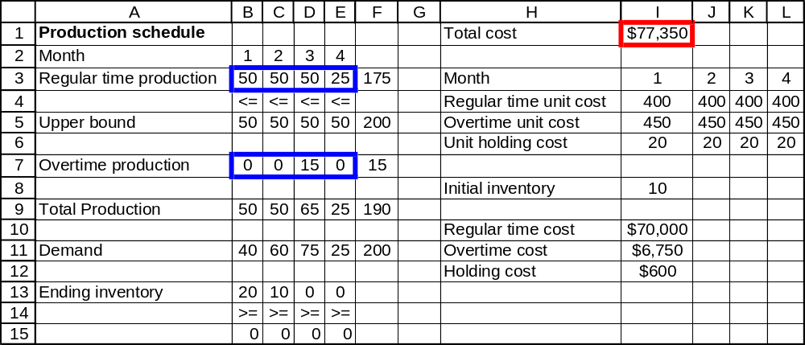
Solution Methodology

Slide 19
Solution Methodology
It is optimal to have 15 boats produced on overtime in the third quarter.
All other demand should be met on regular time.
Total labor cost will be $76,750.

Slide 20
Sensitivity Analysis
Investigate changes in the holding cost, and determine if Sailco would ever find it optimal to eliminate all overtime.
Make a graph showing optimal overtime costs as a function of the holding cost.

Slide 21
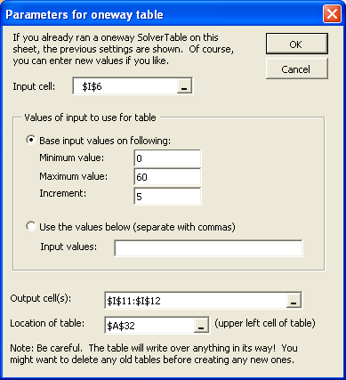
Sensitivity Analysis

Slide 22
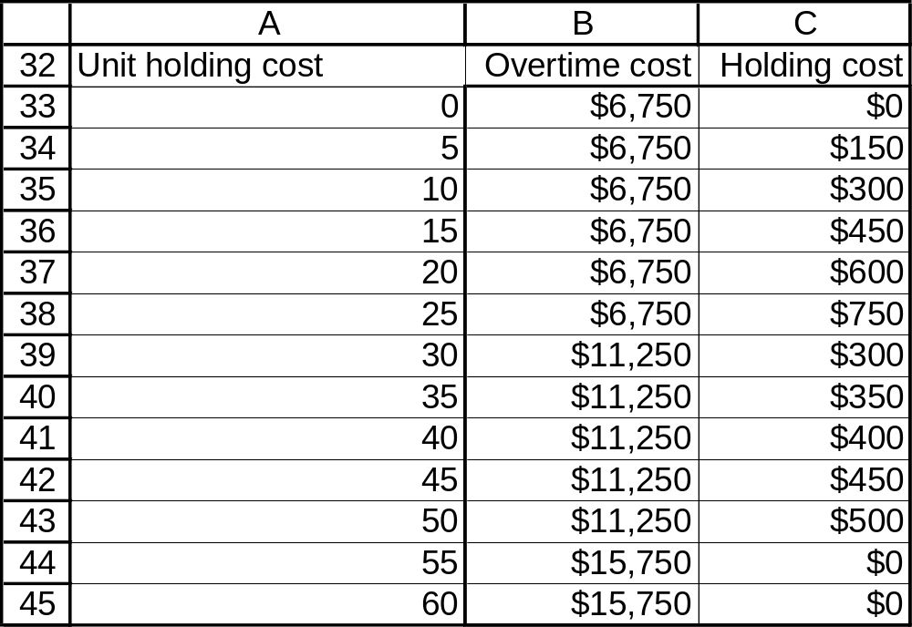
Sensitivity Analysis

Slide 23
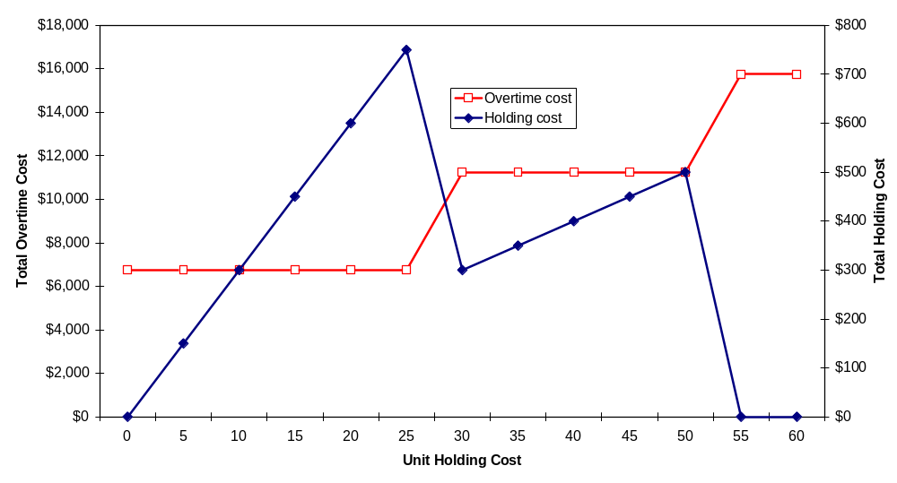
Sensitivity Analysis

Slide 24
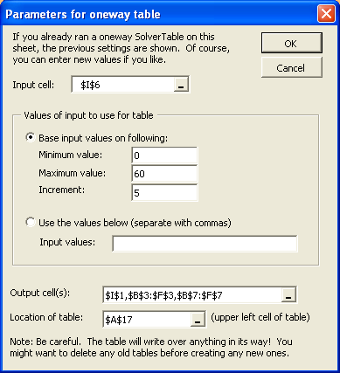
Sensitivity Analysis

Slide 25
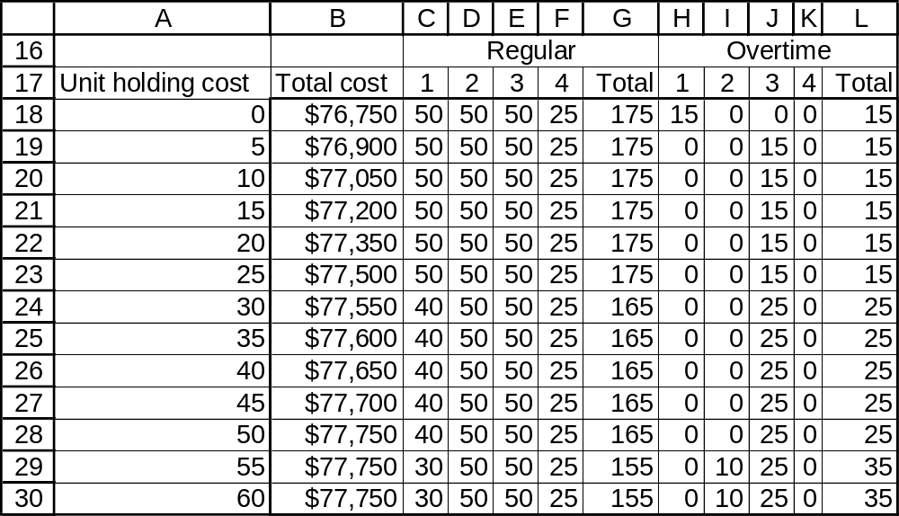
Sensitivity Analysis

Slide 26
Sensitivity Analysis
Conclusions:
It is never optimal to completely eliminate overtime.
In general, as holding costs increase, Sailco will decide to reduce inventories and therefore produce more boats on overtime.
Even if holding costs are reduced to zero, Sailco will need to produce at least 15 boats on overtime. Demand for the first three quarters exceeds the total capacity of regular time production.

Slide 27

Gribbin Brewing
Regional brewer Andrew Gribbin distributes kegs of his famous beer through three warehouses in the greater News York City area, with current supplies as shown:

Slide 28

On a Thursday morning, he has his usual weekly orders from his four loyal customers, as shown :

Slide 29

Tracy Chapman, Gribbin’s shipping manager, needs to determine the most cost-efficient plan to deliver beer to these four customers, knowing that the costs per keg are different for each possible combination of warehouse and customer:

Slide 30
What is the optimal shipping plan?
How much will it cost to fill these four orders?
Where does Gribbin have surplus inventory?
If Gribbin could have one additional keg at one of the three warehouses, what would be the most beneficial location, in terms of reduced shipping costs?
Gribbin has an offer from Lu Leng Felicia, who would like to sublet some of Gribbin’s Brooklyn warehouse space for her tattoo parlor. She only needs 240 square feet, which is equivalent to the area required to store 40 kegs of beer, and has offered Gribbin $0.25 per week per square foot. Is this a good deal for Gribbin? What should Gribbin’s response be to Lu Leng?

Slide 31
Managerial Problem Formulation
Decision Variables
Numbers of kegs shipped from each of three warehouses to each of four customers (12 decisions).
Objective
Minimize total cost.
Constraints
Each warehouse has limited supply.
Each customer has a minimum demand.
Kegs can’t be divided; numbers shipped must be integers.

Slide 32
Mathematical Formulation
Decision Variables
Define X_{ij} = Number of kegs shipped from warehouse i to customer j.
Define C_{ij} = Cost per keg to ship from warehouse i to customer j.
i = warehouses 1-3, j = customers 1-4

Slide 33
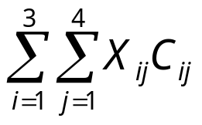
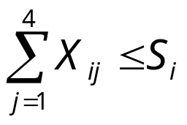
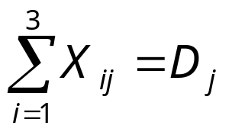
Mathematical Formulation
Objective
Minimize Z =
Constraints
Define S_{i} = Number of kegs available at warehouse i.
Define D_{j} = Number of kegs ordered by customer j.
Do we need a constraint to ensure that all of the X_{ij} are integers?

Slide 34
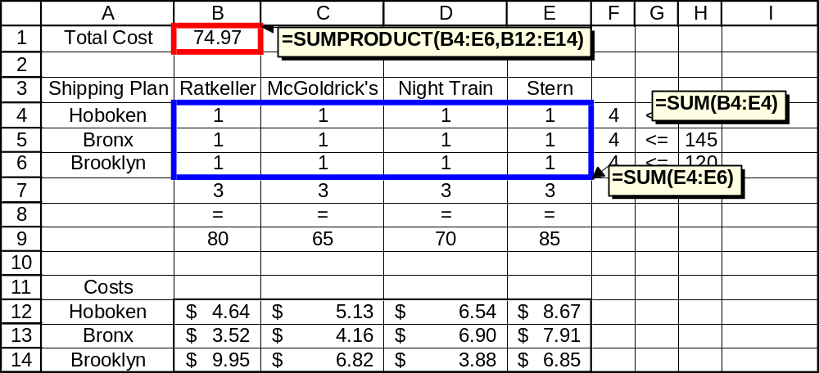

Slide 35
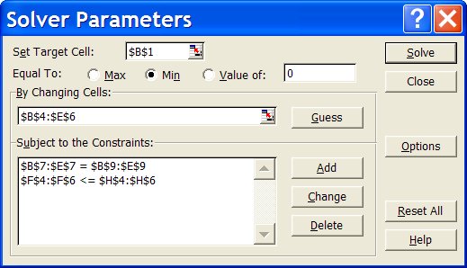

Slide 36
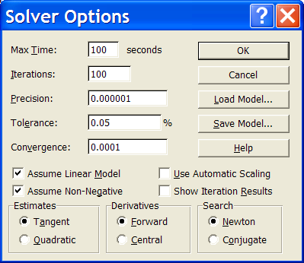

Slide 37
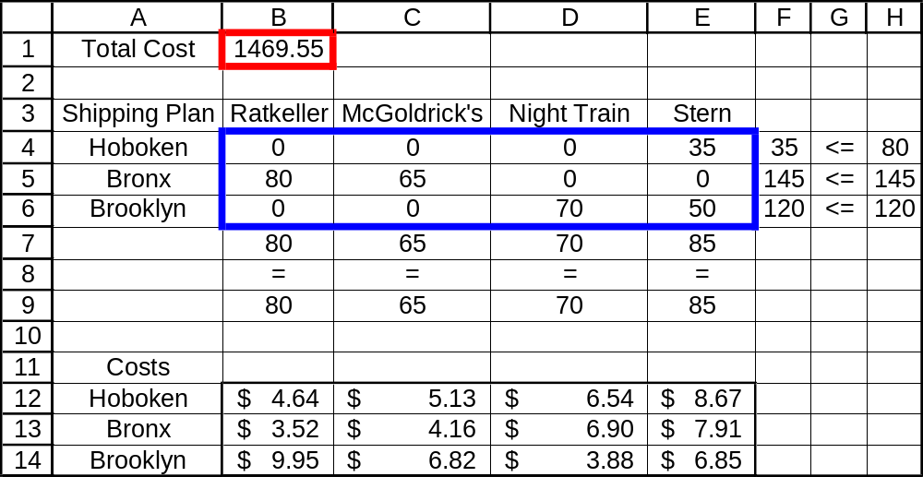

Slide 38
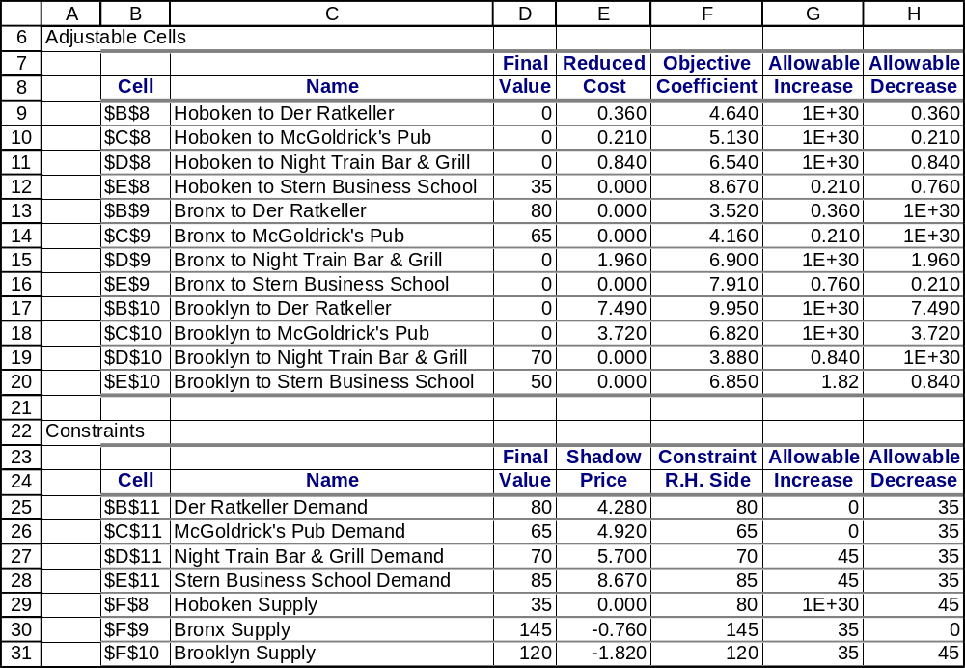

Slide 39
Where does Gribbin have surplus inventory?
The only supply constraint that is not binding is the Hoboken constraint. It would appear that Gribbin has 45 extra kegs in Hoboken.

Slide 40
If Gribbin could have one additional keg at one of the three warehouses, what would be the most beneficial location, in terms of reduced shipping costs?

Slide 41
According to the sensitivity report,
One more keg in Hoboken is worthless.
One more keg in the Bronx would have reduced overall costs by $0.76.
One more keg in Brooklyn would have reduced overall costs by $1.82.

Slide 42
Gribbin has an offer from Lu Leng Felicia, who would like to sublet some of Gribbin’s Brooklyn warehouse space for her tattoo parlor. She only needs 240 square feet, which is equivalent to the area required to store 40 kegs of beer, and has offered Gribbin $0.25 per week per square foot.
Is this a good deal for Gribbin?
What should Gribbin’s response be to Lu Leng?

Slide 43
Assuming that the current situation will continue into the foreseeable future, it would appear that Gribbin could reduce his inventory in Hoboken without losing any money (i.e. the shadow price is zero).
However, we need to check the sensitivity report to make sure that the proposed decrease of 40 kegs is within the allowable decrease.
This means that he could make a profit by renting space in the Hoboken warehouse to Lu Leng for $0.01 per square foot.

Slide 44
Lu Leng wants space in Brooklyn, but Gribbin would need to charge her more than $1.82 for every six square feet (about $0.303 per square foot), or else he will lose money on the deal.
Note that the sensitivity report indicates an allowable decrease in Brooklyn that is enough to accommodate Lu Leng.

Slide 45
As for the Bronx warehouse, note that the allowable decrease is zero. This means that we would need to re-run the model to find out the total cost of renting Bronx space to Lu Leng.
A possible response from Gribbin to Lu Leng:
“I can rent you space in Brooklyn, but it will cost you $0.35 per square foot. How do you feel about Hoboken?”

Slide 46

Contract Bidding Example
A company is taking bids on four construction jobs. Three contractors have placed bids on the jobs. Their bids (in thousands of dollars) are given in the table below. (A dash indicates that the contractor did not bid on the given job.)
Contractor 1 can do only one job, but contractors 2 and 3 can each do up to two jobs.

Slide 47
Formulation
Decision Variables
Which contractor gets which job(s).
Objective
Minimize the total cost of the four jobs.
Constraints
Contractor 1 can do no more than one job.
Contractors 2 and 3 can do no more than two jobs each.
Contractor 2 can’t do job 4.
Contractor 3 can’t do job 1.
Every job needs one contractor.

Slide 48
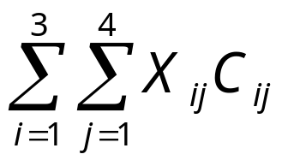
Formulation
Decision Variables
Define X_{ij} to be a binary variable representing the assignment of contractor i to job j. If contractor i ends up doing job j, then X_{ij} = 1. If contractor i does not end up with job j, then X_{ij} = 0.
Define C_{ij} to be the cost; i.e. the amount bid by contractor i for job j.
Objective
Minimize Z =

Slide 49
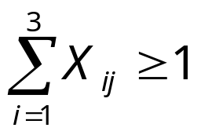
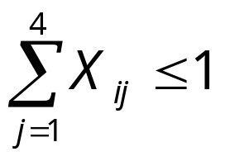
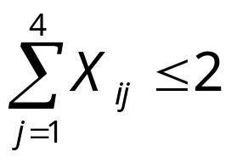
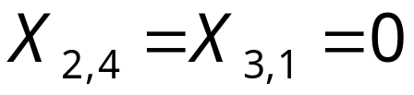
Formulation
Constraints
for all j.
for i = 1.
for i = 2, 3.

Slide 50
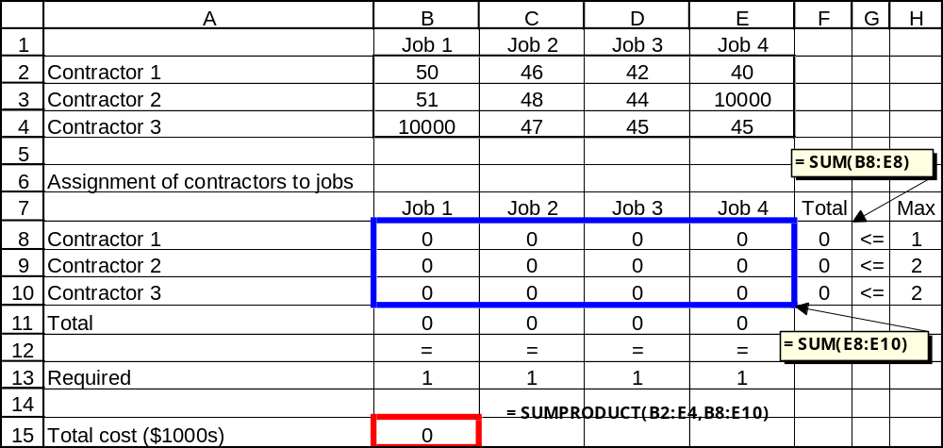
Solution Methodology

Slide 51
Solution Methodology
Notice the very large values in cells B4 and E3. These specific values (10,000) aren’t important; the main thing is to assign these particular contractor-job combinations costs so large that they will never be in any optimal solution.

Slide 52
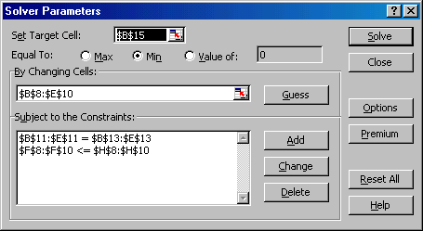
Solution Methodology

Slide 53
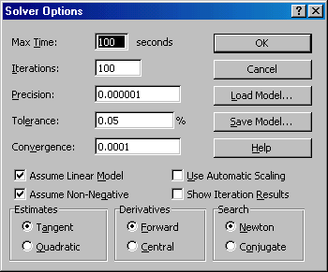
Solution Methodology

Slide 54
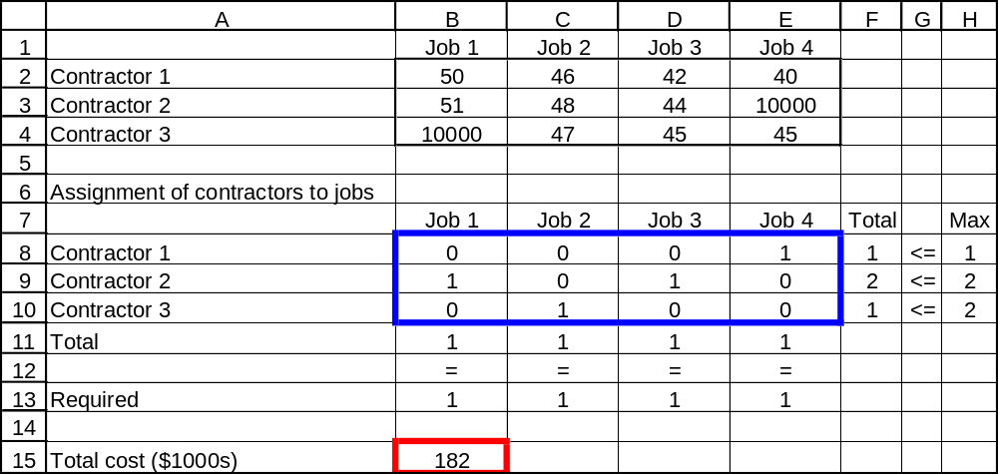
Optimal Solution

Slide 55
Conclusions
The optimal solution is to award Job 4 to Contractor 1, Jobs 1 and 3 to Contractor 2, and Job 2 to Contractor 3. The total cost is $182,000.

Slide 56
Sensitivity Analysis
What is the “cost” of restricting Contractor 1 to only one job?
How much more can Contractor 1 bid for Job 4 and still get the job?

Slide 57
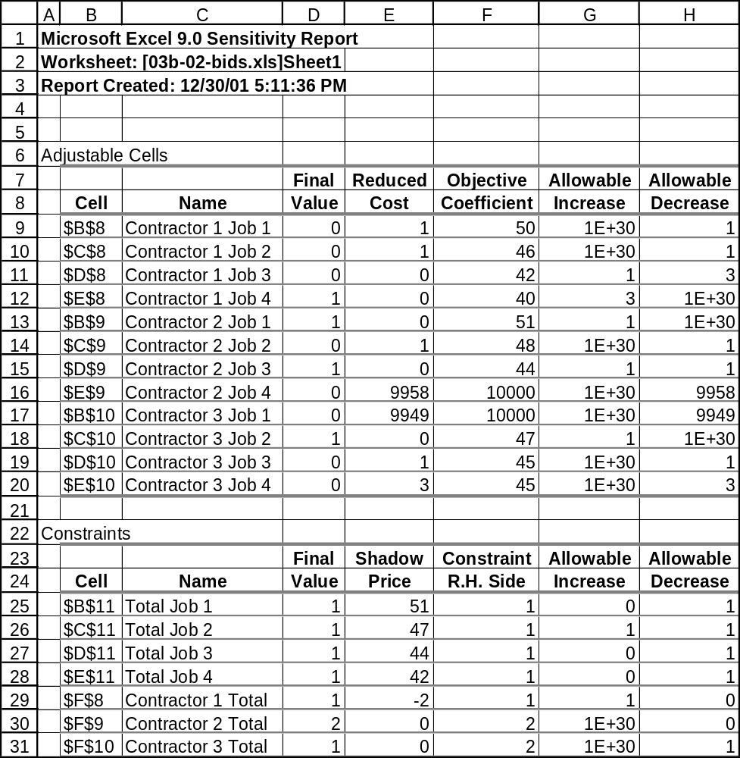

Slide 58
Conclusions
The sensitivity report indicates a shadow price of –2 (cell E29).
  (Allowing Contractor 1 to perform one additional job would reduce the total cost by 2,000.)
The allowable increase in the bid for Job 4 by Contractor 1 is 3.
  (He could have bid any amount up to $43,000 and still have won that job.)

Slide 59
Network Representation
Con. 1
Con. 2
Con. 3
Job 1
Job 2
Job 3
Job 4

Slide 60
Optimal Solution
Con. 1
Con. 2
Con. 3
44
51
47
40
Job 1
Job 2
Job 3
Job 4

Slide 61
Summary
Optimization Extensions
Multiperiod Models
  Operations Planning: Sailboats
Network Flow Models
  Transportation Model: Beer Distribution
  Assignment Model: Contract Bidding
Notes:
2

