Slide 1

Inventory Management

Slide 2
Outline
Basic Definitions and Ideas
Reasons to Hold Inventory
Inventory Costs
Inventory Control Systems
Continuous Review Models
  Basic EOQ Model
  Quantity Discounts
  Safety Stock
  Special Case: The News Vendor Problem
    Discrete Probability Example
    Continuous Probability Example
Periodic Review Model

Slide 3
What is Inventory?
Inventory is a stock of items held to meet future demand.
Inventory management answers two questions:
  How much to order
  When to order

Slide 4
Basic Concepts of Inventory Management can be expanded to apply to a broad array of types of “inventory”:
  Raw materials
  Purchased parts and supplies
  Labor
  In-process (partially completed) products
  Component parts
  Working capital
  Tools, machinery, and equipment
  Finished goods

Slide 5
Reasons to Hold Inventory
Meet unexpected demand
Smooth seasonal or cyclical demand
Meet variations in customer demand
Take advantage of price discounts
Hedge against price increases
Quantity discounts

Slide 6
Two Forms of Demand
Dependent
  items used to produce final products
Independent
  items demanded by external customers

Slide 7
Inventory Costs
Carrying Cost
  cost of holding an item in inventory
Ordering Cost
  cost of replenishing inventory
Shortage Cost
  temporary or permanent loss of sales when demand cannot be met

Slide 8
Inventory Control Systems
Fixed-order-quantity system (Continuous)
  constant amount ordered when inventory declines to predetermined level
Fixed-time-period system (Periodic)
  order placed for variable amount after fixed passage of time

Slide 9
Continuous Review Models
Basic EOQ Model
Quantity Discounts
Safety Stock

Slide 10
The Basic EOQ Model
(Economic Order Quantity)
Assumptions of the Basic EOQ Model:
  Demand is known with certainty
  Demand is relatively constant over time
  No shortages are allowed
  Lead time for the receipt of orders is constant
  The order quantity is received all at once

Slide 11
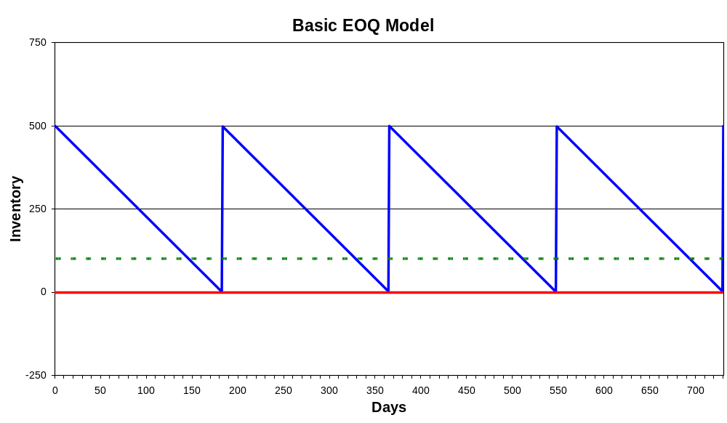
Inventory Order Cycle

Slide 12
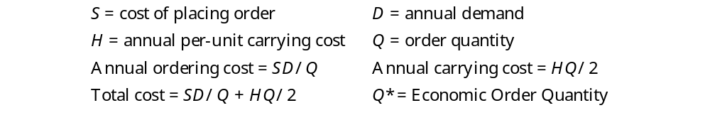
EOQ Model Costs

Slide 13
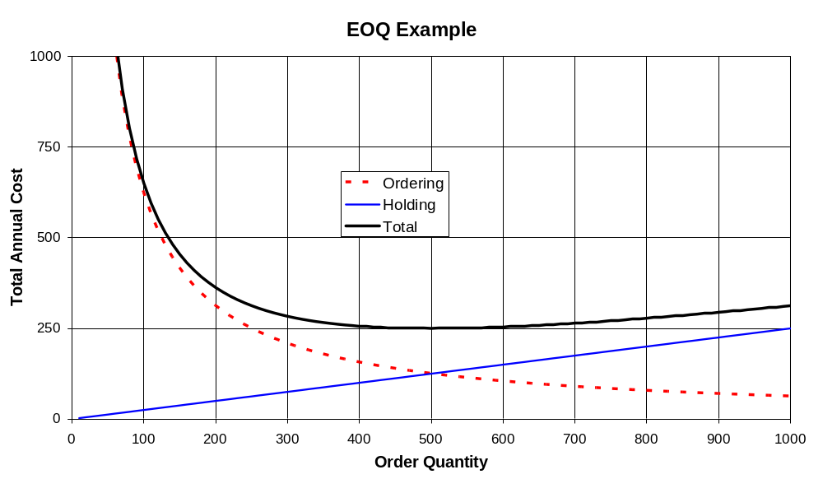
EOQ Cost Curves

Slide 14

EOQ Example
If D = 1,000 per year, S = $62.50 per order, and H = $0.50 per unit per year, what is the economic order quantity?

Slide 15

Quantity Discounts
Price per unit decreases as order quantity increases:

Slide 16
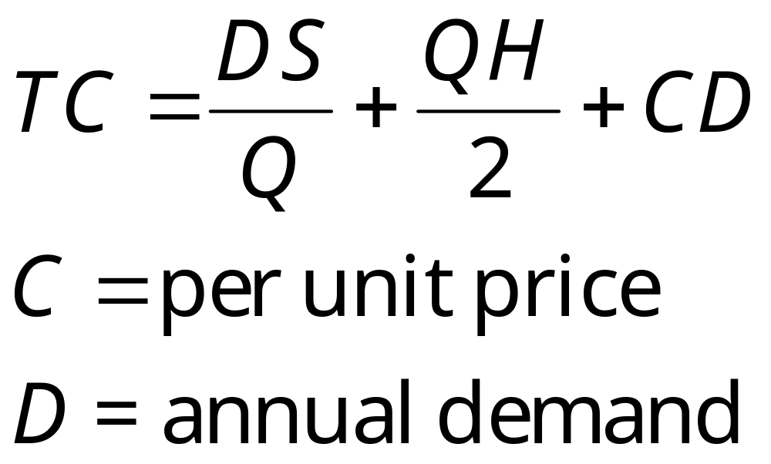
Quantity Discount Costs

Slide 17
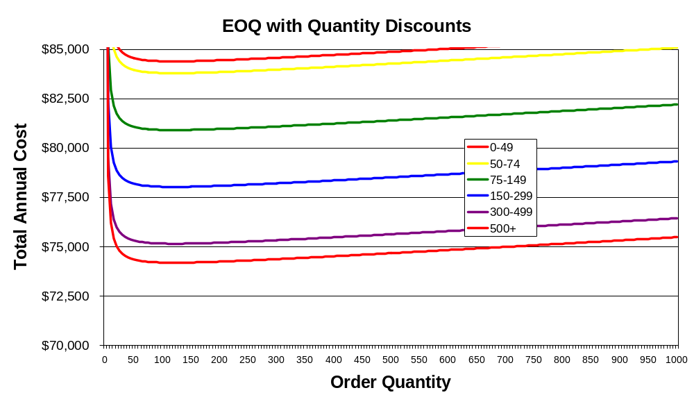
Quantity Discount Cost Curves

Slide 18
Quantity Discount Algorithm
Step 1. Calculate a value for Q*.
Step 2: For any discount, if the order quantity is too low to qualify for the discount, adjust Q upward to the lowest feasible quantity.
Step 3: Calculate the total annual cost for each Q*.

Slide 19

Quantity Discount Algorithm
Step 1. Calculate a value for Q*.

Slide 20
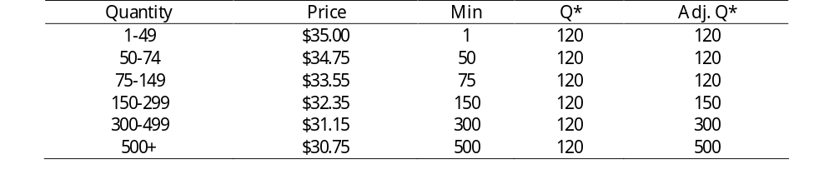
Quantity Discount Algorithm
Step 2: For any discount, if the order quantity is too low to qualify for the discount, adjust Q* upward to the lowest feasible quantity.

Slide 21
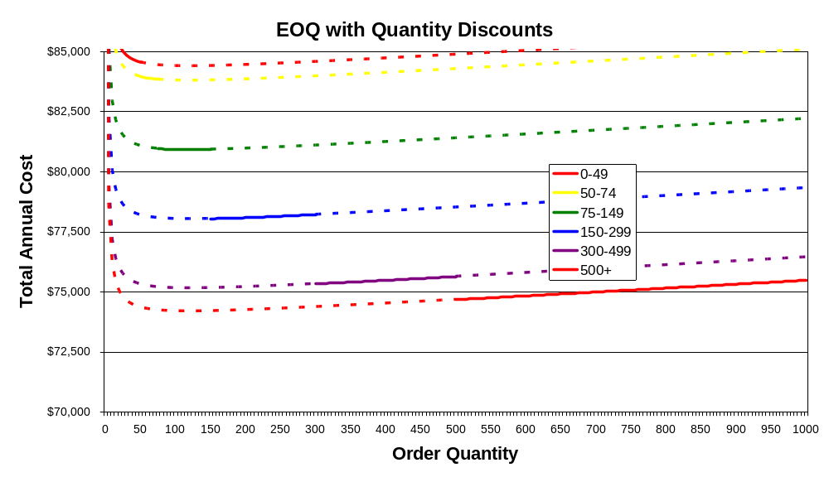

Slide 22
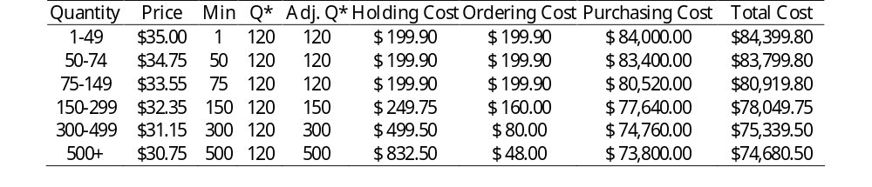
Quantity Discount Algorithm
Step 3: Calculate the total annual cost for each Q*.

Slide 23
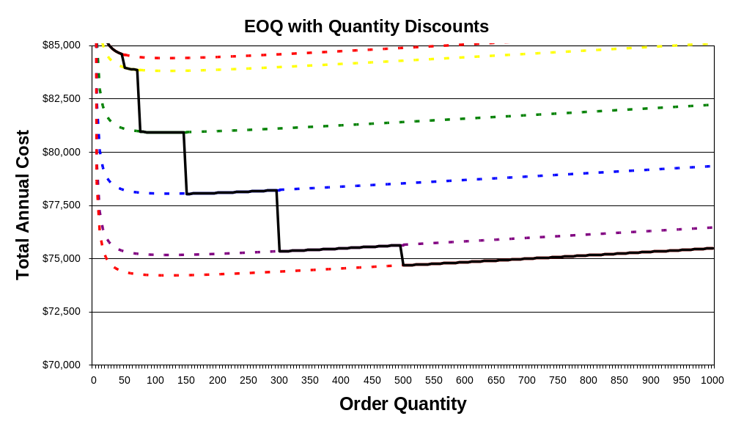

Slide 24

When to Order
Reorder Point = level of inventory at which to place a new order (a.k.a. ROP, R)

Slide 25
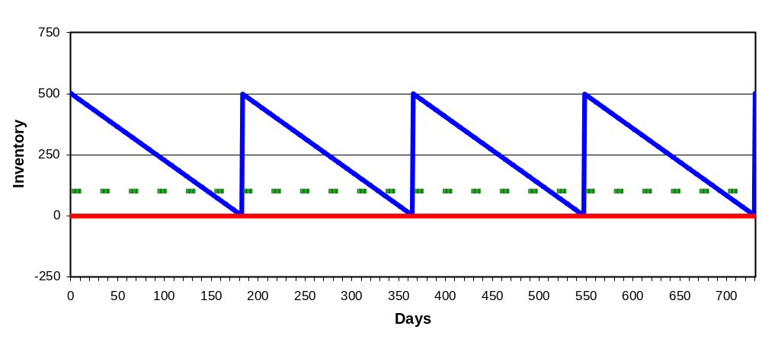

Slide 26

Lead time for one of your fastest-moving products is 21 days. Demand during this period averages 100 units per day. What would be an appropriate reorder point?

Slide 27
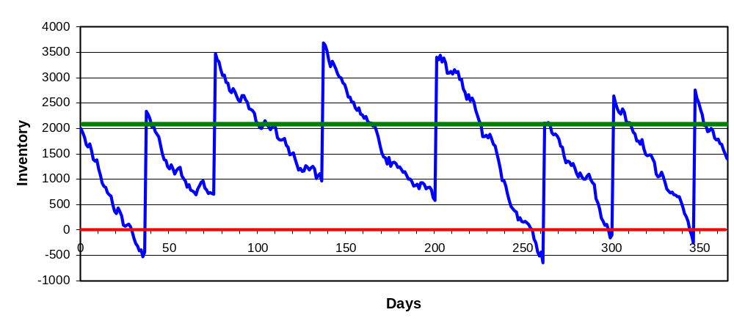
What About Random Demand?
(Or Random Lead Time?)

Slide 28
Safety stock
  buffer added to on-hand inventory during lead time
Stockout
  an inventory shortage
Service level
  probability that the inventory available during lead time will meet demand

Slide 29
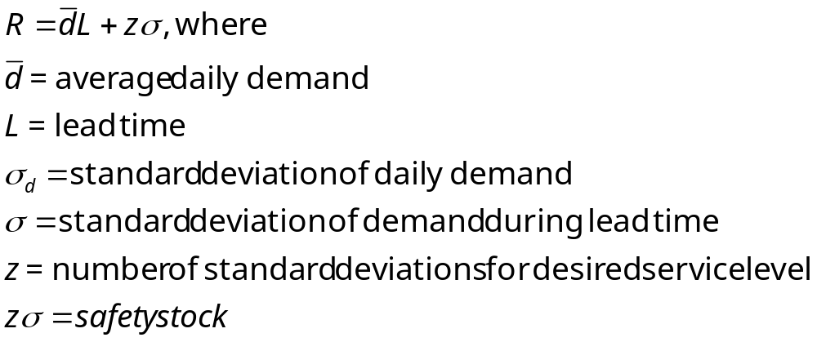
Reorder Point with Variable Demand
(Leadtime is Constant)

Slide 30
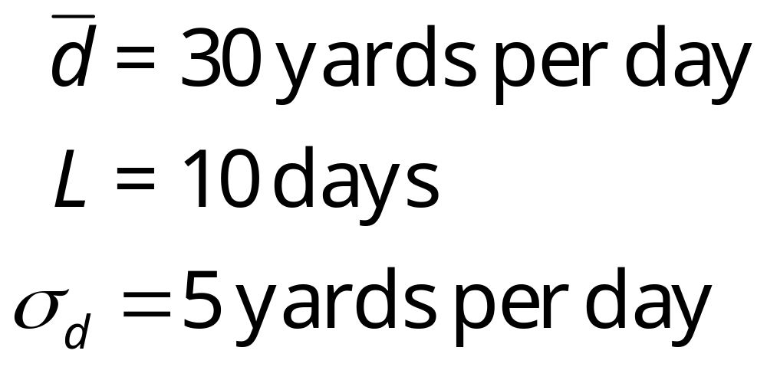
A carpet store wants a reorder point with a 95% service level and a 5% stockout probability during the leadtime.

Slide 31
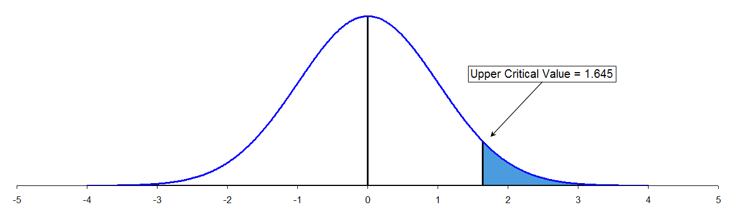
Determining the z-value for Service Level

Slide 32
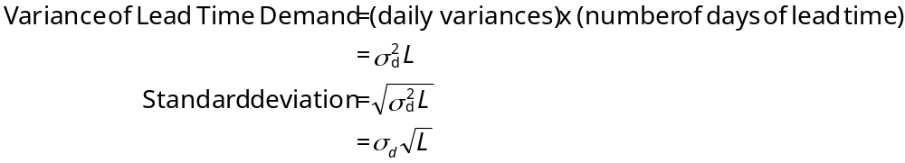

Slide 33
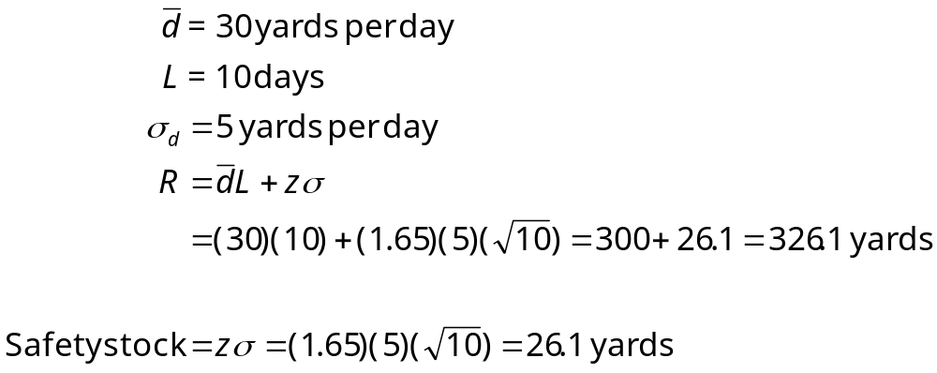

Slide 34
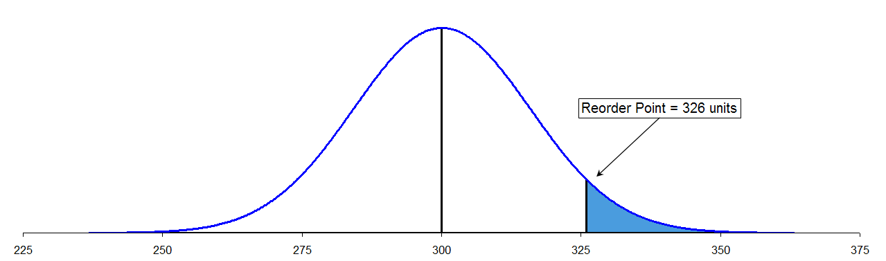
Determining the Safety Stock from the z-value

Slide 35
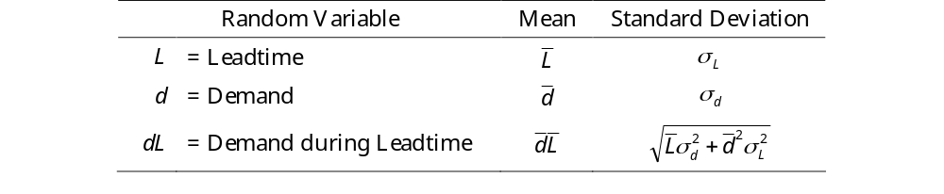
What If Leadtime is Random?

Slide 36
Special Case: The Newsboy Problem
The News Vendor Problem is a special “single period” version of the EOQ model, where the product drops in value after a relatively brief selling period.
The name comes from newspapers, which are much less valuable after the day they are originally published. This model may be useful for any product with a short product life cycle, such as
Time-sensitive Materials (newspapers, magazines)
Fashion Goods (some kinds of apparel)
Perishable Goods (some food products)

Slide 37
Two new assumptions:
There are two distinct selling periods:
  an initial period in which the product is sold at a regular price
  a subsequent period in which the item is sold at a lower “salvage” price.
Two revenue values:
  a regular price P, at which the product can be sold during the initial selling period
  a salvage value V, at which the product can be sold after the initial selling period.
The salvage value is frequently less than the cost of production C, and in general we wish to avoid selling units at the salvage price.

Slide 38
“Damned if you do; damned if you don’t”:
If we order too many, there will be extra units left over to be sold at the disadvantageous salvage price.
If we order too few, some customer demand will not be satisfied, and we will forego the profits that could have been made from selling to the customer.

Slide 39


Discrete Probability Example

Slide 40
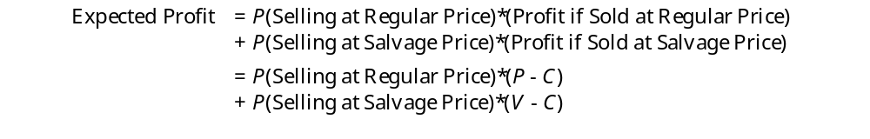
Newsboy Solution
In this case, it is useful to examine the marginal benefit from each unit purchased. The expected profit from any unit purchased is:

Slide 41


Slide 42
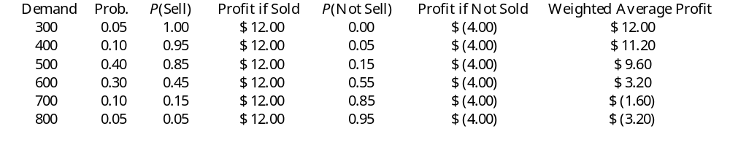

Slide 43
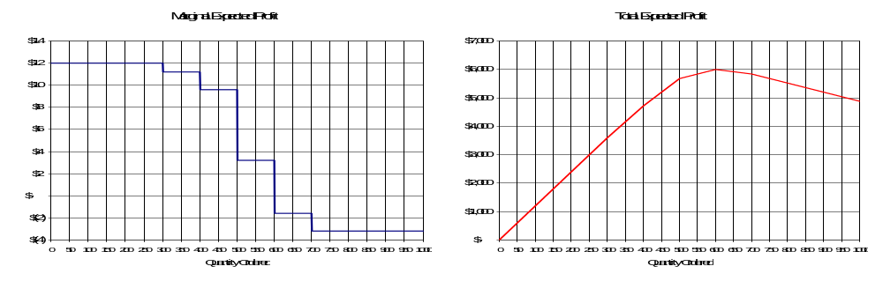
Based on this analysis, we would order 600 units.

Slide 44
Continuous Probability Example
Using the same mean and standard deviation as in the previous case (545.0 and 111.7), what would be optimal if demand were normally distributed?

Slide 45

Define C_{O} and C_{U} to be the “costs” of over-ordering and under-ordering, respectively.
In this case:

Slide 46

It can be shown that the optimal order quantity is the value in the demand distribution that corresponds to the “critical probability”:

Slide 47
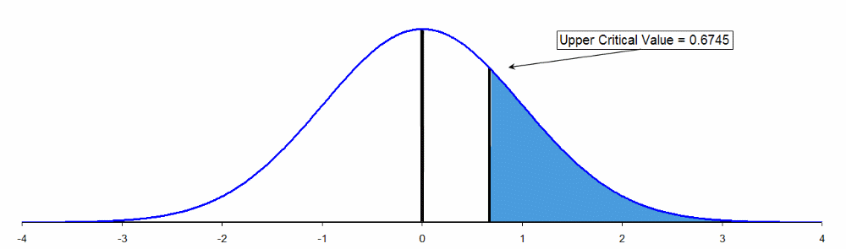
From the standard normal table, the z-value corresponding to a 0.75 probability is 0.6745.

Slide 48

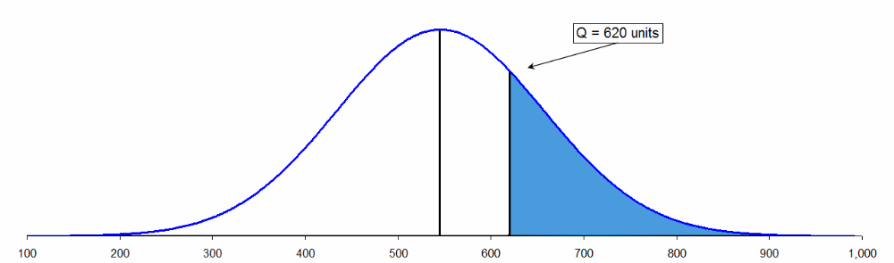

Slide 49
Periodic Review Models
Sometimes a continuous review system doesn’t make sense, as when the item is not very expensive to carry, and/or when the customers don’t mind waiting for a backorder.
A periodic review system only checks inventory and places orders at fixed intervals of time.

Slide 50
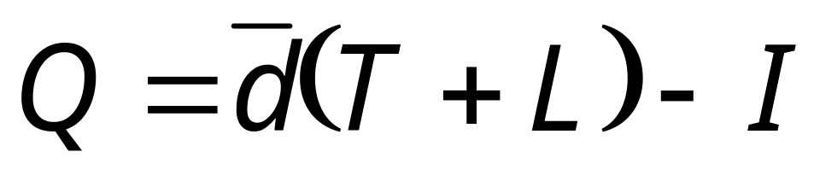
A basic periodic review system might work as follows:
Every T time periods, check the inventory level I, and order enough to bring inventory back up to some predetermined level.
This “order-up-to” level should be enough to cover expected demand during the lead time, plus the time that will elapse before the next periodic review.

Slide 51
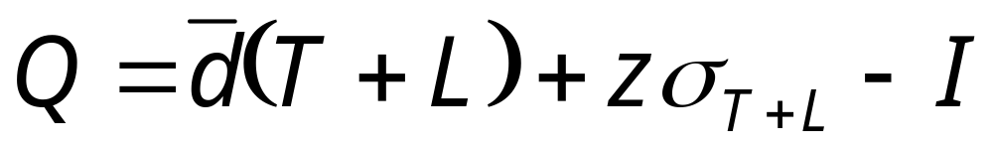
We might also build some safety stock in to the “order-up-to” quantity.

Slide 52
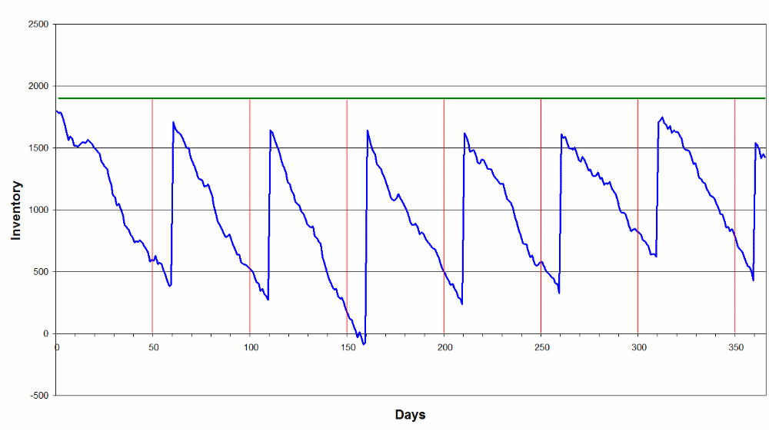

Slide 53
What is Supply-Chain Management?
Supply-chain management is a total system approach to managing the entire flow of information, materials, and services from raw-material suppliers through factories and warehouses to the end customer
Operations Management -- Prof. Juran

Slide 54
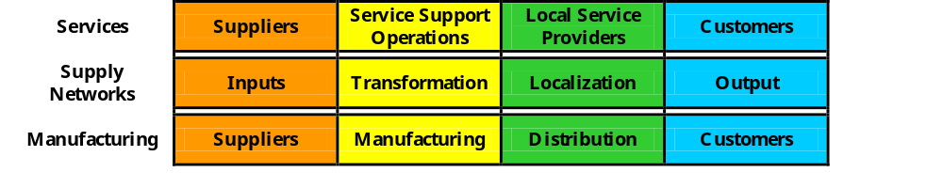
What is a Supply-Chain?
Supply-chain is a term that describes how organizations (suppliers, manufacturers, distributors, and customers) are linked together
Operations Management -- Prof. Juran

Slide 55
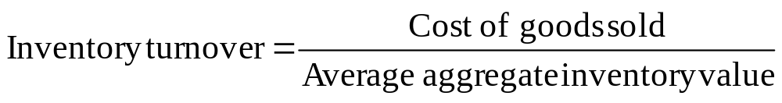
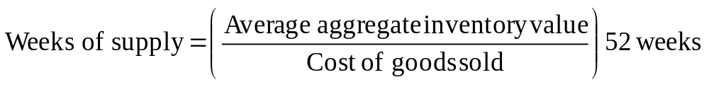
Measures of Supply-Chain Performance
One of the most commonly used measures in all of operations management is “Inventory Turnover”
In situations where distribution inventory is dominant, “Weeks of Supply” is preferred and measures how many weeks’ worth of inventory is in the system at a particular time
Operations Management -- Prof. Juran
Notes:
17

Slide 56
Example: Supply-Chain Performance Measurement
Suppose a company’s new annual report claims their costs of goods sold for the year is $160 million and their total average inventory (production materials + work-in-process) is worth $35 million. This company normally has an inventory turn ratio of 10.
What is this year’s Inventory Turnover ratio?
What does it mean?
Operations Management -- Prof. Juran

Slide 57
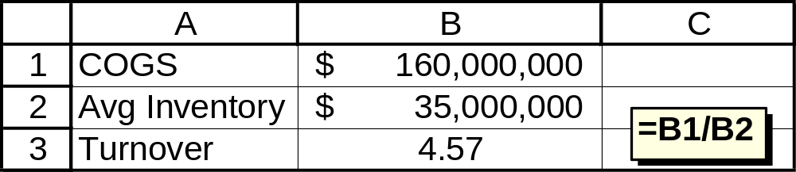
Notes:
17

Slide 58
Since the company’s normal inventory turnover ratio is 10, a drop to 4.57 means that the inventory is not turning over as quickly as it had in the past.
In other words, they now have more inventory relative to their cost of goods sold than before.
What else would you want to know about this situation?
Operations Management -- Prof. Juran
Notes:
17

Slide 59
Supply Chain Strategy
Marshall Fisher:
Adverse effects of price promotions
Functional vs. Innovative products
Operations Management -- Prof. Juran

Slide 60
Hau Lee’s Supply Chain Concepts
Hau Lee’s approach to supply chains centers on aligning the supply chain with process side uncertainties (focus on the supply side)
A stable supply process has mature technologies and an evolving supply process has rapidly changing technologies
Types of Supply Chains
  Efficient
  Risk-Hedging
  Responsive
  Agile
Operations Management -- Prof. Juran
Notes:
7

Slide 61
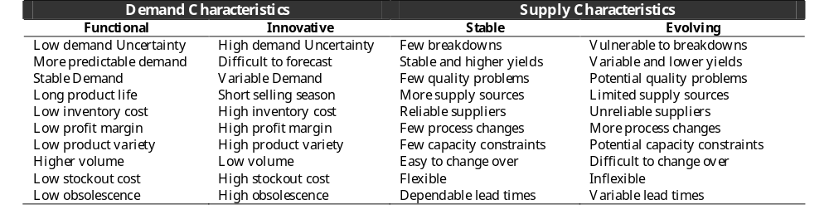
Operations Management -- Prof. Juran

Slide 62
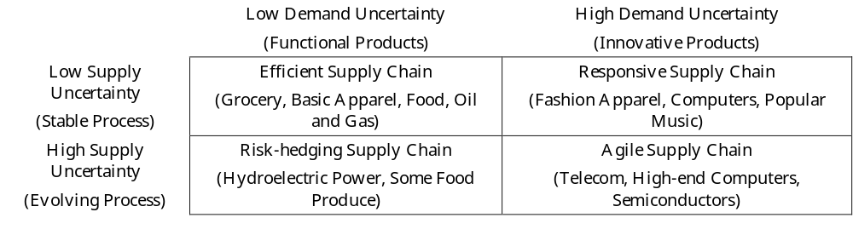
Hau Lee’s Uncertainty Framework
Operations Management -- Prof. Juran
Notes:
7

Slide 63
Value Density
Value density is defined as the value of an item per pound of weight
An important measure when deciding where items should be stocked geographically and how they should be shipped
Operations Management -- Prof. Juran

Slide 64
Mass Customization
Mass customization is a term used to describe the ability of a company to deliver highly customized products and services to different customers
The key to mass customization is effectively postponing the tasks of differentiating a product for a specific customer until the latest possible point in the supply-chain network
Operations Management -- Prof. Juran

Slide 65
Mass Customization
Principle 1: A product should be designed so it consists of independent modules that can be assembled into different forms of the product easily and inexpensively.
Principle 2: Manufacturing and service processes should be designed so that they consist of independent modules that can be moved or rearranged easily to support different distribution network strategies.
Operations Management -- Prof. Juran

Slide 66
Mass Customization
Principle 3: The supply network — the positioning of the inventory and the location, number, and structure of service, manufacturing, and distribution facilities — should be designed to provide two capabilities. First, it must be able to supply the basic product to the facilities performing the customization in a cost-effective manner. Second, it must have the flexibility and the responsiveness to take individual customers’ orders and deliver the finished, customized good quickly.
Operations Management -- Prof. Juran

Slide 67
Summary
Supply-Chain Management
Measuring Supply-Chain Performance
Outsourcing
Value Density
Mass Customization
Operations Management -- Prof. Juran
Notes:
2

Slide 68
Summary
Basic Definitions and Ideas
Reasons to Hold Inventory
Inventory Costs
Inventory Control Systems
Continuous Review Models
  Basic EOQ Model
  Quantity Discounts
  Safety Stock
  Special Case: The News Vendor Problem
    Discrete Probability Example
    Continuous Probability Example
Periodic Review Model

