Slide 1

Project Management

Slide 2
Outline
Definition of Project Management
  Work Breakdown Structure
  Project Control Charts
  Structuring Projects
Critical Path Scheduling
  By Hand
  Linear Programming
PERT
  By Hand
Notes:
2

Slide 3
Project Management
A Project is a series of related jobs usually directed toward some major output and requiring a significant period of time to perform
Project Management is the set of management activities of planning, directing, and controlling resources (people, equipment, material) to meet the technical, cost, and time constraints of a project
An extreme case: Smallest possible production volume, greatest possible customization
Notes:
3

Slide 4
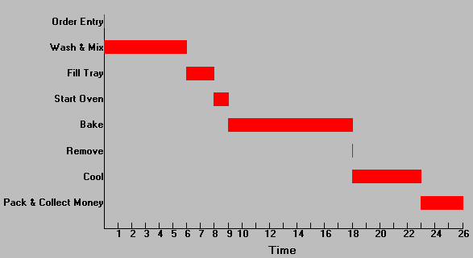
Project Control Charts: Gantt Chart
Notes:
6

Slide 5
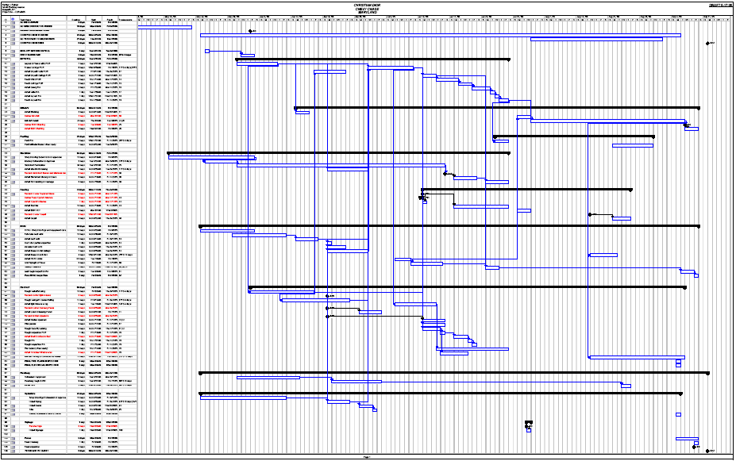

Slide 6
A pure project is where a self-contained team works full-time on the project
Advantages:
The project manager has full authority over the project
Team members report to one boss
Shortened communication lines
Team pride, motivation, and commitment are high
Disadvantages:
Duplication of resources
Organizational goals and policies are ignored
Lack of technology transfer
Team members have no functional area "home"
Notes:
8

Slide 7
Functional Projects
President
Research and
Development
Engineering
Manufacturing
Project
A
Project
B
Project
C
Project
D
Project
E
Project
F
Project
G
Project
H
Project
I
Example: Project “B” is in the functional area of Research and Development.
Notes:
9

Slide 8
Functional Projects
Advantages:
A team member can work on several projects
Technical expertise is maintained within the functional area
The functional area is a “home” after the project is completed
Critical mass of specialized knowledge
Disadvantages:
Aspects of the project that are not directly related to the functional area get short-changed
Motivation of team members is often weak
Needs of the client are secondary and are responded to slowly
Notes:
9

Slide 9
Matrix Project Organization Structure
President
Research and
Development
Engineering
Manufacturing
Marketing
Manager
Project A
Manager
Project B
Manager
Project C
Notes:
12

Slide 10
Matrix Structure
Advantages:
Enhanced communications between functional areas
Pinpointed responsibility
Duplication of resources is minimized
Functional “home” for team members
Policies of the parent organization are followed
Disadvantages:
Too many bosses
Depends on project manager’s negotiating skills
Potential for sub-optimization
Notes:
13

Slide 11
Work Breakdown Structure
A hierarchy of project tasks, subtasks, and work packages
Level
Program
1
Project 1
Project 2
2
Task 1.1
Task 1.2
3
Subtask 1.1.1
Subtask 1.1.2
4
Work Package 1.1.1.1
Work Package 1.1.1.2
Notes:
4

Slide 12
Network Models
A project is viewed as a sequence of activities that form a “network” representing a project
The path taking longest time through this network of activities is called the “critical path”
The critical path provides a wide range of scheduling information useful in managing a project
Critical Path Method (CPM) helps to identify the critical path(s) in the project network
Notes:
15

Slide 13
Prerequisites for Critical Path Method
A project must have:
well-defined jobs or tasks whose completion marks the end of the project;
independent jobs or tasks;
and tasks that follow a given sequence.
Notes:
16

Slide 14
Types of Critical Path Methods
CPM with a Single Time Estimate
  Used when activity times are known with certainty
  Used to determine timing estimates for the project, each activity in the project, and slack time for activities
Time-Cost Models
  Used when cost trade-off information is a major consideration in planning
  Used to determine the least cost in reducing total project time
CPM with Three Activity Time Estimates
  Used when activity times are uncertain
  Used to obtain the same information as the Single Time Estimate model and probability information
Notes:
15

Slide 15
CPM with Single Time Estimate
Activity Identification
Activity Sequencing and Network Construction
Determine the critical path
  From the critical path all of the project and activity timing information can be obtained
Notes:
15

Slide 16
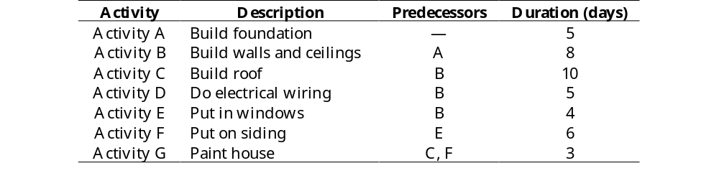
House-Building Example

Slide 17
Managerial Problems
Find the minimum number of days needed to build the house.
Find the “critical path”.
Find the least expensive way to finish the house in a certain amount of time.
Study the possible effects of randomness in the activity times.

Slide 18
Activity-on-Arc Network
F
6
1
3
4
A
5
G
3
E
4
0
Start
5
End
C
10
B
8
D
5
2

Slide 19
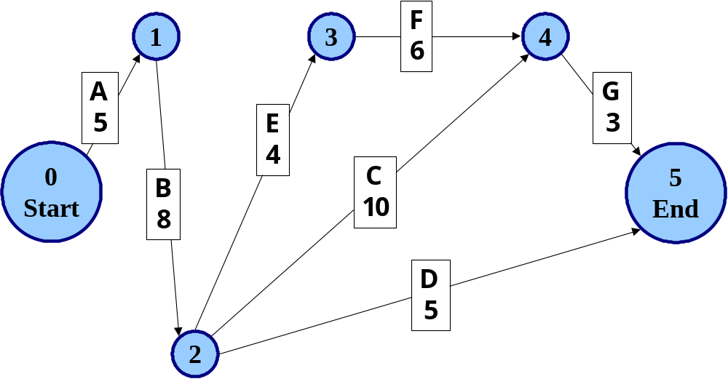
Method 1: “By Hand”

Slide 20
Procedure
Draw network
Forward pass to find earliest times
Backward pass to find latest times
Analysis: Critical Path, Slack Times
Extensions (really hard!):
  Crashing
  PERT

Slide 21
CPM Jargon
Every network of this type has at least one critical path, consisting of a set of critical activities.
In this example, there are two critical paths: A-B-C-G and A-B-E-F-G.
1
3
F
6
4
A
5
G
3
E
4
0
Start
5
End
B
8
C
10
D
5
2

Slide 22
Conclusions
The project will take 26 days to complete.
The only activity that is not critical is the electrical wiring (Activity D).

Slide 23
Time-Cost Models
Basic Assumption: Relationship between activity completion time and project cost
Time Cost Models: Determine the optimum point in time-cost tradeoffs
  Activity direct costs
  Project indirect costs
  Activity completion times
Notes:
32

Slide 24
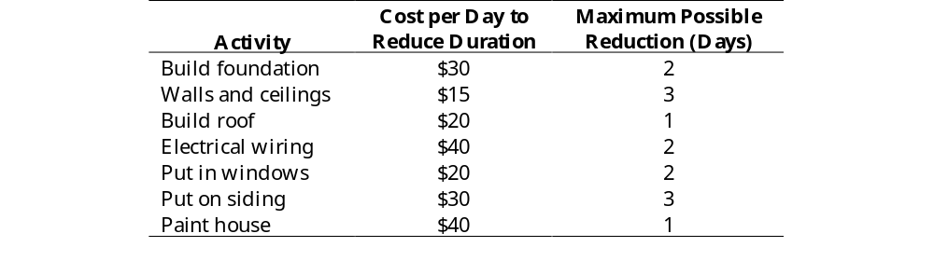
Crashing Parameters
What is the least expensive way to finish this project in 20 days? (This is hard!)

Slide 25
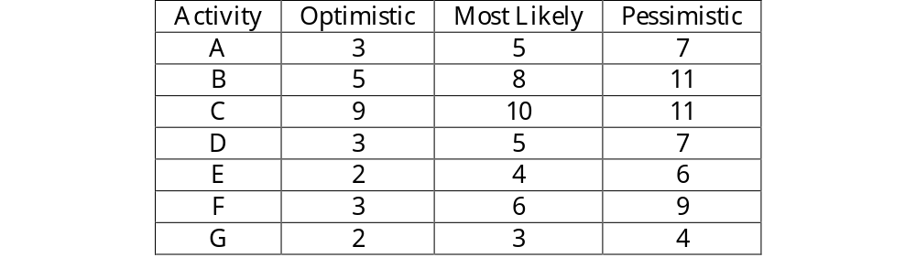
CPM with Three Activity Time Estimates

Slide 26
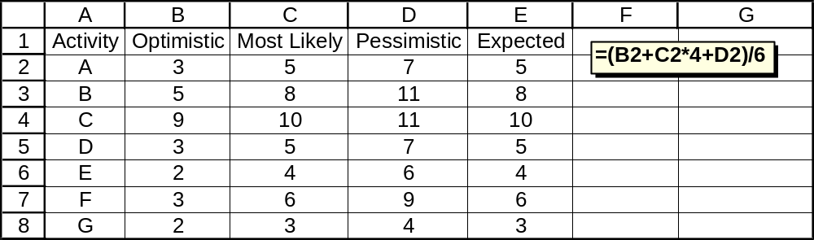
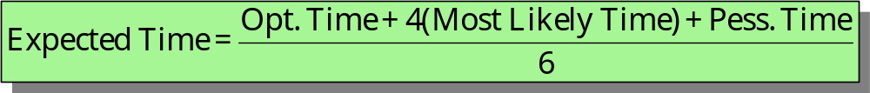
Expected Time Calculations

Slide 27
Expected Time Calculations
Note: the expected time of an activity is not necessarily equal to the most likely time (although that is true in this problem).

Slide 28
1
3
F
6
4
A
5
G
3
E
4
0
Start
C
10
5
End
B
8
D
5
2
The sum of the critical path expected times is the expected duration of the whole project (in this case, 26 days).

Slide 29
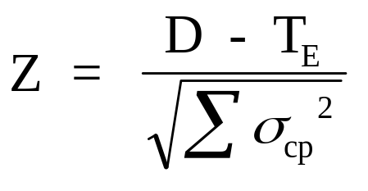
What is the probability of finishing this project in
less than 25 days?

Slide 30
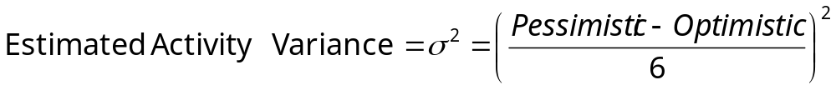
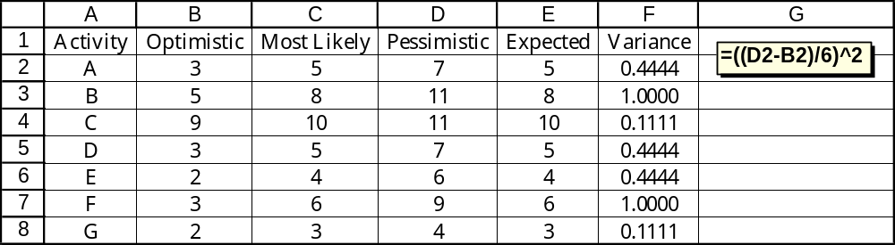

Slide 31
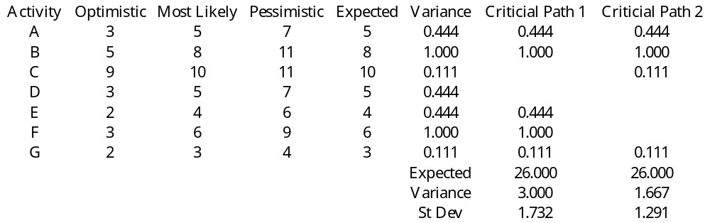
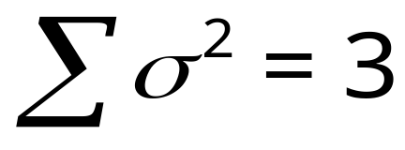
Sum the variances along the critical path.
(In this case, with two critical paths, we’ll take the one with the larger variance.)

Slide 32
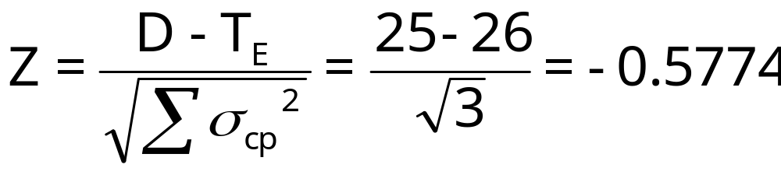
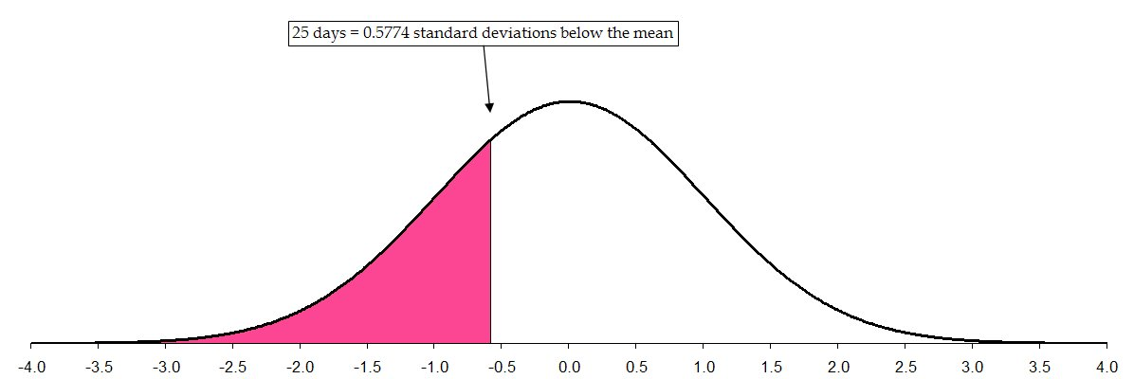
p(Z < -.156) = .438, or 43.8 % (NORMSDIST(-.156)
There is a 28.19% probability that this project will be completed in less than 25 days.

Slide 33
CPM Assumptions/Limitations
Project activities can be identified as entities (there is a clear beginning and ending point for each activity).
Project activity sequence relationships can be specified and networked.
Project control should focus on the critical path.
The activity times follow the beta distribution, with the variance of the project assumed to equal the sum of the variances along the critical path.
Notes:
15

Slide 34
Method 2: Excel Solver
(Linear Programming)

Slide 35
Procedure
Define Decision Variables
Define Objective Function
Define Constraints
Solver Dialog and Options
Run Solver
“Sensitivity” Analysis: Critical Path, Slack
Extensions:
  Crashing (not too bad)
  PERT (need simulation, not Solver)

Slide 36
LP Formulation
Decision Variables
We are trying to decide when to begin and end each of the activities.
Objective
Minimize the total time to complete the project.
Constraints
Each activity has a fixed duration.
There are precedence relationships among the activities.
We cannot go backwards in time.

Slide 37
Formulation
Decision Variables
Define the nodes to be discrete events. In other words, they occur at one exact point in time. Our decision variables will be these points in time.
Define t_{i} to be the time at which node i occurs, and at which time all activities preceding node i have been completed.
Define t₀ to be zero.
Objective
Minimize t₅.

Slide 38
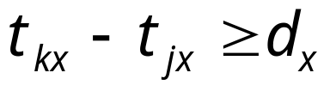
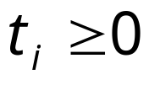
Formulation
Constraints
There is really one basic type of constraint. For each activity x, let the time of its starting node be represented by t_{jx} and the time of its ending node be represented by t_{kx}.
Let the duration of activity x be represented as d_{x}.
For every activity x,
For every node i,

Slide 39
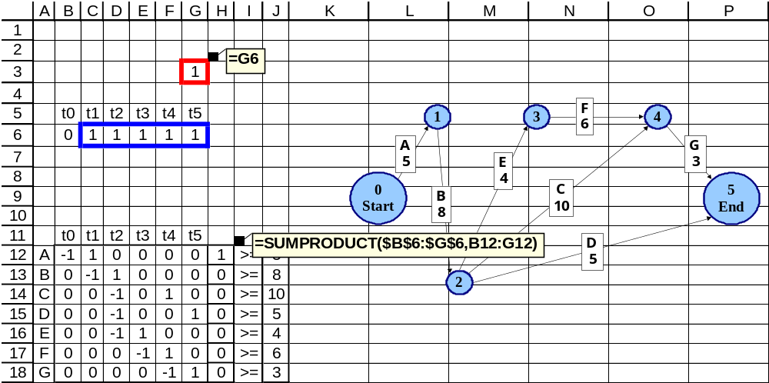
Solution Methodology

Slide 40
Solution Methodology
The matrix of zeros, ones, and negative ones (B12:G18) is a means for setting up the constraints.
The sumproduct functions in H12:H18 calculate the elapsed time between relevant pairs of nodes, corresponding to the various activities.
The duration times of the activities are in J12:J18.

Slide 41
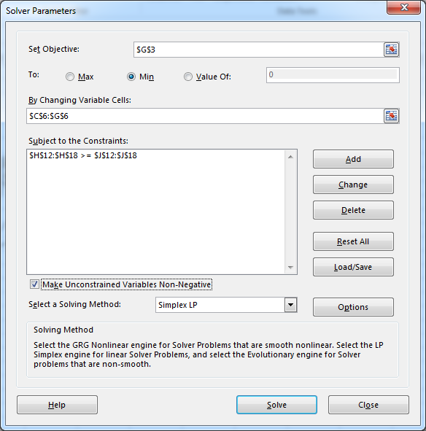

Slide 42
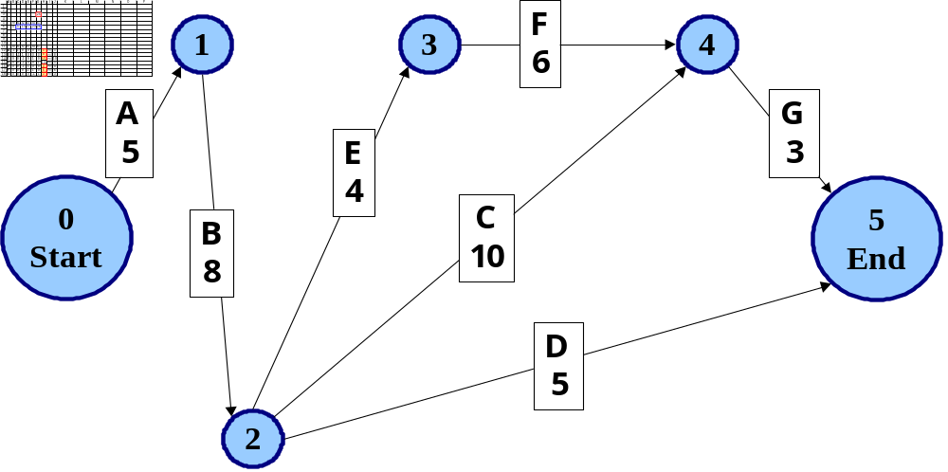
Optimal Solution

Slide 43
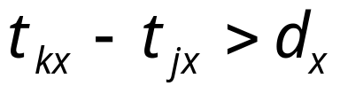
CPM Jargon
Any activity for which
is said to have slack time, the amount of time by which that activity could be delayed without affecting the overall completion time of the whole project. In this example, only activity D has any slack time (13 – 5 = 8 units of slack time).

Slide 44
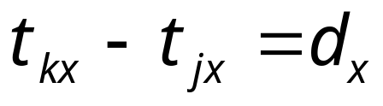
CPM Jargon
Any activity x for which
is defined to be a “critical” activity, with zero slack time.

Slide 45
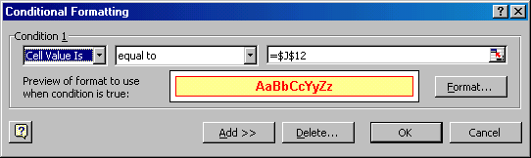
Excel Tricks: Conditional Formatting

Slide 46
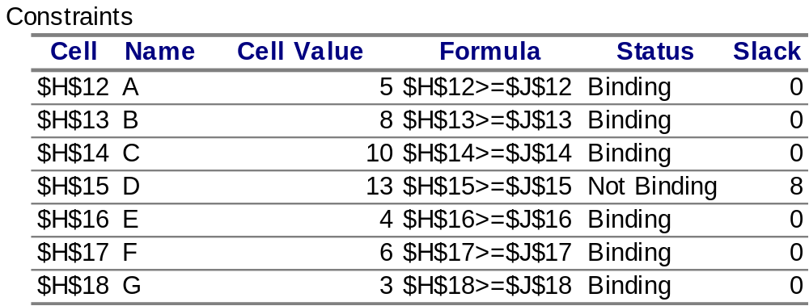
Critical Activities: Using the Solver Answer Report

Slide 47
House-Building Example, Continued
Suppose that by hiring additional workers, the duration of each activity can be reduced. Use LP to find the strategy that minimizes the cost of completing the project within 20 days.

Slide 48
Crashing Parameters

Slide 49
Managerial Problem Definition
Find a way to build the house in 20 days.

Slide 50
Formulation
Decision Variables
Now the problem is not only when to schedule the activities, but also which activities to accelerate. (In CPM jargon, accelerating an activity at an additional cost is called “crashing”.)
Objective
Minimize the total cost of crashing.

Slide 51
Formulation
Constraints
The project must be finished in 20 days.
Each activity has a maximum amount of crash time.
Each activity has a “basic” duration. (These durations were considered to have been fixed in Part a; now they can be reduced.)
There are precedence relationships among the activities.
We cannot go backwards in time.

Slide 52
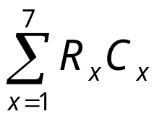
Formulation
Decision Variables
Define the number of days that activity x is crashed to be R_{x}.
For each activity there is a maximum number of crash days R_{max, x}
Define the crash cost per day for activity x to be C_{x}
Objective
Minimize Z =

Slide 53


Formulation
Constraints
For every activity x,
For every activity x,
For every node i,

Slide 54
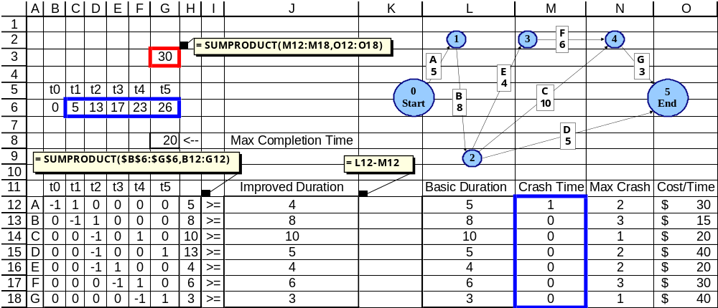
Solution Methodology

Slide 55
Solution Methodology
G3 now contains a formula to calculate the total crash cost.
The new decision variables (how long to crash each activity x, represented by R_{x}) are in M12:M18.
G8 contains the required completion time, and we will constrain the value in G6 to be less than or equal to G8.
The range J12:J18 calculates the revised duration of each activity, taking into account how much time is saved by crashing.

Slide 56
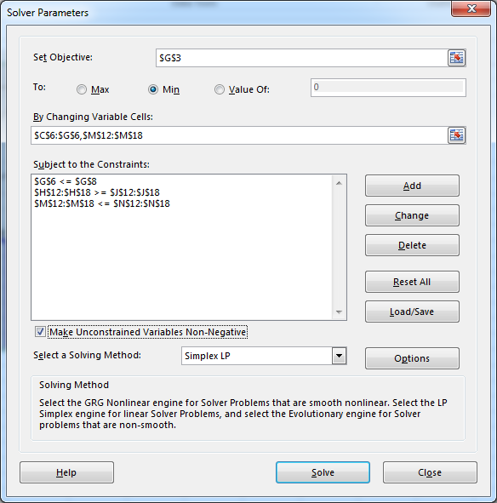

Slide 57
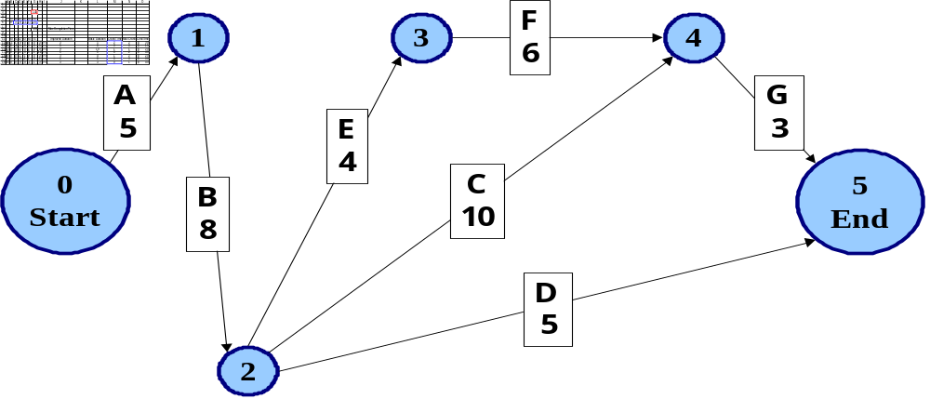
Optimal Solution

Slide 58
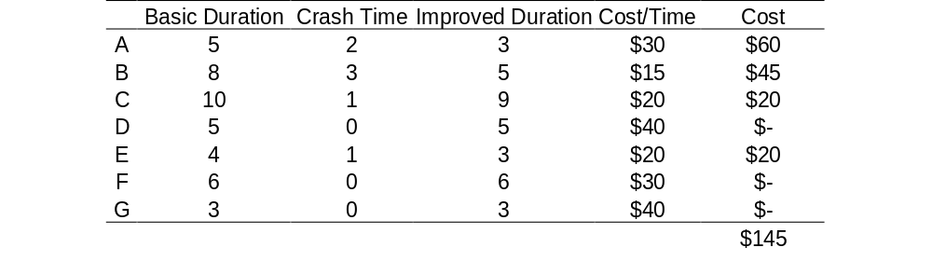
Crashing Solution

Slide 59
Crashing Solution
It is feasible to complete the project in 20 days, at a cost of $145.
1
3
F
6
4
A
3
G
3
E
3
0
Start
5
End
B
5
C
9
D
5
2

Slide 60
Summary
Definition of Project Management
  Work Breakdown Structure
  Project Control Charts
  Structuring Projects
Critical Path Scheduling
  By Hand
  Linear Programming
PERT
  By Hand
Notes:
2

