Slide 1

Simulation

Slide 2
Overview
Monte Carlo Simulation
  Basic concepts and history
Excel Tricks
  RAND(), IF, Boolean
Crystal Ball
  Probability Distributions
    Normal, Gamma, Uniform, Triangular
  Assumption and Forecast cells
  Run Preferences
  Output Analysis
Examples
  Coin Toss, TSB Account

Slide 3
Monte Carlo Simulation
Using theoretical probability distributions to model real-world situations in which randomness is an important factor.
Differences from other spreadsheet models
No optimal solution
Explicit modeling of random variables in special cells
Many trials, all with different results
Objective function studied using statistical inference

Slide 4
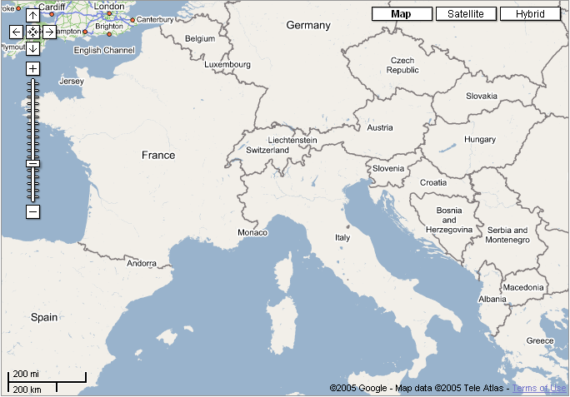

Slide 5
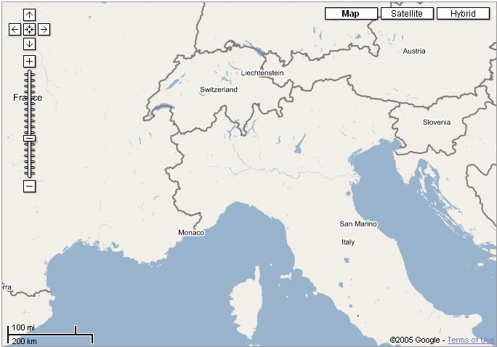

Slide 6


Slide 7


Slide 8
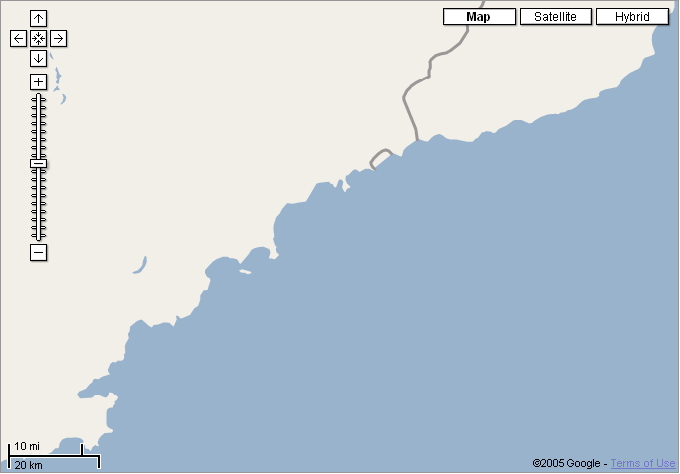

Slide 9
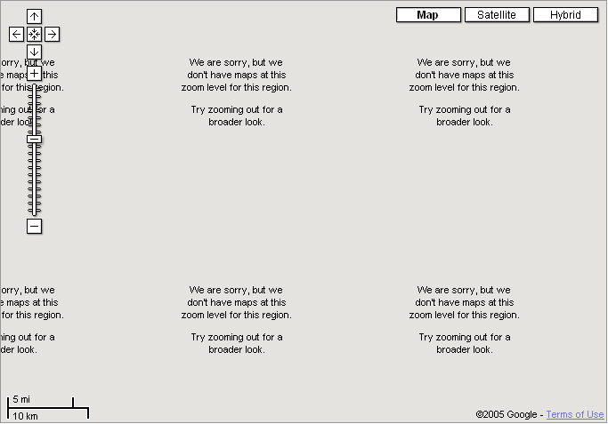

Slide 10


Slide 11
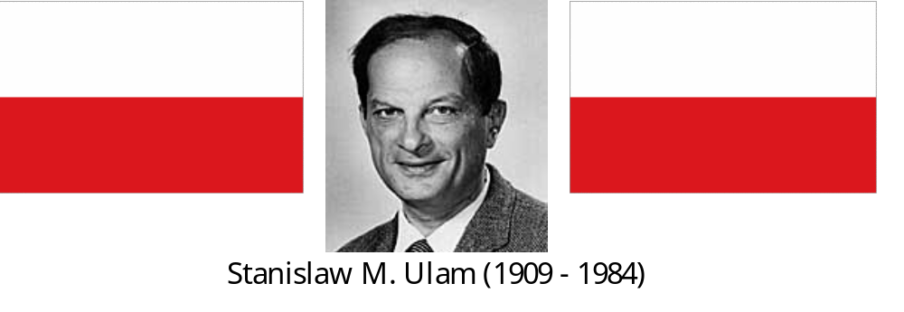
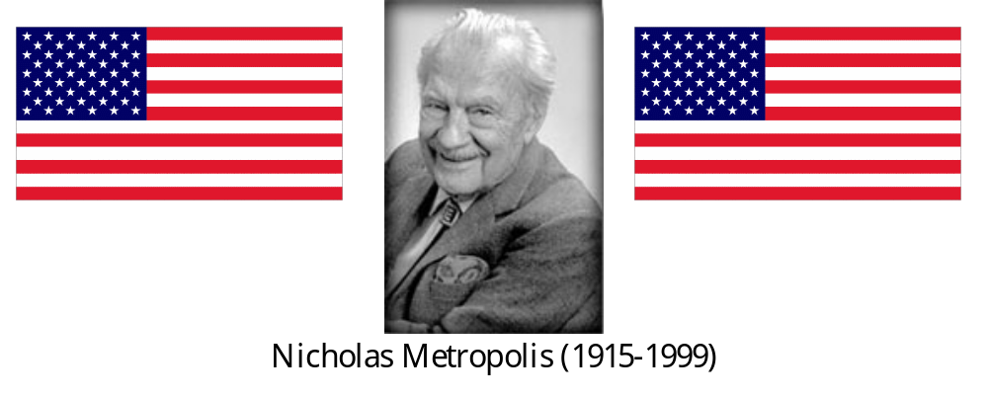
Origins of Monte Carlo

Slide 12
Example: Coin Toss
Imagine a game where you flip a coin once.
If you get “heads”, you win $3.00
If you get “tails”, you lose $1.00
The coin is not fair; it lands on “heads” 35% of the time
What is the expected value of this game?

Slide 13
Simulation “By Hand”
Set up a spreadsheet model
Add an element of randomness
  Excel built-in random number generator
  Use F9 key to create repetitive iterations of the random system (“realizations”)
Keep track of the results

Slide 14
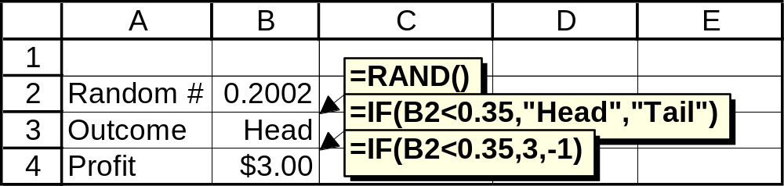

Slide 15
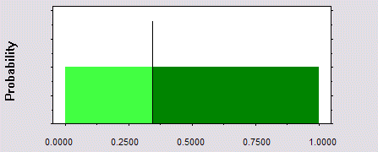
What Does =RAND() Do?
Uniform random number between 0 and 1
Never below 0; never above 1
All values between 0 and 1 are equally likely
P(X<0.35) = 0.35
0.35
0.65

Slide 16
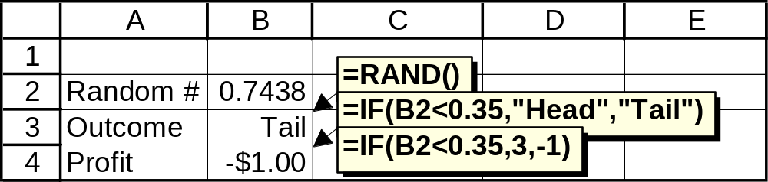
What Does =IF Do?
Evaluates a logical expression (true or false)
Gives one result for true and a different result for false
In our “coin” model, RAND and IF work together to generate heads and tails (and profits and losses) from a specific probability distribution

Slide 17
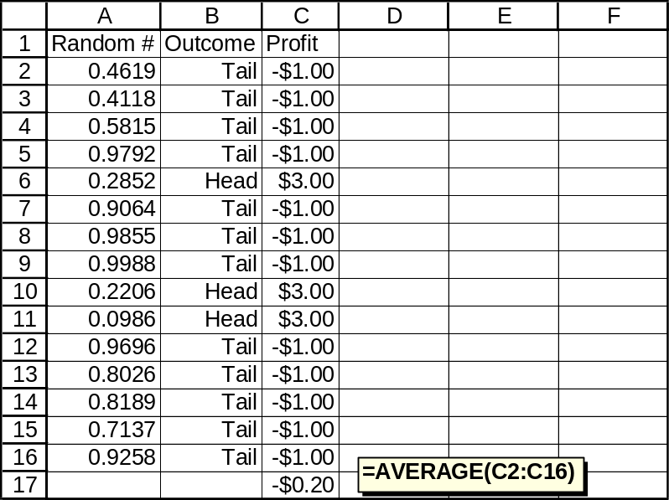
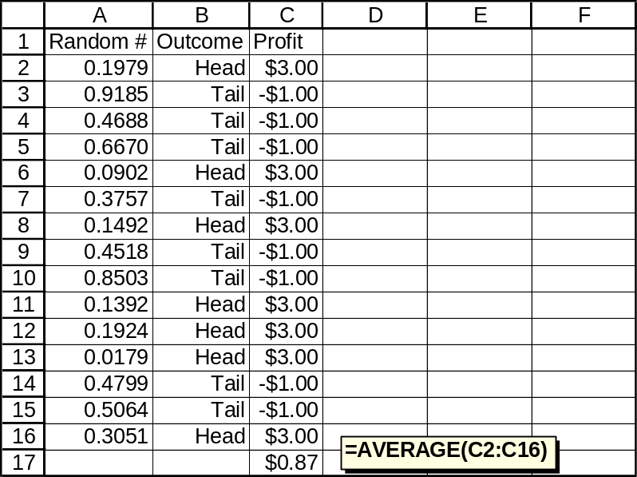
Some Random Results
Sample means from 15 trials:

Slide 18
Problems with this Model
Hitting F9 thousands of times is tedious
Keeping track of the results (and summary statistics) is even more tedious
What if we want to simulate something other than a uniform distribution between 0 and 1?

Slide 19
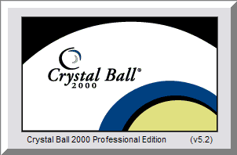

Simulation with Crystal Ball

Slide 20
Simulation with Crystal Ball
Special cells for random variables (Assumptions)
Special cells for objective functions (Forecasts)
Run Preferences
Number of trials
Random number seed
Sampling method
Output Analysis
Studying forecasts
Extracting data

Slide 21
Assumption Cell
An input random number; a building block for a simulation model
The “Define Assumption” button:
Must be a “value” cell (a number, not a function)
Can be ANY number
Gives Crystal Ball permission to generate random numbers in that cell according to a specific probability distribution

Slide 22
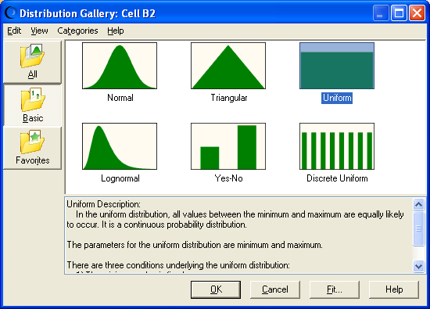

Slide 23
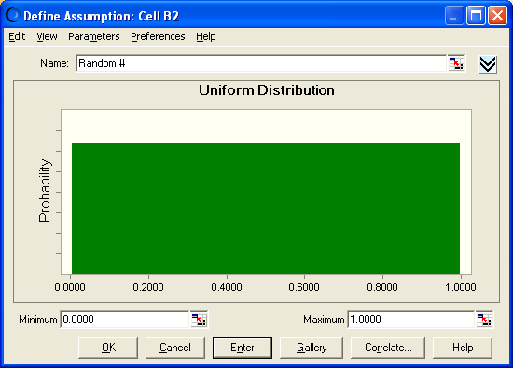

Slide 24
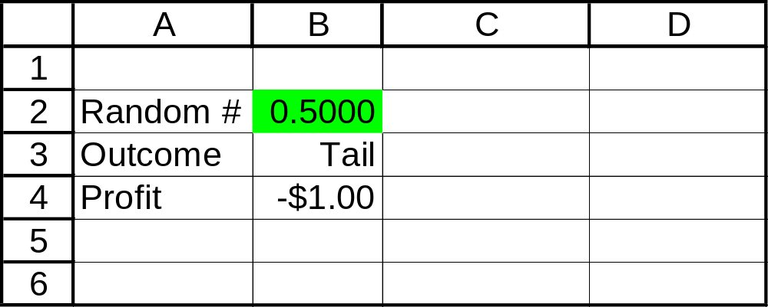

Slide 25
Assumption Cell
Keeps track of important outcome cells during the simulation run. Select the “profit” cell and click on the forecast button.
You can enter a name and units if you want. Then click OK.

Slide 26
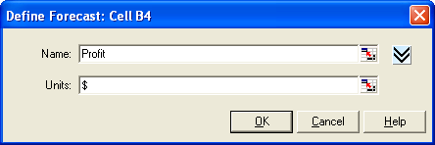

Slide 27
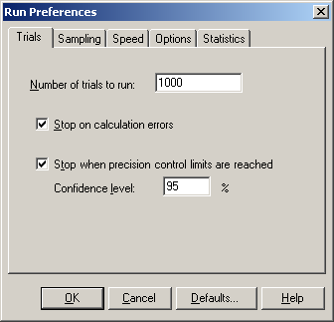
Now click on the run preferences button.

Slide 28

Crystal Ball has buttons for controlling the simulation run, similar to the buttons on a DVD player:

Slide 29
The Crystal Ball toolbar
The “play” button

Slide 30
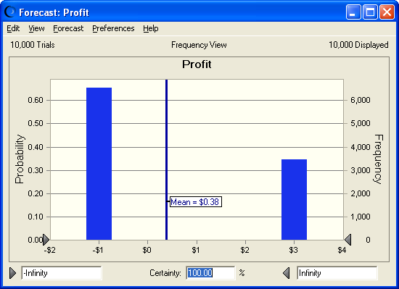

Slide 31
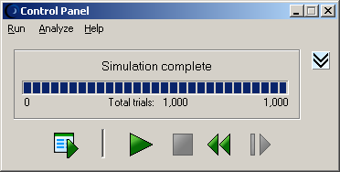
The simulation will run until it reaches the maximum number of trials, at which point it will display this message:

Slide 32
Conclusions
Crystal Ball performs the tedious functions of running a simulation in a spreadsheet model
We can use statistical inference (confidence intervals and hypothesis tests) to study the results
The results are only estimates, but they can be very precise estimates
Much depends on the validity of our model; how well it represents the real-world system we really want to learn about

Slide 33
Random Number Generator
Built into Excel
RAND() function
Tools – Data Analysis – Random Number Generation
Built into all simulation software
Not really random; correctly called pseudo-random

Slide 34
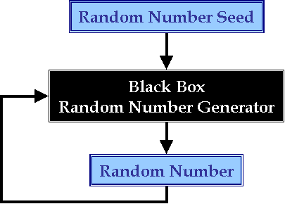
Random Number Generator
Needs a “seed” to get started
Each random number becomes the “seed” for its successor

Slide 35
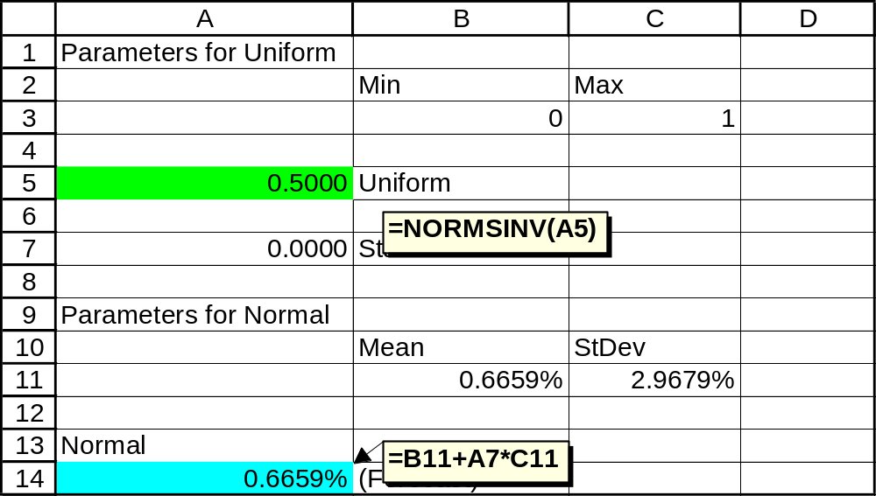
Probability Trick: Uniform to Normal
Start with template file: s-uniform-normal-0.xls

Slide 36
Example: Tax-Saver Benefit
A TSB (Tax Saver Benefit) plan allows you to put money into an account at the beginning of the calendar year that can be used for medical expenses. This amount is not subject to federal tax — hence the phrase TSB.

Slide 37
As you pay medical expenses during the year, you are reimbursed by the administrator of the TSB until the TSB account is exhausted. From that point on, you must pay your medical expenses out of your own pocket. On the other hand, if you put more money into your TSB than the medical expenses you incur, this extra money is lost to you.
Your annual salary is $50,000 and your federal income tax rate is 30%.

Slide 38
Assume that your medical expenses in a year are normally distributed with mean $2000 and standard deviation $500.
Build a Crystal Ball model in which the output is the amount of money left to you after paying taxes, putting money in a TSB, and paying any extra medical expenses. Experiment with the amount of money put in the TSB, and identify an amount that is approximately optimal.

Slide 39
First, we set up a spreadsheet to organize all of the information. In particular, we want to make sure we’ve identified the decision variable (how much to have taken out of our salary and put into the TSB account — here in cell B1), the objective (Maximize net income — after tax, and after extra medical expenses not covered by the TSB — which we have here in cell B14), and the random variable (in this case the amount of medical expenses — here in cell B9).

Slide 40
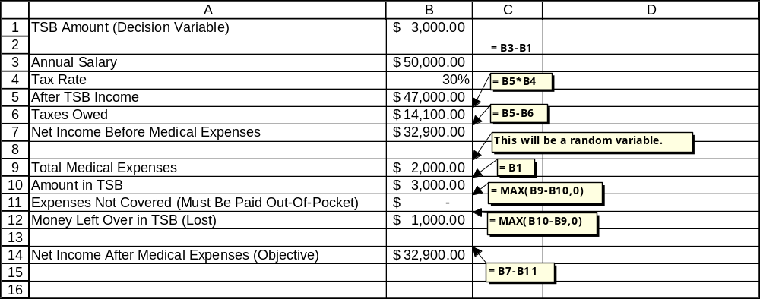

Slide 41
Note (this is important): We will never get a simulation model to tell us directly what is the optimal value of the decision variable.
We will try different values (here we have arbitrarily started with $3000 in cell B1) and see how the objective changes.
Through educated trial-and-error, we will eventually come to some conclusion about what is the best amount of money to put into the TSB account.

Slide 42
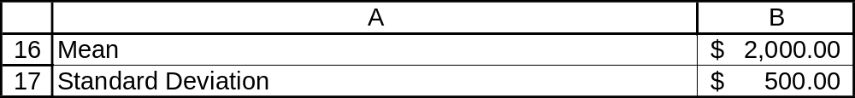
Now we add the element of randomness by making B9 into an assumption cell. First, enter the mean and standard deviation for the medical expenses random variable (we put them in cells B16 and B17, respectively).

Slide 43
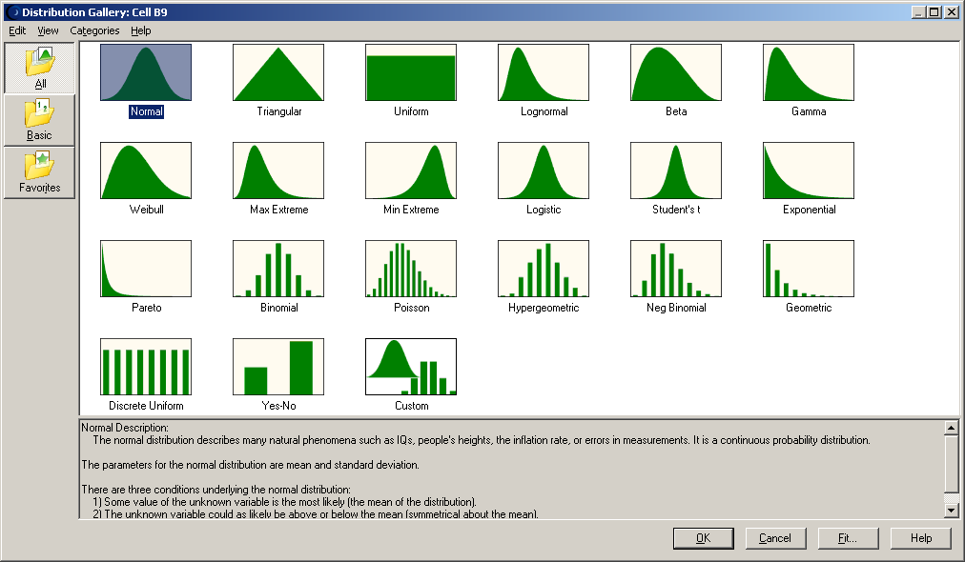
Select the assumption cell B9 and click on the assumption button.
Select “Normal” and click “OK”.

Slide 44
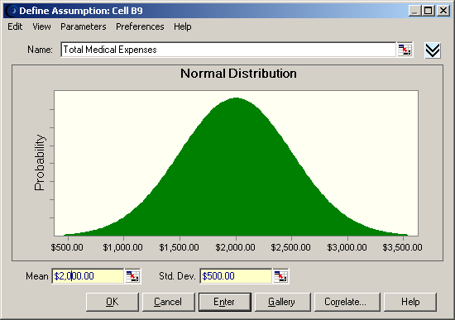
We are presented with a screen where we can enter the parameters for this normal distribution. We can enter values (2000 and 500) or we can use cell references. Here we enter the cell references.

Slide 45
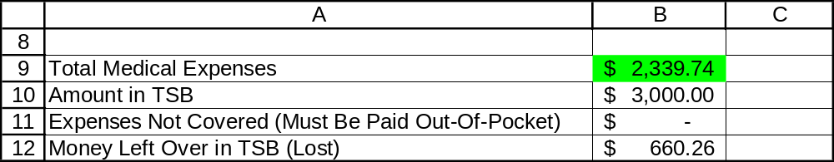

Slide 46
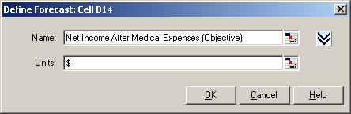
Now we need to tell Crystal Ball to keep track of our objective cell during all of our simulation runs, so we can see its mean and standard deviation over many trials. Select the net income cell B14 and click on the forecast button.
You can enter a name and units if you want. Then click OK.

Slide 47
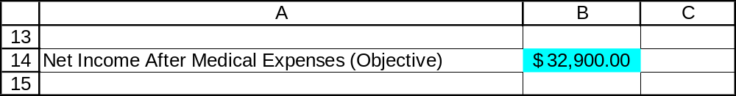

Slide 48
Now click on the run preferences button.

Slide 49
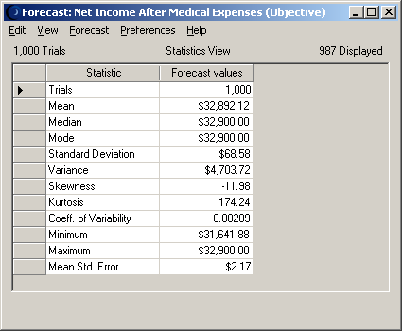

Slide 50
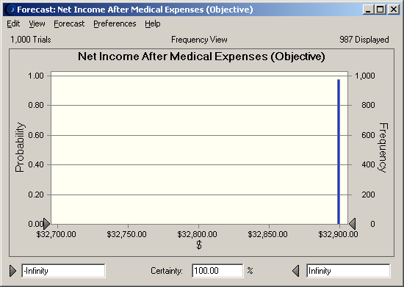

Slide 51
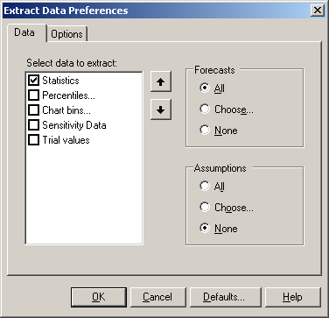
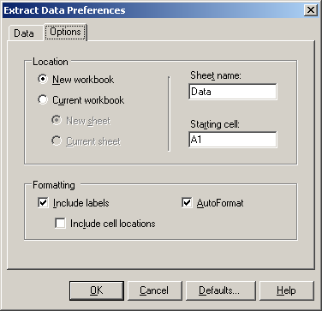
To see the summary statistics from the 1000 simulations, we click on the extract data button.
Select one of the options (here we pick statistics):

Slide 52
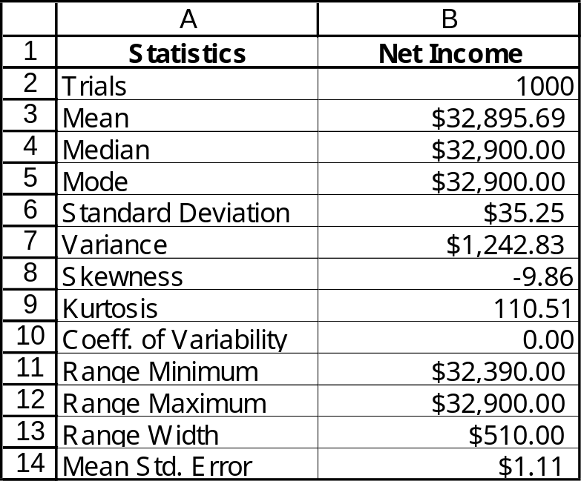
We see the following information appear in a new worksheet:
This gives us everything we need to perform analysis such as making a confidence interval for the true mean net income when we put $3000 into the TSB account.

Slide 53
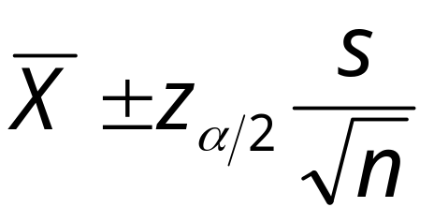
The formula for a 95% confidence interval:
To perform normal distribution calculations in Excel, we use the NORMSDIST and NORMSINV functions.

Slide 54
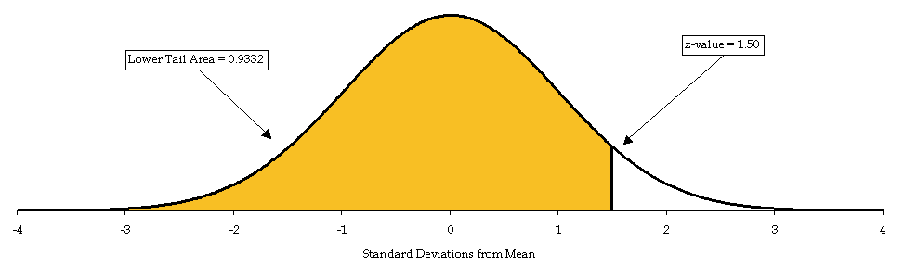
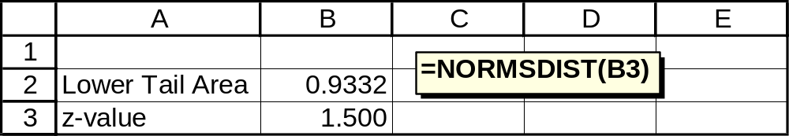
NORMSDIST

Slide 55
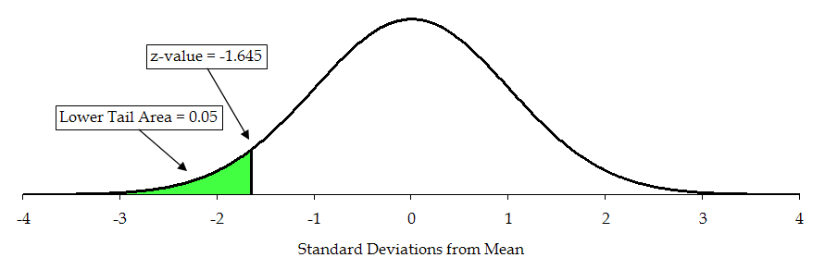
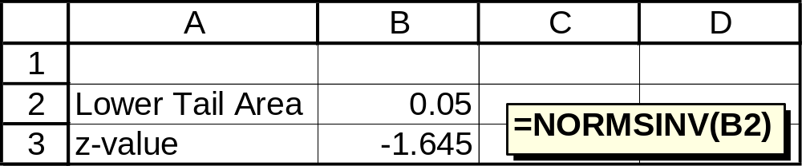
NORMSINV

Slide 56
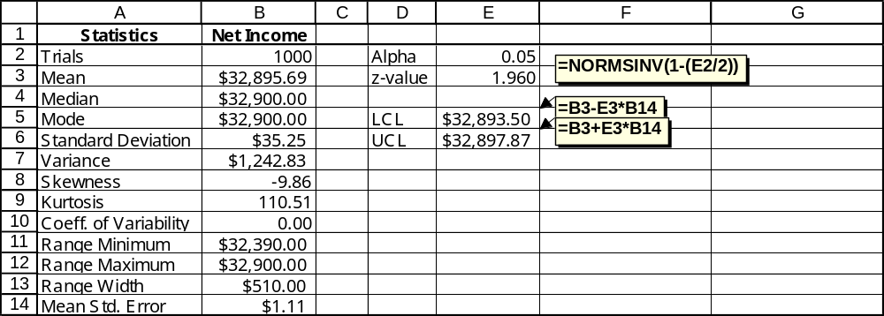
95% Confidence Interval for the Population Mean

Slide 57
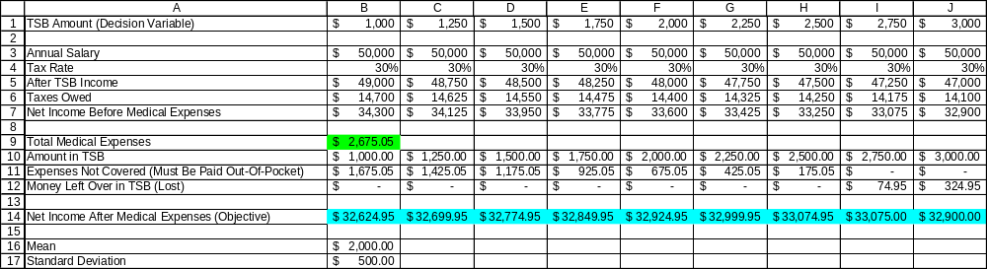
Unfortunately, we can’t tell whether $3000 is the optimal amount without trying many other possible amounts. This could entail a long and tedious series of simulation runs, but fortunately it is possible to test many values at once.
We set up numerous columns in the worksheet, so that we can perform simulation experiments on many possible TSB amounts simultaneously:

Slide 58
Here we have set up different columns, each with its own possible amount to be put into the TSB account in row 1. In row 14 we have the net income forecast for each possible value of the decision variable.
To make the output easy to interpret, we had to select each forecast cell, click on the “define forecast” button, and give each of them a logical name. This is a pain, but it pays off later.

Slide 59
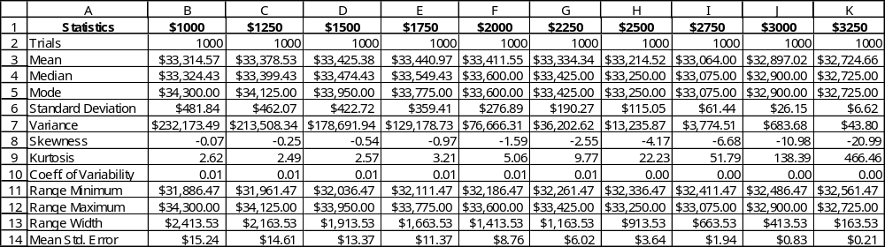
Now we re-run the simulation, click on extract data, select “all” forecasts, and get summary statistics for all of our possible values for the TSB:

Slide 60
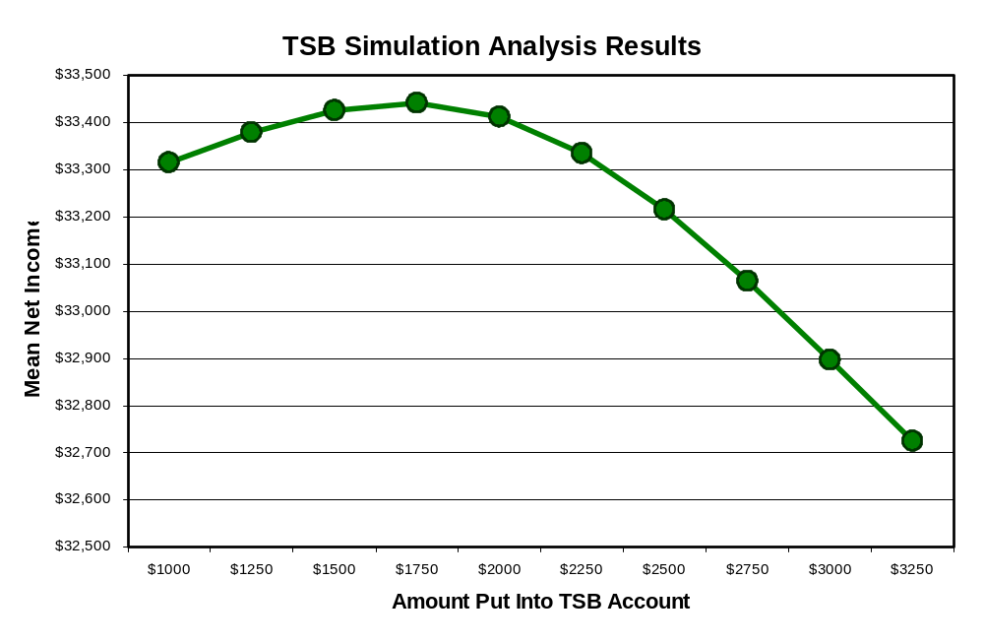

Slide 61
What if we assume that annual medical expenses follow a gamma distribution?
To have the same mean and standard deviation as our normal distribution, we would use $0 for the location parameter, $125 for the scale parameter (sometimes symbolized with β), and 16 for the shape parameter (sometimes symbolized with α).

Slide 62
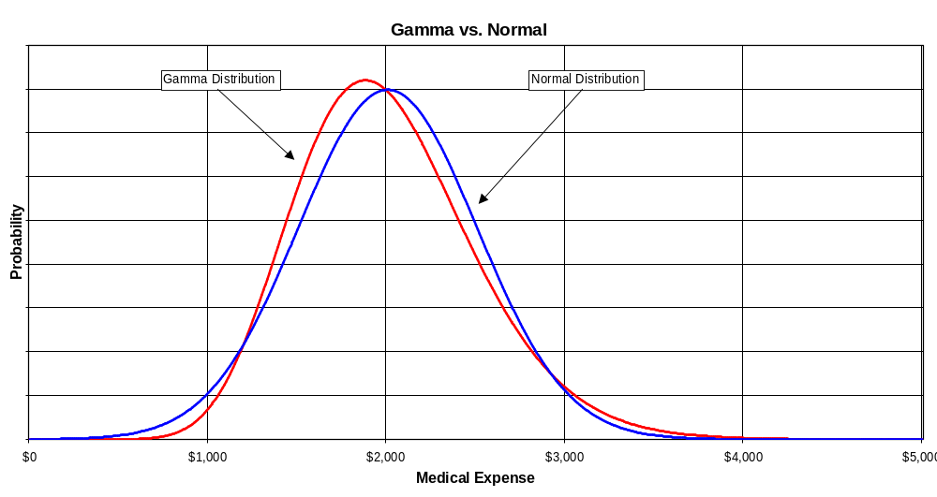

Slide 63
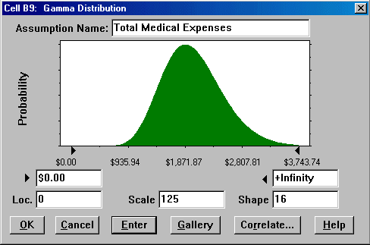

Slide 64
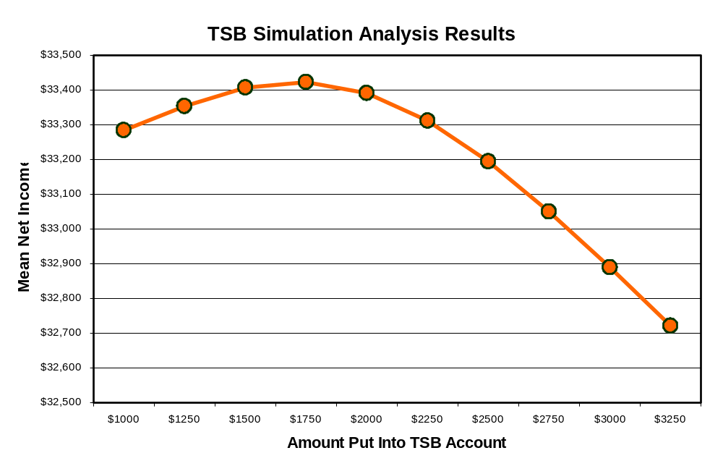

Slide 65
Conclusions
The best amount to put into the TSB is apparently about $1,750 per year.
This result is robust over different distributions of medical costs.
This result is based on sample statistics, not known population parameters.
We have confidence in these sample statistics because of the large sample size (1,000).

Slide 66
Summary
Monte Carlo Simulation
  Basic concepts and history
Excel Tricks
  RAND(), IF, Boolean
Crystal Ball
  Probability Distributions
    Normal, Gamma, Uniform, Triangular
  Assumption and Forecast cells
  Run Preferences
  Output Analysis
Examples
  Coin Toss, TSB Account

