Slide 1

Queueing Theory

Slide 2
Overview
Basic definitions and metrics
Examples of some theoretical models

Slide 3
Basic Queueing Theory
A set of mathematical tools for the analysis of probabilistic systems of customers and servers.
Can be traced to the work of A. K. Erlang, a Danish mathematician who studied telephone traffic congestion in the first decade of the 20th century.
Applications:
  Service Operations
  Manufacturing
  Systems Analysis

Slide 4
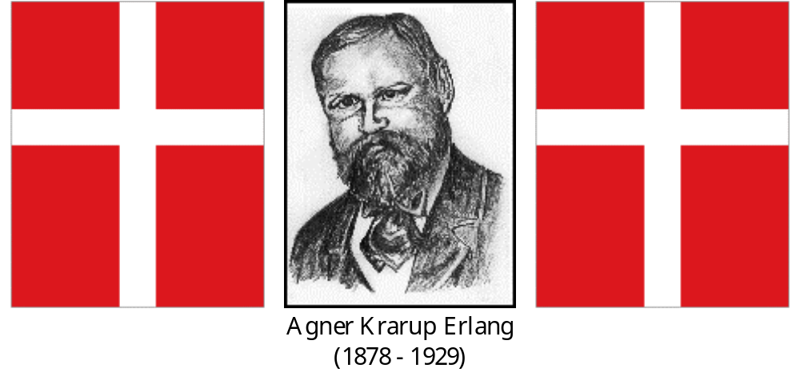

Slide 5
Components of a Queuing System
Service Process
Servers
Queue or
Waiting Line
Arrival Process
Exit
Notes:
3

Slide 6
Customer Population Sources
Population Source
Finite
Infinite
Example: Number of machines needing repair when a company only has three machines.
Example: The number of people who could wait in a line for gasoline.
Notes:
4

Slide 7
Service Pattern
Service Pattern
Constant
Variable
Example: Items coming down an automated assembly line.
Example: People spending time shopping.
Notes:
5

Slide 8
Examples of Queue Structures
Single
Phase
Multiphase
One-person
barber shop
Car wash
Single Channel
Bank tellers’
windows
Hospital
admissions
Multichannel
Notes:
6

Slide 9
Balking and Reneging
No Way!
No Way!
Balking: Arriving, but not joining the queue
Reneging: Joining the queue, then leaving
Notes:
7

Slide 10
Suggestions for Managing Queues
Determine an acceptable waiting time for your customers
Try to divert your customer’s attention when waiting
Inform your customers of what to expect
Keep employees not serving the customers out of sight
Segment customers
Notes:
8

Slide 11
Suggestions for Managing Queues
Train your servers to be friendly
Encourage customers to come during the slack periods
Take a long-term perspective toward getting rid of the queues
Source: Katz, Larson, Larson (1991)
Notes:
9

Slide 12
Arrival Rate refers to the average number of customers who require service within a specific period of time.
A Capacitated Queue is limited as to the number of customers who are allowed to wait in line.
Customers can be people, work-in-process inventory, raw materials, incoming digital messages, or any other entities that can be modeled as lining up to wait for some process to take place.
A Queue is a set of customers waiting for service.

Slide 13
Queue Discipline refers to the priority system by which the next customer to receive service is selected from a set of waiting customers. One common queue discipline is first-in-first-out, or FIFO.
A Server can be a human worker, a machine, or any other entity that can be modeled as executing some process for waiting customers.
Service Rate (or Service Capacity) refers to the overall average number of customers a system can handle in a given time period.
Stochastic Processes are systems of events in which the times between events are random variables. In queueing models, the patterns of customer arrivals and service are modeled as stochastic processes based on probability distributions.
Utilization refers to the proportion of time that a server (or system of servers) is busy handling customers.

Slide 14
In the literature, queueing models are described by a series of symbols and slashes, such as A/B/X/Y/Z, where
  A indicates the arrival pattern,
  B indicates the service pattern,
  X indicates the number of parallel servers,
  Y indicates the queue’s capacity, and
  Z indicates the queue discipline.
We will be concerned primarily with the M/M/1 queue, in which the letter M indicates that times between arrivals and times between services both can be modeled as being exponentially distributed. The number 1 indicates that there is one server.
We will also study some M/M/s queues, where s is some number greater than 1.

Slide 15
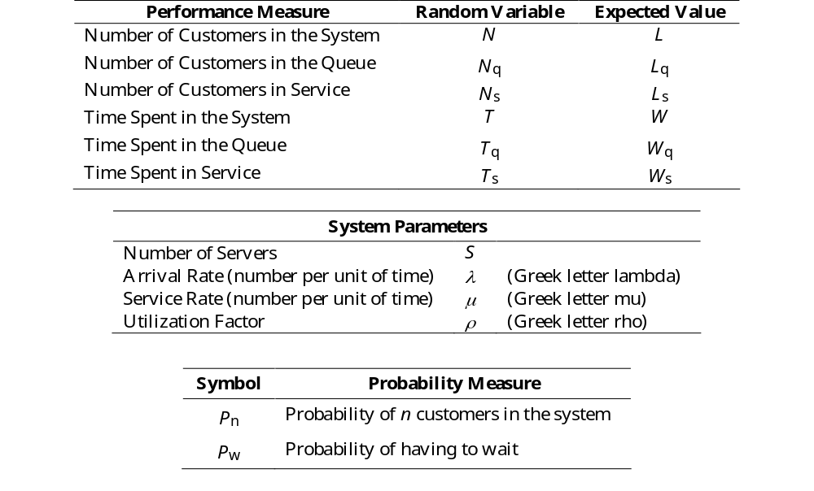
Be careful! These symbols can vary across different books, professors, etc.

Slide 16
General
(all queue models)
Single Phase
Infinite Source
FCFS Discipline
Infinite Queue Length
M/M/1
(Model 1)
Single Server
M/M/S
M/D/1
(Model 2)
M/M/2
(Model 3)

Slide 17

General Formulas

Slide 18
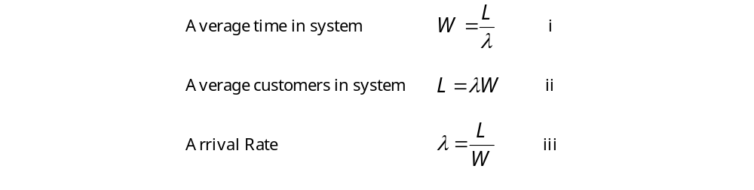

The single most important formula in queueing theory is called Little’s Law:
Little’s Law applies to any subsystem as well. For example,

Slide 19
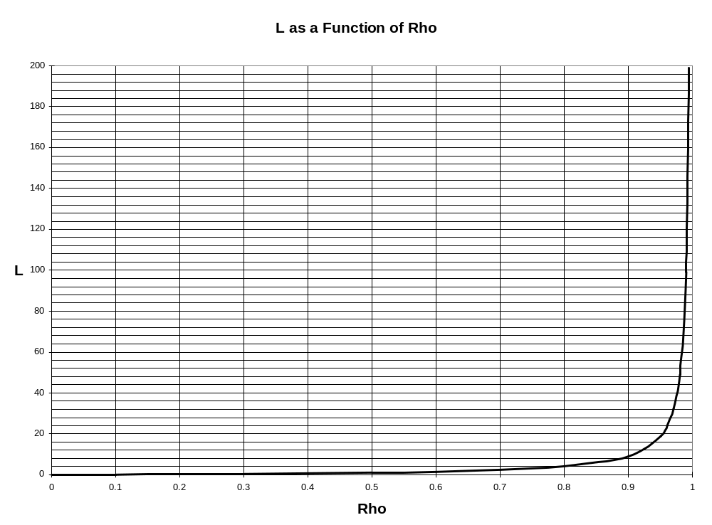

Slide 20

General Single-Server Formulas

Slide 21
There aren’t many general queueing results (see Larry Robinson’s sheet for some of them).
Much of queueing theory consists of making assumptions about the specific type of queue.
The class of models with the most analytical results is the category in which the arrival process and/or service process follows an exponential distribution.

Slide 22
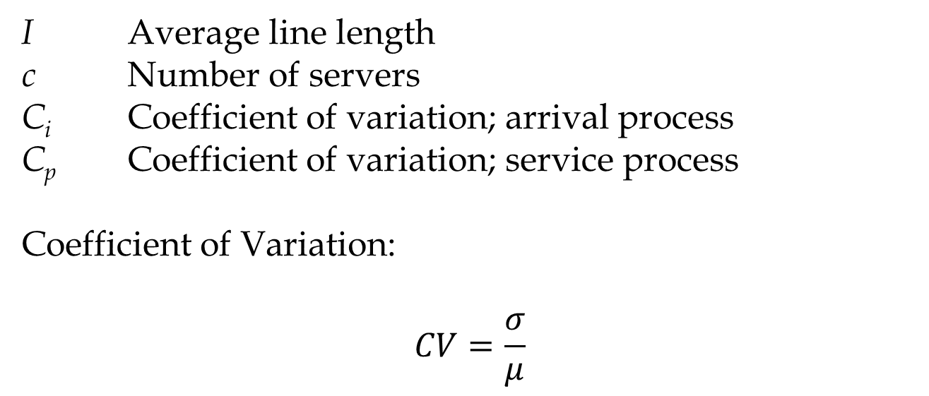
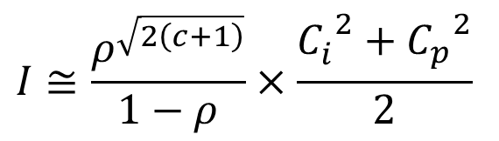
Example: General Formula
$$I≅\frac{ρ^{\sqrt{2\left(c+1\right)}}}{1−ρ}×\frac{{C_{i}^{}}_{}^{2}+{C_{p}^{}}_{}^{2}}{2}$$
I Average line length
c Number of servers
C_{i} Coefficient of variation; arrival process
C_{p} Coefficient of variation; service process
Coefficient of Variation:
$$CV=\frac{σ}{μ}$$

Slide 23
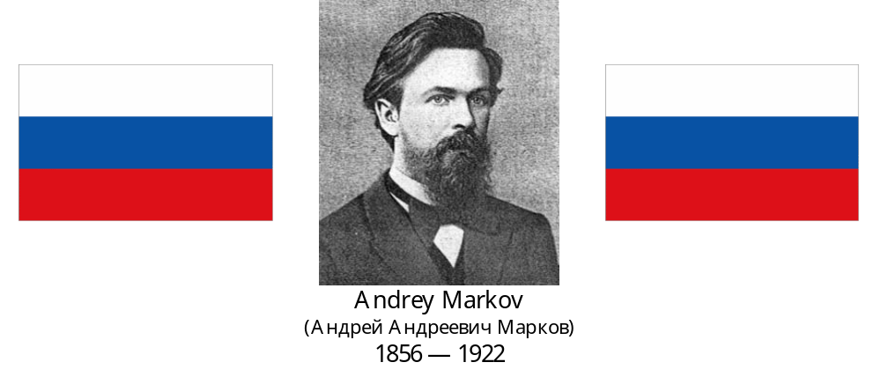

Slide 24
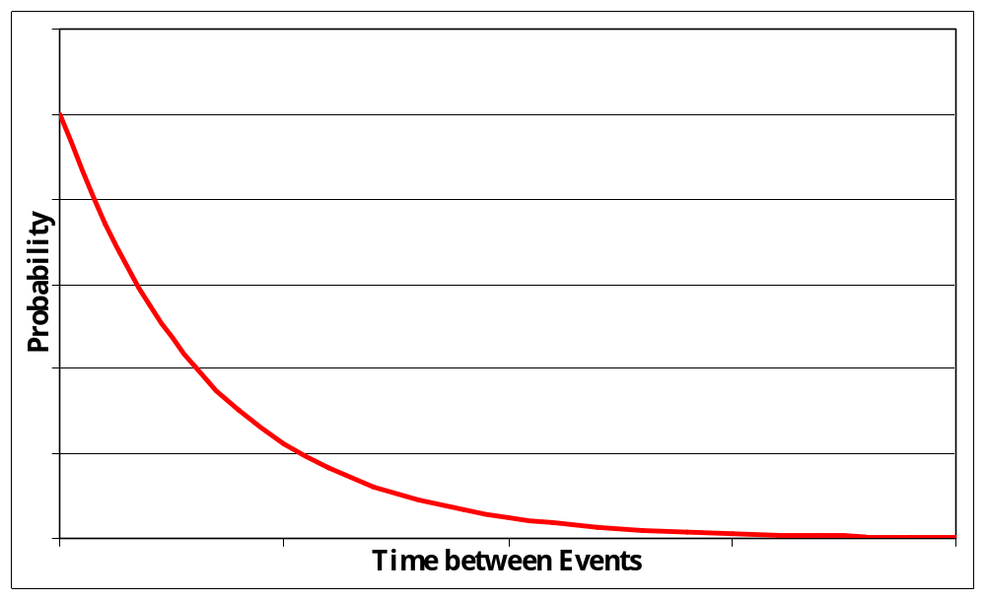
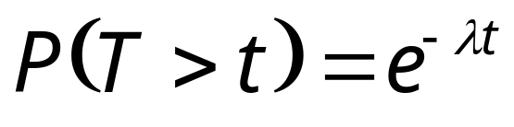
The Exponential Distribution
T is a continuous positive random number.
t is a specific value of T.

Slide 25
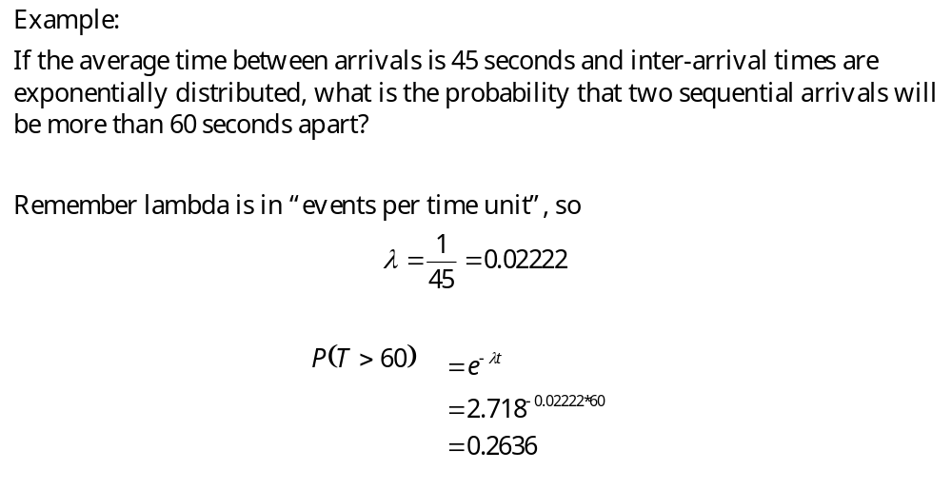

Slide 26
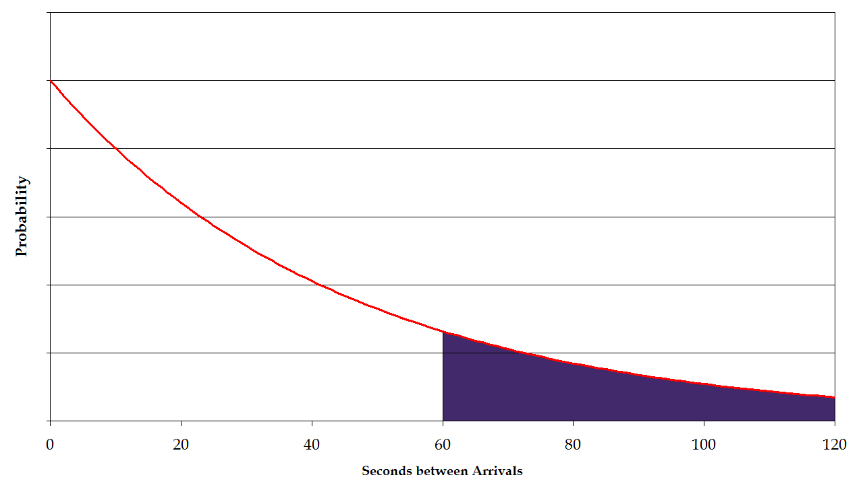


Slide 27
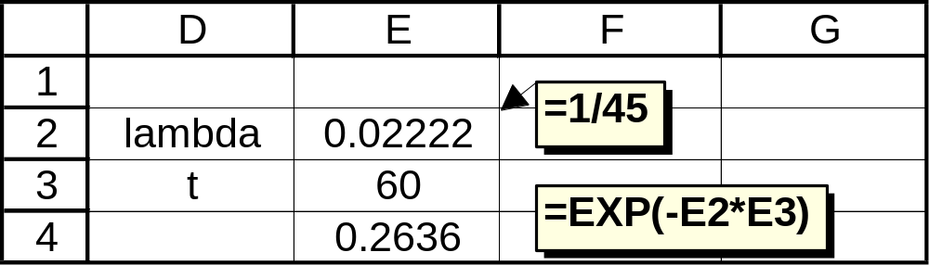
Here’s how to do this calculation in Excel:
The EXP function raises e to the power of whatever number is in parentheses.

Slide 28

Remember that the exponential distribution has a really long tail. In probability-speak, it has strong right-skewness, and there are outliers with very large values.
In fact, the probability of any one inter-event time being longer than the mean inter-event time is:
In other words, only 37% of inter-event times will be longer than the expected value of the inter-event times.
This counter-intuitive result is because some of the 37% are really, really long.

Slide 29
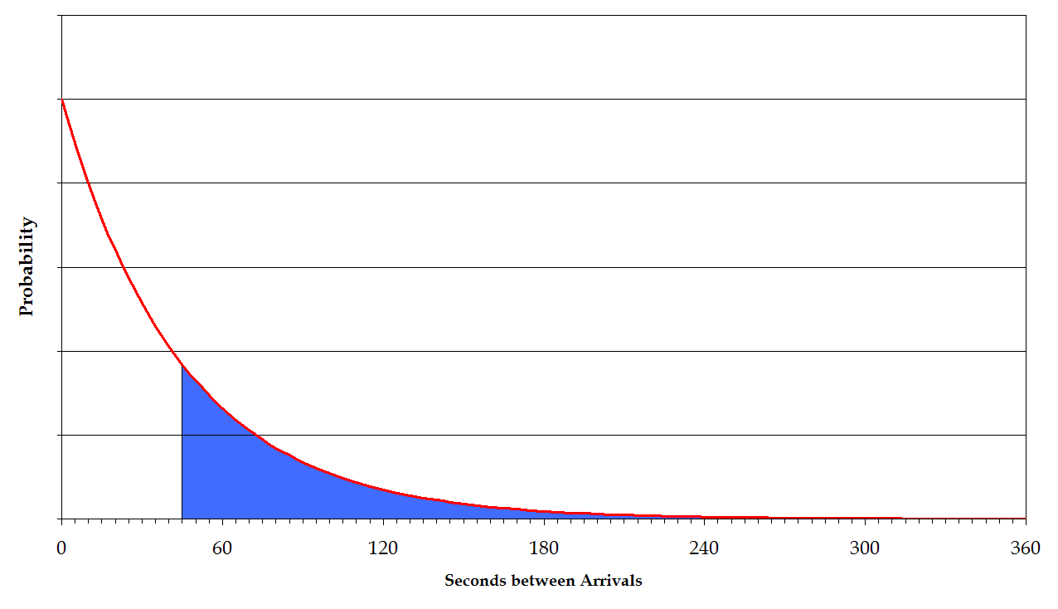

Slide 30
Other Facts about the Exponential Distribution
“Memoryless” property: The expected time until the next event is independent of how long it’s been since the previous event
The mean is equal to the standard deviation (so the CV is always 1)
Analogous to the discrete Geometric distribution

Slide 31
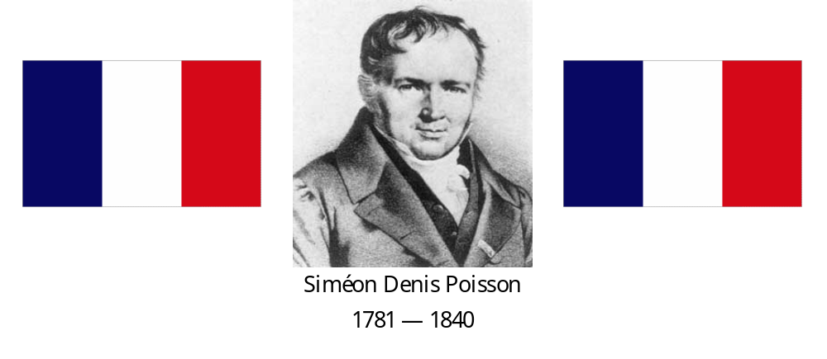

Slide 32
If the random time between events is exponentially distributed, then the random number of events in any given period of time follows a Poisson process.
A Poisson random variable is discrete. The number of events n (i.e. arrivals) in a certain space of time must be an integer.
n is a positive random integer (sometimes zero).

Slide 33
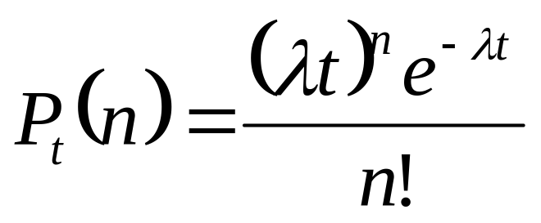
In English: The probability of exactly n events within t time units.

Slide 34
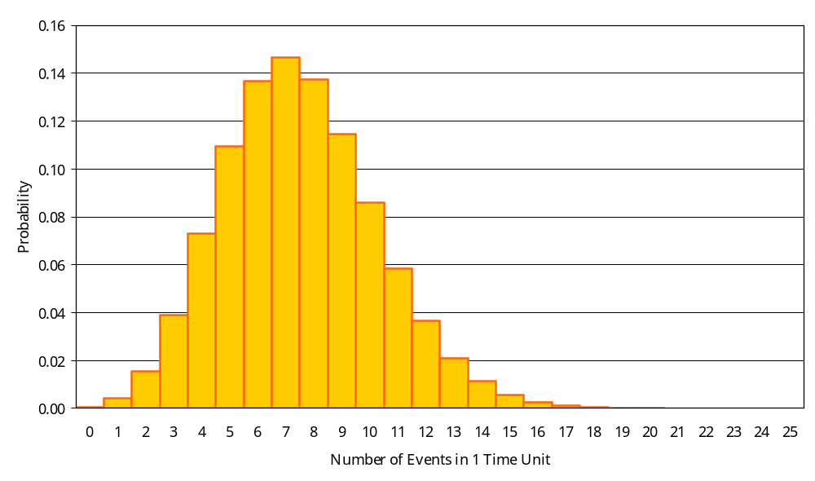
Poisson distribution; λ = 7.5

Slide 35
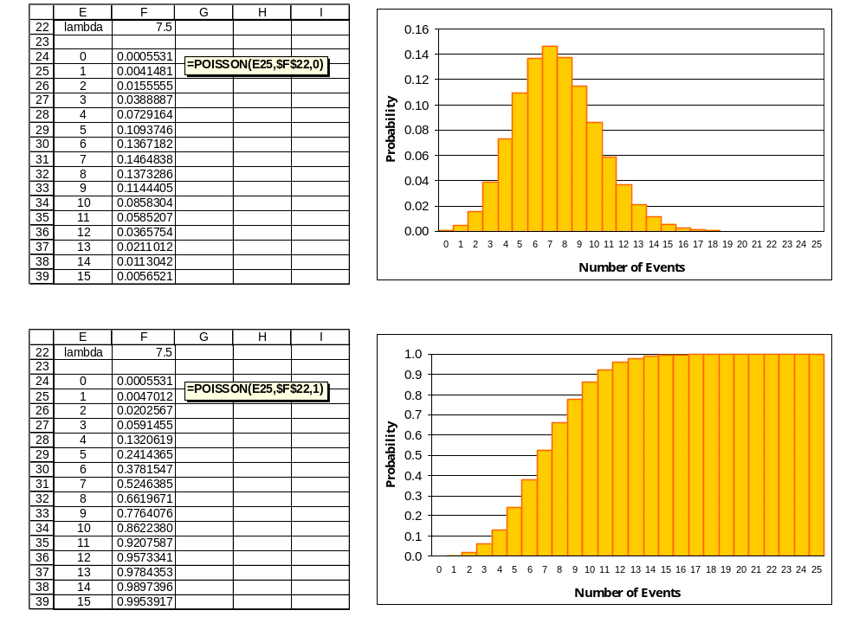

Slide 36
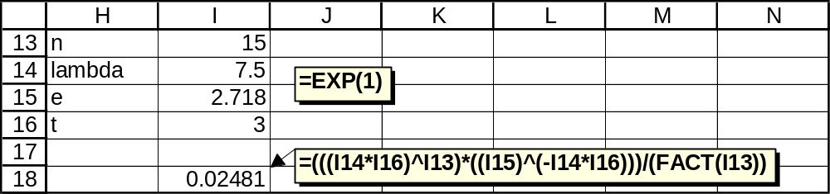
The Excel formula is good for figuring out the probability distribution for the number of events in one time unit. Here is a more general approach:
This gives the probability of exactly fifteen events in three time units, when the average number of events per time unit is 7.5.
You could adapt the Excel formula for general purposes by re-defining what “one time unit” means.

Slide 37
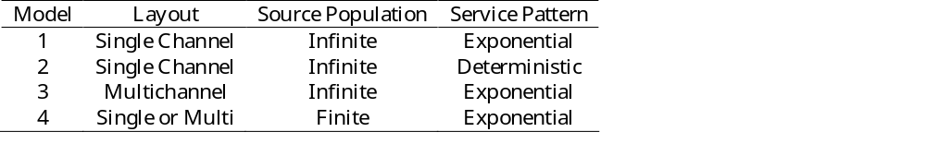
Waiting Line Models
These four models share the following characteristics:
Single Phase
Poisson Arrivals
FCFS Discipline
Unlimited Queue Capacity
Notes:
10

Slide 38
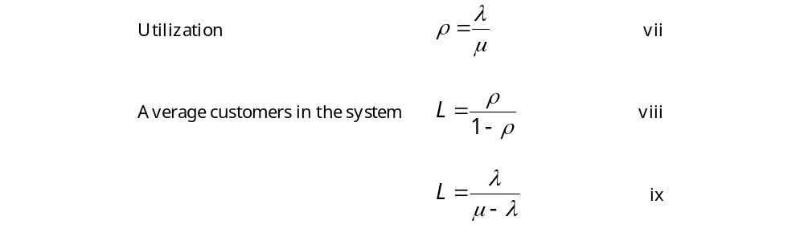
Model 1 (M/M/1) Formulas

Slide 39
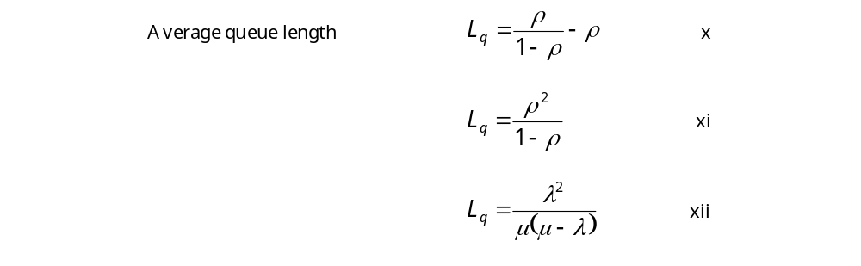
Model 1 (M/M/1) Formulas

Slide 40
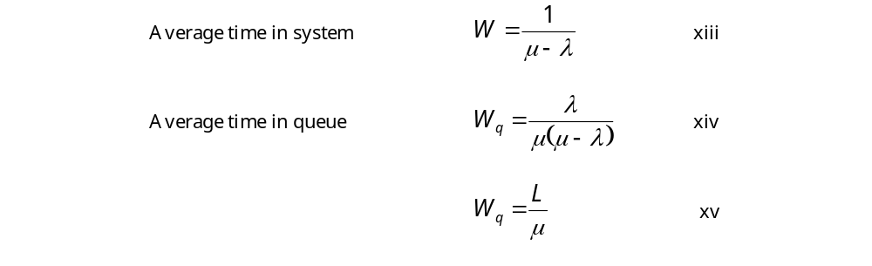
Model 1 (M/M/1) Formulas

Slide 41
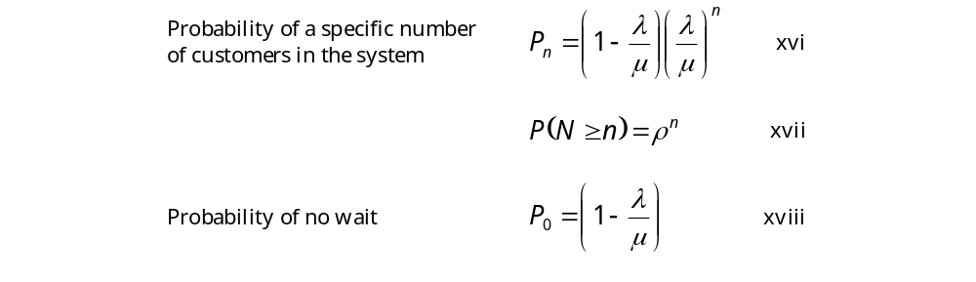
Model 1 (M/M/1) Formulas

Slide 42
Example: Model 1 (M/M/1)
Assume a drive-up window at a fast food restaurant.
Customers arrive at the rate of 25 per hour.
The employee can serve one customer every two minutes.
Assume Poisson arrival and exponential service rates.
Determine:
What is the average utilization of the employee?
What is the average number of customers in line?
What is the average number of customers in the system?
What is the average waiting time in line?
What is the average waiting time in the system?
What is the probability that exactly two cars will be in the system?
Notes:
11

Slide 43
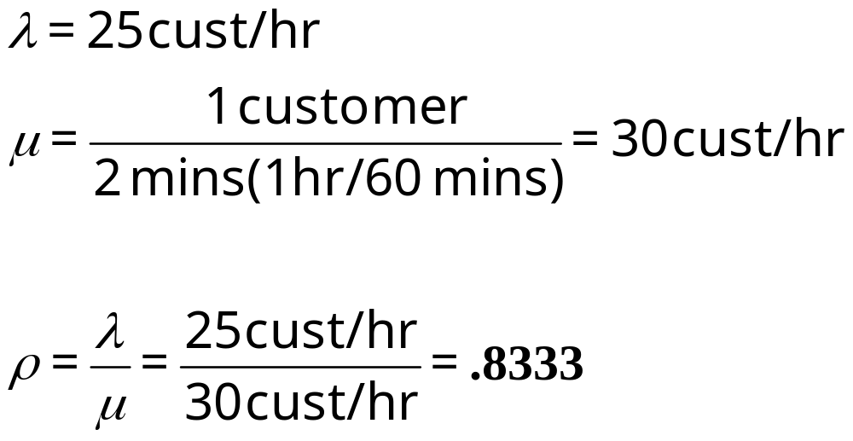
Example: Model 1 (M/M/1)
A) What is the average utilization of the employee?
Notes:
12

Slide 44
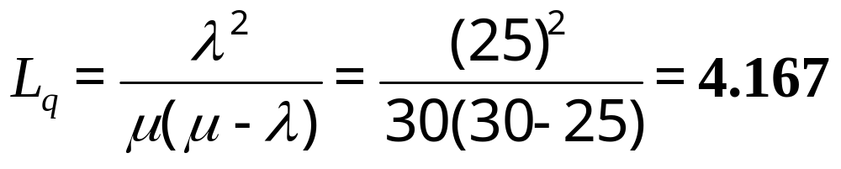
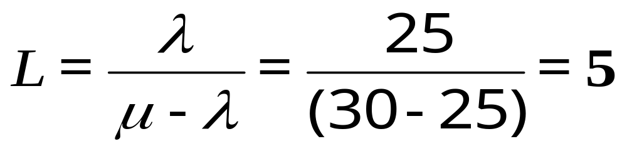
Example: Model 1
B) What is the average number of customers in line?
C) What is the average number of customers in the system?
Notes:
13

Slide 45
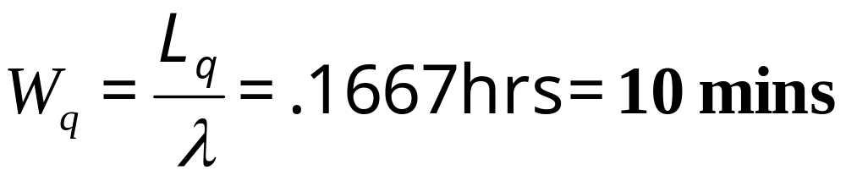
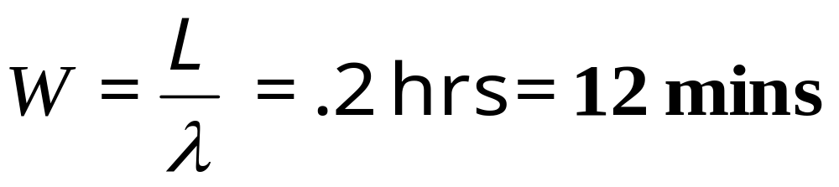
Example: Model 1
D) What is the average waiting time in line?
E) What is the average time in the system?
Notes:
14

Slide 46
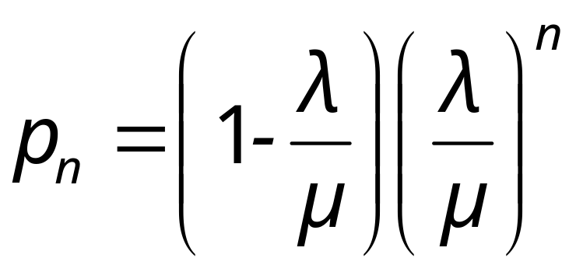
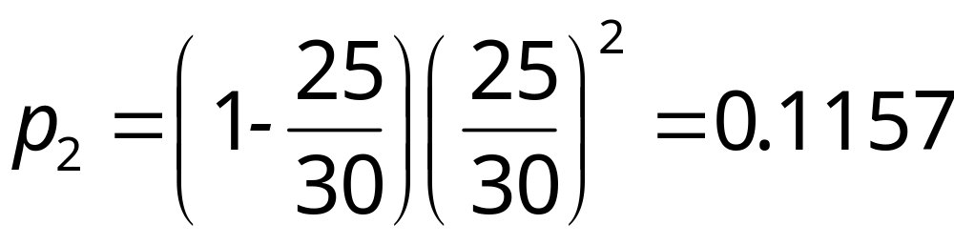
Example: Model 1
F) What is the probability that exactly two cars will be in the system (one being served and the other waiting in line)?
Notes:
15

Slide 47
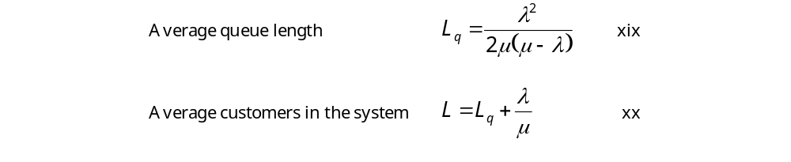
M/D/1 Formulas

Slide 48
Example: Model 2 (M/D/1)
An automated pizza vending machine heats and
dispenses a slice of pizza in 4 minutes.
Customers arrive at an average rate of one every 6 minutes, with the arrival rate exhibiting a Poisson distribution.
Determine:
A) The average number of customers in line.
B) The average total waiting time in the system.
Notes:
16

Slide 49
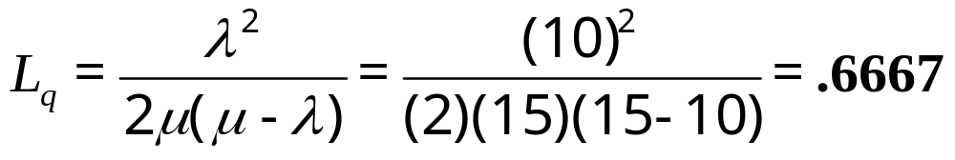
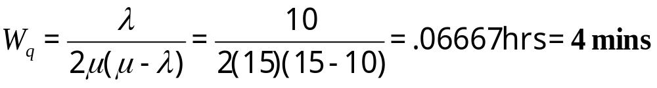
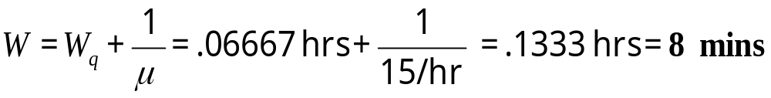
Example: Model 2
A) The average number of customers in line.
B) The average total waiting time in the system.
Notes:
17

Slide 50

M/M/S Formulas

Slide 51
Example: Model 3 (M/M/2)
Recall the Model 1 example:
Drive-up window at a fast food restaurant.
Customers arrive at the rate of 25 per hour.
The employee can serve one customer every two minutes.
Assume Poisson arrival and exponential service rates.
If an identical window (and an identically trained server) were added, what would the effects be on the average number of cars in the system and the total time customers wait before being served?
Notes:
18

Slide 52
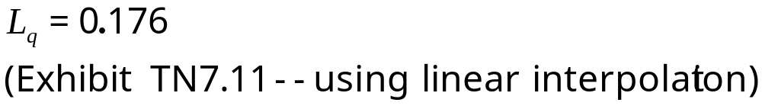
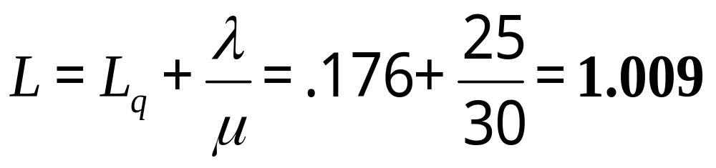
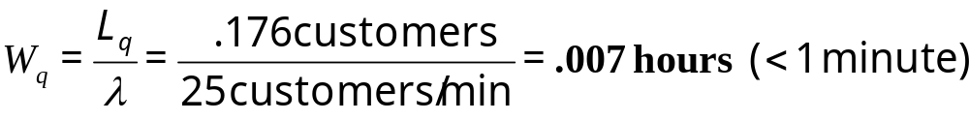
Example: Model 3
Average number of cars in the system
Total time customers wait before being served
Notes:
19

Slide 53
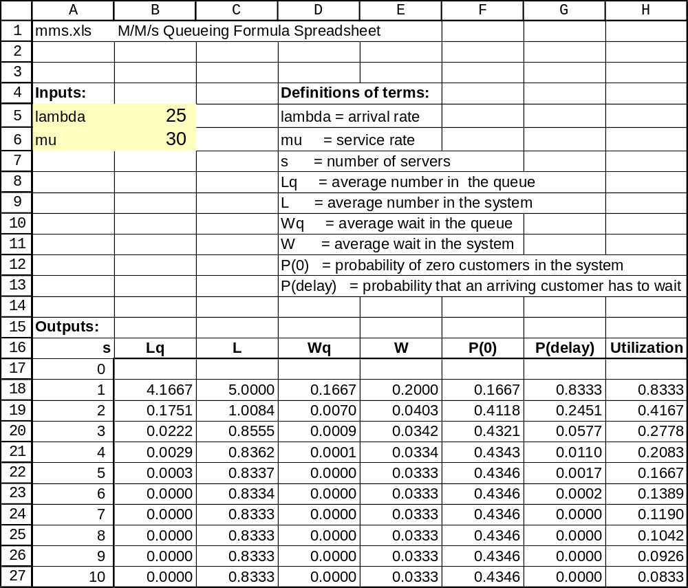
M/M/s Calculator (Mms.xls)

Slide 54
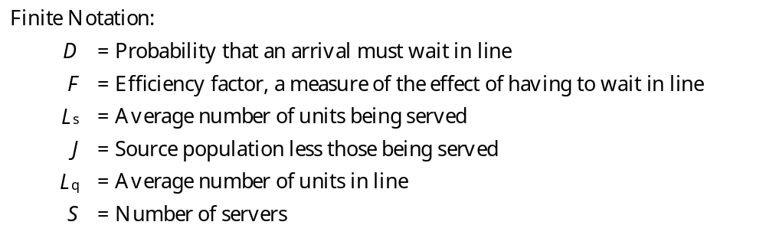
Finite Queuing: Model 4

Slide 55
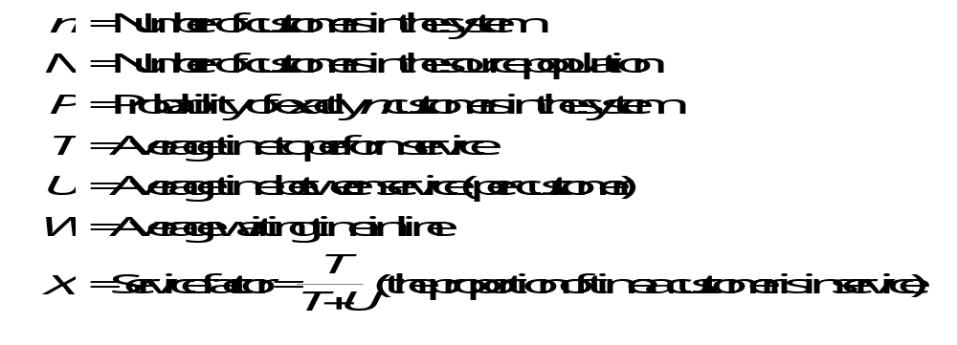

Slide 56
The copy center of an electronics firm has four copy machines that are all serviced by a single technician.
Every two hours, on average, the machines require adjustment. The technician spends an average of 10 minutes per machine when adjustment is required.
Assuming Poisson arrivals and exponential service, how many machines are “down” (on average)?
Notes:
20

Slide 57
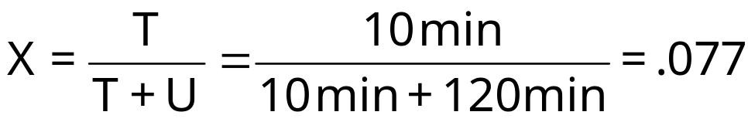
N, the number of machines in the population = 4
M, the number of repair people = 1
T, the time required to service a machine = 10 minutes
U, the average time between service = 2 hours
From Table TN7.12, F = .980 (Interpolation)
Notes:
21

Slide 58
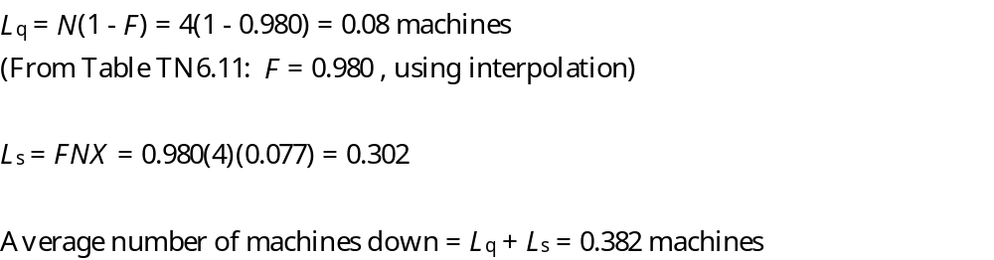
Note: TN7 uses L instead of L_{q}, and H instead of L_{s}

Slide 59
Example: Airport Security
Each airline passenger and his or her luggage must be checked to determine whether he or she is carrying weapons onto the airplane. Suppose that at Gotham City Airport, an average of 10 passengers per minute arrive, where interarrival times are exponentially distributed. To check passengers for weapons, the airport must have a checkpoint consisting of a metal detector and baggage X-ray machine.
Whenever a checkpoint is in operation, two employees are required. These two employees work simultaneously to check a single passenger. A checkpoint can check an average of 12 passengers per minute, where the time to check a passenger is also exponentially distributed.

Slide 60
Why is an M/M/l, not an M/M/2, model relevant here?

Slide 61
What is the probability that a passenger will have to wait before being checked for weapons?

Slide 62
On average, how many passengers are waiting in line to enter the checkpoint?

Slide 63
On average, how long will a passenger spend at the checkpoint (including waiting time in line)?

Slide 64
Difficulties with Analytical Queueing Models
Using expected values, we can get some results
Easy to set up in a spreadsheet
It is dangerous to replace a random variable with its expected value
Analytical methods (beyond expected values) require difficult mathematics, and must be based on strict (perhaps unreasonable) assumptions

Slide 65
Summary
Basic definitions and metrics
Examples of some theoretical models

