Slide 1

Just-in-Time

Slide 2
Outline
The Goal debrief
JIT Defined
The Toyota Production System
Blocking, Starving, and Buffers
JIT Implementation Requirements
JIT in Services
Notes:
2

Slide 3
Historical Development of OM
Craft System
Industrial Revolution
Scientific Management
Organizational Science
Operations Research
JIT and TQM
Supply Chain Management
Internet Commerce
Notes:
14

Slide 4

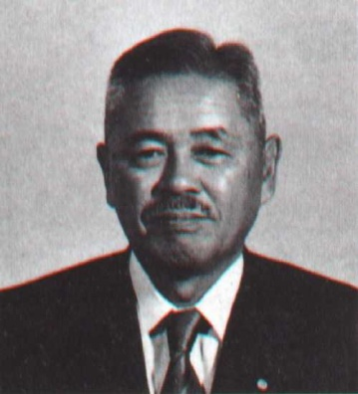
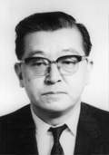
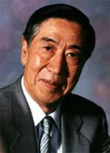
JIT and TQM
Taiichi Ohno
1912 - 1990
Kaoru Ishikawa
1915 - 1989
Genichi Taguchi
1924 - 2012

Slide 5
Just-In-Time (JIT) Defined
JIT can be defined as an integrated set of activities designed to achieve high-volume production using minimal inventories (raw materials, work in process, and finished goods)
JIT also involves the elimination of waste in production effort
JIT also involves the timing of production resources (i.e., parts arrive at the next workstation “just in time”)
Notes:
3

Slide 6
Just-In-Time (JIT) Defined
Not one tool or technique, but many ideas that work together
Key elements
  Product/Process design with an eye towards variance reduction
    Setup time reduction
    Small lot sizes
    Quality management
  Communication links with suppliers and customers
  Balance between production stability and responsiveness
  Redefined role of inventory
  JIT also involves the timing of production resources (i.e., parts arrive at the next workstation “just in time”)
Notes:
3

Slide 7
Planning
Implementation
Traditional Approach
Planning
Implementation
JIT Approach
Notes:
23

Slide 8
Key Terms
Pull system
Focused factories
Group technology
Heijunka (uniform plant loading)
Kanban (card)
Notes:
3

Slide 9
JIT and Lean Management
JIT can be divided into two terms: “Big JIT” and “Little JIT”
Big JIT (also called Lean Management) is a philosophy of operations management that seeks to eliminate waste in all aspects of a firm’s production activities: human relations, vendor relations, technology, and the management of materials and inventory
Little JIT focuses more narrowly on scheduling goods inventory and providing service resources where and when needed
Notes:
3

Slide 10
Push vs. Pull Systems
Push systems have production planned in advanced and each stage in the supply chain pushes inventory to its downstream neighbor.
In a pull system each unit in the supply chain requests inventory from its upstream neighbor.
The beer game resembles more of a pull system.

Slide 11
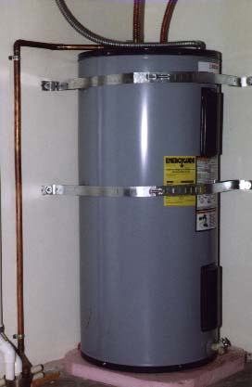
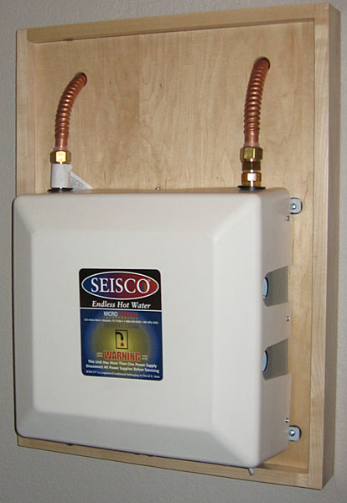

Slide 12
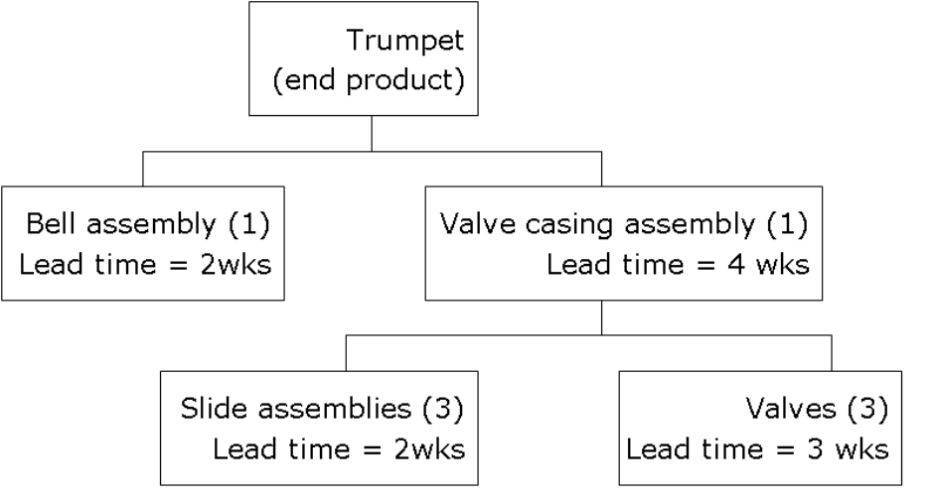
Push Systems
Also known as Materials Resource Planning.
Requires a bill of materials (BOM).
Generate advanced demand forecasts and then use leadtimes in order to work backwards and figure out how much inventory is needed at each point in time in the supply chain.
Inventory is pushed downwards through the supply chain.

Slide 13
Push Systems
Production schedule at factory
Demand forecast at retailer
Week | 4 | 5 | 6 | 7 | 8
Cases of Beer | 4 | 5 | 3 | 6 | 5
Week | 12 | 13 | 14 | 15 | 16
Cases of Beer | 4 | 5 | 3 | 6 | 5
Factory
Distributor
Wholesaler
Retailer
Ready or not hear comes the inventory!

Slide 14
Drawbacks of Push Systems
Changes in demand forecast require a revision of the entire production schedule.
Consequently, push systems can be somewhat inflexible.
Inflexibility can be offset by safety stocks.
Tend to set production quotas for fixed time periods and hence no EOQ.
Large inventory levels can hide quality problems.

Slide 15
Pull Systems
Each stage in the supply chain requests parts from its upstream supplier
Often operated as a just-in-time system.
Place
order
Place
order
Place
order
Distributor
Wholesaler
Retailer
Factory

Slide 16
JIT Demand-Pull Logic
Here the customer starts the process, pulling an inventory item from Final Assembly…
Then sub-assembly work is pulled forward by that demand…
Fab
Vendor
Sub
Fab
Vendor
Final
Assembly
Customers
The process continues throughout the entire production process and supply chain
Sub
Fab
Vendor
Fab
Vendor
Notes:
4

Slide 17
Advantages of Pull Systems
Lower inventory levels which leads to
  Reduced cost
  Higher quality
More adaptive to customer demand
Higher utilization of resources

Slide 18
Disadvantages of Pull Systems
Many small orders can result in high ordering costs
If lead times are large can be slow to respond to customer demand
Low inventory levels mean system can be sensitive to a breakdown in a certain stage in the supply chain
Has the potential to place a high level variability on the suppliers end of the supply chain which can be unfair.

Slide 19
Hybrid Systems
Some supply chains may implement a hybrid strategy which employs both push and pull systems
Upstream portion of the supply chain operates on a push basis
  Demand upstream is aggregated from multiple retailers and tends to be more stable
Downstream portion of supply chain operates as a pull system
  Demand at individual retailers tends to be more variable

Slide 20
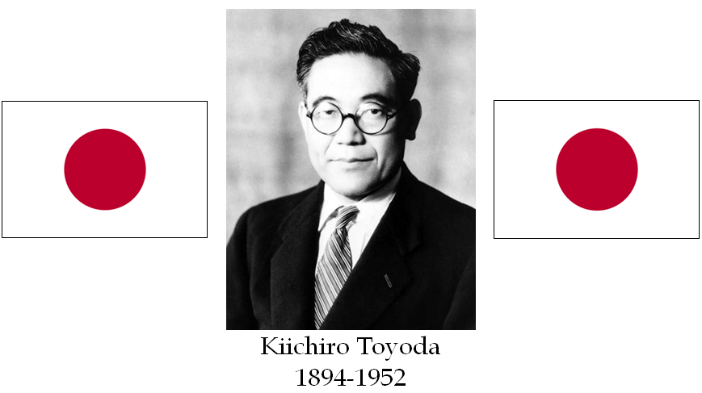

Slide 21
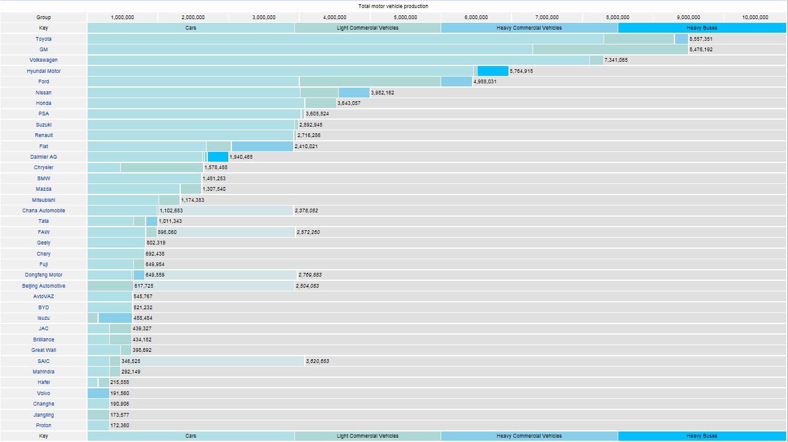

Slide 22
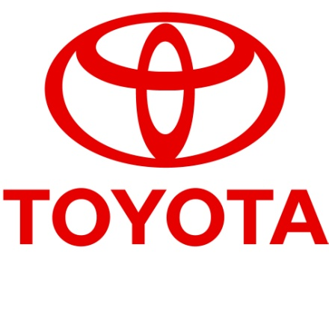
The Toyota Production System
Based on two philosophies:
1. Elimination of waste
2. Respect for people
Notes:
5

Slide 23
Toyota Production System’s Four Rules
All work shall be highly specified as to content, sequence, timing, and outcome
Every customer-supplier connection must be direct, and there must be an unambiguous yes-or-no way to send requests and receive responses
The pathway for every product and service must be simple and direct
Any improvement must be made in accordance with the scientific method, under the guidance of a teacher, at the lowest possible level in the organization
Notes:
21

Slide 24
Waste in Operations
Waste from overproduction
Waste of waiting time
Transportation waste
Inventory waste
Processing waste
Waste of motion
Waste from product defects
Notes:
6

Slide 25
Minimizing Waste:
Focused Factory Networks
These are small specialized plants that limit the range of products produced (sometimes only one type of product for an entire facility)
Some plants in Japan have as few as 30 and as many as 1000 employees
Coordination
System Integration
Notes:
7

Slide 26
Minimizing Waste: Group Technology (Part 1)
Note how the flow lines are going back and forth
Using Departmental Specialization (a.k.a. Functional Layout) for plant layout can cause a lot of unnecessary material movement
Saw
Saw
Saw
Grinder
Grinder
Heat Treat
Lathe
Lathe
Lathe
Press
Press
Press
Notes:
8

Slide 27
Minimizing Waste: Group Technology (Part 2)
Revising by using Group Technology Cells (a.k.a. Product Layout) can reduce movement and improve product flow
Grinder
1
2
Saw
Lathe
Lathe
Press
Heat Treat
Grinder
Saw
Lathe
A
B
Lathe
Press
Notes:
9

Slide 28
Minimizing Waste: Uniform Plant Loading (Heijunka)
Suppose we operate a production plant that produces a single product. The schedule of production for this product could be accomplished using either of the two plant loading schedules below.
Not uniform Jan. Units Feb. Units Mar. Units Total
1,200 3,500 4,300 9,000
or
Uniform Jan. Units Feb. Units Mar. Units Total
3,000 3,000 3,000 9,000
How does the uniform loading help save labor costs?
Notes:
12

Slide 29
Minimizing Waste: Inventory
Hides Problems
Example: By identifying defective items from a vendor early in the production process the downstream work is saved
Machine
downtime
Scrap
Vendor
Work in
delinquencies
Change
process
orders
queues
Engineering design
Design
(banks)
redundancies
backlogs
Example: By identifying defective work by employees upstream, the downstream work is saved
Paperwork
Inspection
Decision
backlog
backlogs
backlogs
Notes:
14

Slide 30

Slide courtesy of Robert B. Decosimo (MBA’11)
Scrap
Change
Orders
Machine
Downtime
Inspection Backlogs

Slide 31
Respect for People
Level payrolls
Cooperative employee unions
Subcontractor networks
Bottom-round management style
Quality circles (Small Group Involvement Activities or SGIA’s)
Notes:
21

Slide 32
Minimizing Waste: Kanban Systems
Once the Production kanban is received, the Machine Center produces a unit to replace the one taken by the Assembly Line people in the first place
This puts the system back were it was before the item was pulled
Withdrawal
kanban
Storage Part A
Storage Part A
Machine Center
Assembly Line
Production kanban
Material Flow
Card (signal) Flow
The process begins by the Assembly Line people pulling Part A from Storage
Notes:
15

Slide 33
Determining the Number of Kanbans Needed
Setting up a kanban system requires determining the number of kanbans cards (or containers) needed
Each container represents the minimum production lot size
An accurate estimate of the lead time required to produce a container is key to determining how many kanbans are required
Notes:
16

Slide 34
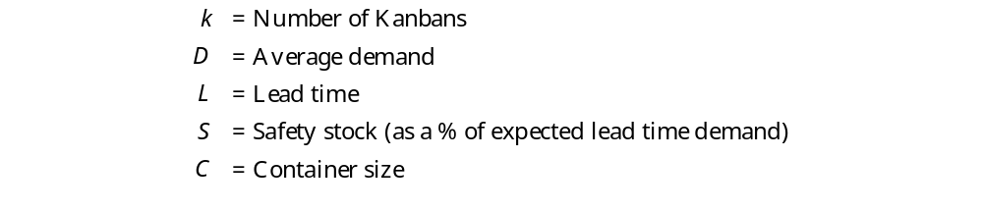

Notes:
17

Slide 35
Example of Kanban Card Determination
A switch assembly is assembled in batches of 4 units from an “upstream” assembly area and delivered in a special container to a “downstream” control-panel assembly operation
The control-panel assembly area requires 5 switch assemblies per hour
The switch assembly area can produce a container of switch assemblies in 2 hours
Safety stock has been set at 10% of needed inventory
Notes:
18

Slide 36

Example of Kanban Card Determination: Calculations
Always round up!
Notes:
19

Slide 37
Blocking, Starving, Buffers
Assume that these are random processing times.
Buffer?
Buffer?
Buffer?
Activity A
4 per minute
Activity B
8 per minute
Activity C
3 per minute
Activity D
5 per minute
Process Flow
Where is the most important place to have a buffer?

Slide 38
Summary
JIT Defined
The Toyota Production System
JIT Implementation Requirements
JIT in Services
Notes:
2

