Slide 1

Six Sigma and
Statistical Quality Control

Slide 2
Outline
Quality and Six Sigma: Basic ideas and history
Juran Trilogy
  Control
  Improvement
  Planning
Quality Strategy
Focus on Statistical Methods
  Process Capability ideas and metrics
  Control charts for attributes and variables

Slide 3
A Brief History
The Craft System
Taylorism (Scientific Management)
Statistical Quality Control
  Pearson, Shewhart, Dodge
Human Relations School
  Mayo, Maslow, Simon, Herzberg, Likert
The Japanese Revolution (1950)
  Ishikawa, Taguchi, Deming, Juran, Feigenbaum
The USA Wakes Up (1980)
  Crosby
1990s: Six Sigma
The Need for Organizational Change

Slide 4

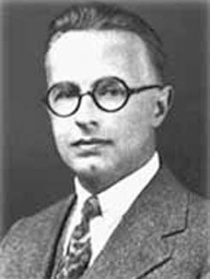
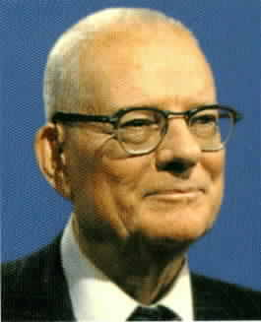
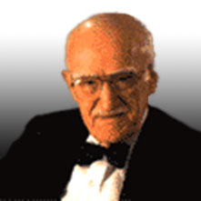



JIT and TQM
Walter Shewhart
1891 - 1967
W. Edwards Deming
1900 - 1993
Joseph M. Juran
1904 - 2008

Slide 5
What is Quality?
Freedom from Defects
  Quality Costs Less
  Affects Costs
Presence of Features
  Quality Costs More
  Affects Revenue

Slide 6
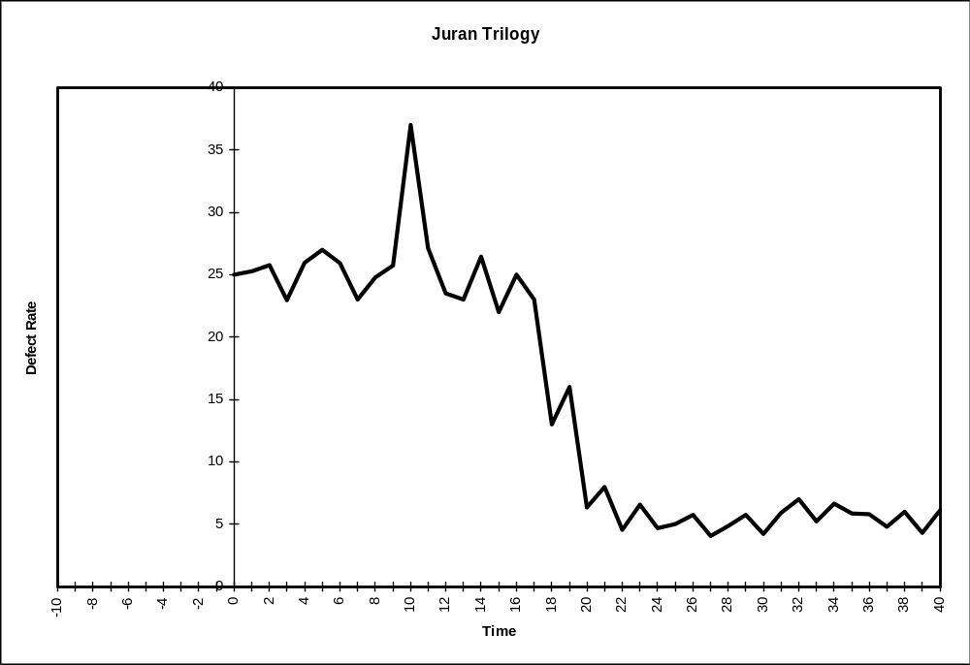
Juran Trilogy
Planning, Control, Improvement

Slide 7
Juran Trilogy
Planning, Control, Improvement
Planning
Control
Improvement
Control
Sporadic Spike
Chronic Waste
Chronic Waste

Slide 8
Quality Control
Aimed at preventing unwanted changes
Works best if deployed at the point of production or service delivery (Empowerment)
Tools:
  Established, measurable standards
  Measurement and feedback
  Control charts
  Statistical inference

Slide 9
Quality Control
Establish Standard
Operate
Measure Performance
Yes
OK?
Corrective Action
Compare to Standard
No

Slide 10
Quality Improvement
Aimed at creating a desirable change
Two distinct “journeys”
  Diagnosis
  Remedy
Project team approach
Tools
  Process flow diagram
  Pareto analysis
  Cause-effect (Ishikawa, fishbone) diagram
  Statistical tools

Slide 11
Quality Improvement
Identify problem
Analyze symptoms
Formulate theories
Test theories - Identify root cause
Identify remedy
Address cultural resistance
Establish control

Slide 12
Quality Planning
Aimed at creating or redesigning (re-engineering) a process to satisfy a need
Project team approach
Tools
  Market research
  Failure analysis
  Simulation
  Quality function deployment
  Benchmarking

Slide 13
Quality Planning
Verify goal
Identify customers
Determine customer needs
Develop product
Develop process
Transfer to operations
Establish control

Slide 14
Strategic Quality Planning
Mission
Vision
Long-term objectives
Annual goals
Deployment of goals
Assignment of resources
Systematic measurement
Connection to rewards and recognition

Slide 15
Strategic Quality Planning
Aimed at establishing long-range quality objectives and creating an approach to meeting those objectives
Top management’s job
Integrated with other objectives
  Operations
  Finance
  Marketing
  Human Resources

Slide 16
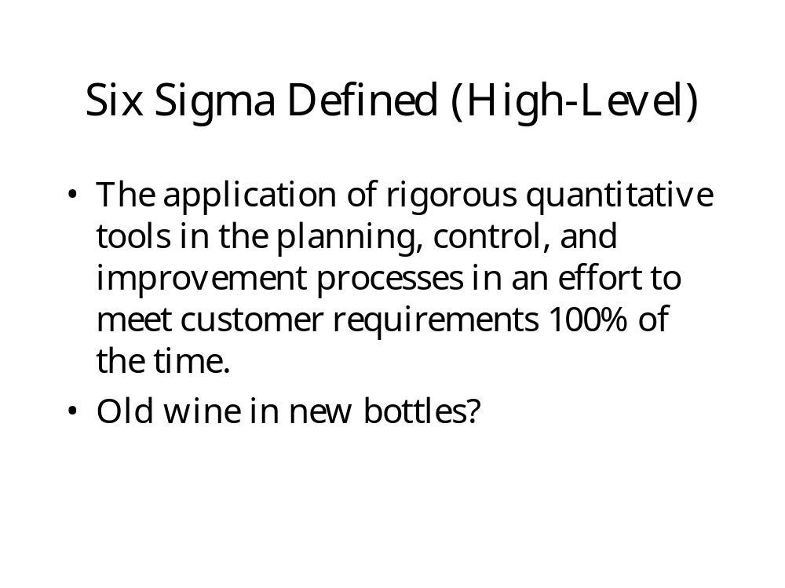

Slide 17
Process Capability
The Relationship between a Process and the Requirements of its Customer
How Well Does the Process Meet Customer Needs?

Slide 18
Process Capability
Specification Limits reflect what the customer needs
Natural Tolerance Limits (a.k.a. Control Limits) reflect what the process is capable of actually delivering
These look similar, but are not the same

Slide 19
Specification Limits
Determined by the Customer
A Specific Quantitative Definition of “Fitness for Use”
Not Necessarily Related to a Particular Production Process
Not Represented on Control Charts

Slide 20
Tolerance (Control) Limits
Determined by the inherent central tendency and dispersion of the production process
Represented on Control Charts to help determine whether the process is “under control”
A process under control may not deliver products that meet specifications
A process may deliver acceptable products but still be out of control

Slide 21
Measures of Process Capability
C_{p}
C_{pk}
Percent Defective
Sigma Level

Slide 22
Example: Cappuccino
Imagine that a franchise food service organization has determined that a critical quality feature of their world-famous cappuccino is the proportion of milk in the beverage, for which they have established specification limits of 54% and 64%.
The corporate headquarters has procured a custom-designed, fully-automated cappuccino machine which has been installed in all the franchise locations.
A sample of one hundred drinks prepared at the company’s Stamford store has a mean milk proportion of 61% and a standard deviation of 3%.

Slide 23
Example: Cappuccino
Assuming that the process is in control and normally distributed, what proportion of cappuccino drinks at the Stamford store will be nonconforming with respect to milk content?
Try to calculate the Cp, Cpk, and Parts per Million for this process.
If you were the quality manager for this company, what would you say to the store manager and/or to the big boss back at headquarters? What possible actions can be taken at the store level, without changing the inherent variability of this process, to reduce the proportion of non-conforming drinks?

Slide 24
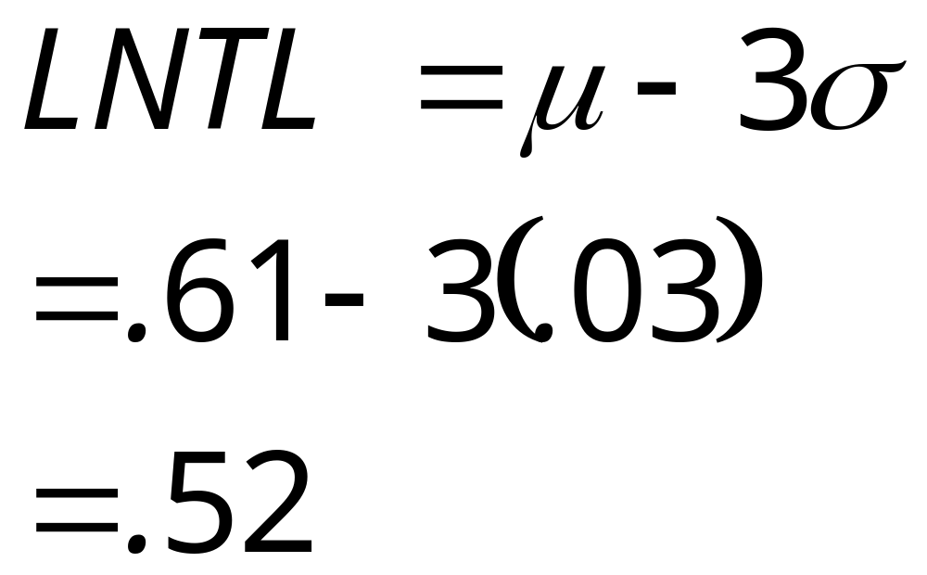
Lower Control Limit

Slide 25
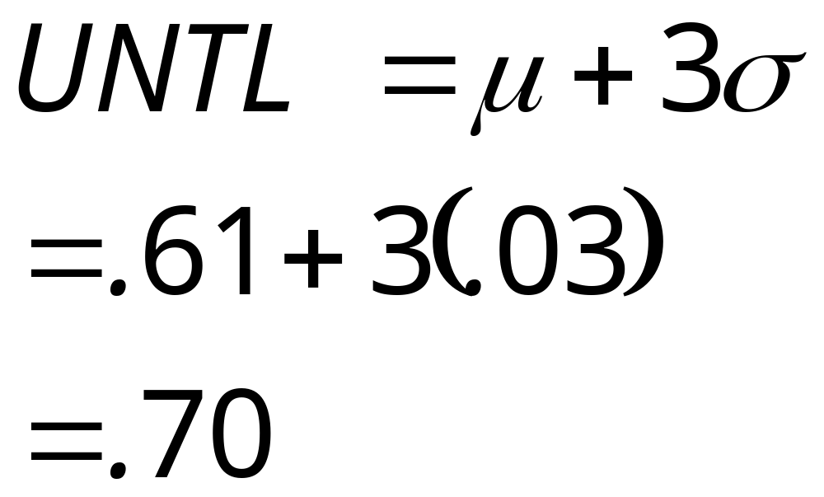
Upper Control Limit

Slide 26
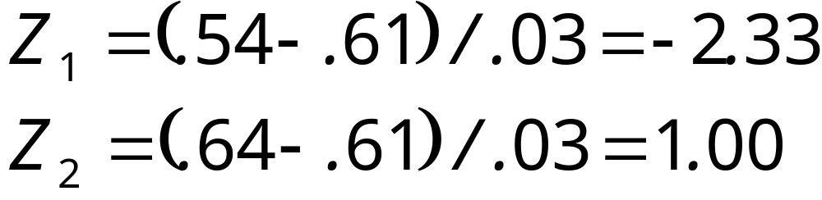
Nonconformance

Slide 27
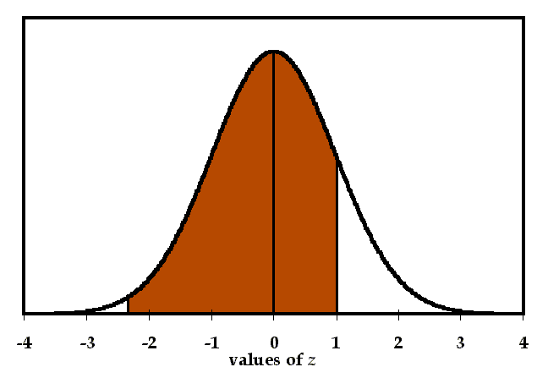
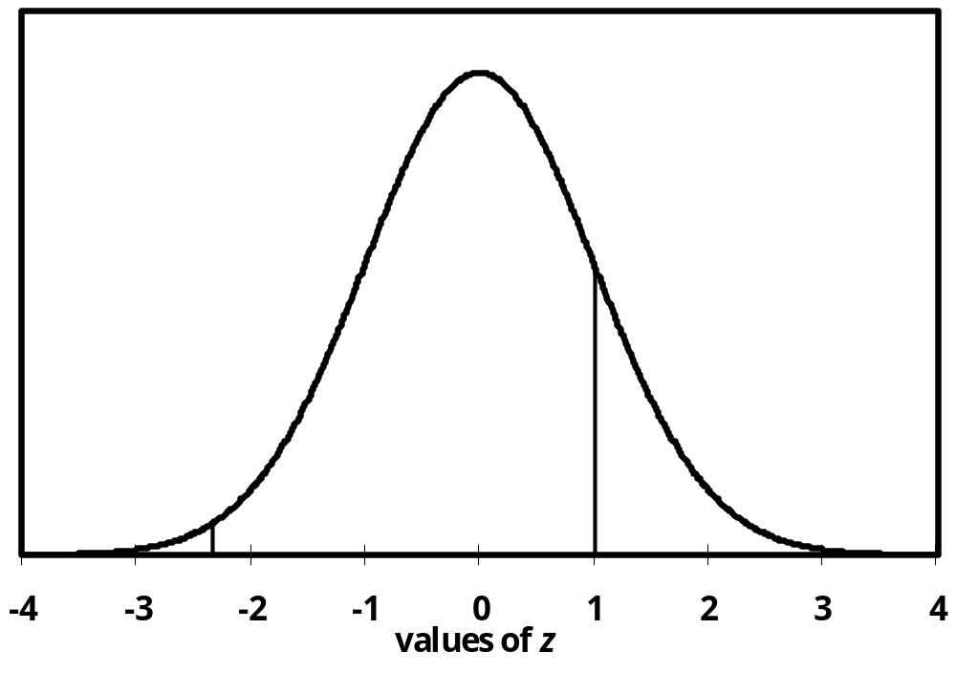
Nonconformance

Slide 28
Nonconformance
0.00990 of the drinks will fall below the lower specification limit.
0.84134 of the drinks will fall below the upper limit.
0.84134 - 0.00990 = 0.83144 of the drinks will conform.
Nonconforming:
  1.0 - 0.83144 = 0.16856 (16.856%)

Slide 29
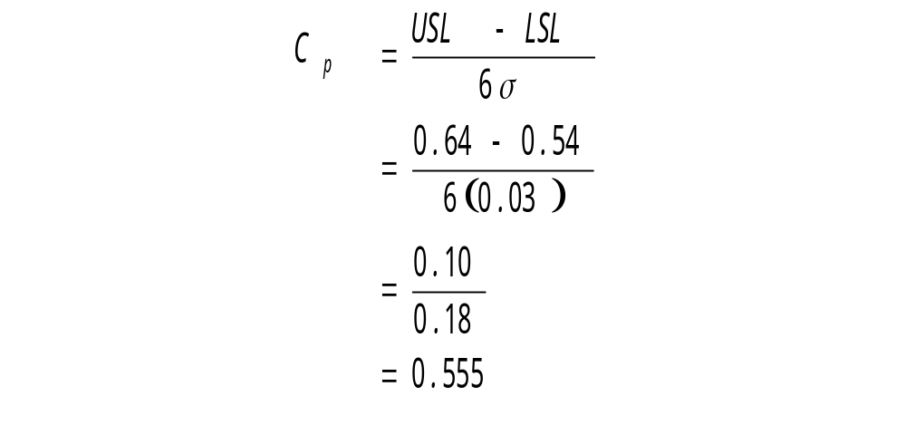
C_{p} Ratio

Slide 30
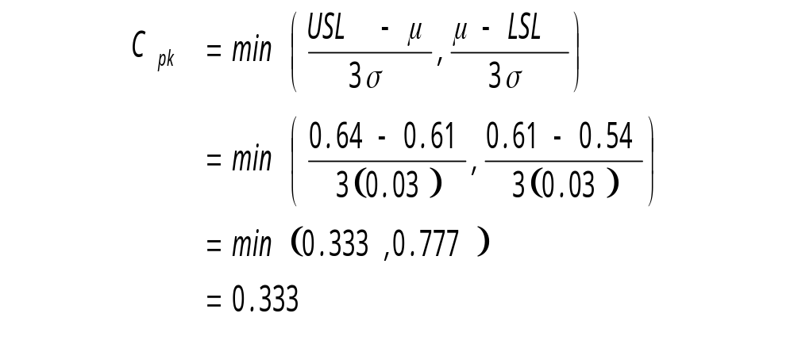
C_{pk} Ratio

Slide 31

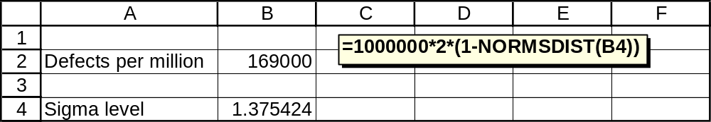
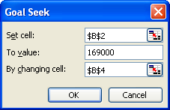
Parts per Million

Slide 32
Quality Improvement
Two Approaches:
  Center the Process between the Specification Limits
  Reduce Variability

Slide 33
Approach 1: Center the Process

Slide 34
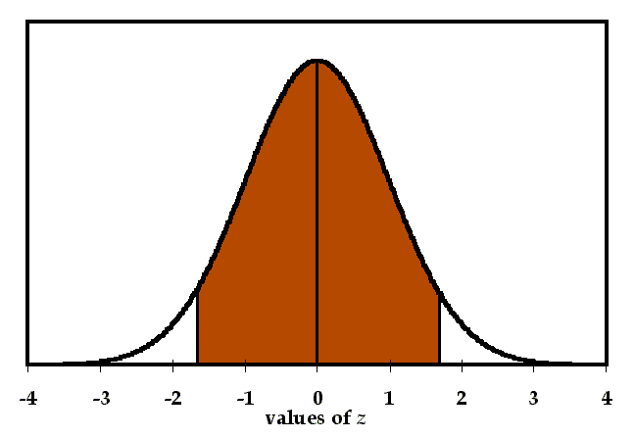
Approach 1: Center the Process

Slide 35
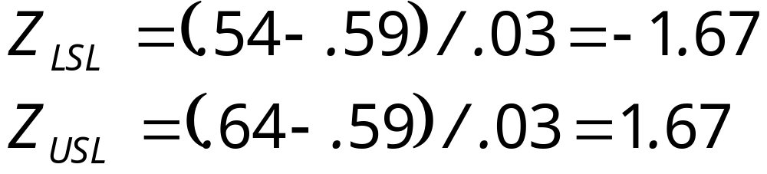
Approach 1: Center the Process

Slide 36
Approach 1: Center the Process
0.04746 of the drinks will fall below the lower specification limit.
0.95254 of the drinks will fall below the upper limit.
0.95254 - 0.04746 = 0.90508 of the drinks will conform.
Nonconforming:
  1.0 - 0.90508 = 0.09492 (9.492%)

Slide 37
Approach 1: Center the Process
Nonconformance decreased from 16.9% to 9.5%.
The inherent variability of the process did not change.
Likely to be within operator’s ability.

Slide 38
Approach 2: Reduce Variability
The only way to reduce nonconformance below 9.5%.
Requires managerial intervention.

Slide 39
Quality Control
Establish Standard
Operate
Measure Performance
Yes
OK?
Corrective Action
Compare to Standard
No

Slide 40
Quality Control
Aimed at preventing and detecting unwanted changes
An important consideration is to distinguish between Assignable Variation and Common Variation
Assignable Variation is caused by factors that can clearly be identified and possibly managed
Common Variation is inherent in the production process
We need tools to help tell the difference

Slide 41
When is Corrective
Action Required?
Operator Must Know How They Are Doing
Operator Must Be Able to Compare against the Standard
Operator Must Know What to Do if the Standard Is Not Met

Slide 42
When is Corrective
Action Required?
Use a Chart with the Mean and 3-sigma Limits (Control Limits) Representing the Process Under Control
Train the Operator to Maintain the Chart
Train the Operator to Interpret the Chart

Slide 43
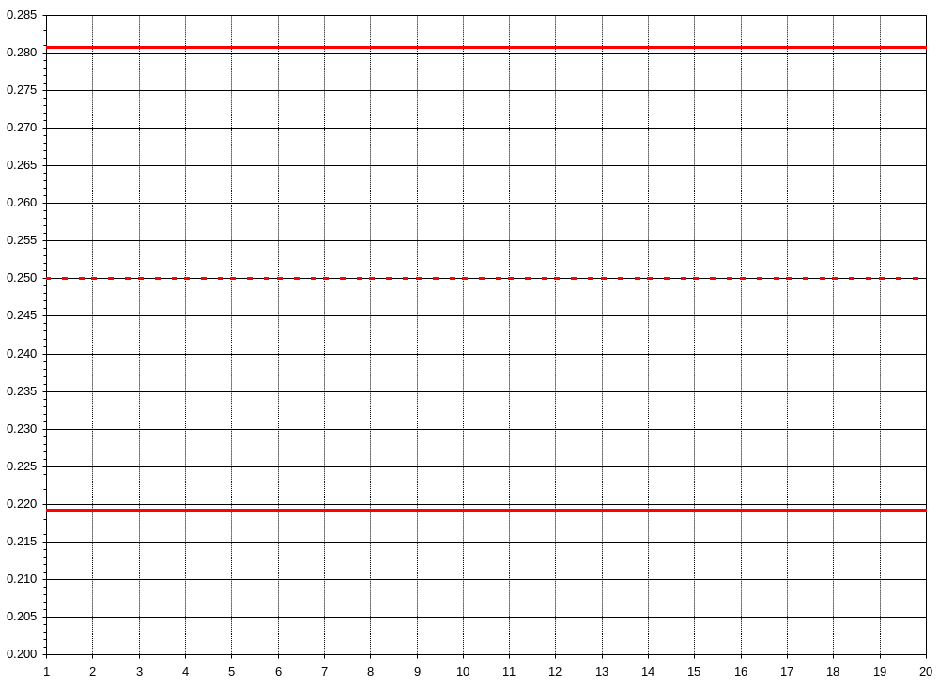
Example: Run Chart

Slide 44
When is Corrective
Action Required?
Here are four indications that a process is “out of control”. If any one of these things happens, you should stop the machine and call a quality engineer:
One point falls outside the control limits.
Seven points in a row all on one side of the center line.
A run of seven points in a row going up, or a run of seven points in a row going down.
Cycles or other non-random patterns.

Slide 45
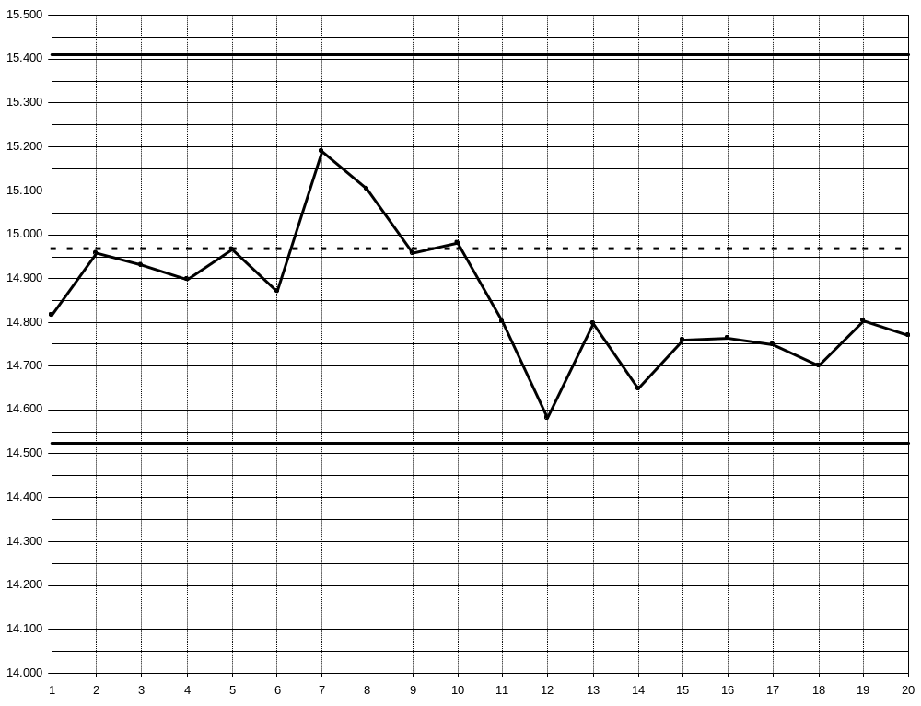
Example: Run Chart

Slide 46
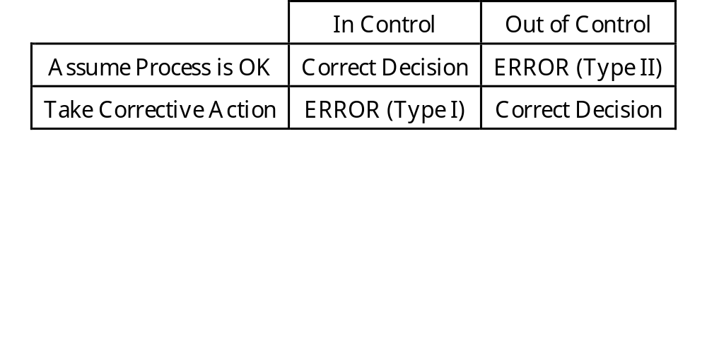
Type I and Type II Errors

Slide 47
When is Corrective Action Required?
One point falls outside the control limits.
  0.27% chance of Type I Error
Seven points in a row all on one side of the center line.
  0.78% chance of Type I Error
A run of seven points in a row going up, or a run of seven points in a row going down.
  0.78% chance of Type I Error

Slide 48
Basic Types of Control Charts
Attributes (“Go – No Go” data)
A simple yes-or-no issue, such as “defective or not”
Data typically are “proportion defective”
p-chart
Variables (Continuous data)
Physical measurements such as dimensions, weight, electrical properties, etc.
Data are typically sample means and standard deviations
X-bar and R chart

Slide 49
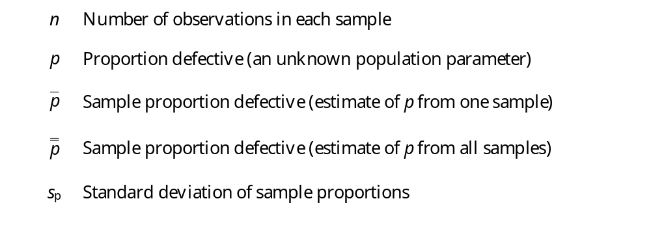
Statistical Symbols (Attributes)

Slide 50
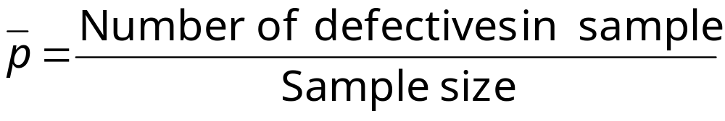
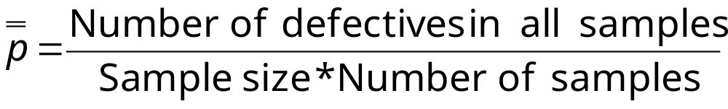
p-chart Example

Slide 51
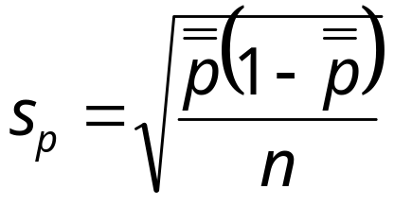
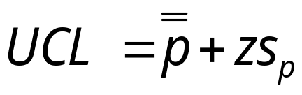
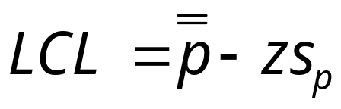
p-chart Example

Slide 52
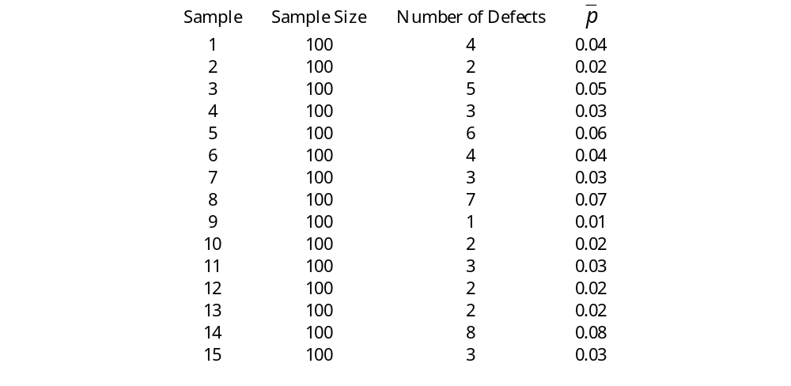

Slide 53
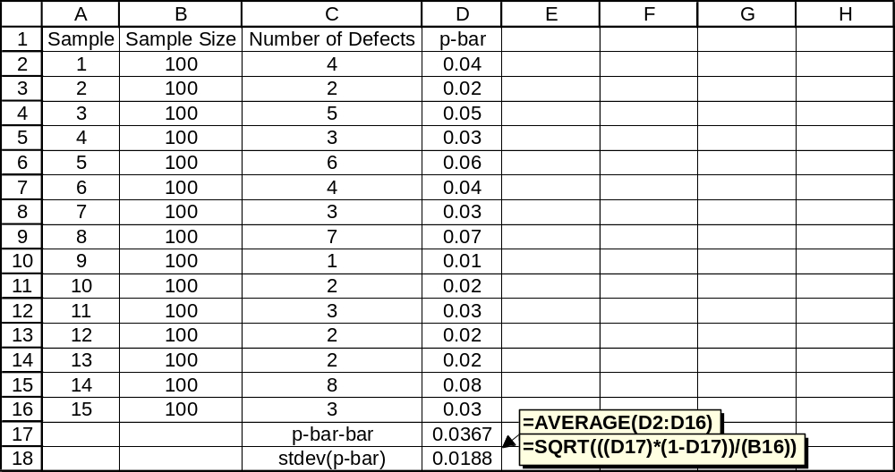

Slide 54
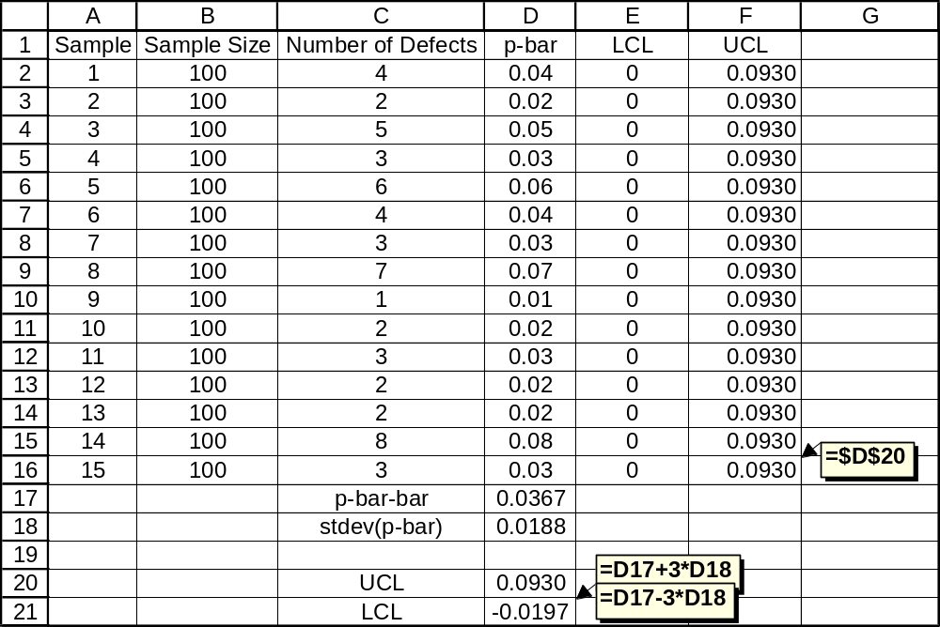
Note: If the LCL is negative, we round it up to zero.

Slide 55
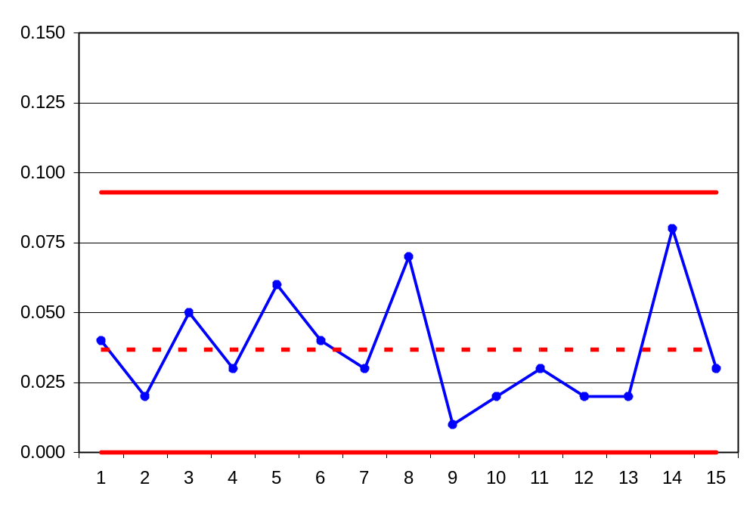

Slide 56
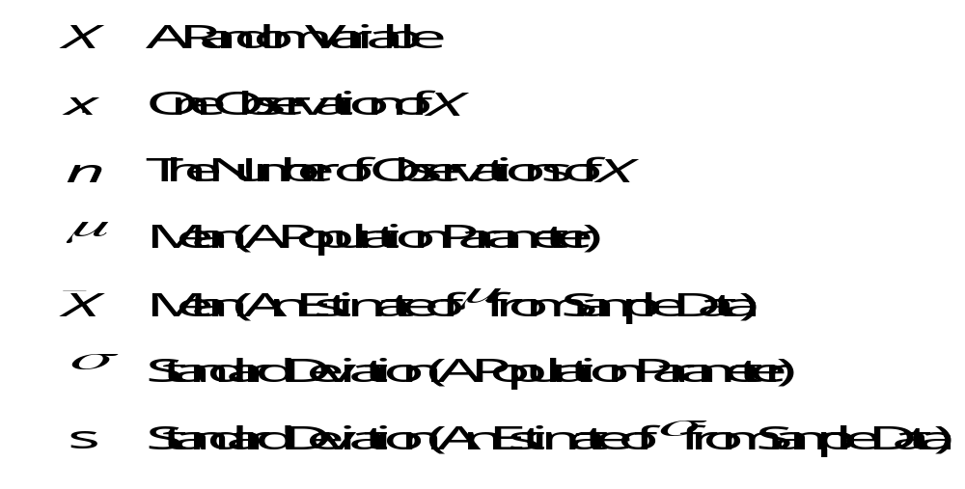
Statistical Symbols (Variables)

Slide 57

X-bar, R chart Example

Slide 58
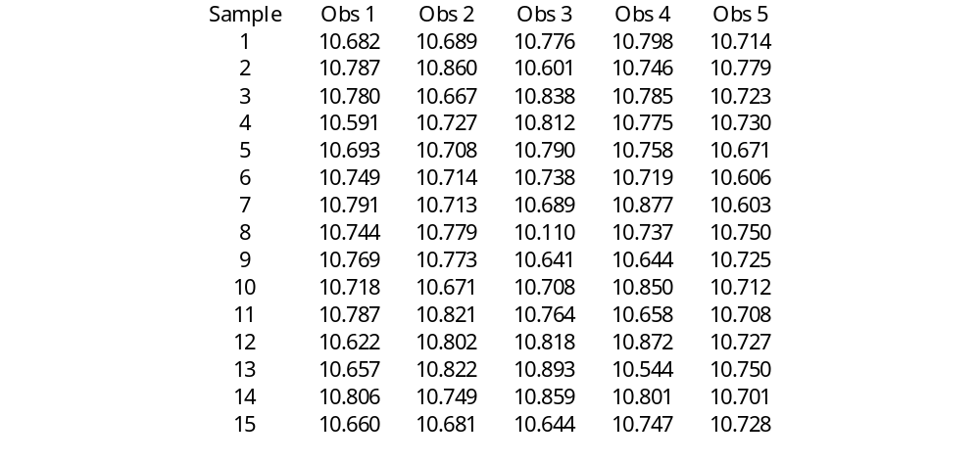

Slide 59

From Exhibit TN7.7

Slide 60
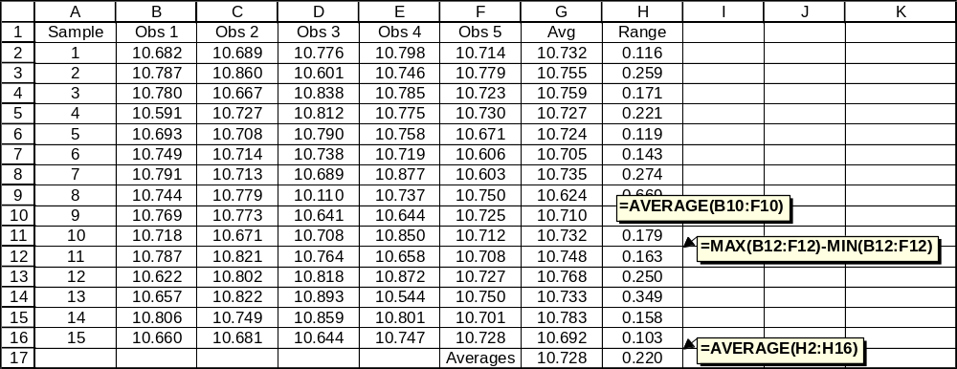

Slide 61
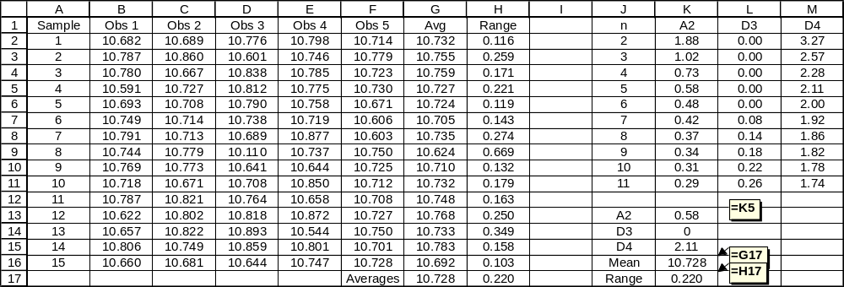

Slide 62
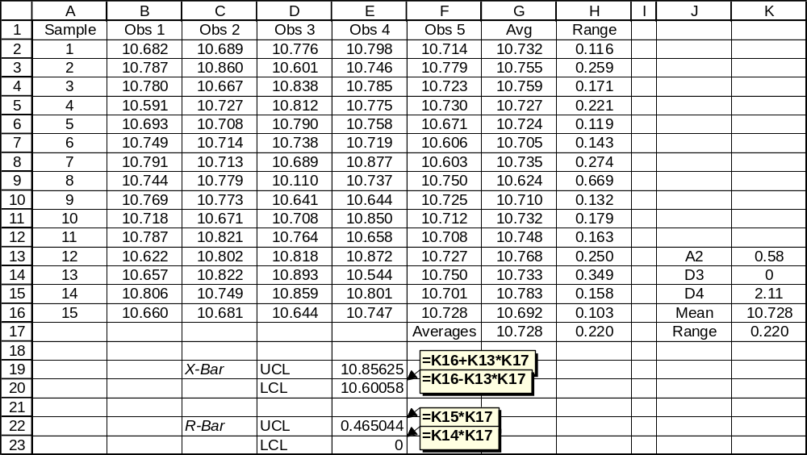

Slide 63
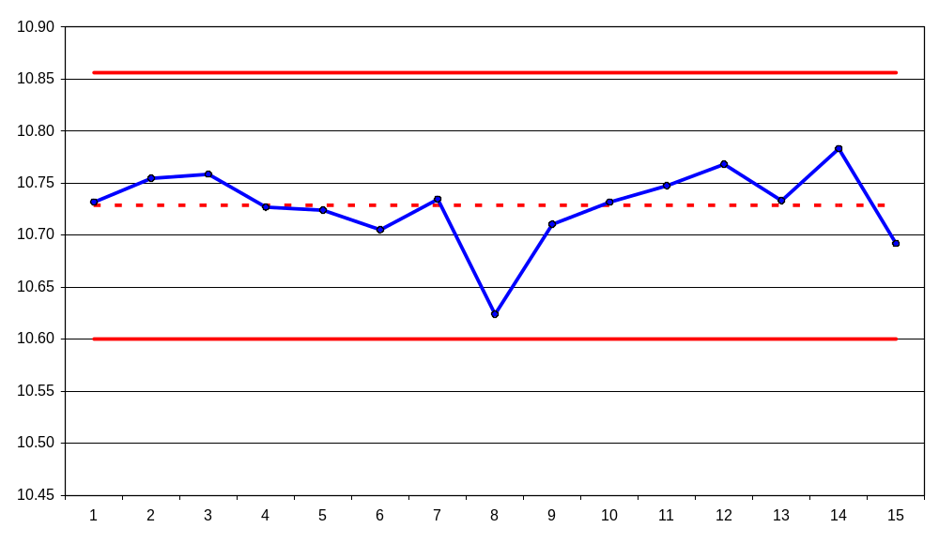
X-bar Chart

Slide 64
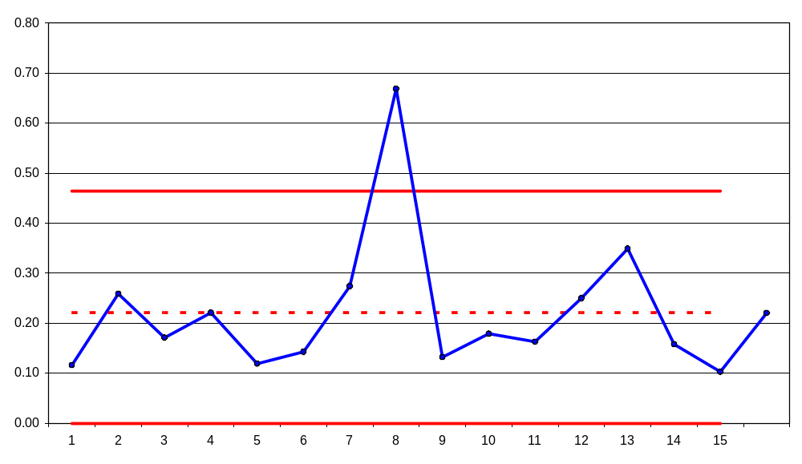
R chart

Slide 65
Interpretation
Does any point fall outside the control limits?
Are there seven points in a row all on one side of the center line?
Is there a run of seven points in a row going up, or a run of seven points in a row going down?
Are there cycles or other non-random patterns?

Slide 66
Six Sigma Defined (Low-Level)
A Process in which the Specification Limits are Six Standard Deviations above and below the Process Mean
Two Approaches:
Move the Specification Limits Farther Apart
Reduce the Standard Deviation

Slide 67
Approach #1
Ask the Customer to Move the Specification Limits Farther Apart.

Slide 68
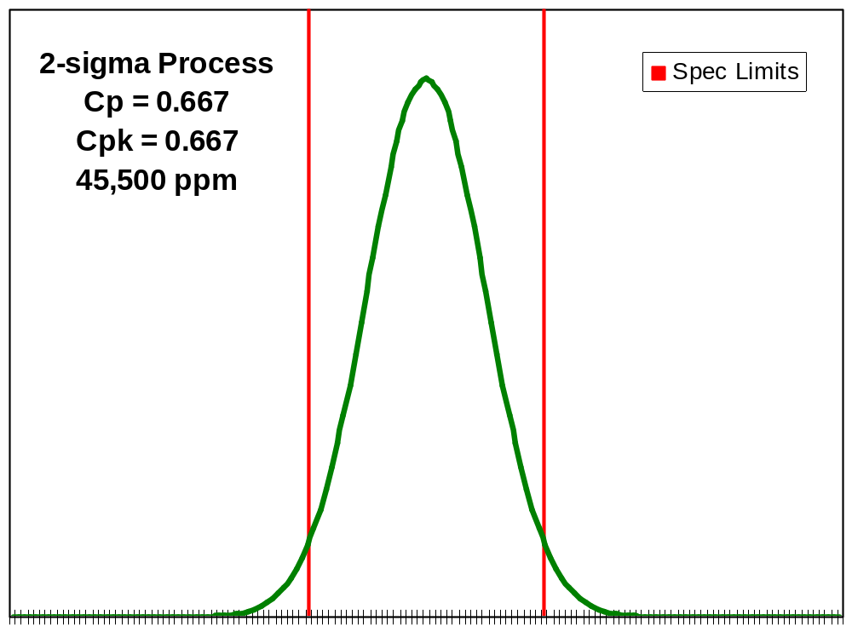

Slide 69
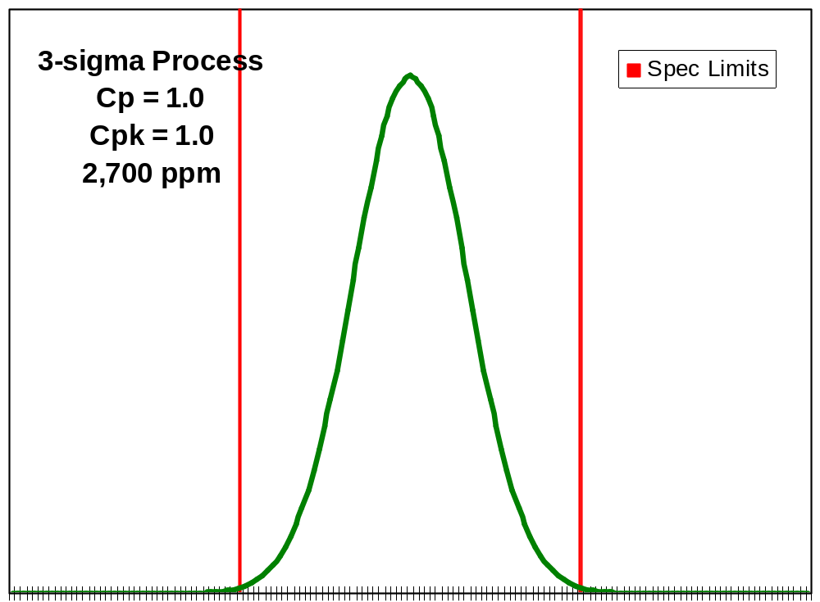

Slide 70
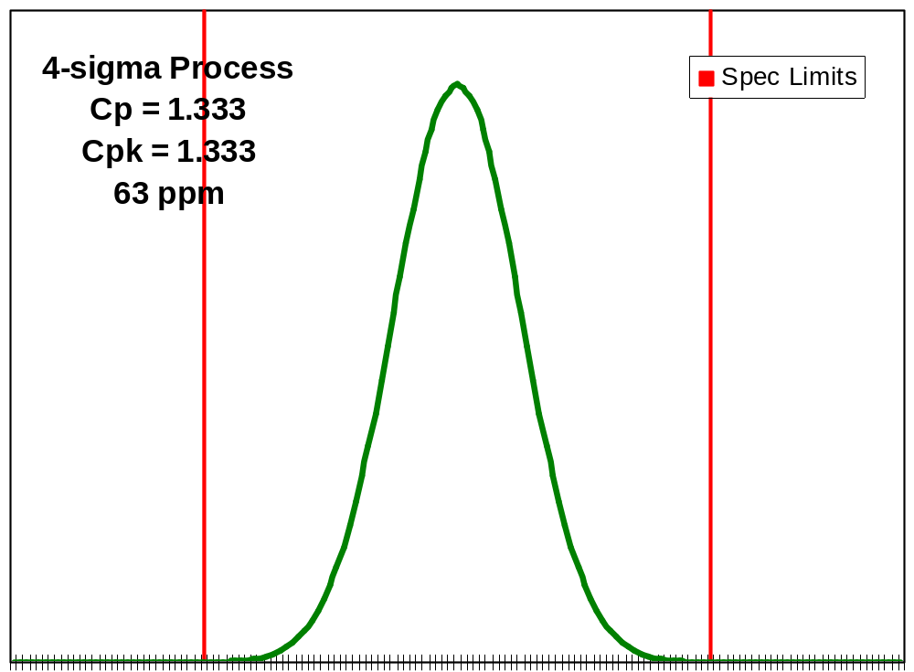

Slide 71
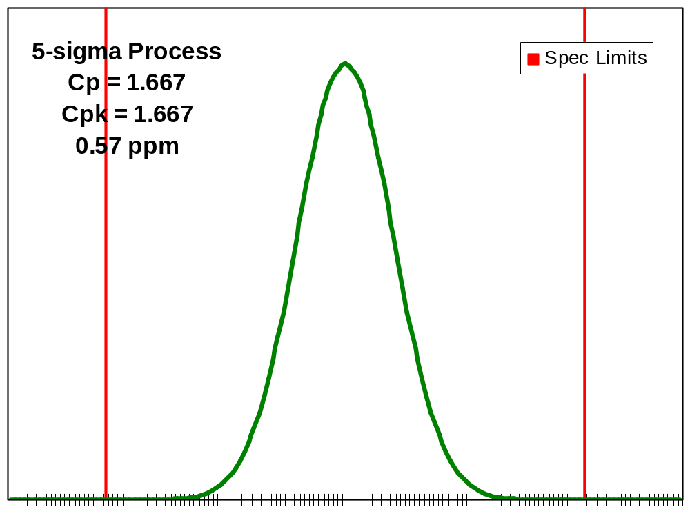

Slide 72
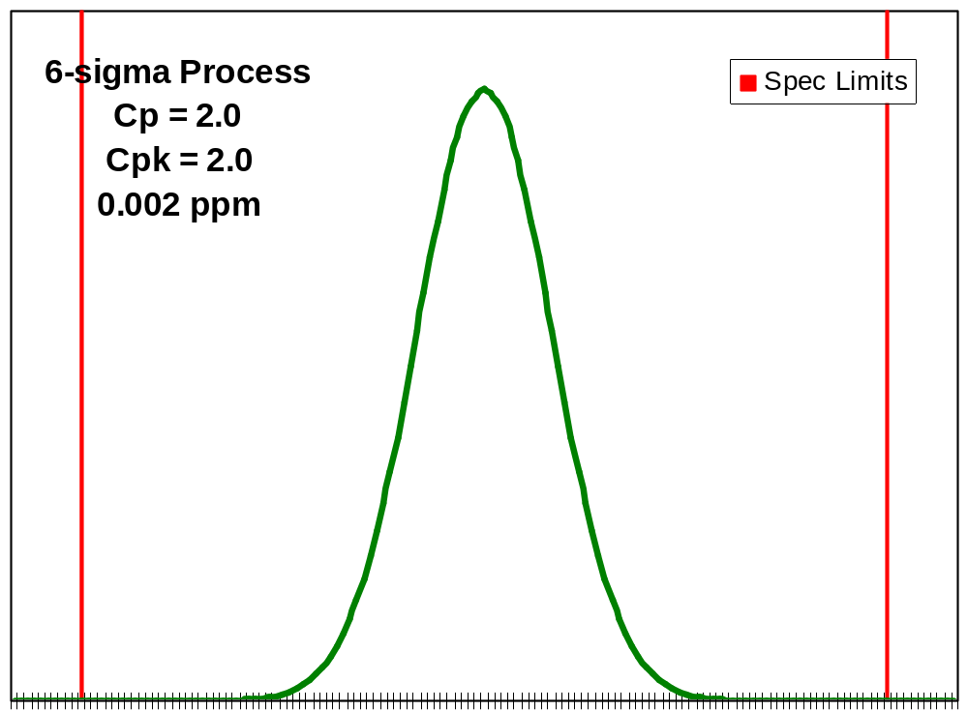

Slide 73
Approach #2
Reduce the Standard Deviation.

Slide 74
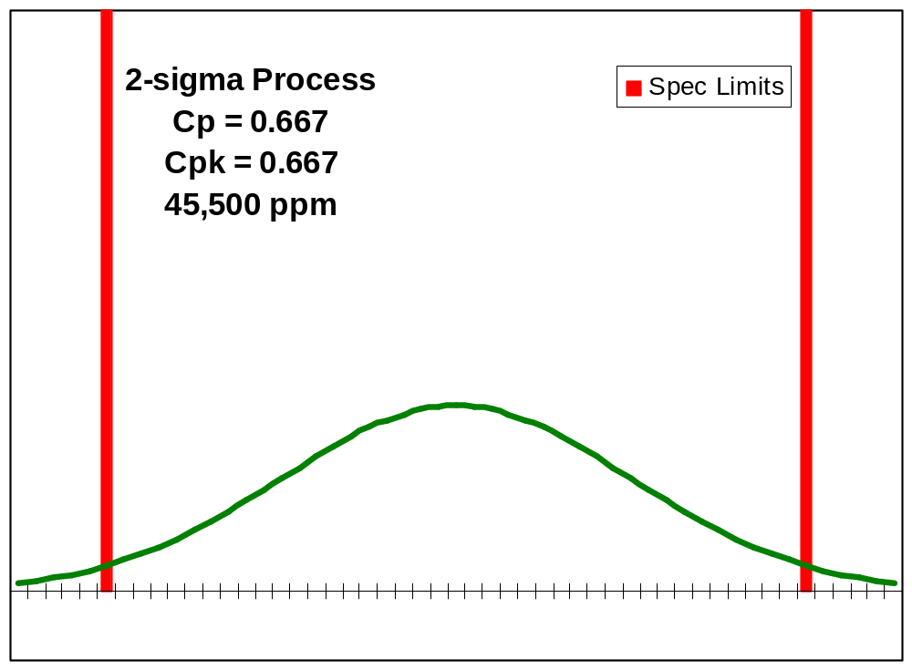

Slide 75
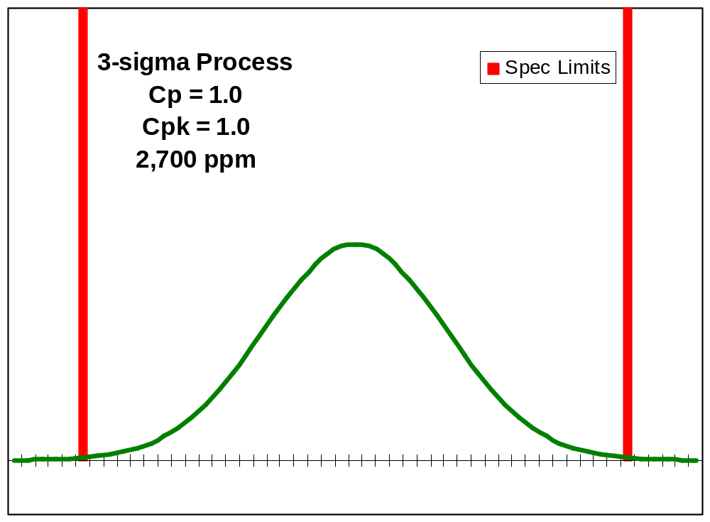

Slide 76
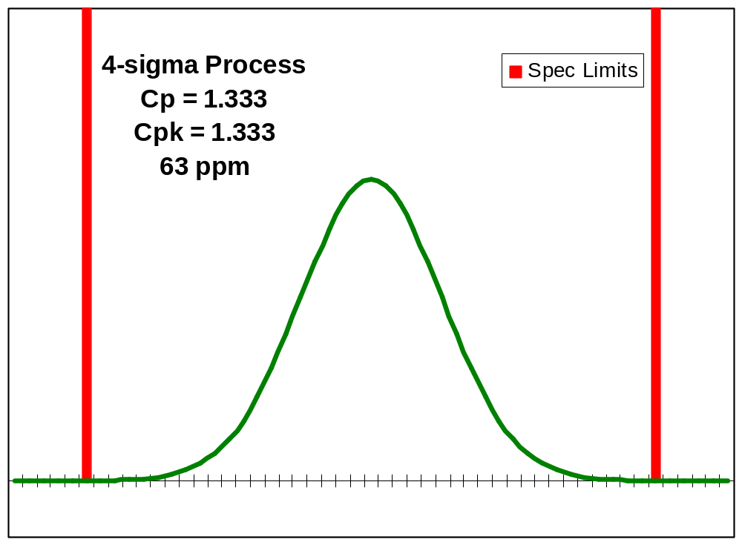

Slide 77
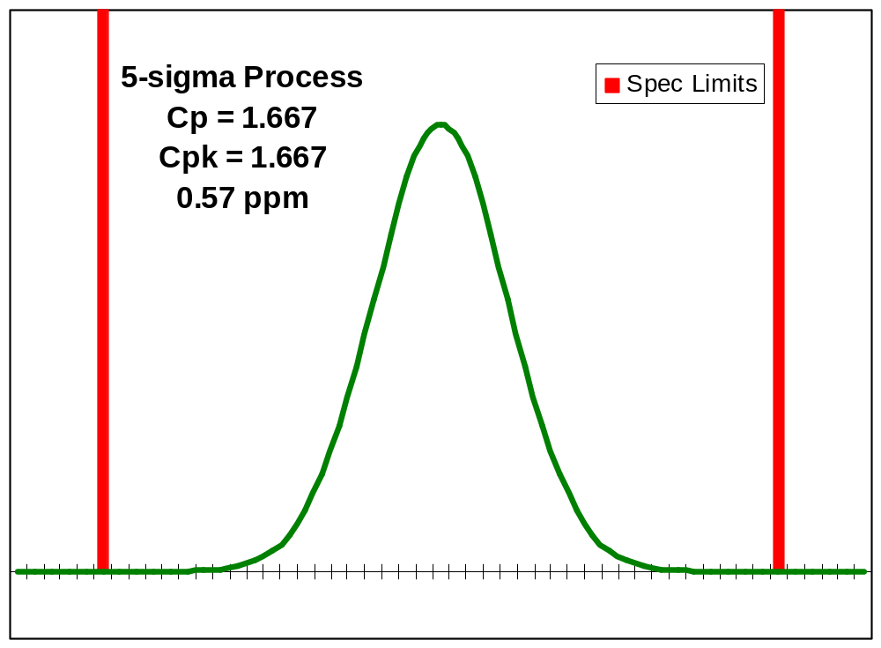

Slide 78
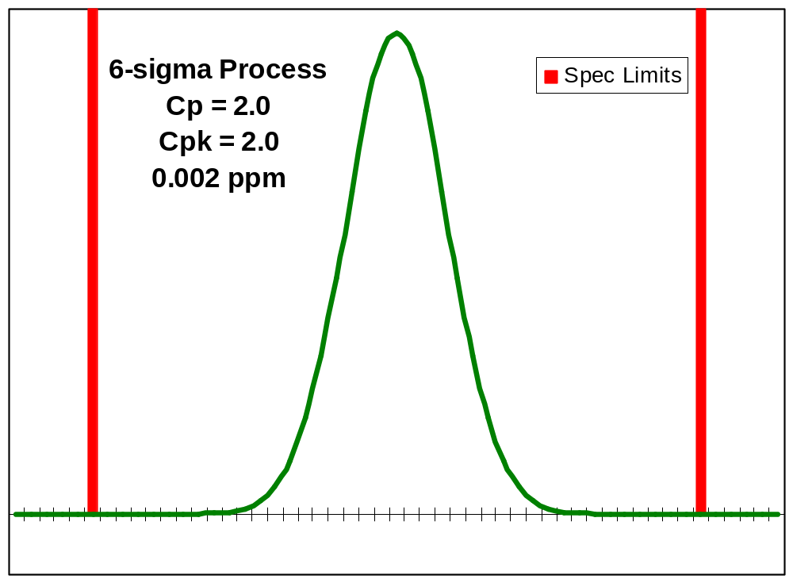

Slide 79
Process Drift
What Happens when the Process Mean Is Not Centered between the Specification Limits?

Slide 80
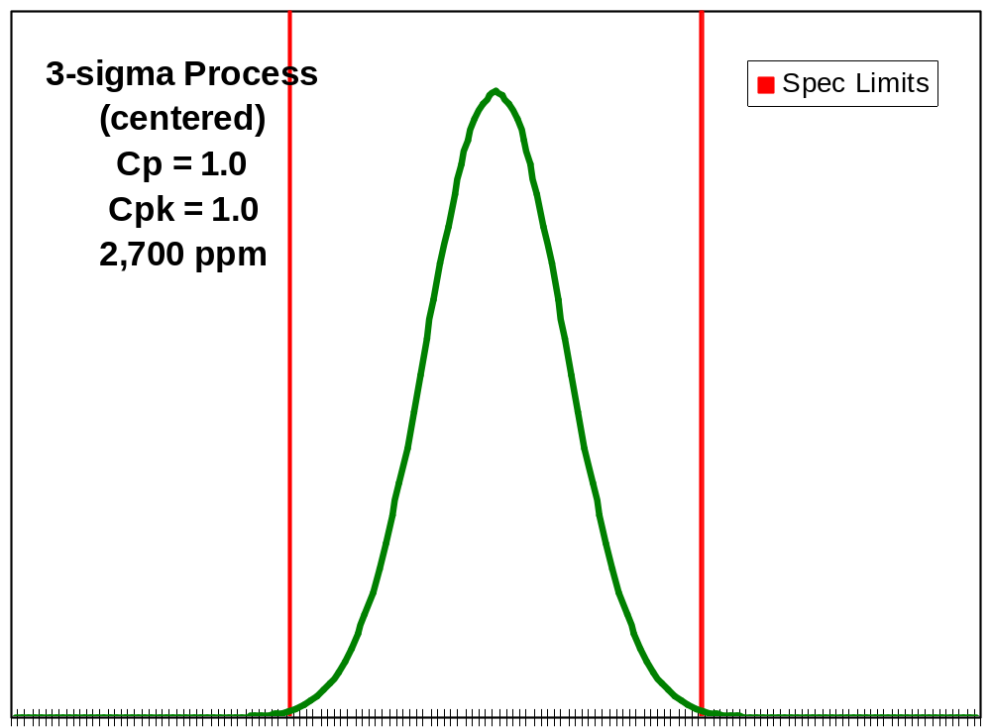

Slide 81
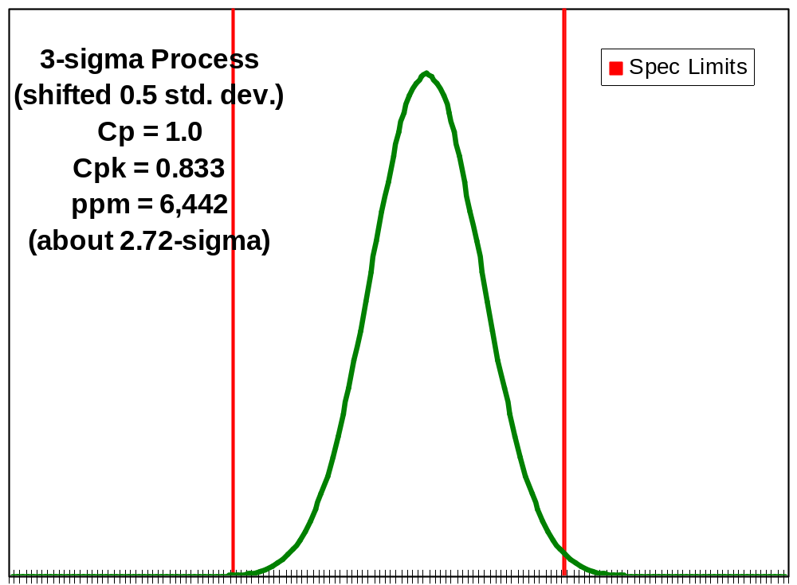

Slide 82
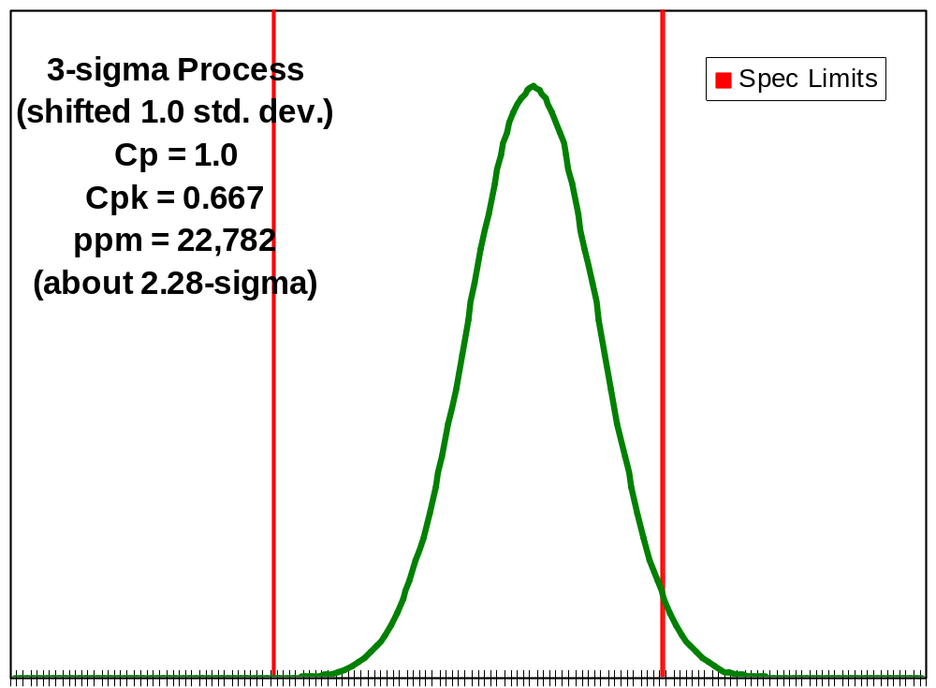

Slide 83
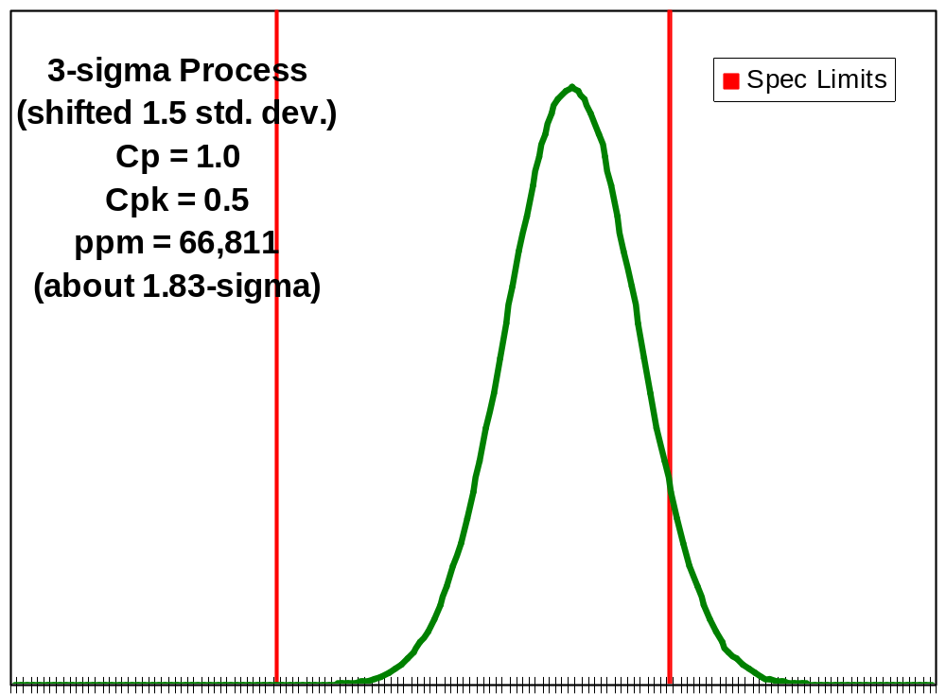

Slide 84
Six Sigma: Many Meanings
A Symbol
A Measure
A Benchmark or Goal
A Philosophy
A Method

Slide 85
Six Sigma: A Symbol
σ is a Statistical Symbol for Standard Deviation
Standard Deviation is a Measure of Dispersion, Volatility, or Variability

Slide 86
Six Sigma: A Measure
The “Sigma Level” of a process can be used to express its capability — how well it performs with respect to customer requirements.
Percent Defects, C_{p}, C_{pk}, PPM

Slide 87
Six Sigma: A Benchmark or Goal
The specific value of 6 Sigma (as opposed to 5 or 4 Sigma) is a benchmark for process excellence.
Adopted by leading organizations as a goal for process capability.

Slide 88
Six Sigma: A Philosophy
A vision of process performance
Tantamount to “zero defects”
A “Management Mantra”

Slide 89
Six Sigma: A Method
Really a Collection of Methods:
  Product/Service Design
  Quality Control
  Quality Improvement
  Strategic Planning

Slide 90
Where Does “3.4 PPM” Come From?
Six Sigma is commonly defined to be equivalent to 3.4 defective parts per million.
Juran says that a Six Sigma process will produce only 0.002 defective parts per million.
What gives?

Slide 91

Normal Curve Probabilities

Slide 92


Slide 93

Process Centered between Spec Limits

Slide 94

Process Shifted by 1.5 Standard Deviations

Slide 95
Where Does “3.4 PPM” Come From?
The 3.4 defective parts per million definition of Six Sigma includes a “worst case” scenario of a 1.5 standard deviation shift in the process.
It is assumed that there is a very high probability that such a shift would be detected by SPC methods (low probability of Type II error).

Slide 96
Six Sigma in Context
Is Six Sigma dramatically different from old-fashioned quality control?
Is Six Sigma a departure from 1980’s-style TQM?

Slide 97
Six Sigma in Context
What Is New?
  Focus on Quantitative Methods
  Focus On Control
  A Higher Standard
  A New Metric for Defects (PPM)
  Lots of training
  Linkage between quality goals and employee incentives?

Slide 98
Using Six Sigma
A New Standard; Not Adopted Uniformly across Industries
Beyond Generalities, Need to Develop Organization-Specific Methods
Hard Work, Not Magic
“A Direction Not a Place”

Slide 99
Summary
Quality and Six Sigma: Basic ideas and history
Juran Trilogy
  Control
  Improvement
  Planning
Quality Strategy
Focus on Statistical Methods
  Process Capability ideas and metrics
  Control charts for attributes and variables

