Slide 1
High frequency trading:
Issues and evidence
Joel Hasbrouck

Slide 2
The US (Regulatory) Perspective
US CFTC Draft Definition, May 2012:
High frequency trading is a form of automated trading that employs:
  (a) algorithms for decision making, order initiation, generation, routing, or execution, for each individual transaction without human direction;
  (b) low-latency technology that is designed to minimize response times, including proximity and co-location services;
  (c) high speed connections to markets for order entry; and
  (d) high message rates (orders, quotes or cancellations).

Slide 3
The Canadian perspective
Investment Industry Regulatory Organization of Canada (2012). Proposed guidance on certain manipulative and deceptive trading practices. IIROC Notice.
The Proposed Guidance would confirm IIROC’s position that employing certain trading strategies commonly known as: layering, quote stuffing, quote manipulation, spoofing, or abusive liquidity detection on a marketplace would be considered a manipulative and deceptive trading practice …
While these strategies are often associated with the use of automated order systems, including “algorithmic” and “high frequency” trading, IIROC would remind Participants and Access Persons that these strategies are prohibited whether conducted manually or electronically.

Slide 4
The UK perspective
U.K. Government Office for Science (2012). Economic impact assessments on MiFID II policy measures related to computer trading in financial markets.
Overall, there is general support from the evidence for …
  the use of circuit breakers
  A coherent tick size policy
The evidence offers less support for
  policies imposing market maker obligations
  minimum resting times
  notification of algorithms
  minimum order-to-execution ratios

Slide 5
HFT: Some claimed costs and benefits
“HFT enhances market liquidity.”
  Hasbrouck, J. and G. Saar (2011). "Low-Latency Trading." SSRN eLibrary.
“HFT increases volatility.”
  J. Hasbrouck (2012). “High frequency quoting”. work in progress.
“HFT improves market efficiency.”
  Brogaard, J., T. Hendershott, Riordan, R. (2012). High-frequency trading and price discovery.

Slide 6
HFT and liquidity (Hasbrouck and Saar)
Measuring HF activity
  Construct low-latency order chains (“strategic runs”)
  RunsInProcess: average contribution of order chains to book depth.
How does RunsInProcess correlate with standard liquidity measures?
  Posted and effective spreads, depth, short-term volatility.

Slide 7
Sample
Common, domestic NASDAQ-listed stocks: Top 500 firms by equity market cap as of September 30, 2007.
  Screen out low activity firms
Market data: Inet message feed (“ITCH”)
Sample periods
  October 2007 (23 trading days; 345 stocks)
  June 2008 (21 trading days; 394 stocks)

Slide 8
NASDAQ Data: TotalView-ITCH.
Real-time suscriber message feed (ms. time-stamps).
Message types:
  Addition of a displayed order to the book
  Cancellation of a displayed order
  Execution of a displayed order
  Execution of a non-displayed order.

Slide 9
Order chains
Principle: the basic building block is the cancel-and-replace.
  Cancel an existing order and replace it with a repriced one.

Slide 10
Imputing links
Sell 100 shares, limit 20.13
Cancel
Sell 100 shares, limit 20.12
Cancel
Sell 100 shares, limit 20.11
Cancel
Explicitly linked

Slide 11
Imputing links
Sell 100 shares, limit 20.13
Cancel
Sell 100 shares, limit 20.12
Cancel
Sell 100 shares, limit 20.11
Cancel
Explicitly linked
Imputed link

Slide 12
Features of imputed runs
Over 50% of messages belong to runs ten or more messages long.
Roughly 20% of the runs end in a passive fill.

Slide 13
Strategies suggest a measure …
RunsInProcess_{i,t}
For stock i in 10-minute window t, the time-weighted average of the number of strategic runs of 10 messages or more.
  Higher values of RunsInProcess indicate more low-latency activity.
How is RunsInProcess correlated with standard measures of liquidity?

Slide 14
Standard Market Quality Measures
HighLow
  Midquote high – midquote low
Spread:
  Time-weighted average of NASDAQ’s quoted spread.
EffSprd
  Average effective spread.
NearDepth
  Time-weighted average number of (visible) shares in the book up to 10 cents from the best posted prices.

Slide 15
And their correlation with RunsInProcess
HighLow: Negative correlation
Spread: Negative correlation
EffSprd: Negative correlation
NearDepth: Positive correlation
Conclusion: HFT is beneficial for liquidity.

Slide 16
Caveats
Correlation is not causation
Our samples don’t reflect episodes of extreme market stress.

Slide 17
Features of market data
(possibly) related to HFT
Periodicity.
Abrupt fits of activity characterized by sudden changes in message traffic

Slide 18
One-second periodicities
A time-stamp of 10:02:34.567
has a millisecond remainder of 567.
We’d expect that these remainders would occur evenly on the integers 0, …, 999.
Instead …

Slide 19
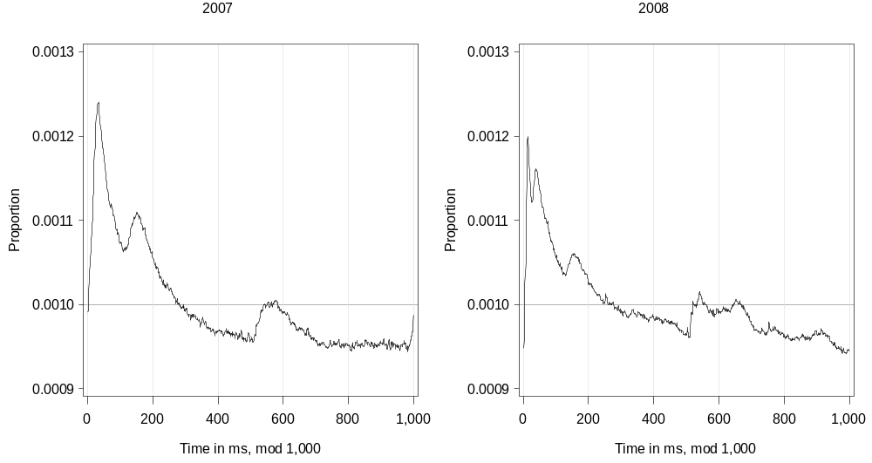
Periodicity (mod(t,1000))

Slide 20
Abrupt fits of activity
Message traffic can quickly intensify and abate.

Slide 21
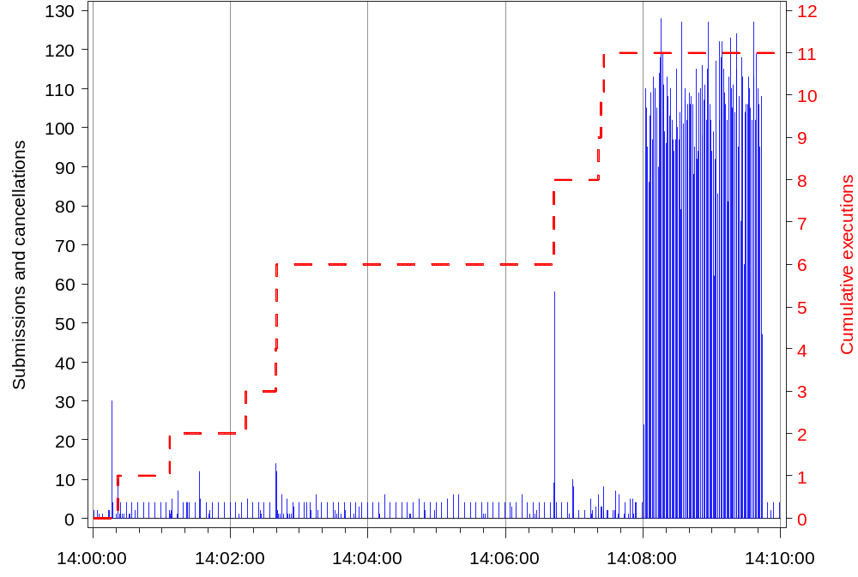
Panel A: INWK on June 2, 2008, 2:00pm to 2:10pm

Slide 22
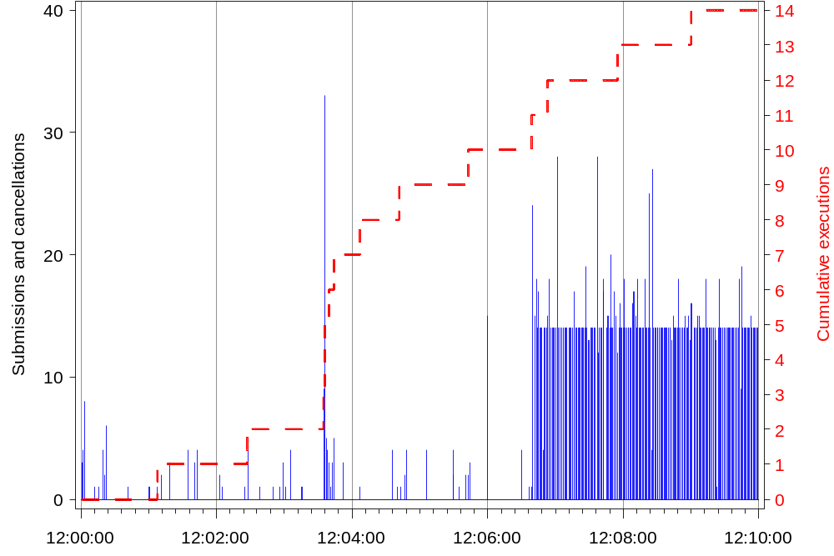
SANM on June 17, 2008, 12:00pm to 12:10pm

Slide 23
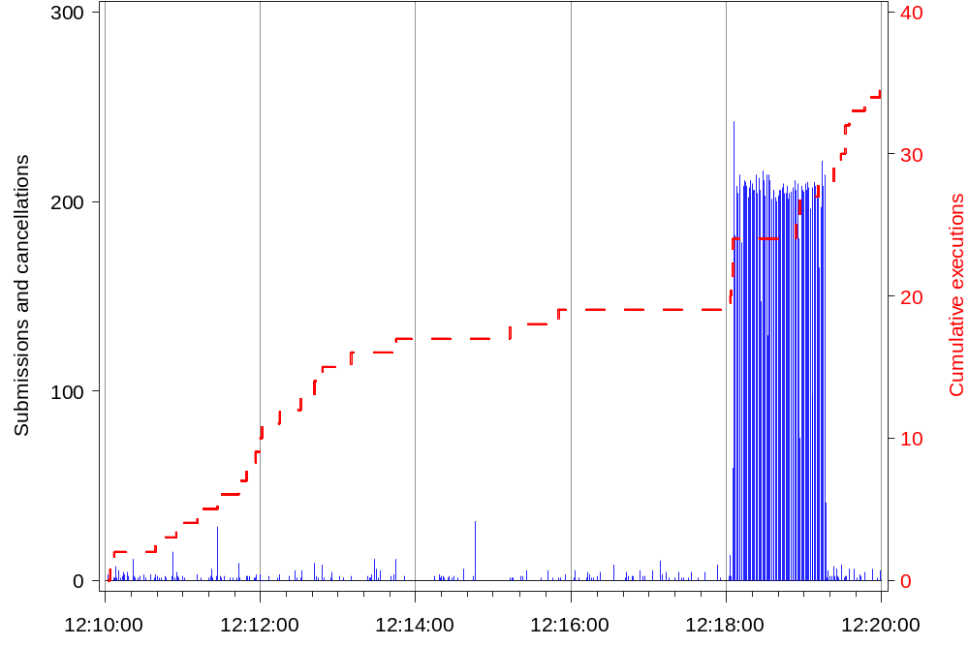
GNTX on June 12, 2008, 12:10pm to 12:20pm

Slide 24
Significance of bursts?
Not apparently related to trades.
Consist of cancellations and resubmissions.
Are these deep in the book, or are they affecting the visible prices?

Slide 25
High-frequency quoting (work in process)
Rapid oscillations of bid and/or ask quotes.
Example
  AEPI is a small Nasdaq-listed manufacturing firm.
  Market activity on April 29, 2011
  National Best Bid and Offer (NBBO)
    The highest bid and lowest offer (over all market centers)

Slide 26
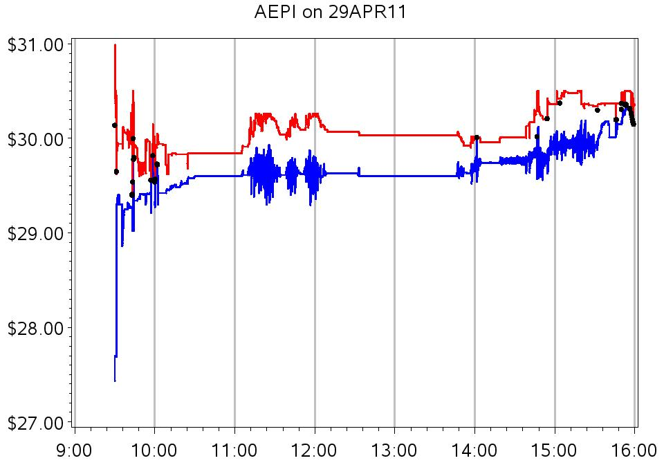
National Best Bid and Offer for AEPI during regular trading hours

Slide 27
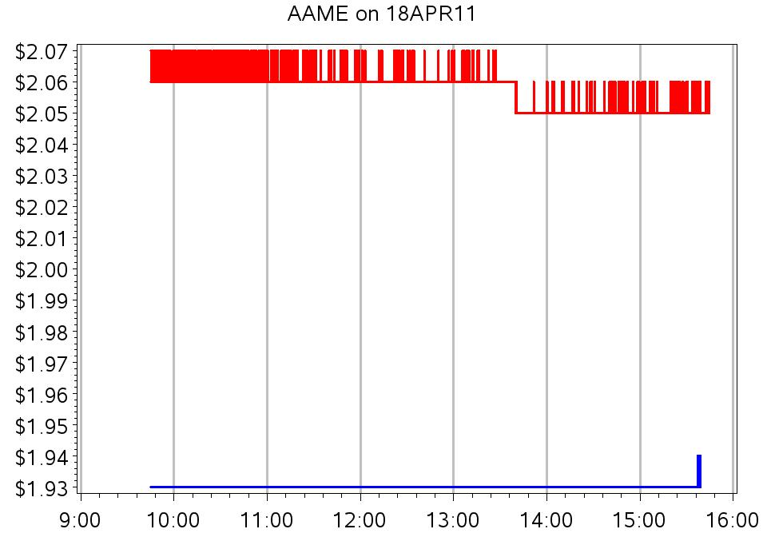

Slide 28
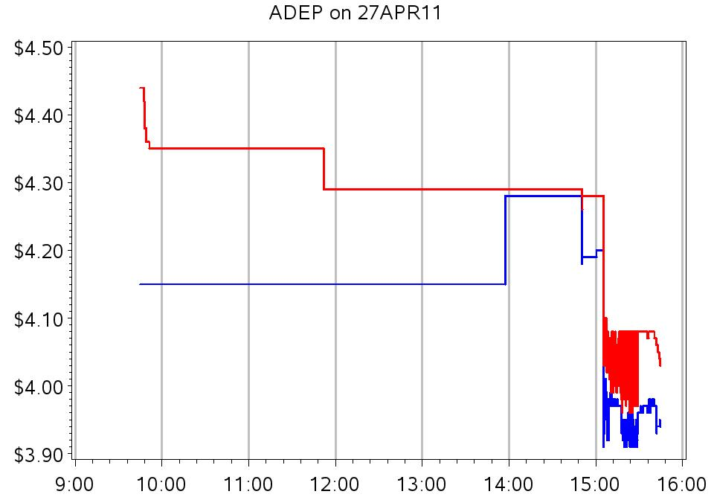

Slide 29
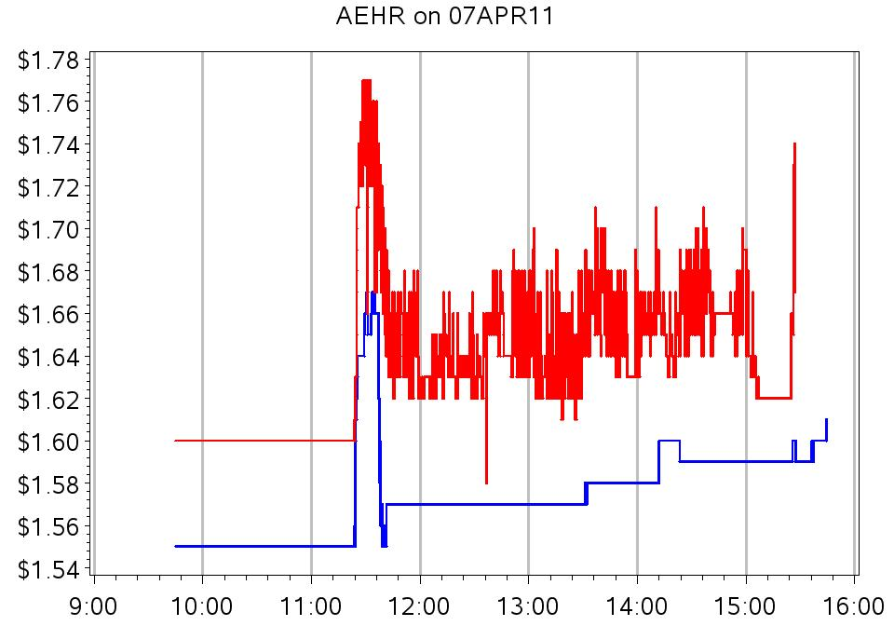

Slide 30
Caveats
Ye & O’Hara (2011)
  A bid or offer is not incorporated into the NBBO unless it is 100 sh or larger.
  Trades are not reported if they are smaller than 100 sh.
Due to random latencies, agents may perceive NBBO’s that differ from the “official” one.
Now zoom in on one hour for AEPI …

Slide 31
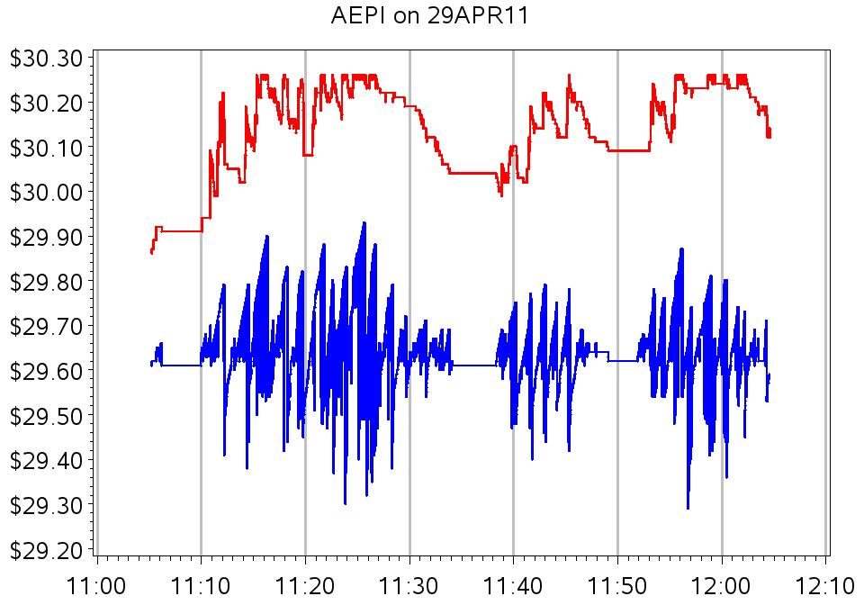
National Best Bid and Offer for AEPI from 11:00 to 12:10

Slide 32
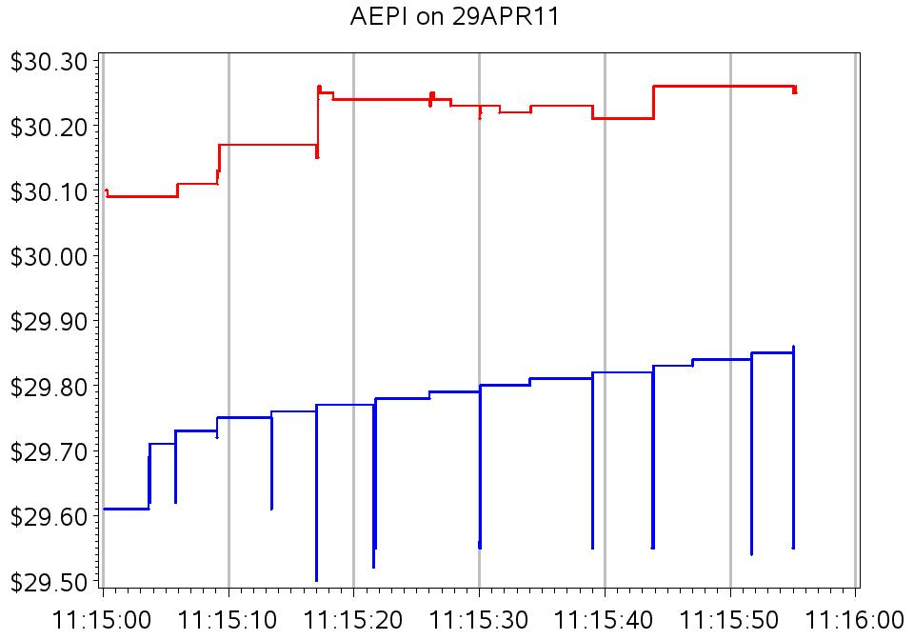
National Best Bid and Offer for AEPI from 11:15:00 to 11:16:00

Slide 33
National Best Bid and Offer for AEPI from 11:15:00 to 11:16:00

Slide 34
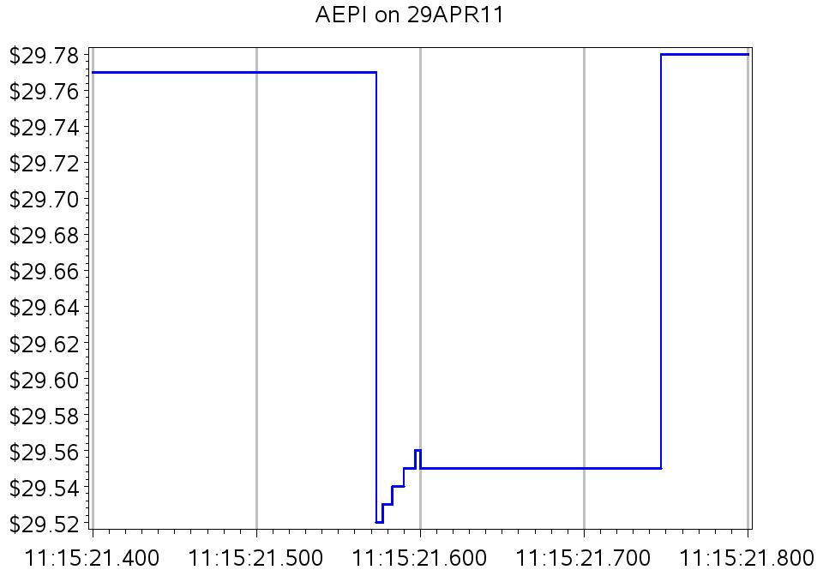
National Best Bid for AEPI:
11:15:21.400 to 11:15:21.800 (400 ms)

Slide 35
So what? Who cares?
HFQ noise degrades the informational value of the bid and ask.
HFQ aggravates execution price uncertainty for marketable orders.
And in US equity markets …
  NBBO used as reference prices for dark trades.
  Top (and only the top) of a market’s book is protected against trade-throughs.

Slide 36
“Dark” Trades
Trades that don’t execute against a visible quote.
In many trades, price is assigned by reference to the NBBO.
  Preferenced orders are sent to wholesalers.
    Buys filled at NBO; sells at NBB.
  Crossing networks match buyers and sellers at the midpoint of the NBBO.

Slide 37
Features of the AEPI episodes
Extremely rapid oscillations in the bid.
Start and stop abruptly
Doubtful connection to fundamental news.
Directional (activity on the ask side is much smaller)

Slide 38
Analysis framework:
Time-scale decomposition
Also known as: multi-resolution analysis, wavelet analysis.
Intuition
  With a given time series
  Suppose that we smooth (average) the series over time horizons of 1 ms, 2 ms, 4 ms, 8 ms, …
  What is left over? How volatile is it?

Slide 39
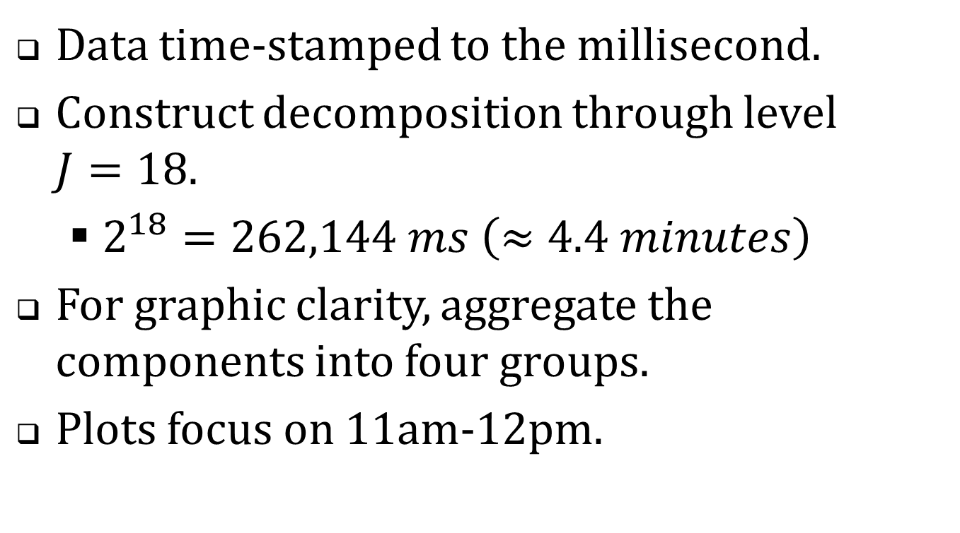
Multi-resolution analysis of AEPI bid
Data time-stamped to the millisecond.
Construct decomposition through level $J=18$.
  $2^{18}=262,144 ms \left(≈4.4 minutes\right)$
For graphic clarity, aggregate the components into four groups.
Plots focus on 11am-12pm.

Slide 40
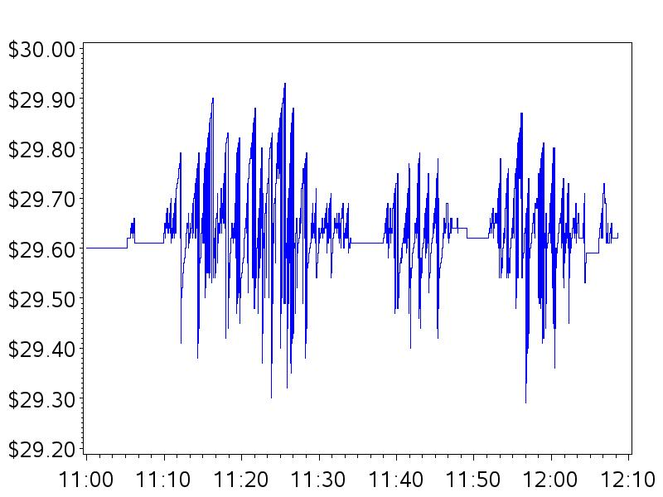

Slide 41
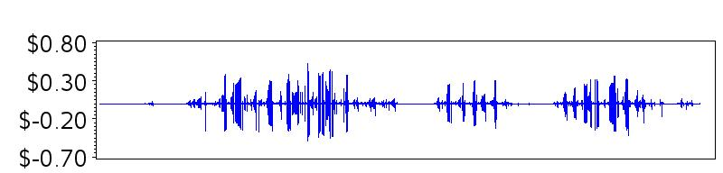
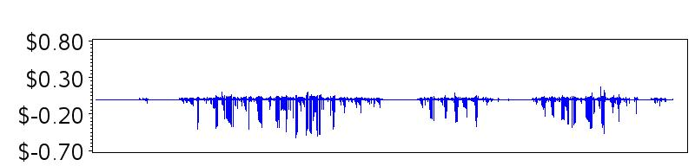
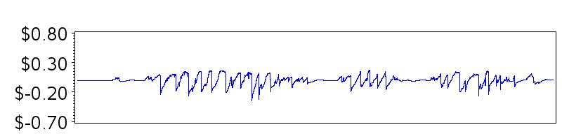
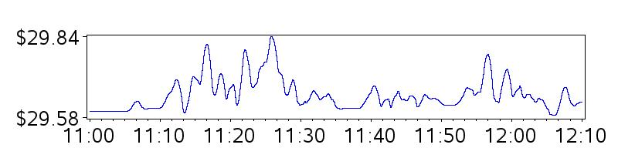
Time scale
1-4ms
8ms-1s
2s-2m
>2m

Slide 42
The (squared) volatility of the 8 ms component is the wavelet variance (at the 8 ms time scale).
The cumulative wavelet variance at 8 ms is the variance of the 8 ms component …
  + the 4 ms variance
  + the 2 ms variance
  + the 1 ms variance

Slide 43
The cumulative wavelet variance: an interpretation
Orders sent to market are subject to random delays.
  This leads to arrival uncertainty.
  For a market order, this corresponds to price risk.
For a given time window, the cumulative wavelet variance measures this risk.

Slide 44
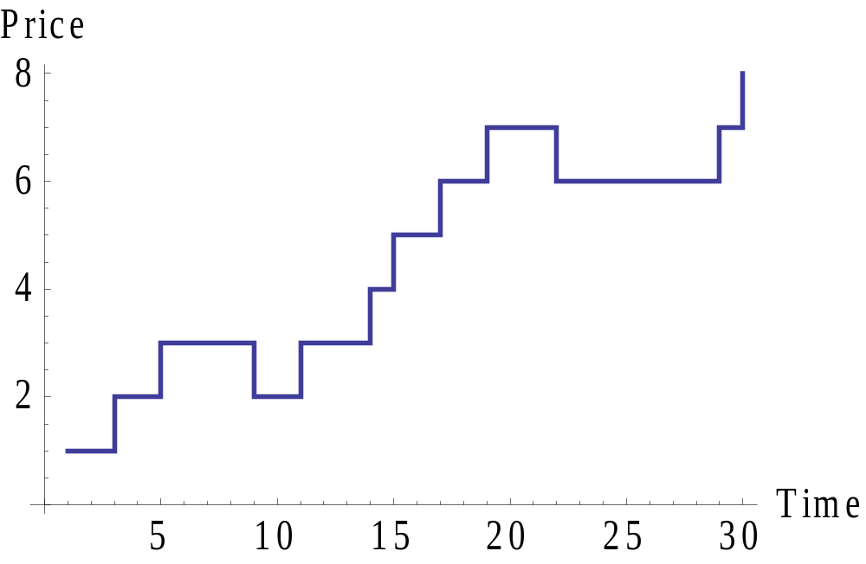
Timing a trade: the price path

Slide 45
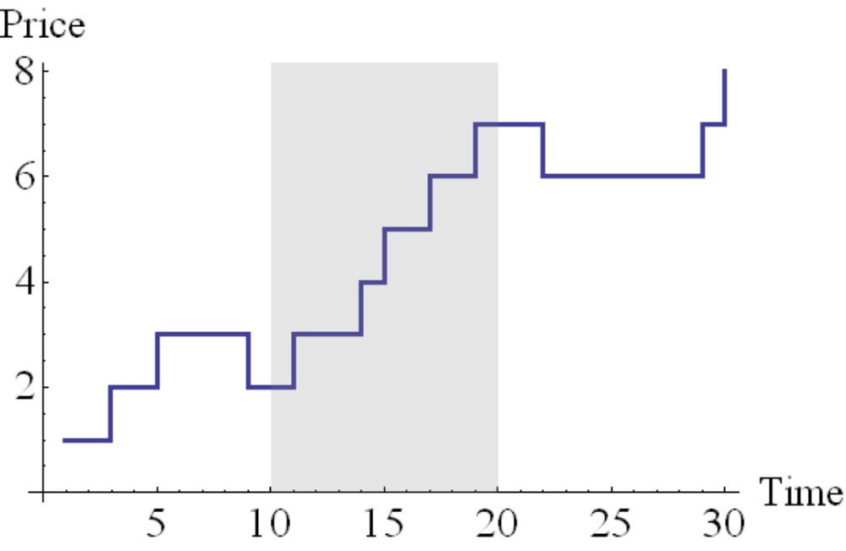
Timing a trade: the arrival window

Slide 46
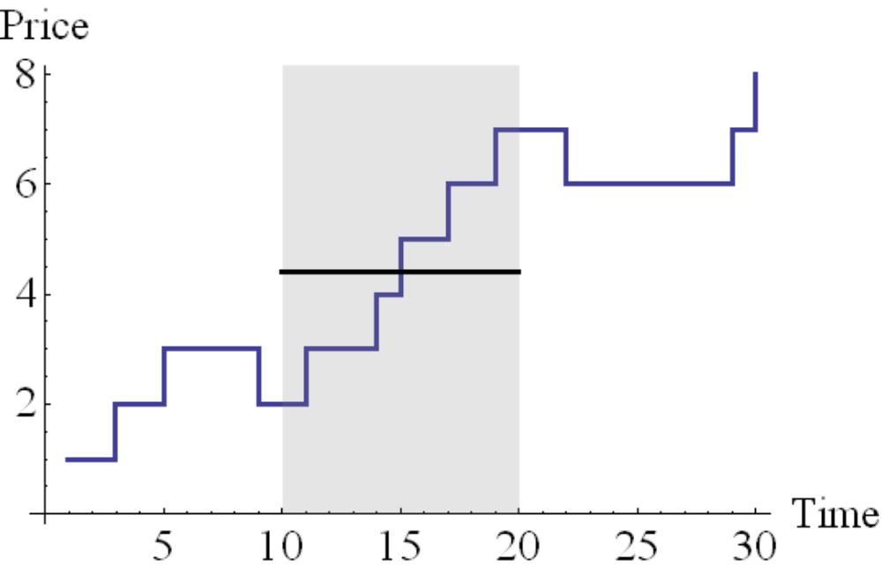
The time-weighted average price (TWAP) benchmark
Time-weighted
average price

Slide 47
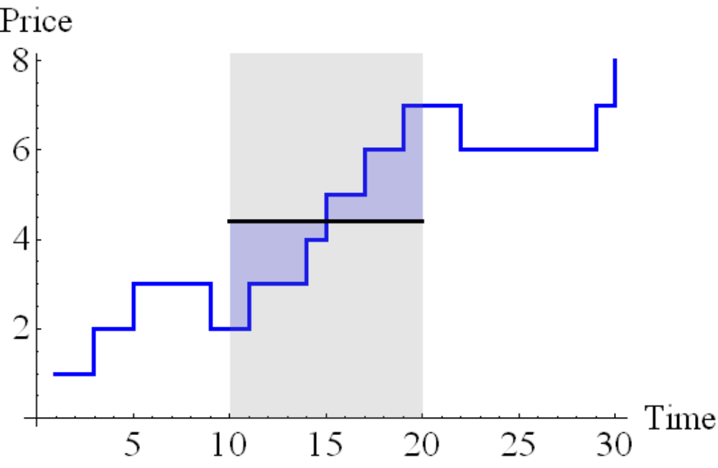
Timing a trade: TWAP Risk
Variation about time-weighted average price

Slide 48
How large is short-term volatility … ?
… relative to long-term volatility
Estimate “long-term” volatility over 20 minutes.
Assuming a Gaussian diffusion process calibrated to 20-minute volatility
… we can construct implied short term volatilities.
How large are actual short term cumulative wavelet variances relative to the implied?

Slide 49
Data sample
100 US firms from April 2011
Sample stratified by dollar trading volume.
  5 groups: 1=low … 5=high
  Take 20 firms from each quintile.
HF data from daily (“millisecond”) TAQ

Slide 50
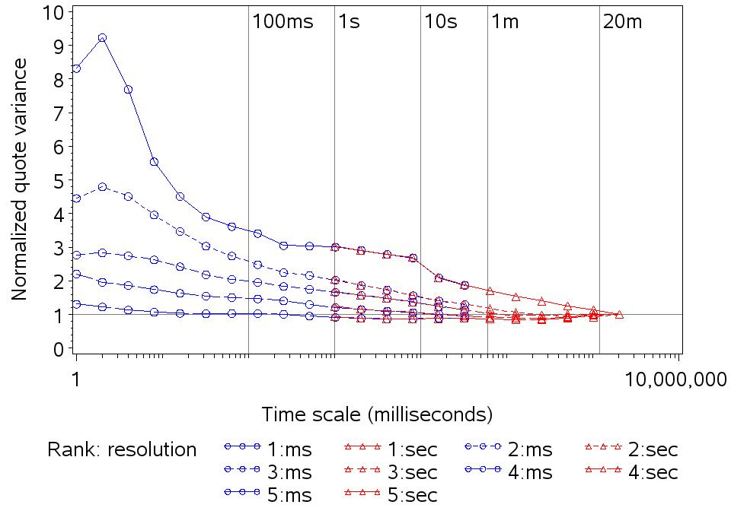

Slide 51
The take-away
For high-cap firms
  Wavelet variances at short time scales have modest elevation relative to random-walk.
Low-cap firms
  Wavelet variances are strongly elevated at short time scales.
  Significant price risk relative to TWAP.

Slide 52
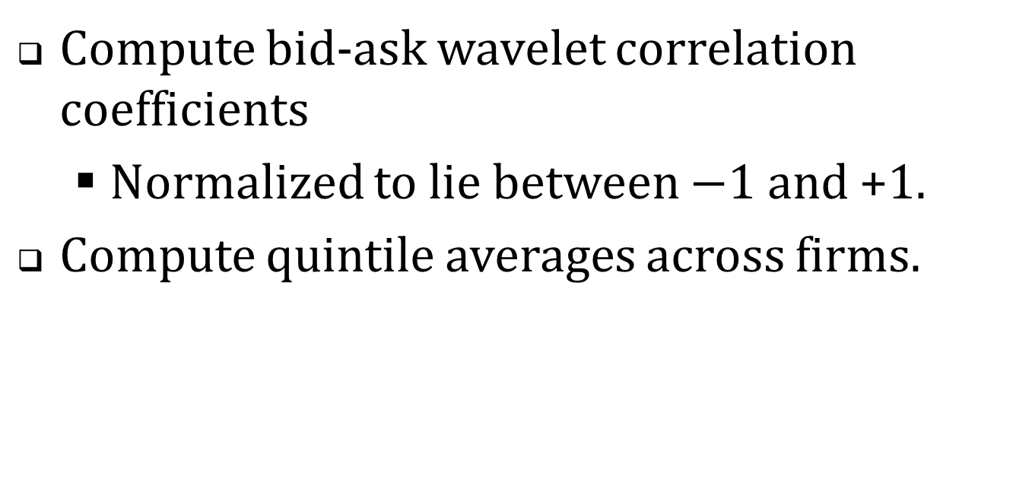
How closely do the bid and ask track at different time scales.
Compute bid-ask wavelet correlation coefficients
  Normalized to lie between $−1$ and +1.
Compute quintile averages across firms.

Slide 53
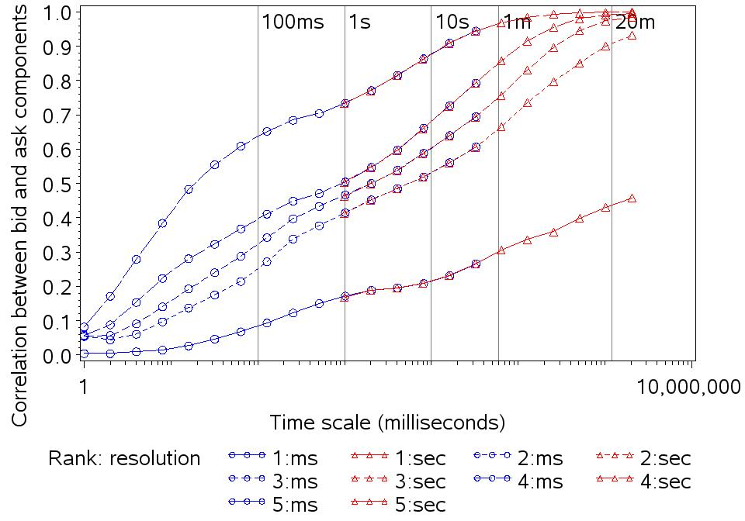

Slide 54
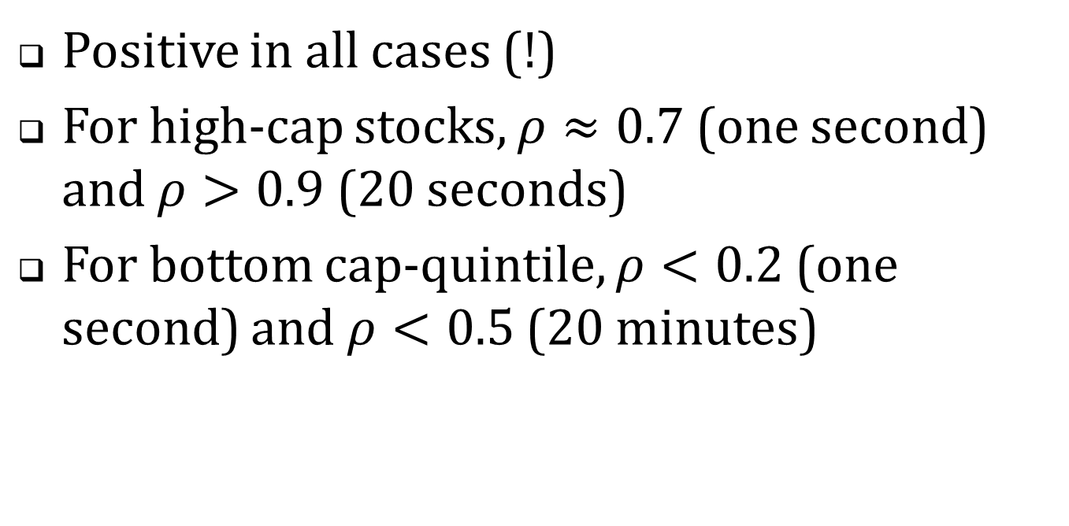
How closely do movements in the bid and ask track?
Positive in all cases (!)
For high-cap stocks, $ρ≈0.7$ (one second) and $ρ>0.9$ (20 seconds)
For bottom cap-quintile, $ρ<0.2$ (one second) and $ρ<0.5$ (20 minutes)

Slide 55
HFT and market efficiency
Brogaard, Hendershott and Riordan
NASDAQ assembled a subset of their Itch data where they marked trades that involved a high frequency trader.
  NASDAQ identified these traders by various criteria.
  2008-2009

Slide 56
BHR conclude:
Overall high frequency traders facilitate price efficiency by trading …
  in the direction of permanent price changes
  and in the opposite direction of transitory pricing errors on average days and the highest volatility days.
This is done through their marketable orders.

Slide 57
Isn’t market efficiency an unqualified benefit?
In the case of free public information, “yes”.
With costly private information, it depends:
  Who is bearing the cost and producing the information?
  How do they profit from the information?

Slide 58
Public information
Data relevant to the pricing of SPDR 500 index ETF is generated in …
  FX markets
  Bond markets
  Other equity markets
If we can more quickly observe, process and trade on the information in these markets, the SPDR will be more correctly priced.

Slide 59
Private information: the fundamental analyst
A mutual fund hires an analyst to generate fundamental information.
They trade on this information, profiting at the expense of uninformed/liquidity traders.
Their trading gains partially offset the cost of the information.

Slide 60
Interject another player …
A mutual fund hires an analyst to generate fundamental information.
They plan to trade on this information.
Trader J “anticipates” their orders and trades in advance of them.
  The fund’s trading profits are shared with J.
Is the mutual fund recouping the cost of the analyst?
  If “no,” less information will be produced.

Slide 62
Why does HFQ occur?
Why not? The costs are extremely low.
Testing?
Malfunction?
Interaction of simple algos?
Genuinely seeking liquidity (counterparty)?
Deliberately introducing noise?
Deliberately pushing the NBBO to obtain a favorable price in a dark trade?

Slide 63
Open and Ongoing Issues
Value of absolute and relative speed
Market makers
Monitoring
Manipulations

Slide 64
The value of absolute speed
A stock with volatility of 3% per day
  ≈ 47% per year
Suppose that the volatility is evenly distributed over 6.5 hours
  The volatility over 10ms ≈ 0.002% = 0.2 bp
Significance
  IndexArb.com: the threshold transaction cost bounds for S&P 500 index arbitrage
  ≈ ±1.3 index pts ≈ 1.3/1300 = 0.1% = 10 bp

Slide 65
Absolute speed more important if …
Traders successively accessing multiple market center.
  50 market centers x 10 ms/center = 0.5 sec.
Traders use successive orders each of which depends on results of the previous order.

Slide 66
The value of relative speed
A stock with volatility of 3% per day
  ≈ 47% per year
A single random announcement causes the stock to move ±3%
  Someone with a relative time advantage can take long or short position against others and earn 3%
  First mover in the case of fundamental information imposes adverse selection costs on the market and can lead to market failure.

Slide 67
First mover advantages
Pre-Reg NMS NYSE specialist had first option on SuperDot order flow.
Broker dealers can re-route orders to public market centers.
Flash orders

Slide 68
Are HF traders the new market makers?
Should they be subject to the same affirmative and negative obligations as market-makers in the old trading floors?
  Do their activities enhance the reputation of the market centers?
  How will they be compensated for assuming the market-making obligations?
How much liquidity are they really providing?

Slide 69
Monitoring
Who is monitoring the activities of HF traders?
  The first-line monitor is the individual market center … of which the HF trading firm might be a partial owner or major customer.
  Individual market centers can’t monitor cross-market activity.

Slide 70
Classic manipulation: one security, one market
Bear raids
Pump and dump
Short squeezes
Detection by …
  Statistical analysis
  Position reports, sequenced trade records, market participants known to each other.

Slide 71
New-wave manipulations: some possibilities
multiple securities, multiple markets
Security can be constructed by
  stripping an index
  via derivatives
Can non-directional trading in the underlying affect volatility in the derivatives?
Can message traffic be used strategically to alter system-wide latency?

