Slide 1
Sales and Trading
Joel Hasbrouck
Kenneth G. Langone Professor of Finance
Stern School of Business

Slide 2
What is it?
The basic products of bank/brokerage are securities
  Stocks, bonds, options, futures, foreign exchange.
The customers need to buy and sell securities
  To raise capital, invest long-term, or manage risk.
A sales and trading desk
  Educates customers about the securities and their uses
  Supplies the customers with market information
  Makes the trade happen.

Slide 3
People who succeed in sales and trading …
Know their products
  The securities available today, and new securities that might be created in the future.
Know their customers
  What do they want?
  How can we add value to their activities?
Know their markets
  How do these markets work?
  How do we execute our customers’ trades at the lowest possible cost?
Where might you learn these things in the Stern finance curriculum?

Slide 4
The Stern finance courses
Foundations of finance
Corporate finance
Mergers and acquisitions
Debt instruments
Equity valuation
Futures and options
Investment banking

Slide 5
Know the markets … How are securities actually traded?
Every trade has a buyer and seller …
  But what’s the procedure?
The price adjusts so that supply=demand …
  But how?
What if the price doesn’t adjust?
What will markets look like next year and beyond?
Notes:
You know that for every trade there’s a buyer and seller, but who makes the first call? how do they find each other? Is the marke

Slide 6
What did markets look like in the past?
The stock market used to have a well-defined physical presence, a trading floor
  The New York Stock Exchange
  The Tokyo Stock Exchange
  The London Futures Exchange
Nowadays the market is now a geographically dispersed network.
In which US state does the highest volume of stock trading occur?

Slide 7
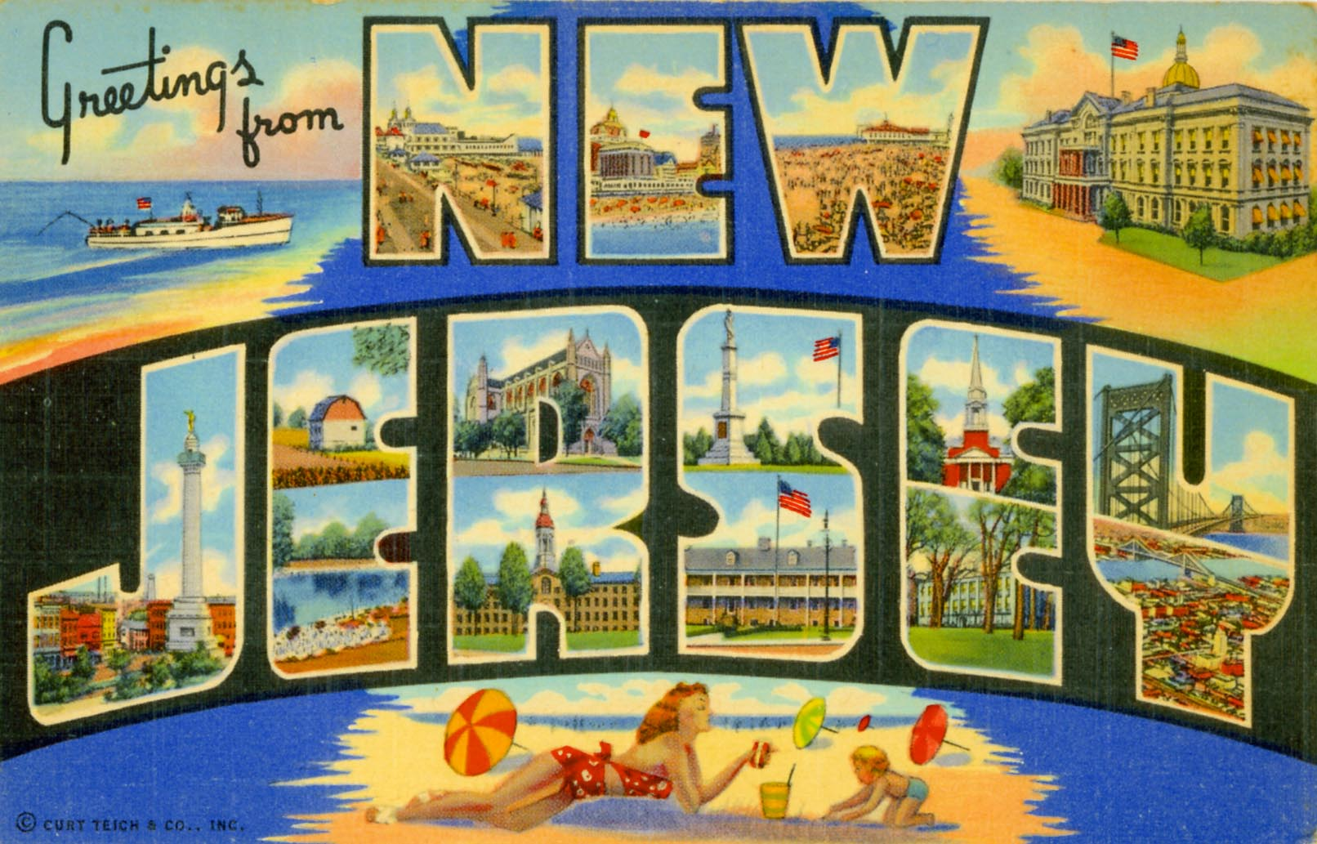
New York Stock Exchange trading occurs in Mahwah
NASDAQ: Carteret
BATS Y and Z: Weehawken
DirectEdge: Secaucus

Slide 8
If the market is “virtual” does physical presence matter?
  Market operations have moved out of Manhattan, but not far, far away.
Will everything be done by machine?
  People still need to conceptualize, design, and manage the big picture.
Does Stern have a course that covers this stuff?

Slide 9
Interface: university and industry
NYU Faculty maintain industry and government contacts at all levels in many countries.
NYU students are immersed in a city and culture of business and finance.
New York is home to many world-class financial firms.
Credit Suisse stands out among them.
Notes:
From top to

