Slide 1
High Frequency Quoting:
Short-Term Volatility in Bids and Offers
Joel Hasbrouck
Stern School, NYU

Slide 2
Disclaimers
I teach in an entry-level training program at a large financial firm that is generally thought to engage in high frequency trading.
I serve on a CFTC advisory committee that discusses issues related to high frequency trading.

Slide 3
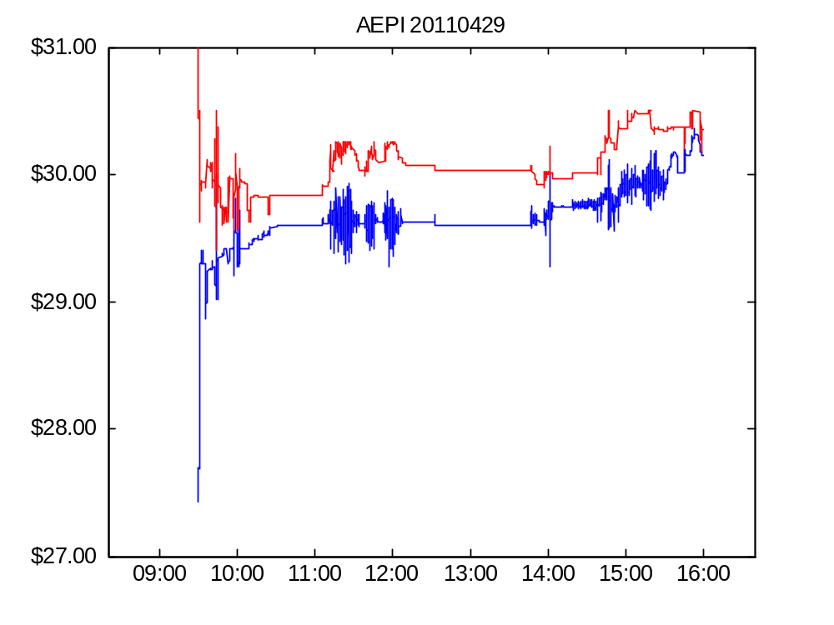
Figure 1. AEPI bid and offer, April 29, 2011

Slide 4
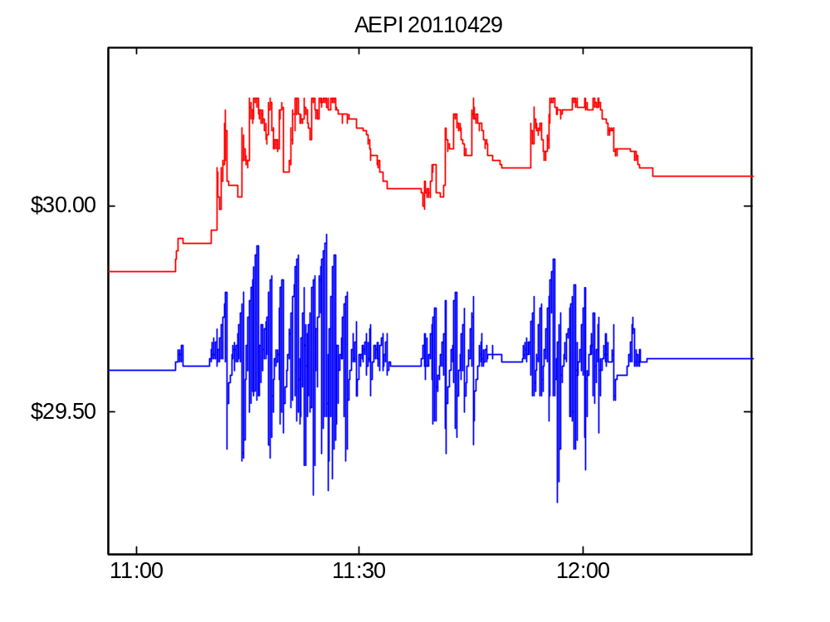
Figure 1. AEPI bid and offer on April 29, 2011 (detail)

Slide 5
More pictures from the
National (High Frequency)
Portrait Gallery

Slide 6
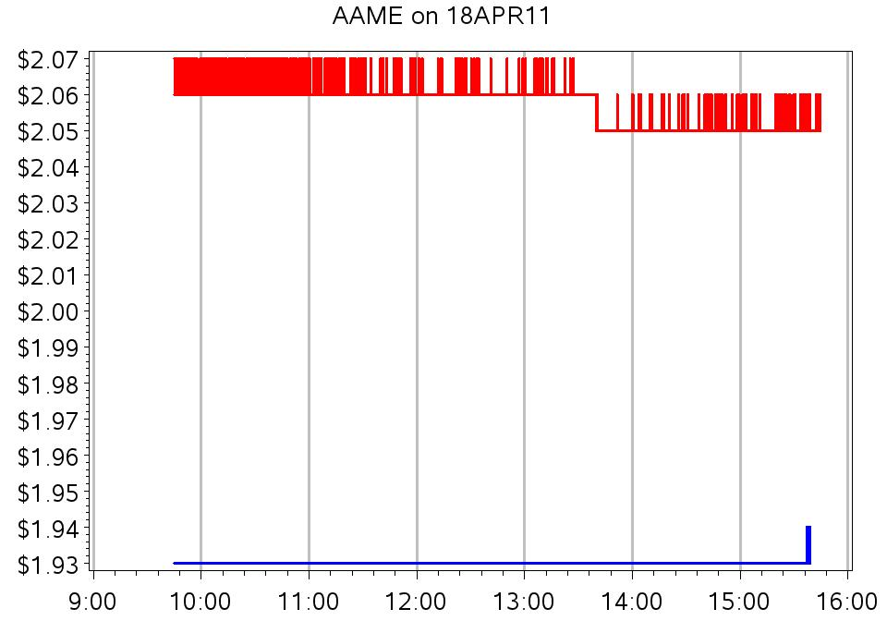

Slide 7
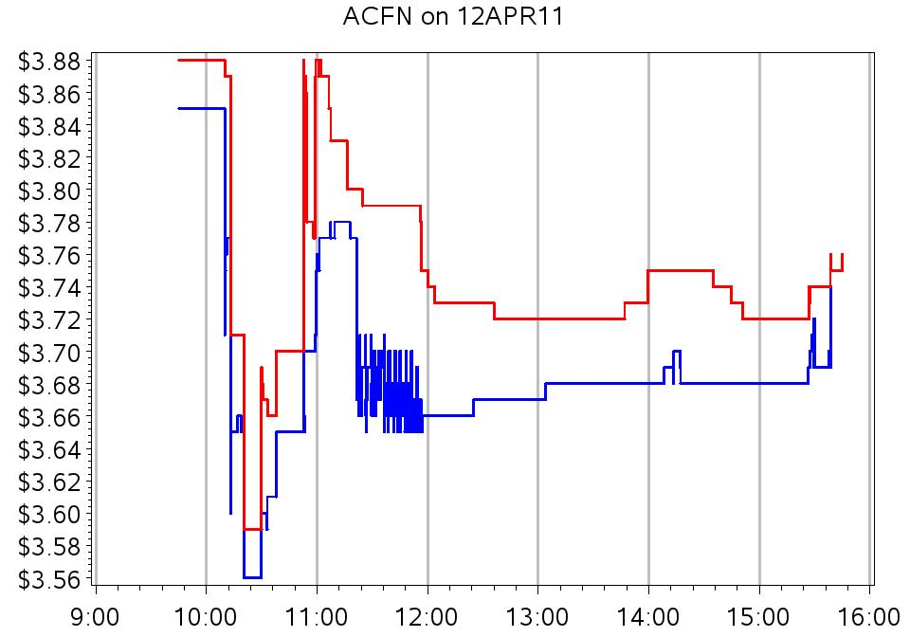

Slide 8
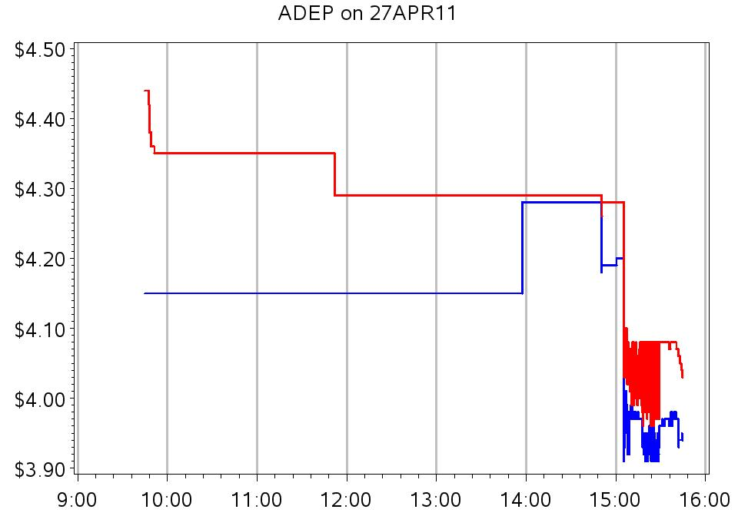

Slide 9
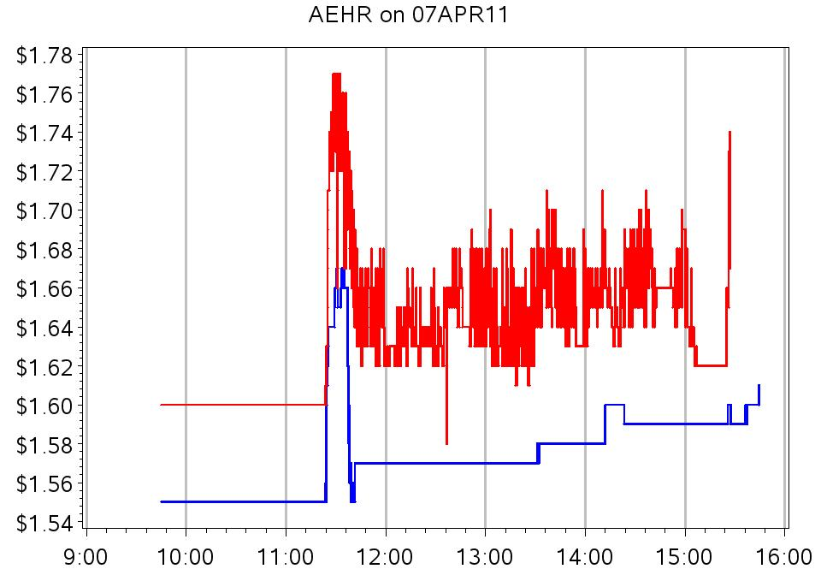

Slide 10
Quote volatility: the questions
What is its economic meaning and importance?
How should we measure it?
Is it elevated? Relative to what?
Has it increased over the recent past along with the utilization of advanced trading technology?

Slide 11
Context and connections
Analyses of high frequency trading
Volatility modeling
Methodology: time scale resolution and variance estimation

Slide 12
“HF traders are the new market makers.”
Provide valuable intermediation services.
  Like traditional designated dealers and specialists.
Hendershott, Jones and Menkveld (2011): NYSE message traffic
Hasbrouck and Saar (2012): strategic runs / order chains
Brogaard, Hendershott and Riordan (2012) use Nasdaq HFT dataset in which trades used to define a set of high frequency traders.
Studies generally find that HFT activity is associated with (causes?) higher market quality.

Slide 13
“HF traders are predatory.”
They profit from HF information asymmetries at the expense of natural liquidity seekers (hedgers, producers of fundamental information).
Jarrow and Protter (2011); Foucault and Rosu (2012)
Baron, Brogaard and Kirilenko (2012); Weller (2012); Clark-Joseph (2012)

Slide 14
Volatility Modeling
ARCH, GARCH, and similar models focus on fundamental/informational volatility.
  Statistically: volatility in the unit-root component of prices.
  Economically important for portfolio allocation, derivatives valuation and hedging.
Quote volatility is non-informational
  Statistically: short-term, stationary, transient volatility
  Economically important for trading and market making.

Slide 15
Realized volatility
Volatility estimates formed from HF data.
  average (absolute/squared) price changes.
  Andersen, Bollerslev, Diebold and Ebens (2001), and others
Hansen and Lunde (2006) advocate using local averaging (“pre-averaging”) to eliminate microstructure noise.
Quote volatility is the microstructure noise.

Slide 16
Economics of quote volatility
Noise degrades the value of any signal.
Creates execution price risk for
  marketable orders
  dark trades
Creates and increases value of intermediaries’ look-back options

Slide 17
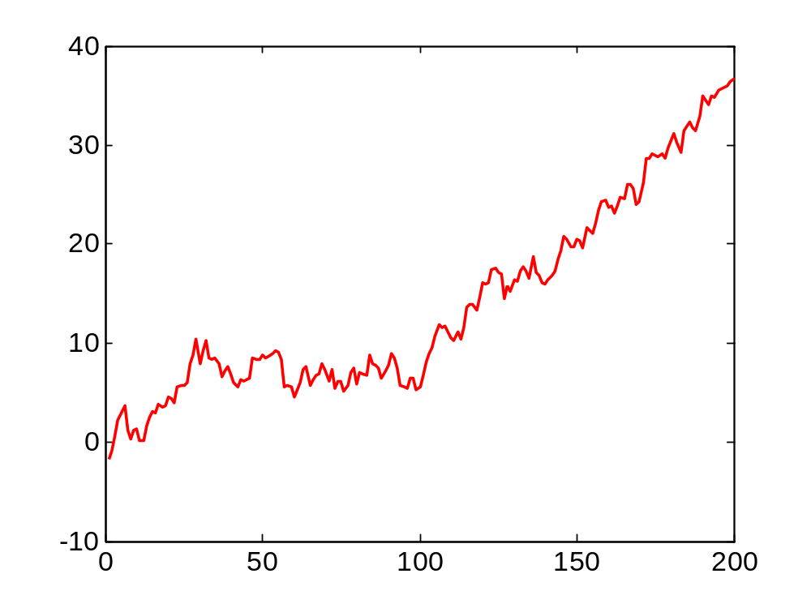
Execution price risk for marketable orders
Offer (ask) quote

Slide 18
A buyer who has arrival time uncertainty can expect to pay the average offer over the arrival period (and has price risk relative to this average).

Slide 19
Dark trading
“Dark” the market executing the order did not previously post a visible bid or offer at the execution price.
  The trade itself is promptly reported.
Dark mechanisms
  Hidden (undisplayed) limit orders
  Internalized executions
  Dark pools

Slide 20
Dark trades: internalized execution
A broker receives a retail buy order.
  The order is not sent to an exchange or any other venue.
  The broker sells directly to the customer at the National Best Offer (NBO)
Volatility in the NBO → volatility in execution price.

Slide 21
Dark trades: dark pools
Mechanism
  Traders send buy and sell orders to a computer.
  The orders are not displayed.
  If the computer finds a feasible match, a trade occurs.
The trade is priced at the midpoint of the National Best Bid and Offer (NBBO)
Volatility in the NBBO causes volatility in the execution price.

Slide 22
Look-back options
Internalization: a broker receives a retail buy order and executes the order at the NBO.
Problem: how does the customer know what the NBO is or was?
Might the dealer take the highest price in the interval of indeterminacy?
  Stoll and Schenzler (2002)

Slide 23
“Spoofing” manipulations
A dark pool buyer enter a spurious sell order in a visible market.
The sell order drives down the NBBO midpoint.
The buyer pays a lower price in the dark pool.

Slide 24
Analyzing quote volatility
Usual approach
  parametric model for variance of price changes (ARCH, GARCH, …)
This study
  Non-parametric analysis of variances of price levels

Slide 25
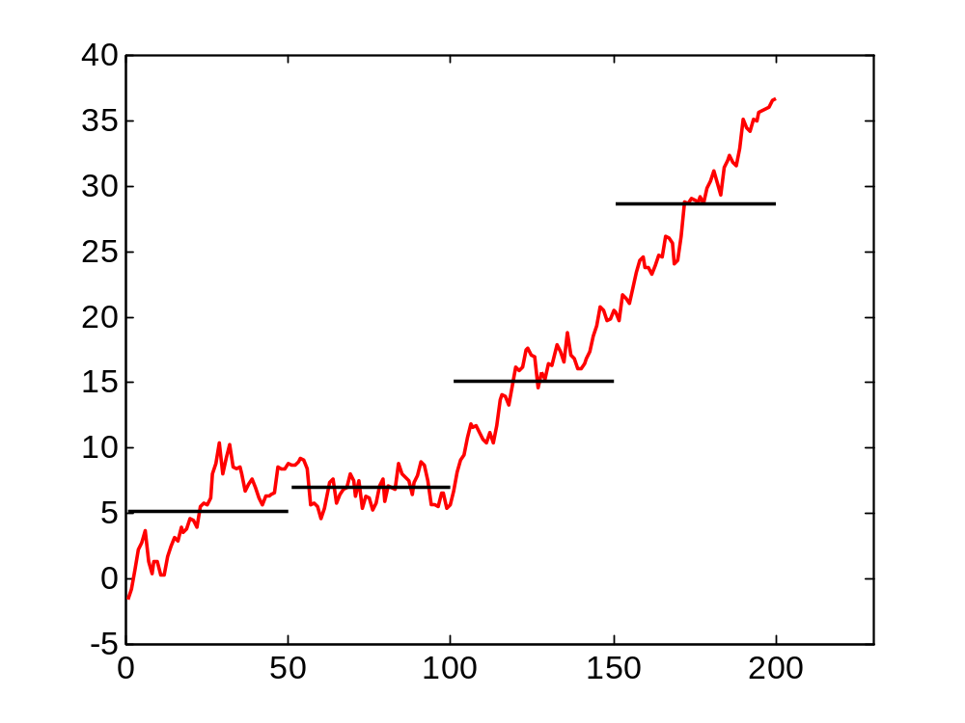
Variance about a local mean of a random walk

Slide 26
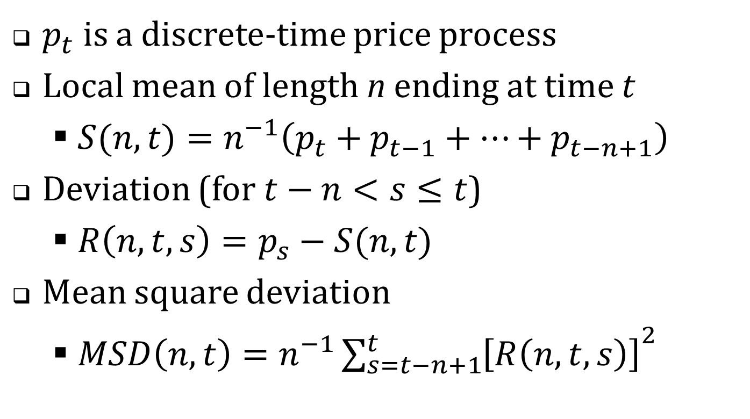
Computational definitions
$p_{t}$ is a discrete-time price process
Local mean of length n ending at time t
  $S(n,t)=n^{−1}\left(p_{t}+p_{t−1}+…+p_{t−n+1}\right)$
Deviation (for $t−n<s≤t$)
  $R\left(n,t,s\right)=p_{s}−S(n,t)$
Mean square deviation
  $MSD\left(n,t\right)={n^{−1}\sum_{s=t−n+1}^{t}{\left[R\left(n,t,s\right)\right]}}^{2}$

Slide 27
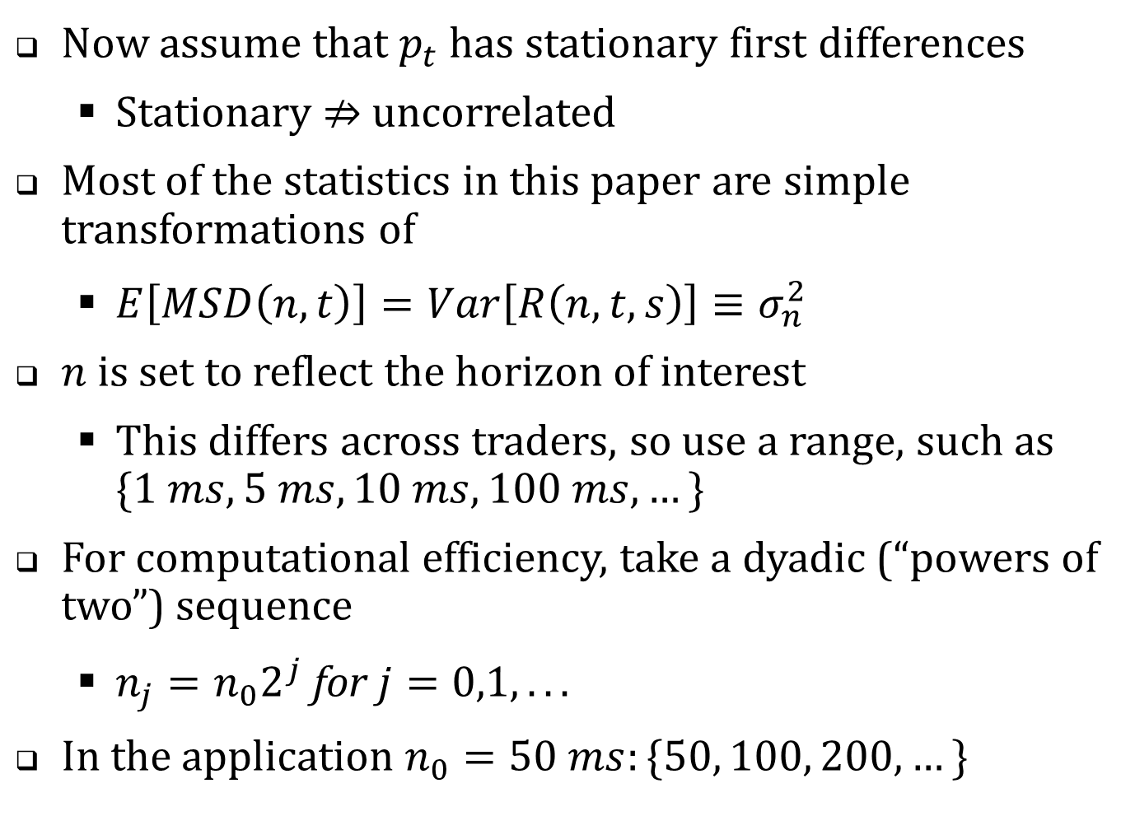
Now assume that $p_{t}$ has stationary first differences
  Stationary $⇏$ uncorrelated
Most of the statistics in this paper are simple transformations of
  $E\left[MSD\left(n,t\right)\right]=Var\left[R\left(n,t,s\right)\right]≡σ_{n}^{2}$
$n$ is set to reflect the horizon of interest
  This differs across traders, so use a range, such as $\{1 ms, 5 ms, 10 ms, 100 ms, …\}$
For computational efficiency, take a dyadic (“powers of two”) sequence
  $n_{j}=n_{0}2^{j} \text{for} j=0,1,...$
In the application $n_{0}=50 ms:\{50, 100, 200, …\}$

Slide 28
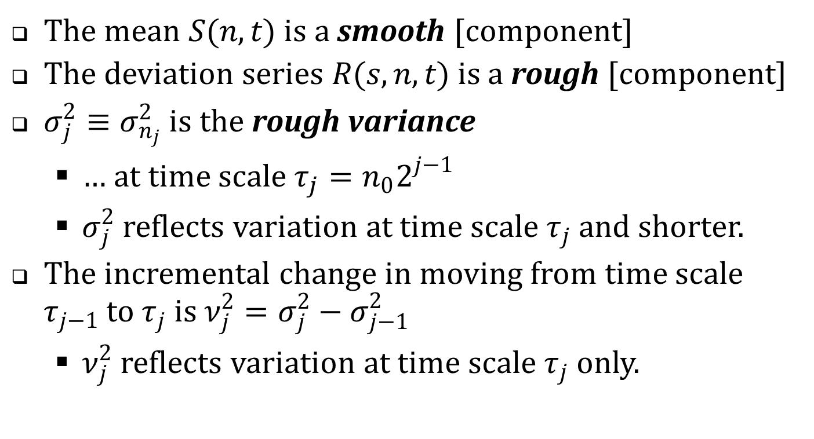
Signal processing and time scale decompositions
The mean $S(n,t)$ is a smooth [component]
The deviation series $R(s,n,t)$ is a rough [component]
$σ_{j}^{2}≡σ_{n_{j}}^{2}$ is the rough variance
  … at time scale $τ_{j}=n_{0}2^{j−1}$
  $σ_{j}^{2}$ reflects variation at time scale $τ_{j}$ and shorter.
The incremental change in moving from time scale $τ_{j−1}$ to $τ_{j}$ is $ν_{j}^{2}=σ_{j}^{2}−σ_{j−1}^{2}$
  $ν_{j}^{2}$ reflects variation at time scale $τ_{j}$ only.

Slide 29
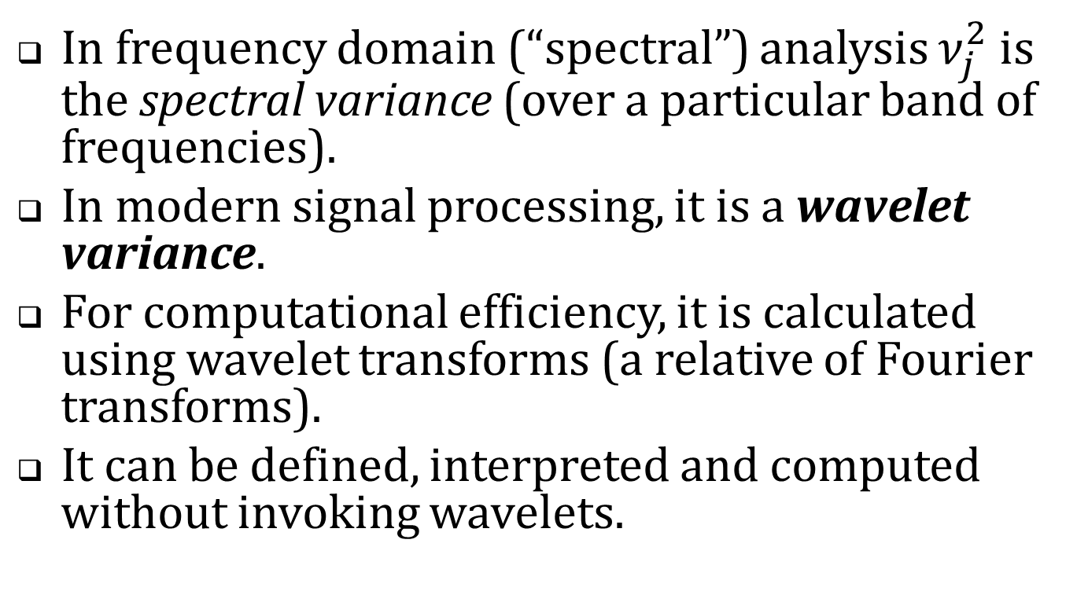
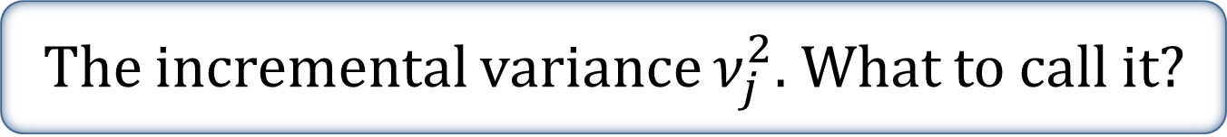
The incremental variance $ν_{j}^{2}$. What to call it?
In frequency domain (“spectral”) analysis $ν_{j}^{2}$ is the spectral variance (over a particular band of frequencies).
In modern signal processing, it is a wavelet variance.
For computational efficiency, it is calculated using wavelet transforms (a relative of Fourier transforms).
It can be defined, interpreted and computed without invoking wavelets.

Slide 30
Interpretation
To assess economic importance, I present the (wavelet and rough) variance estimates in three ways.
  In mils per share
  In basis points
  As a short-term/long-term ratio

Slide 31
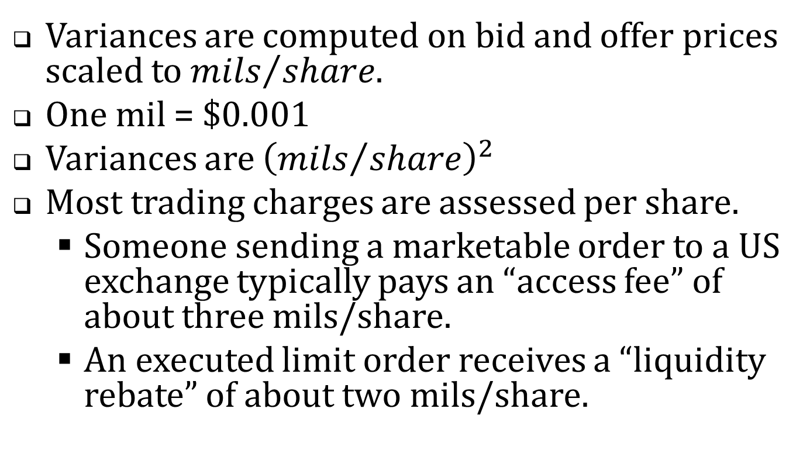
Mils per share
Variances are computed on bid and offer prices scaled to ${mils}/{share}$.
One mil = $0.001
Variances are ${\left({mils}/{share}\right)}^{2}$
Most trading charges are assessed per share.
  Someone sending a marketable order to a US exchange typically pays an “access fee” of about three mils/share.
  An executed limit order receives a “liquidity rebate” of about two mils/share.

Slide 32
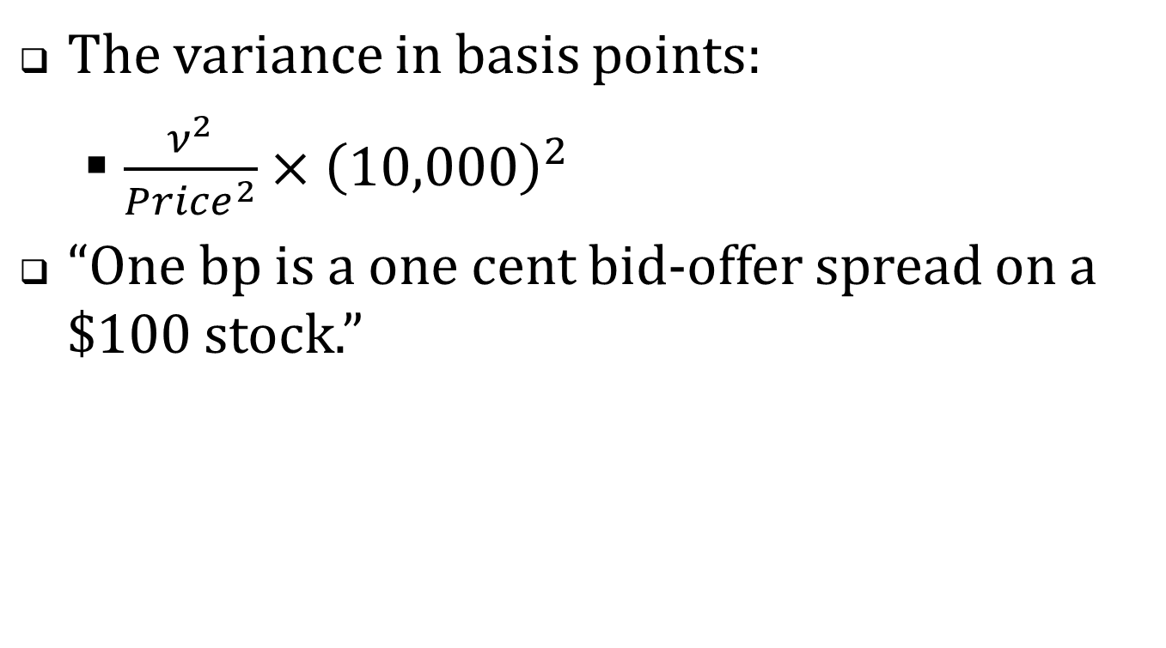
Basis points
The variance in basis points:
  $\frac{ν^{2}}{Price^{2}}×{\left(10,000\right)}^{2}$
“One bp is a one cent bid-offer spread on a $100 stock.”

Slide 33
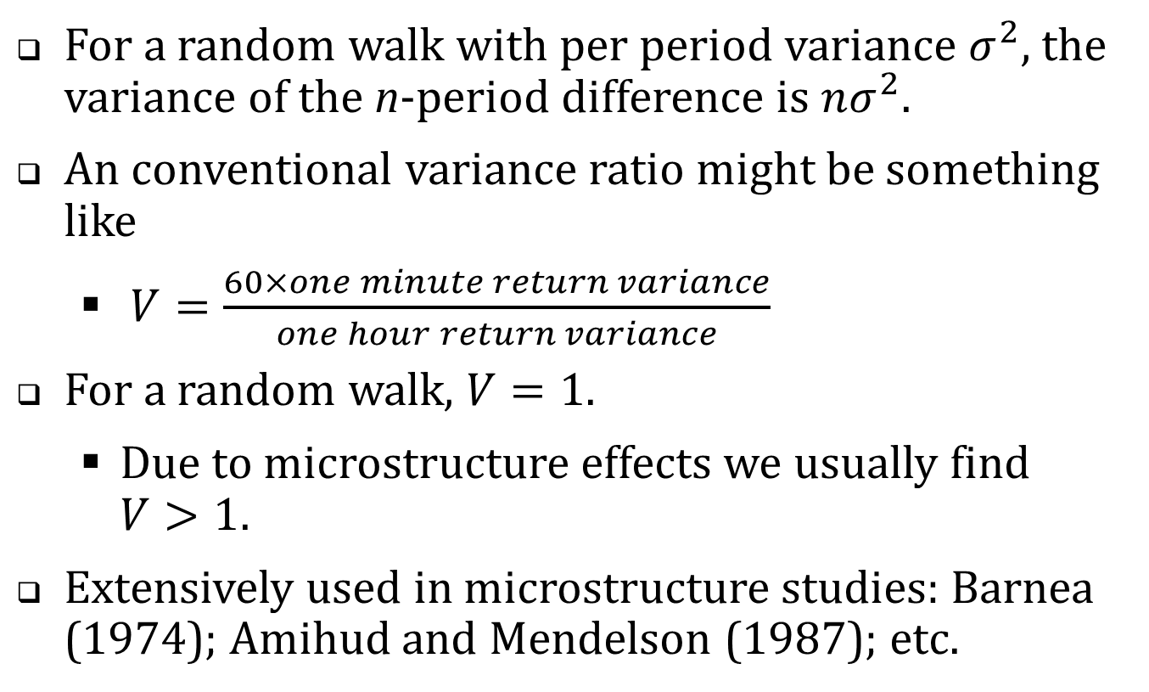
The short/long variance ratio
For a random walk with per period variance $σ^{2}$, the variance of the n-period difference is $nσ^{2}$.
An conventional variance ratio might be something like
  $V=\frac{60×one minute return variance}{one hour return variance}$
For a random walk, $V=1$.
  Due to microstructure effects we usually find $V>1$.
Extensively used in microstructure studies: Barnea (1974); Amihud and Mendelson (1987); etc.

Slide 34
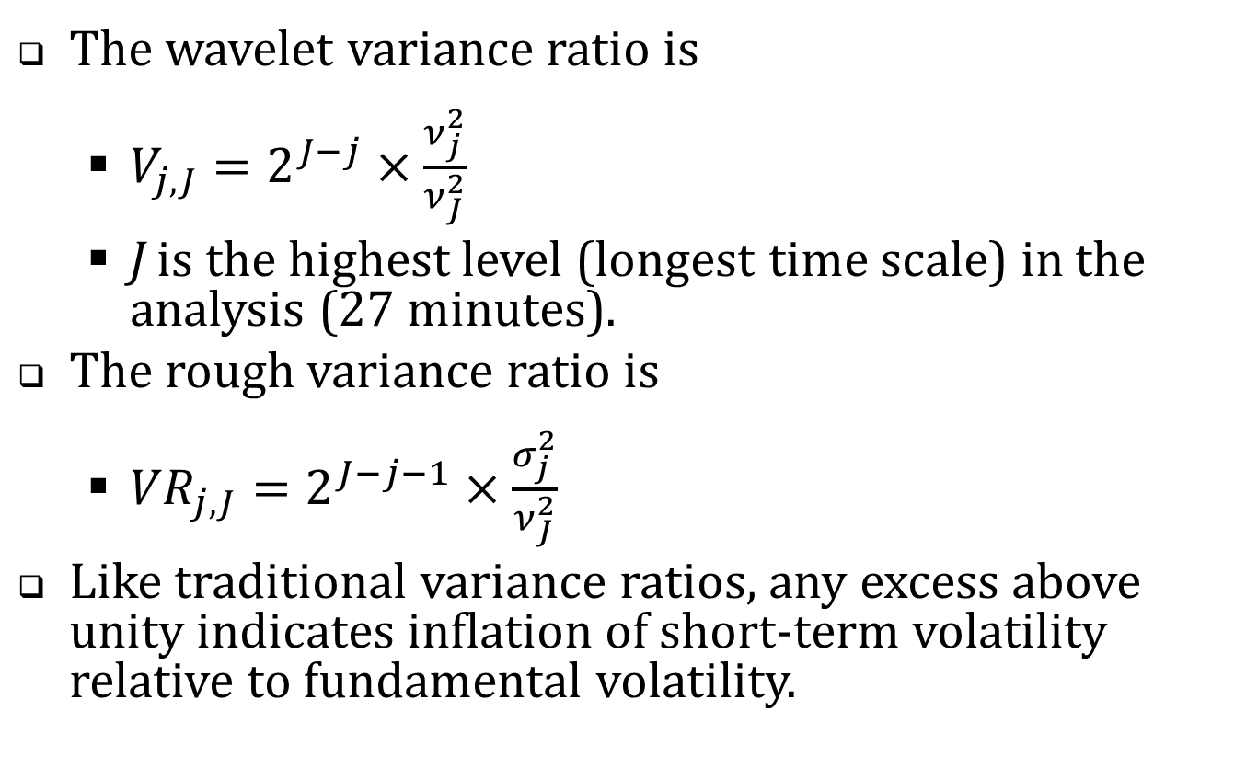
Variance ratios (cont’d)
The wavelet variance ratio is
  $V_{j,J}=2^{J−j}×\frac{ν_{j}^{2}}{ν_{J}^{2}}$
  J is the highest level (longest time scale) in the analysis (27 minutes).
The rough variance ratio is
  ${VR}_{j,J}=2^{J−j−1}×\frac{σ_{j}^{2}}{ν_{J}^{2}}$
Like traditional variance ratios, any excess above unity indicates inflation of short-term volatility relative to fundamental volatility.

Slide 35
The empirical analysis
CRSP Universe 2001-2011. (Share code = 10 or 11; average price $2 to $1,000; listing NYSE, Amex or NASDAQ)
In each year, chose 150 firms in a random sample stratified by dollar trading volume
2011 April TAQ with one-millisecond time stamps
2001-2011
April TAQ data with one-second time stamps
High-resolution analysis
Lower-resolution analysis

Slide 36
Table 1. Summary Statistics, 2011
 |  | Dollar trading volume quintile
 | Full sample | 1 (low) | 2 | 3 | 4 | 5 (high)
No. of firms | 150 | 30 | 30 | 30 | 30 | 30
NYSE | 47 | 0 | 5 | 7 | 16 | 19
Amex | 6 | 2 | 2 | 0 | 1 | 1
NASDAQ | 97 | 28 | 23 | 23 | 13 | 10
Avg. daily trades | 1,331 | 31 | 431 | 1,126 | 3,478 | 16,987
Avg. daily quotes | 23,928 | 967 | 7,706 | 24,026 | 53,080 | 181,457
Avg. daily NBBO records | 7,138 | 328 | 3,029 | 7,543 | 16,026 | 46,050
Avg. daily NBB changes | 1,245 | 120 | 511 | 1,351 | 2,415 | 4,124
Avg. daily NBO changes | 1,164 | 103 | 460 | 1,361 | 2,421 | 4,214
Avg. price | $15.62 | $4.87 | $5.46 | $17.86 | $27.76 | $51.60
Market capitalization of equity, $ Million | $683 | $41 | $202 | $747 | $1,502 | $8,739

Slide 37
Table 2. Time scale variance estimates, 2011
Variance estimates (across)
Time scale (down, shortest to longest)

Slide 38
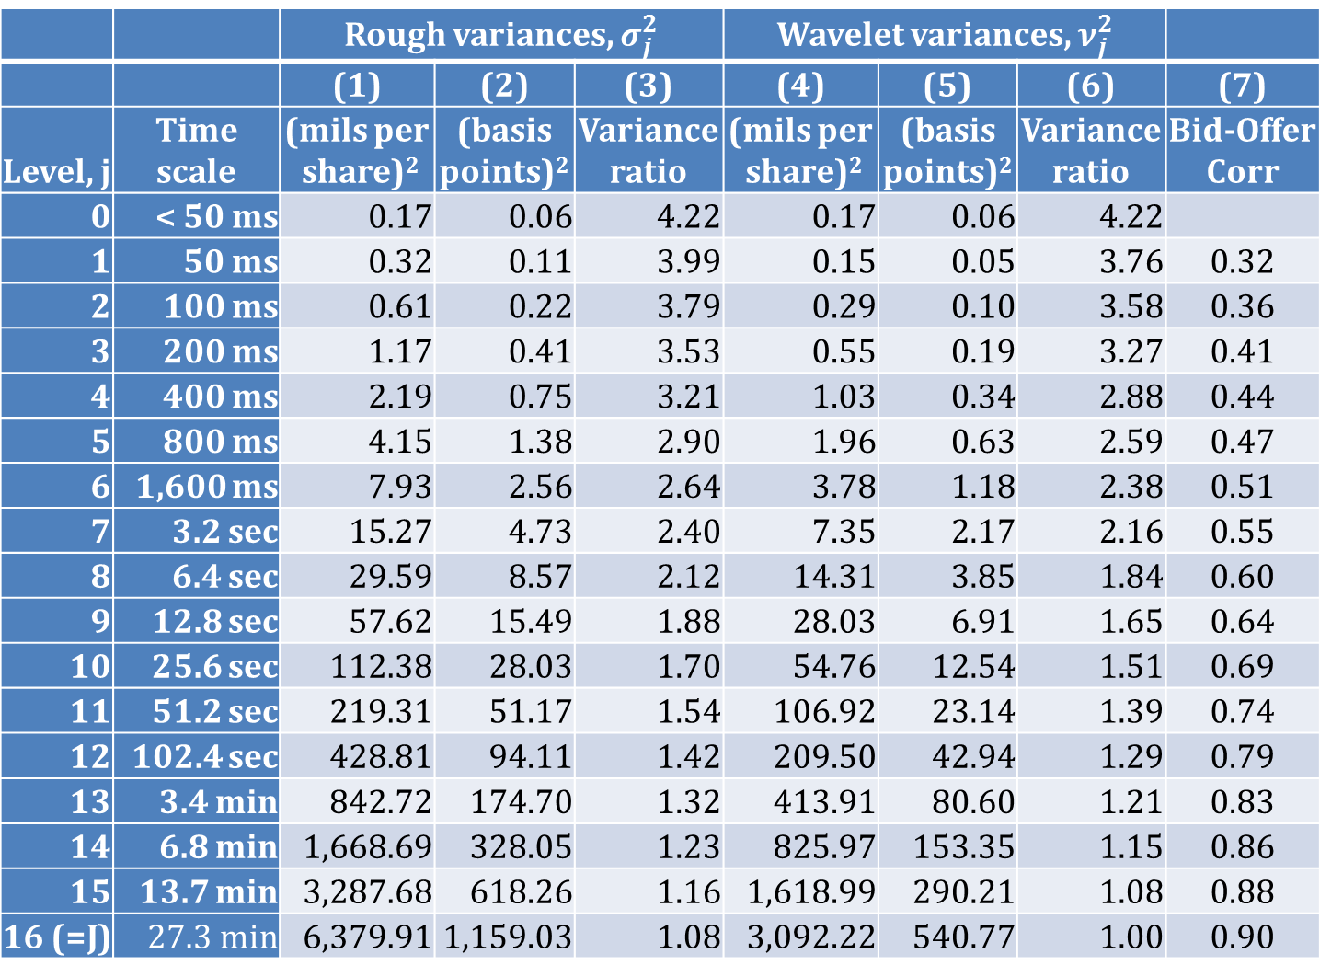
 |  | Rough variances, $σ_{j}^{2}$ |  |  | Wavelet variances, $ν_{j}^{2}$
 |  | (1) | (2) | (3) | (4) | (5) | (6) | (7)
Level, j | Time scale | (mils per share)² | (basis points)² | Variance ratio | (mils per share)² | (basis points)² | Variance ratio | Bid-Offer Corr
0 | < 50 ms | 0.17 | 0.06 | 4.22 | 0.17 | 0.06 | 4.22
1 | 50 ms | 0.32 | 0.11 | 3.99 | 0.15 | 0.05 | 3.76 | 0.32
2 | 100 ms | 0.61 | 0.22 | 3.79 | 0.29 | 0.10 | 3.58 | 0.36
3 | 200 ms | 1.17 | 0.41 | 3.53 | 0.55 | 0.19 | 3.27 | 0.41
4 | 400 ms | 2.19 | 0.75 | 3.21 | 1.03 | 0.34 | 2.88 | 0.44
5 | 800 ms | 4.15 | 1.38 | 2.90 | 1.96 | 0.63 | 2.59 | 0.47
6 | 1,600 ms | 7.93 | 2.56 | 2.64 | 3.78 | 1.18 | 2.38 | 0.51
7 | 3.2 sec | 15.27 | 4.73 | 2.40 | 7.35 | 2.17 | 2.16 | 0.55
8 | 6.4 sec | 29.59 | 8.57 | 2.12 | 14.31 | 3.85 | 1.84 | 0.60
9 | 12.8 sec | 57.62 | 15.49 | 1.88 | 28.03 | 6.91 | 1.65 | 0.64
10 | 25.6 sec | 112.38 | 28.03 | 1.70 | 54.76 | 12.54 | 1.51 | 0.69
11 | 51.2 sec | 219.31 | 51.17 | 1.54 | 106.92 | 23.14 | 1.39 | 0.74
12 | 102.4 sec | 428.81 | 94.11 | 1.42 | 209.50 | 42.94 | 1.29 | 0.79
13 | 3.4 min | 842.72 | 174.70 | 1.32 | 413.91 | 80.60 | 1.21 | 0.83
14 | 6.8 min | 1,668.69 | 328.05 | 1.23 | 825.97 | 153.35 | 1.15 | 0.86
15 | 13.7 min | 3,287.68 | 618.26 | 1.16 | 1,618.99 | 290.21 | 1.08 | 0.88
16 (=J) | 27.3 min | 6,379.91 | 1,159.03 | 1.08 | 3,092.22 | 540.77 | 1.00 | 0.90

Slide 39
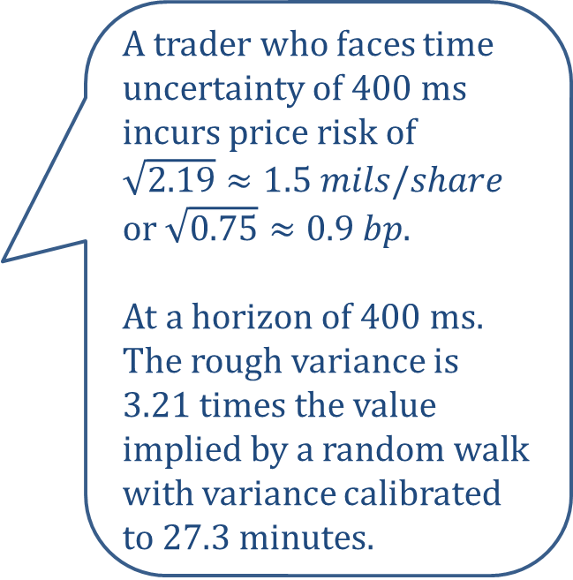
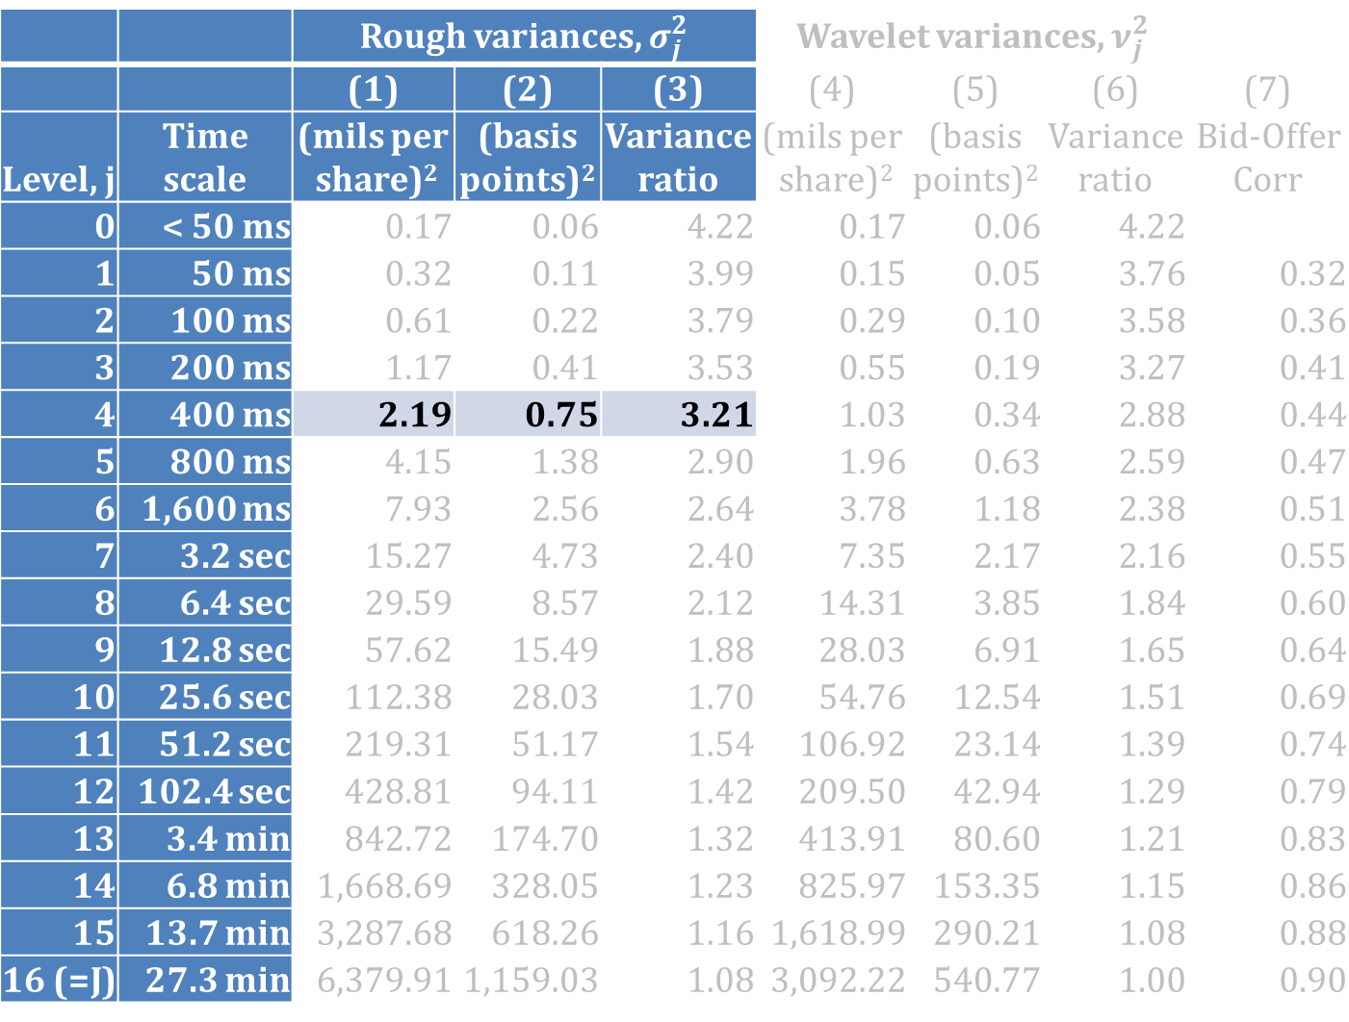
 |  | Rough variances, $σ_{j}^{2}$ |  |  | Wavelet variances, $ν_{j}^{2}$
 |  | (1) | (2) | (3) | (4) | (5) | (6) | (7)
Level, j | Time scale | (mils per share)² | (basis points)² | Variance ratio | (mils per share)² | (basis points)² | Variance ratio | Bid-Offer Corr
0 | < 50 ms | 0.17 | 0.06 | 4.22 | 0.17 | 0.06 | 4.22
1 | 50 ms | 0.32 | 0.11 | 3.99 | 0.15 | 0.05 | 3.76 | 0.32
2 | 100 ms | 0.61 | 0.22 | 3.79 | 0.29 | 0.10 | 3.58 | 0.36
3 | 200 ms | 1.17 | 0.41 | 3.53 | 0.55 | 0.19 | 3.27 | 0.41
4 | 400 ms | 2.19 | 0.75 | 3.21 | 1.03 | 0.34 | 2.88 | 0.44
5 | 800 ms | 4.15 | 1.38 | 2.90 | 1.96 | 0.63 | 2.59 | 0.47
6 | 1,600 ms | 7.93 | 2.56 | 2.64 | 3.78 | 1.18 | 2.38 | 0.51
7 | 3.2 sec | 15.27 | 4.73 | 2.40 | 7.35 | 2.17 | 2.16 | 0.55
8 | 6.4 sec | 29.59 | 8.57 | 2.12 | 14.31 | 3.85 | 1.84 | 0.60
9 | 12.8 sec | 57.62 | 15.49 | 1.88 | 28.03 | 6.91 | 1.65 | 0.64
10 | 25.6 sec | 112.38 | 28.03 | 1.70 | 54.76 | 12.54 | 1.51 | 0.69
11 | 51.2 sec | 219.31 | 51.17 | 1.54 | 106.92 | 23.14 | 1.39 | 0.74
12 | 102.4 sec | 428.81 | 94.11 | 1.42 | 209.50 | 42.94 | 1.29 | 0.79
13 | 3.4 min | 842.72 | 174.70 | 1.32 | 413.91 | 80.60 | 1.21 | 0.83
14 | 6.8 min | 1,668.69 | 328.05 | 1.23 | 825.97 | 153.35 | 1.15 | 0.86
15 | 13.7 min | 3,287.68 | 618.26 | 1.16 | 1,618.99 | 290.21 | 1.08 | 0.88
16 (=J) | 27.3 min | 6,379.91 | 1,159.03 | 1.08 | 3,092.22 | 540.77 | 1.00 | 0.90
A trader who faces time uncertainty of 400 ms incurs price risk of $\sqrt{2.19}≈1.5 mils/share$ or $\sqrt{0.75}≈0.9 bp$.
At a horizon of 400 ms. The rough variance is 3.21 times the value implied by a random walk with variance calibrated to 27.3 minutes.

Slide 40
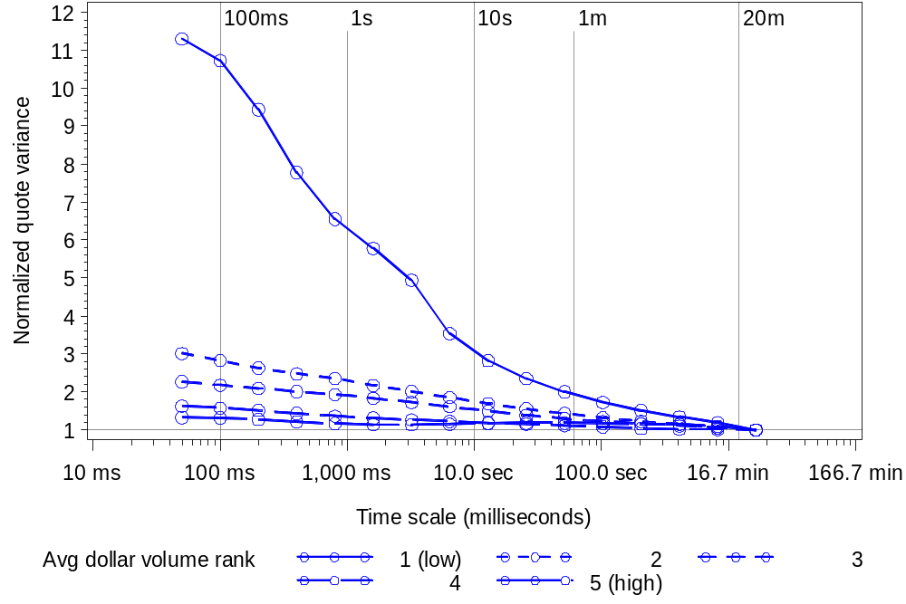
Figure 2. Wavelet variance ratios across time scale and dollar volume quintiles

Slide 41
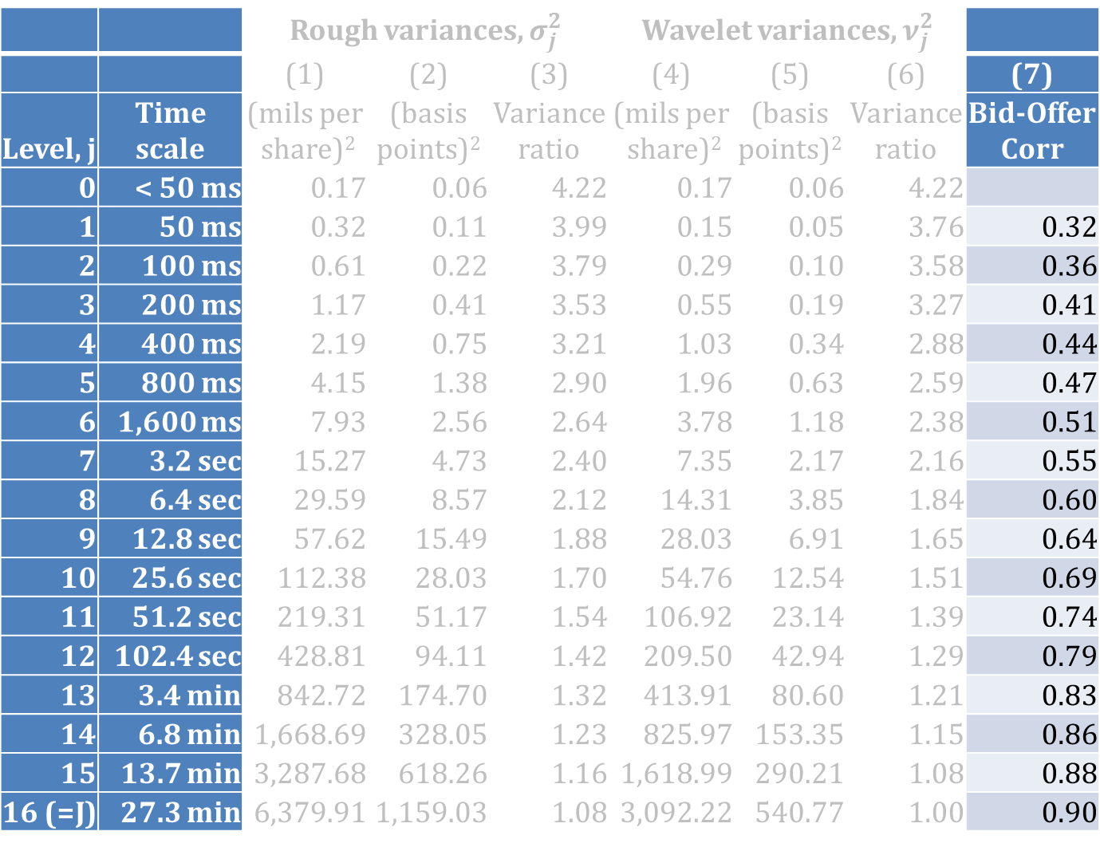
 |  | Rough variances, $σ_{j}^{2}$ |  |  | Wavelet variances, $ν_{j}^{2}$
 |  | (1) | (2) | (3) | (4) | (5) | (6) | (7)
Level, j | Time scale | (mils per share)² | (basis points)² | Variance ratio | (mils per share)² | (basis points)² | Variance ratio | Bid-Offer Corr
0 | < 50 ms | 0.17 | 0.06 | 4.22 | 0.17 | 0.06 | 4.22
1 | 50 ms | 0.32 | 0.11 | 3.99 | 0.15 | 0.05 | 3.76 | 0.32
2 | 100 ms | 0.61 | 0.22 | 3.79 | 0.29 | 0.10 | 3.58 | 0.36
3 | 200 ms | 1.17 | 0.41 | 3.53 | 0.55 | 0.19 | 3.27 | 0.41
4 | 400 ms | 2.19 | 0.75 | 3.21 | 1.03 | 0.34 | 2.88 | 0.44
5 | 800 ms | 4.15 | 1.38 | 2.90 | 1.96 | 0.63 | 2.59 | 0.47
6 | 1,600 ms | 7.93 | 2.56 | 2.64 | 3.78 | 1.18 | 2.38 | 0.51
7 | 3.2 sec | 15.27 | 4.73 | 2.40 | 7.35 | 2.17 | 2.16 | 0.55
8 | 6.4 sec | 29.59 | 8.57 | 2.12 | 14.31 | 3.85 | 1.84 | 0.60
9 | 12.8 sec | 57.62 | 15.49 | 1.88 | 28.03 | 6.91 | 1.65 | 0.64
10 | 25.6 sec | 112.38 | 28.03 | 1.70 | 54.76 | 12.54 | 1.51 | 0.69
11 | 51.2 sec | 219.31 | 51.17 | 1.54 | 106.92 | 23.14 | 1.39 | 0.74
12 | 102.4 sec | 428.81 | 94.11 | 1.42 | 209.50 | 42.94 | 1.29 | 0.79
13 | 3.4 min | 842.72 | 174.70 | 1.32 | 413.91 | 80.60 | 1.21 | 0.83
14 | 6.8 min | 1,668.69 | 328.05 | 1.23 | 825.97 | 153.35 | 1.15 | 0.86
15 | 13.7 min | 3,287.68 | 618.26 | 1.16 | 1,618.99 | 290.21 | 1.08 | 0.88
16 (=J) | 27.3 min | 6,379.91 | 1,159.03 | 1.08 | 3,092.22 | 540.77 | 1.00 | 0.90
How closely do the bid and offer track at the indicated time scale?

Slide 42
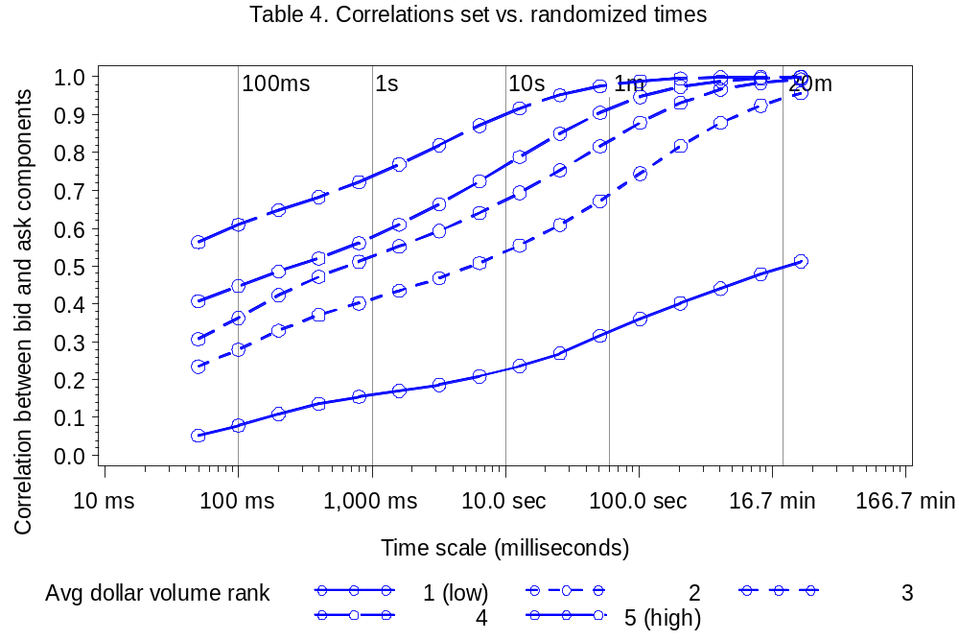
Figure 3. Wavelet correlations between the National Best Bid and National Best Offer

Slide 43
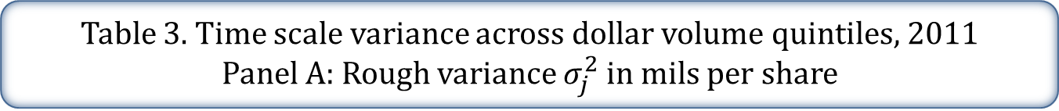
Table 3. Time scale variance across dollar volume quintiles, 2011
Panel A: Rough variance $σ_{j}^{2}$ in mils per share
 |  |  | Dollar trading volume quintiles
Level, j | Time scale | Full sample | 1 (low) | 2 | 3 | 4 | 5 (high)
0 | < 50 ms | 0.17 | 0.13 | 0.10 | 0.14 | 0.22 | 0.25
 |  | (0.01) | (0.07) | (0.02) | (0.01) | (0.01) | (0.01)
1 | 50 ms | 0.15 | 0.12 | 0.09 | 0.12 | 0.20 | 0.23
 |  | (0.01) | (0.07) | (0.01) | (0.01) | (0.01) | (0.01)
3 | 200 ms | 0.55 | 0.38 | 0.29 | 0.43 | 0.75 | 0.89
 |  | (0.04) | (0.22) | (0.03) | (0.02) | (0.04) | (0.05)
5 | 800 ms | 1.96 | 1.03 | 1.00 | 1.53 | 2.79 | 3.35
 |  | (0.09) | (0.40) | (0.09) | (0.07) | (0.14) | (0.20) 13.42
7 | 3.2 sec | 7.35 | 3.33 | 3.45 | 5.41 | 10.73
 |  | (0.28) | (0.93) | (0.30) | (0.23) | (0.57) | (0.84)
10 | 25.6 sec | 54.76 | 15.25 | 20.99 | 34.87 | 81.37 | 117.44
 |  | (2.09) | (2.41) | (1.84) | (1.50) | (4.50) | (8.22)
14 | 6.8 min | 825.97 | 173.25 | 242.94 | 445.93 | 1,273.22 | 1,930.34
 |  | (42.96) | (28.14) | (21.87) | (21.43) | 104.07) | 173.36)
16 | 27.3 min | 3,092.22 | 533.78 | 798.24 | 1,665.48 | 5,425.58 | 6,786.46
 |  | (188.75) | (87.40) | (73.69) | (82.94) | (634.46) | (639.18)

Slide 44
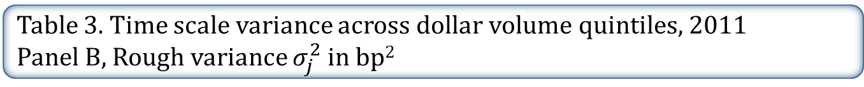
Table 3. Time scale variance across dollar volume quintiles, 2011
Panel B, Rough variance $σ_{j}^{2}$ in bp²
 |  |  | Dollar trading volume quintiles
Level, j | Time scale | Full sample | 1 (low) | 2 | 3 | 4 | 5 (high)
0 | < 50 ms | 0.06 | 0.20 | 0.06 | 0.03 | 0.02 | 0.01
 |  | (0.01) | (0.07) | (<0.01) | (<0.01) | (<0.01) | (<0.01)
1 | 50 ms | 0.11 | 0.38 | 0.12 | 0.05 | 0.03 | 0.02
 |  | (0.03) | (0.14) | (0.01) | (<0.01) | (<0.01) | (<0.01)
3 | 200 ms | 0.41 | 1.33 | 0.44 | 0.19 | 0.11 | 0.06
 |  | (0.09) | (0.47) | (0.02) | (0.01) | (<0.01) | (<0.01)
5 | 800 ms | 1.38 | 4.26 | 1.58 | 0.70 | 0.40 | 0.23
 |  | (0.21) | (1.15) | (0.07) | (0.03) | (0.01) | (0.01)
7 | 3.2 sec | 4.73 | 13.90 | 5.65 | 2.59 | 1.51 | 0.87
 |  | (0.49) | (2.60) | (0.26) | (0.12) | (0.04) | (0.03)
10 | 25.6 sec | 28.03 | 71.52 | 36.85 | 17.37 | 11.39 | 7.27
 |  | (1.46) | (7.44) | (1.74) | (0.78) | (0.34) | (0.25)
14 | 6.8 min | 328.05 | 694.55 | 463.45 | 225.57 | 173.41 | 119.32
 |  | (10.59) | (44.14) | (27.35) | (11.01) | (6.47) | (4.60)
16 | 27.3 min | 1,159.03 | 2,234.94 | 1,718.14 | 815.77 | 685.54 | 446.54
 |  | (41.18) | 143.62) | 138.93) | (42.03) | (27.48) | (18.25)

Slide 45
Table 3. Time scale variance estimates across $ volume quintiles, 2011
Panel C. Rough variance ratios
 |  |  | Dollar trading volume quintiles
Level, j | Time scale | Full sample | 1 (low) | 2 | 3 | 4 | 5 (high)
0 | < 50 ms | 4.22 | 12.72 | 3.45 | 2.62 | 1.76 | 1.37
 |  | (1.28) | (6.96) | (0.18) | (0.07) | (0.04) | (0.02)
1 | 50 ms | 3.99 | 12.01 | 3.23 | 2.44 | 1.69 | 1.35
 |  | (1.25) | (6.81) | (0.16) | (0.06) | (0.04) | (0.02)
3 | 200 ms | 3.53 | 10.40 | 2.83 | 2.20 | 1.57 | 1.30
 |  | (1.06) | (5.77) | (0.11) | (0.05) | (0.03) | (0.02)
5 | 800 ms | 2.90 | 7.82 | 2.50 | 2.02 | 1.43 | 1.21
 |  | (0.66) | (3.56) | (0.08) | (0.04) | (0.03) | (0.02)
7 | 3.2 sec | 2.40 | 5.87 | 2.17 | 1.82 | 1.32 | 1.15
 |  | (0.38) | (2.08) | (0.06) | (0.04) | (0.02) | (0.02)
10 | 25.6 sec | 1.70 | 3.06 | 1.70 | 1.49 | 1.19 | 1.17
 |  | (0.12) | (0.64) | (0.04) | (0.03) | (0.02) | (0.02)
14 | 6.8 min | 1.23 | 1.58 | 1.24 | 1.17 | 1.04 | 1.16
 |  | (0.02) | (0.12) | (0.03) | (0.03) | (0.02) | (0.02)
16 | 27.3 min | 1.08 | 1.19 | 1.08 | 1.06 | 1.01 | 1.06
 |  | (0.01) | (0.06) | (0.03) | (0.02) | (0.02) | (0.02)

Slide 46
Table 3. Time scale variance estimates across $ volume quintiles, 2011
Panel D. Bid-offer correlations
 |  |  | Dollar trading volume quintiles
Level, j | Time scale | Full sample | 1 (low) | 2 | 3 | 4 | 5 (high)
1 | 50 ms | 0.32 | 0.05 | 0.23 | 0.31 | 0.41 | 0.56
 |  | (0.01) | (0.01) | (0.01) | (0.01) | (0.01) | (0.01)
3 | 200 ms | 0.41 | 0.11 | 0.33 | 0.42 | 0.49 | 0.65
 |  | (0.01) | (0.01) | (0.02) | (0.02) | (0.01) | (0.02)
5 | 800 ms | 0.48 | 0.15 | 0.40 | 0.51 | 0.56 | 0.72
 |  | (0.01) | (0.01) | (0.02) | (0.02) | (0.02) | (0.02)
7 | 3.2 sec | 0.55 | 0.19 | 0.47 | 0.59 | 0.66 | 0.82
 |  | (0.01) | (0.02) | (0.02) | (0.02) | (0.02) | (0.02)
10 | 25.6 sec | 0.70 | 0.27 | 0.61 | 0.75 | 0.85 | 0.95
 |  | (0.01) | (0.02) | (0.03) | (0.02) | (0.02) | (0.03)
14 | 6.8 min | 0.86 | 0.44 | 0.88 | 0.97 | 0.99 | 1.00
 |  | (0.02) | (0.03) | (0.04) | (0.03) | (0.03) | (0.03)
16 | 27.3 min | 0.90 | 0.51 | 0.96 | 0.99 | 1.00 | 1.00
 |  | (0.02) | (0.04) | (0.05) | (0.03) | (0.04) | (0.03)

Slide 47
The 2011 results: a summary
Variance ratios: short term volatility is much higher than we’d expect relative to a random-walk.
In mils per share or basis points, average short term volatility is economically meaningful, but small.

Slide 48
Back to the empirical analysis
CRSP Universe 2001-2011. (Share code = 10 or 11; average price $2 to $1,000; listing NYSE, Amex or NASDAQ)
In each year, chose 150 firms in a random sample stratified by dollar trading volume
2011 April TAQ with one-millisecond time stamps
2001-2011
April TAQ data with one-second time stamps
High-resolution analysis
Lower-resolution analysis

Slide 49
High-resolution analysis …
… with low resolution data
TAQ with millisecond time stamps only available from 2006 onwards
TAQ with one second time stamps available back to 1993.
Can we draw inferences about subsecond variation from second-stamped data?

Slide 50
The problem
Quote A | 10:01:35
Quote B | 10:01:35
Quote C | 10:01:35
Where within the second did these quotes actually occur?
With a few simple assumptions, we know how they are distributed and how they may be simulated.

Slide 51
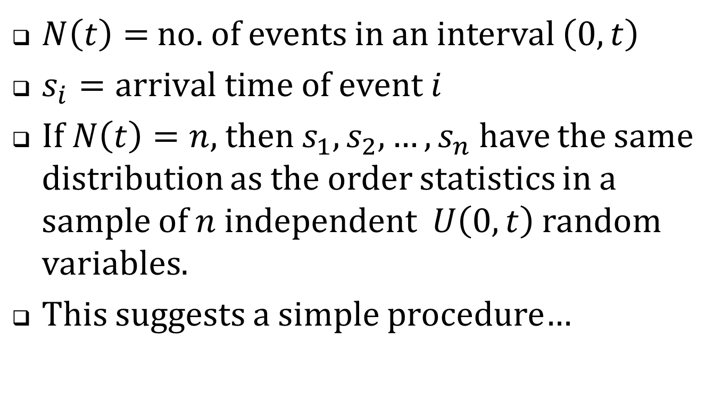
Recall the constant intensity Poisson process …
$N\left(t\right)=$ no. of events in an interval $\left(0,t\right)$
$s_{i}=arrival time of event i$
If $N\left(t\right)=n$, then $s_{1},s_{2},…,s_{n}$ have the same distribution as the order statistics in a sample of $n$ independent $U\left(0,t\right)$ random variables.
This suggests a simple procedure…

Slide 52
Quote A | 10:01:35
Quote B | 10:01:35
Quote C | 10:01:35
Draw three U(0,1) random numbers
Sort them
Assign them as the millisecond remainders
Quote A | 10:01:35.243
Quote B | 10:01:35.347
Quote C | 10:01:35.912
Compute variance estimates using the simulated time stamps.

Slide 53
Formalities
Assume that
  The quotes are correctly sequenced.
  Arrivals within the second are Poisson with (unknown) constant intensity.
  The bid and offer process is independent of the within-second arrival times.
Then each calculated statistic constitutes a draw from the corresponding Bayesian posterior.

Slide 54
Does this really work?
2011 millisecond-stamped TAQ data
Strip the millisecond portions of the time-stamps
Simulate new ms stamps
Wavelet variance estimates using actual ms time-stamps
Wavelet variance estimates using simulated ms. time-stamps.
Correlation?

Slide 55
Table 4. Correlations between statistics based on actual vs. simulated millisecond time stamps.
Panel A: Correlations for wavelet variances, $ν_{j}^{2}$
 |  |  | Dollar trading volume quintiles
Level, j | Time scale | Full sample | 1 (low) | 2 | 3 | 4 | 5 (high)
0 | < 50 ms | 0.952 | 0.948 | 0.960 | 0.958 | 0.916 | 0.979
1 | 50 ms | 0.953 | 0.944 | 0.952 | 0.952 | 0.937 | 0.982
3 | 200 ms | 0.975 | 0.965 | 0.969 | 0.975 | 0.977 | 0.988
5 | 800 ms | 0.994 | 0.991 | 0.989 | 0.995 | 0.996 | 0.998
7 | 3.2 sec | 0.999 | 0.999 | 0.999 | 1.000 | 1.000 | 1.000
10 | 25.6 sec | 1.000 | 1.000 | 1.000 | 1.000 | 1.000 | 1.000
14 | 6.8 min | 1.000 | 1.000 | 1.000 | 1.000 | 1.000 | 1.000
16 | 27.3 min | 1.000 | 1.000 | 1.000 | 1.000 | 1.000 | 1.000

Slide 56
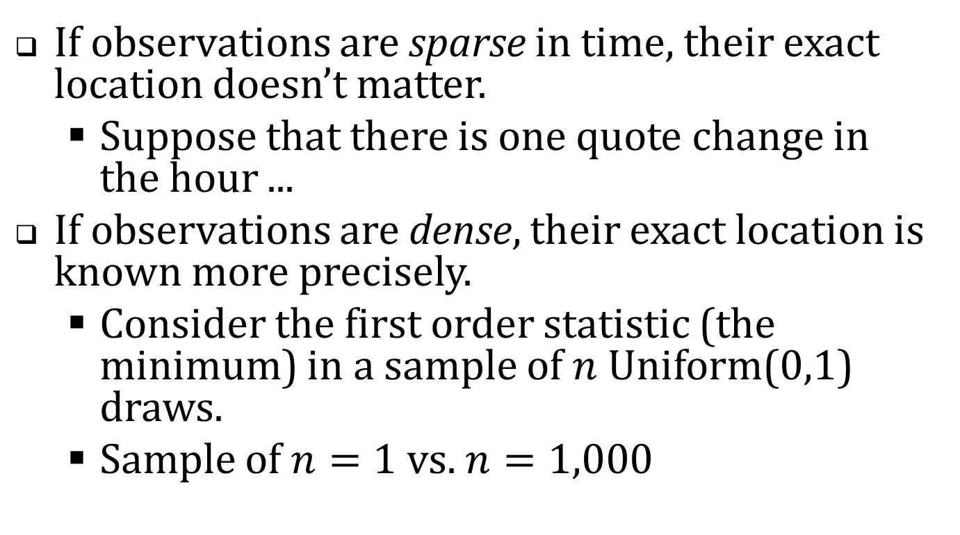
The correlations are terrific. Why?
If observations are sparse in time, their exact location doesn’t matter.
  Suppose that there is one quote change in the hour ...
If observations are dense, their exact location is known more precisely.
  Consider the first order statistic (the minimum) in a sample of $n$ Uniform(0,1) draws.
  Sample of $n=1$ vs. $n=1,000$

Slide 57
Table 4. Correlations between estimates based on actual vs. simulated millisecond time stamps.
Panel B: Correlations for bid-offer wavelet correlation estimates
 |  |  | Dollar trading volume quintiles
Level, j | Time scale | Full sample | 1 (low) | 2 | 3 | 4 | 5 (high)
0 | < 50 ms | 0.775 | 0.333 | 0.768 | 0.896 | 0.919 | 0.943
1 | 50 ms | 0.900 | 0.662 | 0.926 | 0.965 | 0.972 | 0.978
3 | 200 ms | 0.979 | 0.921 | 0.986 | 0.995 | 0.995 | 0.998
5 | 800 ms | 0.999 | 0.998 | 0.999 | 1.000 | 1.000 | 1.000
7 | 3.2 sec | 1.000 | 1.000 | 1.000 | 1.000 | 1.000 | 1.000
10 | 25.6 sec | 1.000 | 1.000 | 1.000 | 1.000 | 1.000 | 1.000
14 | 6.8 min | 1.000 | 1.000 | 1.000 | 1.000 | 1.000 | 1.000
16 | 27.3 min | 0.775 | 0.333 | 0.768 | 0.896 | 0.919 | 0.943

Slide 58
Table 5. Summary statistics, historical sample,
2001-2011 (only odd numbered years are shown)
 | 2001 |  | 2003 |  | 2005 |  | 2007 |  | 2009 |  | 2011
No. firms | 146 |  | 150 |  | 150 |  | 150 |  | 150 |  | 150
NYSE | 108 |  | 51 |  | 48 |  | 55 |  | 56 |  | 47
Amex | 22 |  | 11 |  | 8 |  | 14 |  | 5 |  | 6
NASDAQ | 16 |  | 88 |  | 94 |  | 81 |  | 89 |  | 97
Avg. daily trades | 142 |  | 187 |  | 425 |  | 970 |  | 1,790 |  | 1,331
Avg. daily quotes | 1,078 |  | 1,299 |  | 5,828 |  | 12,521 |  | 39,378 |  | 23,928
Avg. daily NBB changes | 103 |  | 203 |  | 596 |  | 772 |  | 1,618 |  | 1,210
Avg. daily NBO changes | 103 |  | 213 |  | 729 |  | 789 |  | 1,731 |  | 1,126
Avg. price | $18.85 |  | $14.83 |  | $16.10 |  | $15.81 |  | $10.72 |  | $15.62
Market capitalization of equity, $ Million | $745 |  | $189 |  | $325 |  | $480 |  | $316 |  | $683

Slide 59
Table 5. Summary statistics, historical sample,
2001-2011 (only odd numbered years are shown)
 | 2001 |  | 2003 |  | 2005 |  | 2007 |  | 2009 |  | 2011
No. firms | 146 |  | 150 |  | 150 |  | 150 |  | 150 |  | 150
NYSE | 108 |  | 51 |  | 48 |  | 55 |  | 56 |  | 47
Amex | 22 |  | 11 |  | 8 |  | 14 |  | 5 |  | 6
NASDAQ | 16 |  | 88 |  | 94 |  | 81 |  | 89 |  | 97
Avg. daily trades | 142 |  | 187 |  | 425 |  | 970 |  | 1,790 |  | 1,331
Avg. daily quotes | 1,078 |  | 1,299 |  | 5,828 |  | 12,521 |  | 39,378 |  | 23,928
Avg. daily NBB changes | 103 |  | 203 |  | 596 |  | 772 |  | 1,618 |  | 1,210
Avg. daily NBO changes | 103 |  | 213 |  | 729 |  | 789 |  | 1,731 |  | 1,126
Avg. price | $18.85 |  | $14.83 |  | $16.10 |  | $15.81 |  | $10.72 |  | $15.62
Market capitalization of equity, $ Million | $745 |  | $189 |  | $325 |  | $480 |  | $316 |  | $683
25% CAGR
36% CAGR

Slide 60
Table 6. Wavelet variance ratios for bids and offers, 2001-2011
Panel A: Computed from unadjusted bids and offers
Level, j | Time scale | 2001 | 2002 | 2003 | 2004 | 2005 | 2006 | 2007 | 2008 | 2009 | 2010 | 2011
1 | 50 ms | 5.22 | 7.16 | 6.03 | 10.28 | 6.69 | 8.57 | 6.96 | 6.06 | 4.52 | 7.08 | 4.70
2 | 100 ms | 5.44 | 6.58 | 5.28 | 9.69 | 6.51 | 8.07 | 6.27 | 5.38 | 4.12 | 6.26 | 4.32
3 | 200 ms | 5.28 | 6.28 | 5.13 | 9.03 | 6.22 | 7.34 | 5.33 | 4.64 | 3.68 | 5.40 | 3.74
4 | 400 ms | 4.59 | 5.23 | 5.00 | 8.16 | 5.75 | 6.30 | 4.25 | 3.84 | 3.21 | 4.53 | 3.07
5 | 800 ms | 3.12 | 4.04 | 3.93 | 5.57 | 5.03 | 5.10 | 3.41 | 3.11 | 2.76 | 3.71 | 2.56
6 | 1,600 ms | 2.11 | 2.55 | 3.25 | 4.11 | 4.14 | 4.05 | 2.89 | 2.59 | 2.43 | 3.04 | 2.23
7 | 3.2 sec | 1.98 | 2.24 | 2.93 | 3.38 | 3.48 | 3.37 | 2.56 | 2.29 | 2.17 | 2.53 | 2.01
8 | 6.4 sec | 1.94 | 2.11 | 2.62 | 2.91 | 2.93 | 2.92 | 2.35 | 2.08 | 1.95 | 2.16 | 1.82

Slide 61
Table 6. Wavelet variance ratios for bids and offers, 2001-2011
Panel A: Computed from unadjusted bids and offers
Level, j | Time scale | 2001 | 2002 | 2003 | 2004 | 2005 | 2006 | 2007 | 2008 | 2009 | 2010 | 2011
1 | 50 ms | 5.22 | 7.16 | 6.03 | 10.28 | 6.69 | 8.57 | 6.96 | 6.06 | 4.52 | 7.08 | 4.70
2 | 100 ms | 5.44 | 6.58 | 5.28 | 9.69 | 6.51 | 8.07 | 6.27 | 5.38 | 4.12 | 6.26 | 4.32
3 | 200 ms | 5.28 | 6.28 | 5.13 | 9.03 | 6.22 | 7.34 | 5.33 | 4.64 | 3.68 | 5.40 | 3.74
4 | 400 ms | 4.59 | 5.23 | 5.00 | 8.16 | 5.75 | 6.30 | 4.25 | 3.84 | 3.21 | 4.53 | 3.07
5 | 800 ms | 3.12 | 4.04 | 3.93 | 5.57 | 5.03 | 5.10 | 3.41 | 3.11 | 2.76 | 3.71 | 2.56
6 | 1,600 ms | 2.11 | 2.55 | 3.25 | 4.11 | 4.14 | 4.05 | 2.89 | 2.59 | 2.43 | 3.04 | 2.23
7 | 3.2 sec | 1.98 | 2.24 | 2.93 | 3.38 | 3.48 | 3.37 | 2.56 | 2.29 | 2.17 | 2.53 | 2.01
8 | 6.4 sec | 1.94 | 2.11 | 2.62 | 2.91 | 2.93 | 2.92 | 2.35 | 2.08 | 1.95 | 2.16 | 1.82

Slide 62
No trend in quote volatilities?
Maybe …
  “Flickering quotes” aren’t new.
  Concerns about high frequency trading are all media hype.
  The good old days weren’t really so great after all.
What did quote volatility look like circa 2001?

Slide 63
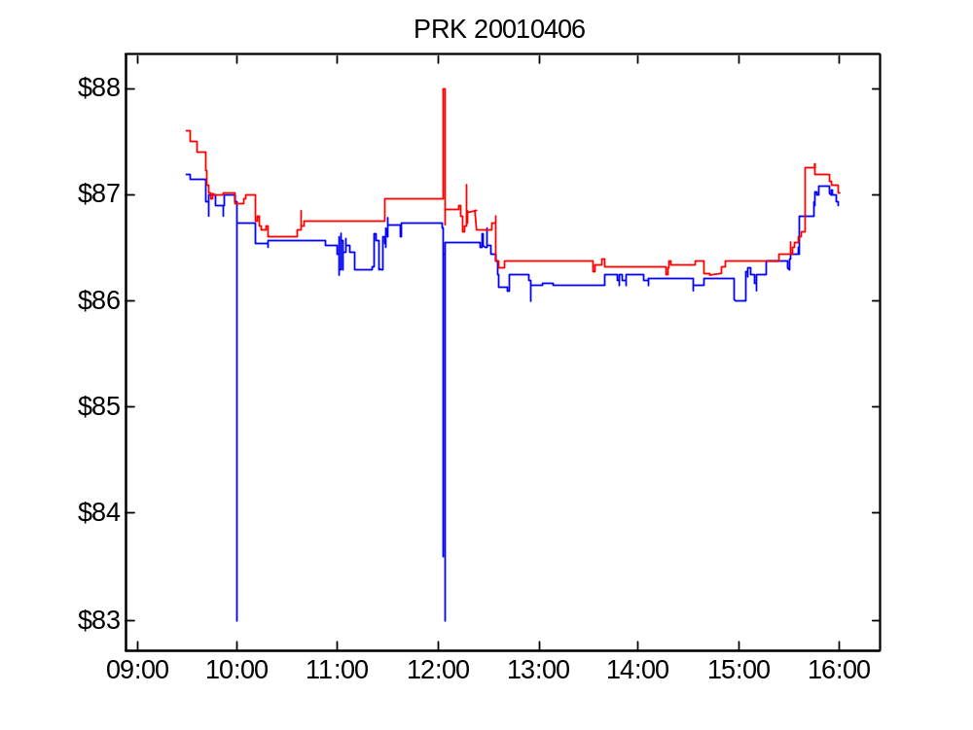
Figure 4 Panel A. Bid and offer for PRK, April 6, 2001.

Slide 64
Compare
PRK in 2001 differs from AEPI in 2011
  PRK: large amplitude, no oscillation.
  AEPI: low amplitude, intense oscillation.

Slide 65
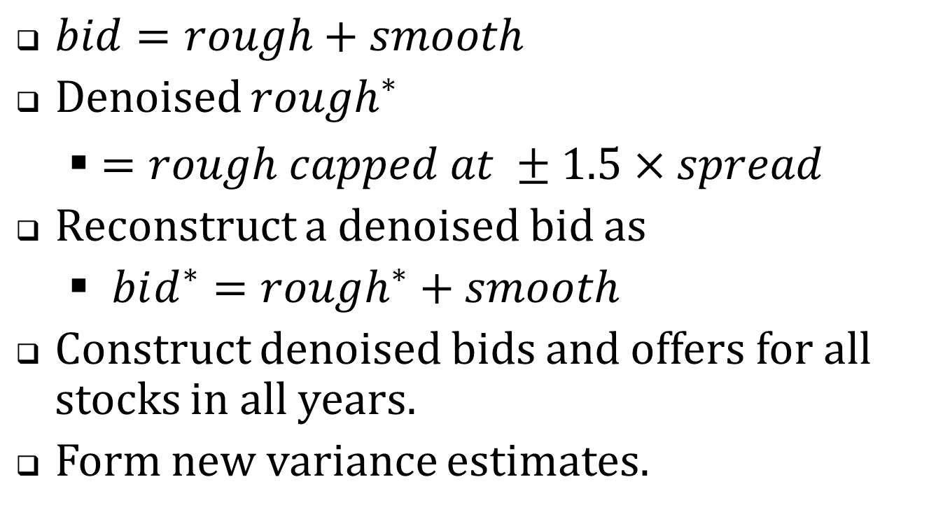
Denoising (filtering) “pops”
$bid=rough+smooth$
Denoised $rough^{∗}$
  $=rough capped at ±1.5×spread$
Reconstruct a denoised bid as
  $bid^{∗}=rough^{∗}+smooth$
Construct denoised bids and offers for all stocks in all years.
Form new variance estimates.

Slide 66
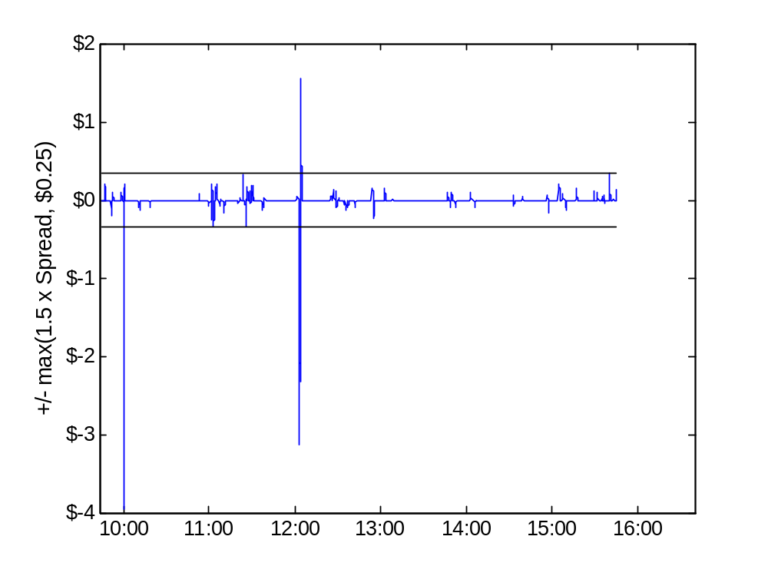
Figure 4 Panel B. PRK, April 6, 2001, Rough component of the bid

Slide 67
Table 6. Wavelet variance ratios for bids and offers, 2001-2011, Detail
Panel A: Computed from unadjusted bids and offers
Panel B: Computed from denoised bids and offers
Level, j | Time scale | 2001 | … | 2011
1 | 50 ms | 5.22 |  | 4.70
2 | 100 ms | 5.44 |  | 4.32
3 | 200 ms | 5.28 |  | 3.74
4 | 400 ms | 4.59 |  | 3.07
5 | 800 ms | 3.12 |  | 2.56
6 | 1,600 ms | 2.11 |  | 2.23
7 | 3.2 sec | 1.98 |  | 2.01
8 | 6.4 sec | 1.94 |  | 1.82
Level, j | Time scale | 2001 | … | 2011
1 | 50 ms | 1.60 |  | 4.46
2 | 100 ms | 1.57 |  | 4.07
3 | 200 ms | 1.56 |  | 3.57
4 | 400 ms | 1.55 |  | 3.00
5 | 800 ms | 1.57 |  | 2.52
6 | 1,600 ms | 1.64 |  | 2.20
7 | 3.2 sec | 1.81 |  | 2.00
8 | 6.4 sec | 2.11 |  | 1.82

Slide 68
Table 6. Wavelet variance ratios for bids and offers, 2001-2011
Panel B. Computed from denoised bids and offers
Level, j | Time scale | 2001 | 2002 | 2003 | 2004 | 2005 | 2006 | 2007 | 2008 | 2009 | 2010 | 2011
1 | 50 ms | 1.60 | 2.37 | 3.15 | 7.02 | 6.09 | 8.24 | 6.56 | 5.83 | 4.20 | 6.79 | 4.46
2 | 100 ms | 1.57 | 2.32 | 3.09 | 6.82 | 5.89 | 7.76 | 5.89 | 5.17 | 3.83 | 6.00 | 4.07
3 | 200 ms | 1.56 | 2.27 | 3.03 | 6.48 | 5.61 | 7.04 | 4.99 | 4.45 | 3.41 | 5.18 | 3.57
4 | 400 ms | 1.55 | 2.23 | 2.94 | 5.90 | 5.16 | 6.02 | 3.96 | 3.68 | 2.97 | 4.36 | 3.00
5 | 800 ms | 1.57 | 2.19 | 2.83 | 5.00 | 4.47 | 4.82 | 3.13 | 2.98 | 2.56 | 3.58 | 2.52
6 | 1,600 ms | 1.64 | 2.20 | 2.71 | 3.99 | 3.60 | 3.79 | 2.63 | 2.51 | 2.27 | 2.94 | 2.20
7 | 3.2 sec | 1.81 | 2.30 | 2.62 | 3.44 | 3.02 | 3.16 | 2.33 | 2.23 | 2.04 | 2.46 | 2.00
8 | 6.4 sec | 2.11 | 2.51 | 2.59 | 3.20 | 2.65 | 2.75 | 2.15 | 2.04 | 1.86 | 2.11 | 1.82

Slide 69
Table 6. Wavelet variance ratios for bids and offers, 2001-2011
Panel B. Computed from denoised bids and offers
Level, j | Time scale | 2001 | 2002 | 2003 | 2004 | 2005 | 2006 | 2007 | 2008 | 2009 | 2010 | 2011
1 | 50 ms | 1.60 | 2.37 | 3.15 | 7.02 | 6.09 | 8.24 | 6.56 | 5.83 | 4.20 | 6.79 | 4.46
2 | 100 ms | 1.57 | 2.32 | 3.09 | 6.82 | 5.89 | 7.76 | 5.89 | 5.17 | 3.83 | 6.00 | 4.07
3 | 200 ms | 1.56 | 2.27 | 3.03 | 6.48 | 5.61 | 7.04 | 4.99 | 4.45 | 3.41 | 5.18 | 3.57
4 | 400 ms | 1.55 | 2.23 | 2.94 | 5.90 | 5.16 | 6.02 | 3.96 | 3.68 | 2.97 | 4.36 | 3.00
5 | 800 ms | 1.57 | 2.19 | 2.83 | 5.00 | 4.47 | 4.82 | 3.13 | 2.98 | 2.56 | 3.58 | 2.52
6 | 1,600 ms | 1.64 | 2.20 | 2.71 | 3.99 | 3.60 | 3.79 | 2.63 | 2.51 | 2.27 | 2.94 | 2.20
7 | 3.2 sec | 1.81 | 2.30 | 2.62 | 3.44 | 3.02 | 3.16 | 2.33 | 2.23 | 2.04 | 2.46 | 2.00
8 | 6.4 sec | 2.11 | 2.51 | 2.59 | 3.20 | 2.65 | 2.75 | 2.15 | 2.04 | 1.86 | 2.11 | 1.82

Slide 70
The facts
Pre-filtering, no trend in quote volatility.
Filtering to remove spikes/pops greatly diminishes quote volatility in the early years, but not later years.
  Early years: volatility due to spikes
  Later years: volatility reflects oscillations

Slide 71
Table 8. Wavelet bid and offer variances, 2001-2011
Panel A. Rough variances, mils per share
Level, j | time scale | 2001 |  | 2003 |  | 2005 |  | 2007 |  | 2009 |  | 2011
1 | 50 ms | 0.05 |  | 0.07 |  | 0.23 |  | 0.08 |  | 0.25 |  | 0.07
 |  | (<0.01) |  | (<0.01) |  | (0.03) |  | (<0.01) |  | (0.03) |  | (0.01)
3 | 200 ms | 0.34 |  | 0.45 |  | 1.52 |  | 0.45 |  | 1.50 |  | 0.40
 |  | (0.01) |  | (0.02) |  | (0.17) |  | (0.02) |  | (0.19) |  | (0.08)
5 | 800 ms | 1.50 |  | 1.85 |  | 5.56 |  | 1.42 |  | 5.16 |  | 1.42
 |  | (0.05) |  | (0.07) |  | (0.53) |  | (0.07) |  | (0.42) |  | (0.22)
7 | 3.2 sec | 6.82 |  | 6.77 |  | 16.03 |  | 4.19 |  | 16.45 |  | 4.74
 |  | (0.52) |  | (0.22) |  | (1.25) |  | (0.16) |  | (0.96) |  | (0.49)
10 | 25.6 sec | 80.46 |  | 47.03 |  | 84.18 |  | 25.18 |  | 109.42 |  | 30.76
 |  | (16.17) |  | (2.57) |  | (5.75) |  | (0.98) |  | (13.16) |  | (3.22)
14 | 6.8 min | 735.03 |  | 489.43 |  | 862.96 |  | 302.16 |  | 1,638.73 |  | 333.50
 |  | (30.23) |  | (12.26) |  | (73.94) |  | (23.79) |  | 492.40) |  | (12.05)
16 | 27.3 min | 2,511.15 |  | 1,554.80 |  | 2,872.45 |  | 1,046.55 |  | 4,623.58 |  | 1,164.98
 |  | (80.99) |  | (39.18) |  | 335.55) |  | 101.74) |  | 849.95) |  | (41.65)

Slide 72
Table 8. Wavelet bid and offer variances, 2001-2011
Panel B. Rough variance ratios
Level, j | Time scale | 2001 |  | 2003 |  | 2005 |  | 2007 |  | 2009 |  | 2011
1 | 50 ms | 1.60 |  | 3.15 |  | 6.09 |  | 6.56 |  | 4.20 |  | 4.46
 |  | (0.02) |  | (0.11) |  | (0.39) |  | (0.40) |  | (0.31) |  | (1.42)
3 | 200 ms | 1.57 |  | 3.06 |  | 5.76 |  | 5.47 |  | 3.65 |  | 3.84
 |  | (0.02) |  | (0.10) |  | (0.36) |  | (0.30) |  | (0.26) |  | (1.16)
5 | 800 ms | 1.56 |  | 2.91 |  | 4.94 |  | 3.87 |  | 2.91 |  | 2.94
 |  | (0.03) |  | (0.09) |  | (0.27) |  | (0.17) |  | (0.16) |  | (0.69)
7 | 3.2 sec | 1.71 |  | 2.71 |  | 3.64 |  | 2.78 |  | 2.31 |  | 2.28
 |  | (0.09) |  | (0.10) |  | (0.15) |  | (0.09) |  | (0.09) |  | (0.35)
10 | 25.6 sec | 2.36 |  | 2.60 |  | 2.42 |  | 2.03 |  | 1.74 |  | 1.70
 |  | (0.37) |  | (0.29) |  | (0.07) |  | (0.05) |  | (0.04) |  | (0.12)
14 | 6.8 min | 1.37 |  | 1.50 |  | 1.49 |  | 1.37 |  | 1.32 |  | 1.23
 |  | (0.04) |  | (0.03) |  | (0.02) |  | (0.02) |  | (0.03) |  | (0.02)
16 | 27.3 min | 1.12 |  | 1.16 |  | 1.16 |  | 1.12 |  | 1.11 |  | 1.08
 |  | (0.02) |  | (0.02) |  | (0.02) |  | (0.02) |  | (0.02) |  | (0.01)

Slide 73
SEC’s Reg NMS (“National Market System”)
Defined the framework for competition among equity markets.
Enhanced protection against trade-throughs
  Example: market A is bidding $10 and market B executes a trade at $9.
For a market’s bid and offer to be protected, they have to accessible instantly (electronically)
  This requirement essentially forced all markets to become electronic.
Timing: Proposed in 2004; adopted 2005; implemented in 2006.

Slide 74
Prior to SEC’s Reg NMS (2004-2006)
Most markets were manual and slow.
Few possibilities of automatic execution.
Dealers were supposed to display customer limit orders … but sometimes didn’t.
Bid and offer quotes were supposed to be firm … but sometimes weren’t.
Protection against trade-throughs was weak.

Slide 75
And now …
Quotes are firm, accessible, and (more strongly) protected.
But quote volatility has increased.
More questions
  What strategies give rise to these patterns?
  Are the HFQ episodes unstable algos?
  Are they sensible strategies to detect and access liquidity?

