Slide 1
High Frequency Quoting:
Short-Term Volatility in Bids and Offers
Joel Hasbrouck
Stern School, NYU
Financial Econometrics Conference
Toulouse School of Economics

Slide 2
Disclaimers
I teach in an entry-level training program at a large financial firm that is generally thought to engage in high frequency trading has been named as a defendant in an HFT lawsuit.
I serve on a CFTC advisory committee that discusses issues related to high frequency trading.
I accept honoraria for presentations at events sponsored by financial firms.

Slide 3
What does quote volatility look like?
In US equity markets, a bid or offer can originate from any market participant.
  “Traditional” dealers, retail and institutional investors.
Bids and offers from all trading venues are consolidated and disseminated in real time.
  The highest bid is the National Best Bid (NBB)
  The lowest offer is the National Best Offer (NBO)
Next slide: the NBBO for AEPI on April 29, 2011

Slide 4
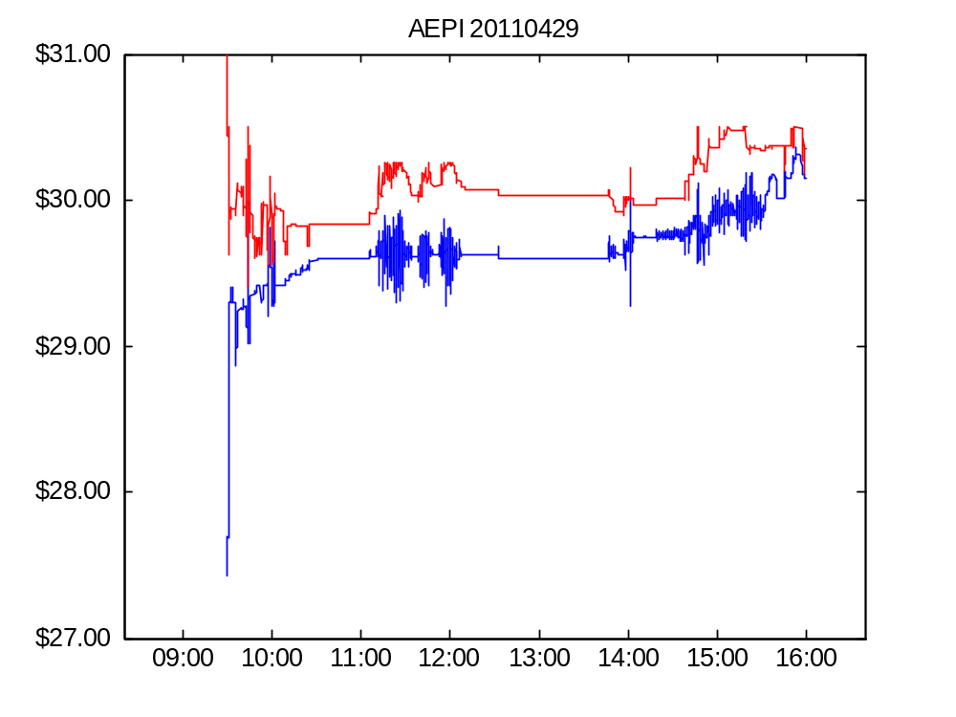
Figure 1. AEPI bid and offer, April 29, 2011

Slide 5
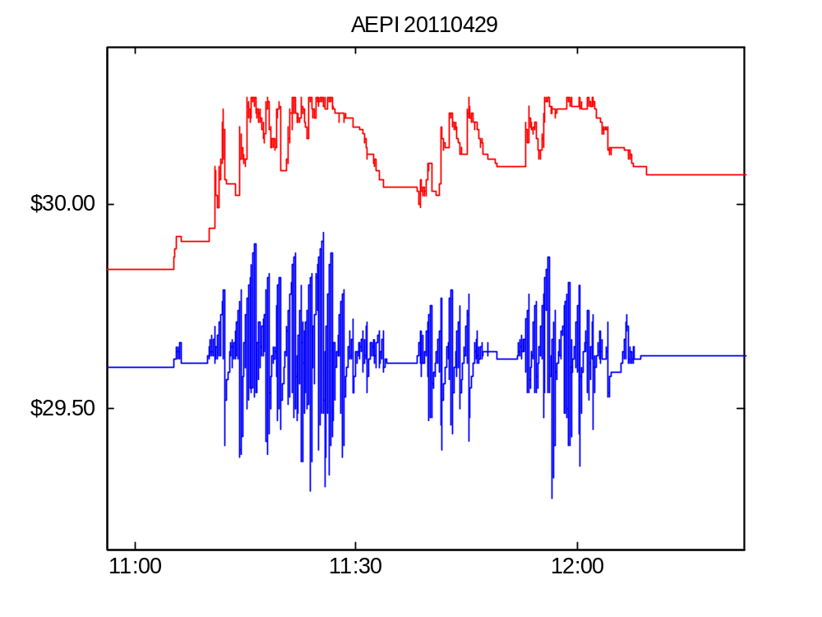
Figure 1. AEPI bid and offer on April 29, 2011 (detail)

Slide 6
Features of the AEPI episodes
Extremely rapid oscillations in the bid.
Start and stop abruptly
Mostly one-sided
  activity on the ask side is much smaller
Episodes don’t coincide with large long-term changes in the stock price.

Slide 7
Quote volatility: why worry?
Noise
  The quotes are price signals. Noise degrades the value of these signals.
Execution price risk (for marketable orders and dark trades)
  We don’t know and can’t time exactly when our order will reach the market.
  Quote volatility links arrival uncertainty to execution price risk.

Slide 8
Quote volatility: the questions
What is its economic meaning and importance?
How should we measure it?
Is it elevated? Relative to what?
Has it increased along with wider adoption of high-speed trading technology?

Slide 9
Context and connections
Analyses of high frequency trading (HTF)
Traditional volatility modeling
Methodology: time scale resolution and variance estimation
Economic models of dynamic oligopolistic pricing.

Slide 10
Traditional volatility modeling
Mainstream ARCH, GARCH, and similar models focus on fundamental/informational volatility.
  Statistically: volatility in the unit-root component of prices.
  Economically important for portfolio allocation, derivatives valuation and hedging.
Quote volatility is non-informational
  Statistically: short-term, stationary, transient volatility
  Economically important for trading and market making.

Slide 11
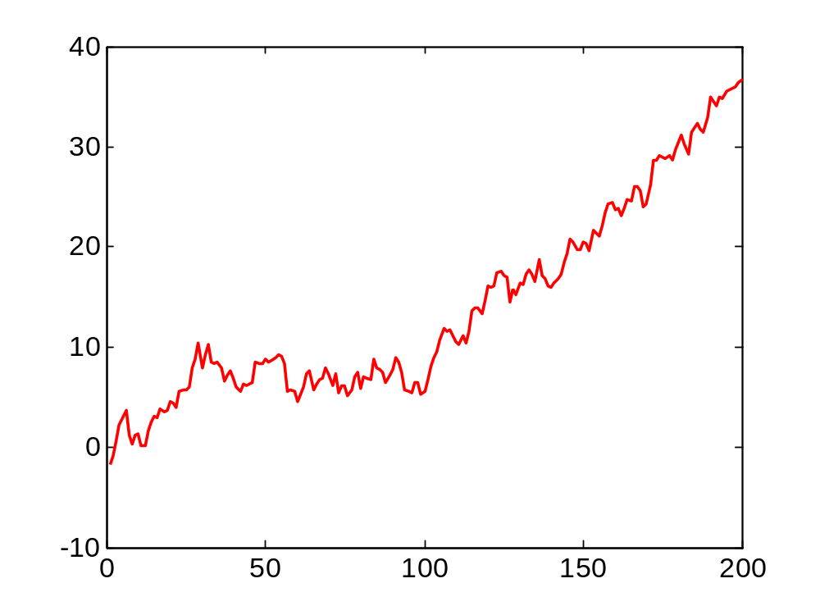
Statistics are local variances about local means

Slide 12
Connection to pre-averaging
Local averaging of price levels is used to remove microstructure noise prior to modeling fundamental variances.
The local volatility is generally not studied.
Here, it is the focus.

Slide 13
Computational issues
In computing a local average …
  How long should the averaging period be?
  How should the averaging periods be aligned?
Wavelet transformations simply provide computationally efficient techniques for
  considering a range of averaging periods
  obtaining alignment-invariant estimates.

Slide 14
The origins of high frequency quoting:
Suggestions from economic theory
Price volatility can result from randomized strategies.
  Varian (1980)
  The Glosten-Baruch (2013) limit order book.
Edgeworth cycles
  Progressive undercutting until all producers but one exit the market
  The remaining producer raises his price to the monopoly level. Repeat.
  Masking and Tirole (1988)

Slide 15
Descriptive statistics: computation and interpretation

Slide 16
Local variances about local means
n = length of averaging interval.
Depends on trader’s latency and order strategies: we want a range of n

Slide 17
Interpretation
To assess economic importance, I present the volatility estimates in three ways.
  In mils ($0.001) per share
  In basis points
  As a short-term/long-term variance ratio

Slide 18
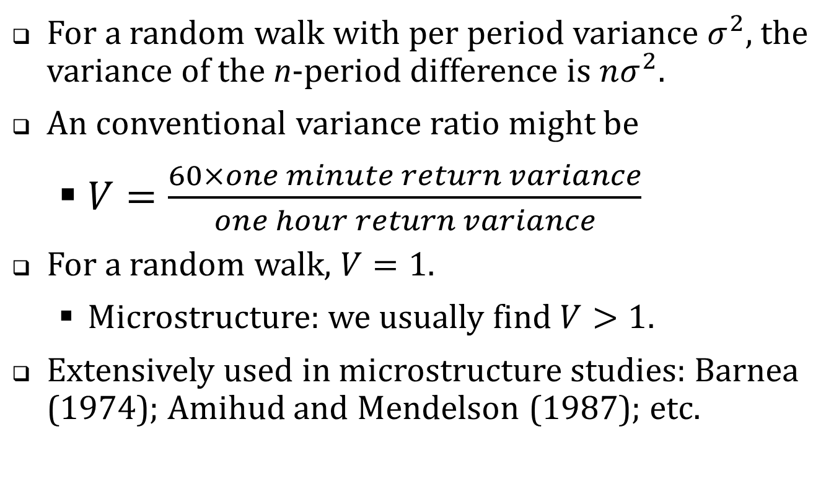
The short/long variance ratio
For a random walk with per period variance $σ^{2}$, the variance of the n-period difference is $nσ^{2}$.
An conventional variance ratio might be
  $V=\frac{60×one minute return variance}{one hour return variance}$
For a random walk, $V=1$.
  Microstructure: we usually find $V>1$.
Extensively used in microstructure studies: Barnea (1974); Amihud and Mendelson (1987); etc.

Slide 19
The empirical analysis
CRSP Universe 2001-2011. (Share code = 10 or 11; average price $2 to $1,000; listing NYSE, Amex or NASDAQ)
In each year, chose 150 firms in a random sample stratified by dollar trading volume
2011 April TAQ with one-millisecond time stamps
2001-2011
April TAQ data with one-second time stamps
High-resolution analysis
Lower-resolution analysis

Slide 20
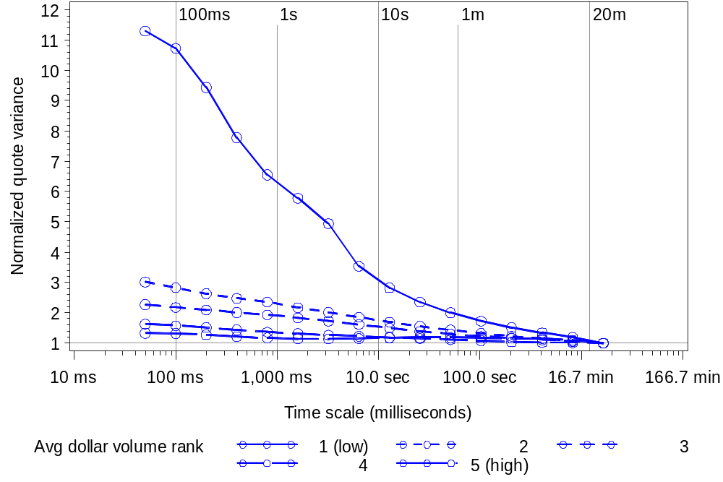
Figure 2. Wavelet variance ratios across time scale and dollar volume quintiles

Slide 21
The 2011 results: a summary
Variance ratios: short term volatility is much higher than we’d expect relative to a random-walk.
In mils per share or basis points, average short term volatility is economically meaningful, but small.

Slide 22
Historical analysis
CRSP Universe 2001-2011. (Share code = 10 or 11; average price $2 to $1,000; listing NYSE, Amex or NASDAQ)
In each year, chose 150 firms in a random sample stratified by dollar trading volume
2011 April TAQ with one-millisecond time stamps
2001-2011
April TAQ data with one-second time stamps
High-resolution analysis
Lower-resolution analysis

Slide 23
High-resolution analysis …
… with low resolution data
TAQ with millisecond time stamps only available from 2006 onwards
TAQ with one second time stamps available back to 1993.
Can we draw inferences about subsecond variation from second-stamped data?
Yes, if we are confident in the ordering of the data.

Slide 24
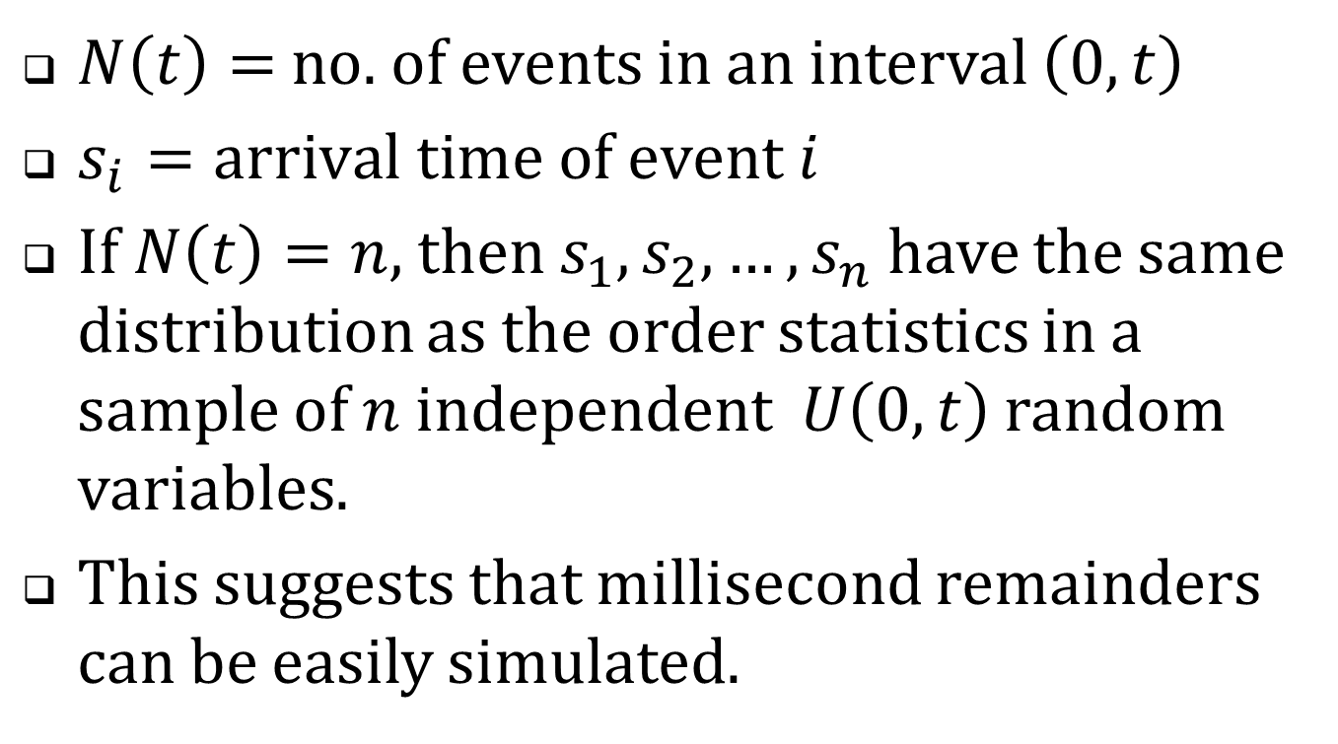
Recall the constant intensity Poisson process …
$N\left(t\right)=$ no. of events in an interval $\left(0,t\right)$
$s_{i}=arrival time of event i$
If $N\left(t\right)=n$, then $s_{1},s_{2},…,s_{n}$ have the same distribution as the order statistics in a sample of $n$ independent $U\left(0,t\right)$ random variables.
This suggests that millisecond remainders can be easily simulated.

Slide 25
Table 5. Summary statistics, historical sample,
2001-2011 (only odd numbered years are shown)
 | 2001 |  | 2003 |  | 2005 |  | 2007 |  | 2009 |  | 2011
No. firms | 137 |  | 141 |  | 144 |  | 150 |  | 145 |  | 149
NYSE | 106 |  | 51 |  | 48 |  | 55 |  | 56 |  | 47
Amex | 16 |  | 10 |  | 8 |  | 14 |  | 5 |  | 6
NASDAQ | 15 |  | 80 |  | 88 |  | 81 |  | 84 |  | 96
Avg. daily trades | 167 |  | 231 |  | 448 |  | 970 |  | 1,993 |  | 1,346
Avg. daily quotes | 1,525 |  | 1,470 |  | 6,004 |  | 12,521 |  | 41,571 |  | 24,053
Avg. daily NBB changes | 128 |  | 210 |  | 611 |  | 772 |  | 1,787 |  | 1,225
Avg. daily NBO changes | 127 |  | 226 |  | 729 |  | 789 |  | 1,789 |  | 1,146
Avg. price | $20.57 |  | $14.41 |  | $16.10 |  | $15.81 |  | $11.25 |  | $15.77
Market equity cap $ Million | $976 |  | $205 |  | $348 |  | $480 |  | $382 |  | $690

Slide 26
Table 5. Summary statistics, historical sample,
2001-2011 (only odd numbered years are shown)
 | 2001 |  | 2003 |  | 2005 |  | 2007 |  | 2009 |  | 2011
No. firms | 137 |  | 141 |  | 144 |  | 150 |  | 145 |  | 149
NYSE | 106 |  | 51 |  | 48 |  | 55 |  | 56 |  | 47
Amex | 16 |  | 10 |  | 8 |  | 14 |  | 5 |  | 6
NASDAQ | 15 |  | 80 |  | 88 |  | 81 |  | 84 |  | 96
Avg. daily trades | 167 |  | 231 |  | 448 |  | 970 |  | 1,993 |  | 1,346
Avg. daily quotes | 1,525 |  | 1,470 |  | 6,004 |  | 12,521 |  | 41,571 |  | 24,053
Avg. daily NBB changes | 128 |  | 210 |  | 611 |  | 772 |  | 1,787 |  | 1,225
Avg. daily NBO changes | 127 |  | 226 |  | 729 |  | 789 |  | 1,789 |  | 1,146
Avg. price | $20.57 |  | $14.41 |  | $16.10 |  | $15.81 |  | $11.25 |  | $15.77
Market equity cap $ Million | $976 |  | $205 |  | $348 |  | $480 |  | $382 |  | $690
23% CAGR
32% CAGR

Slide 27
What statistics to consider?
Long-term volatilities changed dramatically over the sample period.
Variance ratios (normalized to long-term volatility) are the most reliable indicators of trends.

Slide 28
Table 6. Wavelet variance ratios for bids and offers, 2001-2011
Panel A: Computed from unadjusted bids and offers
Time scale | 2001 | 2002 | 2003 | 2004 | 2005 | 2006 | 2007 | 2008 | 2009 | 2010 | 2011
50 ms | 5.29 | 7.36 | 5.96 | 10.31 | 6.56 | 8.57 | 6.96 | 6.07 | 4.53 | 7.09 | 4.71
100 ms | 5.52 | 6.75 | 5.20 | 9.71 | 6.38 | 8.07 | 6.27 | 5.39 | 4.12 | 6.27 | 4.33
200 ms | 5.35 | 6.44 | 5.05 | 9.06 | 6.10 | 7.34 | 5.33 | 4.65 | 3.68 | 5.41 | 3.75
400 ms | 4.65 | 5.35 | 4.92 | 8.18 | 5.64 | 6.30 | 4.25 | 3.84 | 3.21 | 4.54 | 3.07
800 ms | 3.16 | 4.12 | 3.86 | 5.59 | 4.93 | 5.10 | 3.41 | 3.11 | 2.76 | 3.71 | 2.56
1,600 ms | 2.13 | 2.56 | 3.19 | 4.11 | 4.06 | 4.05 | 2.89 | 2.59 | 2.42 | 3.04 | 2.23
3.2 sec | 2.00 | 2.25 | 2.91 | 3.39 | 3.42 | 3.37 | 2.56 | 2.28 | 2.16 | 2.53 | 2.01
6.4 sec | 1.95 | 2.12 | 2.61 | 2.91 | 2.88 | 2.92 | 2.35 | 2.08 | 1.94 | 2.16 | 1.82

Slide 29
Summary 2001-2011
Quote volatility is surprisingly high in the early years.
This reflects large temporary shifts in bids and offers (a consequence of manual markets).
When the bid and offer series are filtered, volatility is lower in the early years.
But over 2001-2011 no evidence of a broader trend.

Slide 30
Follow-up questions
What strategies give rise to the episodic oscillations?
Are the HFQ episodes unstable algos?
Are they sensible strategies to detect and access liquidity?

Slide 31
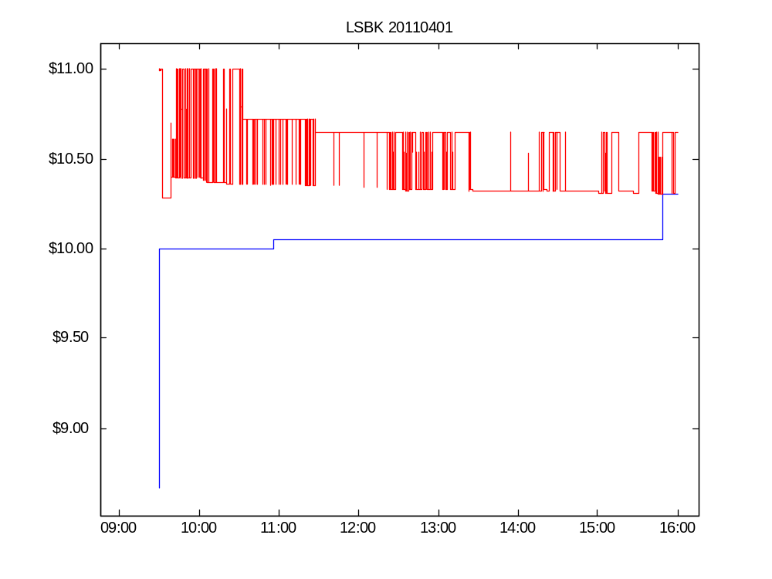

Slide 32
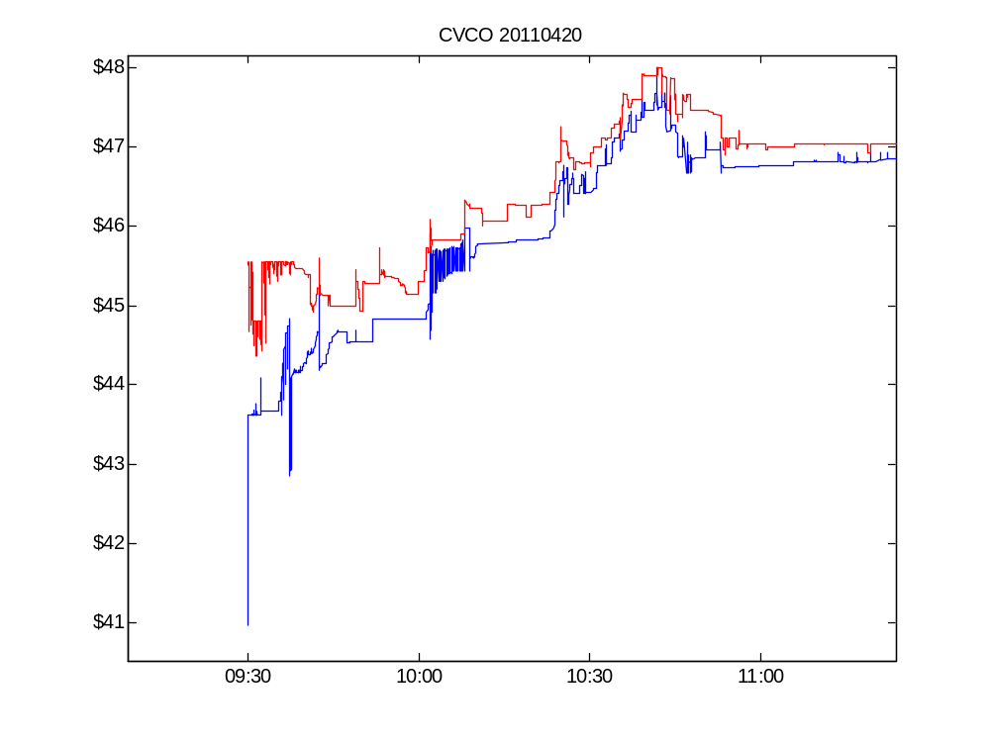

Slide 33
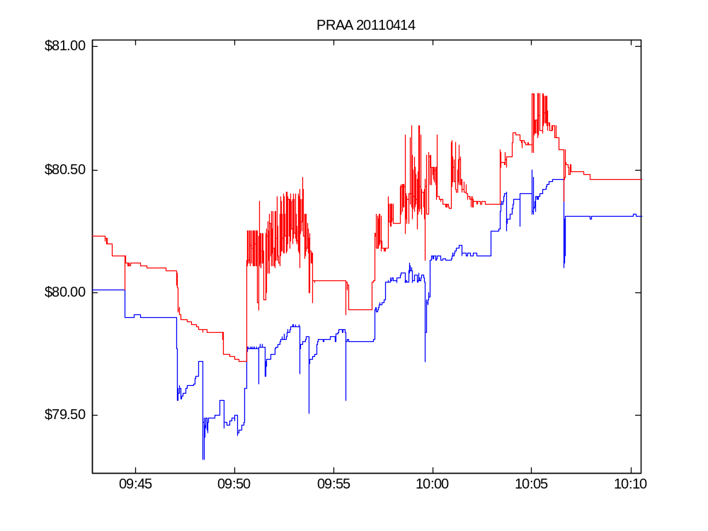

Slide 34
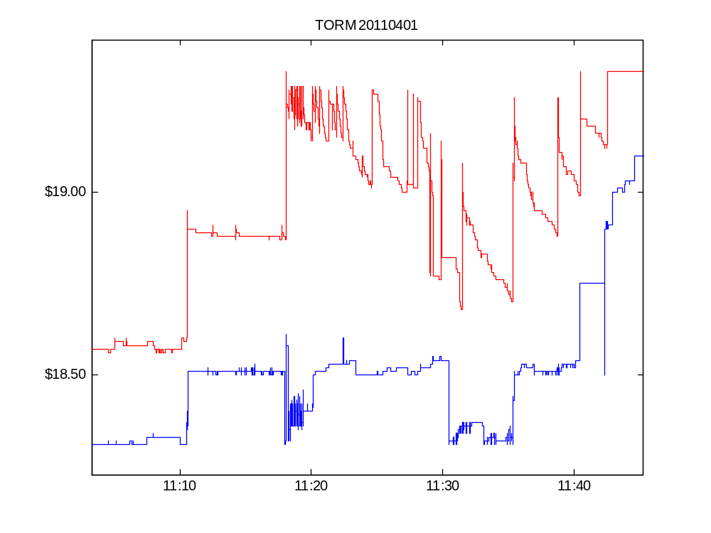

Slide 35
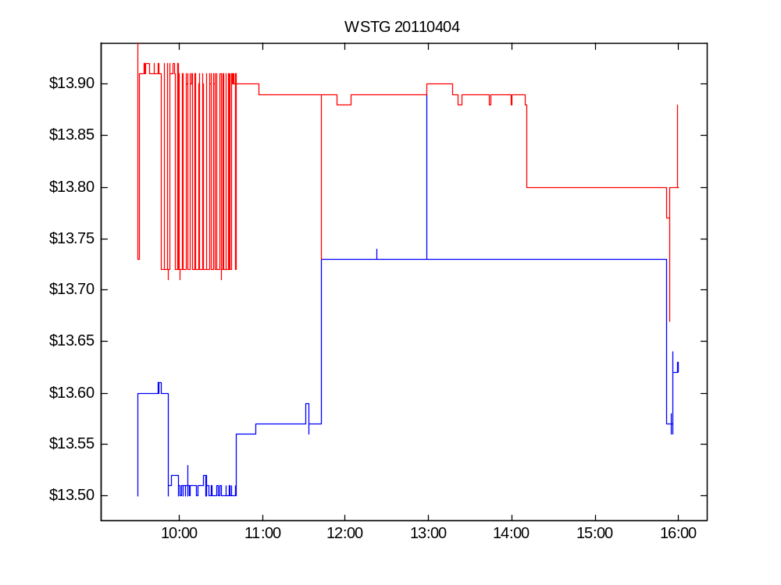

Slide 36
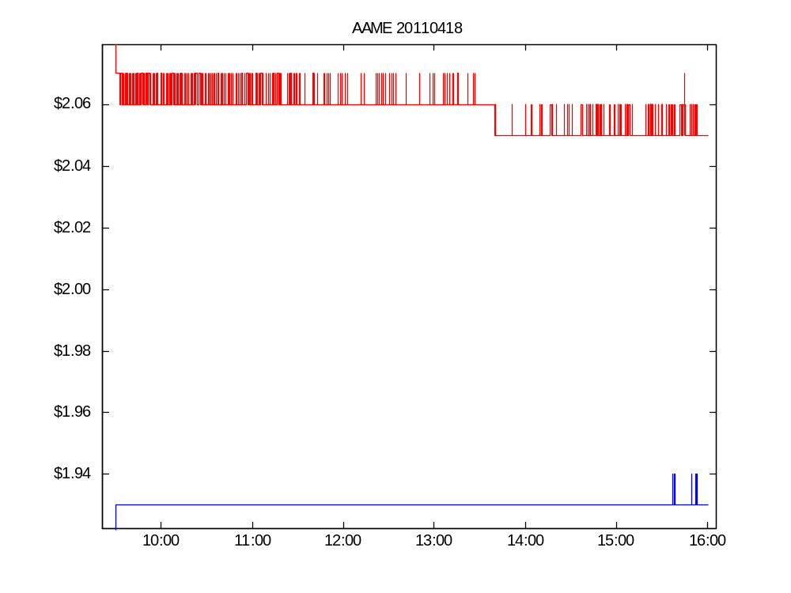

Slide 37
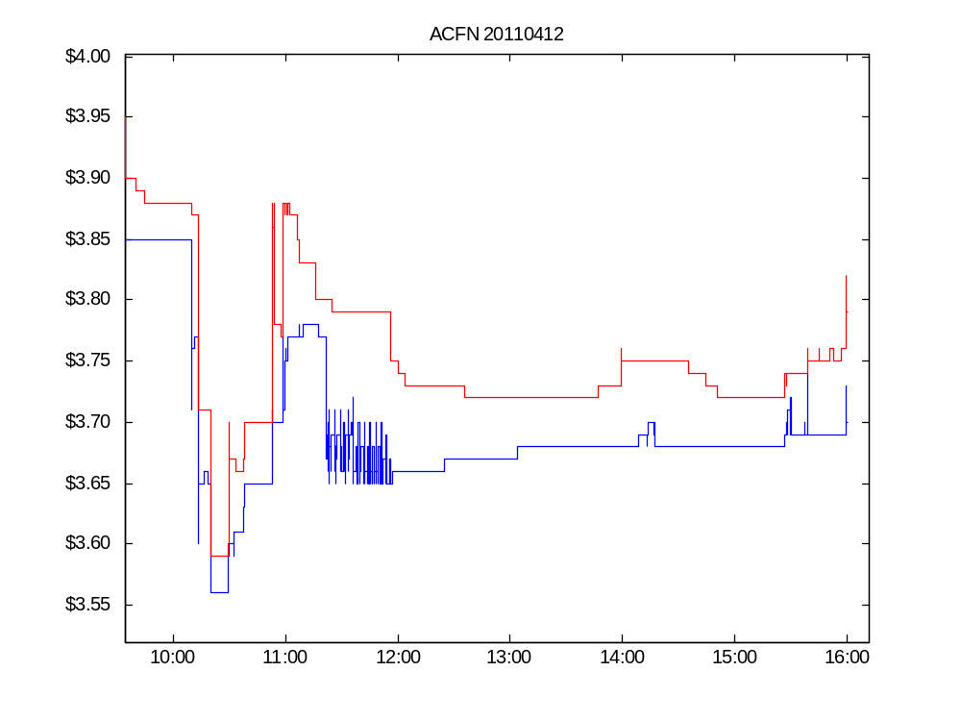

Slide 38
